Slide 1

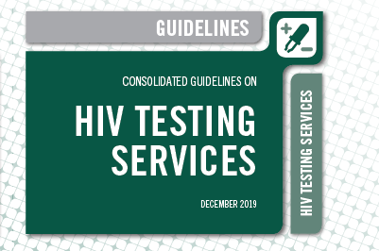
WHO HTS guidelines – presentation part 2
WHO HTS: https://bit.ly/2RQiW4M
HTS Info on the Go: https://apple.co/2LAB8vt
WHO HTS Data Dashboards: http://hts.hivci.org/

Slide 2

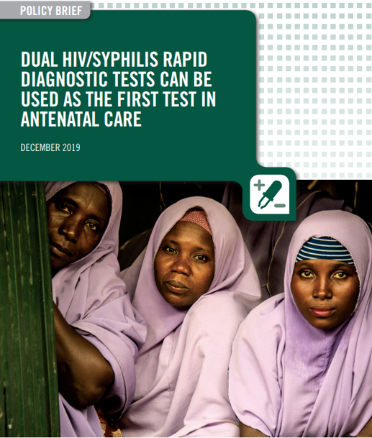
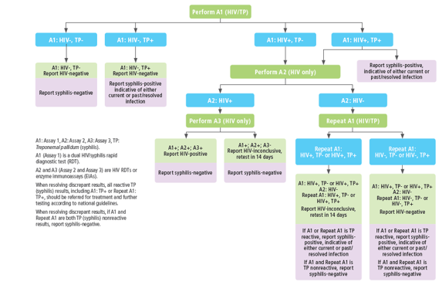
UPDATED GUIDANCE
UPDATED GUIDANCE FOR HTS IN ANC
Key evidence
Cost-savings in high and low HIV burden settings
Dual HIV/syphilis RDT can be first test for ANC
Important to ensure integrated services for maximum impact
Not for retesting women on ART or diagnosed with syphilis during pregnancy

Slide 3
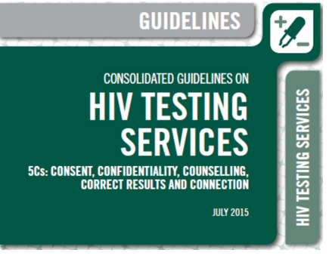

Previous 2015 WHO HTS Guidance on maternal retesting
UPDATED GUIDANCE HTS IN ANC
Retesting criteria | Concentrated epidemic | Generalized epidemic
3rd trimester, labor, or postpartum |  | ✓
Serodiscordant couple | ✓
Member of key population | ✓
Pregnancy
Postpartum
3rd
trimester
Labor

Slide 4




MTCT rates for HIV are underestimated due to acute maternal infections
UPDATED GUIDANCE HTS IN ANC
Attend ANC
HIV test
CHRONIC
78%
33%
+
45%
=
Pre-conception
Pregnancy
Postpartum
ACUTE & MISSED
Njuguna IN, AIDS Patient Care and STDs 2016.

Slide 5
Recommended time points for
HIV retesting for pregnant and postpartum women
UPDATED GUIDANCE FOR HTS IN ANC
Setting | Time points
 | Early in pregnancy (first antenatal care visit) | Late in pregnancy (third trimester ANC visit) | 1 additional postpartum retest (14 weeks, six-month or nine-months post-partum)
High HIV burden settings | All | All | Can be considered for those at ongoing high risk
Low HIV burden settings | All pregnant women as part of EMTCT, otherwise focused on those at high ongoing risk | Can be considered for those at high ongoing risk | Can be considered for those at high ongoing risk
Among key population groups and their partners | All settings | All settings | All settings

Slide 6

Implementation considerations for
HIV testing for pregnant and postpartum women
UPDATED GUIDANCE FOR HTS IN ANC
Overall HIV/Syphilis – can be used as first test in ANC
  Wherever possible linking and integrating HBV
Retesting in general not cost-effective in pregnant and post-partum women in low HIV burden settings
  In high HIV burden settings, retesting at late pregnancy and if first test missed or delayed should be prioritized
  In high HIV burden settings one additional time point can be considered
Countries may need to prioritize testing in ANC based on risk or geography depending on resources
Women in high HIV burden settings or hotspots, from KP groups or with a partner with HIV or from KP group need to be prioritized
  ANC service delivery needs to be adapted to include and reach these women and their partners
  First-test and retesting efforts, where implemented, should be focused in these groups

Slide 7

In ECHO, a trial designed to detect an increase in HIV incidence for women using 3 contraceptive methods, high rates of new HIV and STI infection were found
Women in the ECHO trial
“Women recruited in ECHO based on geography, but not on any other characteristic of HIV risk, eg transactional sex, history of STIs, self-reported higher-risk behaviours”
16-35 years
80% never married
75% secondary school
48.3% reported no condom use with last sex act
6.8% reported >1 partner in last 3 months
STIs were common
18·2% C. trachomatis
4·7% N. gonorrhoeae
38·2% HSV-2
ECHO was designed to detect a 50% increase in HIV incidence for each of the contraceptive methods.
None of the comparisons showed a 50% increase in HIV incidence.
In total, 397 of the 7829 women acquired HIV during the study
The overall rate of new HIV infections 3.81% per year (95% CI 3.45-4.21).

Slide 8
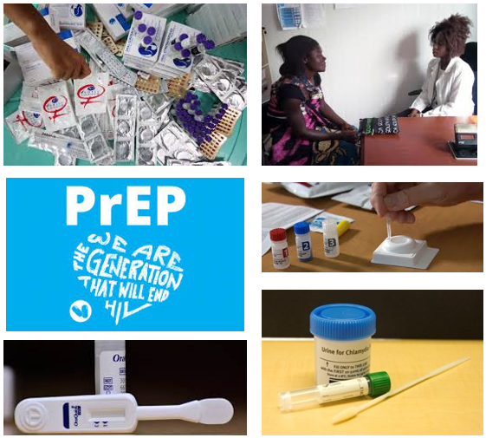
How can we operationalize the new HTS guidelines to address the 5 post-ECHO objectives?
Contraceptive choice (options)
HTS
PrEP
Partner services
STI services
Focus on integrating and linking services for women in high burden settings!

Slide 9
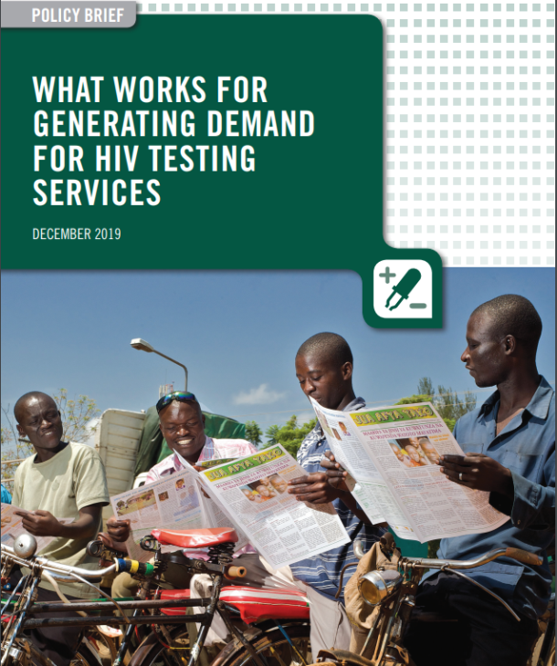






Demand creation for reaching undiagnosed PLHIV
NEW GOOD PRACTICE STATEMENT
Must be focused. Can be critical for increasing uptake of HTS and linkage to ART and other HIV prevention for those currently being missed.
86 RCTs included in the review across diverse populations and settings
  Interventions included: mobilization, incentives, digital, targeted and tailored and messaging/counselling
So what works?

Slide 10
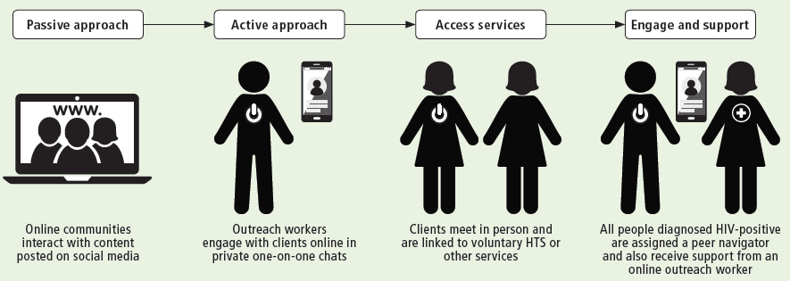
How to deliver HTS demand creation?
NEW GOOD PRACTICE STATEMENT
Peer-led demand creation (moderate quality evidence)
peer-delivered, participatory and community-led approaches, such as using peer educators, community groups and faith-based programmes increase HTS uptake;
Important to focus on priority populations
Digital platforms and videos (moderate quality evidence)
10-fold increase in HTS uptake with short videos
Can be considered or adapted based on population and setting
Costs can be high, but crowd sourcing and community-engagement can increase affordability
May increase efficiency and save health worker time – or be useful for approaches like HIVST
Social media and web-based tools limited, but promising esp young people and key populations
Experience from FHI360 in Viet Nam (March 2016 to January 2019)
Using online platforms, peer outreach workers counselled 6367 online users, of 76%(4879) tested.
75% of those contacted had never been in contact with a peer or outreach worker and 1/3 self-assessed as being at substantial risk for HIV.
Overall, 431 (10%) individuals were diagnosed with HIV. This HIV positivity is higher than among key populations seeking testing through other referrals (10% versus 6%).

Slide 11
Effective ways to create demand for HTS?
NEW GOOD PRACTICE STATEMENT
Key approaches supported by evidence:
advertisement of specific HTS attributes (especially testing via workplace);
brief key messages;
messages encouraging testing during couples counselling (including partner services and provider-assisted referral);
messages related to risk reduction and economic empowerment, particularly for people who inject drugs;
motivational messages.
Approaches that may be less effective:
personal invitation letters (alone);
individualized content messaging;
counselling focused on building relationship between the client and counsellor;
general text messages, such as SMS.
Special considerations if thinking about incentives:
Can improve uptake, but effect on linkage uncertain.
Issues of sustainability, equity and resource use need to be addressed and its benefits and risks carefully weighed when considering financial incentives for demand creation.

Slide 12
What about counselling messages?
Testing, prevention and treatment have evolved - its time for counselling to change
UPDATED GOOD PRACTICE STATEMENT
Pre-test information messages
Post-test counselling core package
Pre-test counselling is not recommended as part of HIV testing services.
Evidence on what works:
Shorter messages have as much effect on HTS uptake as longer counselling.
General and motivational messages increase uptake
Shorter is more feasible
Tailored based on status, but core messages which are:
clear and concise
Include referral and offer of rapid ART initiation
Discussion of partner services
additional linkages to HIV prevention, care, support and other relevant services
Big gap for pre test and post test messages
Implementation gaps – most messages did not explain that people who are on ART and virally suppressed will not transmit HIV to their partners
Communicating this benefit is key and needs to be disseminated

Slide 13

What are social networks and social network-based approaches?
NEW RECOMMENDATION (conditional)
What are social networks and social network-based approaches (SNA)?
A social network refers to a group of individuals linked by a common set of relationships or behaviours and includes sexual and drug-injecting partners as well as social contacts.
Social network-based HIV testing approaches are an extension of HIV partner services: A trained provider asks people with HIV or those who are HIV-negative and at ongoing risk of HIV to encourage and invite individuals in their sexual, drug injecting or social networks to participate in voluntary HTS.
Networks can be:
Sexual
Drug injecting
Social contacts
HIV+ or HIV –
Key populations

Slide 14
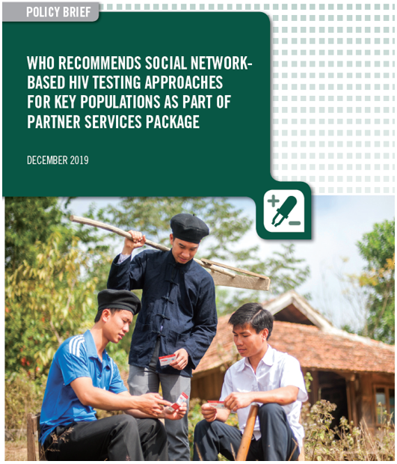
NEW RECOMMENDATION (conditional)
NEW RECOMMENDATION:
Social network-based approaches can be offered as an approach to HIV testing for key populations as part of a comprehensive package of care and prevention (conditional recommendation, very low-quality evidence).
Key evidence from WHO GL showed social network-based approaches:
may increase HIV diagnoses and identify additional people with HIV
may increase the acceptability of HIV partner services
feasible to implement
can be an efficient use of resources when they focus on people with high ongoing HIV risk
seldom result in social harm or adverse events.

Slide 15

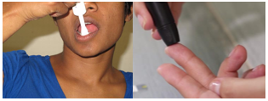
WHO recommendations on HIV self-testing
UPDATED RECOMMENDATION (strong)
Key evidence showed HIVST is:
WHO recommendation:
Safe and accurate
Highly acceptable
Increased access
Increased uptake and frequency of HIV testing among those at high risk and who may not test otherwise
Comparable linkage and HIV+
Empowering
Can be affordable and cost-effective when focused
HIV self-testing should be offered as an approach to HIV testing services
(strong recommendation, moderate quality evidence)
NEW remarks
Providing HIVST service delivery and support options is desirable.
Communities need to be engaged in developing and adapting HIVST models.
HIVST does not provide a definitive HIV-positive diagnosis. Individuals with a reactive test result must receive further testing from a trained tester using the national testing algorithm.
Source: WHO 2016

Slide 16
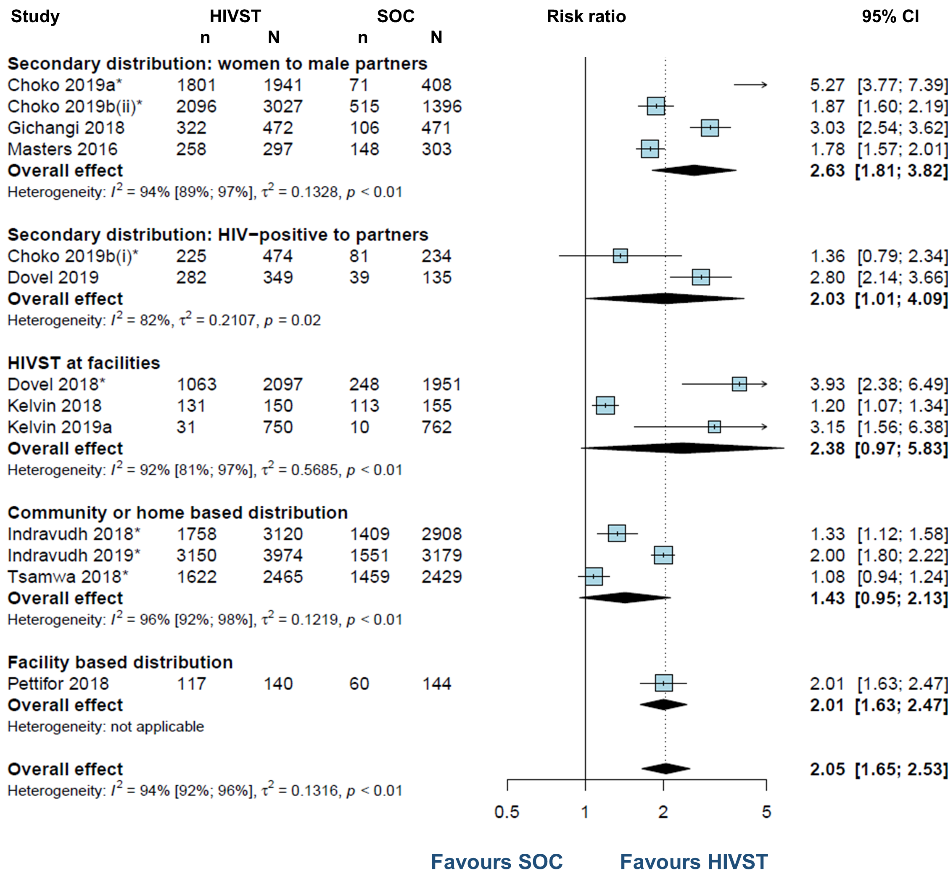
Many HIVST distribution models work well depending on context and population
UPDATED RECOMMENDATION (strong)

Slide 17
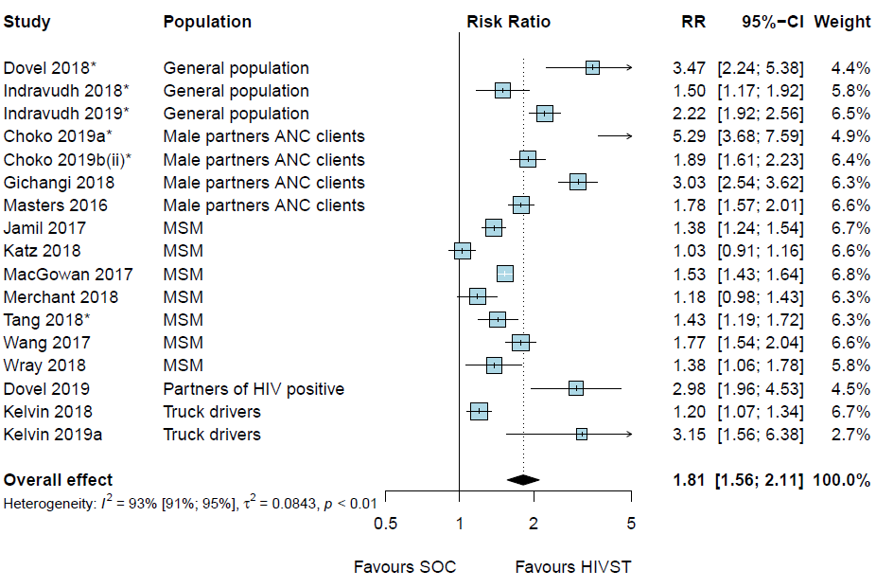
HIVST vs Standard HTS results in
~2-fold increase in uptake among men
UPDATED RECOMMENDATION (strong)
WHO 2019, Jamil ICASA 2019
* Cluster RCT

Slide 18
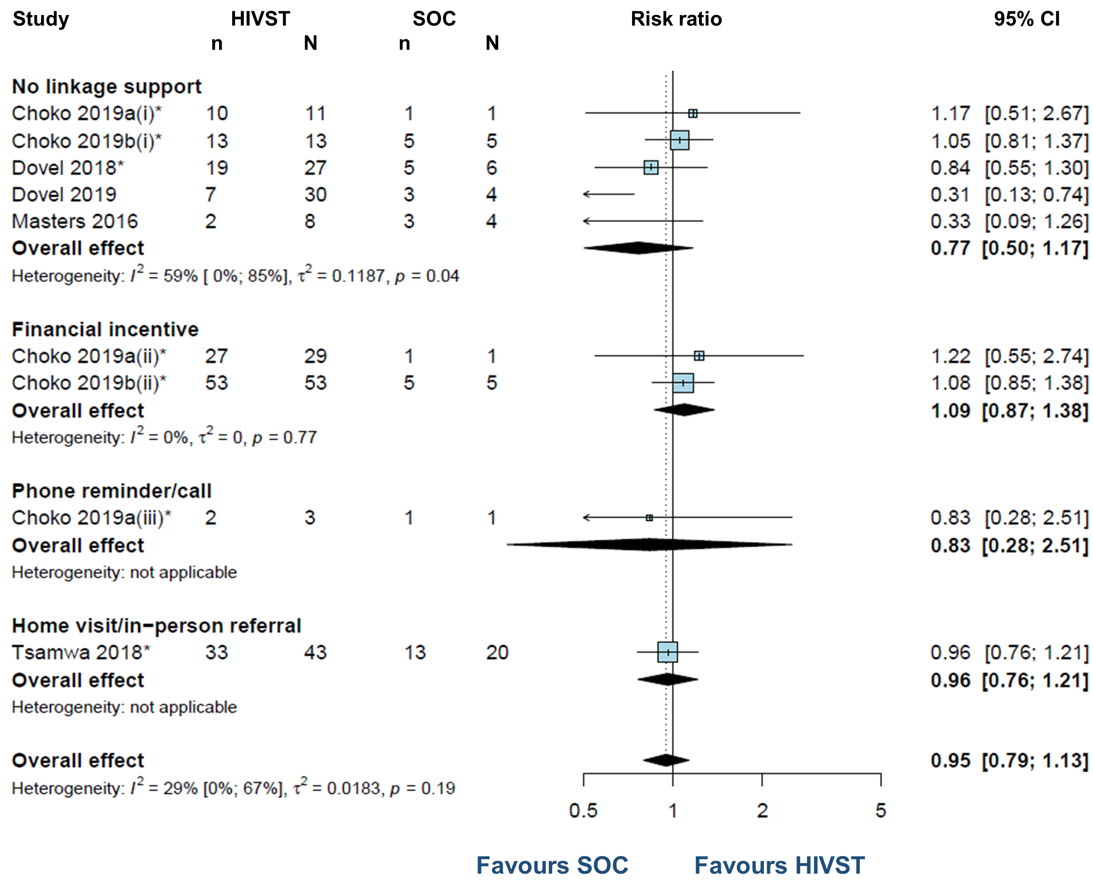
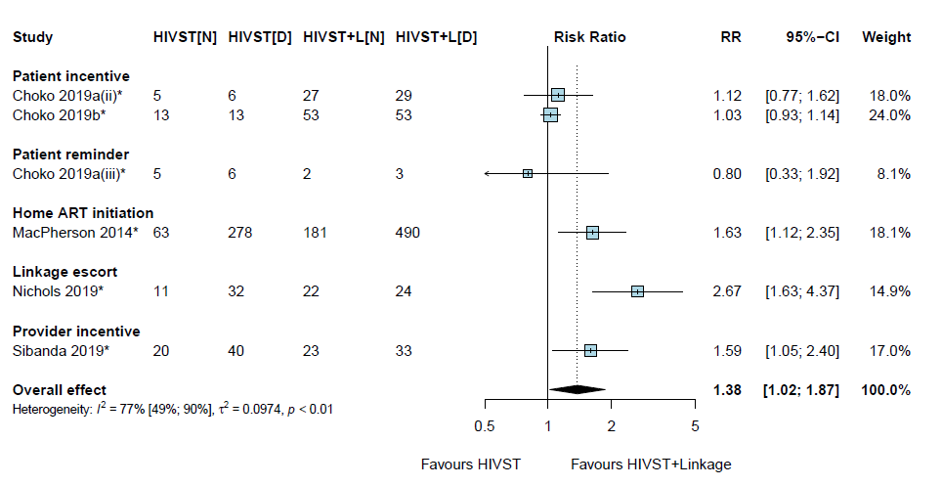
Post-HIVST linkage not significantly different, but linkage support likely helps
UPDATED RECOMMENDATION (strong)
Overall linkage to care post-HIVST
compared with standard testing
Linkage to care post-HIVST with support intervention compared with standard testing

Slide 19

Considering HIVST and HTS programme costs in sub-Saharan Africa may not be too different
(Median cost per person tested reported )
Costs represent crude programme costs and do not take into account
  Efficiency (HIV+%)
  Equity (KP and missed pops)
  Opportunity cost (cost to testers)
HIVST reaches those who never come to facilities or where additional cost to get to facilities is considerable
Source: Sharma Nature, 2015; Mangenah JIAS 2019. Costs are not directly comparable, only illustrative. Sharma reports across approaches. Mangenah only reports on community-based HIVST and substantial start-up costs. Median costs reported for illustrative purposes.

Slide 20

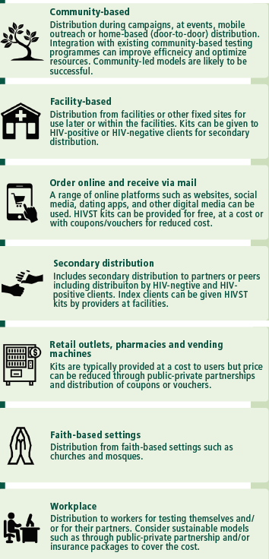

UPDATED RECOMMENDATION (strong)

Slide 21

Variety of support tools for HIVST
In-person demonstration (one-on-one, with partners or in groups)
Demonstration video (including online links to videos)
Telephone hotline (can be integrated into existing national hotline services)
Short message service through telephone, Internet, social media
Educational information via radio, television, leaflets, brochures, the Internet, social media and applications for smartphones/tablets
Local information and resources, for example on counselling services, testing sites, treatment centres and where to access HIV prevention services like VMMC and PrEP.

Slide 22
Where to Begin with HIV Self-Testing
Know your epidemic
& testing gap
Approaches
Considerations
Couples & Partners
Community-based
(outreach, door-to-door)
Facility-based
(PITC, drop-in centres)
Benefits & Risks to Populations
Support tools
Linkage
Increased access
Increased coverage
Men
VMMC programmes
Workplace programmes
Key populations
Pharmacies & Kiosks
Integrated in KP Programmes
Young people
Internet & Apps
Integrated in RHS & Contraceptive Services
Other
At risk populations
(SDC, partners of PLHIV, migrants etc.)
Vending machines
Partner-delivered

Slide 23
Where to Begin with HIV Self-Testing
Know your epidemic
& testing gap
Approaches
Considerations
Couples & Partners
Community-based
(outreach, door-to-door)
Facility-based
(PITC, drop-in centres)
Benefits & Risks to Populations
Support tools
Linkage
Increased access
Increased coverage
Men
VMMC programmes
Workplace programmes
Key populations
Pharmacies & Kiosks
Integrated in KP Programmes
Young people
Internet & Apps
Integrated in RHS & Contraceptive Services
Other
At risk populations
(SDC, partners of PLHIV, migrants etc.)
Vending machines
Partner-delivered

Slide 24
HIVST products with WHO prequalification
Test (manufacturer) | Type
INSTI® HIV Self Test ** (bioLytical Lab., Canada) | Blood
Mylan HIV Self Test | Blood
OraQuick® HIV Self Test (OraSure Technologies, USA) | Oral
SURE CHECK® HIV Self Test (Chembio Diagnostic Systems Inc., USA) | Blood
Global Fund HIVST pricing
US$ 2-3.10
More information available from Global Fund PSM/Sourcing team
Latest list of WHO prequalified products: https://www.who.int/diagnostics_laboratory/evaluations/PQ_list/en/

Slide 25
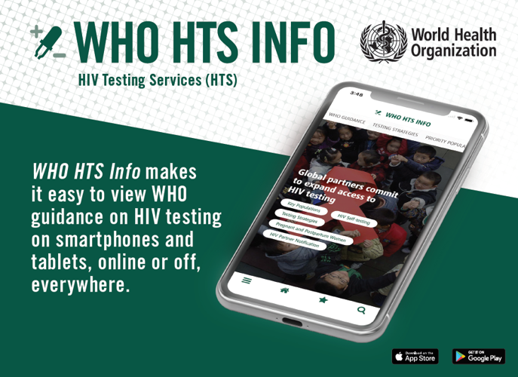
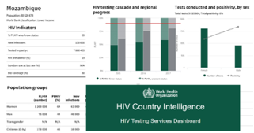

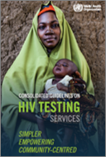
Access the full guidelines on the WHO HTS APP!
Search ‘WHO HTS Info’ wherever you get Apps
Notifications when new content is available
Search, save, send
Country HTS data in one place w/ guidelines
Language updates: French on the way!
Available online and off
Videos coming for 2020

Slide 26


Thank you to all the people and communities who are making a difference!
@WHO – follow the campaign and read their stories
#MaketheDifference

Slide 27











Acknowledgements
More information and questions: Johnsonc@who.int
WHO: Rachel Baggaley, Muhammad Jamil, Maggie Barr-DiChiara, Anita Sands, Arshad Altaf, Alison Wringe, Melanie Taylor, Teodora Wi, Mary Lyn Gafield, Virginia MacDonald, Bradley Mathers, Annette Verster, Niklas Luhman, Fatim Cham Jallow, Van Nguyen, Elena Vovc, Joumana Hermez, Maeve deMello, Anne Brink, Mukta Sharma, Andrew Ball, Tunga Namjilsuren, Belen Dinku, Veronique Millot and Valerie Amiel
WHO HTS Guideline Development Group, Steering Committee, external reviewers and key partners UNAIDS, UNICEF and Global Fund
All systematic and literature review teams and mathematical modellers
Special thanks to funders Unitaid, USAID and Bill and Melinda Gates Foundation

Slide 28


