Slide 1
MODULE 1:
INTRODUCTION TO DIFFERENTIATED TESTING SERVICES

Slide 2

Module Objectives
1
By the end of this module, participants will be able to:
Define differentiated service delivery HIV testing services
Describe the core principles of dHTS
Demonstrate understanding of the 4 different HIV testing approaches
Describe the two different HIV testing focuses and provide various examples of each
List and explain the 7 steps required to implement dHTS
Describe the three Health systems strategies for HTS service delivery

Slide 3

What are Differentiated HIV Testing Services (dHTS) for HIV?
1
dHTS is a person-centered approach that tailors HIV testing strategies to the specific needs, preferences and circumstances of different settings and population groups, moving away from a one-size-fits-all model.
By adapting services to different settings, dHTS optimizes access, efficiency and impact, expanding its reach to those who may not engage with traditional healthcare models.
dHTS are approaches
in which testing and linkage services are designed to overcome specific barriers and meet the needs of specific populations.
What is Innovative about dHTS?
Person-centred:
Links those diagnosed with HIV to treatment services and links those testing negative to effective combination prevention services
Resource optimization:
Increases service utilization while minimizing costs and barriers through flexible testing strategies.
Task sharing and integration:
Involves trained lay providers and integrates testing with other health services to improve access and efficiency.

Slide 4

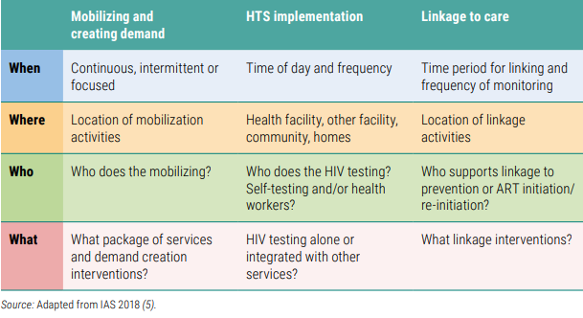
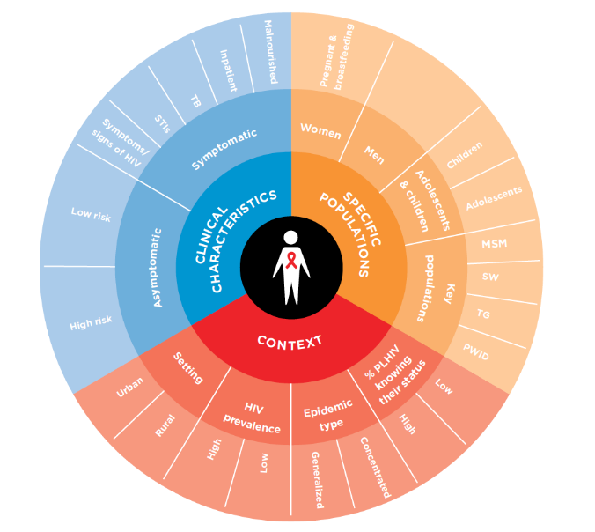
1
Strategic and Core Principles for Differentiated Testing Services
Testing approaches need to consider core principles to implementation:
Mobilizing and creating demand for testing
Testing service delivery
Linkage to post-test services
QUALITY of CARE
These three approaches are then adapted based on the context, population and epidemic

Slide 5

Differentiated HIV Testing Planning Tool – do exercise with participants
1

Slide 6




Example dHTS HIV Testing Planning Tool
1
 | MOBILIZATION | TESTING | LINKAGE
WHEN | Daily placement of posters, in-person sensitization at CBO office, hygiene activities, social media | Daily at CBO office or at the client’s convenience via client request (phone call/WhatsApp/delivery). | If the client tests positive at the CBO office: disclosure via phone follow-up/WhatsApp. Linkage options are provided with the kit.
WHERE | High-volume, male-focused hotspots in high-burden locations (Kisumu, Nairobi), and groups' social media | At a place convenient to the tester. On-site private self-testing and confirmatory testing available. | Client's preferred facility. Referral by on-site counselor or ART starter pack on-site where available/WhatsApp.
WHO | CBO Mobilizers | Client | Client-led by referral information or on-site counselor/1190 helpline.
WHAT | WhatsApp/FB, instructional videos, IEC materials, one-on-one sessions | HIVST demo, HIVST distribution, on-site testing/confirmatory testing. | On-site linkage through HTS counselors for those who test positive, or ART initiation support.

Slide 7
1
What is Innovative about dHTS?
Person-Centered
Tailors services to individual needs, epidemic and local contexts, moving away from a one-size-fits-all model.
Optimizes Resources
Enhances service utilization while minimizing costs and barriers through flexible testing strategies.
Reduces stigma and access challenges for more inclusive care
Task sharing and integration
Involves trained lay providers and integrates testing with other health services to improve access and efficiency.
Quality of Care
Improves quality through systematic monitoring of continuous improvement of the continuum of testing (demand creation, testing and linkages)

Slide 8
1
What are the 4 key differentiated HTS approaches?
Testing services
Facility-based
Community-based
Self-testing
Network-based testing

Slide 9
1
What are the 4 key differentiated HTS approaches?
1. Facility-based HTS: Remains a priority and should be routinely offered to all clients of unknown or HIV-negative status. Includes offering HIV testing in a facility by identifying key entry points for both in-patient and out-patient clinics such as ANC, TB, STI, hepatitis services, VMMC, family planning services and malnutrition clinics.
2. Focused community-based (in addition to routine offering of facility-based testing): Complimenting facility-based HTS and helps identify those in greatest need who are not reached by routine FB HTS. Offers HIV testing in natural community setting with linkage to prevention, treatment and care services, e.g. outreach, CBOs, workplace, schools, clubs, home, faith-based
3. Network-based testing (NBT): includes a range of approaches (partner services, social network testing, family and household testing services) that can extend testing to partners, family members, and other members of social networks. ​ NBT includes distribution of self-tests and should link both prevention and care services Social network testing is now recommended for everyone, and not limited to KPs
4. HIV Self-testing: Offering self-test kits for individual, and/or their partner Enabling them to collect their sample (oral or blood), perform tests, and interpret their results privately. All reactive results need confirmation.

Slide 10
1
Different purposes and focus for testing
Testing services
Facility-based
Community-based
Self-testing
Network-based testing
Case-finding focused testing across all 4 approaches:
Implementation focuses on reaching undiagnosed PLHIV
  as effectively as possible (ensuring the right populations are reached)
  as efficiently as possible (making optimal use of resources)
  as soon as possible – initiate them on ART
HTS is routinely offered through FB HTS in key entry points (PHC, OPD, FP, STI)
Prevention focused testing across all 4 approaches:
Ensuring HIV-negative people stay negative - HTS part of implementing and monitoring prevention services
ANC – retesting of pregnant women & male partner testing
VMMC – uptake by clients and testing those accompanying patients
PrEP and PEP testing
Harm Reduction clinics
Diagnosis with rapid tests and providers include lay providers, community workers as well as self-testing and self-sampling

Slide 11
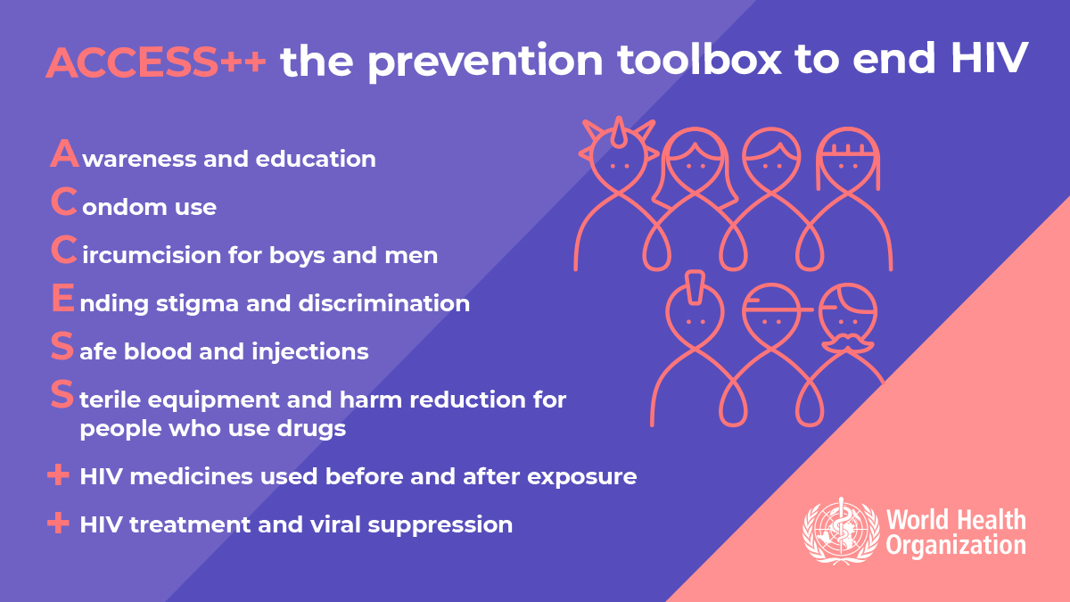

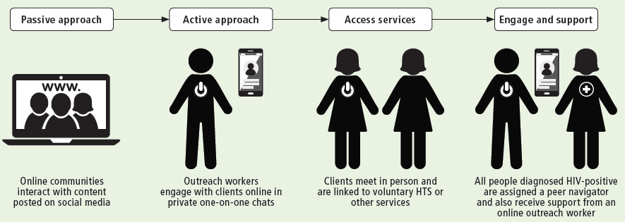
1
Prevention focused HIV testing priorities
  HIV testing services are also part of implementing and monitoring prevention services to help:
HIV-Negative people stay negative (monitoring)
Diagnose PLHIV at high risk and start ART as soon as possible
  Core HIV Prevention packages with HTS:
PMTCT (1st ANC visit test for all, late pregnancy 3rd trimester only for KP or in high burden settings)
VMMC – 1 test or self-test
PrEP – frequent testing & self-testing
Key populations testing at least annually (up to 3-6 month based on risk)
Serodiscordant couples package of services annually (up to 3-6 month based on risk )
AGYW in ESA package of services

Slide 12

1
Case-finding focused HIV testing priorities
Effective Focused Facility-based HTS
High burden settings: HTS in every health contact – integration | Low burden settings: HTS in hotspots/select services (TB, STI, key pops)
Focus on identifying PLHIV who are unaware of their status as effectively as possible (ensuring the right populations are reached) and as efficiently as possible (making optimal use of resources).
HIVST & Community Approaches
High burden settings: Outreach for key pops, partners PLHIV, hotspots, consider workplaces, strategic outreach | Low burden settings: Outreach to key pops, partners of PLHIV
Couples and Partners
High burden settings: For all partners of KP and PLHIV | Low burden settings: All partners of KP and PLHIV

Slide 13
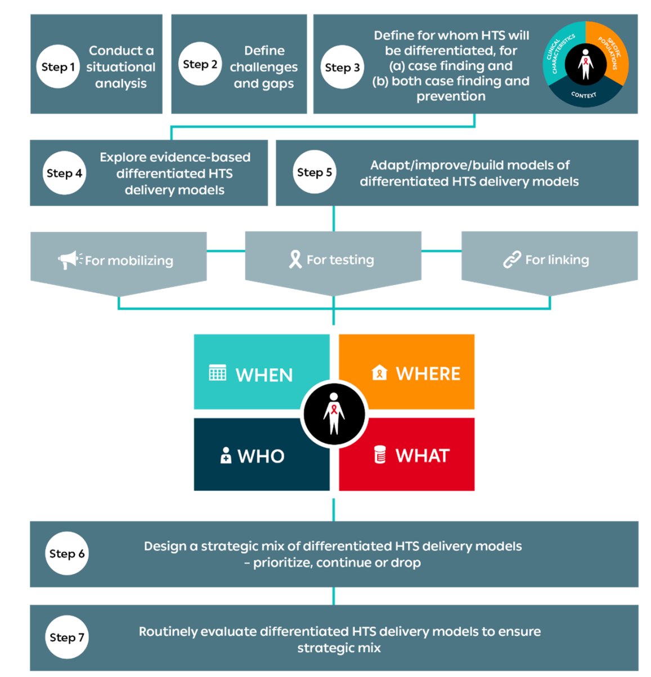
1
The 7-Step Approach to implementing dHTS
Situational Analysis:
Assess current testing services, identify gaps, and understand diverse population needs.
Process must be rapid and led by MoH
Include stakeholder mapping of partners who will support implementation.
2. Identify Challenges & Gaps:
Highlight issues to be addressed through DSD approaches.
3. Define Target Populations:
Determine target populations for tailored testing based on clinical and contextual factors.
4. Review Evidence-based Models:
Explore proven models to guide effective dHTS strategies.
5. Adapt & Develop Models:
Modify/create new service delivery models to address identified needs.
6. Implement Phased Rollout:
Launch adapted models and train in a stepwise approach.
7. Monitor & Evaluate:
Continuously assess and refine testing services for effectiveness and impact.
Source: www.differentiatedservicedelivery.org/Models/Testing

Slide 14
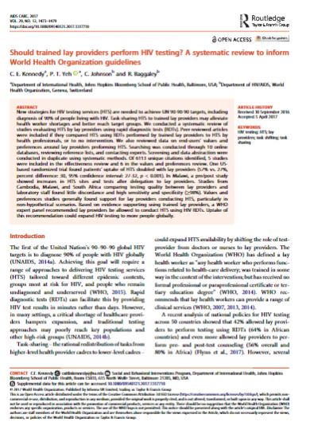
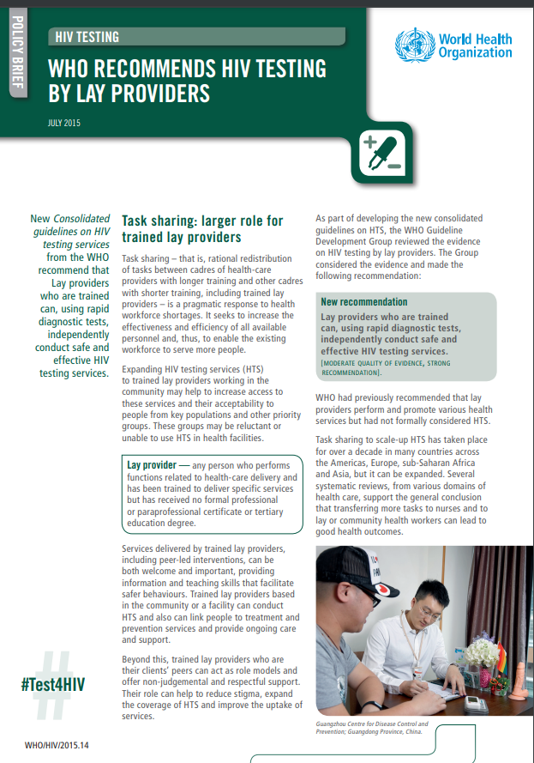

1
Demand creation for HIV testing services
Experience from FHI360 (March 2016 to January 2019)
Using online platforms, peer outreach workers counselled 6367 online users, of 76%(4879) tested.
75% of those contacted had never been in contact with a peer or outreach worker and 1/3 self-assessed as being at substantial risk
for HIV.
Overall, 431 (10%) individuals were diagnosed with HIV. This HIV positivity is higher than among key populations seeking testing through other referrals (10% versus 6%).
WHO good practices that increase uptake of HIV testing services:
    Peer-led approaches
    Virtual and digital tools
    Videos
Messaging matters: Brief pre-test information advised over lengthy pre-test counselling (WHO good practice)
Source: WHO 2019; FHI 360 2019

Slide 15
1
Health System considerations and supporting strategies for dHTS
Decentralization, task sharing and test for triage should be considered across all HTS service delivery options
Decentralization:
providing HIV testing at peripheral health facilities and in the community, and it is a part of DSD
Task sharing:
a rational redistribution of tasks between cadres of health care providers with longer training and cadres with shorter training, such as trained lay providers. Trained Lay providers can independently conduct testing
Test for triage:
a trained provider performs a single RDT and then facilitates linkage to appropriate further services depending on the test result.
Integration:
  Primary purpose of integration is to achieve greater coverage, impact, cost-effective and cost-saving
  It is the co-delivery and sharing of services and resources across different health areas (services in a common facility or community setting)
  HTS can be offered in facilities and other service points by identifying certain
  programmes as key entry points, such as STI, TB, ANC, key populations programmes in communities, and family planning.

Slide 16
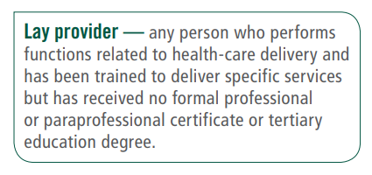
1
Task sharing and supportive policy important for differentiated testing services across HIV, hepatitis and STIs
Task sharing testing services leads to better uptake & is prefered by clients (especially KP and young people) = more people know their status
Lay provider vs HCW: 57% vs 27% (95% CI: 27–32,p<.001)
Strong acceptability and preference
Greater trust and confidentiality in communities
Low cost & affordablity
Using lay providers is less costly and more feasible across HTS sites
Accurate diagnosis
Lay provider HTS equivalent accuracy to HCWs
Shifting to lay providers enhances HCWs work and expands service delivery
Helps with optimising tasks and implementation
Same day diagnosis, prevention and treatment
Lay providers can help implement same day diagnosis and testing linkage
Critical part of operationalizing DSD-like services

Slide 17
1
Supporting Strategies (1/4) – Task Sharing
Task sharing involves reallocating specific tasks from clinical providers to trained lay providers or community health workers to improve service delivery. The World Health Organization (WHO) recognizes it as a key strategy to expand healthcare access in high-demand settings, aligned with the framework of Differentiated Service Delivery (DSD).
Optimized service delivery
Increases capacity by engaging lay providers, allowing clinical staff to focus on complex cases.
Supports the 7-Step approach
Enables flexibility in roles and increases testing coverage by involving non-clinical staff in testing and follow-up.
Enhanced mobilisation, testing, and linkage
Lay providers play crucial roles in reaching clients, conducting tests, and ensuring linkage to care, expanding access and engagement.

Slide 18
1
Supporting Strategies (2/4) – Quality Assurance
Quality Assurance (QA) ensures that HIV services are consistently reliable, safe, and client-centered. QA is essential to maintain high standards and support effective service delivery across diverse settings.
Training and Supervision
Streamlined and comprehensive training and regular supervision ensure that all providers, including lay providers, maintain quality and adhere to protocols.
Monitoring and Evaluation (M&E)
Systems track key indicators (e.g., testing accuracy, client satisfaction, linkage rates) to guide improvements and address gaps.
Client Feedback Mechanisms
Gathering client insights helps refine services and ensures they remain responsive and client-centered.

Slide 19
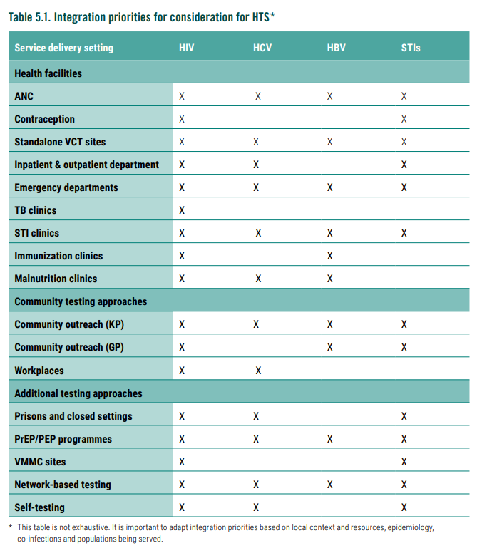
1
Supporting Strategies (3/4) – Service Delivery Integration considerations
Many opportunities to integrate services, particularly for HIV, hepatitis and STI testing
Within service delivery sites
Prioritize based on opportunities, epidemiology and resources
For diagnostic network optimization, resource sharing for labs, training and sample transportation (important to link to TB and health emergency preparedness)
As part of self-testing across disease areas
Integrated testing is good value of resources
Multiplex options becoming more widely available
WHO multiplex guidelines are under development, to be released in 2026
We need collaborative cross-cutting policies, strategies and operational plans that cover DSD for testing across areas
Source: WHO, 2024: iris.who.int/bitstream/handle/10665/378162/9789240096394-eng.pdf

Slide 20
1
Supporting Strategies (4/4) – Shifting to low-cost RDTs
Cut costs without cutting quality
  Stick to the 3-test strategy and discontinue complex and costly testing practices
  Only use serial testing algorithm with HIV RDTs or EIA (stop parallel testing – it is more expensive)
  Discontinue use of recency assays, NAT (RNA or DNA), WB/LIA for routine HIV testing and diagnosis (>18 months of age) and question Ag/Ab RDT
Support rapid country transition
  Focus on switching out A1 (first test in algorithm) for greatest savings) and keep the existing A2/A3
  Use policy waivers for WHO PQ products to accelerate importation and implementation
  Focus on accelerated verification studies with different A1 options
  Adopt streamlined, simplified training & QMS activities
  Push industry to fund training and QA/QC in new agreements and tenders
Place orders as soon as possible with prices at or below those in WHO catalogue, pooled procurement and Wambo or direct procurement if lower cost available (negotiate landed prices).
Collect data in parallel or after algorithm transition per WHO toolkit with low-cost candidate products and share data and experiences with WHO to inform updates.
Notes:
Differentiated Testing Services (dHTS) Overview:
Q: What are the core goals of Differentiated Testing Services (dHTS) in HIV?
The main goals are to increase HIV testing coverage, improve client-centered care, and enhance linkage to treatment or prevention services.
Q: How does dHTS improve accessibility and client-centered care in HIV testing?
dHTS makes testing more accessible by offering flexible, tailored options that meet the diverse needs and preferences of clients, reducing barriers related to location, stigma, and convenience.
Designing Effective dHTS Models:
Q: What key considerations should be taken into account when developing a dHTS model?
Key considerations include understanding the local context, identifying target populations, choosing suitable delivery approaches, and aligning resources with the goals and needs of the community.
Q: How can you determine which population groups would benefit most from differentiated approaches to HIV testing?
Conduct a situational analysis to identify groups with low testing uptake, high HIV risk, or unique barriers to accessing traditional testing, such as young people, men, or key populations.
HIV Testing Approaches and Adaptability:
Q: What are some examples of HIV testing delivery approaches, and how might they suit different settings or populations?
Examples include facility-based, community-based, and network-based testing. Facility-based is ideal for immediate linkage to care; community-based suits underserved areas; network-based reaches high-risk groups within social networks.
Q: In what ways can HIV self-testing complement traditional testing approaches?
HIVST offers a private, flexible option, enhancing accessibility for those uncomfortable with clinic-based testing, thus complementing facility and community testing efforts.
Supportive Strategies and Integration:
Q: How do strategies like task shifting and quality assurance support dHTS implementation?
Task shifting allows trained lay providers to conduct testing, expanding reach and reducing the workload on healthcare providers. Quality assurance ensures consistent standards and reliability in testing services.
Q: Why is it important to monitor and evaluate dHTS approaches, and what are some effective ways to do so?
Monitoring and evaluation help measure effectiveness, identify gaps, and make improvements. Effective methods include routine data collection, client feedback, and performance audits.
Reflections on Practical Application:
Q: How could you apply dHTS principles in your setting?
Apply dHTS by assessing local needs, selecting appropriate testing models, and ensuring a client-centered approach to increase accessibility and linkage to care.
Q: What challenges might arise, and what are potential solutions for effective implementation of dHTS in diverse healthcare settings?
Challenges include stigma, limited resources, and reaching remote populations. Solutions may involve community outreach, using lay providers, integrating HIVST, and adapting models to local preferences and logistical realities.

Slide 21

1
Summary take away message
DSD is an innovation for HIV testing services
HIVST and task sharing are critical – along with decentralization and integration
Encourage a person-centered approach, tailored to the needs and preferences of individuals
Strategic HIV testing approaches are essential to closing gaps and achieving global targets by 2030.
Offer routine testing and highly targeted options together
Optimize limited resources by weighing the absolute public health impact of each strategy

Slide 22
1
Questions
Differentiated Testing Services (dHTS) Overview:
What are the core goals of Differentiated Testing Services (dHTS) in HIV?
What are the core principles of dHTS?
What are the 4 key dHTS approaches?
Designing Effective dHTS Models:
What key considerations should be taken into account when developing a dHTS model?
How can you determine which population groups would benefit most from differentiated approaches to HIV testing?
List and explain the 7 steps required to implement dHTS !
HIV Testing Approaches and Adaptability:
What are the two different HIV testing purposes and focus for testing and provide various examples of each, how might they suit different settings or populations?
In what ways can HIV self-testing complement traditional testing approaches?
Supportive Strategies and Integration:
How do strategies like task shifting and quality assurance support dHTS implementation?
Why is it important to monitor and evaluate dHTS approaches, and what are some effective ways to do so?
Reflections on Practical Application:
How could you apply dHTS principles in your setting?
What challenges might arise, and what are potential solutions for effective implementation of dHTS in diverse healthcare settings?
Notes:
Differentiated Testing Services (dHTS) Overview:
Q: What are the core goals of Differentiated Testing Services (dHTS) in HIV?
The main goals are to increase HIV testing coverage, improve client-centered care, and enhance linkage to treatment or prevention services.
Q: How does dHTS improve accessibility and client-centered care in HIV testing?
dHTS makes testing more accessible by offering flexible, tailored options that meet the diverse needs and preferences of clients, reducing barriers related to location, stigma, and convenience.
Designing Effective dHTS Models:
Q: What key considerations should be taken into account when developing a dHTS model?
Key considerations include understanding the local context, identifying target populations, choosing suitable delivery approaches, and aligning resources with the goals and needs of the community.
Q: How can you determine which population groups would benefit most from differentiated approaches to HIV testing?
Conduct a situational analysis to identify groups with low testing uptake, high HIV risk, or unique barriers to accessing traditional testing, such as young people, men, or key populations.
HIV Testing Approaches and Adaptability:
Q: What are some examples of HIV testing delivery approaches, and how might they suit different settings or populations?
Examples include facility-based, community-based, and network-based testing. Facility-based is ideal for immediate linkage to care; community-based suits underserved areas; network-based reaches high-risk groups within social networks.
Q: In what ways can HIV self-testing complement traditional testing approaches?
HIVST offers a private, flexible option, enhancing accessibility for those uncomfortable with clinic-based testing, thus complementing facility and community testing efforts.
Supportive Strategies and Integration:
Q: How do strategies like task shifting and quality assurance support dHTS implementation?
Task shifting allows trained lay providers to conduct testing, expanding reach and reducing the workload on healthcare providers. Quality assurance ensures consistent standards and reliability in testing services.
Q: Why is it important to monitor and evaluate dHTS approaches, and what are some effective ways to do so?
Monitoring and evaluation help measure effectiveness, identify gaps, and make improvements. Effective methods include routine data collection, client feedback, and performance audits.
Reflections on Practical Application:
Q: How could you apply dHTS principles in your setting?
Apply dHTS by assessing local needs, selecting appropriate testing models, and ensuring a client-centered approach to increase accessibility and linkage to care.
Q: What challenges might arise, and what are potential solutions for effective implementation of dHTS in diverse healthcare settings?
Challenges include stigma, limited resources, and reaching remote populations. Solutions may involve community outreach, using lay providers, integrating HIVST, and adapting models to local preferences and logistical realities.

Slide 23
1
Exercise

