Slide 1
MODULE 2:
INTRODUCTION TO HIV
SELF-TESTING

Slide 2

Learning Objectives
2
By the end of this module, participants will be able to:
Define and describe the concept of HIV Self-Testing (HIVST)
Explain HIVST and test for triage
Understand the evidence supporting the use of HIVST
Describe selfcare and self-testing
Know about available HIVST diagnostic test kits
Explain the potential benefits of HIVST
New recommendations for HIVST use
Know about the use of HIVST in PrEP and PEP and country uptake
Understand the HIVST distribution methods
HIVST distribution models and use cases

Slide 3



Progress toward Global targets: HIV testing innovations
2
Target 2025
# PLHIV
Diagnosed
(Millions)
Scale-up of successes – but gaps remain:
Costs of additional testing increasing, challenging to effectively focus and rationalize core and additional testing
Testing moving to communities, Opt-Out
2030
Test
Countries achieving 95-95-95 & ART coverage high:
86% PLHIV diagnosed / 29.8 million on ART (2022)
More HTS options: HIVST, partner testing, social network approaches, community approaches, DSD, decentralization to achieve success
Initial decelerated increase:
Testing largely confined to health sector testing
Epidemic shifts point toward HIV testing future continuing case-finding while also enabling high impact prevention
Self-testing will play a key role in how we maintain gains and scale-up prevention.
Initial slow start to steep increase:
In 2005 ~10% PLHIV diagnosed & 700,000 on ART by the end of 2004
RDTs & PITC had big impact on scale-up
Source: WHO forecast 2020; UNAIDS 2021; WHO 2005; CHAI 2015; WHO, UNICEF, PEPFAR, GFTAM 2018; GAM reporting 14 October 2020

Slide 4
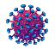








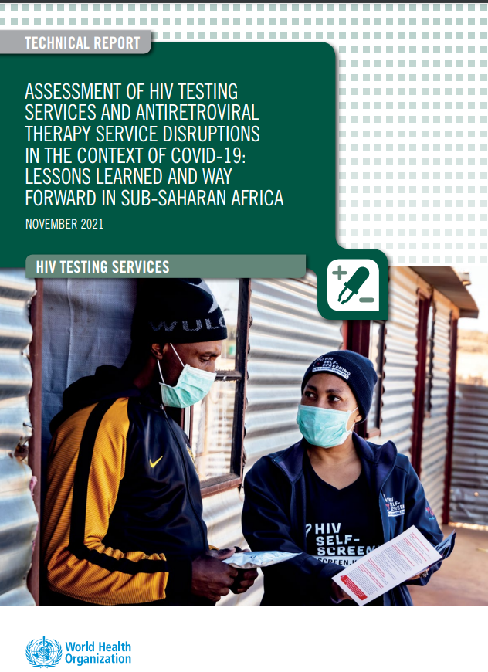
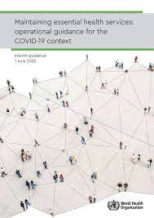
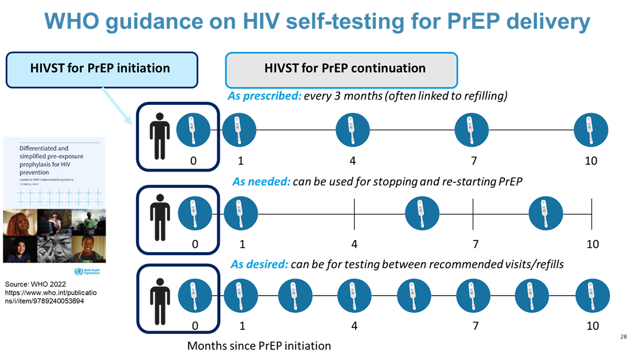
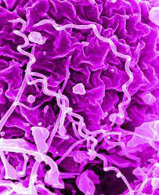
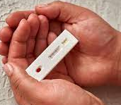

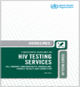
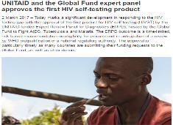





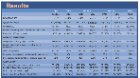


2
Self-Testing Evidence, Implementation, and Policy Scale-Up
1st HIVST kit discussed
2015 – 3 countries with policies and 1 HIVST product
WHO recommends HIVST
ST for syphilis (including dual test) and for PrEP recommended
1986
WHO HIVST scale-up guides
2008
HIVST & ST embraced as a key COVID adaptation
2005
2012
2014
2011
2013
2016
First HIVST kit under review by FDA
2018
2015
WHO review on HIVST in health workers
WHO convenes 1st International Meeting on HIVST
2020
Multiplex self-tests and different combinations now a priority
2017
HIVST comes to Europe: 2 products CE marked and on sale in UK and France
2019
2023
2021
2024
Unitaid PSI-WHO-LSHTM STAR project kick-off Zimbabwe November 2015
1st WHO PQed kit & real world implementation
HIVST: 102 countries, 6 PQ kits, market size > 20 million & price < $1
C19ST: 101 countries, market and use transitioning as pandemic evolves, price <$1
HCVST: 2 products in pipeline, price $1-4
SST: New, pipeline include 3+ products
NG/CT-ST: Emerging
Self-testing studies for HCV &C19 (WHO, 3ACP, FIND)
WHO guidance July 2021 & March 2022
7 WHO GL products, 20 systematic reviews,
12 modelling studies, 58 original research studies, 20 policy, consultation, V&P reports all showing strong evidence and support for ST
WHO Self-Care and Updated HIVST guidelines on optimized service delivery

Slide 5
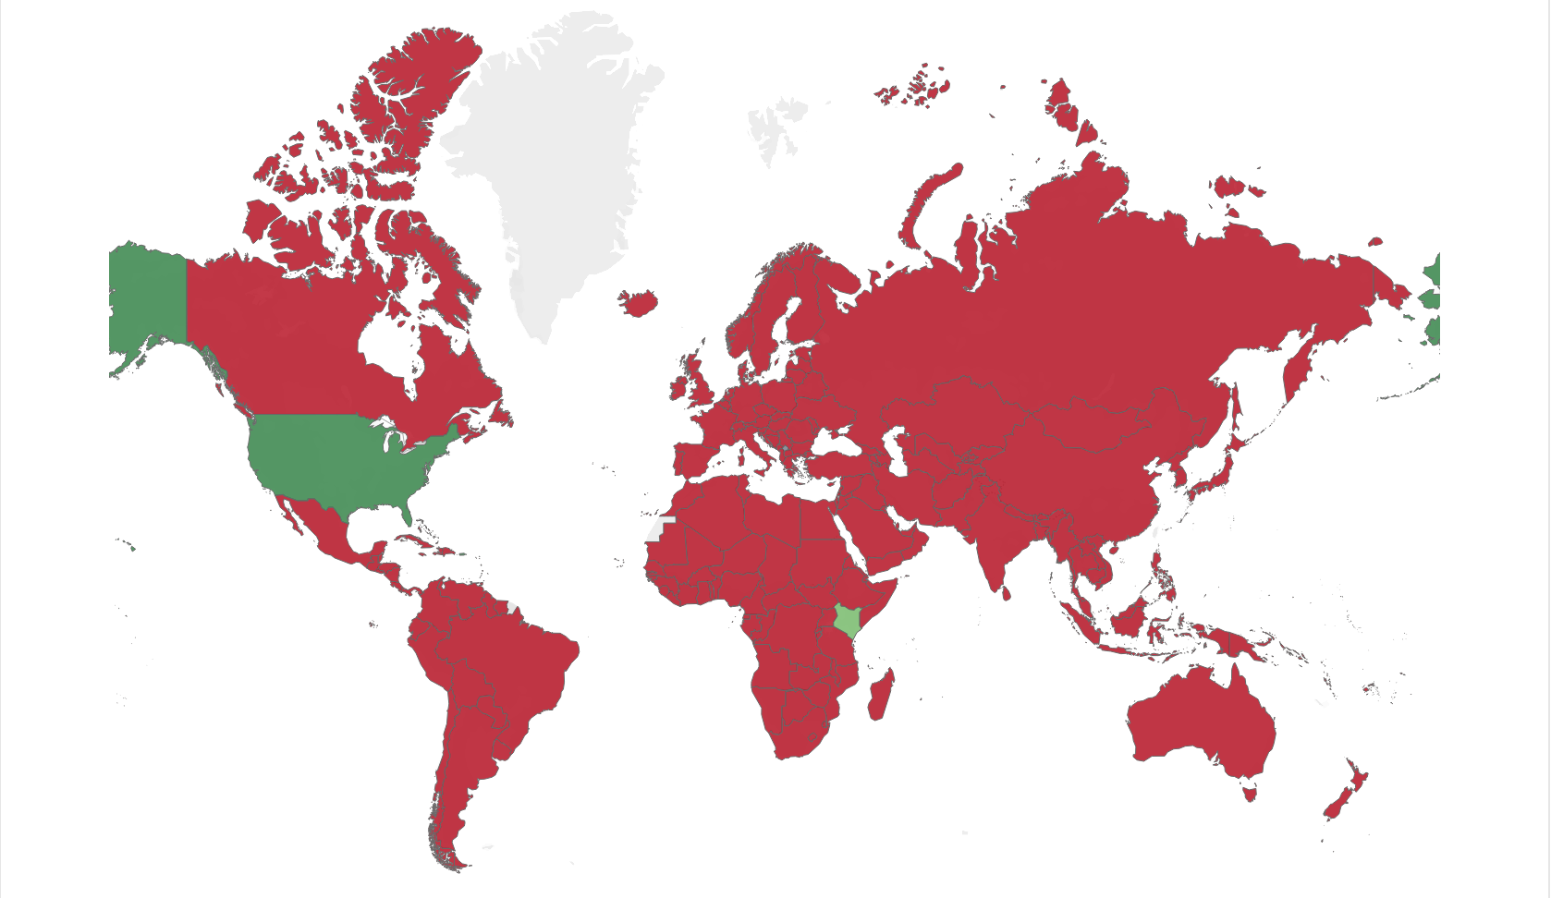
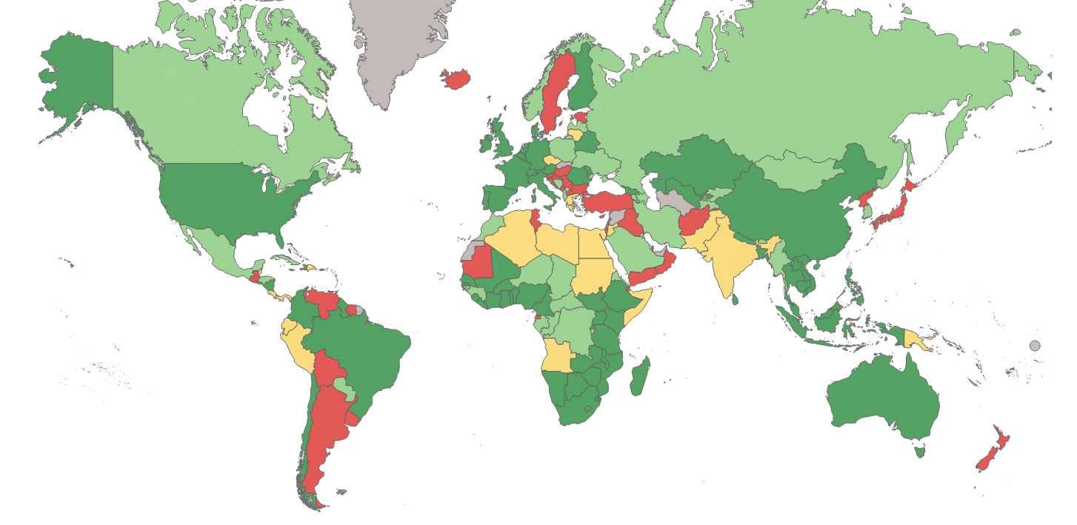
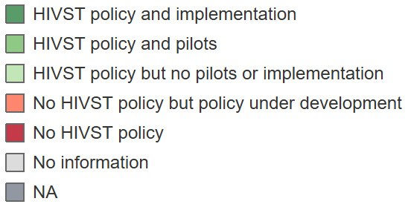
2
Country Adoption of HIVST Policy and Implementation
2014
2024
2014
3 countries with HIVST policies
2024
108 countries with HIVST policies
Source: STAR Project presentation, AIDS 2024 www.bmj.com/content/365/bmj.l1228

Slide 6
2
What is HIV Self-Testing?
HIVST is for individuals who want to test and learn their HIV status on their own.
It is a process in which an individual collects their own specimen (either oral fluid or blood), performs the HIV test, and interprets the result privately.
HIVST is a test for triage and does not provide a definitive HIV-positive diagnosis.
HIVST can replace screening-in tools
HIVST can be used as A1 during stockouts
Age of consent for HIVST varies across different countries, ranging from 12 to 18 years
A reactive (positive) HIVST result is not equivalent to an HIV-positive diagnosis. All reactive HIVST results require further testing by a trained provider, starting with the first test in the national testing algorithm.
Non-reactive HIVST results should be considered negative, with no need for immediate further testing.
For those with ongoing high HIV risk, messages should support linkage to, and/or continued engagement with, HIV prevention services. Individuals can start PEP or PrEP based on a negative self-test
WHO recommends use of Quality-assured self-tests

Slide 7
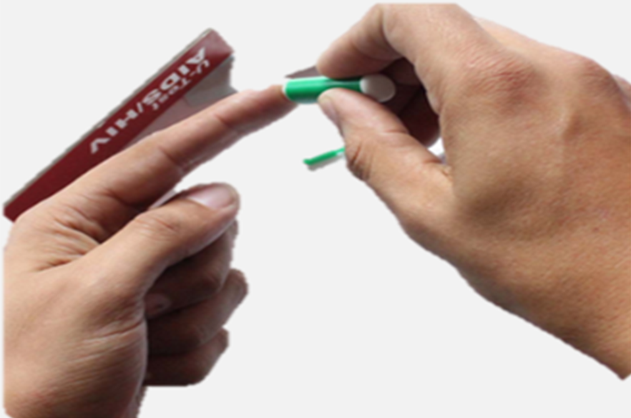

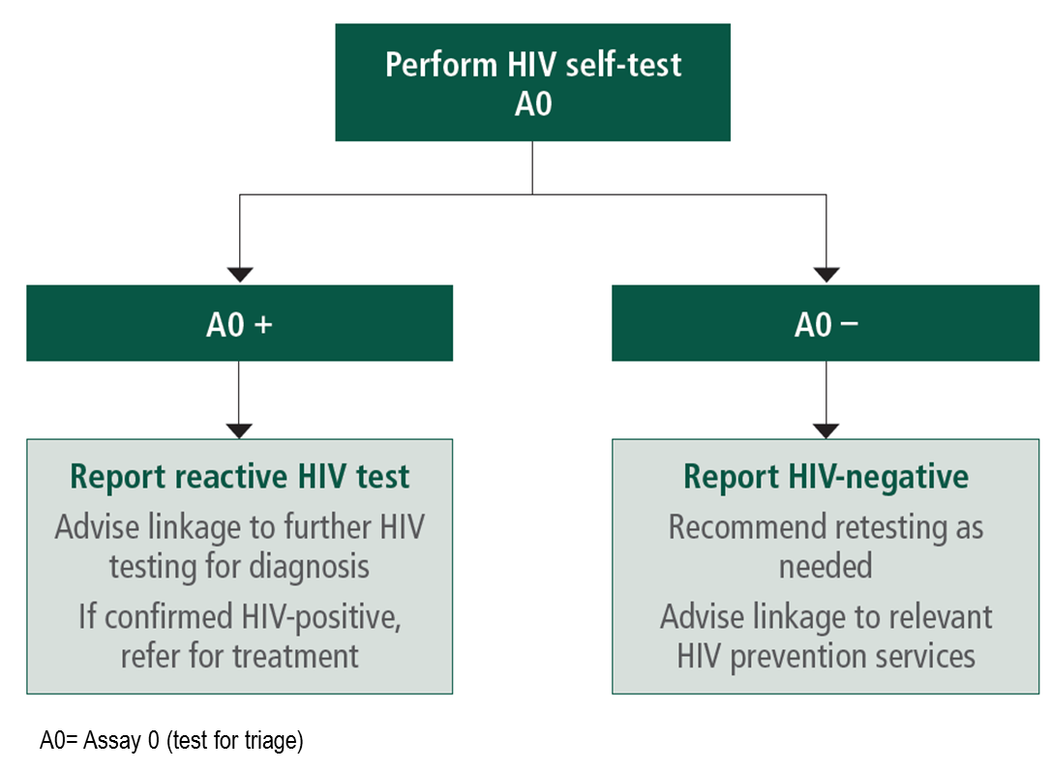
2
HIVST – can be used as a Test for Triage
In test for triage
a trained provider performs a single RDT and then facilitates linkage to appropriate further testing and services depending on the test result.
In the context of HIV, anyone who has an initial reactive test for triage is then promptly linked to further testing for confirmation of HIV status.
This strategy is used for self-testing and can also be used to expand testing in communities by lay providers.
Module 3 will explore the potential to elevate HIVST from A0 to A1 in national HIV testing algorithms, in the context of growing funding and human resource constraints.
Source: WHO 2016, HIV Self-testing guidelines

Slide 8
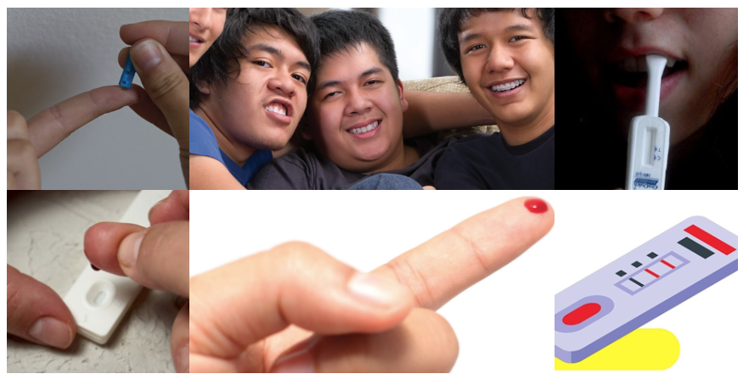
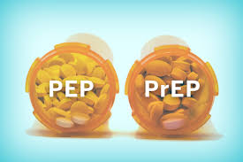
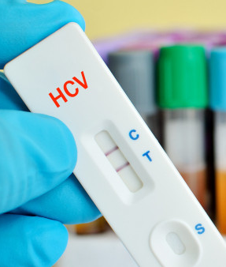
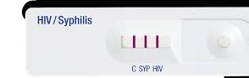
2
Self-Testing?
Self-testing recommended across conditions and diseases
Self-testing and self-care becoming standard of care across many different areas
No difference in blood vs oral self-tests performance
Both accurate and acceptable - no difference in uptake
HIVST recommended in health facilities
Complimenting existing provider-administered HIV testing
Replacing risk-based screening tools
HIVST recommended for PEP and PrEP (oral & DVR)
Covers PrEP initiation, re-initiation and continuation
No need for further testing to confirm negative results
Ongoing research for long-acting injectable PrEP is needed
Syphilis ST, including dual HIV/syphilis ST, recommended
More multiplex ST likely in the future, Critical opportunity for integration

Slide 9
2
Summary of Key Findings from Systematic Review on Facility-Based HIVST
Compared to standard testing services, facility-based HIVST:
May increase uptake of testing
May increase HIV positivity
May achieve comparable linkage to care
May be preferred and considered easier and more acceptable to clients
Did not result in any social harms or adverse events
May be cost-effective and potentially cost-saving.
Source: McGee 2024

Slide 10
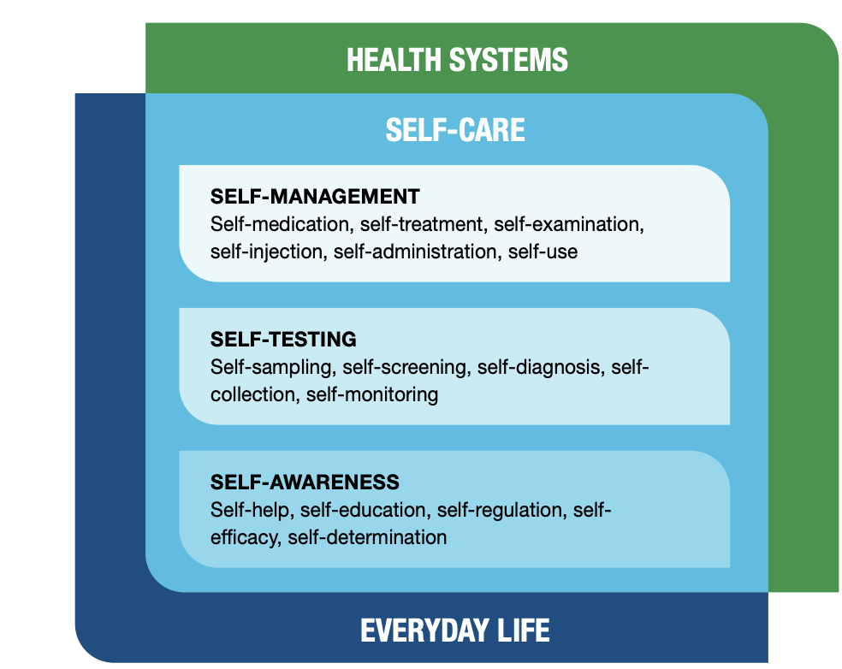
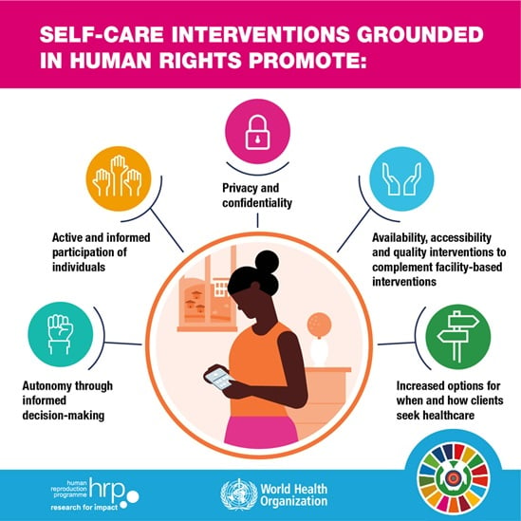
2
The self-care revolution: Why self-care?​
Self-care is the ability of individuals, families and communities to promote health, prevent disease, maintain health and cope with illness and disability with or without the support of a health worker.
Self-testing is a process in which an individual collects their specimen using a simple RDT, performs the test, and interprets their result, when and where they want.
HIVST and Self-Care: HIVST aligns with self-care principles by allowing individuals to control their testing experience (when, where, how), enhance privacy and autonomy.

Slide 11
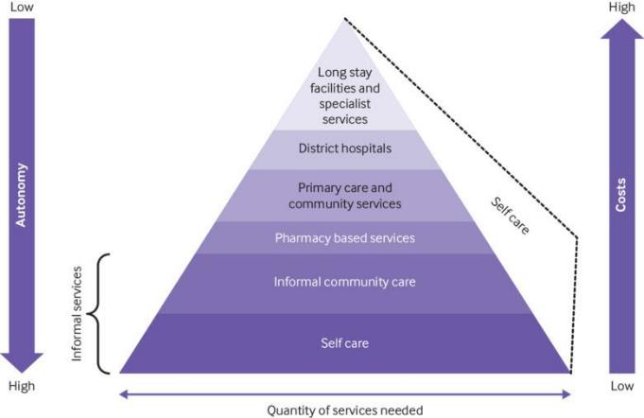
2
Self-Care and Self-Testing: Critical to Health Systems
Increase engagement
and autonomy
Increase access and equity
Expand UHC efforts
Improve quality of care
Reduce costs to health system and individuals
Increase efficiency
Source: Remme 2019 www.bmj.com/content/365/bmj.l1228
Notes:
Self care can increase people’s engagement with and autonomy over their health and provide an opportunity for health systems to improve equitable access to healthcare, quality of care, and financial protection for users. Self care could improve the efficiency of healthcare delivery by including users as lay health workers, thereby increasing people’s access to essential health services. Self care could also increase the use of preventive services and adoption of preventive behaviours, improve adherence to treatment, and reduce the need for healthcare services.

Slide 12
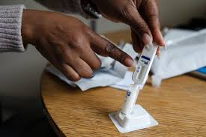
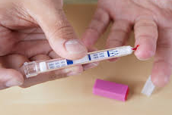
2
HIVST Kits – Oral Fluid & Blood-Based
Oral Fluid-Based HIVST
Uses a swab to collect oral fluid from the gums, providing a non-invasive, convenient option with results in about 20 minutes.
Popular for ease of use and minimal training requirements.
Preferences vary widely by setting and population
Trusting results (blood based)
Painless approaches (oral fluid)
No significant difference in uptake, acceptability, usability or accuracy by product type
Blood-Based HIVST
Requires a small finger-prick to collect blood, which is then applied to a test strip for results.
Known for high accuracy and often preferred in clinical settings.
Offer Choices if Possible
Source: WHO 2024, Jamil 2021, WHO 2019, Figueroa 2018, Figueroa 2015

Slide 13
2
HIVST Kits – Currently Available Options
WHO Prequalified HIVST Kits
Brand | Specimen Type | Manufacturer | Location
OraQuick | Oral | OraSure Technologies | United States
CheckNOW | Blood | Abbott | Germany
SURE CHECK | Blood | Chembio Diagnostics | United States
Wondfo | Blood | Guangzhou Wondfo | China
Insti | Blood | Biolytical | Canada
Mylan/ Atomo | Blood | Atomo Diagnostics | South Africa
HIVST by urine | Urine | Beijing Wantai | China
1 oral & 5 blood-based tests are prequalified
Costs vary from 1-4 USD in LMICs
The tests detect antibodies to HIV (some detect antigens)
Source:
WHO, 2024 extranet.who.int/prequal/vitro-diagnostics/prequalification-reports/whopr
HIV self-testing: Innovations and product choice, WHO, AIDS 2024

Slide 14
2
HIV Self-Testing – Potential Benefits
Convenience
Offers both facility-based and non facility-based options, accommodating those with busy schedules or mobility challenges.
Immediate results
Results can be read right away in a few minutes without waiting.
HIVST contributes to achieving public health goals by increasing testing uptake, reducing undiagnosed HIV cases, and supporting HIV prevention and treatment goals.
Expand testing coverage: Reach underserved, high-risk, and hard-to-reach populations who may not engage with standard testing.
Empower individuals: Promote privacy and autonomy by giving individuals control over their testing process.
Facilitate early diagnosis & linkage to care: Identify HIV cases early, ensuring prompt referral for confirmatory testing and care linkage for those who test positive.
Replacing Risk-Screening Tools: HIVST replaces risk screening tools that previously limited client access to testing, thus offering the potential to significantly increase testing coverage.
HIVST contributes to achieve the goals of self-care.
Reduced Stigma
Provides an alternative to clinic-based testing, valuable for key populations facing stigma.
Flexibility
Offers both oral fluid and blood-based options, tailored to client preferences and needs.
Complete testing kits
The HIVST kits include all necessary materials to perform and interpret the test.

Slide 15
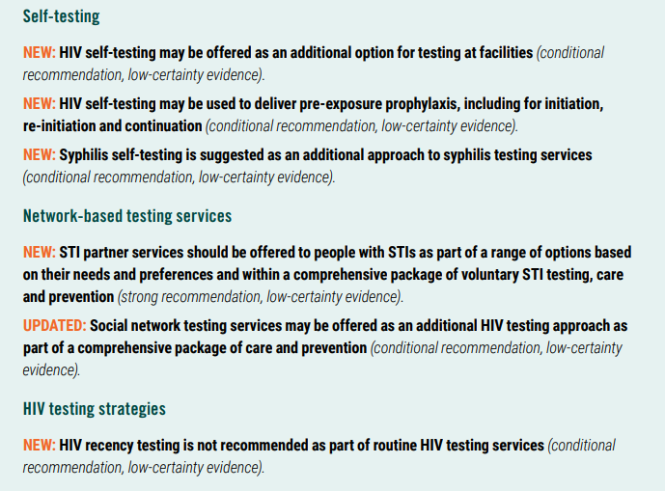
2
Summary of new and updated recommendations

Slide 16

Expanding Self-Testing – WHO recommendations
2
Summary of new and updated recommendations
Self-testing is safe, effective and empowering
Recommended across conditions and diseases including HIV, hepatitis C and syphilis – including dual HIV/syphilis self-tests
Affordable and WHO prequalified self-tests increasingly available ($1)
ST used in facilities, communities, pharmacies and through partners, peers and networks in more than 100 countries
HIVST now recommended more broadly in facilities
Increases testing coverage when needed
Replaces risk-based screening tools which miss too many undiagnosed PLHIV
HIVST now recommended for expanding prevention access
HIVST for PEP delivery – at start and completion
HIVST for initiation, re-initiation and continuation of PrEP (oral & ring w/ ongoing research needed for LA-PrEP)
Greater access, many benefits, lower costs
No risks of increasing drug resistance at population-level
Oral and blood-based ST both acceptable
CQUIN dHTS Meeting | July 9 - 12, 2024 – Durban, South Africa. Source: 2018, 2022, 2022, WHO 2023, McGee 2023, 2023, WHO 2024

Slide 17
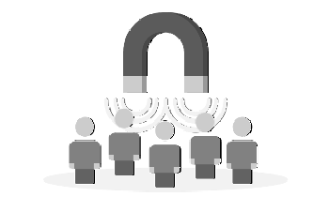



Expanding Self-Testing – WHO recommendations
2
HIVST-Supported PrEP
Rapid uptake of WHO HIVST-supported guidance
As of May 2024, WHO mapped country uptake of the new recommendation on HIVST-supported PrEP identified the following country reports (work ongoing)
HIVST for
PrEP Demand Creation
Philippines, Eswatini, Thailand
HIVST for
PrEP Initiation
Nepal, Zimbabwe, Kazakhstan, Ghana, South Africa, Eswatini, Vietnam
HIVST for
PrEP Re-Initiation
Brazil
HIVST for
PrEP Continuation
Zambia, Spain, Mozambique, Kenya, South Africa, Vietnam
CQUIN dHTS Meeting | July 9 - 12, 2024 – Durban, South Africa

Slide 18
2
Primary and Secondary HIVST Distribution in facilities
Primary distribution:
The client uses the self-test on themselves on site for the facility-based HIVST
HIVST kits are provided directly at facilities or community sites, like clinics, pharmacies, or during outreach events.
Clients receive the kits in person with brief instructions and information on follow-up support.
Secondary distribution:
HIVST kits are given to individuals who then share them with partners, family, or peers.
Extends reach by allowing trusted contacts to promote testing among those who might avoid services.
Both models can be implemented in community and facility settings, covering a wide range of service points, whether mobile or fixed. HIVST

Slide 19
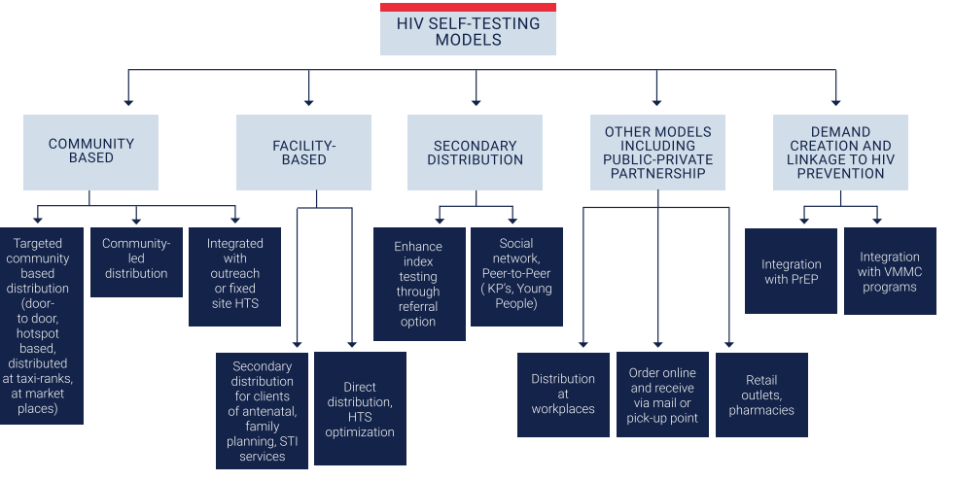
Expanding Self-Testing – WHO recommendations
2
HIVST Models
Partner services
Integration with PrEP and PEP
Source: HIV Self-Testing Operational Guide – For the planning, implementation, monitoring and reporting of HIV self-testing. PEPFAR, USAID, EpiC. 2021

Slide 20
2
Strategic Planning for Facility-Based HIVST
Case-finding focused HIVST
Prevention focused HIVST
Diagnose PLHIV at high risk and to initiate ART as soon as possible
Increase routine offer of HTS in key entry points (PHC, OPD, FP, STI)
Replace risk screening tools to simplify and streamline HTS in facilities
Increase offer in KP settings (clinics and drop-in centers)
Secondary distribution for SN, sexual partners, new HIV cases, and PWID partners
HIVST part of implementing and monitoring prevention services
Support HIV-negative people to stay negative (monitoring)
ANC – retesting & male partner testing
VMMC – uptake and offering those accompanying VMMC clients
PrEP – initiation, re-initiation, continuation
PEP – beginning and end of course
Harm Reduction clinics

Slide 21



2
HIV Self-Testing Framework
+
PREPARATION
DIRECT ACTION
DIRECT IMPACT
ADDITIONAL IMPACT
Demand generation
Link to treatment
Re-link to Tx
Health:
Reduced morbidity
& mortality
Social & Economic
Population productivity
& growth
-
Support package
Disclosure / Shared knowledge of status
Social benefit
Social harm
Reduced transmission & infections averted
Accessible & affordable
Link to prevention
Health Systems
Efficiency
Cost and time savings (Health system & users)
Expanded coverage
Uptake among
at-risk groups
Triaged out of health system
Equity of health
DIFFERENT POPULATIONS
DIFFERENT CONTEXTS
DIFFERENT GEOGRAPHIES
Notes:
This shows you again the HIV Self_testing framework and HIVST use cases, their direct action and potential impact. are adapted to the different populations to be reached, the different context and geograhies. Like for other testing approaches, demand creation and awareness and mobilization is important, in addition providing support tools like instructions for use

Slide 22
2
Who is at risk, in need of testing & not reached by existing services?
Know your epidemic & testing gap
Approaches
Considerations
Couples & Partners
Community-Based
(outreach, door-to-door)
Facility-Based
(PITC, Drop-In Centres)
Benefits & Risks to Populations
Support tools
Linkage
Increased access
Increased coverage
Men
VMMC Programmes
Workplace Programmes
Key populations
Pharmacies & Kiosks
Integrated in KP Programmes
Young people
Other at risk populations
(SDC, partners of PLHIV, migrants etc.)
Internet & Apps
Integrated in RHS & Contraceptive Services
Vending Machines
Partner-Delivered
Notes:
Whose at risk, in need of testing & not reached by existing services

Slide 23
2
Reaching Men
Know your epidemic & testing gap
Approaches
Considerations
Couples & Partners
Community-Based
(hot spots, transport hubs)
Facility-Based
(PITC, Drop-In Centres)
Benefits & Risks to Populations
Support tools
Linkage
Increased access
Increased coverage
Men
VMMC Programmes
Workplace Programmes
Key populations
Pharmacies & Kiosks
Integrated in KP Programmes
Young people
Other at risk populations
(SDC, partners of PLHIV, migrants etc.)
Internet & Apps
Integrated in RHS & Contraceptive Services
Vending Machines
Partner-Delivered
Notes:
Whose at risk, in need of testing & not reached by existing services

Slide 24
2
Reaching Key Populations
Know your epidemic & testing gap
Approaches
Considerations
Couples & Partners
Community-Based
(outreach, door-to-door)
Facility-Based
(PITC, Drop-In Centres)
Benefits & Risks to Populations
Support tools
Linkage
Increased access
Increased coverage
Men
VMMC Programmes
Workplace Programmes
Key populations
Pharmacies & Kiosks
Integrated in KP Programmes
Young people
Other at risk populations
(SDC, partners of PLHIV, migrants etc.)
Internet & Apps
Integrated in RHS & Contraceptive Services
Vending Machines
Partner-Delivered
Notes:
Whose at risk, in need of testing & not reached by existing services

Slide 25
2
Reaching Young People
Know your epidemic & testing gap
Approaches
Considerations
Couples & Partners
Community-Based
(outreach, door-to-door)
Facility-Based
(PITC, Drop-In Centres)
Benefits & Risks to Populations
Support tools
Linkage
Increased access
Increased coverage
Men
VMMC Programmes
Workplace Programmes
Key populations
Pharmacies & Kiosks
Integrated in KP Programmes
Young people
Other at risk populations
(SDC, partners of PLHIV, migrants etc.)
Internet & Apps
Integrated in RHS & Contraceptive Services
Vending Machines
Partner-Delivered
Notes:
Whose at risk, in need of testing & not reached by existing services

Slide 26
2
HIVST to Differentiate Testing Strategies
Targeted community based distribution
Secondary distribution through clinic attendees
Partner Testing
Primary, direct facility based
Social / Sexual network testing
Online ordering and pick up / Pharmacy
Notes:
Many different models of HIVST have been developed based on the information from the Archetypes and the insights and many more have been developed and refined.

Slide 27
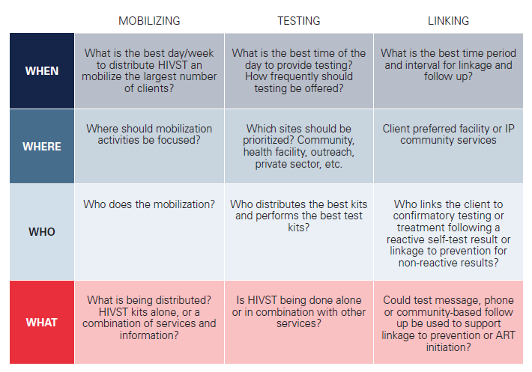
2
Planning of HIVST Services
Use frameworks for planning
Source: HIV Self-Testing Operational Guide – For the planning, implementation, monitoring and reporting of HIV self-testing. PEPFAR, USAID, EpiC. 2021

Slide 28
2
HIVST Use Cases (1) – Community-Based Testing
Workplace
  HIVST kits distributed at workplaces to reach employees conveniently.
Mobile Outreach
  Kits provided through mobile units to underserved or remote areas.
Home-Based HTS
  Kits delivered to homes, enabling private and accessible self-testing.
Faith-Based HTS
  Distribution through religious institutions to engage faith communities.
School-Based
  HIVST offered in schools to reach adolescents and young adults.
Community Campaigns
  Kits distributed during events or campaigns to maximize community outreach and awareness.
Pharmacy
  HIVST kits available for purchase or pick-up at pharmacies for easy access.
Online Distribution
  Kits ordered and delivered through online platforms for private and convenient access.
Vending Machines
  Kits distributed via vending machines in high-traffic or strategic locations.

Slide 29
2
HIVST Use Cases (2) – Facility-Based Testing
Standalone Sites
  Dedicated HIVST centres (formerly VCT).
Within Facilities
  As screening tool, integrated into routine health services at OPD, replacing risk screening tools
Antenatal Care
  HIVST offered to pregnant women during antenatal visits for partner testing (secondary distribution)
Family Planning
  Integrated into family planning services.
TB Services
  HIVST in TB clinics to increase HIV testing uptake
KP Services
  Partner services for key populations (e.g., MSM, PWID, sex workers)
Youth Service
  Youth-friendly clinics for adolescents and young adults
HIV Prevention Services
  PrEP, PEP, VMMC

Slide 30
2
HIVST Use Cases (3) – Network-Based Testing
Partner Services
Social Network Testing
Family & Household Testing
Voluntary testing offered to sexual and/or drug-injecting partners of individuals diagnosed with HIV, using HIVST kits through secondary distribution.
This approach effectively identifies undiagnosed cases while maintaining confidentiality (and previously known as index case testing)
Individuals (e.g., newly diagnosed or at risk) distribute HIVST kits to members of their social, sexual, or drug-using networks.
It enhances access to testing while ensuring privacy and encouraging broader coverage.
HIVST kits are distributed to household members, and family contacts of people with HIV.
It facilitates convenient testing for families, supporting access to care as a unit.

Slide 31
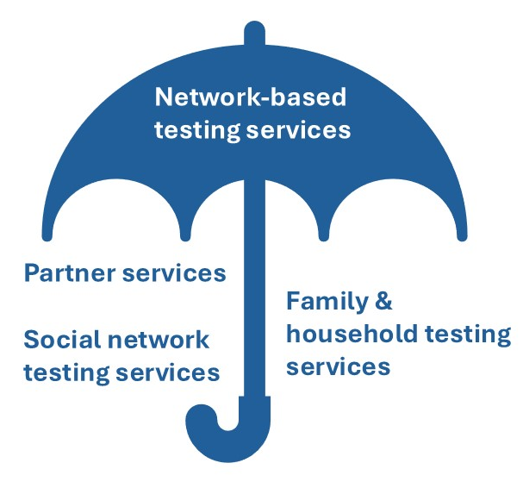
2
What is “Network-Based Testing?”
Partner Services
NBT approaches in which sexual and/or injection partners of clients who have been diagnosed with an infection are contacted, notified of potential exposure, and offered testing and other services
HIV
Hepatitis B
Hepatitis C
Other STIs
Social network testing services
NBT approaches in which individuals living with or at risk of infections encourage and support social contacts to seek testing and other services, or distribute self-testing kits to social contacts
Family & household testing services
NBT approaches in which family members (such as biological children for HIV or HBV) and other household members (for HBV) are contacted, notified of potential exposure, and offered testing and other services

Slide 32
2
Questions
What is the concept of HIV self-testing?
What are the benefits of HIVST?
What is the evidence supporting HIVST?
How does HIVST align with self-care principles?
What aspects of self-care are supported by HIVST?
How does HIVST empower individuals in managing their health independently?
What are the main HIVST distribution models, and how do they differ?
What is the difference between direct and secondary distribution?
How do network distribution and index testing within secondary models reach high-risk or hard-to-reach populations?
What new recommendations are included in the 2024 HIVST guidelines?
How has facility-based HIVST been updated, especially regarding low-coverage clinical settings?
What are the new recommendations for using HIVST alongside PrEP and PEP?
What types of HIVST kits are available, and what are their key features?
What are the differences between oral fluid-based and blood-based kits?
How do these kit types meet the needs of different populations or settings?

Slide 33
2
Exercise

