Slide 1
MODULE 3:
FACILITY BASED HIV SELF-TESTING APPROACHES & HIVST REPLACING RISK SCEENING TOOLS

Slide 2

Learning Objectives
3
By the end of this module, participants will be able to:
Understand the importance of optimizing Facility-Based HIV testing
WHO recommendation on FB HIVST
Understand how HIVST replaces risk screening tools
Current Approaches to Facility-Based HIVST
Explain how to operationalize Facility-Based HIVST
Understand considerations for Implementing Facility-Based HIVST

Slide 3
3
Gaps in Routine Testing at Facilities
Testing gaps remain at facilities
Many clients remain untested with provider-administered RDT testing, thus missing opportunities for early diagnosis.
Suboptimal HIV testing for those at high risk
Priority populations not routinely offered HTS when presenting at the facilities (STI clients, TB patients, FP clients, men)
Facilities face resource limitations
HR: Limited staff time limits testing at scale at busy facilities
Lack of funding for lay cadre positions performing HIV testing in public sector
Space limitations and lack of private spaces
Cost concerns for using resources for testing clients at lower risk
WHO recommendation:
HIV self-testing may be offered as an additional option for testing at facilities
Complements provider-administered testing (not replacing it)
May reduce barriers to testing
May increase uptake for specific populations

Slide 4
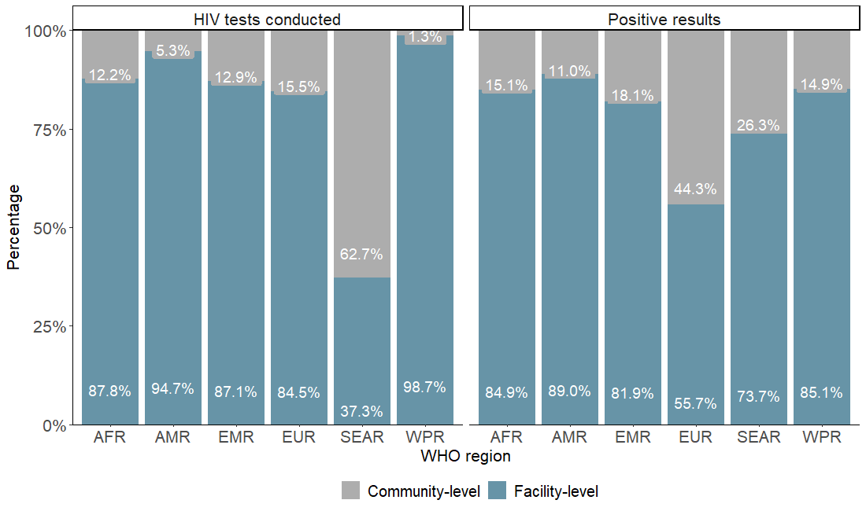
3
Recommendations on Facility-Based HIVST
Evidence Supporting Facility-Based HIVST
Increased Uptake:
FB-HIVST may improve testing uptake.
Higher Positivity:
May increase the detection of HIV-positive cases.
2024
Comparable Linkage:
Achieves similar linkage to care as standard testing services.
Client Preference:
Easier, more acceptable, and preferred by clients.
Safe and Harmless:
No reported social harms or adverse events.
Cost-Effective:
May be cost-effective and potentially cost-saving.

Slide 5
3
Gaps in Routine Testing at Facilities
Testing gaps remain at facilities
Many clients remain untested with provider-administered RDT testing, thus missing opportunities for early diagnosis.
Suboptimal HIV testing for those at high risk
Priority populations not routinely offered HTS when presenting at the facilities (STI clients, TB patients, FP clients, men)
Facilities face resource limitations
HR: Limited staff time limits testing at scale at busy facilities
Lack of funding for lay cadre positions performing HIV testing in public sector
Space limitations and lack of private spaces
Cost concerns for using resources for testing clients at lower risk
Limitations of Risk-Based Screening Tools
Risk-Based Screening Tools:
Are not recommended in all settings as they might unintentionally exclude individuals who require testing, potentially delaying diagnosis and linkage to care. They also increase workload of health care providers using screening tools
Risk-based screening tools have not proven to save costs or improve long-term efficiency.
Performance of screening tools varies by setting, epidemic context, and target population, requiring validation before use. No single screening tool is universally applicable.
For high HIV burden settings, WHO recommends using HIVST to replace screening-in tools.

Slide 6

3
Why replace Screening Tool with HIVST in Facilities?
HIVST can increase detection of HIV:
In high-prevalence areas, risk-based screening tools overlook significant portions of individuals needing testing. HIVST detects 9% more PLHIV than risk-based screening.
Workload reduction:
HIVST reduces healthcare worker time spent on provider-administered testing/ risk-based screening by 82%. Eases facility congestion, allowing staff to focus on higher-need medical cases.
Cost Consideration:
With reduced HIVST kit prices, HIVST is at lower costs compared to risk-based screening approaches, which are provider administered. Need to consider costs for missing HIV positive clients who are not diagnosed and initiate on treatment.
Source: HTS for the Sustainability of the HIV Response. CQUIN dHTS Meeting | July 9 - 12, 2024 – Durban, South Africa

Slide 7
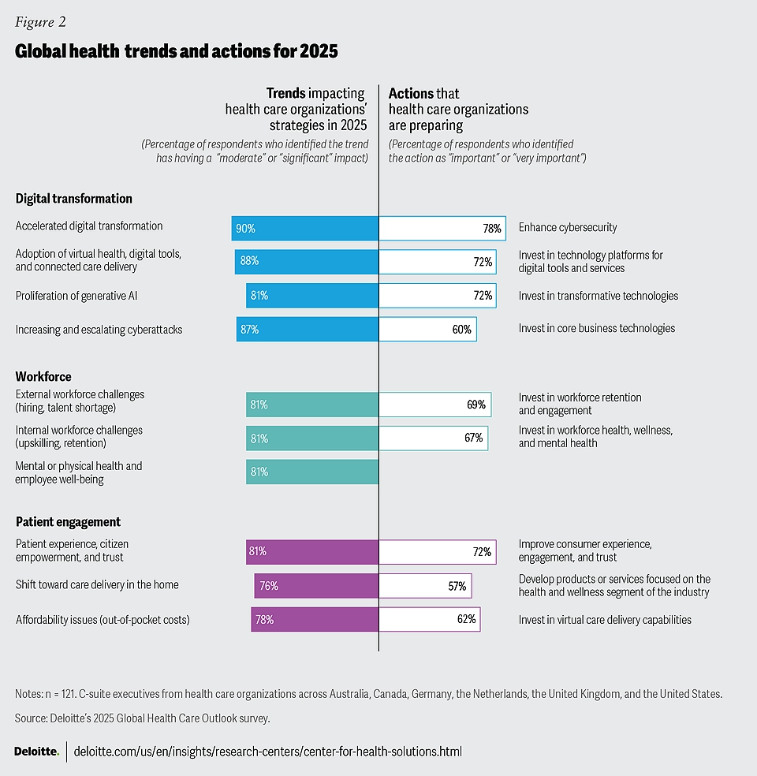
3
Prior to current funding cuts, HRH was already limited
Global health reporting has been showing challenges with growing gaps in human resources for health (HRH)
Policy shifts and reductions in funding have exacerbated these gaps
Reports indicate some HIV testing cadres have been frozen, unpaid or are in process of being eliminated
Multiple countries, particularly in east and southern Africa, report HIV testing is down ≥30%

Slide 8
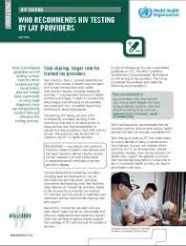
3
HIV self-testing continues to be a critical approach and adaptation
Many countries still have gaps in task sharing and need urgent policy change to fill in testing gaps with less and simpler delivery
Build on to existing WHO guidance and embrace flexibility for using HIVST as A1 and systems to increase efficiencies where needed
Complement existing testing capacity and promote the use of HIVST in facilities per WHO guidance
Clear and simple prioritization of testing staff in facilities is important
Shift to low-cost HIV self-tests
Notes:
Support countries to adopt and scale-up more task shifting and sharing wherever possible
Transition testing tasks to lay providers and cadres with lower remuneration – including volunteers, peers and community cadres
Develop an HRH for testing strategy
Prioritize testing HRH to highest burden, high viremia, high volume settings
Strategically fill gaps in testing HRH with self-tests in facilities and for network testing
Coordinate with community to deploy lay provider testers in strategic locations and periodically (e.g. every 2-5 years plan collective efforts with cross-cutting community health counsels)
Shift more clients to pharmacy and private sector to alleviate pressure and costs
Coordinate with workplaces in high HIV burden settings and affected industries to support testing and self-testing access for men and their families
Reinvigorate ILO and workplace private-public partnerships and insurance schemes
Target specific industry and business leaders in Africa across mining, trucking, etc
WHO testing team working on prioritization plan within TPP and department
Actively inputting into IAS strategy tool kit and documents
Actively coordinating with technical support to countries needing assistance on changes
Using ongoing modelling work to include scenarios on HRH:HIVST ratio to guide country testing plans and open up discussion on creative ideas given limited resources

Slide 9
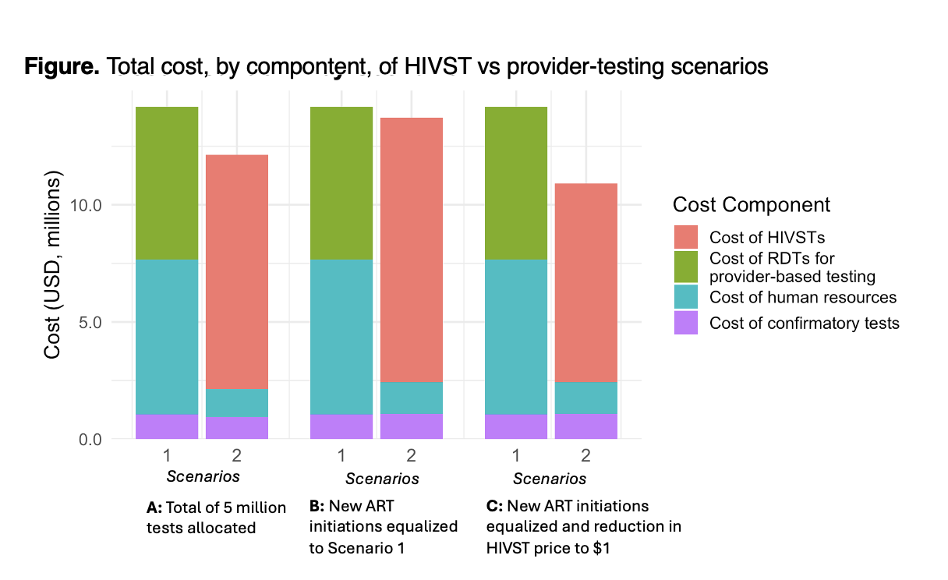
3
Cost-Effectiveness of HIVST in Filling HRH Gaps
Preliminary results
Modelling on the cost-effectiveness of using HIVST in facilities to fill HRH gaps shows:
At least 15% cost-saving – may go up to 23% savings if using $1 WHO PQ HIVST
Up to 85% reduction in staff-time
If considering local economic impact (putting $$ toward jobs versus commodities)
  Return of investment (ROI) is the same at $1.50 but is favorable with high ROI at $1
Cost of change and scale-up?
  Costs still 1.5–3.0% lower, and total staff-time for testing still falls by 40% and 80% respectively, when considering scale-up costs
Country-facing calculator in development for local planning for optimal savings for HRH and HIVST
Source: WHO 2024, Nichols, Edun, Imai-Eaton, Bernsteyn, Johnson 2025 in preparation; for copy of the country calculator that is in beta-testing email johnsonc@who.int

Slide 10
3
Facility Based HIV Self-Testing – Client flow
Clients
Facility reception:
Clients are informed about available testing services and offered choice
HIVST can mitigate
Limited staff capacity
Time constraints for HTS
Counsellor workload
Work-space constraints
HIVST
Provider-delivered HTS
Video or in-person demonstration (individuals or groups)
Testing and follow-up done according to national rapid HIV testing algorithm
Client performs test in tent/cubicle and interprets result
Linkage:
Retesting before ART initiation, ART initiation, TB screening, STI screening, family planning, VMMC, medical care
Non-reactive
Reactive
Linkage:
VMMC, PrEP, family planning, etc

Slide 11









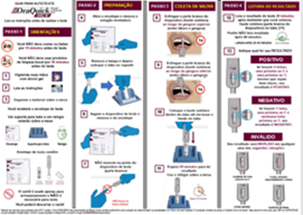
3
HIV Self-Testing used as Screening Test in facilities
Health Education Sessions
Screening
Referral based on results
Pre-test messages provided to all clients in OPD, describing the HIV self-testing process, offering HIV self-testing
HIVST kits are offered to clients who opt for HIVST and are eligible (not HIV positive, not on ART, and willing to test themselves)
Clients who test HIV reactive with self-test receive confirmative testing using national algorithm and initiate treatment.
Those with non-reactive results are linked to prevention services
Clients test themselves while they are waiting
for the health care provider consultation,
HIV self-testing replaces screening tools.
7

Slide 12
3
Strategic Planning for Facility-Based HIVST
Case-finding focused HIVST
Prevention focused HIVST
Diagnose PLHIV at high risk and to initiate ART as soon as possible
Increase routine offer of HTS in key entry points (PHC, OPD, FP, STI)
Replace risk screening tools to simplify and streamline HTS in facilities
Increase offer in KP settings (clinics and drop-in centers)
Secondary distribution for SN, sexual partners, new HIV cases, and PWID partners
HIVST part of implementing and monitoring prevention services
Support HIV-negative people to stay negative (monitoring)
ANC – retesting & male partner testing
VMMC – uptake and offering those accompanying VMMC clients
PrEP – initiation, re-initiation, continuation
PEP – beginning and end of course
Harm Reduction clinics

Slide 13
3
Operationalizing Facility-Based HIVST: Key Considerations
Epidemic profile: Consider the local HIV prevalence among target priority populations and the testing gap.
Population vulnerabilities: Recognize that vulnerabilities—medical, economic, behavioural or social—affect access and engagement in testing.
Facility setting: Match testing approaches to the type of healthcare setting and work load, size of the health care facility, human resource capacity
HIVST vs. provider-administered RDT testing: Balance the pros and cons of privacy in HIVST with the immediate support and confirmation possible in RDT testing.
Available support services: Confirm on-site or off-site resources for confirmatory testing and linkage to care.
Tailoring facility-based HIVST to facility needs while addressing client vulnerabilities, epidemic context, and support services fosters a flexible, effective HIV testing approach that can evolve as circumstances change.

Slide 14
3
Consider (1) – The HIV Epidemic & Population
Prevalence/Incidence
High-prevalence settings: Increase routine offer and add HIVST as an additional option to HIV testing. Prioritize routine, widespread testing in the facility
Low-prevalence settings: Target testing to populations at higher-risk of HIV infection not usually reached by traditional testing. (e.g. MSM, PWID)
Testing Access and Coverage by Population
Identify gaps in testing access and missed opportunities across different population groups.
Optimize testing for the most vulnerable, underserved, missing or populations at high-risk of HIV infection
Regularly reassess and adjust testing strategies to respond to changes in local epidemic data and population needs.

Slide 15
3
Consider (2) – Populations who may benefit most from Facility-Based HIVST
Populations at risk of HIV infection
Key populations like MSM, PWID, and sex workers, where testing coverage is typically low.
Partners of clients with a HIV positive test result
Sero-discordant couples
Young females often have lower awareness of HIV status & high HIV incidence
Clients using specific HIV prevention services such as PrEP, PEP.
High risk males, who have not been tested before, who present at health facilities
Male Partners of Pregnant Women
Testing male partners of pregnant and lactating women in ANC/PNC/MNCH settings can identify HIV positive partner, help them to initiate ART, prevent HIV acquisition in pregnancy and mother to child transmission
Male Partners of Women Accessing Family Planning Services
Testing male partners of women accessing FP services can identify HIV positive partners and help them to initiate ART
Adolescents, Young Adults, Men
Especially those aged 15-24, who often face barriers to testing and benefit from accessible options (low testing coverage)
Men often underuse HIV testing services
General High-Burden Settings
Individuals who are sexually active and have not recently tested, particularly in high-prevalence areas
Individuals Disengaged from ART Care
HIVST may offer a stigma-free, self-directed way for those who have stopped ART to reengage with care at their own pace

Slide 16
3
Consider (3) – Medical Risk Profile
Tuberculosis (TB):
Elevated HIV risk in TB patients; supports early detection and integrated care, with rapid ART initiation and improved health outcomes.
Hepatitis B & C:
Shared transmission routes; early HIV detection in hepatitis care can improve health outcomes.
Sexually Transmitted Infections (STIs):
Higher HIV risk; HIVST in STI clinics aids in undiagnosed case identification as well as curbing intertwined transmission of STIs and HIV.
Respiratory conditions (e.g., COPD, COVID-19):
Underlying immune issues or advanced HIV disease; HIVST offers low-contact testing in high-prevalence areas.
HPV-related cancers (cervical/anal):
Higher prevalence in HIV-positive individuals; early diagnosis through HIVST in oncology settings.

Slide 17
3
Consider (4) – Facility Workload
Facility workload should be considered to optimize testing choice, allowing different approaches based on staff capacity, level of task shifting, and client needs.
High Workload
HIVST: Reduces provider burden by enabling self-testing, allowing staff to focus on reactive results and clients with complex needs.
Provider-administered RDTs: Requires more staff time, which may slow service in busy settings. Use it mainly for confirmatory testing.
Low Workload
HIVST: Useful for clients desiring privacy, though less essential when staff availability is high.
Provider-administered RDTs: Provides personalized support and immediate results with ample staff capacity.
Variable Workload
Flexible approach: Consider HIVST during peak times to manage flow; shift to RDTs when workload is lower.

Slide 18
3
Consider (5) – Facility Set-Up integration with other services
Important to know your current facility set-up & entry points for the best HIVST integration:
Family planning and STI clinics
Integrates HIVST with reproductive health services, providing a seamless option for those accessing family planning and STI services.
Antenatal Care (ANC)
Allows pregnant women share kits with male partners, encouraging family-wide testing and early diagnosis.
Harm Reduction Clinics
Serves people who inject drugs (PWID) who are at higher HIV risk, making HIVST a practical choice in these facilities.
PrEP and PEP Entry Points
Supports ongoing HIV monitoring for individuals on PrEP or PEP, ensuring convenient, frequent testing as needed.
This includes initiation, re-initiation and continuation of PrEP (oral and vaginal ring)
Voluntary Medical Male Circumcision (VMMC) clinics
Provides a testing option for men, increasing HIV testing uptake in facilities where male clients are already engaged.

Slide 19
3
Consider (6) – Additional Possible Service Entry Points
Primary Care and OPDs
Increases testing coverage among routine healthcare visitors, making testing more accessible and convenient. Specifically in high HIV prevalence settings.
Family Planning
It can reach women and couples at risk and supporting comprehensive sexual and reproductive health care.
Emergency Rooms
Reaches clients who might not engage in routine testing, especially in high-prevalence areas, by offering HIVST during urgent care visits. They may immediacy benefit from knowing their HIV status.
Inpatient Services
Offers self-testing to hospitalized patients with conditions indicating potential HIV risk, enabling convenient testing without provider involvement.
TB Clinics
Targets individuals at high risk of HIV due to TB, ensuring prompt testing and linkage to HIV care for those affected.
Hepatitis Services
Provides an integrated approach by offering HIVST during hepatitis care, reducing the need for multiple clinic visits and supporting holistic care.

Slide 20
3
Consider (7) – Balancing HIVST and Provider Assisted RDT Testing
 | HIVST | Provider-Assisted RDTs Testing
Privacy and Autonomy | Clients desiring a private, self-directed experience (e.g. aligns with the self-care principle) | Best for those who value direct provider involvement.
Need for Supervision | Appropriate for clients confident with independent testing or being supported during the process | Clients requiring provider guidance.
Health Complexity | Works well for routine cases with low complexity. | Optimal for clients needing additional clinical assessment.
Confirmatory Testing Needs | Ideal for initial screening with linkage to confirmatory testing. | Ensures immediate diagnosis.
HR Time | Reduces HR demand by allowing clients to self-test, freeing staff to focus on reactive results. Increases number of clients tested. | Requires more provider time per test, which can increase workload in busy settings.
Testing Coverage in Facility | Increases number of clients tested, thus coverage and HIV positive diagnosis | Limitation to achieve high coverage

Slide 21
3
Other Operational Considerations (1)
Many of these requirements may already be in place but should be reviewed regularly to ensure they support high-quality HIVST delivery.
Ensuring testing supplies:
Maintain a steady supply chain for HIVST kits to prevent shortages.
Regularly check inventory to keep kits available at all key service points.
Implementing testing protocols:
Set quality assurance standards to ensure test accuracy and client safety.
Use clear HIVST protocols and SOPs covering distribution, instructions for use, and linkage to care for reactive results and for HIV preventive services.
New innovative opportunities:
A range of support tools can be utilized to support self-testing implementation, including virtual interventions and artificial intelligence

Slide 22
3
Other Operational Considerations (2)
Training and Capacity Building for Staff:
Are all healthcare providers trained on HIVST procedures, client support, and referral pathways.
Equip staff to handle client questions, provide guidance, and encourage follow-up care.
Monitoring and Quality Assurance:
Data Collection: Track key metrics, including testing uptake, client satisfaction, and linkage to care rates.
Quality Control: Ensure kit accuracy, proper use, and adherence to testing protocols.
Feedback Mechanisms: Incorporate feedback from clients and staff to continuously refine HIVST processes.
Moving towards Self-Care and Sustainable HIV testing:
Clients can receive assistance through demonstrations on self-test use if needed.
Over time, increasing client confidence with HIVST promotes a sustainable, self-care-driven testing model, reducing reliance on human resources and enhancing long-term efficiency.

Slide 23
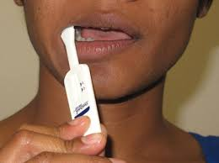
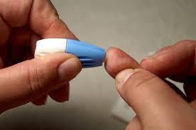
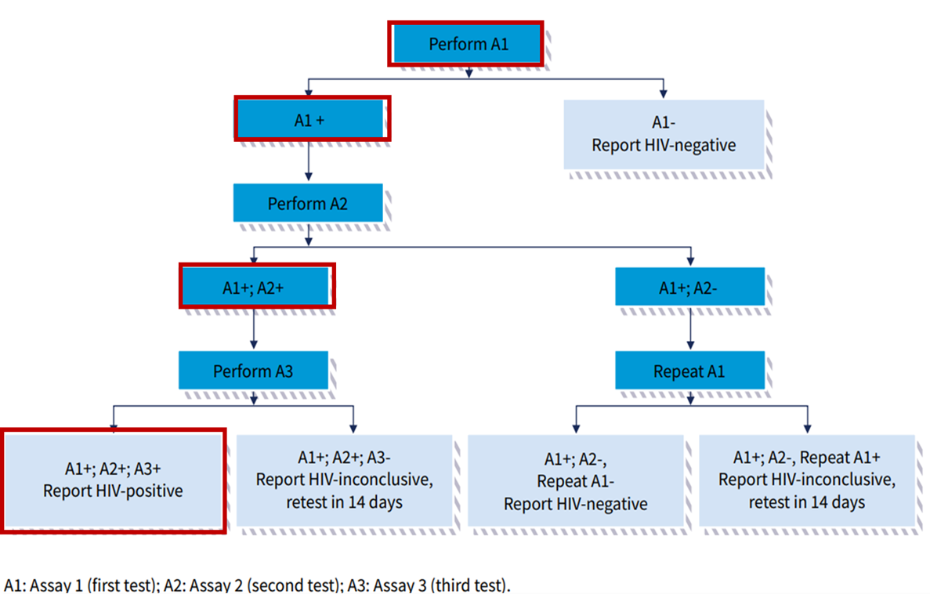
3
Countries already using HIVST to address ongoing disruptions
Adapted HIV testing strategy implementation considerations
HIVST as
optional A1
HIVST still recommended as a “test for triage”
Countries need flexibilities now due to limited HRH capacity and stock-outs
When needed (awaiting stock) use HIVST as A1
Prioritize quality-assured HIVST kits
Prioritize confirming all reactive self-test results with available A2 and A3 (per WHO 3-test strategy)
Do not start ART based on a single reactive test
  Substantial risk of misdiagnosis and unnecessary ART initiation
Source: WHO 2024
Notes:
Reactive self-tests receive full national testing algorithm (3 consecutive reactive tests)
Negative self-tests no further testing or follow-up required

Slide 24
3
Key actions to address gaps
🤝 Support flexibility to maintain testing services
    Support policies that include the use of HIVST to avoid additional disruption
    Highlight benefits of HIVST: it’s flexible, fills staffing gaps, allows private sector use and worked well as critical adaptation during COVID-19
    Switch to low-cost HIV self-tests for cost savings as international funding declines
💰 Optimize resources to maintain testing services
    Review staffing plans and HIVST data to find right balance based on country needs and gaps due to reduced personnel and testers
    Review and use WHO country calculator (for details contact johnsonc@who.int )
    Share HIVST data with WHO to help update guidance

Slide 25
3
Questions
What is the main rationale for introducing HIVST in facility-based settings?
Why might HIVST be preferred over traditional risk-based screening tools in high-prevalence settings?
How does facility-based HIVST improve testing coverage and access?
What are the current WHO recommended approaches to facility-based HIVST, and how are they implemented?
Can you explain the difference between primary and secondary distribution in facility-based HIVST?
How does HIVST replace HIV risk screening tools?
What factors should be considered when implementing HIVST in a healthcare facility?
Why is it important to consider the local HIV epidemic profile and target populations?
How do workload and facility setup impact the choice between HIVST and provider-administered testing?
Which populations benefit most from facility-based HIVST?
Can you identify priority populations that are often underserved in facility-based testing?
Why might facility-based HIVST be especially useful for PrEP/PEP users, sero-discordant couples, and young adults?
What are the facility–based entry points for HIVST, what are the opportunities?
What are some operational considerations for ensuring the success of facility-based HIVST?
Why is it crucial to maintain a steady supply of HIVST kits and establish clear testing protocols?
How can monitoring and feedback mechanisms improve the quality and effectiveness of facility-based HIVST?

Slide 26
3
Exercise

