Slide 1
MODULE 4:
MOBILISING FOR HIV SELF-TESTING
PRE-TEST INFORMATION
CONDUCTING HIV SELF-TESTING

Slide 2

Learning Objectives
4
By the end of this module, participants will be able to:
Outline key demand creation principles
Describe the platforms for demand creation
Explain how to provide clear pre-test information for HIVST
Describe how HIV self-testing is conducted
Role play HIVST procedure
Have knowledge of how to support clients learning how to test

Slide 3
4
Introduction
As more countries reach the 95-95-95 targets, the population of people living with HIV (PLHIV) who remain undiagnosed becomes systematically different from those previously tested
Some demand-creation activities used previously to encourage testing are now less effective
Tailor messages for subpopulations unreached or underserved by existing approaches
Demand creation and mobilization strategies - activities must improve an individual’s knowledge, attitudes, motivations and intentions to test
Demand creation must inform the decision to access HIV testing services.

Slide 4
4
Mobilization platforms for creating demand
Couples-oriented counselling and partner services (including social network-based approaches)
Peer-delivered, participatory and community-led approaches
(using peer educators, community groups, and faith-based programmes)
Educational messages through drama, sports-based, and faith-centered activities
Technology and internet-driven solutions
mobile phone-based
social media platforms
dating apps
telehealth platforms or models
other digital media channels
Online targeted advertisements
adaptive social media promotions
engaging social media influencers
online peer outreach

Slide 5

4
Guiding Principles for HTS adapted to HIVST
WHO 5Cs Encourage All Testing to Include
Consent
Confidentiality
Counselling (pre-test information and post-test messages)
Correct results and
Connection (linkage)

Slide 6
4
Guiding Principles for HTS adapted to HIVST
Why effective communication is crucial for HIVST
Builds client trust and reduces stigma
Increases quality
of care
Effective communication reduces anxiety and helps clients feel confident in self-test including its accuracy, while also feeling comfortable and respected
Ensures client understanding
Ensures clients understand test use, benefits, and follow-up needs to prevent misunderstandings.
Supports client autonomy
Encourages informed decision-making, balancing guidance with independence. Strengthens the concept of self-care
Increases uptake and linkage to onward services
Compassionate guidance supports clients with reactive results, encouraging them to seek confirmatory testing and necessary care.
This approach also reinforces the importance of continued preventive services for clients with negative test results

Slide 7
4
Provider Communication & Instructions for HIVST
Mobilize and support clients in understanding and using HIVST kits confidently through clear, empathetic communication.
Mobilize for HIVST:
Encourage clients to consider HIVST as a convenient, confidential, and empowering way to know their HIV status.
Highlight the benefits of HIVST for individuals and communities.
Provide clear instructions:
Ensure that clients understand each step of the HIVST process, including sample collection, timing, and interpretation of results.
Adapt to client needs:
Tailor communication based on client familiarity and comfort with HIV testing.
Offer different levels of support based on client preference and needs.
Ensure linkage to care:
Explain follow-up options for reactive, negative, and invalid results, ensuring clients know how and where to access further testing or support within facility
Encourage client agency:
Instill confidence in client to interpret their results and understand next steps.

Slide 8
4
Delivery HIVST & Pre-Test Information (1)
Communicating about HIVST in Public Spaces (e.g., waiting areas):
Visual aids: Place posters or infographics with HIVST basics in waiting areas
Educational materials: Provide brochures, posters, or videos to make HIVST information easily accessible
Health talks, group education: Integrate HIVST into health talks. Provide information on the benefits of HIVST, its limitations, and steps to using an HIVST in short, informative sessions. These can be conducted while clients wait for health services
Pre-recorded messages: Use looping video or audio in the waiting area to share consistent information.
QR Codes for digital access: Provide QR codes linking to online videos, FAQs, and user guides.

Slide 9
4
Delivery HIVST & Pre-Test Information (2)
Communicating about HIVST in Private Spaces (e.g., consultation rooms):
One-on-one pre-test information: Provide personalized education and guidance on using an HIVST, interpreting results, and next steps based on HIVST result.
Additional pre-test information: Provide additional counseling support to clients who express specific fears or questions, offering detailed explanations and reassurance. The client's specific situation can be taken into account when considering HIV testing.
Demonstration or visual aid: Show a sample kit or step-by-step guide to ensure clients understand the testing procedure using self-tests.
Written guide: Offer a simple guide covering self-testing steps, result interpretation, and next steps
Reassurance of privacy and confidentiality: Emphasize confidentiality to create a comfortable environment for testing
Linkage to support services: Give clear instructions for confirmatory testing within facility and linkage to both prevention and care services during the same visit, follow-up, including contact details for post-test support.

Slide 10
4
Key Messages for Pre-Test Information
Main talking points:
PURPOSE:
HIVST is a private and convenient way to test yourself in private for you to know your HIV status
USING THE TEST:
Carefully follow the step-by-step instructions provided in the HIVST kit
UNDERSTANDING RESULTS AND NEXT STEPS:
Non-reactive /Negative (one line): Interpret as HIV negative and no need for further testing, but consider retesting based on risk
Reactive (two lines): Confirmatory testing with a healthcare provider is necessary to confirm an HIV reactive test result
Invalid: Retest with a new kit, or test with a health care provider using another test.
PRIVACY:
Testing is private, with options for provider support or self-testing in a private space
SUPPORT:
Contact details for questions, follow-up, and support are available, referral information for post-test services is available.

Slide 11
4
Step by Step Guide for providers to demonstrate HIV Self-Testing (1)
Introduce the HIVST:
Explain the purpose of HIVST and briefly describe the testing steps.
Show the kit components:
Display each item in the kit (e.g., swab, test device, buffer solution, lancet for blood-based tests) and explain their use.
Demonstrate sample collection:
For oral tests, show how to swab the gums properly.
For blood-based tests, demonstrate finger-pricking safely using a lancet.
Explain test activation:
Show how to place the sample (swab or blood drop) on the test device and activate the test (e.g., adding buffer solution).
Describe waiting time:
Inform the client about the required wait time (usually 20 minutes) before reading the result.
Guide on result interpretation:
Explain how to read the results, covering reactive, negative, and invalid outcomes.
Discuss disposal:
Instruct on safe disposal of test materials after testing.

Slide 12
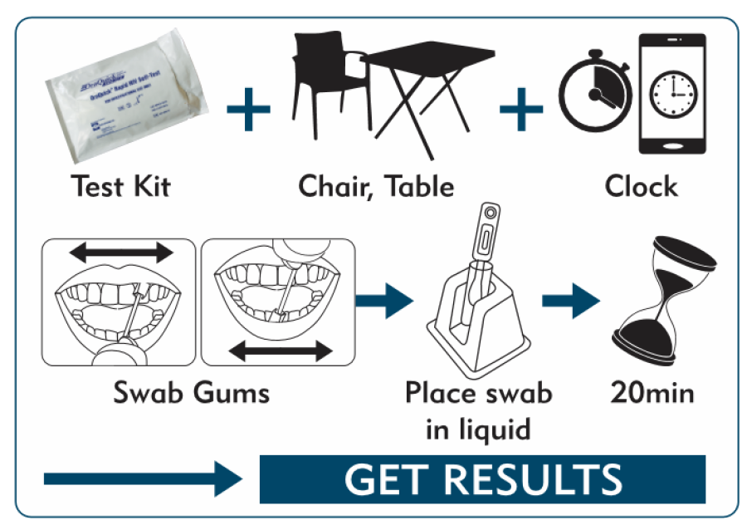
4
Step by Step Guide for providers to demonstrate HIV Self-Testing (2)
Encourage clients to ask questions throughout and remind them of available provider support if needed, during or after testing.
Videos, brochures, posters and in-person can be used for demonstration
Note: Use existing guidance if available. Adapt these steps and information based on the specific type of test kit used at your facility.

Slide 13
4
Determine Level of Provider Support needed for HIVST
Assessing Client Needs: Determine whether the client would benefit from additional information and provider support for HIV self-testing based on their comfort and experience with self-testing.
When might clients need increased provider support/additional information on HIVST?
Clients who may need additional support include first-time testers, those with questions, or individuals with concerns about the testing process. Providers can offer detailed guidance while respecting client privacy, ensuring clients feel in control of their testing experience.
When might clients need less or no additional support for HIVST?
Clients who feel confident and prefer testing independently.
Clients who used HIVST in the past
Providers have ensured instructions are clear, and clients are informed about available support if needed.

Slide 14
4
HIVST Kit access and Pick-Up
Public Areas (e.g., waiting rooms)
Kit Pick-Up:
Clients can pick up HIVST kits directly from a designated area in the waiting room.
Testing Options:
Self-testing in Private Spaces: Clients are directed to nearby private spaces (e.g., designated testing booths or rooms) to ensure privacy while testing.
Follow-Up Support: Instructions are provided on how to seek assistance if needed after testing. Offer higher level of provider support if needed.
Private Areas (e.g., consultation room)
Kit Pick-Up:
Health care provider hands the kit directly to the client, explaining usage if needed.
Testing Options:
Increased provider support: Clients have the option to self-test in front of the provider, who can guide them through the steps and answer questions in real time. Alternatively, the client may choose to test alone by moving to a designated private testing space or by having the provider leave the consultation room temporarily.

Slide 15
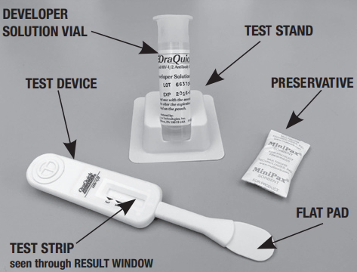
4
Client Prepares the Test Kit
Client accesses private area
Client reads the instructions
Clients prepares the material for the test
Note: there are different test kits available, provide test kit specific information in the testing area for the preparation, testing and interpretation of results
Source: global.oraquick.com/media/howtouse/instructions/3/0/3001-3031-OQ_Self_Test-ENG.pdf

Slide 16
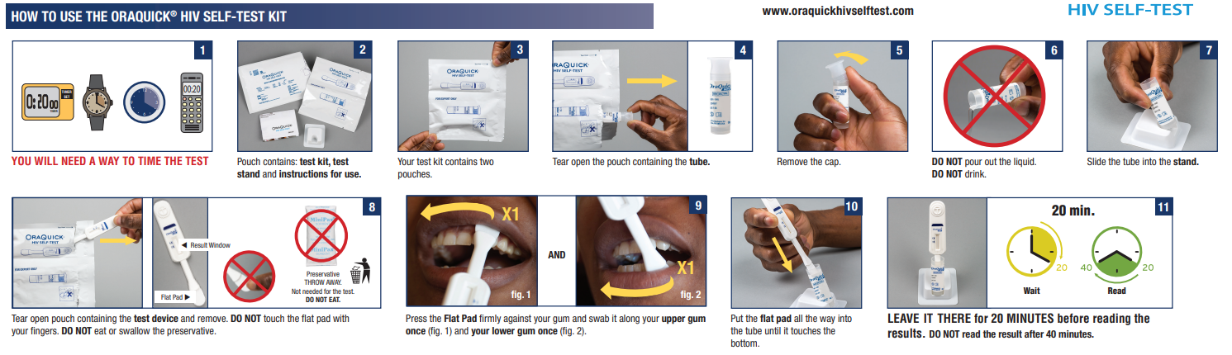
4
Client Performs the Test
Follow Instructions Carefully: Each client should follow the instructions for either the oral fluid or finger-prick test and can ask for more provider support if needed.
Maintain Timing: Reinforce the importance of waiting 15–20 minutes for accurate results for OraQuick. Note that other test kits may have different waiting time.
Reading Results: After the waiting period, clients should review the results based on provided instructions, with staff support available if requested.
Source: global.oraquick.com/media/howtouse/instructions/3/0/3001-3031-OQ_Self_Test-ENG.pdf

Slide 17
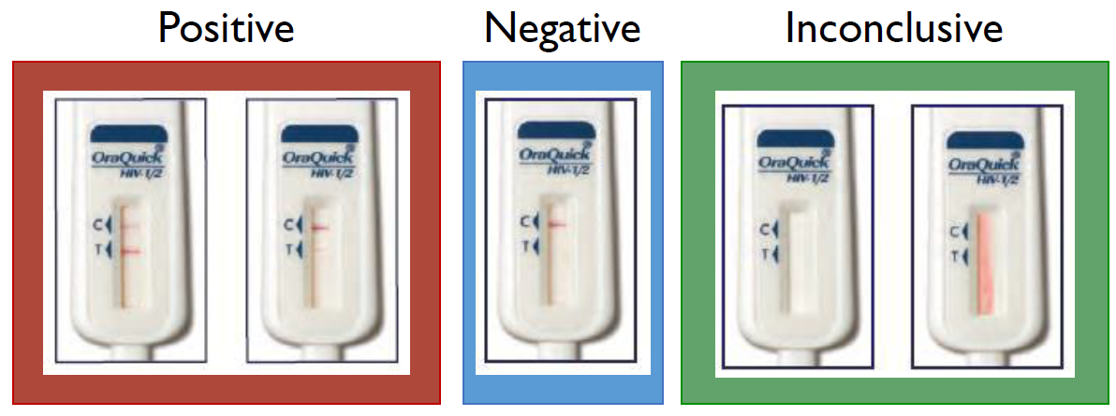
4
Client Reads the Results
NON-REACTIVE RESULT
Only one line appears (Control line).
Interpretation: HIV-negative No detectable HIV antibodies
Next Steps: No need for further testing.
Those at high ongoing risk should be offered PrEP and PEP, if and when eligible
REACTIVE RESULT
Two lines appear (Control and Test lines).
Interpretation: Possible HIV infection.
Next Steps: This is not a definitive result. Requires further testing by a trained provider, beginning with the first test (A1) in national testing algorithm
Initiate post-test counselling as per need. Perform or link to provider-administered RDT testing.
INVALID RESULT
No lines, or only the test line appears.
Interpretation: Invalid results. The test did not work correctly and cannot be interpreted
Next steps: Discard this test and retest with a new kit or the client can be offered provider-administered RDT testing.

Slide 18
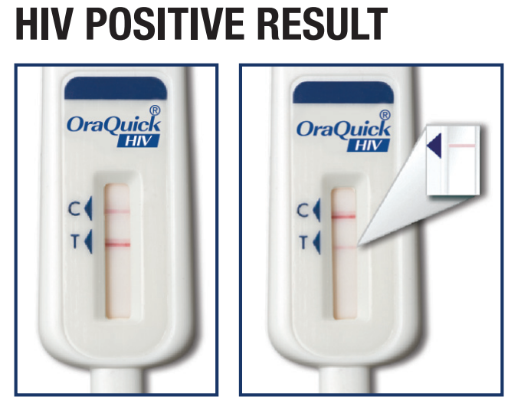
4
How to Address a Reactive HIVST Test Result (1/2)
Attend to the client
If possible, read the test result yourself to confirm the reactive HIVST test result.
Show empathy and encourage clients to get confirmatory testing from a trained provider within facility for an accurate diagnosis.
Use supportive language to reassure that confirmatory testing is a routine part of the process.
Encourage clients to bring any questions or concerns forward, offering resources for counselling.
Explain how confirmatory testing links to further care, including ART if the result is confirmed as positive, and include U=U.
If possible, perform the confirmatory test immediately in the clinic, following the national testing algorithm. If not possible, ensure that clients have contact information and directions to the nearest confirmatory testing and treatment center.

Slide 19
4
How to Address a Reactive HIVST Test Result (2/2)
CRITICAL SKILLS TO FOSTER TRUST AND SUPPORTIVE, EFFECTIVE, COMPASSIONATE TESTING SERVICES
HIVST counseling should begin as soon as a client receives HIVST at the facility
Non-judgmental:
Provide services without judgment to create a safe space for clients.
Respect:
Show respect for the client’s experiences and perspectives.
Tolerance of intense situations:
Maintain composure in challenging or emotionally charged situations.
De-escalation skills:
Calm tensions that may arise from addressing HIV-positive status.
Empathy:
Demonstrate genuine understanding and compassion for the client.
Validation and constructive challenge:
Acknowledge client fears and concerns while gently encouraging them to consider different perspectives.

Slide 20
4
Closing Guidance – Gather Client Feedback on HIVST Experience!
Purpose of Feedback:
Improve service quality by understanding client experiences with HIVST.
Identify areas where communication can be strengthened and to adjust HIVST approaches based on client needs.
Feedback Collection Methods:
Perform it during exit
Short surveys or verbal feedback sessions for clients to share thoughts on clarity of instructions, comfort, and overall satisfaction.
Anonymous options if clients prefer confidentiality.
Key Feedback Areas:
Was the information clear and easy to understand?
Did the client feel comfortable with the testing process?
Was assistance accessible and respectful if needed?

Slide 21
4
Questions
What are the key goals of provider communication in HIVST?
Why is it important to provide clear instructions to clients using HIVST?
How does effective communication support client autonomy?
How can pre-test information be effectively delivered in public areas?
What materials can be used to educate clients on HIVST in public areas like waiting rooms?
How do these methods support client comfort and understanding?
What specific pre-test information and support should be provided in private consultation areas?
How can providers tailor HIVST instructions to individual client needs in private areas?
Why is privacy essential during HIVST instruction?
How should providers guide clients in interpreting their HIVST results?
What are the three possible HIVST outcomes, and what follow-up actions are recommended for each?
Why is it essential to support clients in understanding each result?
Why are communication skills essential in facility-based HIVST?
How does effective communication help build trust and reduce stigma?
How does it support client autonomy and self-care?
How can client feedback improve HIVST service quality?
What are effective methods to gather feedback from clients on their HIVST experience?
What feedback areas should be prioritized for quality improvement?

Slide 22
4
Exercise

