Slide 1
MODULE 6:
HIV SELF-TESTING FLOWCHARTS, SERVICES LAY-OUT & SOPs

Slide 2

Learning Objectives
6
By the end of this module, participants will be able to:
  Design patient flow charts for HIVST in facilities
  Understand the various available options for HIVST stations
  Know the various digital and print resources available to clients in facilities

Slide 3
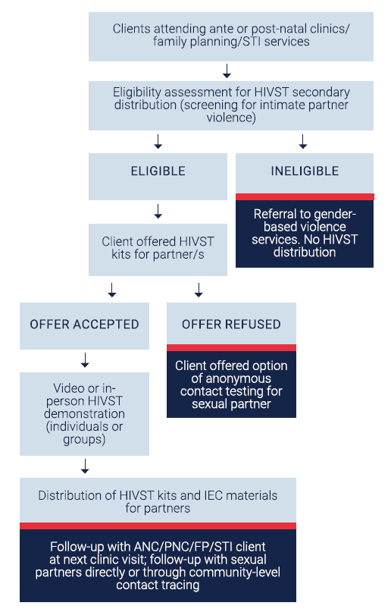
6
Introduction to Flowcharts and Service Layouts for Facility-Based HIVST (1)
Flowcharts are visual diagrams that map each step in the facility-based HIVST process, providing a clear, structured workflow for staff and clients. They streamline client movement through test kits distribution, testing, interpretation, and linkage steps, ensuring consistency and reducing confusion.
Service layouts are the physical arrangements in a clinic that support privacy, accessibility, and ease of navigation. They are designed to create a client-friendly environment, enhancing comfort and confidentiality throughout the HIVST process.
Source: HIV Self-Testing Operational Guide – For the planning, implementation, monitoring and reporting of HIV self-testing. PEPFAR, USAID, EpiC. 2021

Slide 4
6
Practical Steps for Creating HIVST Flowcharts & Service Layouts
Define the context
Assess the clinic setting, volume of clients, and privacy needs to tailor the workflow
Designing the flowchart
Client arrival: include registration and a brief introduction to HIVST options
Mobilisation/Pre-test information: provide brief instructions and answer common questions
HIVST kit distribution: ensure staff give clear usage instructions with the kit
HIV self-testing: ensure staff gives support if needed
Results interpretation: guide clients on how to read and understand their results
Linkage to care: outline steps for confirmatory testing, and HIV preventive services
Setting up the service layout
Client flow: position entry and exit points to streamline movement
Privacy: arrange private testing spaces, such as cubicles, to ensure confidentiality
Clear signage: provide visual cues from registration to testing areas to reduce confusion

Slide 5
6
Flowchart for High-Volume Outpatients Settings
Context: high-traffic outpatient departments where efficient client flow is essential
Workflow Steps
Registration and triage
clients are informed of HIVST options at registration
HIVST station
clients collect the kit and receive brief instructions for use
Test performance
clients proceed to a designated area to perform the HIVST, with optional assistance by the provider if needed
Results interpretation
optional provider support is available if clients need help interpreting results
Linkage to confirmatory testing
clients with reactive results are guided to follow-up testing for confirmation
Linkage to preventive services
clients with negative results are offered referrals to preventive options, such as PrEP

Slide 6
6
Flowchart for Outpatients Settings
Context: adapted workflow for smaller clinics with lower client volumes, allowing for personalized interaction
Workflow Steps
Registration and triage
clients are informed of HIVST options at registration
HIVST station
clients collect the kit and receive brief instructions for use
Test performance
clients proceed to a designated area to perform the HIVST, with optional assistance by the provider if needed
Results interpretation
optional provider support is available if clients need help interpreting results
Linkage to confirmatory testing
clients with reactive results are guided to follow-up testing for confirmation
Linkage to preventive services
clients with negative results are offered referrals to preventive options, such as PrEP

Slide 7
6
Flowchart: Facility Based Primary Distribution
Mobilisation/Pre-test information in waiting area:
provide brief instructions on HIVST and answer common questions
Clients at health facility
Facility reception:
Pre-screening for eligibility
Clients are informed about available testing services and offered choice
HIVST
Provider-delivered HTS
Take test home
Video or in-person demonstration (individuals or groups)
Client performs test
off-site, follow up conducted via phone, SMS, WhatsAPP
Confirmative testing by provider on site
Testing and follow-up done according to national rapid HIV testing algorithm
Client performs test in tent/cubicle and interprets result
HIV (+) linkage:
ART initiation, TB screening, STI screening, medical care
Non-reactive
Reactive
Linkage:
VMMC, PrEP, family planning, etc.

Slide 8
6
Key steps in HIVST offer for ANC/FP/STI Partner Testing
Context: promote HIVST for partner testing within ANC/FP/STI settings, supporting client and partner health
Workflow Steps
Routine offer to pregnant clients
encourage HIVST for partners as part of routine ANC services
Kit distribution
provide take-home HIVST kits for clients to give to their partners
Test performance and support
offer guidance on performing the test at home and provide contact details for any questions
Support for reactive results
advise clients on next steps, including confirmatory testing at the clinic for any reactive results of partner
Linkage to preventive services
for clients and partners testing negative, offer preventive services such as PrEP, VMMC, counselling, and routine follow-up testing as appropriate and needed

Slide 9
6
Flowchart: Facility Based Secondary Distribution, HIV Negative Client
Facility based secondary distribution, HIV negative client at ANC, PNC, FP and STI clinics
Clients attending ante or post-natal clinics/family planning/STI services
Eligibility assessment for HIVST secondary distribution
(screening for intimate partner violence)
Eligible
Ineligible
Referral to gender-based violence services.
No HIVST distribution.
Client offered HIVST kits for partner/s
Offer accepted
Offer refused
Client offered option of anonymous contact testing for sexual partner
Video or in-person HIVST demonstration (individuals or groups)
Distribution of HIVST kits and IEC materials for partners
Follow-up with ANC/PNC/FP/STI client at next clinic visit; follow-up with sexual partners directly or through community-level contact tracing

Slide 10
6
Flowchart for Facility Based Secondary Distribution, HIV Positive Client/Partner Test
Context: promote HIVST for partner testing with clients who test HIV positive at health care facilities
Workflow Steps
Use Partner Testing Talking Points to introduce partner testing to client and complete Client Information Form
Use Partner Elicitation Form to record partner/s names and contact details
Use the Partner Information Form (one for each partner) to record results of IPV screening. Offer HIVST for partner, if applicable
Discuss Options:
  Client referral: Coach client on disclosure, provide HIVST kit plus Tips for Telling your Partner about HIV and referral slip
  Contract referral: Provide HIVST kit plus referral slip and Disclosure Script; agree that client will refer partner for HTS within 30 days
  Provider referral: Initiate partner contact attempts using Telephone and Home Visit Scripts; CHWs conduct assisted HIVST during home visit
  Dual referral: Coach client on joint disclosure, make a plan for when and where it will take place. Offer HTS/HIVST to partner
Kit Distribution:
provide take-home HIVST kits for clients to give to their partners
Test Performance and Support:
offer guidance on performing the test at home and provide contact details for any questions
Support for Reactive Results:
advise clients on next steps, including confirmatory testing at the clinic for any reactive results of partner
Linkage to Preventive Services:
for clients and partners testing negative, offer preventive services such as PrEP, VMMC, counseling, and routine follow-up testing as appropriate and needed

Slide 11
6
Steps for Partner Testing Options Using HIV Self-Testing
STEP 1: Introduce partner testing services to client during pre-test session
Use Partner Testing Talking Points to introduce partner testing to client and complete Client Information Form
STEP 2: Obtain a list of sex and needle-sharing partners
Use Partner Elicitation Form to record partner/s names and contact details
Use the Partner Information Form (one for each partner) to record results of IPV screening. Offer HIVST for partner, if applicable.
Exclude partners posing risk of IPV, refer index client to IPV services and discuss other disclosure options
STEP 3: Screen all named partners for intimate partner violence (IPV)
STEP 4: Identify preferred method of partner notification for each named partner, record on Partner Information Form
HIVST FOR PARTNER/S OFFER ACCEPTED
Client referral: Coach client on disclosure, provide HIVST kit plus Tips for Telling your Partner about HIV and referral slip
Contract referral: Provide HIVST kit plus referral slip and Disclosure Script; agree that client will refer partner for HTS within 30 days.
Provider referral: Initiate partner contact attempts using Telephone and Home Visit Scripts; CHWs conduct assisted HIVST during home visit
Dual referral: Coach client on joint disclosure, make a plan for when and where it will take place. Offer HTS/HIVST to partner
STEP 5: Contact all named partners using preferred approach
STEP 6: Record partner notification outcomes
HIVST
HIVST
Were partners successfully contacted?
STEP 7: Provide appropriate services for partners; work to support disclosure
YES: Record successful partner contact and HIV status on Outcome of Partner Testing Form
NO: Record successful partner contact and HIV status on Outcome of Partner Testing Form
Source: HIV Self-Testing Operational Guide – For the planning, implementation, monitoring and reporting of HIV self-testing. PEPFAR, USAID, EpiC. 2021

Slide 12
6
Flowchart: Facility Based Secondary Distribution, HIV Positive Client/Partner Test
Clients testing positive for HIV
Eligibility assessment for HIVST secondary distribution
(screening for intimate partner violence)
Eligible
Ineligible
Referral to gender-based violence services.
No HIVST distribution.
Client offered HIVST kits for partner/s
Offer accepted
Offer refused
Client offered option of anonymous contact testing
Video or in-person HIVST demonstration (individuals or groups)
Distribution of HIVST kits and IEC materials for partners
Follow-up with clients; at next clinic visit; follow-up with sexual partners directly or through community-level tracing

Slide 13
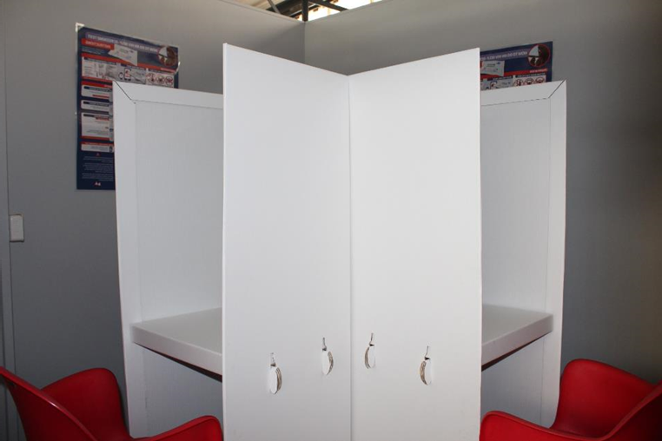
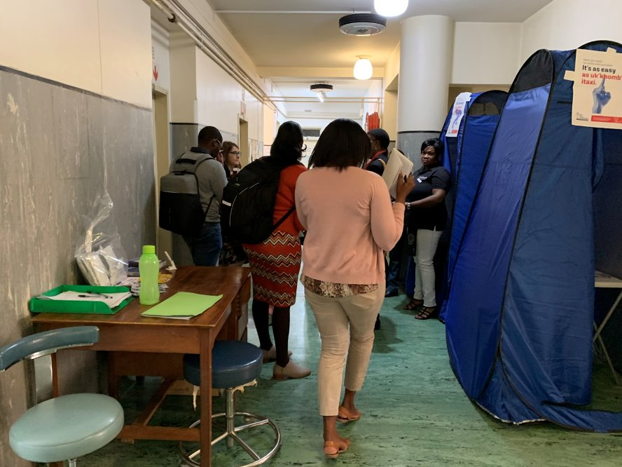
6
Operational Aspects (1) – HIVST stations: Indoor Spaces within Facilities
Private Rooms or Partitioned Areas:
Room setup: Use designated private rooms with ventilation and comfortable seating
Partitions and cubicles: Use portable partitions OR tents to create testing spaces in larger rooms or waiting areas
Signage for privacy: Clearly mark areas with signs like "Testing in Progress" to maintain confidentiality
Dedicated HIVST Stations:
Centralized kiosk or desk: Place an HIVST station in high-traffic areas to increase accessibility
Information desk: Provide staff to answer questions, distribute kits, and clarify the testing process
Separate Entry and Exit Points:
Where possible, create separate entrances and exits for discreet client flow

Slide 14
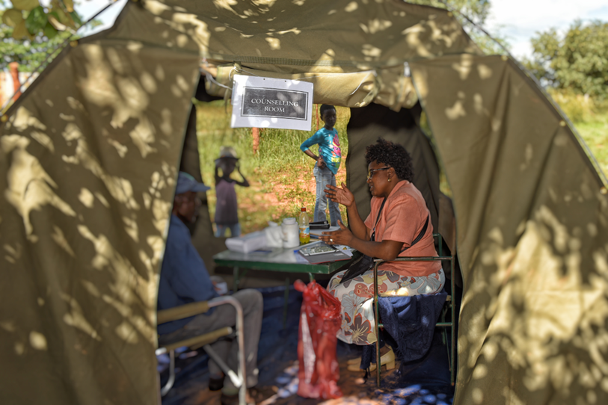
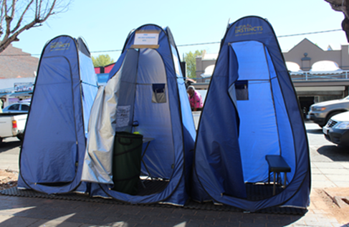
6
Operational Aspects (2) – HIVST stations: Outdoor Spaces around Facilities
Gazebos or Portable Tents:
Gazebo setup: Place outside the facility for high-traffic periods, ensuring privacy and ventilation
Ventilation and lighting: Ensure adequate lighting for instructions and ventilation for client comfort
Mobile or Pop-Up Units:
Vans or mobile clinics: Provide a self-contained testing space for facilities with limited indoor space
Pop-up cubicles: Set up modular cubicles or temporary walls for privacy during community events or outreach

Slide 15

6
Operational Aspects (3) – Other Facility Layout Considerations for HIVST in Facilities
Clear Signage and Directions:
Post signs in high-traffic areas to direct clients easily to HIVST stations
Accessible Hygiene Stations:
Hand-washing or hand sanitizer stations at testing area entrances for client hygiene
Seating Arrangements:
Place chairs outside testing rooms or gazebos to ensure client comfort and orderly flow
Privacy Screens for Public Areas:
Use screens around testing booths in public areas to protect client privacy

Slide 16
6
Operational Aspects (4) – Security and Safety Measures
Security personnel:
Ensure client safety with nearby security staff, especially for outdoor and mobile units
Response procedures:
Develop response plans for distressed clients, particularly for reactive results
Temperature control:
Manage temperature in both indoor and outdoor settings for client comfort, especially in direct sunlight or low-ventilation areas

Slide 17
6
Operational Aspects (5) – Equipment and Supplies
Test kit storage and accessibility:
Store kits securely in a temperature-controlled area, with regular checks to prevent shortages
Disposal Bins for HIVST Kits:
Use designated bins for used kits, with scheduled collection to ensure cleanliness and safety. Some facilities may provide labeled disposal bins specifically for HIVST kits

Slide 18
6
Operational Aspects (6) – Placement of Client Educational Materials
Purpose:
Enhance client understanding of HIVST procedures without needing constant staff assistance
Types of materials:
Posters and brochures: Place at HIVST stations to provide step-by-step instructions and contact information for follow-up
Instructional videos: Set up video loops on tablets or monitors in waiting areas to guide clients on HIVST use and next steps
Placement:
Ensure materials are visible and easily accessible at registration areas, testing stations, and waiting areas

Slide 19
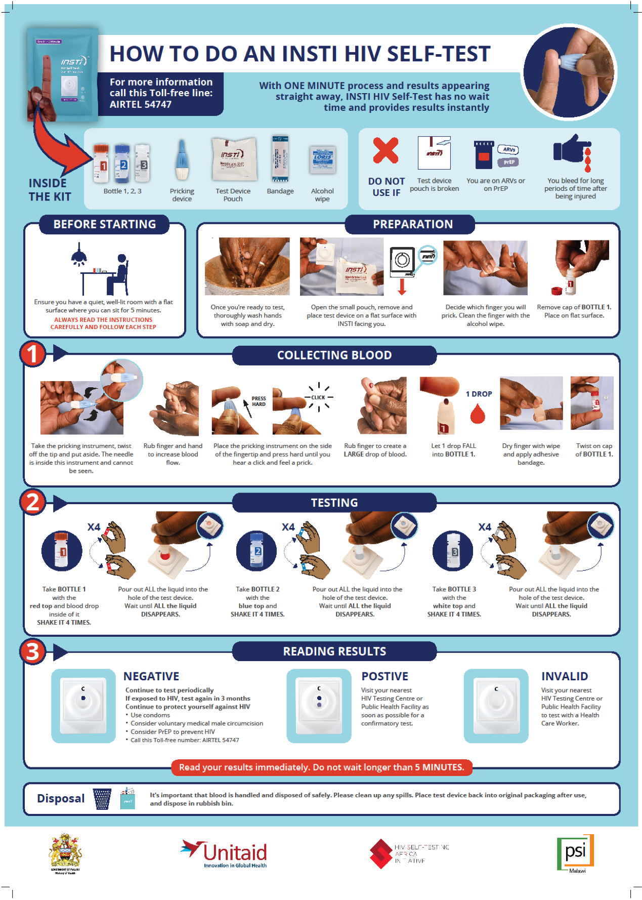
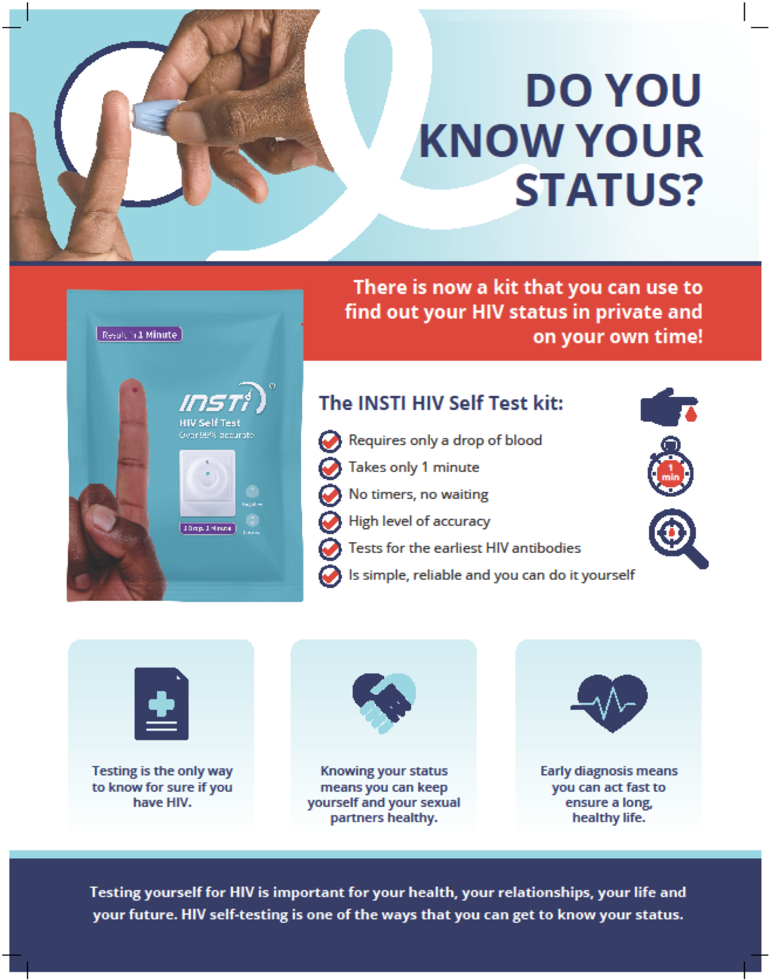
6
Operational Aspects (7) – Placement of Client Educational Materials

Slide 20
6
Operational Aspects (7) – Human Resources
Apply Principles of Task Sharing:
Allow multiple staff members (e.g., nurses, counselors, and support staff) to share responsibilities, ensuring all critical services are covered)
Designated roles in HIVST:
Mobilisation and pre-test education: Lay staff or trained volunteers can
Kit distribution and initial guidance: Lay staff or trained volunteers can distribute kits, provide basic usage instructions, and answer initial questions
Results interpretation support: Lay staff can offer optional guidance on results interpretation, enhancing client confidence in self-testing
Linkage to confirmatory testing and preventive services: Nurses or trained counselors guide clients with reactive results to confirmatory testing, while lay staff can refer HIV-negative clients to HIV preventive services

Slide 21
6
Questions
How can flowcharts and service layout design improve the integration of HIVST in facilities?
Why is it important to establish clear client flow for HIVST services?
What are some essential elements to include in an HIVST service layout?
What operational considerations are critical for effective HIVST integration?
How does facility setup, such as space and privacy, impact client experience in HIVST?
Why is hygiene and security important in areas designated for HIVST?
How can health workers support clients with HIVST instructions and result interpretation?
What strategies can be used to make HIVST instructions clear and easy to follow?
How can staff assist clients who have questions about interpreting their HIVST results?
What are the linkage to care requirements for clients with reactive HIVST results?
Why is it important to have a clear linkage pathway to confirmatory testing for reactive results?
How can facilities support clients with the non-reactive results to engage in preventive services?
Notes:
1. How can flowcharts and service layout design improve the integration of HIVST in facilities?
a. Why is it important to establish clear client flow for HIVST services?
Answer: Clear client flow ensures clients know where to go and what to do, reducing confusion and wait times.
b. What are some essential elements to include in an HIVST service layout?
Answer: Key elements include designated testing areas, clear signage, private spaces for confidentiality, and areas for disposal and counseling.
2. What operational considerations are critical for effective HIVST integration?
a. How does facility setup, such as space and privacy, impact client experience in HIVST?
Answer: Proper space and privacy arrangements ensure clients feel comfortable and safe, encouraging testing uptake.
b. Why is hygiene and security important in areas designated for HIVST?
Answer: Ensuring hygiene prevents contamination, while security provides clients a safe environment to test without fear.
3. How can health workers support clients with HIVST instructions and result interpretation?
a. What strategies can be used to make HIVST instructions clear and easy to follow?
Answer: Simple written instructions, visual aids, and demonstrations can improve comprehension.
b. How can staff assist clients who have questions about interpreting their HIVST results?
Answer: Staff can provide contact information, on-site counseling, or access to follow-up guidance as needed.
4. What are the linkage to care requirements for clients with reactive HIVST results?
a. Why is it important to have a clear linkage pathway to confirmatory testing for reactive results?
Answer: Prompt linkage ensures clients receive accurate diagnosis and access to ART if needed.
b. How can facilities support clients with non-reactive results to engage in preventive services?
Answer: Facilities can offer PrEP, education on safe practices, and regular testing to maintain negative status.

Slide 22
6
Exercise

