Slide 1
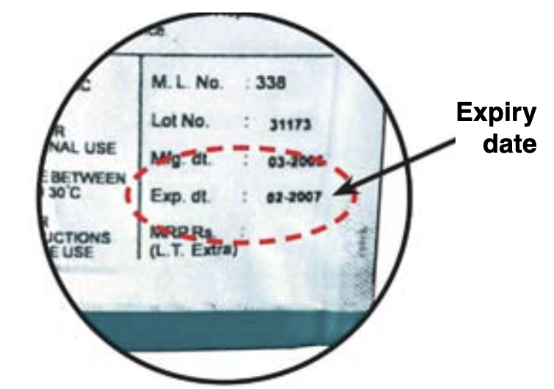
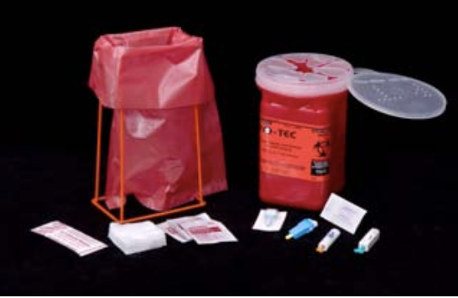
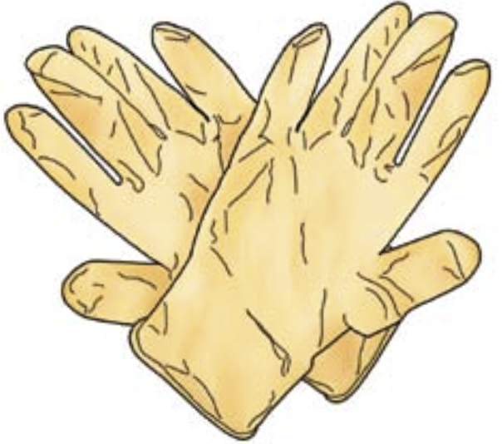
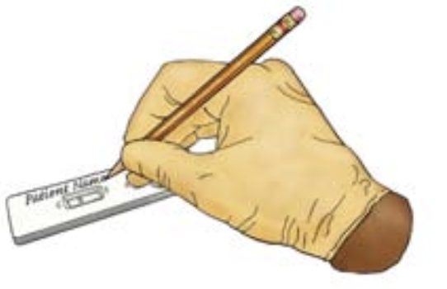
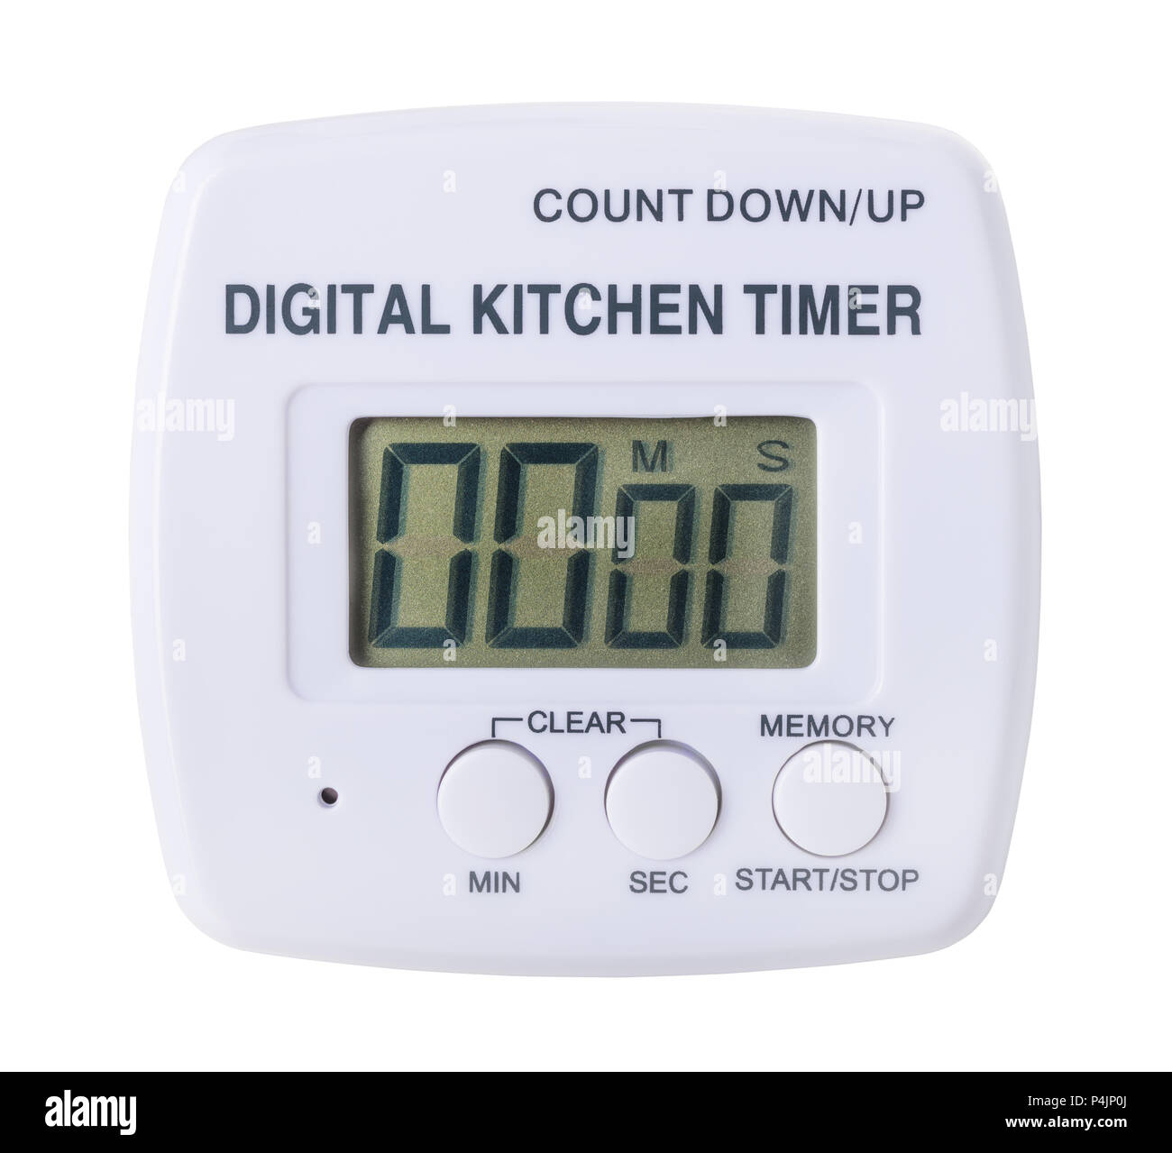
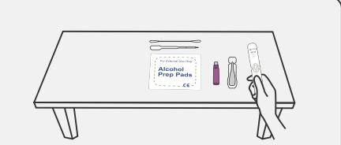
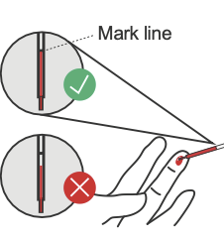
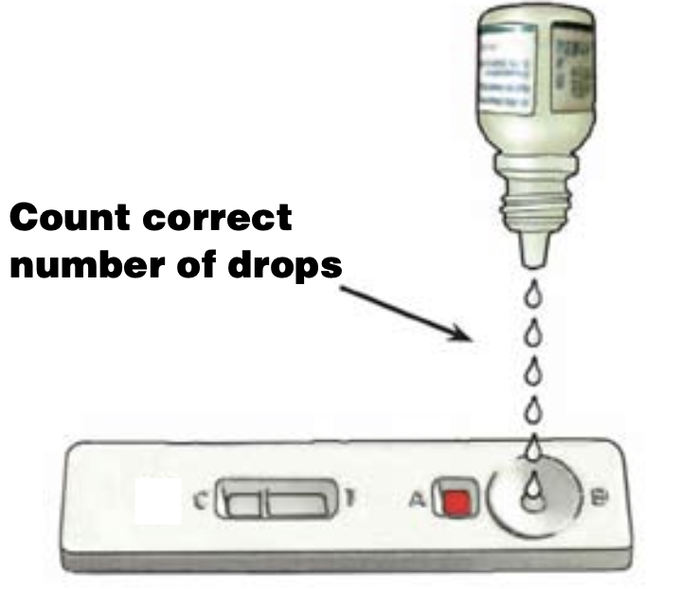
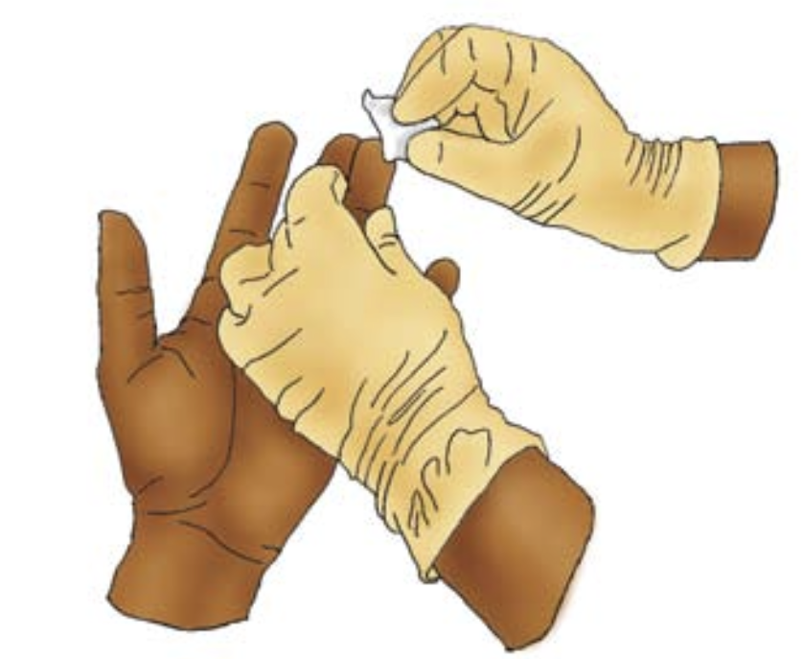
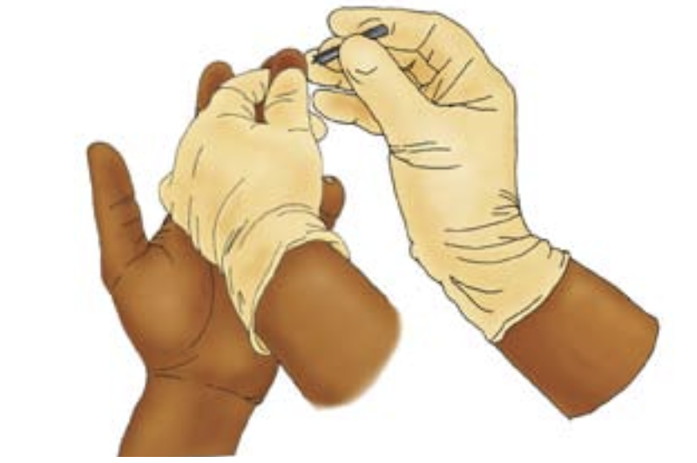
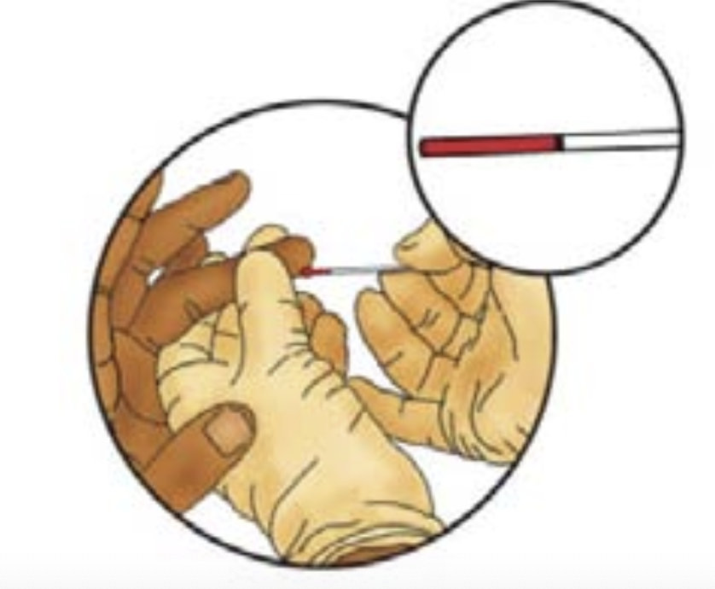
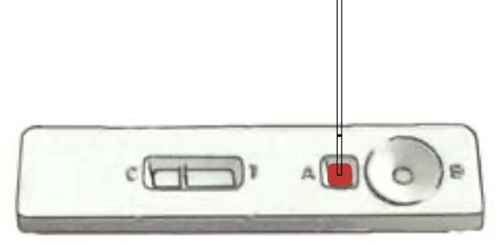
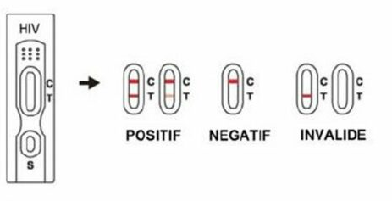

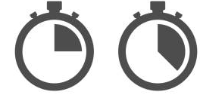
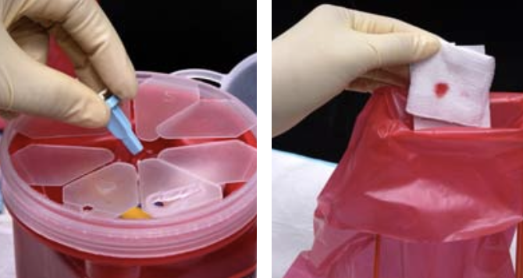
Bench Aid: perform a RDT
3: Open the test packaging just before conducting the test
Bring the cassette/strip and buffer to room temperature (From IFU°C)
Identify the cassette with the number/name of the client to be tested
1: Gather all necessary items from the test kit; Don’t use expired or damaged items ; Bring kit at room temperature (18-25°C) prior to use if stored in a fridge. Additional necessary equipment: timer/ clock/ phone to respect waiting time. Gloves, Sharp and infectious material container
2: Perform the test in a clean, organized, flat surface and bright space. Always use universal safety precaution when handling specimens
4: Rub client finger to warm it up. Clean and dry the client finger (4th one). Once the client finger is dry, open the lancet. Prick client finger. Remove the 1st drop of blood
5: Fill the collection device up to the mark line (not too little, not too much)
6: Place X vol {from IFU} of client sample in the dedicated {from IFU} area.
7: Place Y vol {from IFU} of buffer in the dedicated {from IFU} area.
REACTIVE
NON REACTIVE
INVALID
8: Wait for specified time (from IFU)
Read the result exactly during the recommended reading time: between X and Y {from IFU} minutes after depositing the buffer (neither before nor after)
9: Interpret the test as specified (from IFU):
The test is valid only if the internal control line is visible. Otherwise, the test is invalid and must be repeated using a new cassette/strip.
10: Discard sharp and infectious material in appropriate container

