Slide 1

0: QMS in Non-lab testing: Introduction to the training package

Slide 2
Learning objectives
At the end of this training module, the trainees will:
know the composition of the QMS for non-lab testing sites training curriculum
know the training methods to ensure efficiency of the training
Understand the importance of the competency-based assessment
The target audience will be the QA officers/Supervisors

Slide 3
Let's introduce ourselves
As part of the whole group or in small groups, please share the following:
Your name
Job position
Organization
Expectations for the workshop

Slide 4



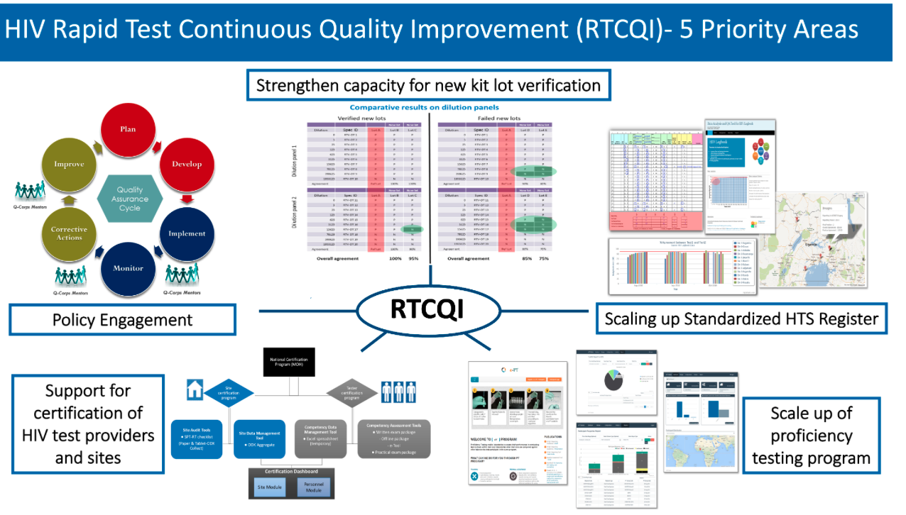
QMS in Non-lab Training Package Overview
These training packages have been developed using already available guidance and resources from WHO and partners
They should be used as templates/examples for developing nationally tailored training packages
2 training module types: for testing providers, for Quality officer/site supervisor
A competency-based assessment must validate the proficiency of the testing provider at the end of the training period and before starting testing clients.
An "authorization of practice attestation" must be delivered to successful testing providers
.https://www.who.int/publications/i/item/9789241508179
https://iris.who.int/bitstream/handle/10665/363501/9789240058972-eng.pdf?sequence=1
https://www.who.int/publications/i/item/9789241548274
https://www.rtcqi.org/training-packages

Slide 5

Modules overview: Training package
00 – Introduction to the training package
01 − Introduction to rapid serology testing and national testing guidance
02 − Introduction to QMS
03 - Testing environment, Safety and IPC measures
04 -Test procedure result interpretation
05 − Site Inventory, stock management and ordering process
06 − Testing provider professional ethics and code of conduct
07 − Documents, records and information management
08 - Collect, review, analyse and use routine data
09 − Process control and assessment (QC, PT-EQA scheme)
10 - Site supportive supervision visits
11- Competency-based Assessment and Testing provider Authorization of practice
•For sites tester+ QA officer/supervisor
•For QA officer/supervisor

Slide 6
What training methods to include
Several methods should be use:
Lectures
Paper-based exercises/case study
Hands-on practice
Q&A and discussions
A Competency-based assessment must be done to validate testing provider competency, skills and ability to perform testing and related tasks
In person trainings should be organized where possible but online option could be possible for some modules and in places where it is not possible to do in-person trainings

Slide 7
Competency-based assessment
Successful completion of training for both trainers and users requires them to:
obtain a passing score of 80% on the practical tests, in which trainers and users will be required to perform RDTs on blinded samples while being observed by a supervisor
obtain a passing score of 80% on the written theoretical test, in which trainers and users will be required to answer five multiple-choice questions on content presented in the workshop
obtain a passing score of 80% on the practical result reading test, in which trainers and users will be required to correctly interpret different RDT results from photographs provided.
Authorization of practice
Theoritical test
20-30 Multiple choice questions
Covering the training content
Passing score: 80%
Practical tests
Test a panel of unknown samples using validated testing strategies
Under direct observation (check list)
Passing score: 90%
Authorization of practice/work letter

Slide 8
Questions?

