Slide 1

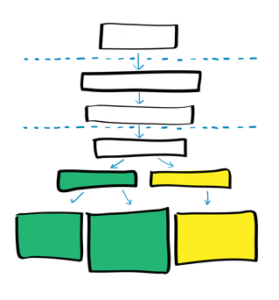
01 Introduction to rapid serology testing and national testing strategy/algorithm

Slide 2
Learning objectives
At the end of this module, you should be able to:
Explain the importance of correct diagnostic in patient care.
Understand what is serological testing and Rapid Diagnostic Test (RDT)
Understand Antigen/ Antibody reaction principle used in RDT
Understand the concepts of test performances: sensitivity, specificity, PPV and NPV,
Know what are testing strategies and algorithms and understand the different types of testing strategies
Know the main considerations for national implementation of testing algorithms
QMS in Non-lab testing site –Training Package– v1.0 | Introduction to rapid serology testing and national testing policy

Slide 3
Importance of Diagnostic
To empower health workforce in the identification of diseases or health conditions to decide patient care/prevention interventions
It is important to increase equitable access to testing services
  Rapid Diagnostic Tests support decentralization of diagnosis and increase access especially for the hard-to-reach population.
Testing providers should refer to national testing strategies and algorithms which are specific to each disease.
QMS in Non-lab testing site –Training Package– v1.0 | Introduction to rapid serology testing and national testing policy

Slide 4
Serological testing: Basic terms
Serological testing: to identify directly or indirectly if a person has a specific disease
Antigen test: detect directly the pathogen (eg: viral proteine, toxin)
Antibody test: detect antibodies produced by the immune response to an antigen (indirect)
RDTs are serological tests (antibodies/antigens tests) easy to perform that aim to diagnose the cause of an infection quickly (within few minutes)
Antigen
Antibody
Toxin or foreign substance which induces an immune response by the body.
Protein (immunoglobulin) produced by the body's immune system in response to and counteracting a specific antigen
QMS in Non-lab testing site –Training Package– v1.0 Introduction to rapid serology testing and national testing policy

Slide 5


Principle of RDTs (1/2): Antibody(Ab)/Antigen(Ag) reaction
Serological tests (including RDT) use the antigen/antibody reaction principle to detect the disease.
Antibody tests: detect the pathogen specific antibodies
Antigen tests: detect pathogen protein
From different sample type: capilary blood, oral fluid, urin, serum, plasma….
Pathogen-specific antibodies detected by antibody tests
antigens
Pathogen: virus, bacteria, parasite
Human antibodies
Pathogen proteins detected by antigen tests
QMS in Non-lab testing site –Training Package– v1.0 Introduction to rapid serology testing and national testing policy

Slide 6
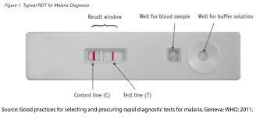
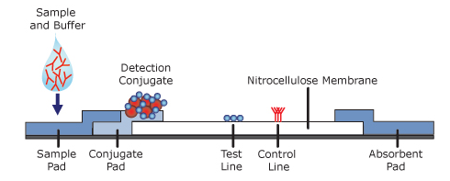
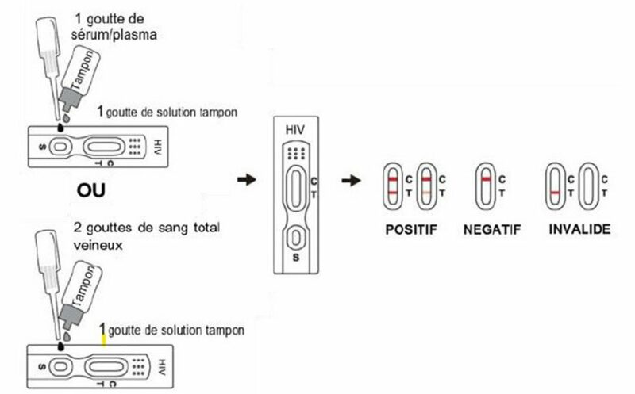

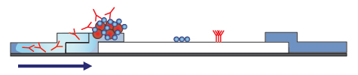
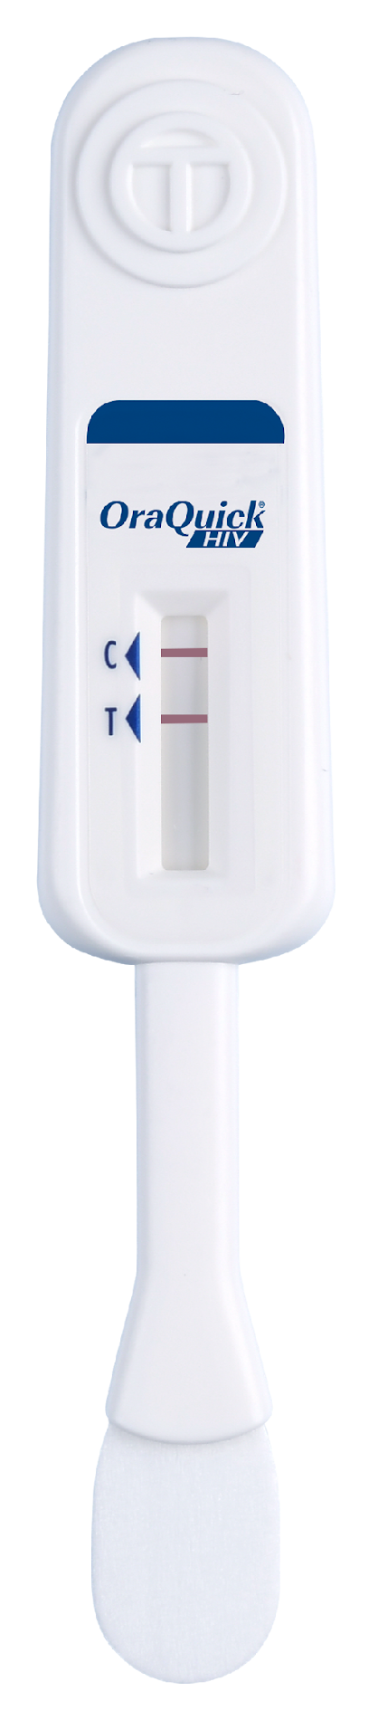




Principle of RDTs (2/2): Antibody(Ab)/Antigen(Ag) reaction on a cassette /strip
Ag/Ab reaction principle. Eg: Lateral flow RDT
RDTs: Different formats, different samples but same principle
1. Sample (Ab) and buffer added on the test strip
Pathogen specific Ag capture on the strip
2. Ab from the sample linked to conjugate (color)
T C
3. Ab/conjugate complex migrate on T line and stop if sample contain pathogen specific Ab
T C
4. Visible T line appaears if pathogen specific Ab present in the sample
T C
QMS in Non-lab testing site –Training Package– v1.0 Introduction to rapid serology testing and national testing policy

Slide 7
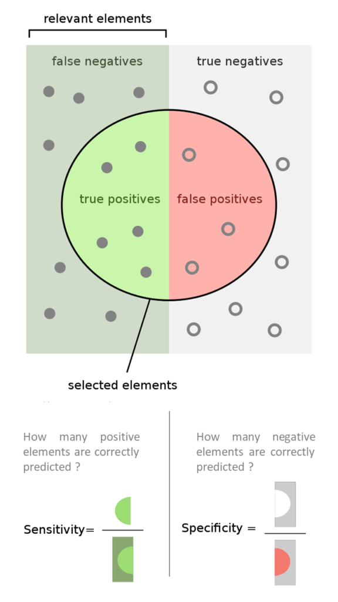
Tests Performance characteristics: sensitivity (Sen) and specificity (Spe) (1/2)
Sensitivity and specificity depend on the test ONLY
Sensitivity: the probability/chance of correctly identifying an infected individual.
  True negative: test is negative, and the client not infected
  False negative: the test is negative, BUT the client is infected
Specificity: the probability/chance of correctly identifying an uninfected individual.
  True positive: the test is reactive, and the client is infected
  False positive: the test is reactive, BUT the client is not infected
infected
not infected
Reactive tests
High sensitivity few false negative results
High specificity
few false positive results
.
QMS in Non-lab testing site –Training Package– v1.0 | Introduction to rapid serology testing and national testing policy

Slide 8
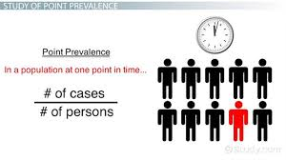
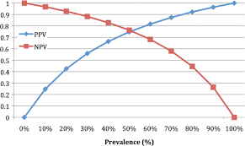
Tests Performance characteristics: NPV and PPV
Positive predictive value (PPV) and Negative predictive value (NPV): depend on the test AND the prevalence
PPV: Probability/chance that, when the assay is reactive, the individual is truly infected.
NPV: Probability/chance that, when the assay is negative, the person is truly not infected.
Prevalence: % of person infected in a population
Low prevalence= low PPV= high risk of false positive
High prevalence= high PPV= low risk of false positive
Low prevalence= high NPV= low risk of false negative
High prevalence= low NPV= high risk of false negative
QMS in Non-lab testing site –Training Package– v1.0 Introduction to rapid serology testing and national testing policy

Slide 9

Understanding positive predictive value (PPV)
PPV= probability a person with a reactive HIV test result has HIV
High HIV prevalence
Low HIV prevalence
HIV testing with more undiagnosed PLHIV = greater likelihood of accurately diagnosing person with fewer tests
HIV testing with few undiagnosed PLHIV = lower likelihood of accurately diagnosing person with fewer tests
QMS in Non-lab testing site –Training Package– v1.0 | Introduction to rapid serology testing and national testing policy

Slide 10
Importance of national testing strategies and algorithms (1/2)
To establish the presence or absence of a disease with certitude and decide treatment/prevention measures: disease specific testing strategies and algorithms must be nationally validated.
  Testing strategy: describe the sequence of tests (type of tests, how many tests, in parallel or in serie...)
  Testing algorithm: describe the sequence of tests + indicate exact brand of each test
Testing strategy can be composed of one test only (e.g: Malaria) or several tests (e.g: HIV)
  Malaria: the client is diagnosed with malaria and refer to treatment if 1 test reactive
  HIV: the client is diagnosed as HIV+ and refer to treatment ONLY if 3 consecutive tests are reactive
Testing strategies and algorithms are validated by national level using several criteria including test performances, prevalence of the disease, tests available, delivery models, international guidance …
Updated nationally validated algorithms must be known by testing providers and easily accessible in each testing site for reference
Always follow
nationally
validated algorithms
QMS in Non-lab testing site –Training Package– v1.0 | Introduction to rapid serology testing and national testing policy

Slide 11
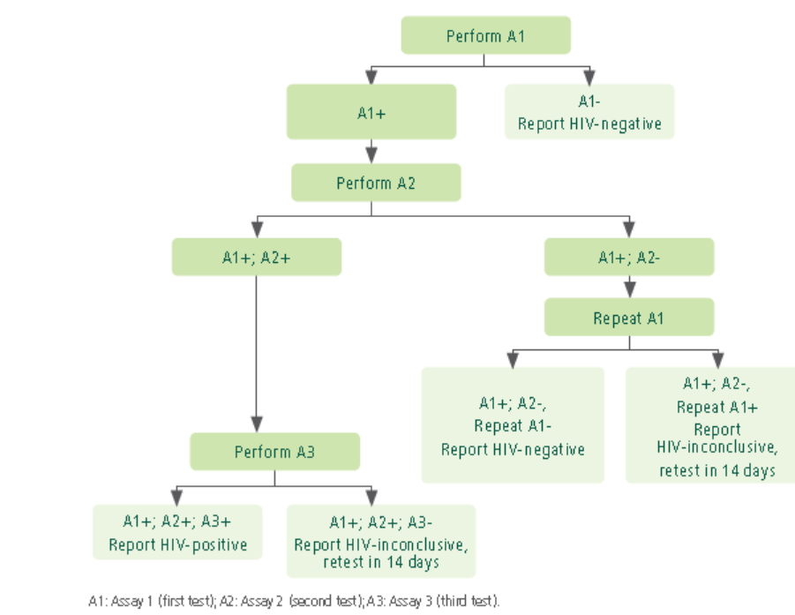
Exemple of testing strategies
HIV: 3-test strategy: 3 consecutive reactive tests for an HIV + diagnosis
https://www.who.int/publications/i/item/9789240096394
Malaria: 1-test strategy. Malaria is confirmed if 1 test is positive
Perform RDT or microscopy
RDT or microspy -
RDT or microspy +
Report Malaria –
Report Malaria +
Do not treat and look for other cause
start treatment
https://iris.who.int/bitstream/handle/10665/379635/B09146-eng.pdf?sequence=1
QMS in Non-lab testing site –Training Package– v1.0 | Introduction to rapid serology testing and national testing policy

Slide 12
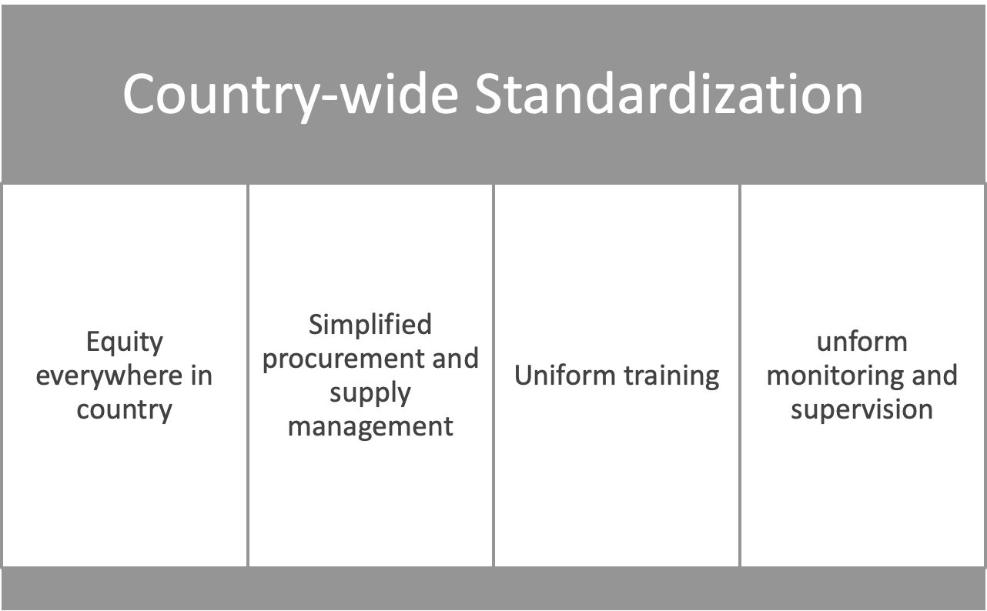
Importance of national testing strategies and algorithms 2/2)
QMS in Non-lab testing site –Training Package– v1.0 | Introduction to rapid serology testing and national testing policy

Slide 13
Considerations for national implementation of testing strategies and algorithms
When national testing algorithms are nationally validated, authorities need to ensure that all testing providers and responsible staff are trained and authorized to perform testing.
Specific supportive materials (SOPs, bench aids, registers…) must be created or updated.
Testing providers must always:
  Know and understand the testing strategy/algorithm for each disease they are testing for
  Being trained and authorized to perform testing
  Refer to SOPs, job aids and Instructions For Use (IFUs) for each test devices they use
QMS in Non-lab testing site –Training Package– v1.0 | Introduction to rapid serology testing and national testing policy

Slide 14
Questions?

