Slide 1

10
Site supportive supervision visits
Target audience: QA officers

Slide 2
Overall Learning objectives
At the end of this module, you should be able to:
Explain the supervision visit process
know the different steps for conducting a supervision visit
Know the supervision visit tools that need to be used
QMS non-lab testing sites; training package – v1.0 | Site supportive supervision visits

Slide 3
Quality Assurance Cycle (QAC) and site supervision visits
Plan
Establish supervision team(s)
Develop tools
Ensure sites and testing providers are ready to perform testing
Provides means to prevent, detect, and correct errors
Ensures quality data for targeted response
Define
  Requirement
  Role & Responsibility
Improve
Provide feedback
Corrective action plan
QAC
Site supervision
Evaluate
Review & analyze
Identify root causes
Implement
Train monitors/ auditors/supervisors
Conduct site supervision
Monitor
Collect data
Identify gaps
QMS non-lab testing sites; training package – v1.0 | Site supportive supervision visits

Slide 4
Objectives of site supportive supervision visits
Objectives of site supportive supervision visits:
Ensure that testing strategies are aligned with national guidelines
Determine if a testing site and/or users are providing accurate and reliable results
Identify the quality of testing improvement areas
Plan and implement corrective actions as needed and promptly
Frequency: at least once/year per testing site (remote tools available if not possible to go onsite)
Site supervision visits are not punitive but supportive for continuous improvement.
Supervision visits can integrate (resources optimization):
Testing provider competency-based assessment
Site premises and organisation assessment
External quality assessment scheme event
QMS non-lab testing sites; training package – v1.0 | Site supportive supervision visits

Slide 5
Supervision visit planning
National level should:
Allocate adequate resources,
Identify a team responsible to plan and conduct the visit (Eg: QA officer)
Develop and validate the supervision visit tools
Frequency: at least once/year per testing site
Standardized tools should be used
Important to plan: One testing site can have several testing points and several testing providers
Site supervision visits are not punitive but supportive for continuous improvement
QMS non-lab testing sites; training package – v1.0 | Site supportive supervision visits

Slide 6
Site supportive supervision visit process
National planning
  Develop site supervision visit program and plans
  Allocate budget and resources
  Identify and train the supervision team
  Develop and validate tools (check list)
Planning
  Identify site (including all testing points)& notify site
  Organize logistical arrangements for transportation and lodging
  Prepare tools: PT samples, checklist, report template
  Preparatory meetings: aligned on visit duration, agenda, ensure staff will be present, provide list of necessary documents
Conducting
  Site assessment
  Tester competency-based assessment: direct observation, PT…
  Documents and records review
  M&E: quality indicators review (including EQA results)
Reporting
  Fill and share the reporting Form/report
  Provide direct feedback to the testing site including improvement/corrective action with action plan
  Inform management line of findings
Following
  Regular contacts with the site to monitor implementation of any corrective actions and improvement measures
QMS non-lab testing sites; training package – v1.0 | Site supportive supervision visits

Slide 7

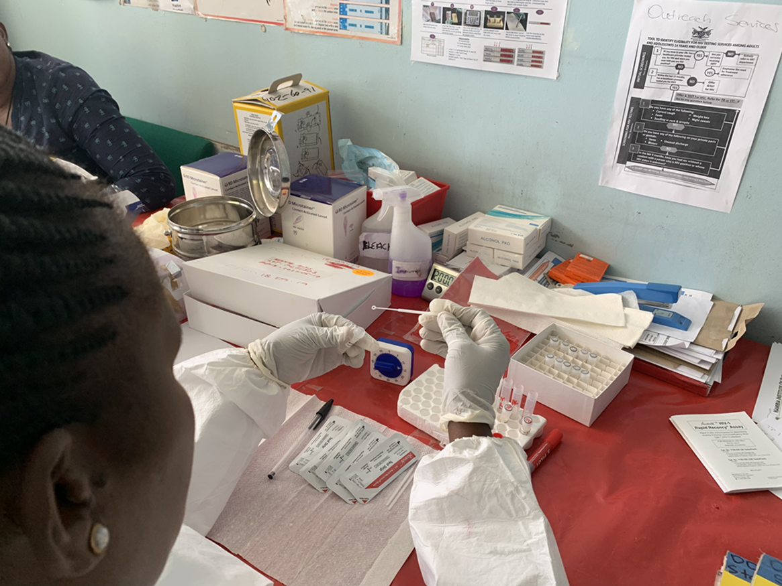



During a site supervision visit (1/2)
  Put the personnel at ease
  Show respect and allay fears
  Provide constructive feedbacks
Review site records and documents
Observe site organization and operations
Ask open ended questions?
Follow client specimen through the entire testing process
  from sample collection to result report and recording
Compile informations and disseminate findings
QMS non-lab testing sites; training package – v1.0 | Site supportive supervision visits

Slide 8
During a supervision visit (2/2)
  Review site documents and records: registers, standard operating procedures (SOPs), job aids, HR authorization of work, EQA results, previous visits reports, incident reports… to ensure all are complete, updated and accurate...
R
  OBSERVE rapid testing site operations to ensure that:
  All testing points are adapted to perform testing (using check list): organization, safety…
  All tests are conducted according to validated procedure and QMS measures are in place (using checklist)
  Identified gaps and improvement areas and propose corrective/improvement actions.
O
  ASK open-ended questions to clarify evidence gathered and observations made. Ask questions such as "show me how..." or "tell me about...". It is often not necessary to ask every question on the checklist word for word.
A
  DISCOVER: Whenever possible, follow a sample through the specified RDT process, from sample collection to testing, analysis, and results reporting.
D
QMS non-lab testing sites; training package – v1.0 | Site supportive supervision visits

Slide 9

Sites Supervision visit tools available
Have to be nationally validated before used
Several standardized tools exist
  CDC The Stepwise Process for Improving the Quality of Rapid Testing (SPI-RT) checklist (https://rtcqi.org/tools/spi-rrt)
    Paper-based
    Open-source software (ODK) to collect, manage, and use the data generated during supervision visits
  WHO site supportive supervision checklist
    Agnostic
    Lighter/simpler SPI-RT
QMS non-lab testing sites; training package – v1.0 | Site supportive supervision visits

Slide 10



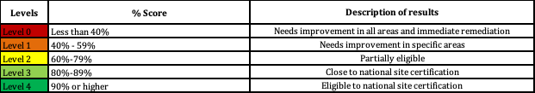
The Stepwise Process for Improving the Quality of HIV Rapid Testing (SPI-RT) checklist
Audit Score Sheet
Section | Section Name | Total Points
Section 1 | Personnel Training and Certification | 10
Section 2 | Physical Facility | 5
Section 3 | Safety | 11
Section 4 | Pre-Testing Phase | 12
Section 5 | Testing Phase | 9
Section 6 | Post-Testing Phase | 9
Section 7 | External Quality Assessment | 8/14
TOTAL SCORE |  | 64/70
WHO 2015 Guidelines were used to create the SPI-RT checklist
A checklist to evaluate quality assurance (QA) processes for HIV rapid testing (can be expanded and adapted to other pathologies), establishing minimum standards against which testing sites measure their performance
https://rtcqi.org/tools/spi-rrt
QMS non-lab testing sites; training package – v1.0 | Site supportive supervision visits

Slide 11
Supportive site supervision visit components
It is important to optimize supportive site supervision visit as much as possible by performing several activities:
Site general assessment: assess if testing site environment is adequate
Testing provider competency-based assessment: assess competency of testing providers through
  Direct observation
  Proficiency testing event (if possible)
Routine testing indicators review: assess capacity of testing site to collect, calculate routine testing indicators
Use of indicators review: assess capacity of testing site personnel to use routine testing indicators and implement root cause analysis and actions (preventive, corrective) in case of any concerns
QMS non-lab testing sites; training package – v1.0 | Site supportive supervision visits

Slide 12
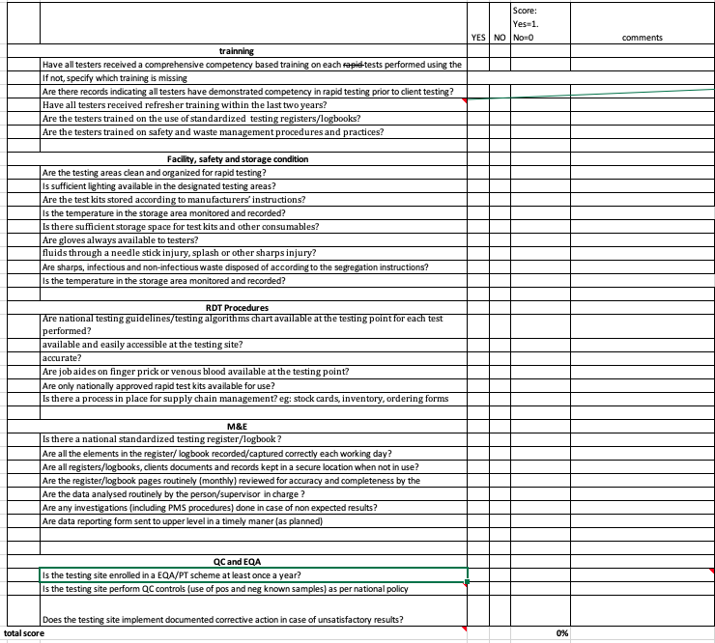
WHO supervision tools (1/4)
Composed of:
Site general assessment checklist
Assess site capacity to perform testing activities
For each « no »: implement corrective action
If score:
>90%: site performing well
80% > score< 90%: site adequately performing, need improvements
<80%: site not performant enough. Implement immediate corrective action and inform management line for further action
QMS non-lab testing sites; training package – v1.0 | Site supportive supervision visits

Slide 13
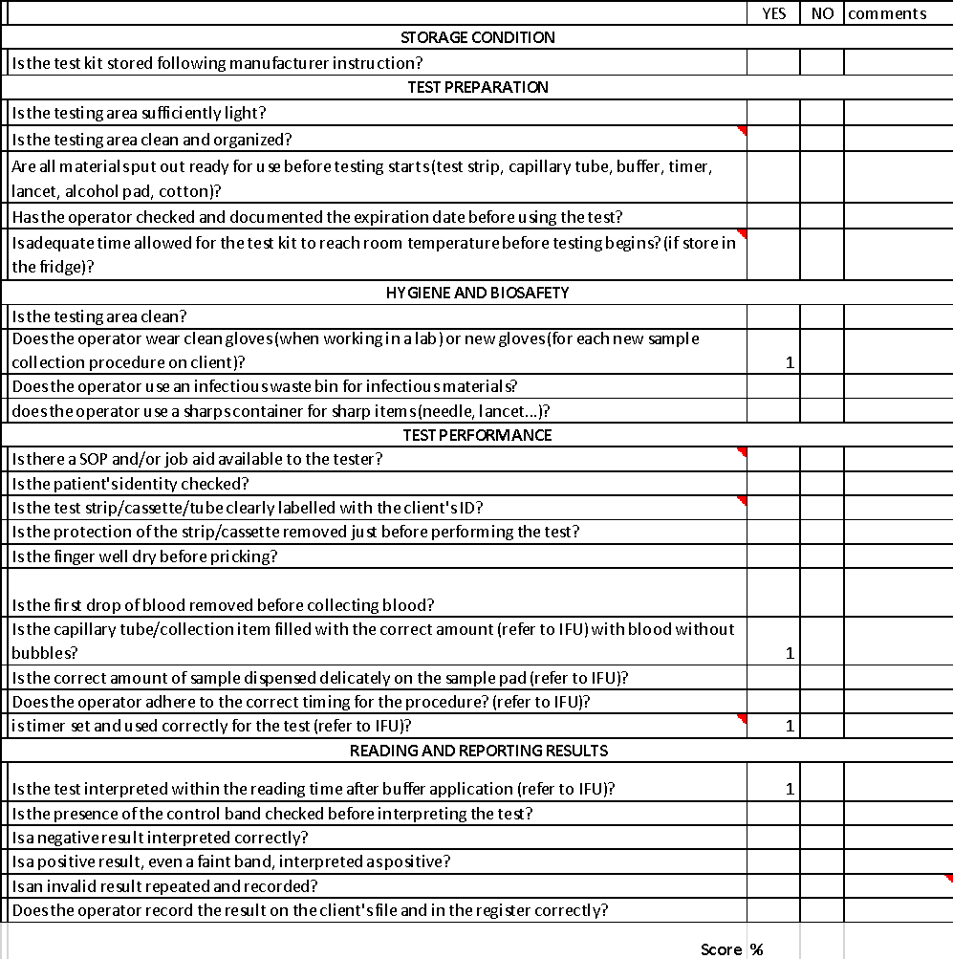
WHO supervision tools (2/4)
Adapt according to the guidelines in your country
Testing provider competency-based assessment checklist
Direct Observation: assess the competency of the tester to conduct testing
        For each « no »: implement corrective action
If score:
>90%: testing provider pass
<90%: testing provider fail; need refresher training prior to perform testing
Where possible, add a proficiency testing (PT) event to assess tester competency.
Expected PT score: 100%
Competency-based assessment successful only if:
PT score=100% and checklist score>90%
QMS non-lab testing sites; training package – v1.0 | Site supportive supervision visits

Slide 14
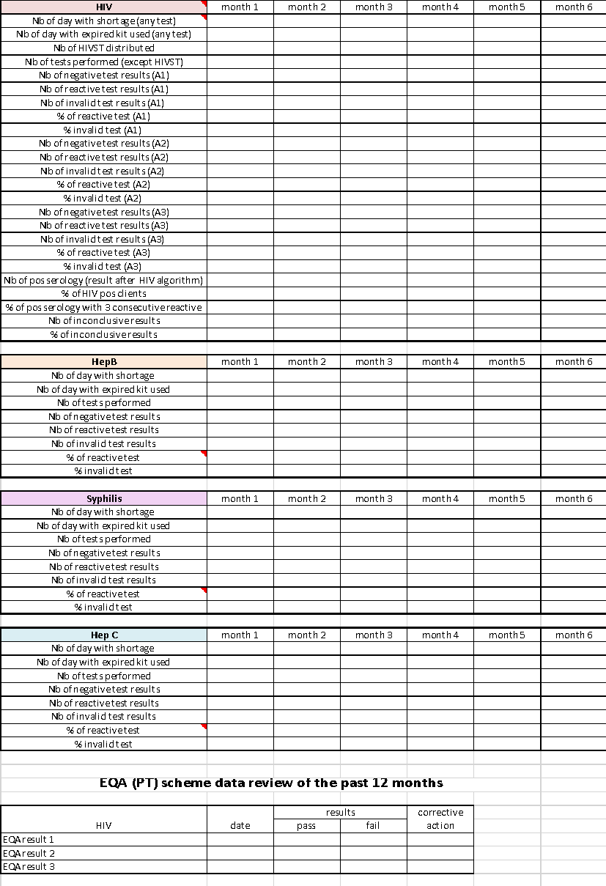
WHO supervision tools (3/4)
Routine Testing indicators reporting form
Compile all testing indicators to review
To be filled by the site supervisor and reviewed by the assessor
If data are not complete, perform a refresher training on data collection and/or calculation of indicator
QMS non-lab testing sites; training package – v1.0 | Site supportive supervision visits

Slide 15
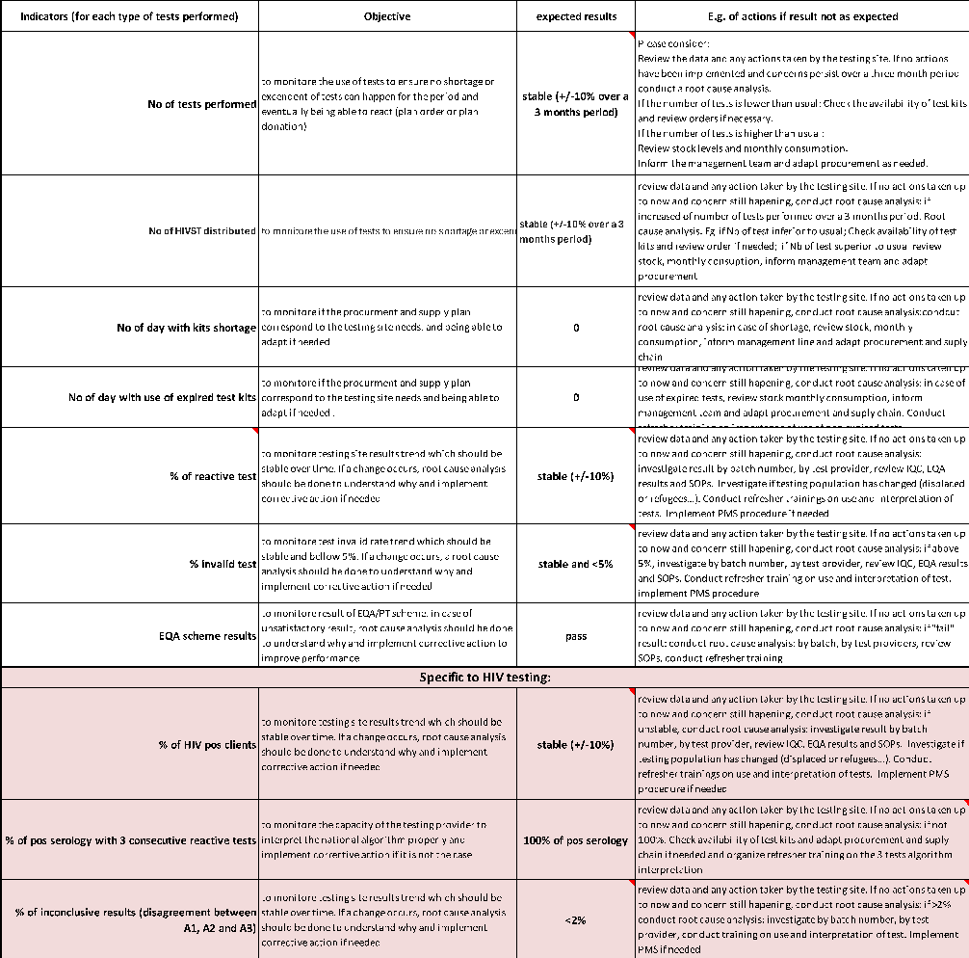
WHO supervision tools (4/4)
Use of indicators tool
Describe:
Objective
expected value
Action to implement if result not the one expected
If data are not regularly analysed and/or action taken in case of any concerns, refresher training on how to use data should be implemented
QMS non-lab testing sites; training package – v1.0 | Site supportive supervision visits

Slide 16
Supervision visit site feedbacks
Important to provide feedback to the site directly at the end of the site visit and to the management line
Constructive and future-oriented feedbacks.
Positive feedbacks
What was performed according to standard.
Encourage to continue that way;
Negative feedbacks
What did not reach the standards.
Discourages from continuing
Propose improvement measures
Assessor should provide feedback on:
  Overall site performance
  Best practices and deficiencies
  Opportunities for improvement
  Corrective actions, action plan and contact point
  The probable date of the final report
QMS non-lab testing sites; training package – v1.0 | Site supportive supervision visits

Slide 17


Key points
Regular) on-site supervision visits are crucial to monitor the trend of the quality of testing in a testing site and individual tester competency and provide adequate, timely support for continuous improvement when needed.
On-site supervision visit aims to:
Ensure that testing strategies are aligned with national guidelines
Determine if a testing site and/or users are providing accurate and reliable results
Identify the quality of testing improvement areas
Plan and implement corrective actions as needed and promptly
It is recommended to use a standardized supervision tools
Integration of activities is recommended to optimize resources
QMS non-lab testing sites; training package – v1.0 | Site supportive supervision visits

Slide 18
Questions?

