Slide 1

11
Testing provider Competency-based assessment for authorization to work/practice
Target audience: Assessors/evaluators

Slide 2
Learning objectives
At the end of this module, you should be able to:
Understand the importance and objectives of a testing provider competency-based assessment program.
Describe the national competency-based assessment program cycle: initial and regular/ongoing
List the different components of competency-based assessment at initial and ongoing: theoretical exams (questionnaire) and practical (observation checklist +/- proficiency testing using known samples)

Slide 3
Key Definitions
Assessor/ Evaluator
An individual who assess the testing provider competencies and deliver the authorization of practice/work
Assessment
The systematic process of collecting and analyzing data to determine the knowledge and competencies of a testing provider
Competence
The demonstration of the ability to apply knowledge and skills
Tester Authorization
The procedure by which an authorized person like a QA officer gives written assurance that an individual performing testing according to specified requirements

Slide 4
Certification vs. competency-based assessment programs
Certification programs (eg RT-CQI) are used to assess and recognize testing provider competencies. Can be difficult to implement in some contexts (lack of resources). Competency-based assessment programs can be an alternative
Same objectives (ensure testing provider competencies are adequate) but ≠ organization (national versus simplified/decentralized approach)
Certification program | Competency-based assessment program
Assess competencies of testing providers Theoretical and practical exams Cycle: initial and regular intervals Managed at central/national level: centralization (national level) of testing providers assessment results Certification provided by a nationally recognized body | Assess competencies of testing providers Theoretical and practical exams Cycle: initial and regular intervals Decentralized (subnational level) management Authorization of practice/work provided by subnational QA officers Integration with regular site supervision visits program

Slide 5
Objectives of testing providers competency-based assessment
Ensure testing providers are trained and recognized as competent to perform testing and related tasks
To be done after initial training and regularly (at least once every 2 years) : Cycle
Competencies requirements should be nationally validated
Using a standardized competency-assessment tool composed of 2 parts: theoretical and practical
Recognized by an authorization of practice letter/attestation
Initial training
If not competent: redo training and assesment
Initial competency-based assessment
1 per 2 years re-assessment
Authorization letter
Notes:
Points to mention:
Written and practical exam
Don’t want to interrupt services of facility

Slide 6
Competency-based Assessment Components
Competency-based Assessment program definition: Standardized and nationally validated method to assess testing provider competencies to perform testing and related tasks and, if successful, provide an authorization of practice/work attestation/letter | Countries to: Decide testing providers competency requirements Establish training and competency- based assessment programs Develop and validate competency-based assessment tools train and authorize evaluator/assessor to provide authorization letter to successful testing providers
 | Feedback to testing providers Summary, assessment conclusions 🡪 authorization letter/attestation or additional trainings

Slide 7
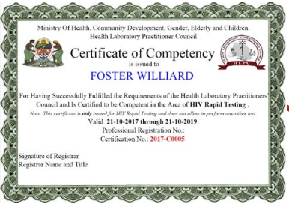
Testing provider Training and competency-based assessment Program
Authorization of work/practice
provided on-site by the evaluator/assessor
Initial
and
Regular
- In-person (preferred)
- National Training Package
- National Competency-based assessment tools: theoretical (written test) + practical (direct observation +/- proficiency testing). Eg:
Locally developed
CDC/CLSI packages
- Integration with site supportive supervision visits:
Ongoing training
Mentoring/coaching
Practical competency-based assessment (direct observation +/- proficiency testing)
- During targeted training (in-person or online). Eg:
RT-CQI training program
Refresher training videos
Data from Competency-based assessments should be recorded and can be managed using the Excel spreadsheet template or by e-tools like Certification Dashboards that will be accessible online and help to automatically generate analyses of the personnel certification data.

Slide 8
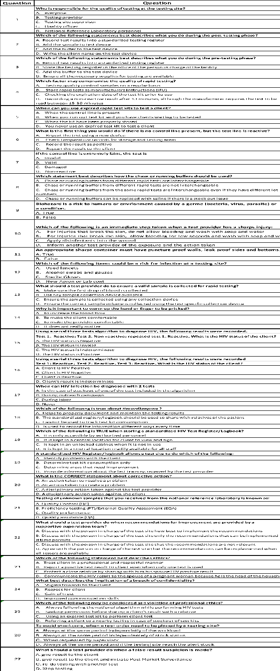
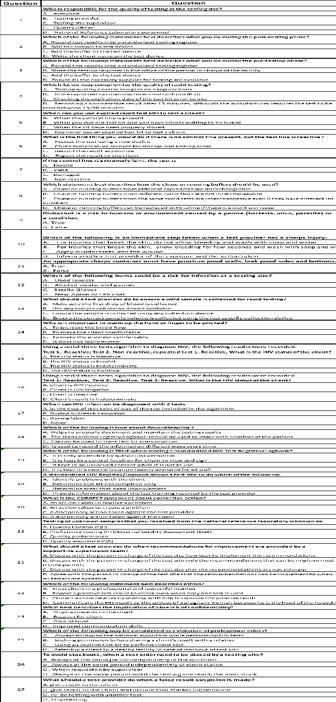
Competency based assessment tools: written questionnaire
20-25 questions covering the entire testing process and all QMS pillars:
Test Preparation
Hygiene and safety
Sample collection
Test procedure and algorithm interpretation
Reading and reporting results
Successful if score ≥80%
This can be done: on-site using the paper-based system or online

Slide 9
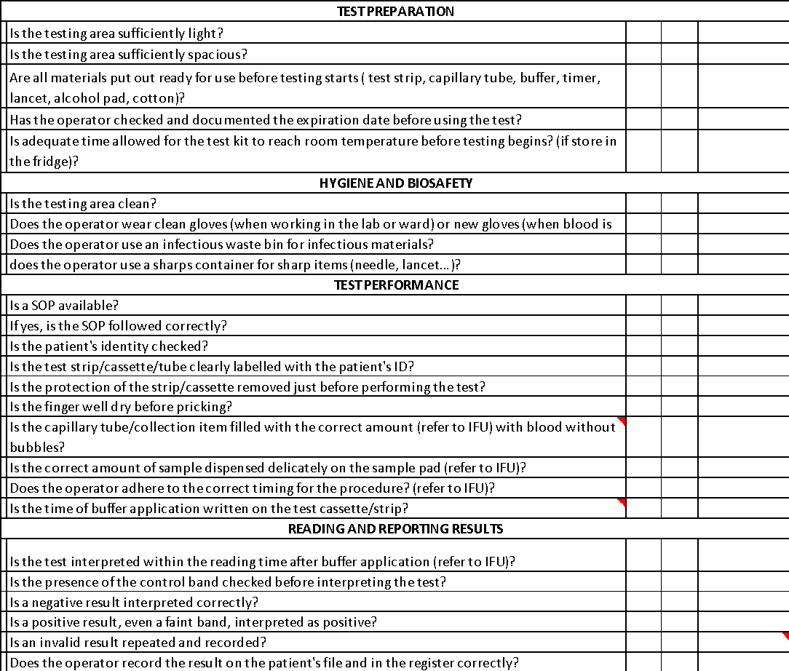
Competency based assessment tools: direct observation checklist
Should cover the entire testing process:
Test Preparation
Hygiene and safety
Sample collection
Test procedure
Reading and reporting results (tests and algorithm)
Can be used while testing provider is :
Testing DTS
Testing stored samples or
Testing client
Successful if score ≥90%

Slide 10

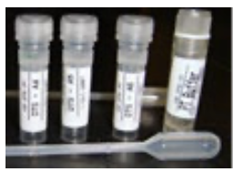
Competency based assessment tools: Proficiency Testing panel
Proficiency testing events should be part of the competency-based assessment
Should include the testing procedure using a validated national algorithm and result reporting
At least 4 samples/disease: at least 1 pos and 1 neg sample (using the entire testing algorithm).
The testing provider must be blinded from the result
Depending on resources and local capacity different samples can be used:
Dry Tube Specimen (DTS) obtained from national/subnational level
Stored samples from the closest site
Commercial pos and Neg solutions
Where available, multiparametric/multi-disease samples are preferred in case the testing provider is trained in several diseases
Successful if score ≥100%
sample | Tester result | Expected result | Pass/fail
Sample 1
Sample 2
Sample 3
Sample 4

Slide 11


Summary of the competency-based assessment Process Flow
Questionnaire
Paper-based
Written Exam
(Initial)
Successful if score ≥ 80%
OR
Digital tool
if the 3 parts are successful =
Authorization of practice letter
Can be provided directly by assessor
1 copy to testing provider and 1 copy to the assessor
Testing provider to be assessed
Direct observation check list
Successful if score ≥ 90%
Practical exam
(Initial and regular)
Proficiency Testing
Successful if score ≥ 100%

Slide 12
Example of an Authorization to practice letter
MOH logo
Ministry of Health
Authorized body logo if not MOH
Letter of Authorization
is issued to
First Name Middle Name and Last Name
For having successfully fulfilled the requirements of the national tester Authorization program and being Authorized to be Competent in the Area of …. Rapid diagnostic Testing.
Note. This letter is only issued for … Testing and does not allow performing any other test.
Valid <<Date Month Year>> through <<Date Month Year>>
Professional Registration No.: ………………………………………
Authorization No.: …………………………………………………..……
Seal of authorized body
Signature of Registrar / evaluator ………………………………………………………………………
Name and Title ………………………………………………………………………
QMS non-lab testing sites; training package – v1,0| Competency-based assessment for Personnel authorization to practice

Slide 13


Key points
Countries must understand and establish the components/overall structure & format of personnel competency-based assessment and Authorization program.
Decentralization of the program will simplify process: need to train and authorize subnational personnel (QA officer) to provide authorization of practice letter
Testing provider Authorization programs should use nationally validated competency-based assessment tools.
Competency-based assessment has 3 parts: written test (questionnaire) and practical exams (direct observation + PT exercice)

Slide 14
Questions?

