Slide 1
02
Introduction to Quality Management System (QMS)

Slide 2
Learning objectives
At the end of this module, you should be able to:
  Understand what quality means and explain why quality is important
  Describe Quality Management System (QMS)
  List the important elements of QMS specific to non-lab settings and serological RDTs (rapid diagnostic tests)
  List key factors that may affect the quality of testing

Slide 3
Definition of a quality management system (QMS)
The organizational structure, responsibilities, processes, procedures, and resources necessary to implement quality management in a testing site.
Through the QMS, the health system can monitor all parts of the test system and detect and reduce errors as we Improve consistency across test sites.
It is a set of building blocks that, if respected can ensure the quality of testing
All activities that contribute to test quality, directly or indirectly.

Slide 4
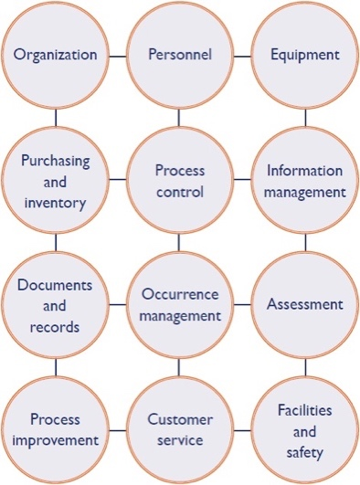






Organization of the QMS toolkit by pillars
Laboratories
Non-laboratory testing sites
Organisation, governance and planning
Workforce development
Procurement, supply chain and inventory management
Simplification
Process control assessment and continuous quality improvement
Documents, records and information management
Post Market Surveillance
Notes:
Guidelines and policies, regulatory affairs, HR organigram, roles, and responsibilities, [QA FP] managerial commitment/organizational structure, financial needs, facility and safety, personnel with a focus on training modules,
, managerial commitment/organizational structure, financial needs, facility and safety, personnel with a focus on training modules

Slide 5



What does Quality of testing mean?
Ensure the testing site results are:
Accurate
Reliable
Timely

Slide 6

Why the quality of testing is important? (1/2)
Accepting a 1% error rate would mean in France, every day:
50,000 letters lost by postal services
22 newborns falling from midwives’ hands
600,000 lunches contaminated by bacteria
Three bad landings at Paris airport

Slide 7



Why the quality of testing is important? (2/2)
Testing errors (false positive, false negative) cost in:
Time
Money
Personnel effort
poor outcomes

Slide 8
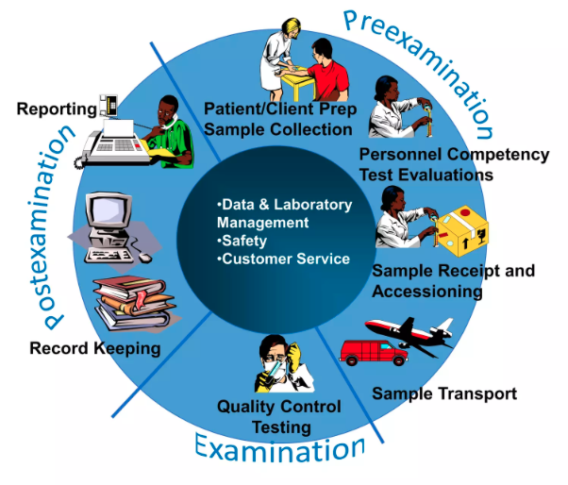

How Can we achieve quality testing in all testing sites?
All aspects (before, during, and after) of testing need to be addressed to ensure the quality of testing
QMS = Coordinated activities to direct and control testing activities

Slide 9




Who is responsible for quality?
Everyone, each at their level
Everyone
All admin and other staff
All test site personnel implementing the procedures
Testing provider implementing QA procedures
All management and program staff who supervise the procedures
Program staff
Supervisor, quality officer establishing QA procedures

Slide 10
Why do errors occur?
Individual responsibilities unclear
No written procedures or procedures not followed
Training is not done or not completed
Checks not done for transcription errors
Test not stored properly
QC, EQA not performed

Slide 11




When do testing errors occur?
Test kit selection
Sample collection/
transport
Sample/test kit storage
Use of PPE
Personnel competency
Individual responsibilities
Record Results
Report Results
Use of registers
Transcription errors
Disposal of waste
During testing
QC/ EQA
Follow testing procedures
Interpretation
After testing
Before testing
At all stages of the testing process

Slide 12

Personnel/workforce development
Job descriptions and clear responsibilities
Job Qualifications
Training
Competency-based assessments (initial and regular)
Supportive supervision
Professional development and continuing education

Slide 13


Testing environment
Safety
Ergonomics
Lighting
Waste management and IPC
Security

Slide 14


Documents and records
Documents | Records
creation | collection
revisions and review | review
control and distribution | storage
 | retention

Slide 15

Information Management
Confidentiality of client information
logs and records
Reports
Use of data
If possible, computerized information systems

Slide 16




Procurement and stock management
National selection and validation of quality-assured tests
Appropriate (quantity and timely) orders. Define an alert stock
Review monthly consumption versus needs
Stock management:
Inform management of site needs.
Proper storage conditions (temperature...)
Regular inventory
Inspect incoming orders
QMS non-lab testing sites; training package – v1.0 | Introduction to Quality Management System

Slide 17
Process control
Quality Controls
IQC
EQC
Monthly testing indicators review:
Pos rate; invalid rate, inconclusive rate
External Quality Assessment:
- Proficiency testing /EQA
scheme
- Site supervision visit
QMS non-lab testing sites; training package – v1.0 | Introduction to Quality Management System

Slide 18

Occurrence Management and Post Market Surveillance
It is the process by which errors are identified and handled.
complaints
mistakes and problems
documentation
root cause analysis
immediate actions
corrective actions
preventive actions
▪Post Market surveillance if problem mistake due to the test kit

Slide 19
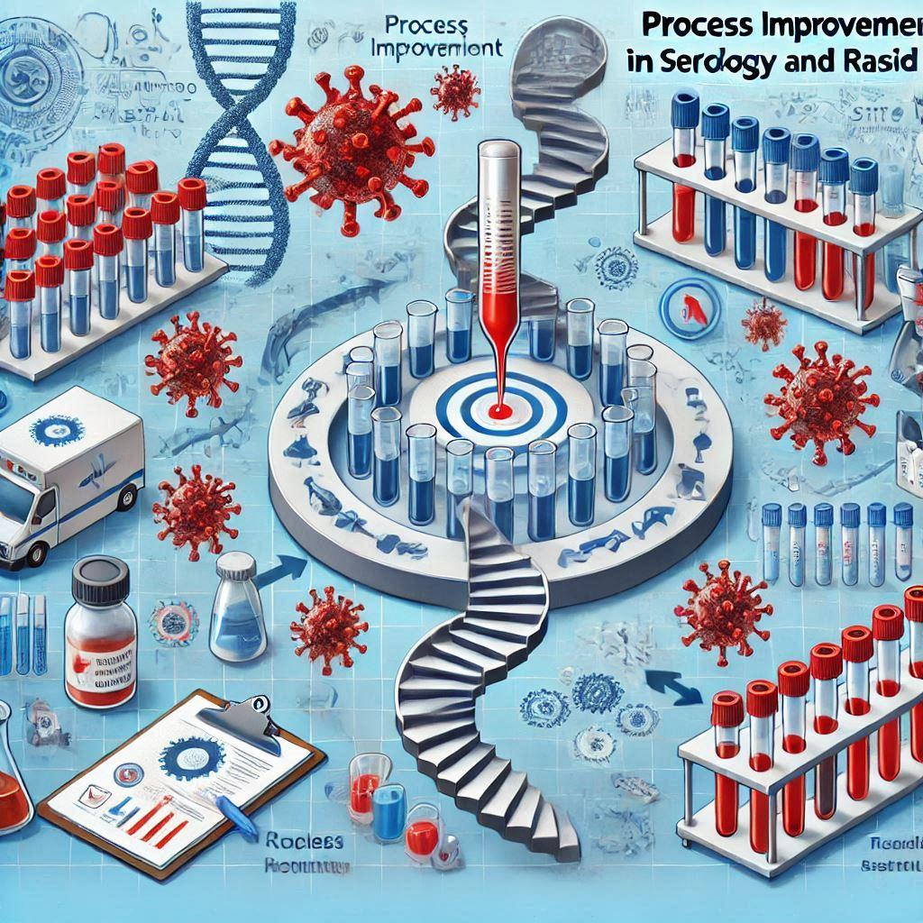
Process Improvement
opportunities for improvement (OFIs)
stakeholder feedback
problem resolution
risk assessment
preventive actions
corrective actions

Slide 20

Key points
QMS = set of policies, procedures, and practices implemented in each testing site to ensure constant quality of testing (accurate, reliable, and timely results)
Implementing QMS does not guarantee an error-free site
But it detects errors that may occur and prevents them from recurring
Sites without QMS will produce undetected errors

Slide 21
Questions?

