Slide 1

3
Testing environment, Safety, and IPC measures

Slide 2
Learning objectives
At the end of this module, you will :
  Know and follow adequate personal health and safety practices.
  Maintain a clean and organized workspace
  Segregate and dispose of wastes properly
  Describe what to do in the case of an accident
  Follow safety procedures and keep safety records

Slide 3
Definition of terms
Hazard: Any organism, material, or substance (chemical, sharp…) capable of causing injury, infection, disease, or death
  Biological hazard: infectious agent (bacteria, virus…)
  Chemical hazard: chemical agent (test buffer, detergent..)
  Sharp hazard: needle, lancet
Biosafety: A set of measures to protect people's health in testing sites. Biosafety aims to reduce or eliminate exposure of testing providers, the community, and the environment to potentially infectious or hazardous agents.
Incident/accident: any irregularity during the handling of biological material likely to cause injury, infection, allergy, or poisoning
Identify the risks

Slide 4
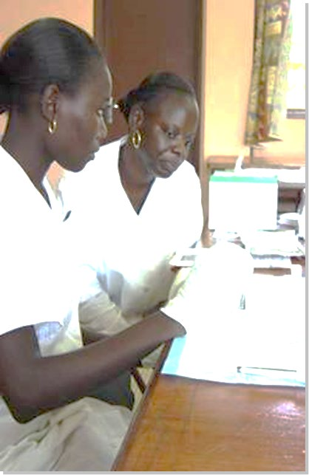
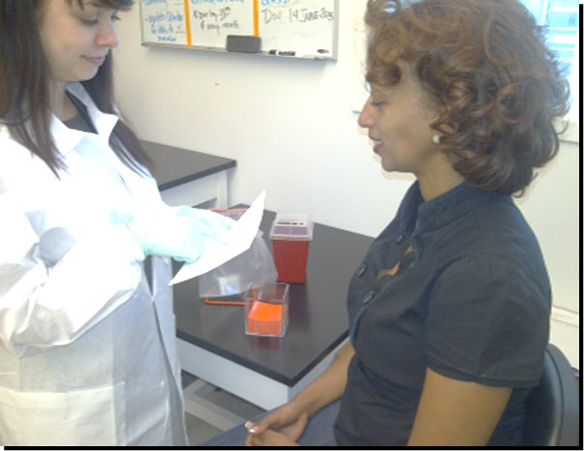
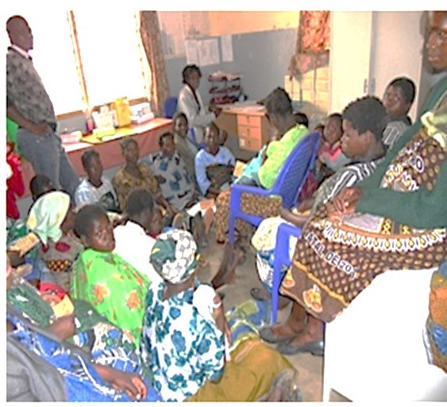

Who Needs to be safe in a testing site?
Tester
Client
Others
We cannot wait until a serious accident or illness occurs before implementing safe practices.
Biosafety: set of measures to protect yourself, the client, and others against infection, accident, or injury.

Slide 5
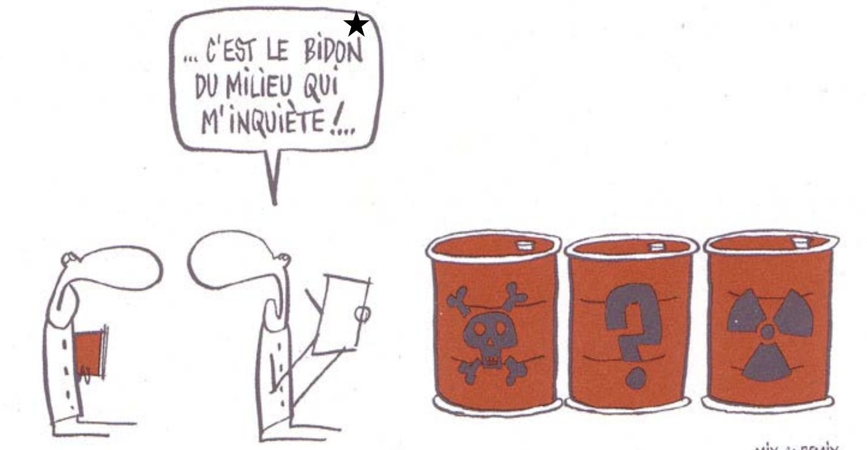
Testing site common hazards (1/2)
Specific to each testing site, procedures and material available
Need to identify hazards and risk of exposure before defining biosaftery measures
In fact, its is the middle containers that worries me most
Identify the risks

Slide 6
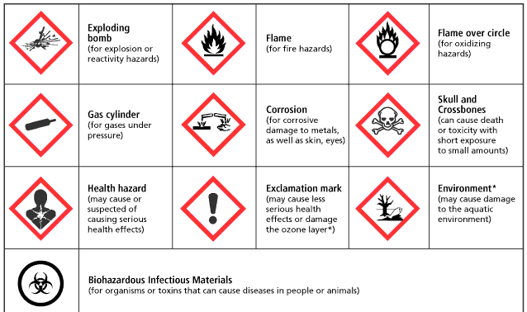
Testing site common hazards (2/2)
chemicals
Biological

Slide 7

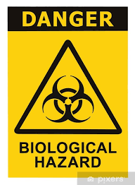
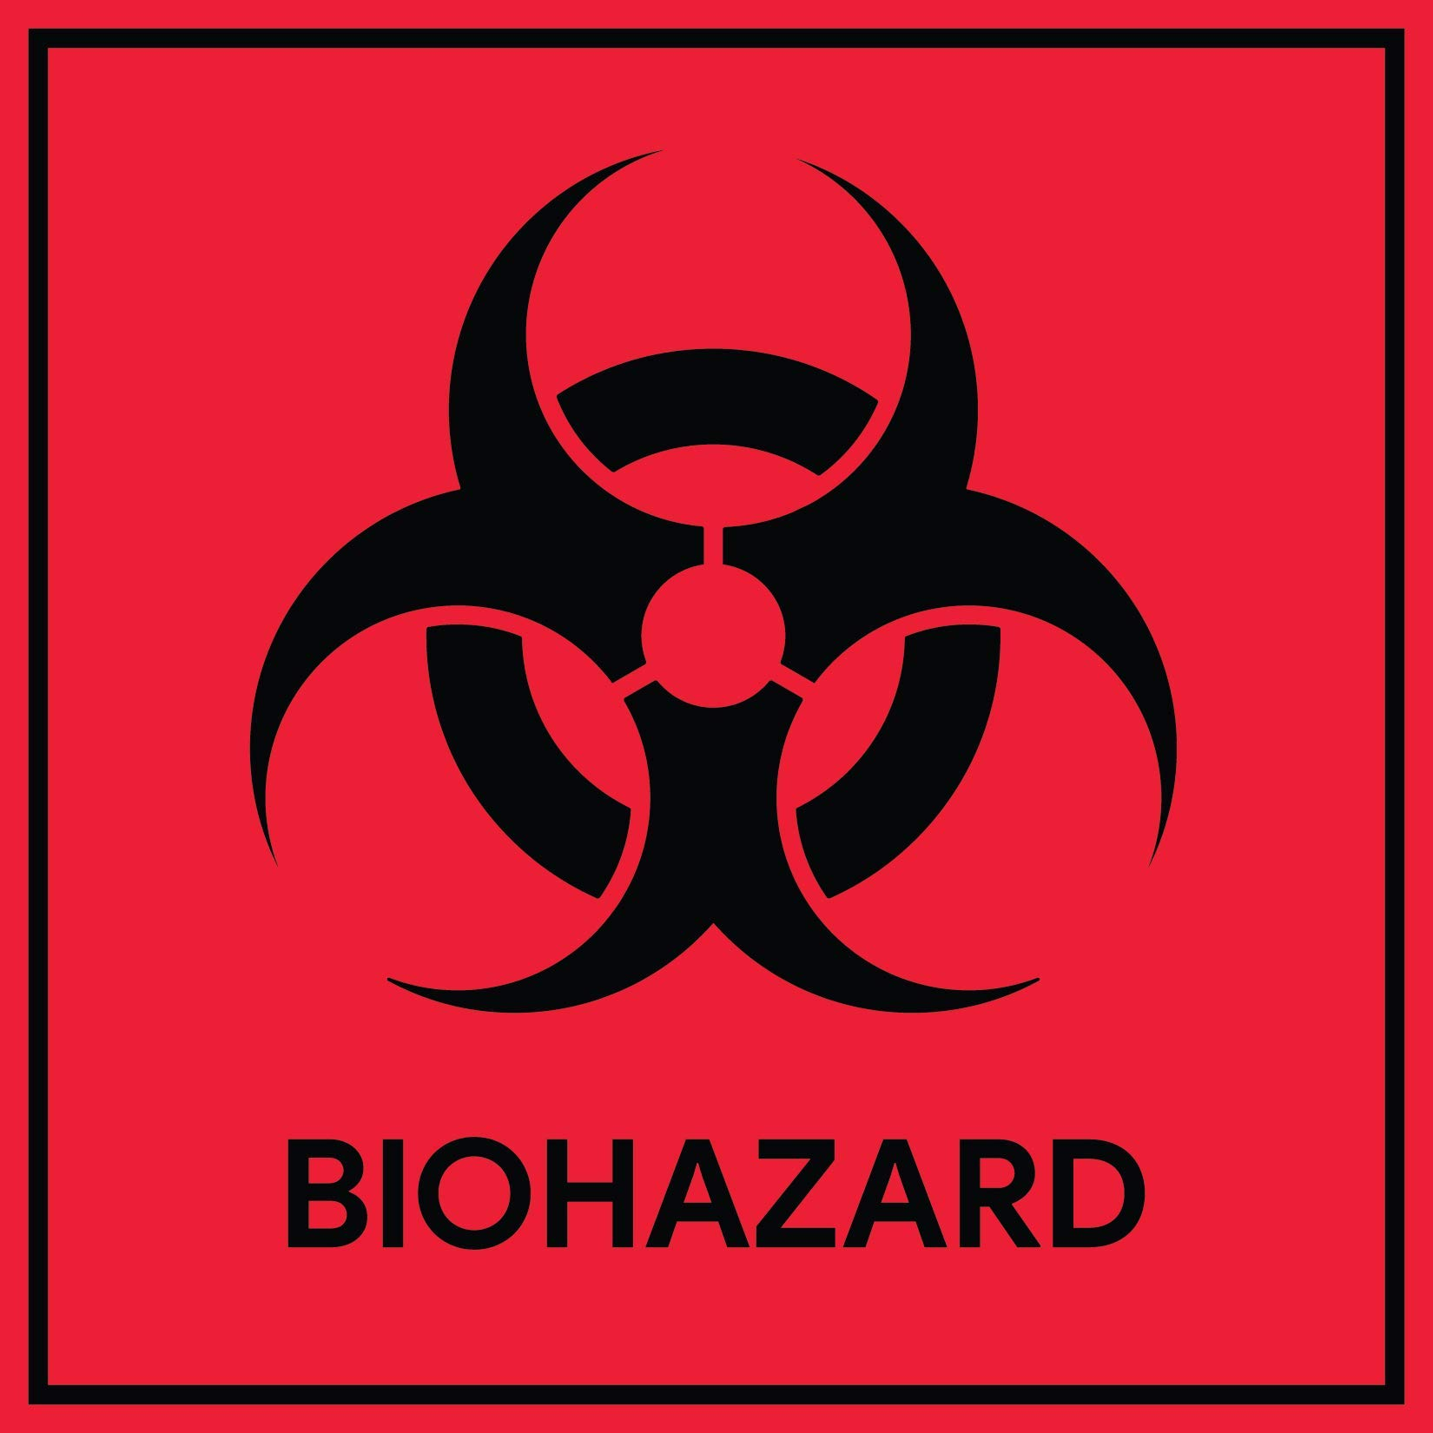



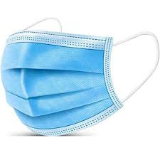

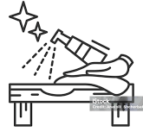
Universal Safety precautions (not exhaustive)
Adapt according to the guidelines in your country
All specimens and materials that you come in contact with should be treated as infectious
Protect yourself and others:
Restcited access into the testing zone
Never eat, drink, smoke in the testing zone
Wear Protective Personal Equipement (PPE)
Desinfect work surfaces
Hand hygiena

Slide 8
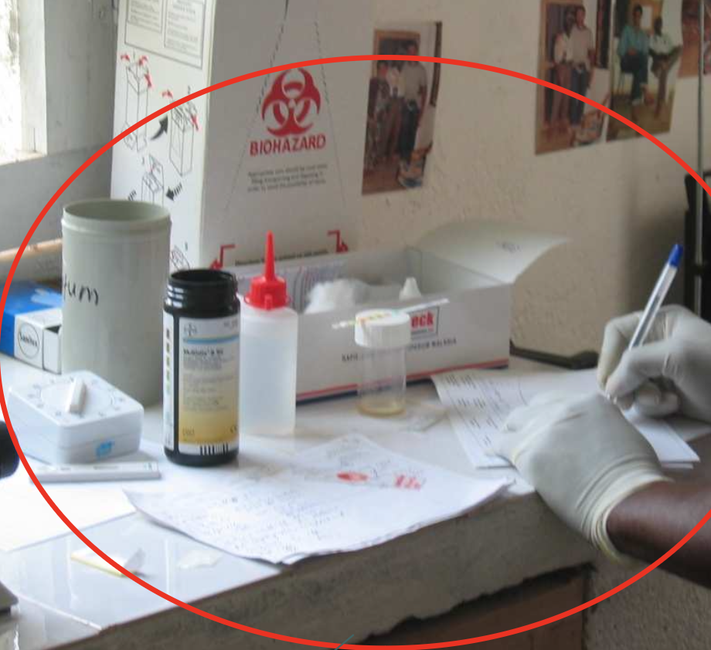


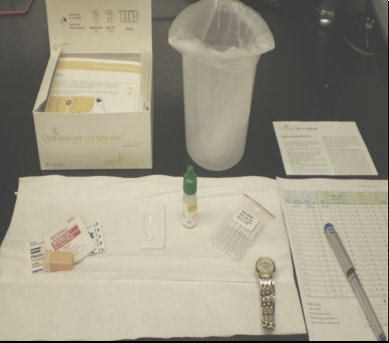


Maintain clean and orderly workspace
Cluttered workplace
Keep work areas uncluttered and clean
Disinfect work surfaces daily
Organized workplace
Restrict or limit access when working
Keep supplies locked in a safe and secure area

Slide 9


Organised Workstation setup
Don’t forget good lighting
Supplies
infectious, Sharp containers and cleaning solutions
RDT
Timer
Gloves
consumables
Register/Logbook
Testing done here
(place a diaper or similar absorbent material)

Slide 10
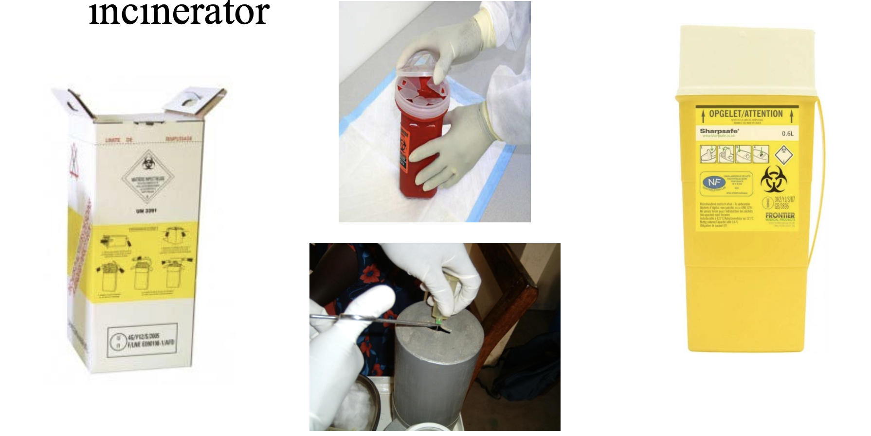
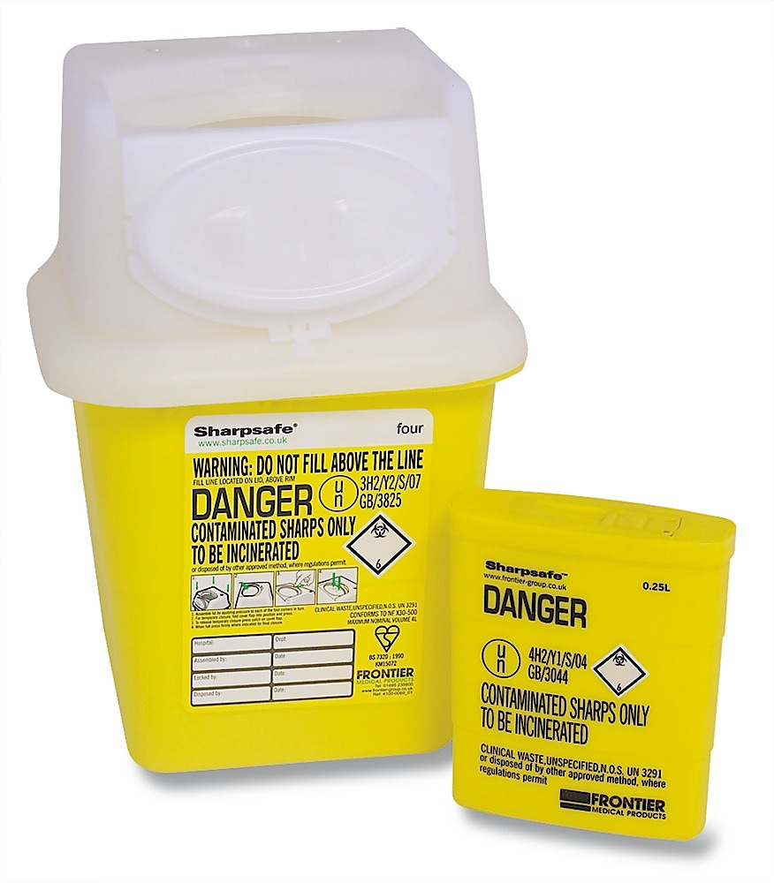
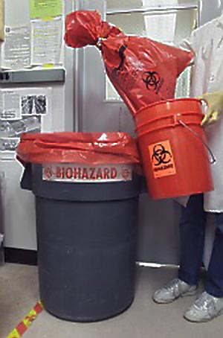
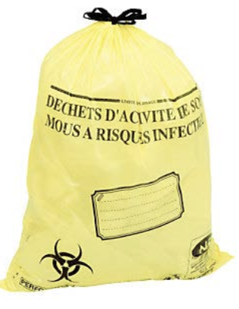
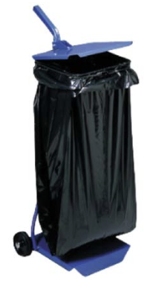
Waste Management (1/3): segregation
Waste disposal methods are specific to type of waste (liquid, solid, sharp, infectious material, chemicals…) and risk of injury, contamination.
Type of Waste | Disposal Method | Requirements
Sharps | Sharps Container- With “Biohazard” sign | Labelled puncture and leak proof containers, sealed when ¾ full and incinerated or in sharp pit. Do not shake!
Infectious | Bin liners color code: red or yellow with « biohazard » sign | Waste segregation, color coded bin liners labeled with biohazard sign, sealed and inciderated when ¾ full
Non-Infectious | Bin liners- Color coded green or black | Waste segregation, without biohazard sign, sealed when ¾ full and incinerated
Identify the risks

Slide 11
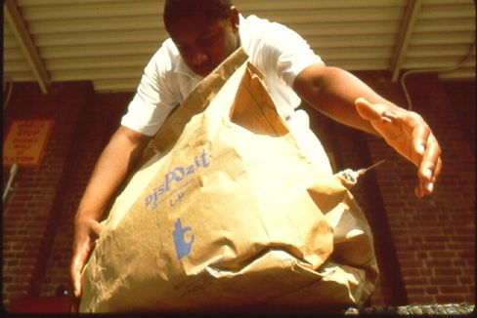

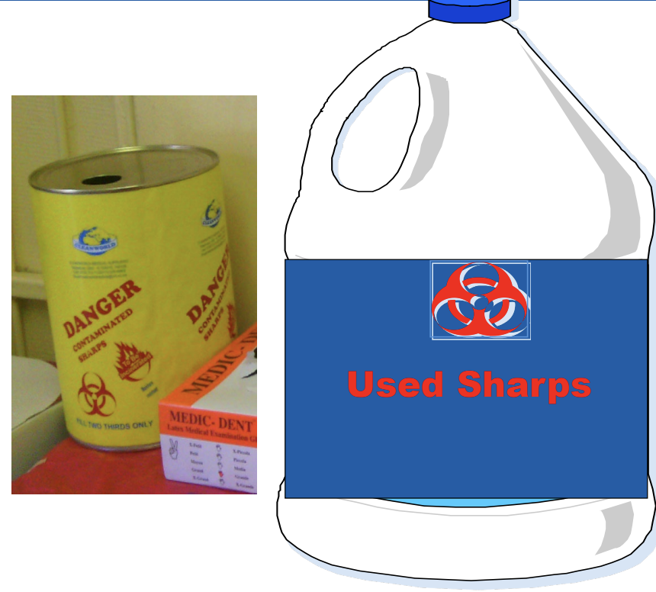
Waste management (2/3): Discard used lancets and any sharp material in special containers
Place the sharp container near the workspace
Dispose of lancet directly after use in the sharp container; never re-use a lancet
Always close when not in use
Never shake sharp containers to make space
Discard when the sharp container is ¾ full

Slide 12
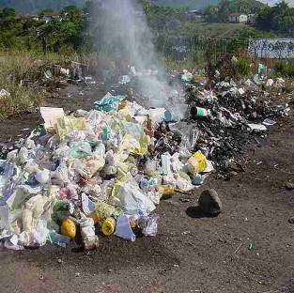
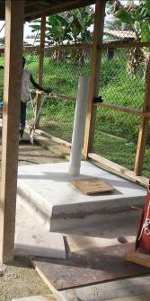
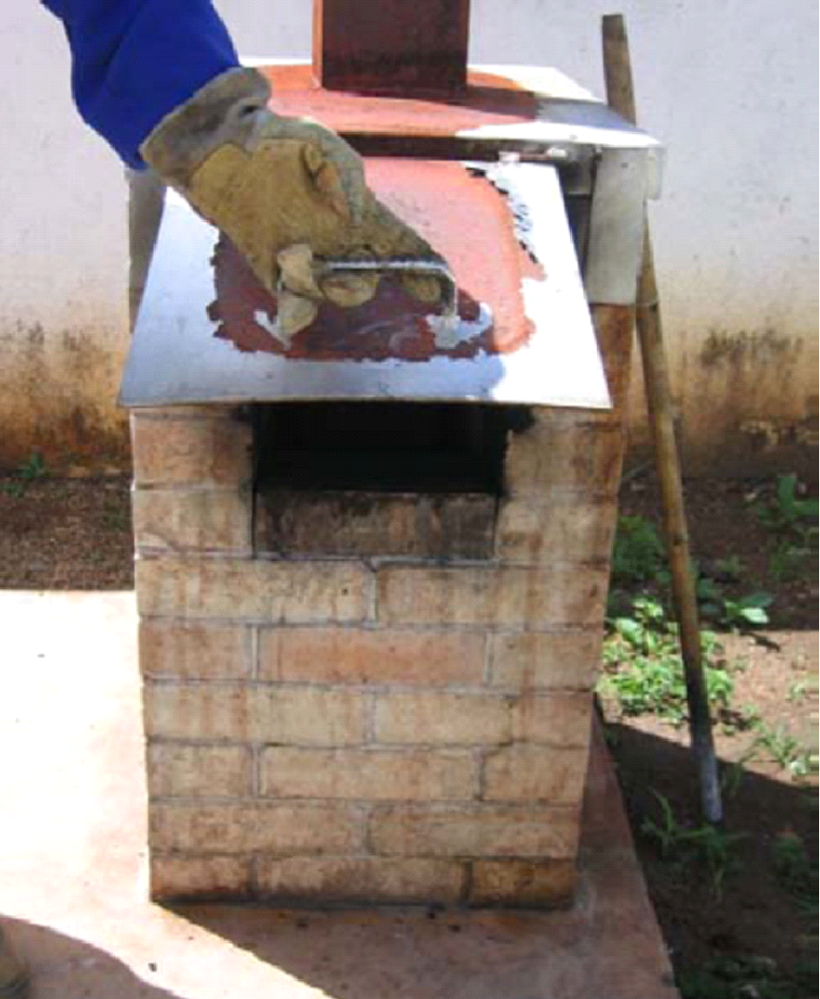
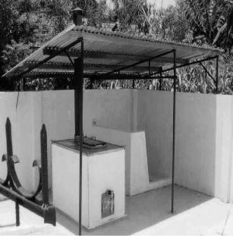
Waste Management (3/3)- after disposal
Adapt according to the guidelines in your country
After disposal, waste containers can be incinerated autoclave or disposed in a sharp pit (sharp containers)
Incineration is the burning of contaminated waste to destroy and kill microorganisms.
Incineration:
–Prevents re-use
–Protects environment
–Must be conducted by authorized institutions
Be aware of what is done with your waste
incinerators
Sharp pit
¹ Laboratory biosafety manual. 4th edition. Geneva: World Health Organization; 2021 (https://www.who.int/publications/i/item/9789240011311).

Slide 13
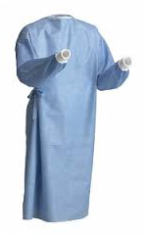
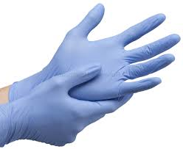
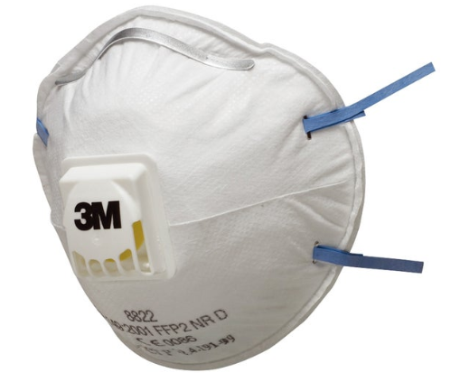
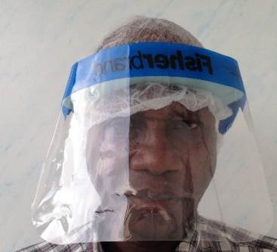
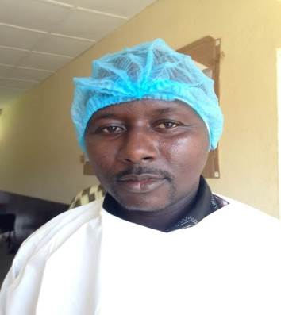
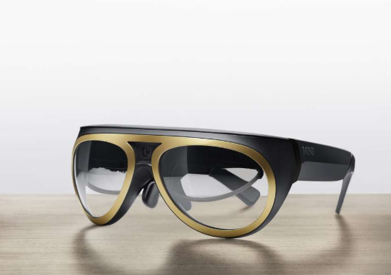
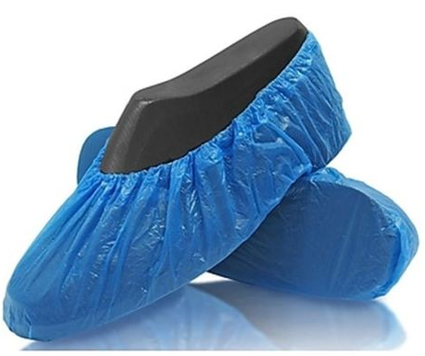
Use appropriate PPE during sample collection and testing
Put on appropriate Personal Protective Equipment (PPE)
PPE is always specific to the define risk (including biohazard), route of exposure (blood, aerosol …) and procedure
Eg: covid-19 PPE ≠ Ebola PPE ≠ HIV PPE
Adapt according to the guidelines in your country
Procedure | Infectious agent | PPE
Sample collection (lancet, needle) and testing | HIV | Non-sterile gloves Lab coat or gown
Sample collection and testing | Covid-19 | Non-sterile gloves; single-use only Gown Medical mask
Lab coat or gown
Mask
Visor
Gloves
Cap
Glasses
Overshoes

Slide 14
Cleaning and disinfection of workstation (1/3)
Adapt according to the guidelines in your country
Workstation must be washable and support disinfection:
Cleaning: removes germs, dirt and impurities from surfaces (using water, soap and scrubbing)
Disinfection:
  Kills germs and pathogens
  Keeps work surface clean
  Prevents cross-contamination
  Reduces risks of infection
Always clean before desinfection
Differents solutions can be used: Bleach/chlorine solutions, surfanios….
Different concentrations must be used depending on:
what needs to be cleaned/desinfect (general cleaning, spills…),
Infectious agents risk (eg: HIV vs Ebola vs Covid vs TB..)
Identify the risks

Slide 15
Cleaning and disinfection (2/3): Bleach dilutions for HIV, HepB, HepC, syphilis, and Malaria testing sites
Adapt according to the guidelines in your country
For damp dusting/general cleaning, prepare a 0.01% bleach solution (100ppm) by adding 1 part 0.05% bleach plus nine parts water.
For general disinfection purposes, use 0.05% bleach solution (1 part bleach + 99 parts water), i.e., 1:100 bleach solution.
Make a 0.05% bleach (500 ppm) solution by adding 1 part of 5% stock household bleach plus 99 parts water.
For spills use 0.5% bleach solution (1 part bleach and 9 parts water).
The larger the spill is, the longer the contact time with 0.5% bleach solution.
You must prepare 0.5% (5 000ppm) bleach when a spill occurs at your test site (not in advance).
Availability of already prepared kit for handling spills are useful
  The container must be labeled with:
  Content
  Date of preparation
  Name of the person who prepared the solution
  Prepare bleach fresh daily.
  Opened stock is stable for up to 30 days.
Household Bleach
Source: https://iris.who.int/bitstream/handle/10665/332096/WHO-2019-nCoV-Disinfection-2020.1-eng.pdf https://www.cdc.gov/hygiene/about/cleaning-and-disinfecting-with-bleach.html

Slide 16
Cleaning and disinfection (3/3): Procedure for managing spills of blood and body fluids
Adapt according to the guidelines in your country
Standard precautions
– Put personal protective equipment (PPE): at least gloves and gown
– Prepare 0,5% (1:10 dilution) of household bleach solution
Spills on the floor
– Clear up spills before the area is cleaned
– Avoid adding cleaning liquids to spills (increases size of spill)
– Cover the spill with paper towels and soak with 1:10 dilution (0,5% bleach solution) of bleach solution
– Allow to stand for at least 15 minutes
– Discard contaminated towels in infectious waste containers

Slide 17
What can cause needle, lancet stick injury / exposure to blood ?
Lack of concentration
Inexperience
Improper disposal of sharps
Lack of concern for others
Inadequate PPE
No respect of procedures

Slide 18
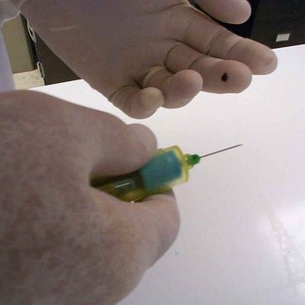
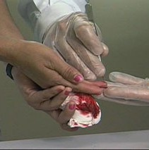
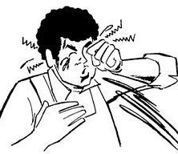
Routes of infection in the testing site and Occupational Exposure to Blood
Needle, lancet stick
Percutaneous:
•Needle, lancet or any other sharp items
•Injuries, abrasions from contaminated sharp objects
Other sharp injuries
•Pouring infected biological fluid onto damaged skin
Mucous membranes: conjunctivas, nostrils,
splaches
•Splashing from contaminated liquids
•Hands or objects soiled on a mucous membrane

Slide 19
Immediate Steps Taken by Exposed Healthcare Worker?
Adapt according to the guidelines in your country
Exposure to eyes or nose
Sharps Injury
Assess and take action
  Flush exposed mucous membranes with water only
  If bleeding occurs, allow bleeding for a few seconds before washing
    Flush the area well in clean running water and wash thoroughly with soap
  Do not apply bleach, antiseptics, or disinfectants to the wound
  Cover with dressing if necessary
Identify the risks
Report to supervisor immediately
Record on standard form
Immediately inform the supervisor of exposure and action taken
Discuss your PEP (Post exposure Prophylaxis) options

Slide 20
HIV Post Exposure Prophilaxy (PEP)- WHO 2024 recommendations
Start early - PEP should be offered, and as early as possible, to individuals with suspected or known exposure to HIV, ideally within 24 hours but not later than 72 hours.
The crucial factor that influences PEP efficacy is the time between exposure and starting PEP drugs and starting as soon as possible after exposure is the most important consideration when taking PEP.
PEP duration: A 28-day prescription of antiretroviral drugs should be provided for HIV post-exposure prophylaxis following initial risk assessment. (Strong recommendation, low-quality evidence)
HIV PEP should be delivered in community settings. (strong recommendation, very low certainty of evidence)
After completion of the 28 days PEP regimen, HIV serological status should be assessed using nationally validated HIV testing strategy
In case of occupational exposure to blood= inform immediately to have access to a risk assessment and PEP regimen (if needed) ASAP and within 72 hours maximum post exposure
Source: https://www.who.int/publications/i/item/9789240095137
QMS in Non-lab testing site –Training Package– v1.0| Testing Environment, Safety, and IPC measures

Slide 21
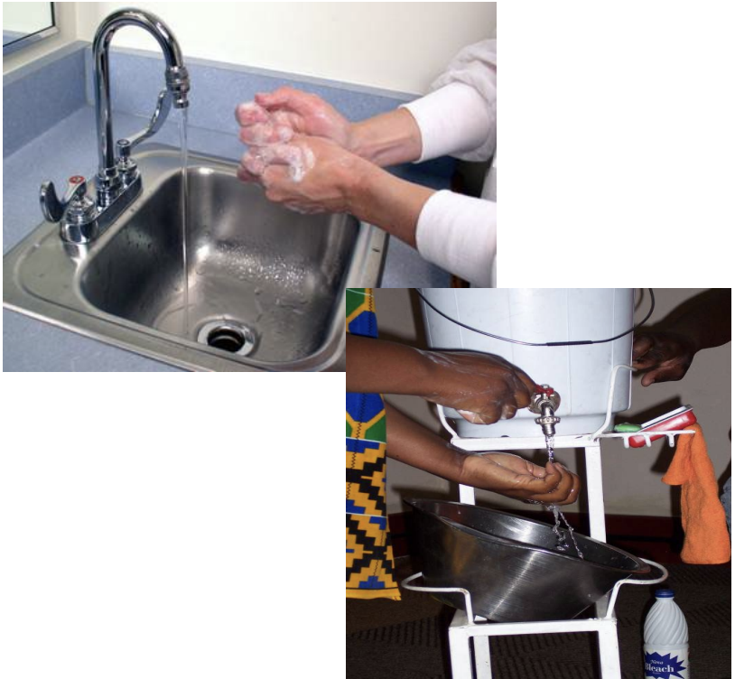
Summary/ safe work habits: When working with RDTs, you should:
Adapt according to the guidelines in your country
Clean and organize your working station
Be trained on the procedures (SOPs)
Wear adequate PPE: at least gloves + lab coat (or gown)
Never eat, drink, smoke, apply make-up, put pencils/pens in your mouth, remove or insert contact lenses while testing
Wash hands before and after each client
Change gloves for each client
Discard disposable equipment after use. Lab coats should be re-used following proper cleaning and decontamination.
Always perform hand hygiene before and after using gloves.
Remove PPE and wash your hands before leaving the workstation
Know the procedures in case of an exposure accident
Identify the risks

Slide 22
Summary/ Waste management: When working with RDTs, you should:
Adapt according to the guidelines in your country
All components of RDTs are single-use and must not be reused.
Place all sharps material (lancet, needle) in a specific safety box
Place all potentially contaminated materials (such as used sample containers, used extraction tubes, transfer pipettes, and used test cassettes) in a biohazard bag.
At the end of the day, seal the biohazard bag and follow your facility’s guidelines for biohazardous waste disposal.

Slide 23
Summary/ Waste management: : while testing in the community, you should:
Adapt according to the guidelines in your country
Take enough biohazard bags when going to perform testing in the community.
Take a safety box for sharp material
Place all potentially contaminated materials (such as used sample extraction tubes, transfer pipettes and used test cassettes) in a biohazard bag and seal the bag.
Use a new (unused) biohazard bag for waste disposal at different locations in the community.
Disposed of the sealed biohazard bags in the health facility for further management.

Slide 24
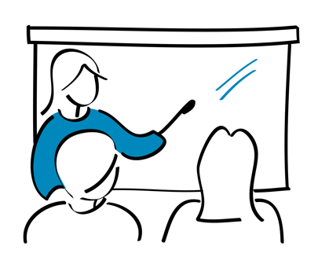
Questions?

