Slide 1

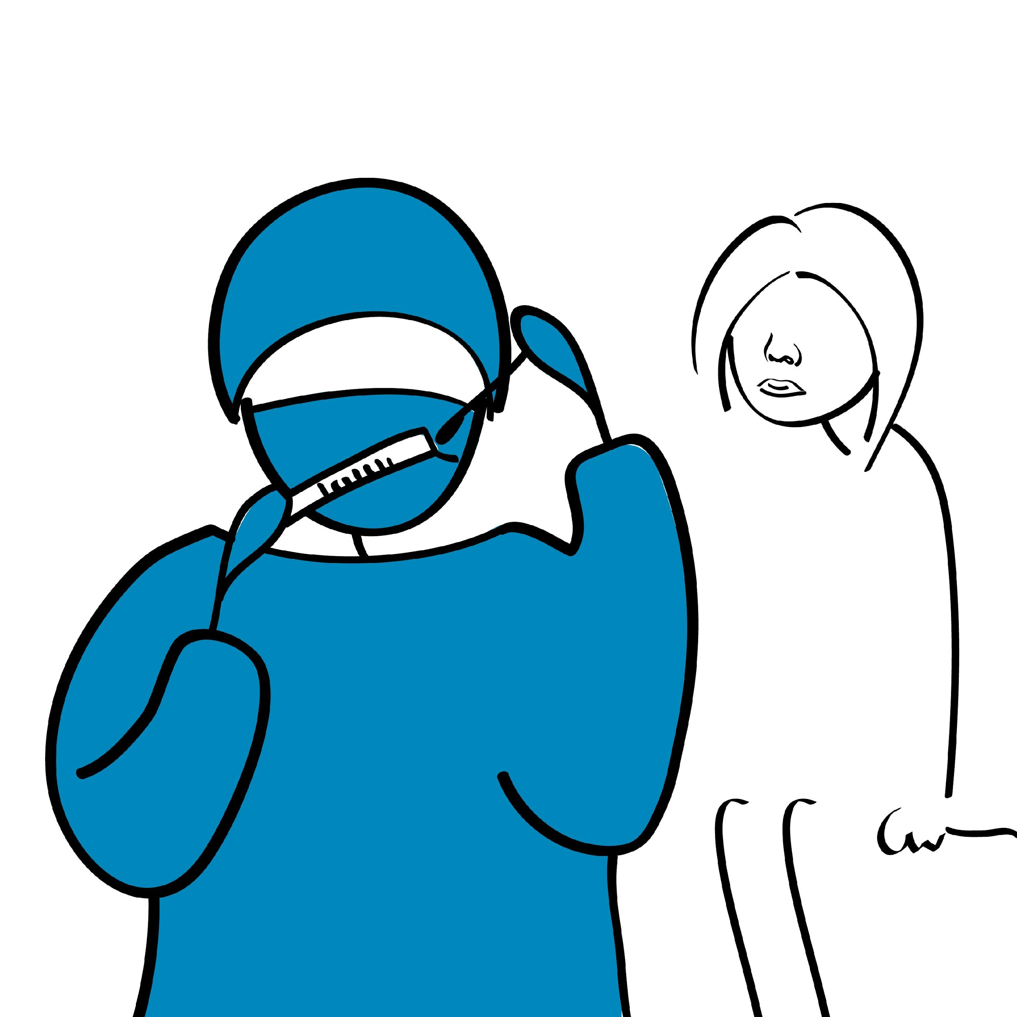
4
Testing procedure and interpreting the results using the IFU and SOP/bench aids

Slide 2
Learning objectives
At the end of this module, you should be able to:
Know the different steps of the testing process
Understand what are RDTs
Know what is needed to perform the testing procedure
Understand the importance of adequate RDT storage conditions and know where to find the information
Understand the importance of IFU, SOP, and bench aid and know what information is included in those
Know how to perform the finger prick procedure
Know how to perform RDT procedure
Know the main cause of errors

Slide 3
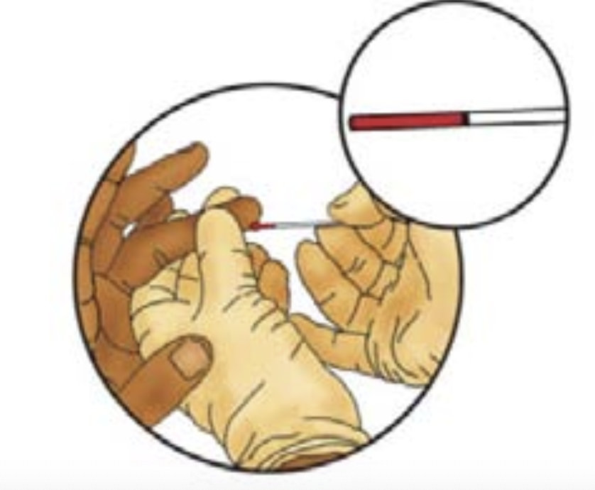
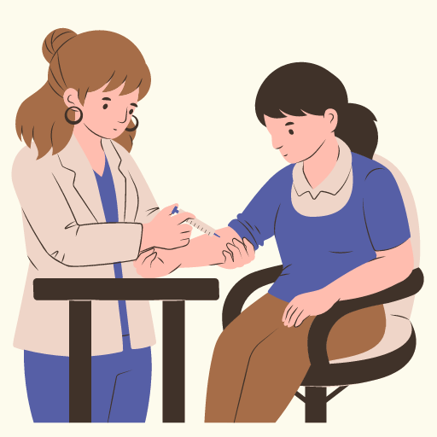

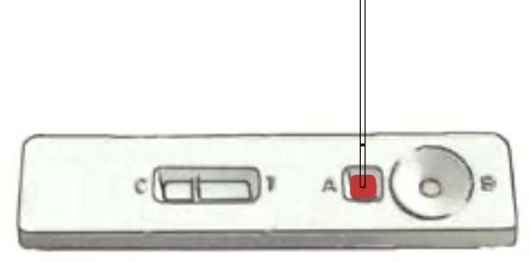


Testing process
Remember: Testing = 3 phases
Pre-analytical
Sample collection, storage, transport, handling, labeling…
Analytical
Test procedure (RDTs)
Post-analytical
Report final result, record results

Slide 4
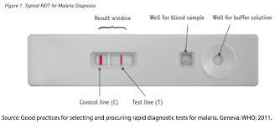
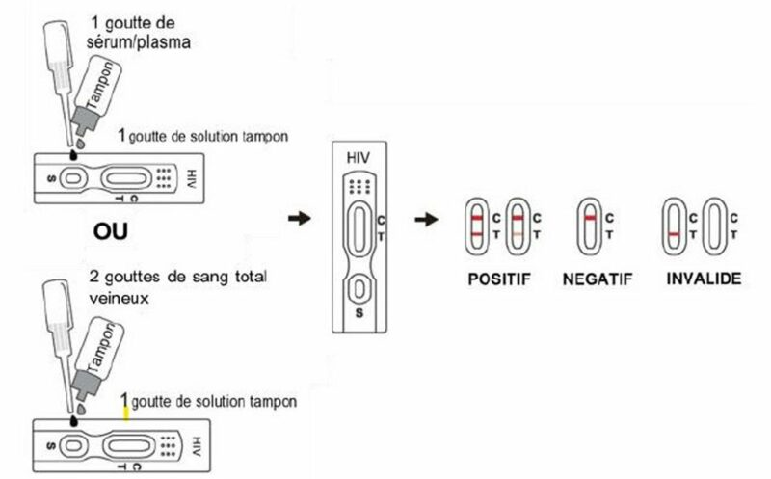
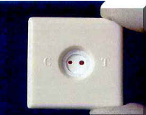
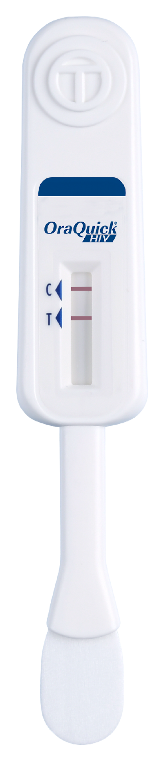
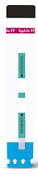
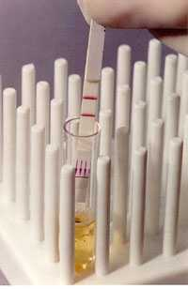
What are RDTs?
RDTs: Different formats, different samples but the same principle
RDTs are single-used serological tests (antibodies/antigens tests) easy to perform and aim to diagnose the cause of an infection quickly (within a few minutes)
Serological test: identify directly or indirectly if a person has a specific disease
Antigen test: detect directly the pathogen (eg: viral protein, toxin)
Antibody test: detect antibodies produced by the immune response to an antigen (indirect)
RDTs do not require any equipment or electricity
Most RDTs can be performed using capillary whole blood samples collected by a finger-stick, some are validated on urine or oral fluid.
With training and supervision, RDTs can be used in laboratory and non-laboratory settings including community.

Slide 5
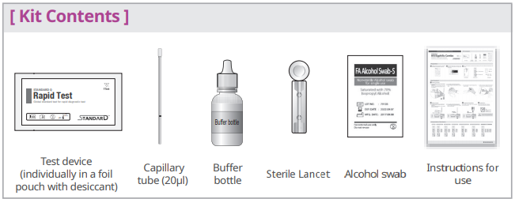
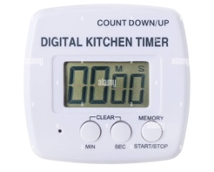
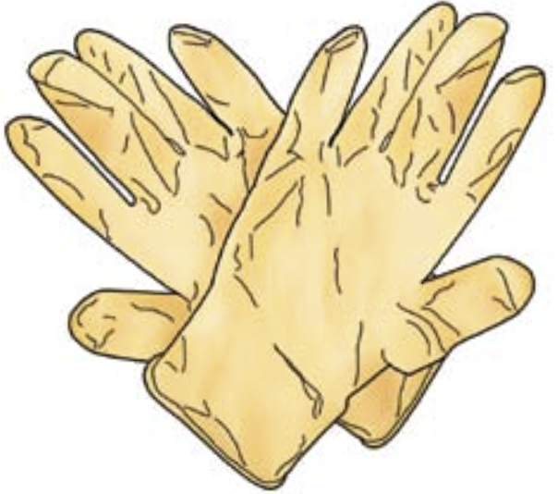
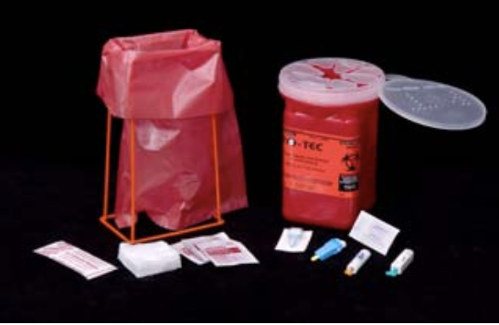
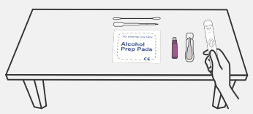

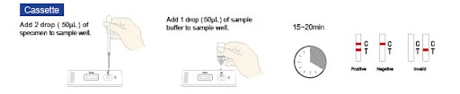
What do you need to perform an RDT?
All material and consumables to do the entire procedure: from sample collection to result interpretation
PPE material
Adequate space and lighting:
IFU, SOPs and bench aids for reference

Slide 6
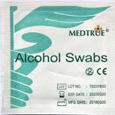
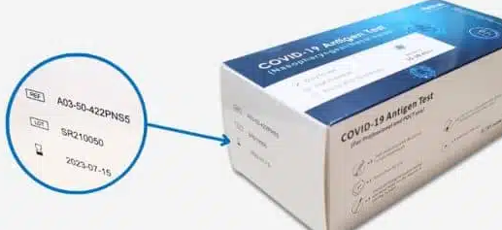
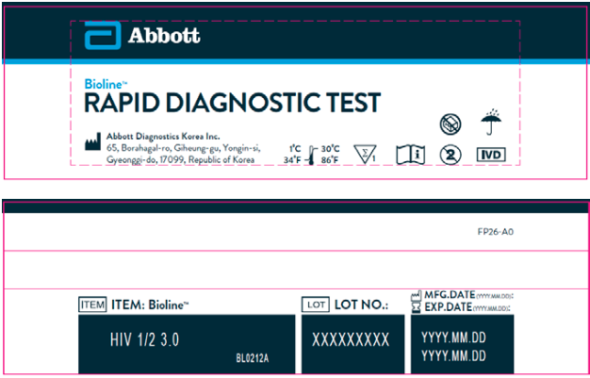
RDTs storage conditions and shelf life
Good storage conditions are critical to ensure quality of testing – indicated in the IFU and on each box.
Appropriate storage conditions are indicated on each box: protected from direct sunlight and humidity.
Expiration date is indicated on each box and on each component (cassettes, strips, lancet, buffer…)
Appropriate storage and use temperature, depend on the test, e.g.:
from 1 to 40°C
from 8 to 30°C (no fridge, AC needed?)
from 1 to 27°C (AC needed?)….
Buffer stable until expiration if properly closed between 2 uses
Never use expired or damaged items

Slide 7
Instructions For Use (IFU)
A critical document, contains all necessary information, in different languages, about the test kit and its use:
The intended use of the test
Principle of test
Material provided,
Material required but not provided
Storage requirements
Safety and handling precautions
Specimen type (capillary blood, oral fluid, venous whole blood, serum, plasma)
Test procedure: from sample collection to result interpretation
Test Limitations
….
Information are used to develop SOPs and Bench aids but changes can happen anytime. Important to check
The manufacturer must include any product changes in the IFU: Important to check the IFU for every new batch of tests.

Slide 8
Standard Operating Procedure (SOP)
SOP: standardized and validated written document describing each step to perform a procedure
SOP are specific to each procedure: 1 procedure=1 SOP
Each Sample type collection procedure
Each Test procedure
Hygiene and safety
SOP should be reviewed once a year by testing site supervisor/QA officer
IFUs serve as a reference to develop the SOP: IFUs information is tailored to the testing site context in the SOP
Contain (eg RDT procedure):
The intended use of the test
Principle of test
Material needed to perform the test
Storage requirements
Safety and handling precautions
Specimen type (capillary blood, oral fluid, venous whole blood, serum, plasma)
Test procedure
Test Limitations
QC procedures

Slide 9
Bench aids
Bench Aids: a standardized and validated written document describing each step to perform a procedure
Bench aids are specific to each procedure: 1 procedure bench aids
Bench aids should be reviewed once/year
Bench aid =Summarized version of the SOP:
One page document
Easily accessible (eg: fixed on the wall)
Highlighting critical steps
Contain Picture/ image

Slide 10
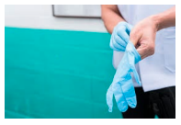
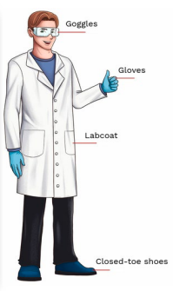
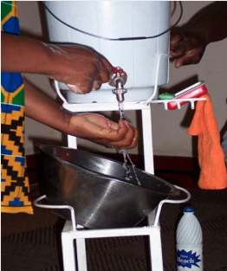
Sample collection- capillary blood sample from finger prick (1/2)
Accurate result needs an adequate sample = good sample, correct quantity, collected, transported, and stored properly
A specific sample collection SOP should be available
Universal precaution (PPE) will depend on the identified risks (see hygiene and safety)
Inform your client:
Identify your client (ID number)
Explain the sample collection procedure
Explain what test will be performed
Verify client consent for the procedure and test
Gather all necessary material
Change gloves
Wash hands

Slide 11
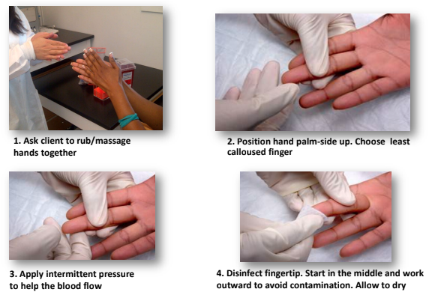
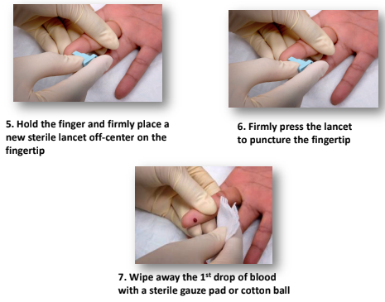
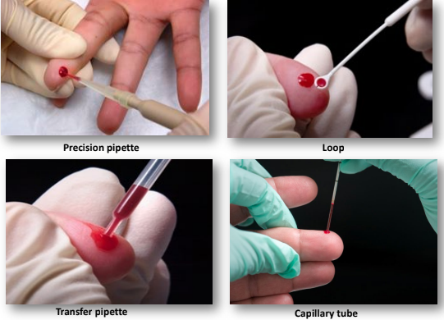
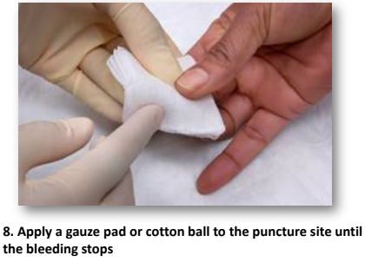
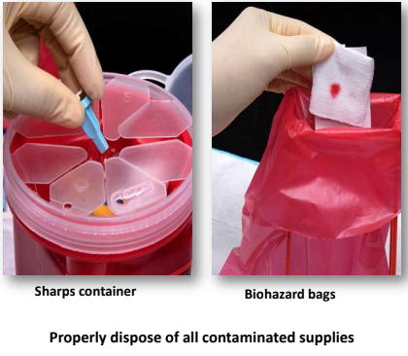
Sample collection- capillary blood sample from finger prick (2/2)
Collection of the sample: depend on collection device

Slide 12

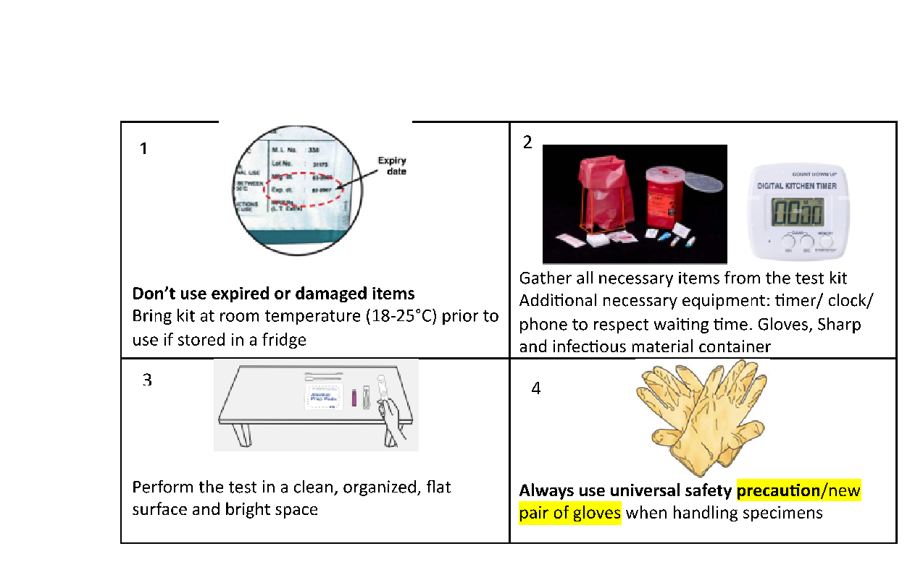

Generic RDTs procedure (1/5)
To check before performing the test:
Don’t use expired or damaged items

Slide 13
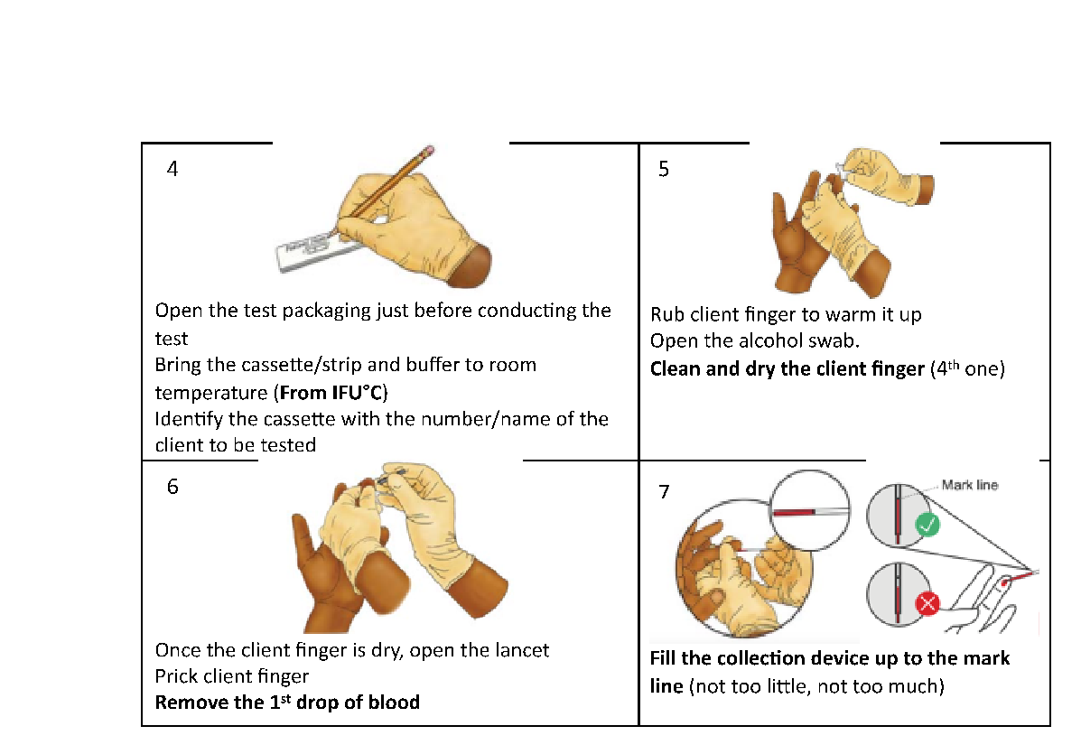
Generic RDTs procedure (2/5)
Identify test cassette/strip, collec blood
- Collect the adequate amount of blood: not too little, not too much
- Remove the 1st drop of blood

Slide 14
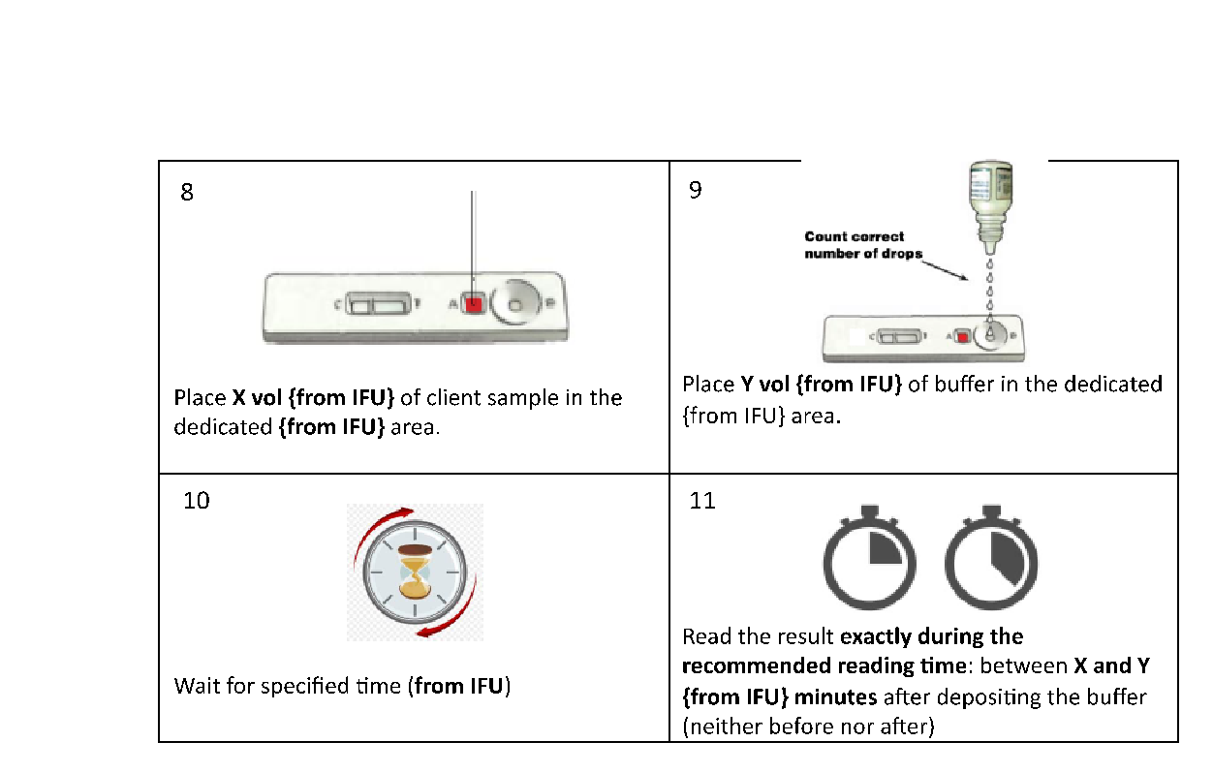
Generic RDTs procedure (3/5)
For any pathologies that national/international recommendations require more than one test to confirm the disease, make sure that the algorithm is respected before dissemination of the final results
Conduct the test
Apply proper volume of sample
Apply proper volume of buffer
Buffer cannot be exchanged between test
read result exactly during the recommended reading time

Slide 15
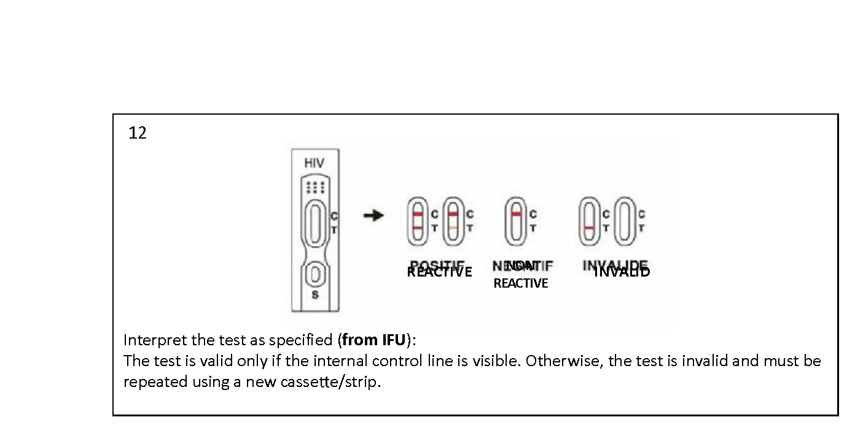
Generic RDTs procedure (4/5)
Interpret the test
control line visible = Test valid
No control line = test invalid = redo the test with another cassette/strip
« T » line visible = reactive result irrespective of its intensity (strong, very weak)
reactive
Non Reactive
Invalid

Slide 16
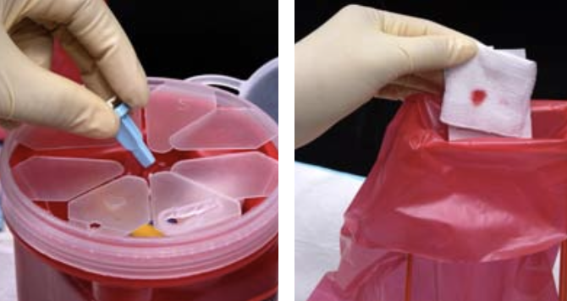
Generic RDTs procedure (5/5)
Record results in the result form and register
Inform the client about the result and provide post-test messages
Discard sharp and infectious material in an appropriate container
- Each result needs to be recorded in the testing site register/log book
- Refer client to appropriate services (treatment, prevention…)

Slide 17
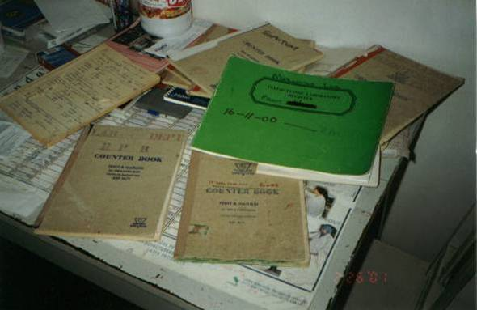
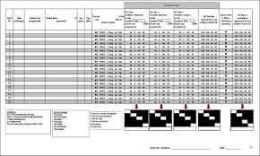
Post-analytical phase: what to do after testing?
Do not forget to fill out the specific registers and respect procedures to disseminate the results and refer clients for consultation or potential treatment
Referring the client to the care unit or prevention unit based on test results
Registration and use of result forms
Write the following information on the resulting form:
Test name/Batch number and Expiration date
Sample/client identifier (code)
Test date and Final result
Name and identification and tester and site supervisor

Slide 18
Main causes of incorrect results
Good procedure not known
Use of expired or damaged items
Improper storage conditions
Miss identification of the client versus sample versus test strip/cassette versus result form
Inappropriate specimen type
Improper quantity of specimen
Inappropriate buffer
Improper quantity of buffer: Do not shake buffer/reagents bottles, Hold the bottle vertically and ensure that its tip does not touch the deposit area
No respect for the reading time
Miss interpretation: faint/weak line considered as negative

Slide 19
Questions? Then practical exercise

Slide 20
Practical exercise
1er part: Practical (90 min)
3 groups / 2-3 people (organise rotation for each person to conduct testing):
1 uses the test(s)
1 uses the check-list
(1 observer)
Each group gets the required material for:
Group1: HIV testing (using the national testing strategy)
Group 2: Malaria Ag P.f
Groupe : Syphilis
Each group perform the entire testing process: test(s), interpretation of final result and fill the reporting file (register, result form)
2nd part: Restitution (30 min)
DBF participants
Identification of the critical steps in the tests use and main sources of errors

