Slide 1

05
Supply chain and inventory management at testing site level

Slide 2
Learning objectives
At the end of this module, you should be able to:
  Identify the principles and importance of good supply chain management
  Identify and implement adequate storage conditions
  Define testing site needs
  Define order parameters: Average Monthly Consumption, Buffer and alert stock, lead time…
  Calculate quantity to order
  Describe how to inspect the delivery of supplies before acceptance
  Know good inventory practices and procedure

Slide 3
What is good supply chain management?
When you have all the needed tests, materials, equipments, and consumables when you need them:
No stock rupture
No overstock, no expired items
Stock available to cover X (to be decided by country) months of activities + Buffer stock (to cover activity in case of any issue)
Appropriate storage conditions (appropriate humidity, temperature, and space)
Ensures availability what is needed, when needed
Minimizes wastage and stock out
ensures good storage conditions
Proper Supply chain management = Uninterrupted testing

Slide 4
Who is responsible for supply chain management?
In the testing site:
  Testing provider: identify needs, store items adequately, fill stock cards, and prepare the order
  Site pharmacist/store manager receives orders, organizes the store, delivers items to different testing points, performs inventories
  Site supervisor oversees the storage conditions, consumption, and ordering
At the district and central level, a designated person gathers all the orders, analyzes the consumption, and authorizes the delivery from the central warehouse.
Need to train the staff at different levels on «supply chain management», know the supply chain process, and how to place orders.

Slide 5
To implement good supply chain management, you need to know:
What do you need?
  What? specifications for commodities ¹
  How much? What is your average monthly consumption (AMC), Buffer and Alert stocks
  For how long?
What are the appropriate storage conditions for each item?
Where and how to store? sufficient storage capacity?
When was the last order?
What and how much was ordered?
When did this order arrive? Was the order complete?
How much of the received stock has been consumed?
What is your available stock (stock balance) for each item and each lot number?
How many months of activities does this stock cover?
When to order?
How much to order?
What is the supply time?
^{1.} Only use tests approved in your country. Ensure that country requirements for sample collection swabs, disinfectants and PPE are followed. Only obtain supplies from reputable suppliers.

Slide 6
Supply chain and inventory tasks
Identify and update your needs: Develop, update, and submit a list of needs to management
Ensure proper storage conditions and good cycling of stock
Manage inventory: Perform regular inventory, maintain proper records and analyse data
Calculate monthly consumption, buffer stock and alert stocks
Decide when, what, and quantity to re-order
Inspect incoming orders

Slide 7
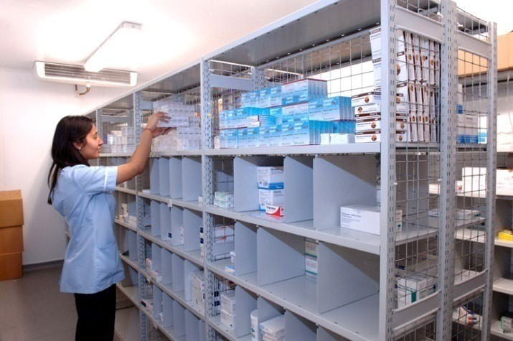
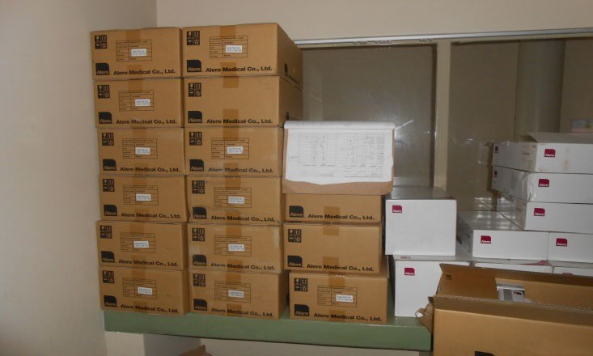
Ensuring proper storage conditions and good cycling - store rooms
Place items on shelves
Organize existing and new shipments by expiry dates
Keep the storeroom clean, organized, and locked
Store according to manufacturers’ instructions (e.g., 2–30°C)
Keep temperature record
Store items away from direct sunlight
Stored items away from humidity
discuss with your logistic team any improvements needed (shelves, high temperature…)
Storerooms

Slide 8
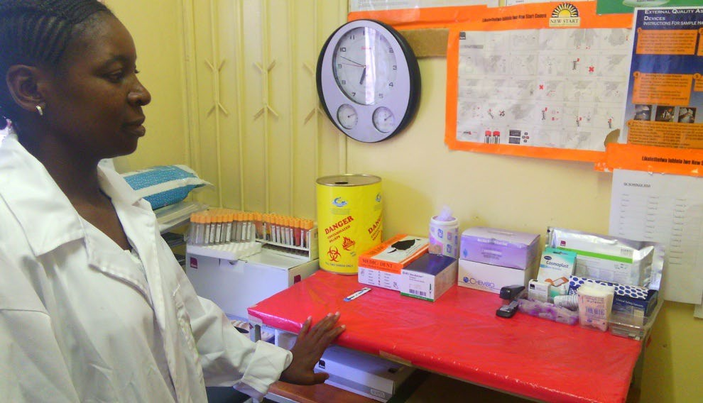
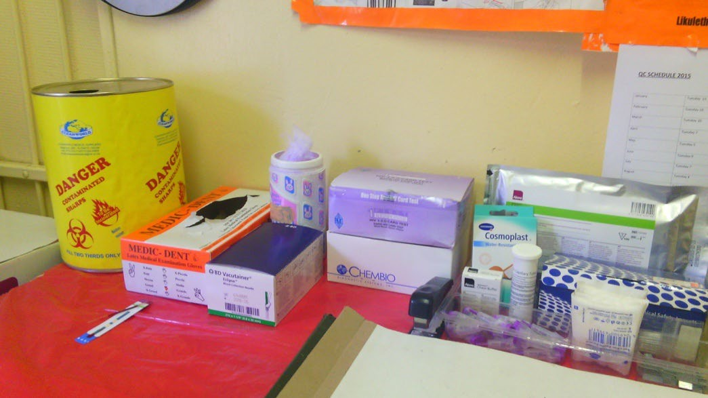
Ensuring proper storage conditions and good cycling- Testing areas
Label all supplies with the date received and the date first opened
Rotate stock using “first expired, first out” to ensure that expired reagents are not used
Expired reagents should be separated, marked as "Expired − Do not use", and then discarded according to the manufacturer's instructions
Store according to manufacturers’ instructions (e.g., 2–30°C)
Store items away from direct sunlight and humidity
Identify adequate testing site stock levels based on workload, storage capacity, supply availability, and frequency of re-supply
Testing area

Slide 9
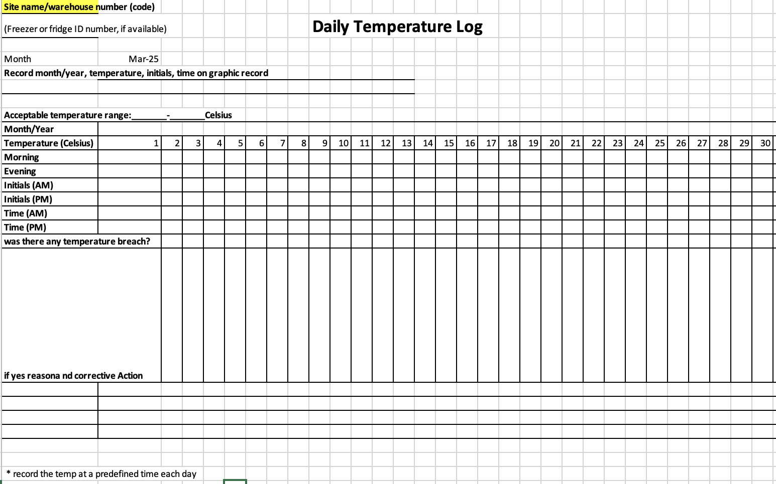
Ensure proper storage conditions according to manufacturer’s requirements
Many reagents must be kept at « room temperature » under 25°C -30°C (instruction on the packaging)
Equipment (fridges, analyzers…) do not work well if the temperature is too hot.
Must know each items appropriate storage conditions (temperature, humidity)
Must implement those conditions in collaboration with logistics and pharmacy teams:
Must have the tools: thermometer, 3M card, tags...
Must monitor: Temperature log (morning and evening)
Define responsibilities:
- Who is doing what?
- What to do in case of problems (temperature breaches)?
!!! And take action: inform/correct !!!

Slide 10
Inventory management- inventory book (1/3)
Implementing a inventory/stock book register (paper-based or electronic)
  A list of all items available - complete overview
  At least: exact name item, manufacturer and packaging
  Should be updated regularly and at least after a physical inventory
Item Number | CODE (Manufacturer Catalogue number) | ITEM (exact name) | Manufacturer name (exact name) | Packaging (Number of unit per box)
1 | XXXXX | Malaria RDT | XXX | 25
2 | YYYY | HIV RDT 1 | YYY | 100
3 | ZZZZ | gloves size M | ZZZ | 100
4
5
All items must be accounted for.
Everything that comes in and goes out must be recorded.

Slide 11
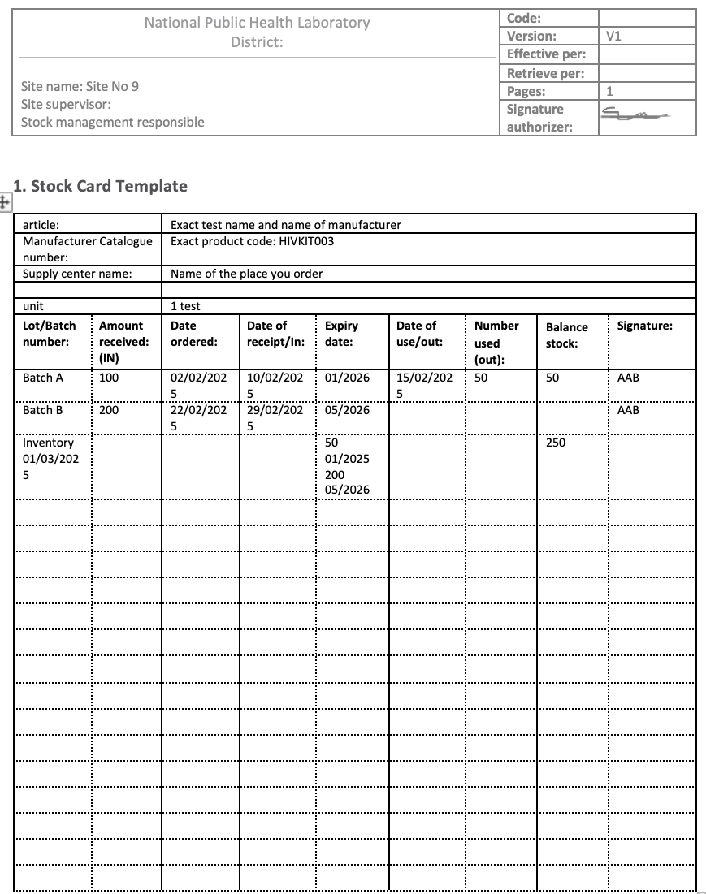
Inventory management (2/3) - stock card
Visually represent each item’s stock availability
Can be paper based or electronic):
  1 stock card per item In each stock location
  Each batch of each item should be included
  Should indicate:
    All movements (IN/OUT)
    Available stock
    Physical inventory value
Must be filled at every movement and when physical inventory is performed
All items must be accounted for.
Everything that comes in and goes out must be recorded.
QMS non-lab testing sites - training package – v1.0 | Supply chain management, Quantification and Inventory

Slide 12
Inventory management (3/3)- physical inventory
Perform regular physical inventory/ stock count: at least every 3 months AND before each order
CODE (Manufacturer Catalogue number) | ITEM (exact name) | Manufacturer name (exact name) | Quantity batch A | expiration date batch A | Quantity batch B | expiration date batch B | total stock available batch A (D) + batch B (F) | Average Monthly Consumption (AMC) of the stock point | Total months of stock available: stock available (H)/ AMC (I) | Next delivery planned (in month) | Risk of shortage before next delivery (Y/N) ? Number of months available (J) - next delivery (K) | Risk of over stock (expired item before use) (Y/N)
XXXXX | Malaria RDT | XXX | 1000 | 10/10/25 | 2000 | 01/01/2026 | 3000 | 500 | 6 | 5 | N | Y
YYYY | HIV RDT 1 | YYY | 600 | 30/1/2026 | 800 | 31/3/2026 | 1400 | 400 | 3.5 | 5 | Y | N
Analyse your stock data: theoretical stock (from stock cards) vs physical stock and investigate in case of discrepancy; identify risk of shortage and overstock
Take actions: immediate order, donnation, refresher training
CODE (Manufacturer Catalogue number) | ITEM (exact name) | manufacturer name (exact name) | physically stock (report physical iventory stock level) | theoritical stock (report stock card stock level) | difference physical stock and theoritical stock (D-E) | in case of difference, include reason for discrepency and action taken
XXXX | XXX |  | 100 | 100 | 0
YYYY | YYYY |  | 200 | 500 | 300 | Stock card not filled properly (value for OUT not included), refreshment on how to fill the stock card made, emergency order placed

Slide 13
Ordering process (1/3)
Adequate order = quantity to cover activity for a predefined period
Must avoid shortage and overstock (not used before expiration date)
Must follows known predefined timeline (monthly, quarterly, if alert stock reached…) and process (validated order form)
Storage capacity (cool and cold chain) should be in adequation with the predefined period to cover: is the storage capacity sufficient?
Information's mandatory to place an adequate order:
  List of all the required commodities for sample collection and testing
  What period the order will cover (P): 1 week, 1 month, 6 months?
  Delivery time (D): delays to receive the order when placed: 1 day, 1 week, 1 month, 6 months?
  Average Monthly Consumption (AMC): how many items are used in average in 1 months (calculate over representative period)
  What is the current stock (S) available? (from physical inventory)
  What should be buffer Stock (BS)? BS: quantity always available to cover an unexpected increase in activity and/or absorb a supply delay - context specific
  AMC = Average Monthly Consumption
  P: Period (months) of activity the order will cover
  BS = months of buffer stock
  D= delivery time
  S= Current Stock
Quantity = AMC x (P + D) + BS – S

Slide 14
Ordering process (2/3)
To place an order: Each site needs to know it's AMC, lead time, buffer stock and order frequency.
How to calculate:
Average Monthly Consumption (AMC) = Total Consumption over a Period​ / Number of Months
E.g.: syphilis test kits. M1: 522 tests; M2: 152 tests; M3: 96 tests
AMC = (522+152+96)/3=257 tests per month
Buffer stock= total consumption for a predefined period.
E.g. If the supply lead time is one month, BS should cover 1 month activity
Alert Stock Level = Average Monthly Consumption (AMC) * (Lead time) + Buffer Stock
E.g.: AMC= 257 tests; lead time= 3 months, BS=257 tests (1 month consumption)
Alert Stock= 257*3+ 257= 1028 tests. When the stock of syphilis tests each 1028, place an order without delay
When to place an order?
At pre-defined period
When the alert stock is reached
Alert stock: a pre-defined level of stock which triggers immediate order
To avoid stock rupture:
Monitor your stock regularly
Calculate your AMC
Define Buffer and alert stocks
Prepare and place order when needed

Slide 15
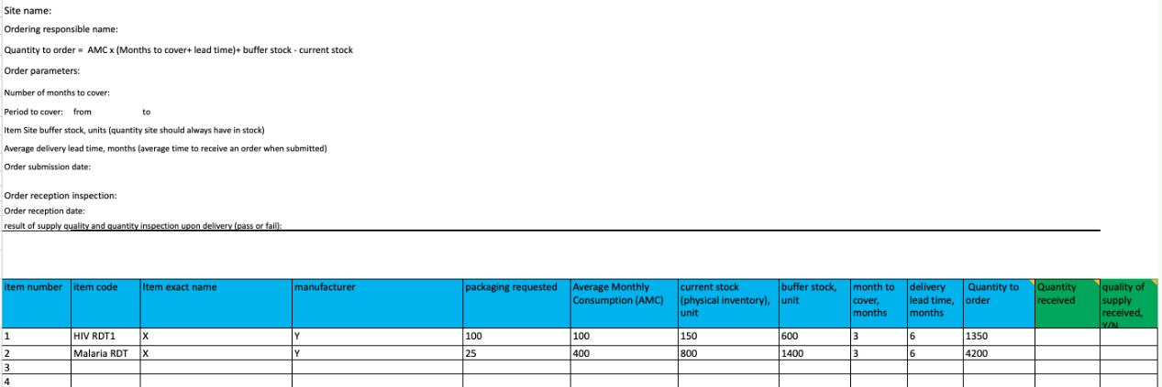
Ordering process (3/3)
Use country-validated order forms
Include comprehensive items informations: exact name, manufacturer name, product code, packaging
Use site specific order parameters: AMC, buffer stock, alert stock, period to cover, lead time, current stock
Complete a purchase order form and have it approved according to the testing site procedure
Forward the purchase order to the procurement officer according to the testing site procedure

Slide 16
Inspect orders at reception
Upon receipt:
Compare the contents of the order received with the requisition: check you have received everything
Check the quality and integrity of the received supplies
Date each item received
Note the lot numbers and expiry dates
Store the items according to the manufacturer's instructions, with later expiry dates behind the items with earlier expiry dates
Create or update records (stock cards)
Inform supervisor immediately of the status of the reception (complete or not, quality…)

Slide 17

Questions?
Exercise: how to calculate order quantity?

Slide 18
Exercise- How to calculate order quantities?
Depending on the trainees group composition, organise a group exercise (group of 3-4 persons) or individual exercise.
Expected duration: 45 minutes
exercice explanation: 5 min
group constitution: 5 min
group discussion: 20 min
restitution: 15 min
In a testing site:
HIV, syphilis testing are performed
HIV testing algorithm is composed of 3 different RDTs
Syphilis algorithm is composed of 1 RDT
In 3 different testing points (laboratory, ANC, ER)
You have to place an order for HIV and syphilis testing for 6 months of activities(only RDTs)
Questions:
What informations/data do you need to place the 6 months order for HIV and syphilis testing?
Using the provided informations, calculate the quantities to cover the 6 months activities
QMS non-lab testing sites - training package – v1.0 | Supply chain management, Quantification and Inventory

Slide 19
Question 1 answers
What informations and data do you need to place this order?
list of necessary commodities to perform those activities
  For testing activities:
    PPE material (gloves)
    Disinfectant, cotton
    Nationally validated tests/consumables (product manufacturer) for each testing activities
  For Malaria and syphilis testing: testing algorithm composed of one test only
  For HIV: 3-tests algorithm in place. need to order HIV RDT 1, 2 and 3
Average Monthly Consumption (AMC) for each of those items and each testing point
  Use data from testing registers
  Calculate AMC over a minimum 3 month period
The supply time delays (lead time)
The Buffer Stock for each of the items
The current physical stock for each of the items
Packaging for each test
Name of the person to place the order
QMS non-lab testing sites - training package – v1.0 | Supply chain management, Quantification and Inventory

Slide 20
Data/informations provided
HIV and syphilis testing indicator forms tables (all testing point combined):
Supply delay (D): 3 months
Buffer stock (BS): 3 months of activities
Period to cover (P): 6 months of activities
Current stock available from physical inventory (S) and packaging:
Syphilis | month 1 | month 2 | month 3 | month 4 | month 5
Total Nb of tests performed | 121 | 98 | 132 | 101 | 113
Nb of negative test results | 115 | 90 | 125 | 98 | 106
Nb of reactive test results | 6 | 8 | 7 | 3 | 7
HIV | month 1 | month 2 | month 3 | month 4 | month 5
Total Nb of HIV tests performed | 372 | 312 | 628 | 487 | 413
Nb of negative test results (A1) | 314 | 246 | 508 | 383 | 343
Nb of reactive test results (A1) | 20 | 22 | 41 | 35 | 24
Nb of negative test results (A2) | 2 | 0 | 3 | 1 | 2
Nb of reactive test results (A2) | 18 | 22 | 38 | 34 | 22
Nb of negative test results (A3) | 0 | 0 | 1 | 0 | 1
Nb of reactive test results (A3) | 18 | 22 | 37 | 34 | 21
Test | Quantity available | Packaging
HIV1 | 700 | 100
HIV2 | 45 | 25
HIV3 | 85 | 20
Syphilis RDT | 350 | 25
QMS non-lab testing sites - training package – v1.0 | Supply chain management, Quantification and Inventory

Slide 21
Informations provided- Order form
Item code | Item exact name | Manufacturer | Packaging requested | Average Monthly Consumption (AMC) | Current stock (physical inventory), unit | Buffer stock, unit | Month to cover, months | Delivery lead time, months | Quantity to order | Quantity received | Quality of supply received, Y/N
QMS non-lab testing sites - training package – v1.0 | Supply chain management, Quantification and Inventory

Slide 22
Answers: Average Monthly Consumption calculation
Calculate AMC for each of the tests used over the 5 months period provided:
Syphilis AMC: 113 tests/month
Participant should calculate the AMC for the 3 different tests needed. For each test, must include pos and neg tests
HIV A1 AMC: 387 tests/month
HIV A2 AMC: 29 tests/month
HIV A3 AMC: 27 tests/month
HIV | month 1 | month 2 | month 3 | month 4 | month 5
Total Nb of HIV tests performed | 372 | 312 | 628 | 487 | 413
Nb of negative test results (A1) | 314 | 246 | 508 | 383 | 343
Nb of reactive test results (A1) | 20 | 22 | 41 | 35 | 24
Nb of negative test results (A2) | 2 | 0 | 3 | 1 | 2
Nb of reactive test results (A2) | 18 | 22 | 38 | 34 | 22
Nb of negative test results (A3) | 0 | 0 | 1 | 0 | 1
Nb of reactive test results (A3) | 18 | 22 | 37 | 34 | 21
total A1: | 334 | 268 | 549 | 418 | 367
Total A2 | 20 | 22 | 41 | 35 | 24
Total A3 | 18 | 22 | 38 | 34 | 22
QMS non-lab testing sites - training package – v1.0 | Supply chain management, Quantification and Inventory

Slide 23
Answer - Order calculation
Formula: Quantity to order Q = AMC x (P + D) + BS – S (eg: HIV A1 : Q = 386 x (6 +3) + 1158 - 700 = 3932 tests)
item code | Item exact name | manufacturer | packaging requested | Average Monthly Consumption AMC | current stock (physical inventory), unit S | buffer stock, unit BS | month to cover P | delivery lead time, months D | Quantity to order Q | Quantity received | quality of supply received, Y/N
1 | HIV A1 | XXX | 100 | 387 | 700 | 1158 | 6 | 3 | 40 kits/ 3941 tests
2 | HIV A2 | XXX | 25 | 29 | 45 | 87 | 6 | 3 | 13 kits/ 303 tests
3 | HIV A3 | XXX | 20 | 27 | 85 | 81 | 6 | 3 | 12 kits/ 239 tests
4 | Syphilis RDT | XXX | 25 | 113 | 350 | 339 | 6 | 3 | 41 kits/ 1006 tests
QMS non-lab testing sites - training package – v1.0 | Supply chain management, Quantification and Inventory

