Slide 1

07
Documents, records and information management

Slide 2
Learning objectives
At the end of this module, you should be able to:
Explain why testing site need to manage document, records
List the important documents and records needed in a testing site
Explain why it is important to collect informations
Describe different information systems solutions

Slide 3


Why do testing sites need to manage documents and records?
To find information
whenever it is needed!

Slide 4



Differences between documents and records
Documents
  communicate information via policies, processes, and procedures
  Change on regular basis: need updating
Records
  capture information on worksheets, forms, labels, and charts
  permanent, do not change (eg: client result form)
RECORDS

Slide 5
Exemple of documents and records in testing sites
Documents: polcies, processes and procedures
Standards Operating Procedures (SOPs)
Tests package inserts
Blank forms/templates:
  Testing registers
  Request form
  Client results form
  Inventory forms
  Temperature log forms
  Stock cards
Must be easily available to testing providers
Records: include information captured in process
Filled forms:
  Registers
  Request form
  Client results form
  Inventory forms
  Temperature log forms
  Item specicif stock cards
Must be secured

Slide 6

Why documents and records are important :
Documents and records reflect the testing site organization, activities and its quality management.
A good rule to follow is:
“Do what you wrote and write what you are doing.”

Slide 7
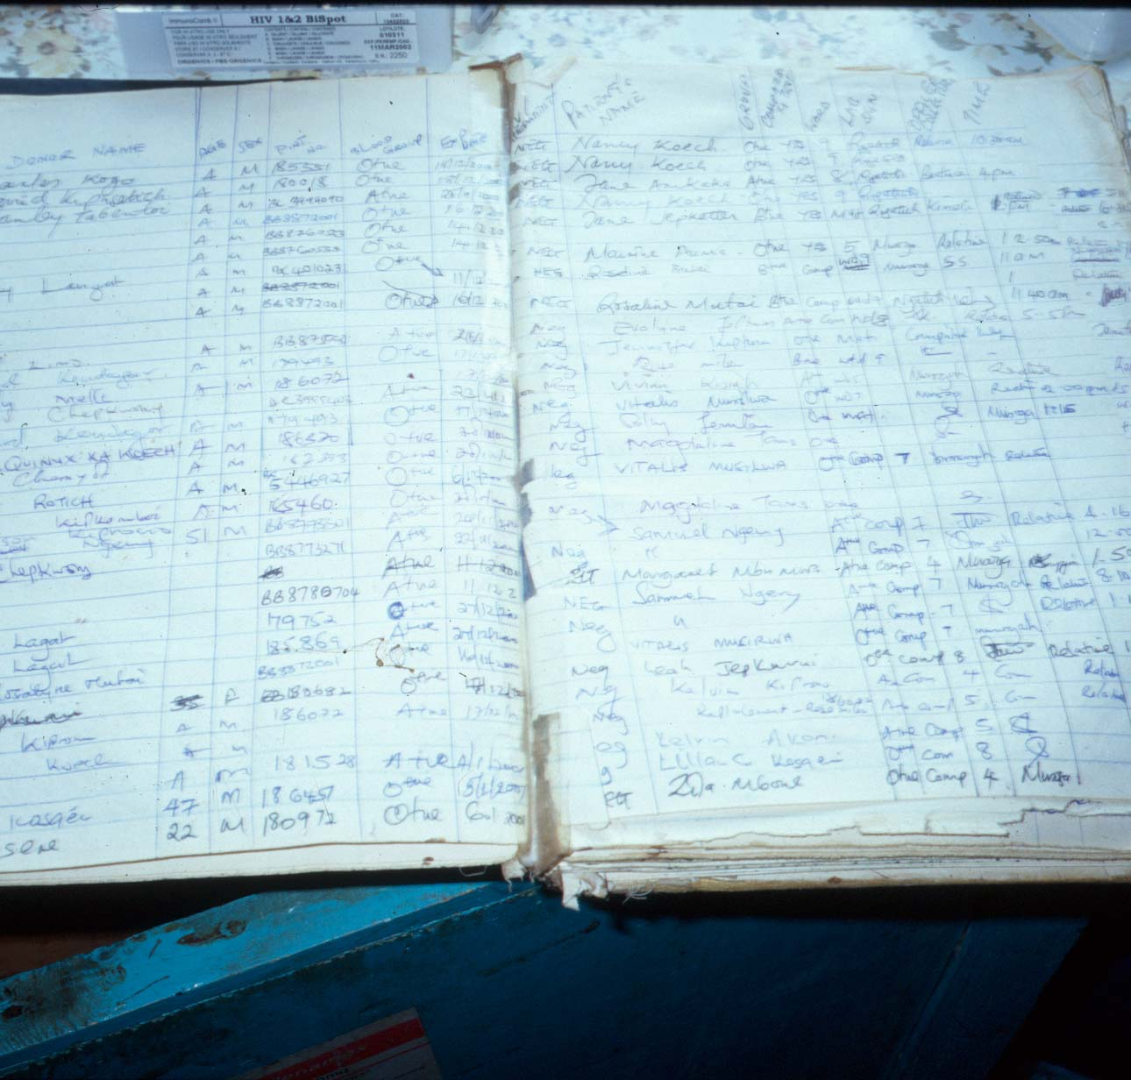
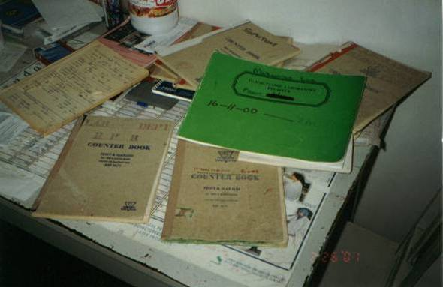
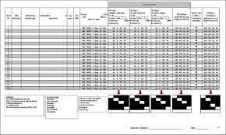

And… informations must be available when needed by whom need them

Slide 8
The documents
Not permanent
Need to be updated
Need to be easily available

Slide 9





Why documents are important (1/2): they are the communicators of the QMS
Verbal instructions often are:
not heard
misunderstood
quickly forgotten
difficult to follow

Slide 10

Good documents are:
clear
concise
user-friendly
explicit
accurate
up-to-date

Slide 11
Documents for work processes should be accessible where procedures/tests are performed
instructions on samples collection
SOPs and bench aids for each test
quality control forms and trouble-shooting
instructions
Hygiene and safety precautions

Slide 12

Standard Operating Procedures (SOPs) are documents that:
Must be specific to each procedure
Describe how to perform a test using step-by-step instructions
Provide detailed, clear and concise instructions
Must be easily understood by new personnel
Must be reviewed and approved once a year
Must be read, understand and sign by each testing provider
Written SOPs help ensure:
  consistency
  accuracy
  quality

Slide 13
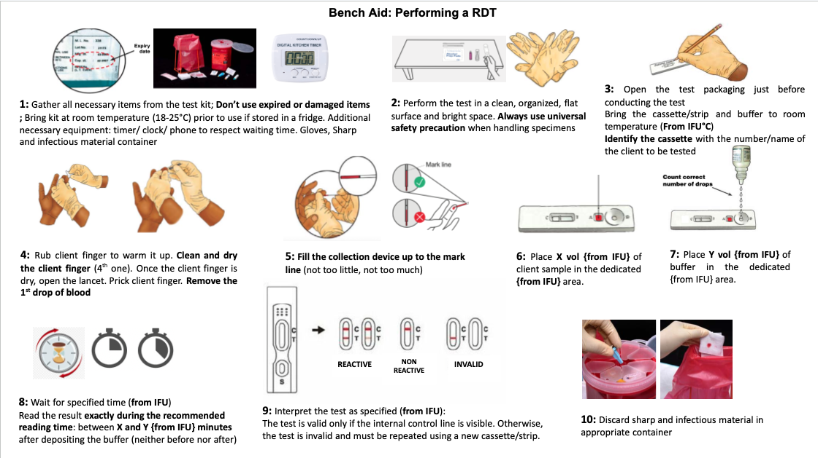
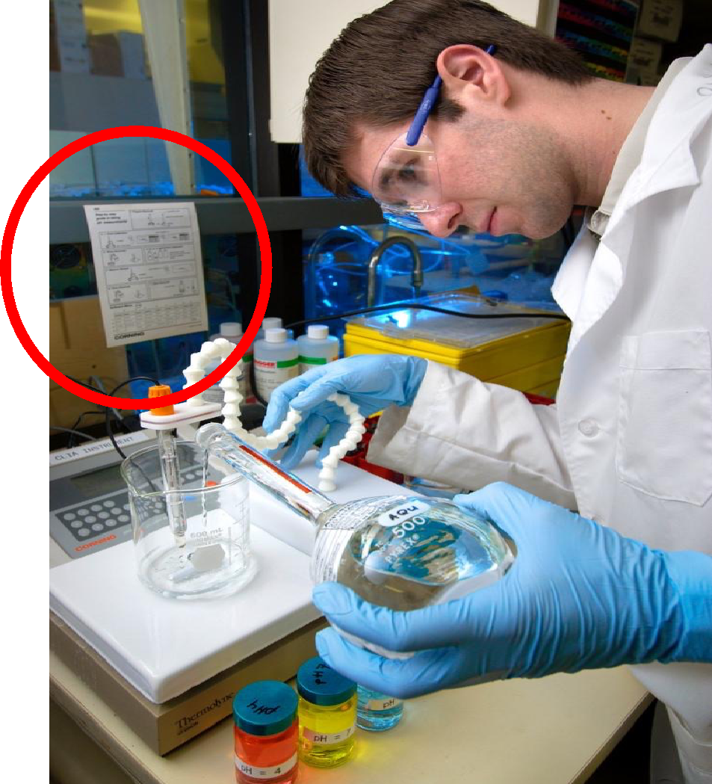

Job/Bench Aids
shortened version of SOPs
handwritten or printed
visible location at testing site
useful tool to assure all testing steps are correctly performed

Slide 14
Records
Permanent
No need to update
Must be secured

Slide 15
Why are records essential?
Records are management tools
To monitor continuously QMS
To find informations (eg: client result)
To identify occurence (problems)
To Track sample/client throughout process

Slide 16
Testing sites records
registers
EQ//PT results
stock cards
Testing site records
QC data
Site supervision visit reports
personnel records
client results reports

Slide 17
Testing sites records
registers
EQ//PT results
stock cards
Keep things that you might forget !!!
Testing site records
QC data
Site supervision visit reports
personnel records
client results reports

Slide 18
Informations management
Adapt training content to country information management system
How to keep records and documents organised ?
Need to be context dependent

Slide 19
Paper based systems
Permanence
  bind books
  number pages
  use permanent ink
  control storage
Security
  maintain confidentiality
  keep safe from environmental hazards
Accessibility
  use system that will allow ease of access
Traceability
  allow for tracking of a client/specimen throughout all processes

Slide 20
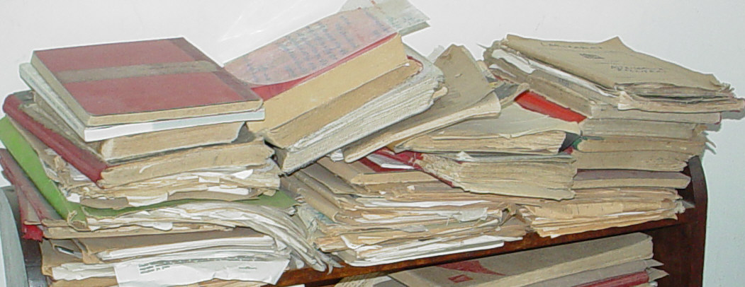
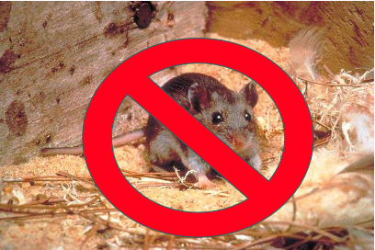
But…..

Slide 21

Electronic system
Permanence
  Computer system
  Backups (online, physical)
Security
  maintain confidentiality (password)
  keep safe from environmental hazards
  Protected from power variation
Accessibility
  use system that will allow ease of access
  Depend where computer is located
Traceability
  allow for tracking of a client/specimen throughout all processes

Slide 22
Advantages of electronic systems
Integrate with other sites
direct transmission of information
Data retrieval option
Advantages
Access control
Automatic detailed report
Track, analyse trends

Slide 23
BUT….
Initial Training needs
Back up requiements
Constraints/
disadvantages
Refreshment training (new system)
Costs: Purchase and maintenance

Slide 24
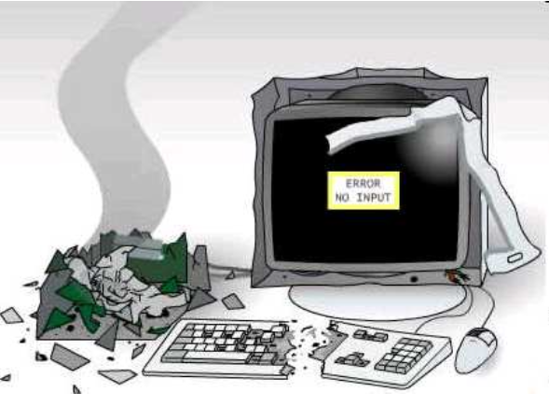
And…

Slide 25
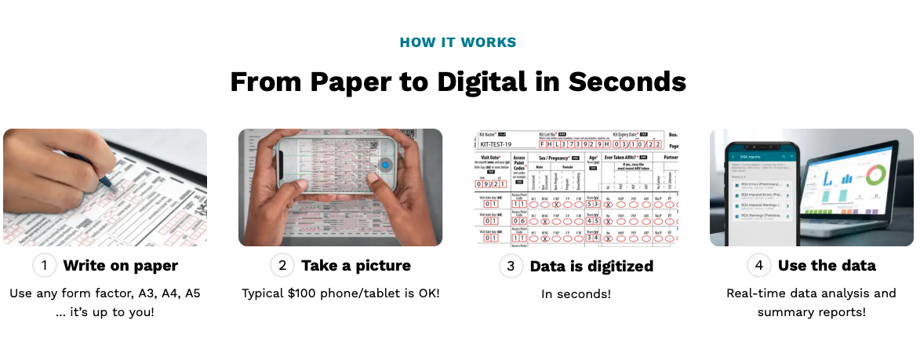
Combined paper and digital systems
Exemple: ScanForm (https://about.scanform.qed.ai)

Slide 26

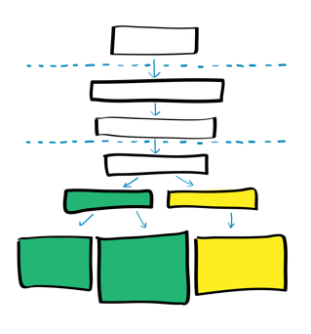
Key points
Documents
Include written policies, processes and procedures
Need to be updated, maintained and easily available
Records:
Include informations captured during processes
Are permanent, not need to update
Need to be secure
Information management system
Paper based, electric, combined
Selected according to country context

Slide 27
Questions?

