Slide 1

08
M&E: collect, review, analyze and use routine data

Slide 2
Learning objectives
At the end of this module, you should be able to:
Explain why it is important to collect data
Know how to fill the nationally validated standardized data collection tools
Know what are the testing indicators
Know how to calculate indicators and what are their expected values/range
Analyze indicators and know what to do in case indicators are not within expected range

Slide 3
Why do we collect and analyze data? To have a clear picture of testing sites activities
To monitor the Workload
To monitor epidemiological trends and adapt activities: pos rate, negative rate
To monitor testing quality: pos rate, negative rate, invalid rate, discordant results rate
To identify any occurrence (problem) and select corrective/preventive actions in a timely manner: unexpected change in trends, failed QC results, high invalid rate, days without testing activity
To manage stocks and place orders
To define workforce requirement versus workload and type of testing
….
Report to management line at pre defined schedule

Slide 4
Collection of routine testing data- standardize system
Data and informations must be collected in each testing site using nationally validated strandardized testing register
Paper based or digital systems can be used
All testing activities must be reflected in the testing register:
All diseases (HIV, HepB, HepC, Syphilis, malaria…)
All and only nationally validated testing strategies and algorithms
All services delivery models
Testing registers should include ONLY activities performed in the testing site
Each testing provider should be trained on how to fill it and on what do do with it
Always use what is nationally validated and not what you like

Slide 5


Data collection tools…
Need to be as simple as possible
Need to be adapted to the testing site context
(eg: availability of IT, power…)
Located where needed
Need to be useful (testing site, district, national level)
Need to be understood:
What does it mean?
What to do with it?
What indicators should be calculated?
How to calculate those?
Where to find the informations to calculate indicators?
What are the expected indicator values/ranges
How to interpret?

Slide 6
Exemple of multidisease serology testing register
 |  |  |  |  |  |  |  |  |  |  | TESTS RESULTS (NR: Non reactive test, RE: reactive test, INV: invalid test, P: HIV pos serology, N: HIV negative serology, I: HIV Inconclusive serology)
 |  |  |  |  |  |  |  |  |  |  | Hepatitis B |  |  | Hepatitis C |  |  | syphilis (dual HIV syphilis test or syphilis single test) |  |  | HIV
N° | Date (JJ/MM/AAAA) | Code or ID client | Sex (M/F) | Age (year) | place of residence | HIV counselling |  | HIV testing history |  |  |  |  |  |  |  |  |  |  |  | Assay 1 HIV single test or HIV/syphilis dual test |  |  | Assay 2 |  |  | Assay 3 |  |  | Repeated Assay 1 (if applicable) |  |  | HIV serology Final Result |  |  | HIVST /ST distribution |  |  | Partners sevices |  | if Hep B pos client | If hep C pos client | If Syphilis pos client | If HIV pos status | if HIV neg status | Tester name or intials | comments
 |  |  |  |  |  |  |  | never tested before | if tested before
 |  |  |  |  |  | pre-test (Y/N) | post-test (Y/N) |  | Date (DD/MM/YY) | results |  |  |  |  |  |  |  |  |  |  |  |  |  |  |  |  |  |  |  |  |  |  |  |  | Y/N | Nb for primary distrib | Nb for secondary distrib | proposition done (Y/N) | proposition accepted (Y/N) | referal for care services (Y/N) | referal for care services (Y/N) | referal for care services (Y/N) | referal for care services (Y/N) | referal for prevention services (Y/N)
1 |  |  |  |  |  |  |  |  |  |  | NR | RE | INV | NR | RE | INV | NR | RE | INV | NR | RE | INV | NR | RE | INV | NR | RE | INV | NR | RE | INV | P | N | I
2 |  |  |  |  |  |  |  |  |  |  | NR | RE | INV | NR | RE | INV | NR | RE | INV | NR | RE | INV | NR | RE | INV | NR | RE | INV | NR | RE | INV | P | N | I
3 |  |  |  |  |  |  |  |  |  |  | NR | RE | INV | NR | RE | INV | NR | RE | INV | NR | RE | INV | NR | RE | INV | NR | RE | INV | NR | RE | INV | P | N | I
4 |  |  |  |  |  |  |  |  |  |  | NR | RE | INV | NR | RE | INV | NR | RE | INV | NR | RE | INV | NR | RE | INV | NR | RE | INV | NR | RE | INV | P | N | I
5 |  |  |  |  |  |  |  |  |  |  | NR | RE | INV | NR | RE | INV | NR | RE | INV | NR | RE | INV | NR | RE | INV | NR | RE | INV | NR | RE | INV | P | N | I
6 |  |  |  |  |  |  |  |  |  |  | NR | RE | INV | NR | RE | INV | NR | RE | INV | NR | RE | INV | NR | RE | INV | NR | RE | INV | NR | RE | INV | P | N | I
7 |  |  |  |  |  |  |  |  |  |  | NR | RE | INV | NR | RE | INV | NR | RE | INV | NR | RE | INV | NR | RE | INV | NR | RE | INV | NR | RE | INV | P | N | I
8 |  |  |  |  |  |  |  |  |  |  | NR | RE | INV | NR | RE | INV | NR | RE | INV | NR | RE | INV | NR | RE | INV | NR | RE | INV | NR | RE | INV | P | N | I
9 |  |  |  |  |  |  |  |  |  |  | NR | RE | INV | NR | RE | INV | NR | RE | INV | NR | RE | INV | NR | RE | INV | NR | RE | INV | NR | RE | INV | P | N | I
10 |  |  |  |  |  |  |  |  |  |  | NR | RE | INV | NR | RE | INV | NR | RE | INV | NR | RE | INV | NR | RE | INV | NR | RE | INV | NR | RE | INV | P | N | I
11 |  |  |  |  |  |  |  |  |  |  | NR | RE | INV | NR | RE | INV | NR | RE | INV | NR | RE | INV | NR | RE | INV | NR | RE | INV | NR | RE | INV | P | N | I
12 |  |  |  |  |  |  |  |  |  |  | NR | RE | INV | NR | RE | INV | NR | RE | INV | NR | RE | INV | NR | RE | INV | NR | RE | INV | NR | RE | INV | P | N | I
13 |  |  |  |  |  |  |  |  |  |  | NR | RE | INV | NR | RE | INV | NR | RE | INV | NR | RE | INV | NR | RE | INV | NR | RE | INV | NR | RE | INV | P | N | I
14 |  |  |  |  |  |  |  |  |  |  | NR | RE | INV | NR | RE | INV | NR | RE | INV | NR | RE | INV | NR | RE | INV | NR | RE | INV | NR | RE | INV | P | N | I
15 |  |  |  |  |  |  |  |  |  |  | NR | RE | INV | NR | RE | INV | NR | RE | INV | NR | RE | INV | NR | RE | INV | NR | RE | INV | NR | RE | INV | P | N | I
16 |  |  |  |  |  |  |  |  |  |  | NR | RE | INV | NR | RE | INV | NR | RE | INV | NR | RE | INV | NR | RE | INV | NR | RE | INV | NR | RE | INV | P | N | I
17 |  |  |  |  |  |  |  |  |  |  | NR | RE | INV | NR | RE | INV | NR | RE | INV | NR | RE | INV | NR | RE | INV | NR | RE | INV | NR | RE | INV | P | N | I
18 |  |  |  |  |  |  |  |  |  |  | NR | RE | INV | NR | RE | INV | NR | RE | INV | NR | RE | INV | NR | RE | INV | NR | RE | INV | NR | RE | INV | P | N | I
19 |  |  |  |  |  |  |  |  |  |  | NR | RE | INV | NR | RE | INV | NR | RE | INV | NR | RE | INV | NR | RE | INV | NR | RE | INV | NR | RE | INV | P | N | I
20 |  |  |  |  |  |  |  |  |  |  | NR | RE | INV | NR | RE | INV | NR | RE | INV | NR | RE | INV | NR | RE | INV | NR | RE | INV | NR | RE | INV | P | N | I
page total
Tester comments: |  |  |  |  |  |  |  |  |  |  |  |  |  |  |  |  |  |  |  |  |  |  |  |  |  |  |  |  |  |  |  |  |  |  | supervisor comments:

Slide 7
Exemple of multidisease serology testing register
 |  |  |  |  |  |  |  |  |  |  | TESTS RESULTS (NR: Non reactive test, RE: reactive test, INV: invalid test, P: HIV pos serology, N: HIV negative serology, I: HIV Inconclusive serology)
 |  |  |  |  |  |  |  |  |  |  | Hepatitis B |  |  | Hepatitis C |  |  | syphilis (dual HIV syphilis test or syphilis single test) |  |  | HIV
N° | Date (JJ/MM/AAAA) | Code or ID client | Sex (M/F) | Age (year) | place of residence | HIV counselling |  | HIV testing history |  |  |  |  |  |  |  |  |  |  |  | Assay 1 HIV single test or HIV/syphilis dual test |  |  | Assay 2 |  |  | Assay 3 |  |  | Repeated Assay 1 (if applicable) |  |  | HIV serology Final Result |  |  | HIVST /ST distribution |  |  | Partners sevices |  | if Hep B pos client | If hep C pos client | If Syphilis pos client | If HIV pos status | if HIV neg status | Tester name or intials | comments
 |  |  |  |  |  |  |  | never tested before | if tested before
 |  |  |  |  |  | pre-test (Y/N) | post-test (Y/N) |  | Date (DD/MM/YY) | results |  |  |  |  |  |  |  |  |  |  |  |  |  |  |  |  |  |  |  |  |  |  |  |  | Y/N | Nb for primary distrib | Nb for secondary distrib | proposition done (Y/N) | proposition accepted (Y/N) | referal for care services (Y/N) | referal for care services (Y/N) | referal for care services (Y/N) | referal for care services (Y/N) | referal for prevention services (Y/N)
1 |  |  |  |  |  |  |  |  |  |  | NR | RE | INV | NR | RE | INV | NR | RE | INV | NR | RE | INV | NR | RE | INV | NR | RE | INV | NR | RE | INV | P | N | I
2 |  |  |  |  |  |  |  |  |  |  | NR | RE | INV | NR | RE | INV | NR | RE | INV | NR | RE | INV | NR | RE | INV | NR | RE | INV | NR | RE | INV | P | N | I
3 |  |  |  |  |  |  |  |  |  |  | NR | RE | INV | NR | RE | INV | NR | RE | INV | NR | RE | INV | NR | RE | INV | NR | RE | INV | NR | RE | INV | P | N | I
4 |  |  |  |  |  |  |  |  |  |  | NR | RE | INV | NR | RE | INV | NR | RE | INV | NR | RE | INV | NR | RE | INV | NR | RE | INV | NR | RE | INV | P | N | I
5 |  |  |  |  |  |  |  |  |  |  | NR | RE | INV | NR | RE | INV | NR | RE | INV | NR | RE | INV | NR | RE | INV | NR | RE | INV | NR | RE | INV | P | N | I
6 |  |  |  |  |  |  |  |  |  |  | NR | RE | INV | NR | RE | INV | NR | RE | INV | NR | RE | INV | NR | RE | INV | NR | RE | INV | NR | RE | INV | P | N | I
7 |  |  |  |  |  |  |  |  |  |  | NR | RE | INV | NR | RE | INV | NR | RE | INV | NR | RE | INV | NR | RE | INV | NR | RE | INV | NR | RE | INV | P | N | I
8 |  |  |  |  |  |  |  |  |  |  | NR | RE | INV | NR | RE | INV | NR | RE | INV | NR | RE | INV | NR | RE | INV | NR | RE | INV | NR | RE | INV | P | N | I
9 |  |  |  |  |  |  |  |  |  |  | NR | RE | INV | NR | RE | INV | NR | RE | INV | NR | RE | INV | NR | RE | INV | NR | RE | INV | NR | RE | INV | P | N | I
10 |  |  |  |  |  |  |  |  |  |  | NR | RE | INV | NR | RE | INV | NR | RE | INV | NR | RE | INV | NR | RE | INV | NR | RE | INV | NR | RE | INV | P | N | I
11 |  |  |  |  |  |  |  |  |  |  | NR | RE | INV | NR | RE | INV | NR | RE | INV | NR | RE | INV | NR | RE | INV | NR | RE | INV | NR | RE | INV | P | N | I
12 |  |  |  |  |  |  |  |  |  |  | NR | RE | INV | NR | RE | INV | NR | RE | INV | NR | RE | INV | NR | RE | INV | NR | RE | INV | NR | RE | INV | P | N | I
13 |  |  |  |  |  |  |  |  |  |  | NR | RE | INV | NR | RE | INV | NR | RE | INV | NR | RE | INV | NR | RE | INV | NR | RE | INV | NR | RE | INV | P | N | I
14 |  |  |  |  |  |  |  |  |  |  | NR | RE | INV | NR | RE | INV | NR | RE | INV | NR | RE | INV | NR | RE | INV | NR | RE | INV | NR | RE | INV | P | N | I
15 |  |  |  |  |  |  |  |  |  |  | NR | RE | INV | NR | RE | INV | NR | RE | INV | NR | RE | INV | NR | RE | INV | NR | RE | INV | NR | RE | INV | P | N | I
16 |  |  |  |  |  |  |  |  |  |  | NR | RE | INV | NR | RE | INV | NR | RE | INV | NR | RE | INV | NR | RE | INV | NR | RE | INV | NR | RE | INV | P | N | I
17 |  |  |  |  |  |  |  |  |  |  | NR | RE | INV | NR | RE | INV | NR | RE | INV | NR | RE | INV | NR | RE | INV | NR | RE | INV | NR | RE | INV | P | N | I
18 |  |  |  |  |  |  |  |  |  |  | NR | RE | INV | NR | RE | INV | NR | RE | INV | NR | RE | INV | NR | RE | INV | NR | RE | INV | NR | RE | INV | P | N | I
19 |  |  |  |  |  |  |  |  |  |  | NR | RE | INV | NR | RE | INV | NR | RE | INV | NR | RE | INV | NR | RE | INV | NR | RE | INV | NR | RE | INV | P | N | I
20 |  |  |  |  |  |  |  |  |  |  | NR | RE | INV | NR | RE | INV | NR | RE | INV | NR | RE | INV | NR | RE | INV | NR | RE | INV | NR | RE | INV | P | N | I
page total
Tester comments: |  |  |  |  |  |  |  |  |  |  |  |  |  |  |  |  |  |  |  |  |  |  |  |  |  |  |  |  |  |  |  |  |  |  | supervisor comments:
Make sure registers are stored in a secure place

Slide 8
Exemple of multidisease serology testing register- General informations
Site general informatons:
tests general informatons: to ensure tracability and needed in case of any concern with a test (Post Market Surveillance-PMS)
Name and national ID of testing site:
Type of testing site/entry point: VCT, TB clinic, STI clinic, community.....
 | name and manufacturer | Batch Number | expiration date
HIV A1
HIV A2
HIV A3
HIV/syphilis dual test
Syphilis test
Hep C test
Hep B test
other

Slide 9
Exemple of multidisease serology testing register- Client informations
Client general informations:
- To contact client after if needed
- To include in referal forms (to care or prevention)

Slide 10
Exemple of multidisease serology testing register- tests results
Legend
NR | non reactive test
RE | reactive test
INV | Invalid test
P | Positive HIV serology
N | Negative HIV serology
I | Inconclusive HIV serology
- Don’t forget the legend
Include only tests performed in the testing site
Each tests résults should be recorded: Reactive, non reactive or invalid
Final status should be recorded for all disease diagnosed using a multi –tests strategy (eg: HIV and 3-tests strategy): Positive, negative and inconclusive status

Slide 11
Exemple of multidisease serology testing register- post test and delivery models
Include post tests informations: referal to care or prevention
Include all service delivery modles in place: Partners services , Self Test (including HIV) distribution

Slide 12
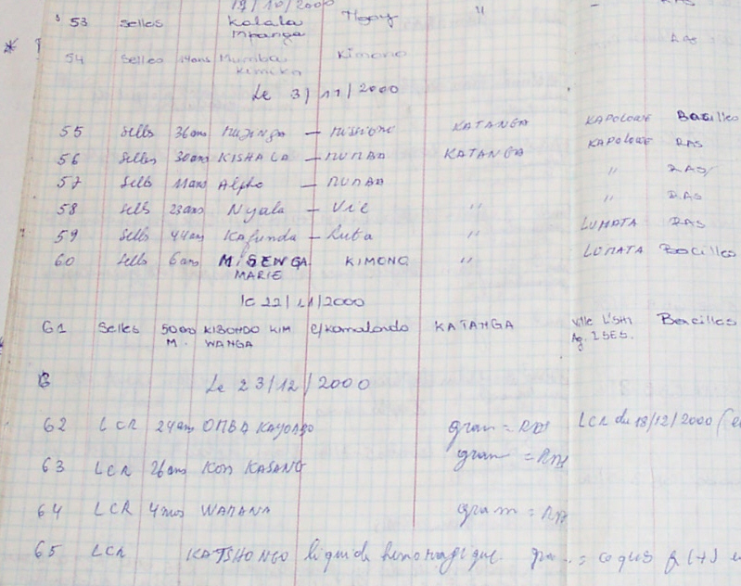
Importance of data entry
Age not recorded
Results recorded in village column
Village name not recorded

Slide 13
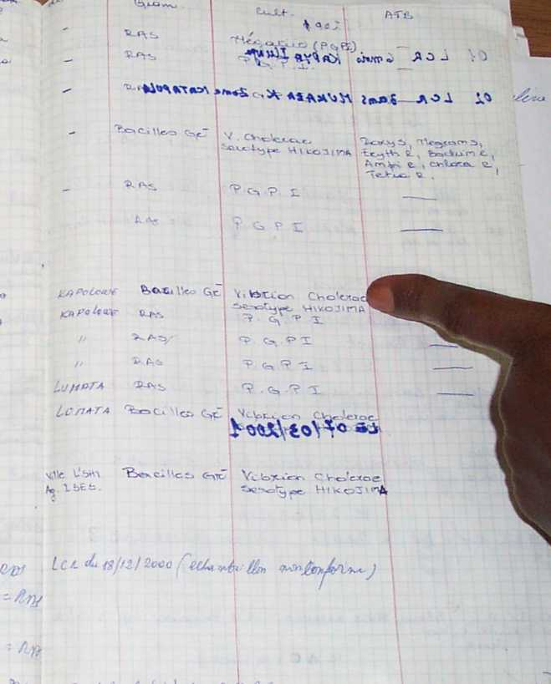
Importance of data entry
Unreadable-thick felt-tip pen used on other side
Writing illegible

Slide 14
Use of data- Through indicators
An indicator is a quantitative or qualitative measure a current condition to see how close we are to achieving a set objective.
Purpose:
To have a clear picture of testing activities
To assess performance against set standards.
To identify areas needing improvement.
To track changes over time and evaluate the impact of corrective actions.
Qualitative Indicators: Measure the quality of outcomes, often through surveys or interviews.
Quantitative Indicators: Numerical measures used to assess performance, such as the number of tests performed, positivity rate...
Process Indicators: Track the efficiency and effectiveness of processes (e.g., turnaround time for test results).
Outcome Indicators: Measure the results of activities (e.g., improvement in patient care as a result of testing).

Slide 15
Testing activity indicators, pupose and target values/range
Indicators (for each type of tests performed) | Objective | expected results | E.g. of actions if result not as expected
No of tests performed (for each test in used) | to monitor the use of tests to ensure no shortage or excendent of tests can happen for the period and eventually being able to react (plan order or plan donation) | stable (+/-10% over a 3 months period) | Review the data and any actions taken by the testing site. If no actions have been implemented and concerns persist over a three-month period conduct a root cause analysis. If the number of tests is lower than usual: Check the availability of test kits and review orders if necessary. If the number of tests is higher than usual: Review stock levels and monthly consumption. Inform the management team and adapt procurement as needed.
No of Self Test distributed | to monitor the use of tests to ensure no shortage or excendent of tests can happen for the period and eventually being able to react (plan order or plan donation) | stable (+/-10% over a 3 months period) | if increased of number of tests performed over a 3 months period. Root cause analysis. Eg if Nb of test inferior to usual; Check availability of test kits and review order if needed; if Nb of test superior to usual review stock, monthly consuption, inform management team and adapt procurement
No of day with kits shortage (for each test in use) | to monitor if the procurment and supply plan correspond to the testing site needs. and being able to adapt if needed | 0 | in case of shortage, review stock, monthly consumption, inform management line and adapt procurement and suply chain
No of day with use of expired test kits (for each test in use) | to monitor if the procurment and supply plan correspond to the testing site needs and being able to adapt if needed . | 0 | in case of use of expired tests, review stock monthly consumption, inform management team and adapt procurement and suply chain. Conduct refresher training on importance of use of non expired tests,
% of reactive test (for each test in use) | to monitor testing site results trend which should be stable over time. If a change occurs, root cause analysis should be done to understand why and implement corrective action if needed | stable (+/-10%) | if unstable, conduct root cause analysis: investigate result by batch number, by test provider, review IQC, EQA results and SOPs. Investigate if testing population has changed (displaced or refugees…). Conduct refresher trainings on use and interpretation of tests. Implement PMS procedure if needed
% invalid test (for each test in use) | to monitor test invalid rate trend which should be stable and bellow 5%. If a change occurs, a root cause analysis should be done to understand why and implement corrective action if needed | stable and <5% | if above 5%, investigate by batch number, by test provider, review IQC, EQA results and SOPs. Conduct refresher training on use and interpretation of test, implement PMS procedure
EQA/PT scheme results (for each serology performed) | to monitor result of EQA/PT scheme. in case of unsatisfactory result, root cause analysis should be done to understand why and implement corrective action to improve performance | pass | if "fail" result: conduct root cause analysis: by batch, by test providers, review SOPs, conduct refresher training

Slide 16
Testing activity indicators, pupose and target values/range- additional HIV testing specific indicators
Indicators (for each type of tests performed) | Objective | expected results | E.g. of actions if result not as expected
Specific to HIV testing:
% of HIV pos clients | to monitor testing site results trend which should be stable over time. If a change occurs, root cause analysis should be done to understand why and implement corrective action if needed | stable (+/-10%) | if unstable, conduct root cause analysis: investigate result by batch number, by test provider, review IQC, EQA results and SOPs. Investigate if testing population has changed (displaced or refugees…). Conduct refresher trainings on use and interpretation of tests. Implement PMS procedure if needed
% of pos serology with 3 consecutive reactive tests | to monitor the capacity of the testing provider to interpret the national algorithm properly and implement corrective action if it is not the case | 100% of pos serology | if not 100%. Check availability of test kits and adapt procurement and suply chain if needed and organize refresher training on the 3 tests algorithm interpretation
% of inconclusive results (disagreement between A1, A2 and A3) | to monitor testing site results trend which should be stable over time. If a change occurs, root cause analysis should be done to understand why and implement corrective action if needed | <2% | if >2% conduct root cause analysis: investigate by batch number, by test provider, conduct training on use and interpretation of test. Implement PMS if needed

Slide 17
How to calculate indicators ? Using data included in testing register
Indicators must be:
Calculated and recorded in the indicator reporting form monthly
Reviewed in the testing site, by the supervisor monthly
Analysed in the testing site, by the supervisor monthly
Actions should be taken if needed (inform, decide and implement preventive and corrective actions, PMS procedures)
Be available during site supervision visit for assessor review

Slide 18
Indicators reporting form
HIV | month 1 | month 2
Nb of day with shortage (any test)
Nb of day with expired kit used (any test)
Nb of HIVST distributed
Nb of tests performed (except HIVST)
Nb of negative test results (A1)
Nb of reactive test results (A1)
Nb of invalid test results (A1)
% of reactive test (A1)
% invalid test (A1)
Nb of negative test results (A2)
Nb of reactive test results (A2)
Nb of invalid test results (A2)
% of reactive test (A2)
% invalid test (A2)
Nb of negative test results (A3)
Nb of reactive test results (A3)
Nb of invalid test results (A3)
% of reactive test (A3)
% invalid test (A3)
Nb of pos serology (result after HIV algorithm)
% of HIV pos clients
% of pos serology with 3 consecutive reactive tests
Nb of inconclusive results
% of inconclusive results
HepB | month 1 | month 2
Nb of day with shortage
Nb of day with expired kit used
Nb of tests performed
Nb of negative test results
Nb of reactive test results
Nb of invalid test results
% of reactive test
% invalid test
Must:
Include all testing activities performed in the testing site
Be calculated, recorded, review and analysed monthly
Reported to the management at pre-defined interval
Data collected should permit indicators calculation
In case of un expected results, inform supervisor take action and, if needed, the management line
Syphilis | month 1 | month 2
Nb of day with shortage
Nb of day with expired kit used
Nb of tests performed
Nb of negative test results
Nb of reactive test results
Nb of invalid test results
% of reactive test
% invalid test

Slide 19
How to calculate monthly indicators?
During the 5 first days of the months calculate the indicators of the previous month:
Nb of day with shortage | In the register, count each day where testing was not possible because of assay shortage
Nb of day with expired kit used | In the register, count each day where testing was done using expired assays
Nb of tests performed | In the register, count the total number of test performed over the month
Nb of negative test results | In the register, count the total number of negative test performed over the month
Nb of reactive test results | In the register, count the total number of reactive test performed over the month
Nb of invalid test results | In the register, count the total number of invalid test performed over the month
% of reactive test | Number of reactive tests / total number of tests performed
% invalid test | Number of invalid tests / total number of tests performed

Slide 20
HIV specific indicators
HIV
Nb of day with shortage (any test) | In the register, count each day where testing was not possible because of assay shortage
Nb of day with expired kit used (any test) | In the register, count each day where testing was done using expired assays
Nb of HIVST distributed | In the register count the total number of HIV-ST distributed
Nb of tests performed (except HIVST) | In the register, count the total number of testing provider test performed over the month
Nb of negative test results (A1) | In the register, count the total number of negative A1 test performed over the month
Nb of reactive test results (A1) | In the register, count the total number of invalid A1 test performed over the month
Nb of invalid test results (A1) | In the register, count the total number of reactive A1 test performed over the month
% of reactive test (A1) | Number of reactive A1 tests / total number of A1 tests performed
% invalid test (A1) | Number of invalid A1 tests / total number of A1 tests performed
Nb of negative test results (A2) | In the register, count the total number of negative A2 test performed over the month
Nb of reactive test results (A2) | In the register, count the total number of invalid A2 test performed over the month
Nb of invalid test results (A2) | In the register, count the total number of reactive A2 test performed over the month
% of reactive test (A2) | Number of reactive A2 tests / total number of A2 tests performed
% invalid test (A2) | Number of invalid A2 tests / total number of A2 tests performed
Nb of negative test results (A3) | In the register, count the total number of negative A3 test performed over the month
Nb of reactive test results (A3) | In the register, count the total number of invalid A3 test performed over the month
Nb of invalid test results (A3) | In the register, count the total number of reactive A3 test performed over the month
% of reactive test (A3) | Number of reactive A3 tests / total number of A3 tests performed
% invalid test (A3) | Number of invalid A3 tests / total number of A3 tests performed
Nb of pos serology (result after HIV algorithm) | In the register count the Number of positive serology over the month (after the entire HIV algorithm)
% of HIV pos clients | Number HIV postive client/ total number of client tested
% of pos serology with 3 consecutive reactive tests | Number of pos serology with 3 consercutive reactive tests/ total number of positive serology
Nb of inconclusive results | In the register count the Number of inconclusive serology over the month (clients with discordant tests results)
% of inconclusive results | Number HIV inconclusive client/ total number of client tested

Slide 21

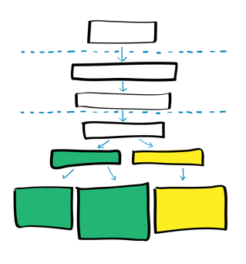
Key points
Collect and analyse data provide a picture of the testing site activity
Data collection form should be standardized and validated nationally
Testing indicators should be validated nationally
Schedule for reporting should be pre-defined
Testing provider and site supervisor/QA officer should be train on:
Filling the testing registers
Calculating indicators value
Interpreting the value/range compared to predifined targets
Deciding and implementing preventive and corrective actions in case of un expected value/range
Inform management line in case of unexpected range/value

Slide 22
Questions?

