Slide 1
09
Process control and assessment: IQC, EQC and PT/EQA scheme

Slide 2
Learning objectives
At the end of this module, you should be able to:
  Describe the different process control activities (QC and EQA)
  describe the importance and objectives of internal and external quality control (QC) specimens
  Understand the EQA/PT program/scheme process
Describe the dried tube specimen (DTS) technique/Understand the DTS reconstitution process
Describe the tester’s responsibility in the PT program

Slide 3
Globally: Quality of testing …
Ensure transmission of accurate, precise, and rapid results
  Avoiding human-linked errors
  Avoiding material-linked errors
Quality Assurance does not indicate having no errors
Quality Assurance means errors will be detected and corrected.

Slide 4
Quality assurance and process control – set of activities
Quality Controls (QC)
External Quality Assessment (EQA)
Quality indicators review
  Internal QC
  External QC
  Proficiency testing (PT)/EQA
  schemes
  Site supervision visits
  Pos rate trends; invalid rate…

Slide 5







Quality Assurance Cycle
Phases of Quality Assurance Cycle : Plan/Do/check/Act
Plan: Engage leadership, establish national teams, define roles, develop policies, and assess current status.
Implement/do: Train and certify testers, establish quality control measures, and conduct regular assessments.
Check: Use routine QC, EQA data and site supervision visit to identify errors and areas of improvement
Act:Implement corrective and prevention actions to improve
Quality Assurance Cycle:
Ensures that correct test results are provided to the client
Provides means to prevent, detect, and correct errors
Reduces costs (as errors cost)
Plan
Improve
Develop
Training tools
Data capture tools
QAC
Corrective Actions
Provide feedback
On-site Refresher
Implement
Train testers
Collect data
Monitor
Review & Analyze data

Slide 6


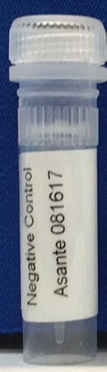
Different types of Quality Control (QC)
Internal QC (IQC): Built in control line (C line)
External Quality Controls (EQC)
Known pos and neg samples to ensure the performance of kits and continuous competency of the tester
Prepared and validated locally or purchased internationally/regionally
Stored sites samples could be used if no other option
Minimum frequency: every new user, every new batch and in case of storage condition breaches
Procedural control: check migration and revelation if working well
Does not check test nor testing provider performances
For most of the test, control line will appear what ever the liquid is applied to the test (even water)
If C line not visible = test INVALID
POS Control Lot # xxxx
Neg Control Lot # xxxx
In case of non-expected result: investigate and correct the source of the error Prior providing result to client

Slide 7
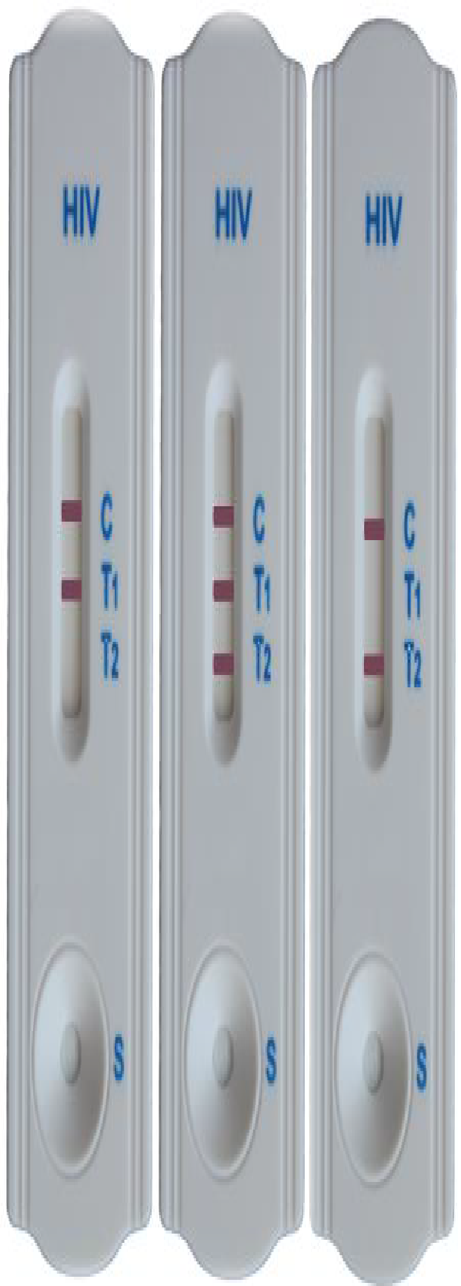
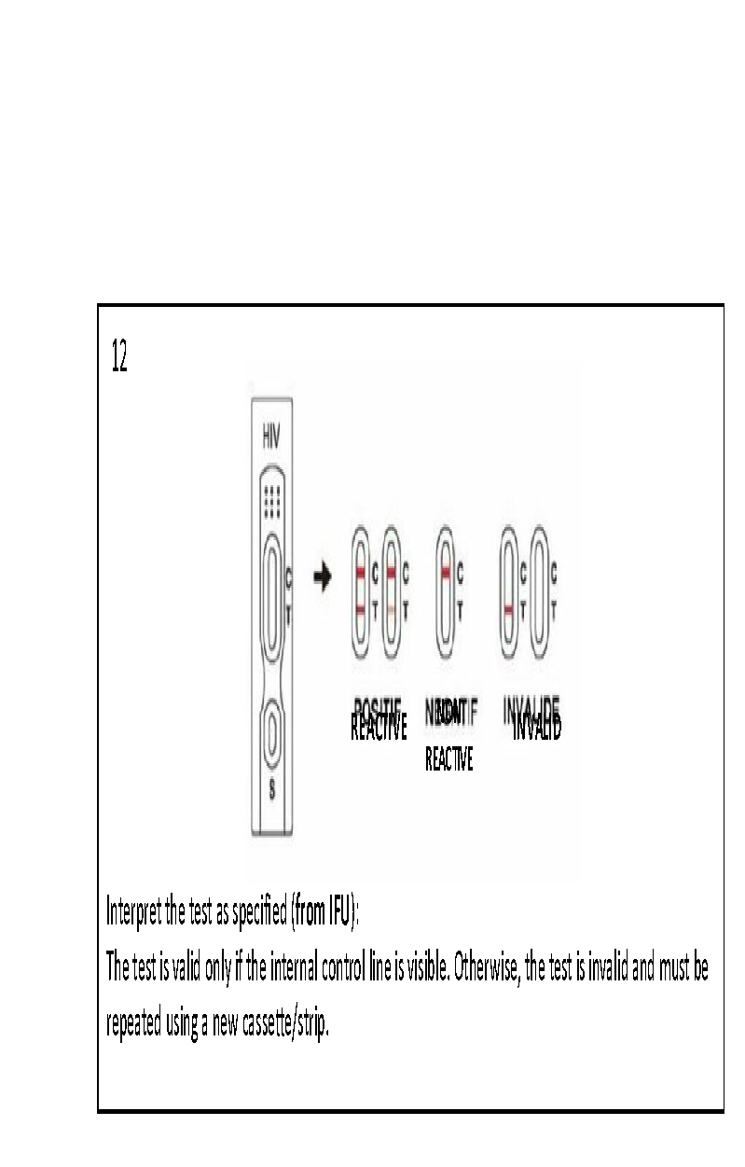
Built-in IQC- Control line
Procedural control included in the cassette/strip: check migration and revelation if working well
If the C line is not visible = test INVALID
If the test is invalid = re-do the test with another cassette/strip
IQC:
Does not check test nor testing provider performances
For most of the test, a control line will appear whatever liquid is applied to the test (even water)
For some tests, the control line will appear ONLY if the human sample is applied
Invalid results should be recorded in the HTS register
INVALID
VALID

Slide 8
External Quality control (EQC)
Objective: Check if the test kit is working adequately using a panel of known samples (result should be the expected one).
Minimum frequency of EQC: each testing site should perform EQC
  Every new user,
  Every new batch and
  In case of any storage condition breaches (during transportation or storage)
QC material : panel of at least 1 Pos and 1 Neg sample
  Commercial solutions, locally produced and nationally validated, closest site well stored samples
  Liquid (stored in fridge), freeze or Dry Tube Specimen (DTS)
  Can be single or multi diseases (to support integration of testing)
  Must be processed with exactly same procedure as patient samples.

Slide 9
Appropriate EQC Specimens and storage
Venous whole blood is stable:
  between 2°C - 8°C: 3 days
Plasma and serum are stable:
  between 2°C - 8°C: 5 days
  At -20°C: 6 months
Frozen serum/plasma must be thaw at room temperature, 5 freeze/thawn cycles are allowed, Discard leftover specimens after the 5th thaw
Dried Tube Specimen (DTS) has been validated for use as an alternative to plasma/serum QC
  Shipped at room temperature and rehydrated upon receipt at the test site
  between 2°C - 8°C: 3 days
  At -20°C: 12 months

Slide 10
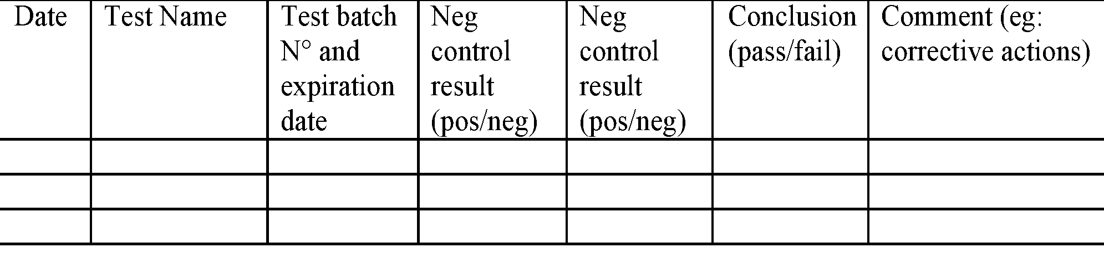
Maintaining EQC Records
Results should be recorded in a QC result form
QC results should be reviewed, at least:
  Once per month by site supervisor/QA officer
  During the site supportive supervision visit
For any failed result: stop testing client, investigate (root cause analysis) and solve the problem

Slide 11
External Quality Assessment
Composed of 2 complementary activities
Site supportive supervision Visits
EQA/Proficiency Testing (PT) scheme
A team of supervisors/QA officers assesses the testing site once/a year and provides feedback reports for improvement.
A panel of unknown samples is sent to each testing site by an external provider regularly. Sites submit their results and providers analyze, compare site results, and provide feedback
EQA activities should not be punitive but as a tool to support continuous improvement

Slide 12
Unsatisfactory EQA results must Lead to Corrective Actions
EQA
Identify
Problems
Take
Corrective
Action
A Corrective action is, an action taken to correct a problem or improve a process.
Corrective action is NOT a disciplinary action against the tester.

Slide 13
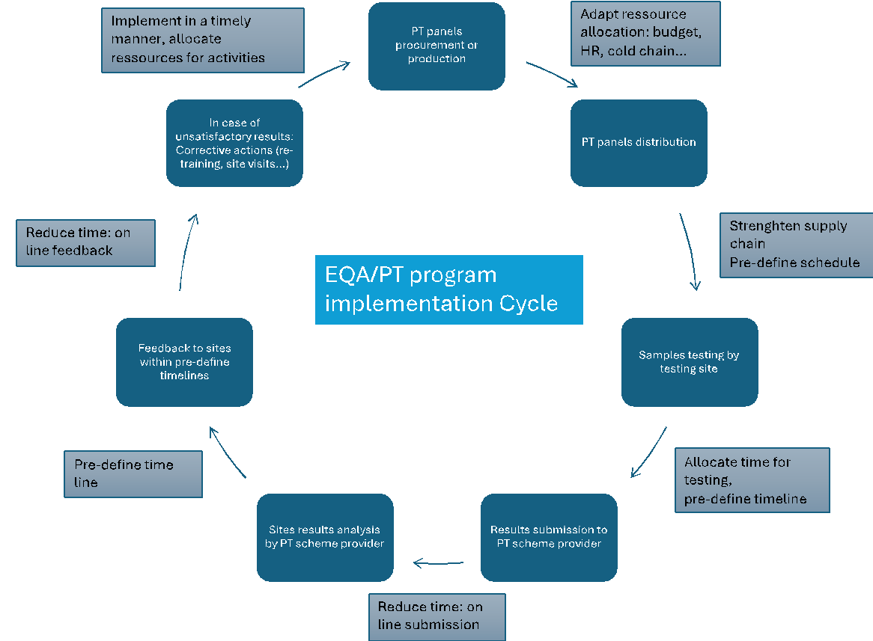
Proficiency Testing program Cycle
National authorities should develop policies, standards, and operational plans and allocate enough resources
At least 1 event/year for each testing provider
PT provider should be carefully selected:
  ideally, ISO 17043 accredited
  In country, regional or international; Non-profit or Commercial provider.
  Locally (reference lab) produced PT panels (e.g DTS) is an option
A panel of at least 6 pos and neg specimen panel
Tested as client specimens
Evaluation reports should contain: site performance results + recommendations for improvement
Prompt implementation of corrective actions is key to ensure efficiency (need resources)

Slide 14
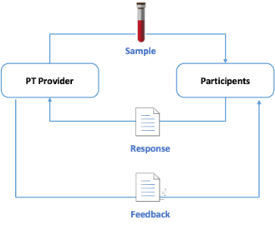
PT Data management systems: paper or digitalized
Paper based (eg: via post service) and online data management system can be used: important to know what system has been selected !!!
Online PT Data Management tools help countries to manage PT programs. It reduces the burden of using paper forms, manual evaluations, and reports to reduce turnaround time in providing feedback to participants.
Data Flow and Management:

Slide 15
Roles and Responsibilities
PT service providers (eg: NRL)
National or subnational QA officer
Testing Site
Provide DTS personnel
train and support testing personnel
Verify panel components upon receipt
Handle sample as per PT provider IFU (eg: reconstitute DTS panel)
Supervise distribution of PT panels in each testing site
Analyse PT results submitted
Test according to the country algorithm
Supervise the timely testing and result submission by the testing site
Submit report within deadline
Provide timely feedback to testing sites
Support the implementation of corrective actions (site visit, phone…)
Report problems with testing
Review feedback report
Provide PT summary reports to National, Province and Districts
Review EQA and QC results during the site supervision visit
Implement corrective actions

Slide 16
Proficiency Testing Sample Types
Sample type
Characteristics for PT
Serum/plasma
Requires cold chain transport
Rapid test and lab-based testing
Expensive
Bio-hazard (incl risk of spills)
Sample type = Important criteria when selecting a PT scheme provider
Dried blood spot (DBS)
Transported at room temperature
Inexpensive
Lab-based testing only
Dried tube specimen (DTS)
Stable at room temperature
Easily transported
Inexpensive
Rapid test and lab-based testing

Slide 17
Example of Country PT program Cycle
Training of all testing providers Before starting the program
Periodic distribution of PT panel (minimum frequency: once a year/tester)
Testing site Tests PT panel samples using a national testing algorithm
The testing site Reports PT results to the PT service provider after each PT panel distribution within a pre-determined timeframe
The service provider provides feedback to testing sites after each PT panel distribution within a pre-determined timeframe
In case of unsatisfactory PT results, the testing site Implements timely corrective actions and improvement measures with the support of the QA officer (phone, site visit, re-training)

Slide 18
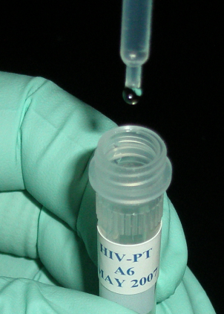
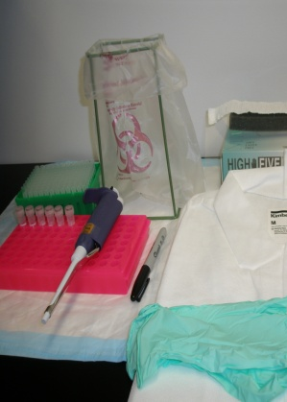
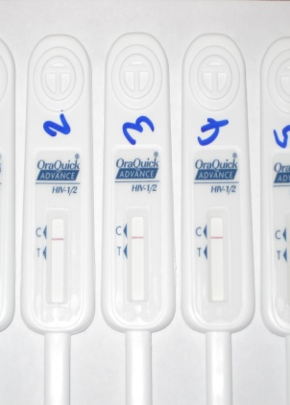
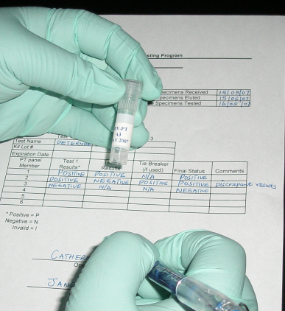
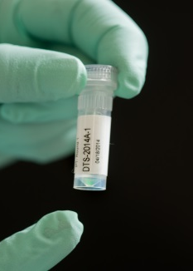

Exemple of PT scheme using Dried tube specimen (DTS) panels
Adapt according to the PT program
https://rtcqi.org/pillars/increasing-proficiency-testing
Notes:
Briefly introduce the DTS technique, this is a new concept and terminology. Please avoid providing too many technical details

Slide 19
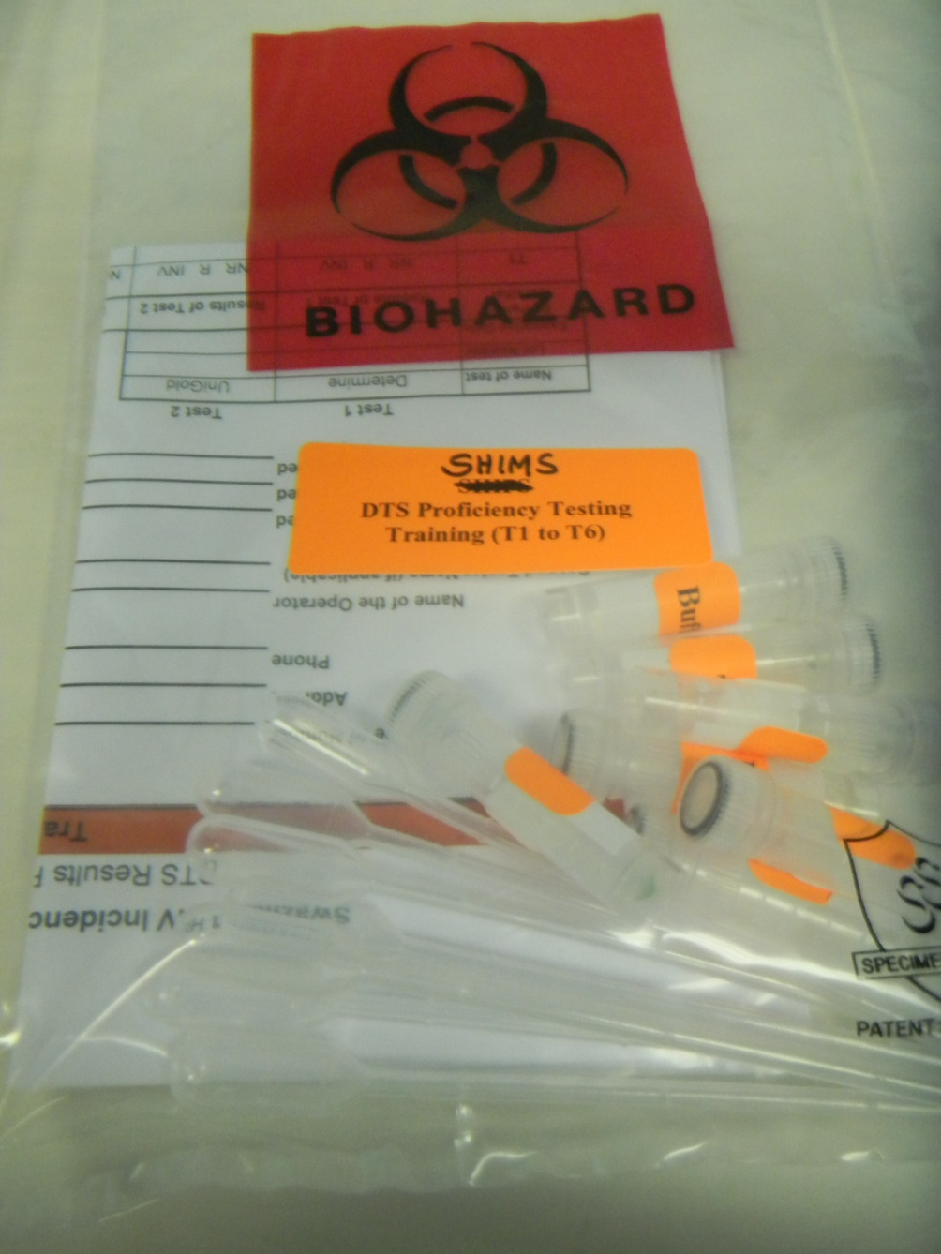
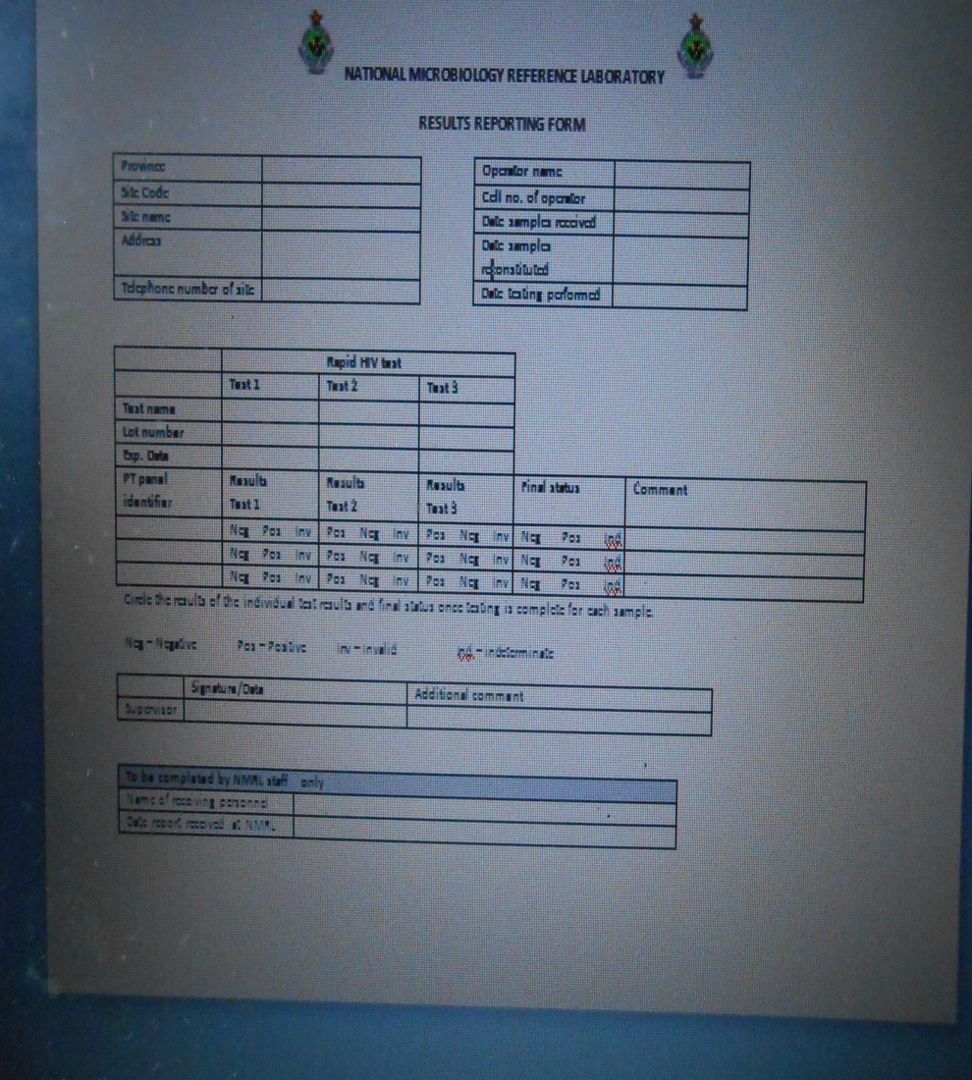
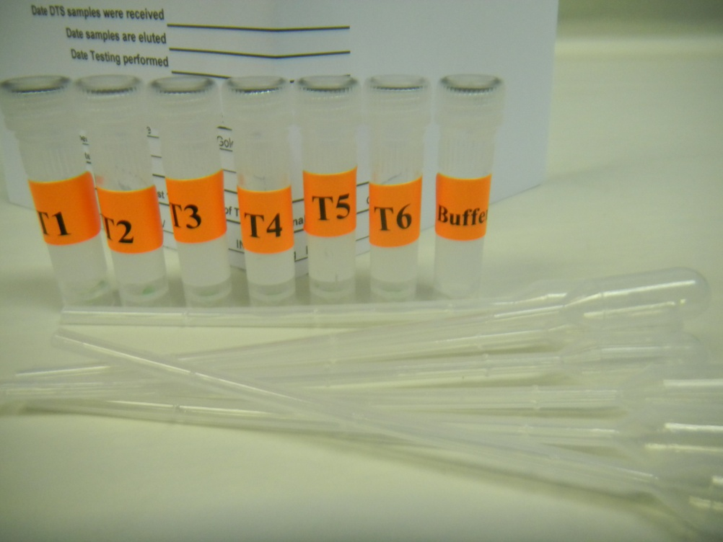
DTS PT Pack is sent to testing within pre-define timelines
DTS PT Pack received by sites
Composition of the DTS pack:
6 sample tubes
1 buffer tube
2 droppers
1 Results recording form
1 Testing Instructions
Adapt according to the PT program
Result form
PT Panel tubes
Buffer
Droppers

Slide 20
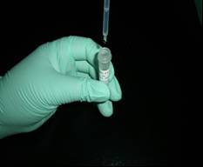
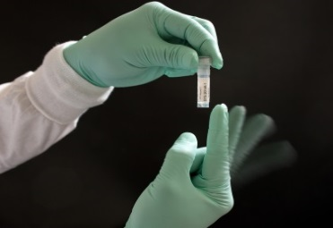
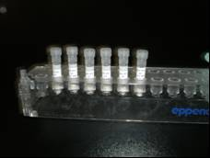
DTS Reconstitution, Testing and Reporting Procedure
  Reconstitute only when you are ready to test the DTS panel the next day
1
2
3
4
5
Using plastic pipette, add 7 drops of buffer to each tube
Tap the tubes to
mix well
Leave tubes
standing upright at room temperature overnight.
The next day, tap tubes, mix and test according to
national algorithm
  Record the results on the Results submission form and send to NRL
Ensure the form is filled out completely, accurately and sent back (online or post) within pre-define timelines.
Contact the district QA officer, if any components of the panel are missing or compromised.

Slide 21
Storage and Handling of DTS QC Specimens
Short-term storage (<7 days): store at 4°C
Long-term storage: -20°C or colder up to 1 year
–Shipped at room temperature and rehydrated upon receipt at the test site
–Overnight rehydration will be done by the health facility tester and the QC will be performed the next day (https://rtcqi.org/pillars/increasing-proficiency-testing)

Slide 22


Key points
Process control is a set of activities: QC (IQC and EQC) and EQA (site supportive supervision, EQA/PT scheme)
Objectives: identify problems in order to solve them to avoid recurrence: identify, investigate and take corrective and preventive actions
QC and EQA
Identify
Problems
Take
Corrective/preventive
Action

Slide 23
Questions?

