Slide 1
Session 1
Understanding violence against women as a public health problem

Slide 2

Learning objective
Demonstrate general knowledge of VAW as a public health problem
Competencies
Know the epidemiology of VAW
Describe the health consequences of VAW
Understand the role and limitations of providers in responding to VAW
Know about WHO guidelines and tools to respond to VAW

Slide 3
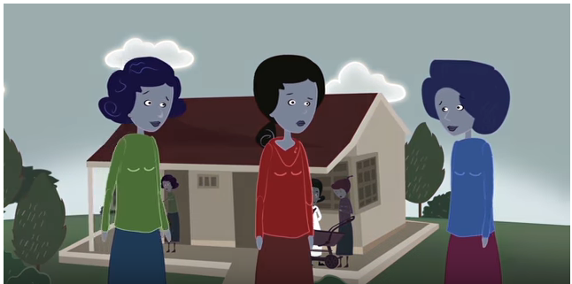

Violence against women: Strengthening the health system response
https://www.youtube.com/watch?v=Qc_GHITvTmI
Notes:
Ctrl + mouse click on the underlined link opens a video on YouTube.
If you cannot access the YouTube video, please contact WHO to request a downloadable version by emailing: reproductivehealth@who.int

Slide 4
Definitions and forms of VAW

Slide 5


Any public or private act of gender-based violence that results in, or is likely to result in physical, sexual or psychological harm or suffering to women, including threats of such acts, coercion, or arbitrary deprivation of liberty with the family or general community
Violence
against women
Notes:
This global definition is the UN definition from the Declaration of the Elimination of Violence Against Women.
Acknowledge: Countries might have variations on these definitions derived from their own legal frameworks. These will be discussed or presented in the session on legal and policy context. The important thing to recognize is that, while some types of behaviour may not be legally recognized as forms of violence (for example, marital rape), nonetheless they are still forms of violence with important implications for women’s health and health-care needs, whether or not there is legal redress.
Emphasize: Violence against women is an expression of unequal power or a form of abuse of power.
Explain: Sometimes there are cases of mutual violence, and it is important to listen to women’s experiences of violence in their own words and respond accordingly.

Slide 6
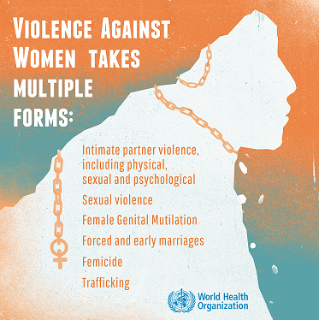
Violence against women… …takes many forms
Domestic/ intimate partner violence:
the most common form of violence experienced by women
Notes:
There are many forms of violence against women, including domestic violence/intimate partner violence, sexual violence by someone other than a husband or partner, femicide, forced and early marriage, human trafficking, female genital mutilation in some regions. The most common form of violence experienced by women is domestic or intimate partner violence.
Violence by an intimate partner – a husband, ex-husband, boyfriend, ex-boyfriend or dating partner – including physical, sexual and psychological violence. In some settings this is known as domestic violence. However, domestic violence also includes violence by other family members.
Sexual violence can also be perpetrated by friends, family members, acquaintances and strangers.
In some parts of the world acid-throwing, as well as honour killings, may be other forms of violence experienced by women.
Invite reflection and discussion by asking if there are other examples of violence not listed, what forms of abuse do trainees think are most common in their setting, and what forms are recognized by their legal framework.

Slide 7
Prevalence of VAW

Slide 8
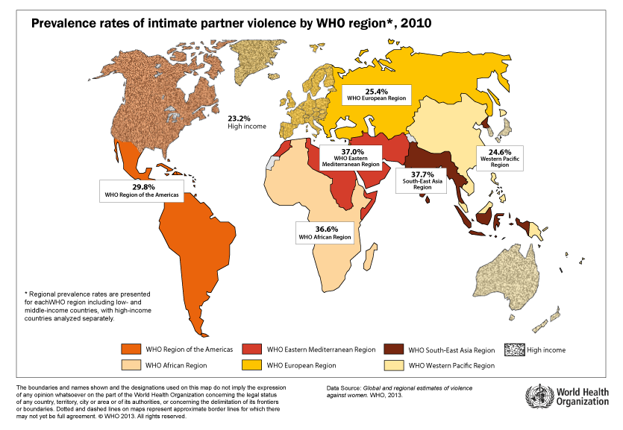
30%♀globally have experienced physical &/or sexual violence by their partner
Notes:
This map shows global and regional estimates of women’s experience of violence. (Distribute handout, Violence Against Women: Global Picture Health Response for estimates for your region.) These numbers come from population-level data from all over the world that was compiled by WHO and published in 2013.
Globally, data show that 30% of women – nearly 1 in every 3 women – have experienced physical or sexual violence by an intimate partner in their lifetime. This varies somewhat by WHO region. This highest prevalence estimates are for WHO South-East Asia Region and WHO Eastern Mediterranean Region. However, even for the high-income countries of North America, Western Europe, Australia and New Zealand, the estimate is still high at over 23%.
In most populations intimate partners are the primary perpetrators of violence against women. While it might be difficult for us to think of partners as perpetrators, it is important to remember that these individuals often pose the greatest risk to women’s safety.

Slide 9
7%♀globally have experienced sexual violence
Non-partner sexual violence, 2010
Globally and by WHO income region, ages 15-16 (total)
Notes:
Sexual violence by someone other than a partner is less common, and there are far fewer survey data available on non-partner sexual violence. However, estimates are 7% for non-partner sexual violence globally. In high-income countries (HIC) the estimate is just above 12% and in Africa close to 12%.
More countries are collecting data on this form of violence in surveys so better estimates should be possible in future, including for the Eastern Mediterranean region, not shown here for lack of data.

Slide 10
[Add local prevalence data]
Notes:
If available, provide national or sub-national prevalence data for your country. These may be available through Demographic and Health Surveys (DHS) or other, equivalent national surveys on VAW. Explain the figures and the forms of violence that are most common.

Slide 11
Violence starts early in women’s lives
Age group, years | Prevalence, % | 95% CI, %
15 – 19 | 29.4 | 26.8 to 32.1
20 – 24 | 31.6 | 29.2 to 33.9
25 – 29 | 32.3 | 30.0 to 34.6
30 – 34 | 31.1 | 28.9 to 33.4
35 – 39 | 36.6 | 30.0 to 43.2
40 – 44 | 37.8 | 30.7 to 44.9
45 – 49 | 29.2 | 26.9 to 31.5
50 – 54 | 25.5 | 18.6 to 32.4
55 – 69 | 15.1 | 6.1 to 24.1
60 – 64 | 19.6 | 9.6 to 29.5
65 – 59 | 22.2 | 12.8 to 31.6
Lifetime prevalence of partner violence by age
Notes:
Violence starts early in women’s lives. By ages 15-19, already 30% of girls have experienced intimate partner violence.
Prevention and response are particularly crucial for adolescents because they have specific vulnerabilities related to age, autonomy, not having reached full legal capacity to access services in some settings, etc. While some of this may be dating violence, in many settings where child marriages are highly prevalence, intimate partner violence for adolescent girls may be in the context of being child brides.

Slide 12
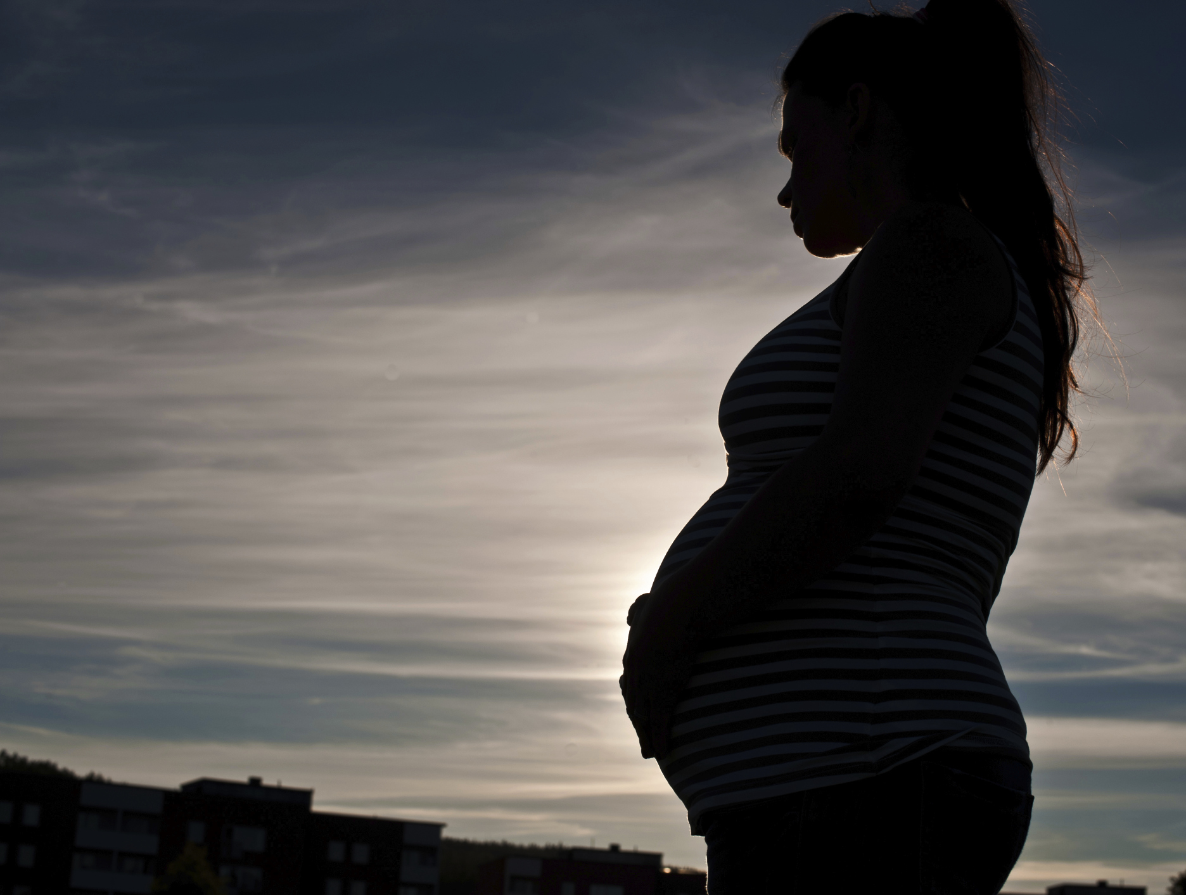
HIGH levels of VIOLENCE during pregnancy
“
He hit me in the belly and made me miscarry two babies….
I went to the hospital with heavy bleeding and they cleaned me up.
– Woman interviewed in Peru
Notes:
Pregnancy is not a protected time for women. In many instances violence starts before and continues throughout pregnancy or may start during pregnancy. Health-care providers’ attention to violence during pregnancy is important because of its consequences for the woman and for the foetus. As this woman in Peru tells us, violence can cause miscarriages.
We don’t have good data for violence against other populations of women, but small studies indicate disproportionate violence faced by women living with HIV, women with disabilities, indigenous women and women who engage in sex work. It is important to be aware of this. As a health-care provider you will encounter these women as your patients in your routine work.

Slide 13
Health and socio-economic consequences

Slide 14
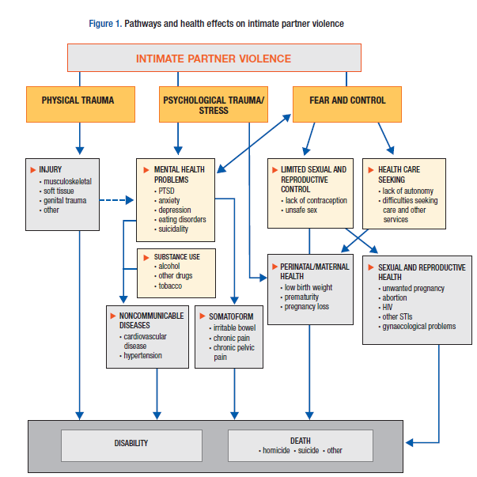
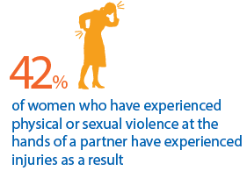
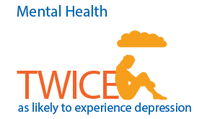
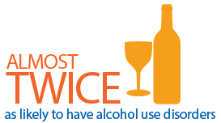
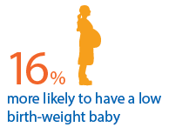
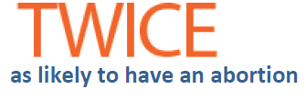
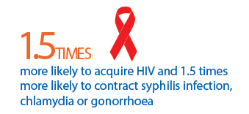
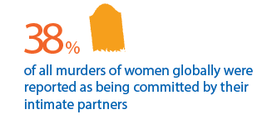
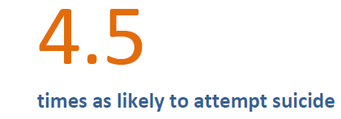
Pathways & health effects
Notes:
Violence against women has both physical (including sexual and reproductive health) and mental health consequences. There are both fatal and nonfatal outcomes. Also, there are short-term and long-term outcomes. Further, these health outcomes vary by population and setting.
WHO global estimates, published in 2013, draw on systematic reviews of published studies. These estimates show the following: [Read the numbers/figures that show the associations with health consequences one by one and explain the following:]
The pathways by which intimate partner violence affects women’s health include physical trauma (click to reveal image), which results in injuries, and also psychological trauma, which is linked to depression (click to reveal image), post-traumatic stress syndrome (PTSD), alcohol and substance use disorders (click to reveal image), and which also contributes to noncommunicable diseases and to somatoform symptoms. And to fear and subjection to control that limits sexual and reproductive autonomy and health-care seeking, which in turn can lead to low-birth weight babies (click to reveal image), pre-term births, lack of contraceptive use, unsafe sex, induced abortions (click to reveal image), STIs and HIV (click to reveal image).
Violence against women also leads to deaths – femicides: 38% (some estimates suggest 50%) of murders/homicides of women are by their intimate partners (in comparison with 6% of murders of men) (click to reveal image). Also, women subjected to intimate partner violence are more likely to attempt suicide (click to reveal last image).
Invite reflection by asking if there are any surprises in terms of the health outcomes presented, and whether and what kind of health symptoms and conditions are seen by the participants in their clinical practice.

Slide 15
Inter-generational &
socio-economic consequences
Effects on children | Higher rates of infant mortality Behaviour problems Anxiety, depression, attempted suicide Poor school performance Experiencing or perpetrating violence as adults Physical injury or health complaints Lost productivity in adulthood
Effects on families | Inability to work Lost wages and productivity Housing instability
Social and economic effects | Costs of services incurred by victims and families (health, social, justice) Lost workplace productivity and costs to employers Perpetuation of violence
Notes:
Beyond the health consequences on the woman, there are also consequences for children and families and socio-economic consequences for her and her family and for communities and societies.
Read the consequences from the slide. Highlight the inter-generational consequence: Children exposed to violence or subjected to violence themselves are more likely to perpetrate or experience violence.
Thus, it is important for health-care providers to see if the children who accompany women subjected to violence show signs or symptoms. Similarly, children’s signs and symptoms may be a cue to also assess whether their mothers are experiencing IPV.
15

Slide 16
Role of health-care providers

Slide 17

Health providers and health systems have a critical role in supporting women, minimizing the impact of violence and preventing violence
Why health systems?
Women and girls experiencing violence are more likely to use health services
Health-care providers are often women’s first point of professional contact
All women are likely to seek health services at some point in their lives
Notes:
Health-care providers are often trusted by women and serve as role models in the community.
Research shows that abused and non-abused women alike feel that violence-related discussion in health settings…
can help abused women get help
makes women glad that someone took an interest
is not insulting to women who are not being abused
Violence is an underlying cause of injury and ill health.
All women are likely to attend health services at some point, especially sexual and reproductive health services.
Human rights obligations to the highest standard of health care.

Slide 18
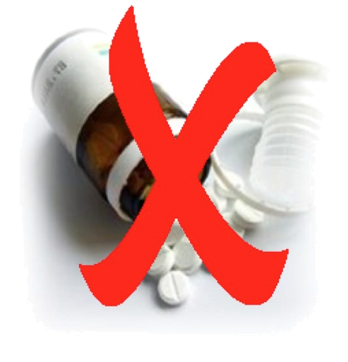
Why is the VAW response different?
No magic pill
Needs may include:
Emotional support
Reassurance
Physical health care
Safety may be an ongoing concern
Referrals for other resources that the health system cannot provide
Help to feel more in control and able to make her own decisions
Notes:
There is no magic pill to solve the issue. Instead, providers need to offer empathic support and enable and help women to feel more in control in order to make their own choices and decisions, including whether they want to use referral services outside the health system. Ask for or provide an example of safety concerns and practical needs that require resources from other sectors.

Slide 19
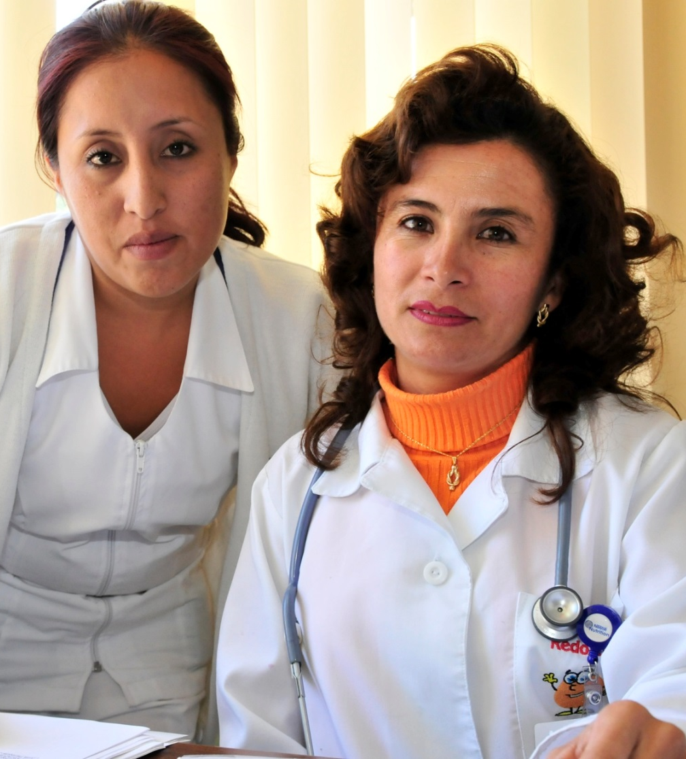
Role of health-care providers
Do no harm
Identify violence
Empathic response
Clinical care
Referrals as needed
Documentation
Medico-legal evidence
Advocacy as community role models
Notes:
Highlight the nature of the provider-patient relationship as one of trust and also where the provider may be a role model. In that context it is important that providers do no harm, focus on identification, empathy, care, referrals, documentation, evidence for courts (if woman wants to legal action) and advocacy in the community.
The needs of a woman subjected to violence are complex, and the health-care provider may not be able to address them all. The health-care providers’ role focuses on support and care.
If health workers know about a history of violence they can give better services for women
Identify women in danger before violence escalates
Provide appropriate clinical care
Reduce negative health outcomes of violence
Assist survivors to access help / services/ protection
Improve sexual, reproductive health and HIV outcomes

Slide 20
Providers are NOT responsible for
  Solving violence-related issues
  Addressing all violence-related needs
  Addressing all aspects of treatment, care & support in one consultation
Notes:
Providers are not responsible for solving the issues or making decisions for women or even addressing all the issues that a survivor faces at one go. Instead, their task is to really help women make choices and decisions about their lives.

Slide 21
Ignoring violence can do harm
Provider behaviour
Possible consequences
Blames or disrespects women or girls
Doesn’t recognize VAW behind chronic or recurring conditions
Fails to provide post-rape care or address VAW in FP, STI/HIV care
Breaches privacy or confidentiality
Ignores signs of fear or emotional distress
Inflicts additional emotional distress or trauma
Woman receives inappropriate or inadequate medical care
Unwanted pregnancy, STIs, HIV, unsafe abortion, more violence
Partner or family member becomes violent after overhearing information
Woman is later injured, killed or commits suicide

Slide 22
WHO guidelines & tools to assist providers

Slide 23
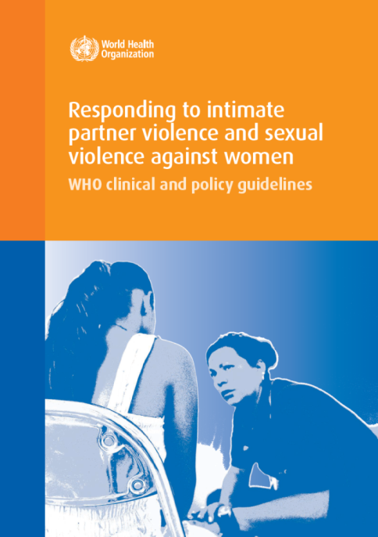
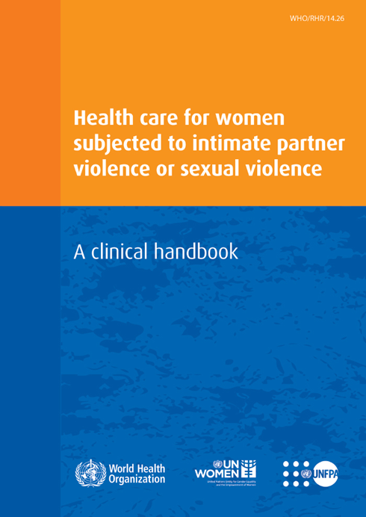
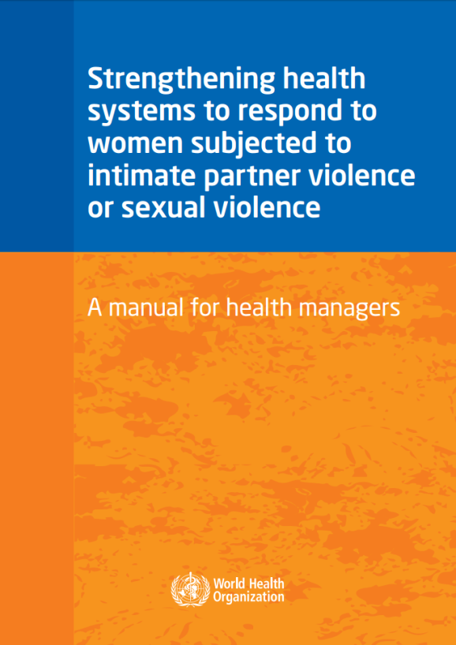
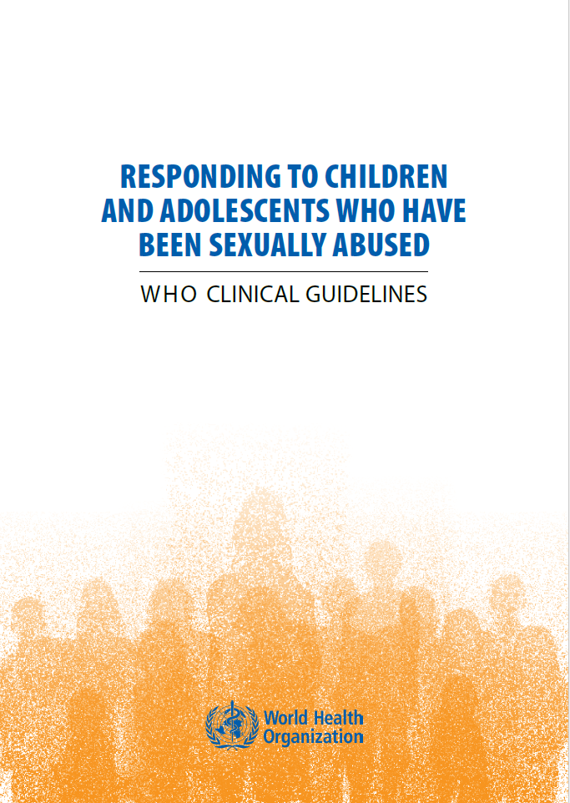
WHO guidelines & implementation tools
"What"
"How”
Notes:
“What”: WHO has developed guidelines for the health sector response to intimate partner violence and sexual violence. In 2013 WHO launched Clinical and policy guidelines for health sector response to intimate partner violence and sexual violence.
The clinical guidelines provide evidence-based recommendations in 6 areas:
Provision of women-centred – first line support
Identification and provision of clinical care for survivors of IPV
Clinical care for survivors of sexual assault
Training of health-care providers
Health service delivery
Mandatory reporting.
The first 3 sets of recommendations address front-line providers. The next 3 sets of recommendations address health managers and policy-makers.
Additionally, in 2017 WHO published clinical guidelines for care of children and adolescents who have been sexually abused. These guidelines specifically consider child- or adolescent-centred first-line support,; clinical care for sexual abuse, including history taking, examination and documentation to minimize trauma and distress; treatment, including mental health care; and ethical considerations for reporting such abuse.

Slide 24
Contents of clinical handbook
Part 1
Part 2
Part 3
Addendums
Family planning
& HIV
Awareness & Identification
First-line support
Part 4
Additional care after sexual assault
Additional care for mental health
Notes:
“How”: To help front-line health-care providers apply the guidelines in their daily practice, in 2014 WHO published the clinical handbook, Health care for women subjected to intimate partner violence or sexual violence: a clinical handbook. The clinical handbook consists of 5 parts. They focus on how to identify survivors of intimate partner violence, how to offer first-line support, care for survivors of sexual assault, mental health care and specific considerations for family planning and HIV providers.
If you are a front-line provider, the clinical handbook will be your main reference guide for this training. You may have a version that is global or a version that is nationally adapted and adopted. If you also have additional responsibilities as a health manager – someone with supervisory responsibilities or management responsibilities – you will also find job aids in the health manager’s manuals useful, particularly for areas such as how to establish and provide referrals (chapters 3 and 8); how to document IPV and tools for documentation (chapter 9, annexes 9 and 10), and how to strengthen infrastructure for privacy and confidentiality (chapter 5). The content relevant to specific considerations for children and adolescents is included in this training in relevant sessions on clinical care for sexual assault/abuse.

Slide 25
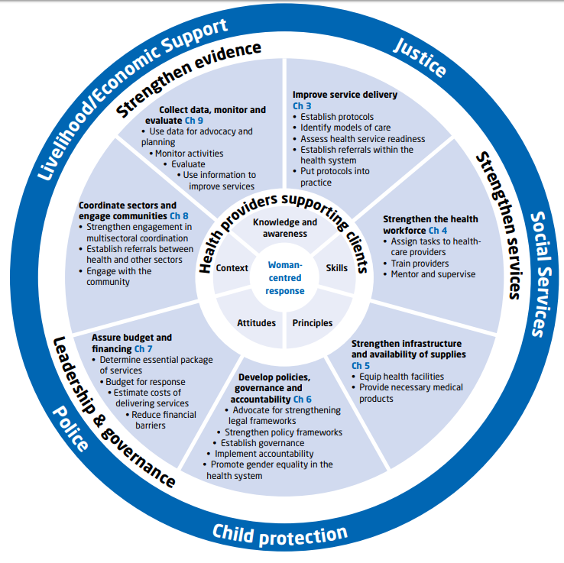
Health managers’ manual: contents
Notes:
“How”: In 2017 WHO published the health manager’s manual to help managers at all levels to strengthen the health systems response to violence against women. As shown in the circle diagram at right, the health manager’s manual applies WHO’s health systems building blocks to provide instructions to assess the situation; improve service delivery; strengthen health workforce capacities; improve infrastructure and supplies; develop policies, budget and funding; improve coordination and referrals and engage communities; and collect data, monitor and evaluate services, including through improved documentation systems. These implementation tools have job aids that are useful resources for health-care providers and for those who may have additional managerial responsibilities to guide provision of care and support.
This training draws primarily from the clinical handbook for health providers but also includes some content from the health manager’s manual.

Slide 26
Key messages
Violence against women takes many forms
Health impact can be short- and long-term consequences for health and well-being
While not disclosing abuse spontaneously, many women seek treatment for conditions or complications caused by violence
Therefore, health-care providers have a central role to identify and support survivors
Notes:
While addressing violence against women requires all sectors to work together in a coordinated way, the health sector and health-care providers have a central role to play in identifying and supporting survivors.

Slide 27
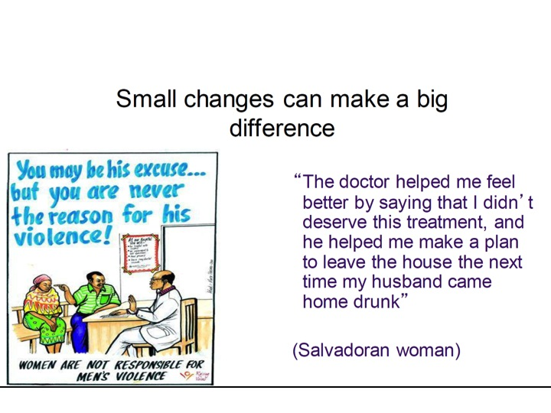

Small changes make a BIG difference
“The doctor helped me feel better by saying that I don’t deserve this treatment, and he helped me to make a plan to leave the house the next time my husband became violent .”
— Salvadoran woman
Notes:
Often small changes in how a health-care provider responds – for example, speaking with empathy – make a big difference to women. This is reflected in the words of a Salvadoran woman.

