Slide 1
Session 13
Addressing family planning and HIV disclosure for women subjected to violence (supplemental)

Slide 2

Learning objective
Demonstrate clinical skills appropriate to one’s profession and specialty to respond to VAW
Competency
Demonstrate skills in identifying and caring for women experiencing violence who present to either family planning or HIV services

Slide 3
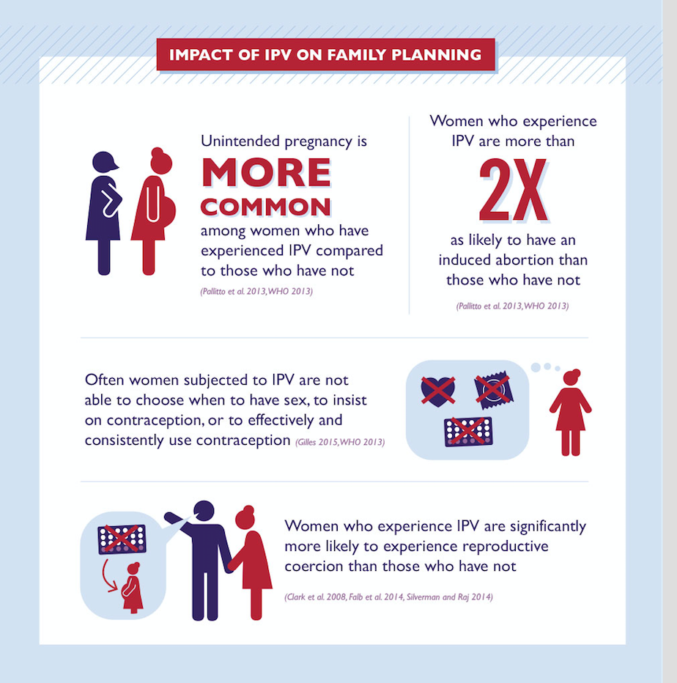
Why talk about IPV and family planning?
IPV = intimate partner violence
Notes:
Intimate partner violence (IPV) can interfere with a woman’s ability to make choices about her reproductive health, such as her ability to plan her pregnancies and/or use contraception effectively and consistently. In nearly all settings women subjected to IPV have high rates of unintended pregnancies and negative reproductive health outcomes. There’s a lot that a family planning provider can do to support and empower a woman facing IPV who is seeking help with family planning.

Slide 4
Family planning and IPV
What is reproductive coercion?
  Behaviours that interfere with contraceptive use and/or pregnancy
Family planning providers can help by:
  Knowing when to suspect and how to ask about IPV
  Using “LIVES”, especially enhancing safety and promoting autonomy regarding contraception and family planning
Notes:
Examples of reproductive coercion
Attempts to make a woman pregnant against her wishes
Controlling the outcome of a pregnancy
Coercing a partner to have unprotected sex
Interfering with contraceptive methods

Slide 5
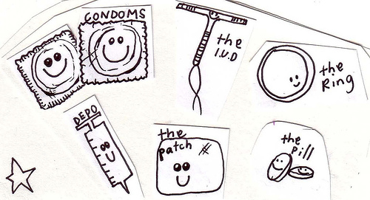
Asking about violence in the FP setting
In addition to questions about violence, ask:
Has your partner ever hidden or taken away your contraceptive pills?
Has your partner ever tried to force you or pressure you to become pregnant?
Has your partner ever refused to use a condom?
Has your partner ever
forced you have sex without
contraception to try to
make you pregnant?
Notes:
As in other settings, use clinical inquiry to identify possible intimate partner violence.

Slide 6
Consider and explain the pros and cons of contraceptive methods in the context of violence
Method | Pros | Cons | Discussion points
Injectable contraceptive, (depot shots) | - Does not leave any signs on the skin - No supplies to store | - With 2- and 3-month types, monthly bleeding often stops after a time - Another injection needed every 1, 2 or 3 months, depending on type | - Are you concerned that your partner may track your periods? - Do you think you could go for re-injection visits without fail?
Implant | - Works well for several years - Usually, no follow-up required - No supplies to store | - Sometimes can be felt and seen under the skin of the arm - May cause spotting or changes in menstrual bleeding (often improves after 3 months) | - Are you concerned that your partner may track your periods?
Copper or LNG IUD | - Remains out of sight in the uterus - Copper IUD works well for at least 12 years; LNG-IUD, for 3–5 years - Usually, no follow-up required - No supplies to store | - Copper IUDs often increase menstrual flow - Hormonal IUDs can make periods lighter or stop - Caution if woman has current STI or high STI risk - Partner may feel ends of strings in cervix | - Are you concerned that your partner may track your periods? - Do you think that you may have an STI or likely to get an STI?
The pill | - Does not leave any signs on the skin - Little effect on menstrual bleeding | - Must be taken every day - Pills/packaging must be kept in a safe place | - Do you have a safe place to keep the pills?
Notes:
Distribute handout of this slide.

Slide 7
HIV testing in the context of violence against women
Links between
IPV and HIV
Benefits
Increased social support
Increase access care and treatment
also encourage partner-testing → safer sex and condom use, PreP
Increase women to seek services for kid
Risks
Some women in violence, risk for lives
Loss of trust
Physical, emotional or sexual violence
Thrown out of house, loss of kids, jobs
Stigma
Violence
HIV infection
HIV risk
Notes:
For other section – “How HIV providers can help”
For women who may fear their partner’s reaction, you can help them weigh the risks and benefits in making the decision about:
Whether
When
How to disclose
You can facilitate safer HIV status disclosure for women who fear violence.

Slide 8
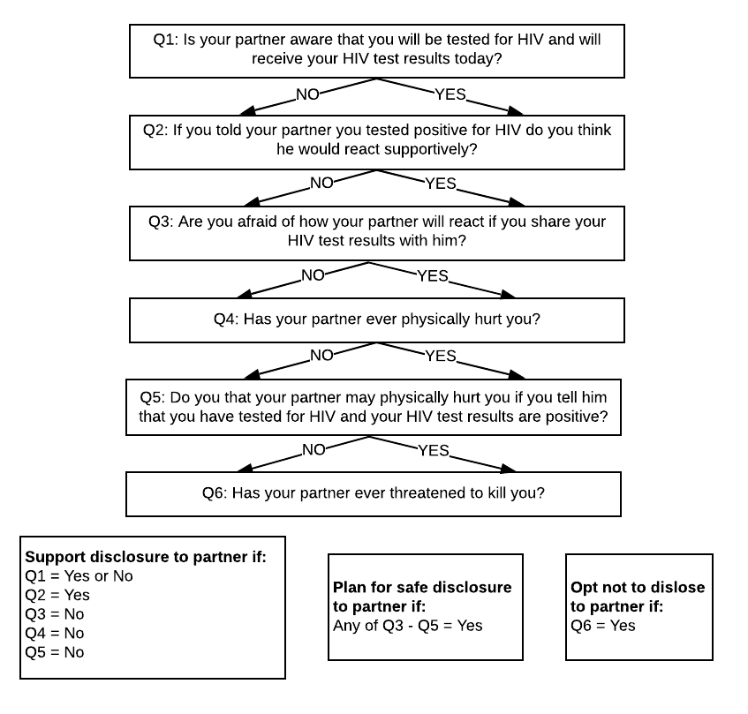
HIV disclosure: Is there potential for violence?
Job aid
SOP for safe HIV disclosure counselling in the context of violence
Notes:
If you are counselling a woman who has already received an HIV-positive test result, discuss all 6 questions with her.
“Yes” to question 4 or 5; “no” to question 6: If a woman’s partner has never threatened to kill her ( “no” to question 6), but he has harmed her or threatened to harm her (“yes” to question 5) or she thinks disclosing her HIV-positive status could lead to violence (“yes” to question 4), discuss whether to disclose. If she chooses to disclose, help her plan for safe disclosure.
“Yes” to question 6: If a woman’s partner has ever threatened her life (“yes” to question 6), counsel against disclosing HIV-positive status.
In all other situations, offer support for disclosure.
Question 1 may be a good question to ask every woman being tested for HIV, before or after she has received her results and regardless of the result. If her partner knows she is being tested, you can then ask how he reacted to that information. Was he angry, brooding or violent? Or was he supportive? If her partner does not yet know that she is being tested, you can ask how he might react if and when he learns this. (In some cases just learning that she has tested may make him violent – regardless of the test result.)

Slide 9
Planning for safer HIV disclosure
Timing: Discuss a suitable time – when partner is not tired, under the influence of alcohol or other substances or stressed for other reasons.
Place: Discuss finding a place that gives privacy but other adults are close by.
Should others be present?
In some cases having another adult present can be crucial
Should be someone the woman trusts and who knows her HIV status
This person’s role should be to support the woman, observing/listening only. But if tension builds, this person can try to calm the tension and, if necessary, to help the woman leave.
Overhearing disclosure may be traumatic for the children. Finding a space to talk without the children is important.
– continued –

Slide 10
Planning for safer HIV disclosure
– continued –
Finding the words and role playing: Help the woman find and practice words that tell of her HIV-positive diagnosis directly and simply, without blaming. eg:
Safe exit strategy : Help the woman develop an exit plan if tension escalates during disclosure (eg: locating herself in a room where she can easily exit if she needs to leave quickly).
Opting not to disclose: In some cases it may not be possible to enhance a woman’s safety. If her partner has ever threatened to kill her, the safest plan would be to avoid disclosing her HIV-positive status to him.
“I have something important to tell you.”
Notes:
Finding words: It is best to avoid too much explanation and not to make accusations or to blame a partner if she suspects that he infected her. It may help to say that treatment is available and helps people with HIV live long, healthy lives.
Exit plan: It is important to choose a place that she can leave quickly and easily.
For more information on enhancing safety, see clinical handbook page 14.

Slide 11
Exercise 13.1: Case reviews for family planning and HIV settings
Learning objective of the exercise: To develop clinical decision-making/case management skills to respond to survivors of violence who present in family planning or HIV testing settings
Form 2 groups
Each group reads the scenario and discusses answers to the questions. Record answers on the flip chart.
Each group then reads the other scenario and answers the questions.
Time: 10 minutes for each group discussion
Then, 10 minutes for plenary discussion
Notes:
Exercise 13.1. See facilitator’s guide for detailed instructions. For each case providers will need to decide what questions to ask, how best to ask and what specific care and counselling the survivor needs.

Slide 12
Key messages
Check your knowledge!
Yes or no: should you recommend that all women disclose their HIV status to their partners?"
Clinicians will need to develop specific skills to provide care to survivors of violence based on setting, presentations and her specific needs
Some aspects of care are standard. For example, first-line support, asking about violence and management of sexual assault are relevant in any setting.
Family planning clients, however, may need specific counselling on choice of a contraceptive method choice that meets their need for safety
Similarly, HIV-positive women will need specific counselling on disclosure and safer sex negotiation
Notes:
Click to pop up knowledge check:
Answer: Every woman's situation should be considered individually. It is your role as a health provider to help women make an informed choice by alerting them to the potential benefits and risks. It is the woman's decision on whether she would like to disclose. In a small number of cases, disclosure may put the woman in an unsafe situation, and it may be best to avoid disclosure to protect the woman's safety.

Slide 13
Exercise 13.1a: Extra scenarios: Case reviews for family planning and HIV settings
Learning objective of the exercise: To develop clinical decision-making/case management skills to respond to survivors of violence who present in mental health or humanitarian health care settings.
Form 2 groups
Each group reads the scenario and discusses answers to the questions. Record answers on the flip chart.
Each group then reads the other scenario and answers the questions.
Time: 10 minutes for each group discussion
Then, 10 minutes for plenary discussion
Notes:
Exercise 13.1a. See facilitator’s guide for detailed instructions. For each case providers will need to decide what questions to ask, how best to ask and what specific care and counselling the survivor needs.

