Slide 1
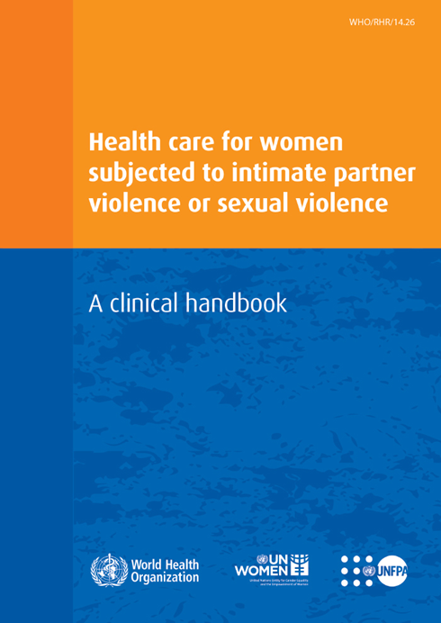
Session 3
Guiding principles and overview of the health response to violence against women
Notes:
This session begins with a focus on the guiding principles for offering women-centred care and discusses how to put these principles into practice in your settings. Then, it provides an overview of the clinical handbook, which is the main resource for this training, so that you can follow it as we progress though the training sessions.

Slide 2

Learning objective
Demonstrate behaviours and understand values contributing to a safe & supportive service culture
Competencies
Know the guiding principles of woman-centred care
Understand how to apply the guiding principles in your practice

Slide 3
Guiding principles
Notes:
In this section we will go through the ways that you, as providers, can put the guiding principles into clinical practice for women-centred care.

Slide 4



Guiding principles
Two fundamental principles:
Respect for human rights
Promotion of gender equality
Notes:
The foundation of woman-centred care is respect for human rights and promotion of gender equality and women’s empowerment (SDG 5). We will explore how this can be operationalized in your settings.

Slide 5
Guiding principles
What does it mean to respect human rights?
  Autonomy
  Freedom from fear & violence
  Highest attainable standard of health
  Non-discrimination
Notes:
1. Respecting women’s autonomy to make decisions and choices for their own lives and situation. Her wishes determine the care that you give. This can include respecting her right to say “no” to medical interventions or to taking legal action.
2. Freedom from fear and violence requires that your actions and interventions promote safety and do no harm. Confidentiality and privacy are part of promoting safety.
3. Highest attainable standard of health: Even where resources are limited, providers can offer all survivors important care and support. These include first-line support, treatment for underlying conditions and referrals for additional care and services. Wherever the provider sits – at the primary, secondary or tertiary level – it is important to offer the best possible care.
4. Non-discrimination: Survivors of violence are not all the same. Many face multiple forms of discrimination. These same forms of discrimination may also affect their ability to obtain health care – and their experience of health care – because of our own beliefs and values about:
Sex – for example, we may blame women or not believe that boys can also be sexually abused.
Age – for example, we may blame adolescent girls for the way they dress or behave.
Race/ethnicity – for example, women from ethnic or racial minorities or indigenous women may not only face a higher burden of violence, but they also may face discrimination.
Others may face obstacles in accessing services or discrimination when seeking care because of class, socioeconomic status, sexual orientation (for example, LBTIQ), religion (religious minorities), HIV-positive status, substance use (injecting drugs or engaging in harmful alcohol use) or marital status (single women).
Discrimination and inequalities often intersect: Gender and other social stratifiers add layers, making it more difficult for some groups to access services or receive quality care. Providers need to be aware of this, take it into account and ensure that their values and beliefs do not add to discriminatory treatment of survivors of violence.
Pay attention to how people are treated based on many characteristics.
Treat all people with respect and be a role model of fair and respectful treatment.
Recognize your own biases (self-awareness).
Understand the fears that patients may have in seeking care. For those exposed to violence in the past, particularly during childhood, routine things such as undressing or gynaecologic exams can trigger memories of the abuse and be retraumatizing if not handled sensitively.

Slide 6
Guiding principles
What does it mean to promote gender sensitivity/equality?
Be aware of power differences
Avoid reinforcing unequal power dynamics
  Reinforce her value as a person
  Respect her autonomy and dignity
  Provide information and counselling that help her to make her own decisions
  Listen, believe and take what she says seriously
  Do not blame or judge
Notes:
Violence is meant to disempower or take power away from the victim, or is a way that a perpetrator chooses to exercise power over the victim. Violence against women is driven by unequal power relations between women and men in society.
These power dynamics show up in many ways. For example, women may…
have less access to and control over resources than men
not have the freedom to make decisions for themselves
be blamed or shamed for violence; feel low self-esteem
be subjected to norms that prevent them from leaving relationships or seeking care
feel that there is something wrong with themselves or with their situation and, blaming themselves, lack confidence to take action.
As health-care providers, you can recognize these power differences and avoid reinforcing unequal power dynamics by…
reinforcing the survivor’s value as a person
respecting her autonomy by providing information and counselling that help her make her own choices and decisions
treating her with respect and dignity
listening to her, believing her story and taking what she says seriously
not judging but instead validating her story without blaming.
By respecting women’s choices, autonomy and decision-making, you help them reclaim some of the power that the abuse took away. You may not always agree with her choices and decisions. This can be challenging for you. Nonetheless, if you put your own opinions aside and empower the survivor with options, you are role-modelling equality in your capacity as a health-care provider.

Slide 7
Privacy and confidentiality
Privacy, safety and confidentiality must drive:
  When and where violence is discussed
  Documentation
  Referral processes
Discussion: What do confidentiality & privacy entail in practice?
Notes:
Confidentiality entails:
Maintaining health information and documents confidential. This includes confidentiality from family members.
Exception: situations of mandatory reporting – for example, for minors (in which case this needs to be explained to the woman)
Obtaining the survivor’s permission to share information with those in the health-care system who need to know
Safely and securely storing records
Ensuring that all written information is anonymized when shared and kept with access limited to those who need it.
Privacy entails:
Visual and auditory privacy during consultation: Only those who need to be present are allowed.
Survivors should not…
ideally, have to move from room to room to receive care; minimize the number of points of care
be made to repeat their story to multiple providers.
Breaches of privacy can put women further at risk, especially in cases of partner violence.

Slide 8
Additional considerations for child
& adolescent-centred care
Best interests of the child
Empower non-offending care-givers
Create child friendly environment
Evolving capacities
  Provide age-appropriate information
  Seek informed consent, as appropriate
  Ask child’s or adolescent’s opinions
Notes:
For sexual assault experienced by children or adolescents, there are additional guiding principles based on the best interests of the child. These require:
Empowering non-offending care-givers with information about the care of the child or adolescent
Create a child friendly environment (e.g. toys, drawing pad and pencils)
Considering the evolving capacities of the child:
Give age-appropriate information that the child or adolescent can easily understand. Tailor its delivery to their needs (for example, in choice of words or language, use of visual aids).
Seek informed consent as well as assent during consultation and examination as appropriate.
Ask the child’s or adolescent’s opinions and take them into account, especially for decisions that affect their health
Respect the child’s or adolescent’s wishes and autonomy.

Slide 9
Clinical handbook contents overview
Notes:
The rest of this session presents an overview of the clinical handbook. Later sessions will cover this material in more detail.
Ask the participants to turn to the appropriate pages of the clinical handbook as you review its various sections.

Slide 10
Contents of clinical handbook
Part 1
Part 2
Part 3
Addendums
Family planning
& HIV
Awareness & identification
First-line support
Part 4
Additional care after sexual assault
Additional care for mental health
Notes:
Highlight the five parts of the clinical handbook.
Part 1: basic definitions, awareness about needs of women subject to violence, guiding principles and how to ask about partner violence
Part 2: first-line support as an initial response to disclosure
Part 3: how to provide care for sexual assault
Part 4: mental health care including basic psychosocial support and assessing for moderate-to-severe mental health conditions
Addenda: specific considerations for family planning and HIV settings and how to manage FP counselling and HIV disclosure counselling for women experiencing violence

Slide 11
Clinical handbook part 1
Identifying women subjected to violence
Pages 7–12

Slide 12
Possible entry points for health care
Maternal health (antenatal or postnatal)
Family planning services
Post-abortion care
STI or HIV care
Child health & early childhood development
Adolescent health
Mental health
Substance abuse
Notes:
Women experiencing violence may be seeking care for related emotional or physical conditions, including injuries.
They may be first seen in a variety of services/programmes such as those listed in this slide.
You could start by asking participants what are the most likely entry points for health care in their setting.

Slide 13
Clinical inquiry to identify IPV
NOTE: Universal screening NOT recommended
Instead, discuss violence if the woman brings it up or her signs and symptoms suggest violence.
Asking about violence
Ask only when the woman is alone
Make no judgements
Use appropriate language
Notes:
WHO recommends clinical inquiry – that is, providers trained to have a low threshold for asking based on signs and symptoms or specific conditions – rather than universal screening – that is, asking everyone. A clinical inquiry approach that is rights-based and gender-sensitive means ensuring her safety and asking in anon-judgemental way and using appropriate language.
Asking about violence
Talk about violence only when alone with her.
Be sensitive, non-judgemental and empathic.
Language is important: Some women may not like the words “violence” and “abuse”. Use words that women themselves use. [Last month I was counselling a woman who had been brutally raped. The word “rape” was traumatic for her. We talked about “the event”, and, without re-traumatizing her, I was able to say, “The event was not your fault. The event violated your rights.”]
If a woman does not disclose violence when asked, do not pressure her but instead offer information and invite her back for a follow-up visit.
WHO recommends not asking women before meeting the following minimum requirements:
Providers have been trained on how to ask and provide first-line support
A protocol or standard operating procedure has been established
A referral network/pathway has been established
Privacy and confidentiality can be ensured

Slide 14
Clinical handbook part 2
First-line support
Pages 13-38
Notes:
For those who disclose violence, first-line support is the first and most important initial response to offer. First-line support is an initial response that is non-judgemental, empathic and based on the woman’s needs and concerns and that addresses her needs for practical and emotional support as well as physical care. We will go into depth later in the training on first-line support, but here we will simply learn about the memory aid – the word “LIVES”.

Slide 15
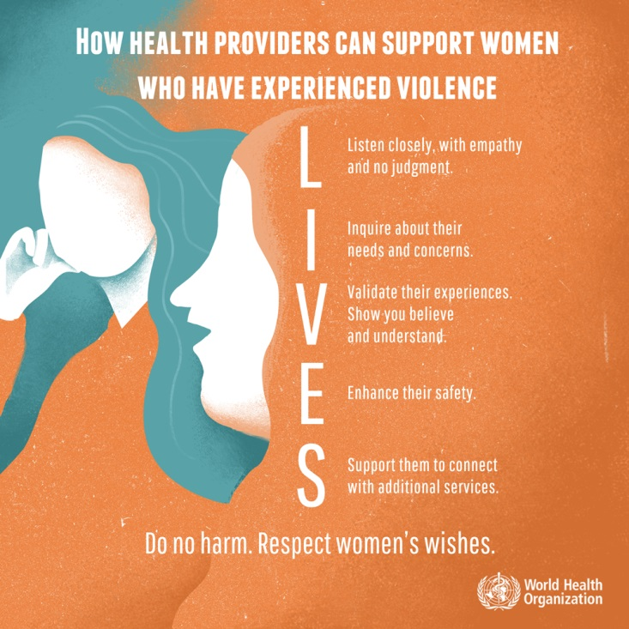
First-line support – job aid
Learn to listen with your
N | Eyes – | giving her your undivided attention
O | Ears – | truly hearing her concerns
Y | Heart – | with caring and respect
Notes:
This job aid can help you remember the five steps in first-line support. The word LIVES can help you remember to Listen, Inquire, Validate, Enhance safety and facilitate Support. This training will go into depth to build skills for LIVES.
This is the most important care that you can provide to a survivor of violence. In low-resource settings this may be the only care that you can provide. It involves care that is non-judgemental, empathic and based on the woman’s needs and concerns.
Next we will introduce the protocol or job aid outlining the steps in care for intimate partner violence. These steps will be covered in more depth later.

Slide 16
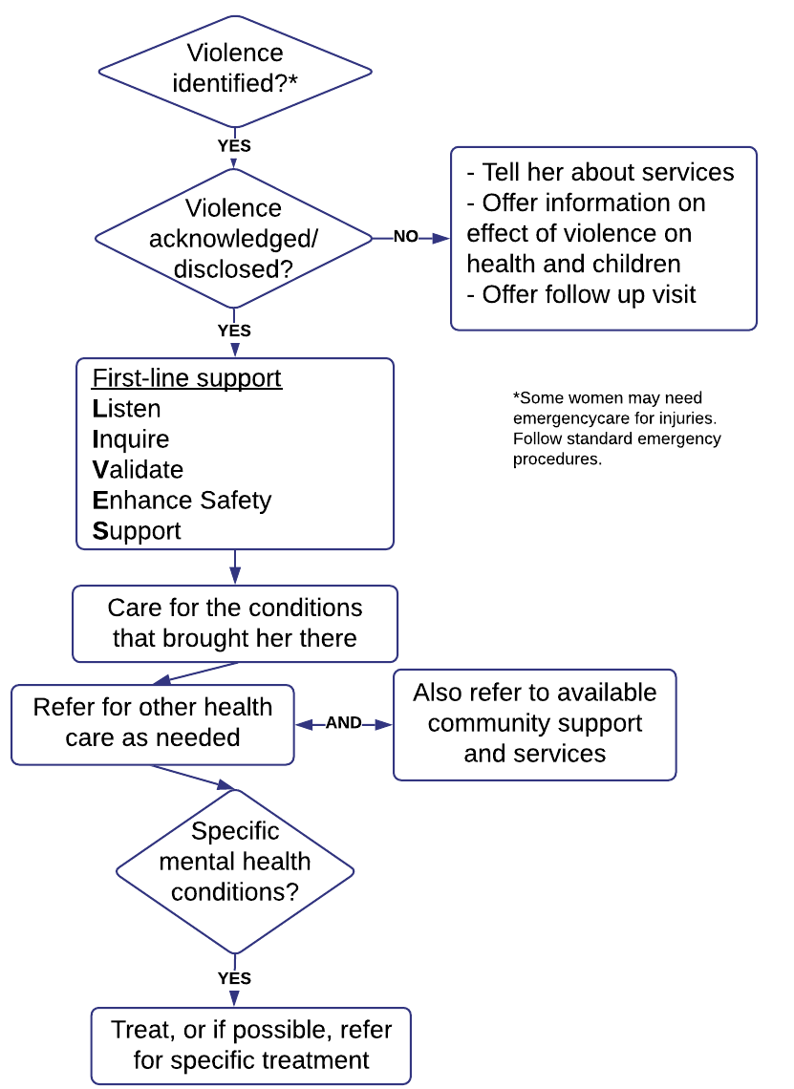
Job aid: Intimate partner violence summary protocol
(page 38)
Notes:
(Next we will introduce the protocol or job aid outlining the steps in care for intimate partner violence. These steps will be covered in more depth later. )
Job aid: .This job aid can be enlarged and placed on a facility wall or otherwise easily accessible for reference.
TIP: There is no need to go through each step in the pathway now. Session 5 will explore this protocol in depth.

Slide 17
Clinical handbook part 3
Clinical care for sexual assault/abuse
Pages 39-65
Notes:
Next we will go through an overview of the steps for clinical care for sexual assault or abuse. These, too, will be covered in depth later in the training.

Slide 18
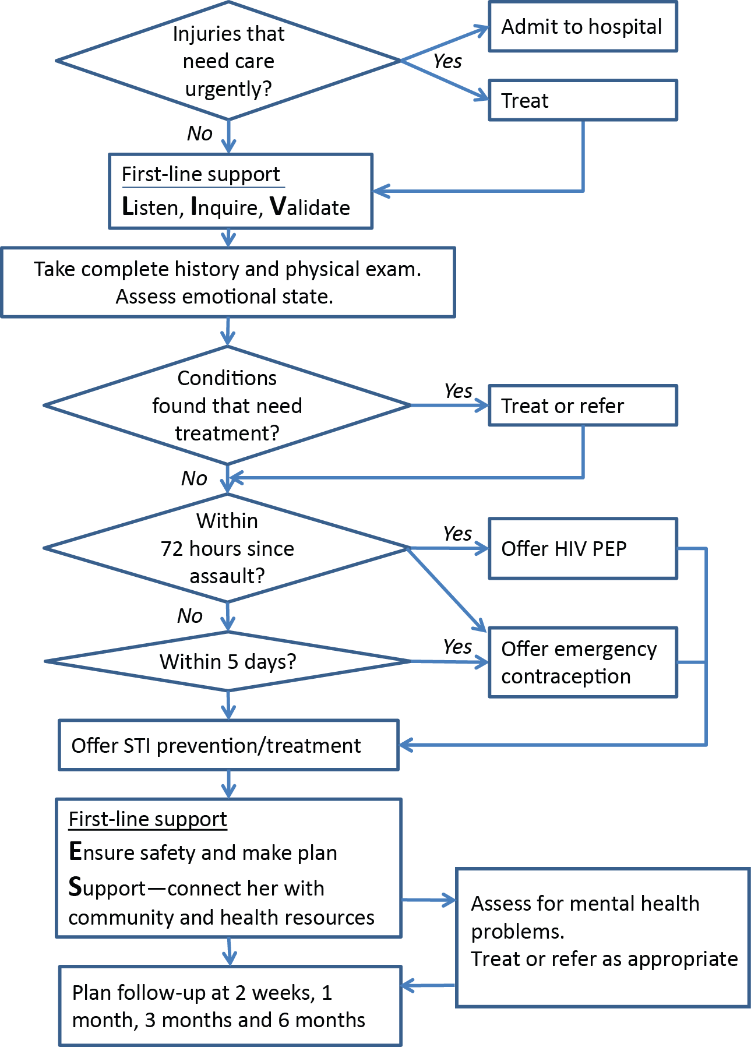
Job aid: sexual assault summary protocol
(page 65)
Notes:
Job aid: This protocol appears on page 65 of the clinical handbook.
TIP: There is no need to go through each step in the pathway now. Session 9 will explore this protocol in depth.

Slide 19
Clinical handbook part 4
Mental health care
Pages 67-84
Notes:
Here we are going briefly into what front-line health-care providers can do to provide mental health care even where mental health specialists are not available.

Slide 20
Mental health care:
Basic psychosocial support
Help strengthen positive coping methods
Explore availability of social support
Teach stress reduction exercises
Make regular follow-up appointments
Assess for moderate–severe depression or PTSD
Notes:
What care for mental health? Not all women or children who are sexually abused or women who experience IPV will have mental health problems. With psychosocial support, some will recover. Much of this support can be offered by frontline providers – for example, counsellors, medical social workers, nurses or doctors. These steps include strengthening coping methods, exploring availability of social support within the survivor’s networks, teaching stress reduction techniques and making regular follow-up appointments.
Those who continue to experience symptoms such as sleeplessness, anxiety, lack of interest in usual activities for 2 weeks or longer should be assessed for depression or post-traumatic stress syndrome (PTSD) and then treated or referred accordingly. In the training we will cover how to carry out the basic steps but not detailed treatment for PTSD or depression. These need to be managed by specifically trained mental health specialists.

Slide 21
Clinical handbook addendums: Considerations for family planning and HIV settings
Notes:
Women who are seeking family planning or HIV services may experience violence as an underlying situation. They often have specific challenges with uptake of contraceptives or with disclosing HIV status because of fear of violence.
Providers in these settings need to be trained in identification and first-line support. They also need to know how to offer counselling for family planning and HIV disclosure keeping in mind women’s need for safety.

Slide 22
Considerations for family planning & HIV
Family planning
Understand reproductive coercion
Assess barriers to FP in context of violence
Facilitate appropriate method choice
HIV
Risks & benefits of disclosure
Counselling on disclosure of HIV status
Planning for safe HIV status disclosure
Notes:
IPV can interfere with a woman’s ability to make choices about her reproductive health, such as her ability to plan her pregnancies and/or effectively and consistently use contraception. A partner may try to control a woman’s contraception – “reproductive coercion”. Therefore, family planning providers need to assess barriers to contraception in the context of violence and facilitate appropriate method choice.
Similarly, women subjected to IPV may not want to test for HIV or disclose a positive HIV test result to partners because they fear violence. HIV service providers need to assess and discuss the risks and benefits of disclosure and offer tailored counselling about whether, when and how to disclose HIV status, including making a plan for safety.

Slide 23
Reporting violence
& Enabling health systems
Notes:
In this section we cover two responsibilities of managers – reporting violence to authorities and creation of an enabling health systems environment.

Slide 24

Reporting considerations
  For women: mandatory reporting NOT recommended
    Offer to report if woman wants
    If required, tell the woman at the outset
  For child sexual abuse, where obligation to report:
    Assess health, safety & well-being implications of reporting
    Inform about limitations on confidentiality before consultation
Notes:
Some countries have laws (or policies) requiring providers to report all cases of IPV and/or sexual assault to relevant or designated authorities. Similarly, many countries require providers to report child sexual abuse.
WHO does not recommend mandatory reporting for women for two reasons: First, women are adults and should have the choice, agency and autonomy to report or not as they choose. Second, most women do not want to report, especially partner violence. This may be because they depend on their partners economically and do not want them in jail or because they would like the relationship to continue without the violence. If however, women wish to report, providers should offer help with this.
In contrast, for children, laws and policies to report aim to protect them as minors. Where there is an obligation to report – whether in law, policy or ethics – then providers should assess the implications of reporting for health, safety and well-being, taking into account the best interests of the child and also balancing their evolving capacities. It is important to inform the child and care-giver of the limitations on confidentiality before the history-taking.

Slide 25
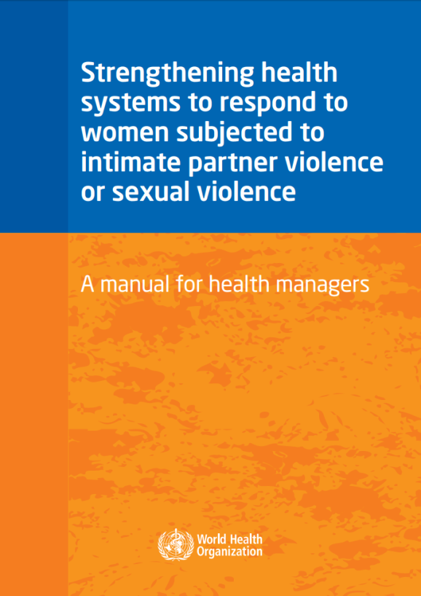
Necessary system-wide changes
  Assure supervision and feedback
  Improve infrastructure
  Strengthen referrals
  Document
  Monitor and evaluate
Notes:
Evidence shows that, in addition to staff training, these systems changes also have to be in place in order for providers to apply their training in clinical practice. These are managers’ responsibilities.
One-off training is not enough. Regular supervision and mentoring are crucial.
Clinic infrastructure should make possible private confidential consultation, provide sufficient supplies and commodities to provide care and have referral mechanisms in place.
A documentation system and routine quality monitoring are also key.
We will cover some of these aspects, including referrals and documentation, in this training. For other topics, refer to the health manager’s manual, shown here.
It is important for you, both providers and those with managerial duties, to pay attention to these systems strengthening needs and to advocate that they be put in place.

Slide 26
Key messages
    The health system response should be based on respect for human rights and promotion of gender equality
    This training covers skills in the 5 parts of the WHO clinical handbook
    An enabling health system is key to helping providers put training into practice

