Slide 1
Session 6
First-line support using LIV(ES), part 1: Listen, Inquire, Validate
Notes:
This session will cover the elements in first-line support, as summarized by the word “LIVES” and how to provide them.

Slide 2

Learning objective
Demonstrate clinical skills appropriate to one’s profession and specialty to respond to VAW
Competencies
Know the content of first-line support (LIVES)
Demonstrate skills in offering the first three elements of first-line support – Listen, Inquire, Validate

Slide 3
What is first-line support?
DO
identify needs and concerns
respond to emotional, physical, safety and support needs
listen & validate experiences & concerns
help her feel connected to others, calm and hopeful
empower her to feel able to help herself and to seek help explore options respect her wishes
DON’T
try to solve her problems
try to convince her to leave a violent relationship
try to convince her to go to the police or courts
ask questions that force her to relive painful events
ask her to analyse what happened or why
pressure her to tell you her feelings & reactions
Notes:
First-line support is the most important care that you can provide for women subjected to violence. It is likely to help even if it is all you can do. First-line support provides practical care and responds to a woman’s emotional, physical, safety and support needs, without intruding on her privacy.
First-line support is based on psychological first aid. It has helped people who have been through various upsetting or stressful events, including being subjected to violence.

Slide 4
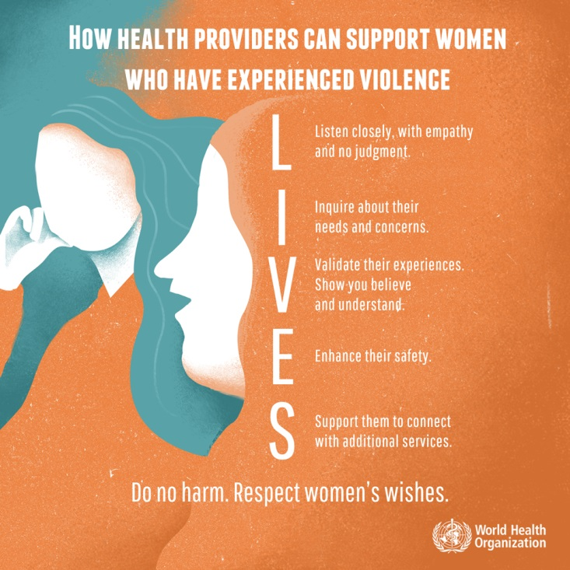
First-line support – job aid
Learn to listen with your
N | Eyes – | giving her your undivided attention
O | Ears – | truly hearing her concerns
Y | Heart – | with caring and respect
Notes:
This session focuses on the first three elements of LIVES – Listen, Inquire and Validate. These elements are in the order they will usually be done, but the first – listening – should continue throughout your contact with the survivor.

Slide 5
Listen
Active listening dos and don’ts
Dos ✓ | Don’ts 𝗫
How you act
Be patient and calm. | Don’t pressure her to tell her story.
Let her know you are listening; for example, nod your head or say “hmm…” | Don’t look at your watch or speak too rapidly. Don’t answer the telephone, look at a computer or write.
Your attitude
Acknowledge how she is feeling | Don’t Judge what she has or has not done, or how she is feeling. Don’t say: “You shouldn’t feel that way,” or “You should feel lucky you survived,” or “Poor you”.
What you say
Give her the opportunity to say what she wants. Ask, “How can we help you?” | Don’t assume that you know what is best for her.
Encourage her to keep talking if she wishes. Ask, “Would you like to tell me more?” | Don’t interrupt. Wait until she has finished before asking questions.
Notes:
Listening is:
Giving her the chance to say what she wants to a caring person who wants to help and in a safe and private space
Critical for emotional recovery
Most important part of good communication (recall Session 3)
Being aware of the feelings behind her words
Hearing both what she says and what she does not say
Paying attention to her body language
Sitting or standing at the same level and close enough
Through empathy, showing understanding of how she feels.

Slide 6
Listen
Active listening dos and don’ts
Dos ✓ | Don’ts 𝗫
Allow for silence. Give her time to think. | Don’t try to finish her thoughts for her.
Stay focused on her experience and on offering support. | Don’t tell her about someone else’s story or talk about your own troubles.
Acknowledge what she wants and respect her wishes. | Don’t think and act as if you must solve her problems for her.
Notes:
Recall the principles of good communication from session 4.

Slide 7
Inquire about needs and concerns
Phrase your questions as invitations to speak. | “What would you like to talk about?”
Ask open-ended questions instead of yes or no questions. | “How do you feel about that?”
Check your understanding (repeat what she says). | “You mentioned that you feel very frustrated.”
Reflect her feelings. | “It sounds as if you are feeling angry about that…” , “You seem upset.”
Explore as needed. | “Could you tell me more about that?”
Ask for clarification if you don’t understand. | “Can you explain that again, please?”
Help her to identify and express her needs and concerns. | “Is there anything that you need or are concerned about?”
Sum up what she has expressed. | “You seem to be saying that....”
Notes:
Things to avoid:
Avoid asking leading questions, such as “I would imagine that made you feel upset, didn’t it?”
Avoid asking “why” questions, such as “Why did you do that…?” They may sound accusing.

Slide 8
Validate
Job aid, handbook page 24
Important things that you can say:
“It’s not your fault. You are not to blame.”
“It’s okay to talk.”
“Help is available.” [Say this only if it is true.]
“No one deserves to be hit by her husband.”
“You are not alone. Unfortunately, many other women have faced this problem, too.”
“What happened has no justification or excuse.”
“Your life, your health, you are of value.”
“Everybody deserves to feel safe at home.”
“I am worried that this may be affecting your health.”
Notes:
Job aid:: Helping women cope with negative feelings (page 24 of the clinical handbook) identifies the most common feelings and some ways that health-care providers might respond to them.

Slide 9


Video on Listening, Inquiring about needs, Validating (LIV)
https://youtu.be/Hu06nVCzih0?t=520
Watch from 8:40 until 20:36
Notes:
Start showing at 8:40 until 14:20, then from 14:47 to 20:36.
This video is from the Royal Australian College of General Practitioners Professional Development Program on Family Violence, https://www.racgp.org.au/familyviolence/modules.htm.
If you cannot access the YouTube video, please contact WHO to request a downloadable version by emailing: reproductivehealth@who.int. There is also an additional video for LIVES from Timor Leste available upon request from WHO, using the same email address.

Slide 10
Exercise 6.1: Role-play LIV(ES)
Learning objective for the exercise: Develop skills for the LIV elements of first-line support
Form groups of 3. In each group choose roles: patient, health-care provider or observer
Patients and observers: Choose one of the scenarios
Patients and health-care providers: Act out the role-play (20 minutes)
Then, observers give feedback to their team
(5 minutes)
Notes:
Exercise 6.1. See facilitator’s guide for detailed instructions.
Follow the role-play with either a group discussion or else a demonstration role-play by volunteers followed by group discussion. See facilitator’s guide for detailed instructions.

Slide 11
Key messages
Effective listening and LIVES can be powerful healing tools. For some, they are sufficient.
When meeting a patient, minimize distractions and focus on her
Later, find a colleague and practice the LIV elements of LIVES, using your own words

