Slide 1

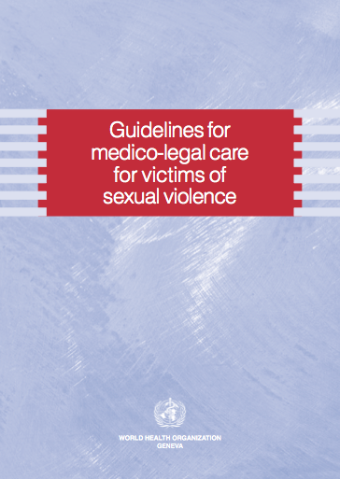
Session 9a
Forensic Examination (supplemental)

Slide 2

Learning objective
Demonstrate clinical skills appropriate to one’s profession and specialty to respond to VAW
Competencies
Know how to conduct a medico-legal (forensic) examination
Know when and how to collect forensic evidence

Slide 3
Demonstration: Forensic examination
See step 4
https://apps.who.int/iris/handle/10665/44190
Notes:
Play e-learning clip from Clinical management of rape survivors, case study: Forensic examination section – Step 4. For examples of more in-depth questions, see Part 4: Mental health.
Tip: Check this link before your presentation. If it is working, the link on the web page will download a .zip file that you will need to un-zip in advance

Slide 4
Review the legal & policy context
Who can examine?
  What is the minimum training required?
  Who can act as expert witness in court?
What forms are required to document forensic evidence?
  Who keeps these or where are they kept?
  Who can issue/sign a medico-legal certificate?
  Who gets a copy of the certificate and where are the copies kept?
― continued ―
Notes:
If there are mandatory reporting laws, these should be explained clearly and up front to the survivor so that she can make an informed choice as to whether to proceed or not.

Slide 5
Review the legal & policy context
― continued ―
Reporting
  What are requirements for reporting to authorities?
Storing and laboratory facilities
  What samples and evidence can be stored and analyzed & in what time frame?
  What are the laws/policies regarding the chain of custody of the samples?

Slide 6
When should a forensic exam be done?
Four conditions must be met:
Woman wants to go to the police or it is mandatory
Woman has come within 7 days after sexual assault
Health-care provider trained in forensic examination is available
Forensic science laboratory is available
The physical health and emotional well-being and safety of the survivor should be the primary consideration.
Notes:
The four conditions listed on the slide must be met to conduct a forensic examination.
After 7 days it is unlikely that useful forensic evidence will be found. Encourage the woman to receive medical care and treatment even if she refuses a forensic exam.
A specifically trained/designated provider should collect the evidence.
Some types of forensic samples require simple laboratory facilities, others like DNA require specialized lab facilities.
Even if evidence is not collected, conduct a full physical examination and document well. This can be useful if she decides later to pursue a legal case.
Collection of forensic evidence should be based on the account of the sexual assault or abuse and what evidence can be collected, stored and analysed. Too often, evidence is collected according to a standard list when it is not required or relevant. This adds unnecessary distress and trauma. Also, it can be used in court to argue that there is no evidence, when in fact no evidence could be expected if the person came after 7 days or had taken a bath, etc. Too often, also, evidence is collected when it cannot be stored or analysed.
Health-care providers should focus on details relevant to the provision of medical care. If the health-care provider is collecting evidence, the narrative should guide what evidence to gather. Specific information about perpetrators for the purpose of legal processes should be gathered by trained investigators.

Slide 7
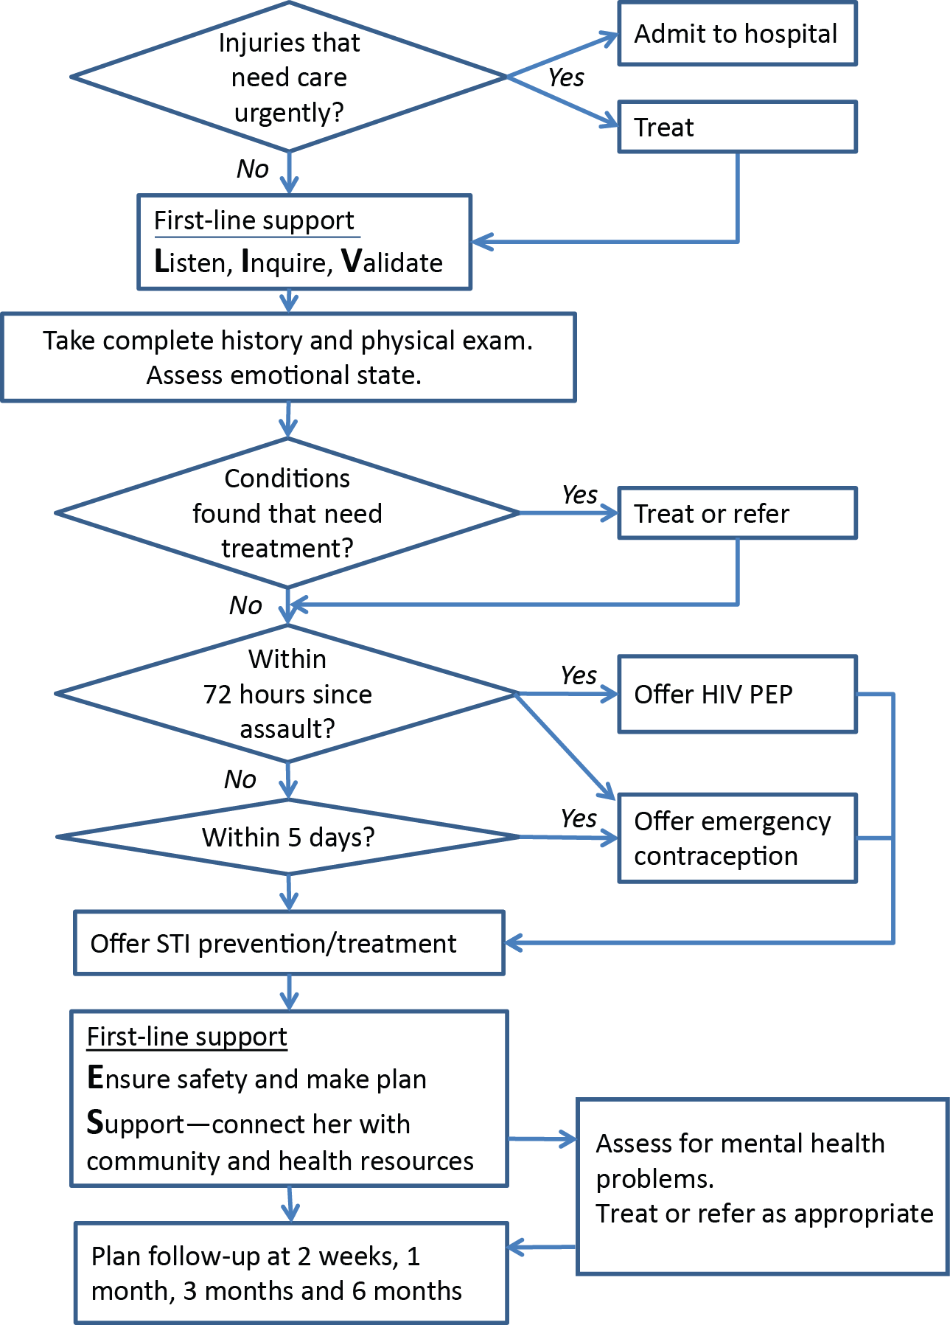
Summary protocol:
Pathway for initial care after sexual assault
Immediately refer patient with injuries that need urgent care.
Otherwise:
First-line support part one: Listen, Inquire, Validate
Take history, assess emotional state, head-to-toe physical exam PLUS full forensic examination
Provide treatment (injuries, PEP, STI prophylaxis, EC)
First-line support part 2: Enhance safety, arrange Support
Assess mental health, discuss self-care & plan follow-up visits.
See clinical handbook, page 65
Notes:
Briefly review the steps in the protocol (clinical handbook page 65). These steps will be explored in depth in this session and the next.
Note that, at every step in the protocol, providers should always:
Assure confidentiality.
Practice the elements of LIVES and provide psychosocial support.
Listen, respect the woman and her decisions and support her connection with other services.
Note that PEP (for HIV prevention) and emergency contraception (EC) are effective only within a certain time after the incident – PEP within 72 hours; emergency contraception within 5 days.

Slide 8
Overview: History-taking, conducting physical and forensic examination
History-taking (Session 9)
Prepare for physical examination (Session 9)
Conduct a head-to-toe physical examination (Session 9) PLUS
Conduct full forensic exam/specimen collection when doing the physical examination (this session – 9a)
Notes:
Remind participants that history-taking was covered in Session 9, so you will not go into detail here. However, emphasize that a good history is the basis for the forensic evidence collection because the history of the assault will guide what forensic specimens to collect. Otherwise don’t cover history-taking in detail.
Maximize efforts to have only one examination combining physical examination and forensic evidence collection. If she wants to have evidence collected, do this while undertaking the physical exam.
If only some health-care providers are legally allowed to conduct the exam, request that they do both the physical exam as well as the forensic part.
Confidentiality of the survivor must be guaranteed. If there are limitations to confidentiality (such as in situations of mandatory reporting), share this information as early as possible, preferably before a survivor has disclosed.

Slide 9
General tips
Only providers that are specifically trained and supervised should undertake full forensic examination
Only medico-legal evidence that can be collected, stored and analyzed should be gathered
Obtain separate consent for collecting forensic evidence including any photographs
The head-to-toe physical exam is primarily for medical care, but it is also useful for forensic documentation
Documentation of injuries can provide important evidence
Notes:
Issues of consent and sensitivities (particularly if genital photographs are taken) need to be addressed and agreed with the woman.

Slide 10
Job aid for head-to-toe examination
Physical exam checklist (job aid)
Look at all the following | Look for and record
General appearance Hands and wrists, forearms, inner surfaces of upper arms, armpits Face, including inside of mouth Ears, including inside and behind ears Head Neck Chest, including breasts Abdomen Buttocks, thighs, including inner thighs, legs and feet | Active bleeding Bruising Redness or swelling Cuts or abrasions Evidence that hair has been pulled out, and recent evidence of missing teeth Injuries such as bite marks or gunshot wounds Evidence of internal traumatic injuries in the abdomen Ruptured ear drum
Job aid, handbook page 47
Notes:
Make sure equipment and supplies are prepared.
Take the patient's vital signs – pulse, blood pressure, respiratory rate and temperature.
Work systematically using the physical examination checklist, page 47 of the clinical handbook.
Give time to the examination. Do not hurry.
Record all your findings and observations clearly and fully on a standard exam form (see Sample history and examination form, pages 89–98).
Maximize efforts to have only one forensic and physical examination.
Offer information about the implications of positive or negative findings of the physical examination and forensic examinations.
For children and adolescents specifically, use examination instruments and positions that minimize physical discomfort and/or psychological distress.

Slide 11
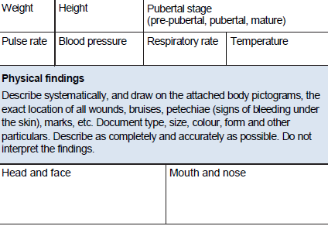
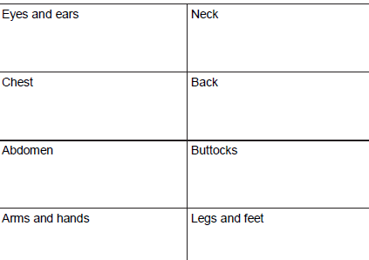
Physical examination form
Form, handbook pages 89–98
Notes:
Be sure to document carefully and fully any injury or other mark, as this can be important evidence.

Slide 12
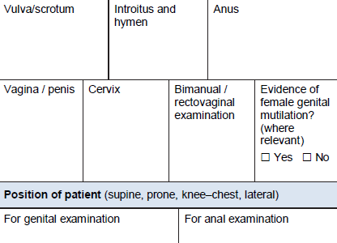
Job-aid: genito-anal examination
Genito-anal examination checklist
Look at all the following: | Look for and record:
Genitals (external) Genitals (internal examination, using a speculum) Anal region (external) | Active bleeding Bruising Redness or swelling Cuts or abrasions Foreign body presence
Job aid, handbook page 47
Form, handbook pages 89–98
Notes:
For children

Slide 13
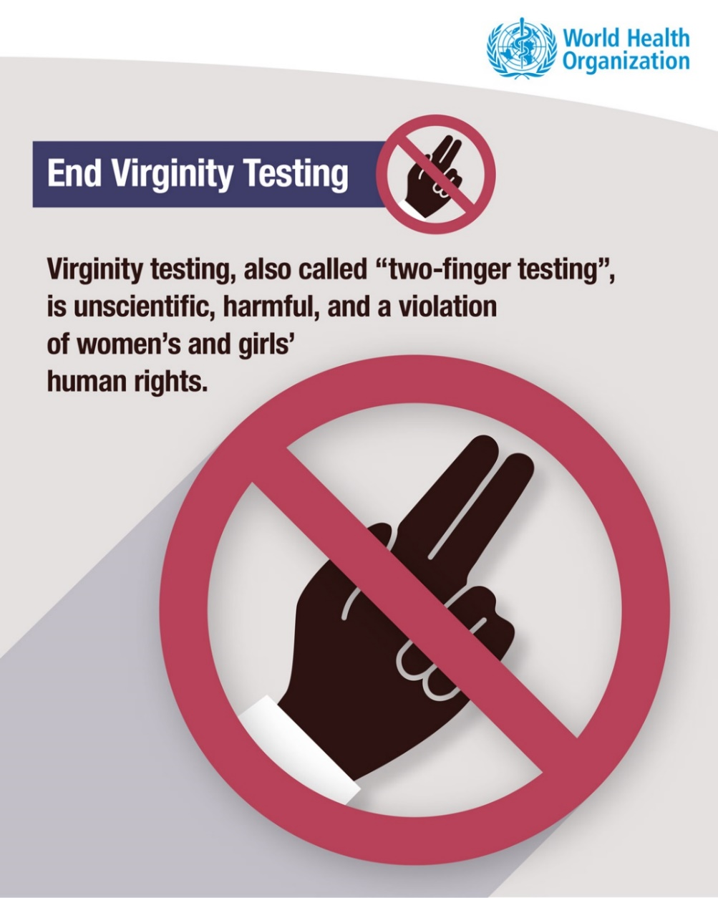
End virginity testing
Hymen is a poor marker of penetrative sexual activity or virginity in post-pubertal girls
Digital examination of anus or vagina is rarely warranted and not an indication of likelihood or frequency of penetration
Notes:
“Virginity testing” has no scientific or clinical basis. There is no examination that can prove that a girl or woman has had sexual intercourse or is sexually active, including the appearance of girl’s or woman’s hymen.
In many settings such tests are considered part of the assessment of survivors of rape. This is unnecessary, and it can cause pain and mimic the original act of sexual violence, exacerbating the survivors’ sense of disempowerment and re-victimization.
A survivor’s virginity prior to the rape is irrelevant to determining whether or not rape occurred, and it does not predict how traumatic or severe the effects of the rape will be on an individual. The result of this unscientific test can impact proceedings, often negatively, for the survivors and favour perpetrators.
Digital examinations of the vagina and anus are rarely warranted. They should not be used to assess the tone or elasticity of the vagina or anus or to comment on the likelihood or frequency of penetration. For pre-pubertal children, speculums or anoscopes and digital or bimanual examinations of the vagina or rectum are not routinely required unless medically indicated; if a speculum is needed, sedation or general anaesthesia should be considered.

Slide 14
What specimens to collect?
The woman’s account of the assault guides what specimens to collect
Health (pathology) versus legal (forensic) specimens
  Pathology specimens – diagnose or monitor a condition
  Forensic specimens – for legal purposes
  Some pathology specimens may have forensic importance (for example, evidence of STI)
  ― continued ―
Notes:
There are different purposes and processes for collecting specimens for health (pathology) and legal (forensic) investigations.
Pathology specimens are analyzed to establish a diagnosis and/or monitor a condition.
Forensic specimens are used to assess whether an offence has been committed and whether there is a link between individuals and/or locations.
Pathology specimens may be significant as forensic evidence – for example, if an STI is found.
The forensic laboratory requires information about the specimen (time, date, patient name/ID number, nature and site of collection) and what is being looked for.

Slide 15
What specimens to collect?
― continued ―
Clothing (especially underwear)
Blood and urine samples if suspicion of covert or non-consenting drug administration
Hair if suspicion of covert drug administration
Specimens where biological material may have been deposited: skin, hair, mouth, vagina and anus
Photographs – to document injuries
Notes:
Hair – cut scalp hair may be useful if there is suspicion or allegation of covert drug administration.
Clothing (especially underwear) and toxicological samples should be collected if required.
Collect blood and urine samples for toxicological analysis if there are suspicions or allegations of covert or non-consenting drug administration.
Collect specimens from locations where biological material (for example, semen) might have been deposited: skin, hair and oral, vaginal and anal orifices.
Photographs provide a useful adjunct to document injuries.
Photograph any injuries while ensuring confidentiality if possible.
Ensure that the photographs do not allow direct identification of the individual. Use a confidential code system to enable authorized staff to identify the individual. Note when photographs were taken.

Slide 16

Time frame for specimen collection
After a certain time or activity following the rape, not all evidence can be collected
Maximum agreed times for collecting evidence after assault:
  skin, including bite marks – 72 hours
  mouth – 12 hours
  vagina – up to 5 days
  anus – 48 hours
  foreign material on objects (condom/clothing) – no time limit
  urine (toxicology) 50 mL – up to 5 days
  blood (toxicology) 2 × 5 mL samples – up to 48 hours in tubes containing sodium fluoride and potassium oxalate
Notes:
(From: UNODC, WHO. Strengthening the medico-legal response to sexual violence. Geneva: WHO; 2015. https://www.who.int/reproductivehealth/publications/violence/medico-legal-response/en/)
Persistence of biological material is variable. It will be affected by time, activities (washing) and contamination from other sources.

Slide 17
Storage
Carefully label, store and record chain-of-custody
Document information about specimen – time, date, patient name/ID number, nature and site of collection
Dry and package samples
Notes:
Careful labelling, storage and chain-of-custody recording is required in all cases.
Samples should be dried and packaged. They should not be placed in culture media.
Take precautions against contamination: restrict access to examination facilities, ensure that facilities are cleaned between cases and change gloves frequently.

Slide 18
Documentation
Note general appearance and functioning of the patient
Note limitations to the examination (e.g., poor lighting)
Describe in detail all recent and old injuries, recording any negative findings
Survivor should be informed that some injuries may become evident only after a few days. In that case she should return for examination and documentation.
Note the specimens collected, photographs taken, tests ordered and treatments given
Give detailed explanation of findings and treatment

Slide 19
Understanding forensic evidence
Signs of injury in penetrative sexual activity are rare
  Absence of injury to hymen does not rule out penetration
  Penetration of pre-pubertal genitalia does not necessarily result in physical injury
The health-care practitioner cannot make any comment on whether the activity was consensual or not
Notes:
Penetrative sexual activity of the vagina, anus or mouth rarely produces any objective signs of injury.
The hymen may not appear injured even after penetration has occurred. Hence, the absence of injury does not rule out penetration.
Penetration of the pre-pubertal genitalia (and some other forms of sexually abusive actions) do not necessarily result in physical injury.
The health-care practitioner cannot make any comment on whether the activity was consensual or not.

Slide 20
Providing testimony
Health-care providers may be called to answer questions and provide documentation
Information that authorities may need:
  Types of injury (cuts, bruises, abrasions, fractures)
  Where injury is on body and description of injury (length, depth, other characteristics)
  Possible cause of injury (for example, gunshot, bite, use of restraints)
  Immediate and potential long-term consequences of injury
  Treatment provided
Notes:
Health-care providers may be called to answer questions from police, lawyers or courts.
Therefore, careful documentation on the history and examination forms of all examinations, findings and treatment provided is important.

Slide 21
Exercise 9a.1: Decision-making on forensic evidence collection
Learning objective for the exercise
To understand how to establish whether and when forensic evidence should be collected and what evidence should be collected

Slide 22
Exercise 9a.1: Decision-making on forensic evidence collection
In groups of 6–8 read the scenario
Based on the scenario, discuss:
  What questions would you ask or what information would you need to determine how to proceed with the examination? Explain why.
  What forensic evidence would you collect? Explain why.
Document responses, including the “why”, in the table
Time: 15 minutes

Slide 23
Key messages
Collect forensic evidence only when all four conditions are met
Separate consent is needed for a forensic examination
Head-to-toe examination, but NO vaginal/“two-finger test”
The assault history guides forensic evidence collection
Time elapsed and activities undertaken after the incident determines whether evidence can be found
Storage that avoids contamination, labelling and detailed documentation are essential
Health-care providers may need to provide testimony. They cannot conclude whether evidence points to rape. That is for the courts to establish.
Notes:
Reminder: the 4 conditions for collecting forensic evidence:
Woman wants to go to the police or it is mandatory
Woman has come within 7 days after sexual assault
Health-care provider trained in forensic examination is available
Forensic science laboratory is available

