Slide 1
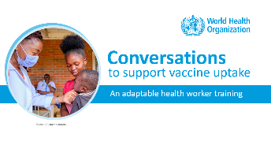
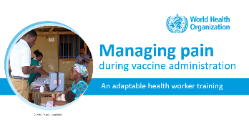
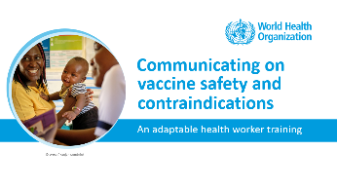
NOTES FOR FACILITATOR. REMOVE BEFORE SHARING.
How to use this resource
    About this resource: This resource is part of a package of training modules to strengthen health worker skills in communicating on vaccination.
    It is part of a series on the following topics:
    Suggested learning format: The modules are designed for peer-facilitated and interactive sessions. Each module can be completed in one session or can be divided across several sessions. The modules are best suited for small groups of up to 10 participants to encourage active participation.

Slide 2
NOTES FOR FACILITATOR. REMOVE BEFORE SHARING.
How to use this resource
    Adapt the modules for your local use. The contents of the modules are based on evidence and best practices. Please retain the main concepts as you make the deck your own. Customize this resource for your local needs by:
      Modifying examples, sample conversations and visuals,
      Translating to your local language, and
      Tailoring the suggested exercises.
    Share your feedback. We would like to learn how you have been using these modules, what aspects have been helpful and in what ways we can improve the content and approach. After using the module, please fill out the online form linked below.
Link to Microsoft Forms
https://forms.microsoft.com/e/vJBakm3PCx

Slide 3

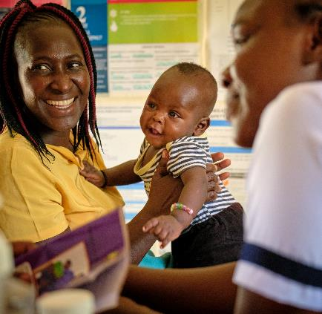
Communicating on
.
vaccine safety and
contraindications
Lisa
An adaptable health worker training
© WHO / Fanjan Combrink

Slide 4
Training objectives
At the end of this training, participants will be able to:
    Update their knowledge of the basics of vaccine safety and the benefits of vaccination
    Understand the importance of effectively communicating about vaccine safety
    Identify valid and false contraindications on immunization and vaccination precautions
    Be able to reassure parents/caregivers about accepting vaccination

Slide 5
A quick survey before we start…
How well do you agree with the following statements? | Strongly Agree | Agree | Disagree | Strongly Disagree
I am confident about communicating on vaccine safety and vaccination benefits with parents/caregivers
I am confident about communicating contraindications to vaccination with parents/caregivers
I am confident about communicating precautions to vaccination with parents/caregivers
Notes:
Facilitation Notes
Start the training session with this three-question survey to provide baseline measures on confidence in communicating about vaccine safety, contraindications and precautions.
You may print the slide, and each participant ticks off their level of agreement on each statement.
At the end of the session, participants answer the survey again. Compare the changes in the measures.
Use the survey results to think of ways to improve content adaptation and delivery for future sessions.

Slide 6
Outline
    Introduction
    Communicating on vaccine safety
    Considerations for contraindications
    Considerations for precautions

Slide 7
Outline
    Introduction
    Communicating on vaccine safety
    Considerations for contraindications
    Considerations for precautions

Slide 8
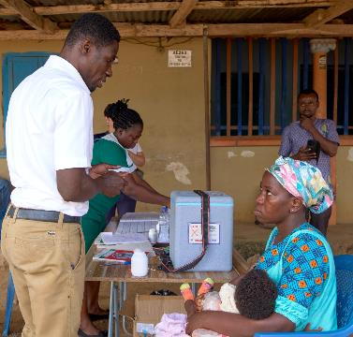
Vaccines are safe and effective
Vaccines have been used for decades, with millions receiving them safely every year, routinely or in response to disease threats.
Vaccines protect against serious diseases including measles, polio, and hepatitis B. We also have new vaccines against cervical cancer and malaria.
Vaccines are strictly tested over many years to ensure their safety and efficacy and are continuously monitored for any adverse events.
© WHO / Fanjan Combrink

Slide 9
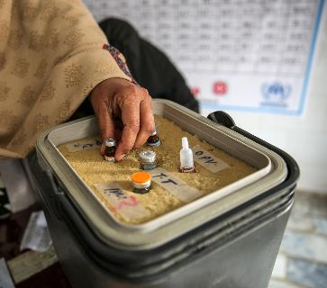
Shifting beliefs on vaccine safety
Thanks to the success of immunization programmes, many diseases that are prevented by vaccination are no longer as visible as they once were.
In some places, this leads to an increased complacency towards the risk of these diseases (they are no longer feared).
Further, some parents/caregivers have questions or misconceptions about vaccines and/or think that vaccination is no longer necessary.
© WHO / Asad Zaidi

Slide 10

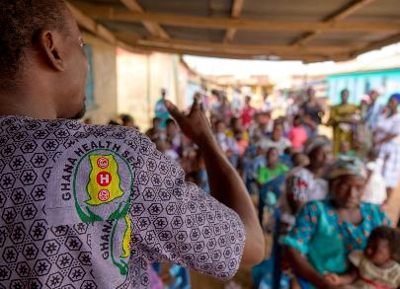
Your role as health workers
Health workers are generally the most trusted source of information about vaccination.
It is essential that they are skilled and confident in managing conversations about the benefits and safety of vaccination.
Health workers should also be well-informed about vaccine safety and contraindications to vaccination so that they can reassure parents/caregivers and avoid any missed opportunities for vaccination.
© WHO / Fanjan Combrink

Slide 11


Let’s discuss!
In pairs or groups of three:
What are some questions or concerns that you have heard from the community about the safety of vaccines?
In the plenary:
What are some of the most common questions that emerged? Write down these questions, as these will be used in the next exercise.
© WHO / Mukhsin Abidzhanov
Notes:
List the questions raised in this exercise. These will be used in the next exercise on communicating on vaccine safety.

Slide 12
Outline
    Introduction
    Communicating on vaccine safety
  Ensuring vaccine safety: A closer look
  Minor reactions and AEFIs
    Considerations for contraindications
    Considerations for precautions

Slide 13
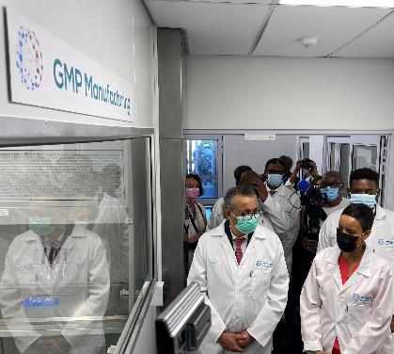
Ensuring vaccine safety: A closer look
Vaccines are assessed and monitored for their safety…
During development
Prior to introduction
During use in programmes
© WHO / Paul Garwood

Slide 14
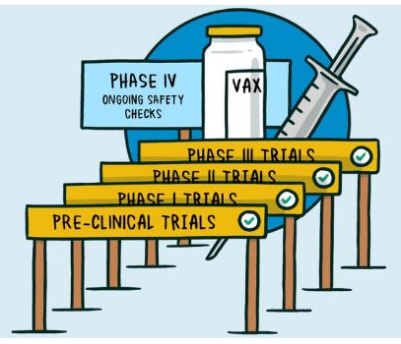
Ensuring vaccine safety
During development
Vaccines are tested extensively for safety and efficacy in laboratories and clinical trials.
All vaccine ingredients are tested for safety. Each component serves a specific purpose.
An experimental vaccine is first tested in animals.
If the vaccine shows safety and efficacy in animals, it is then tested extensively in human clinical trials to find out the safest and most effective dose.
The thousands of healthy volunteers is important to understand that rare and very rare adverse events cannot be picked up in clinical trials

Slide 15

Ensuring vaccine safety
Prior to introduction
Vaccines are certified by international and national regulatory agencies prior to their use.
This helps ensure the vaccine meets the highest safety and efficacy standards before being considered suitable for health programmes.
WHO works with scientists, pharmaceutical companies, experts, and National Regulatory Agencies (NRA) to ensure the safety and quality of vaccines and adherence to international standards.

Slide 16

Ensuring vaccine safety
During use in programmes
National health authorities continuously monitor vaccine safety to detect and respond to concerns.
In case of an adverse event, an independent group of experts assesses whether such an event is related to vaccines.
The Global Advisory Committee on Vaccine Safety (GACVS), an independent group of experts, evaluates vaccine safety and provides advice to countries through WHO.

Slide 17
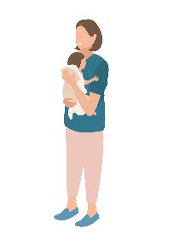

Communicating on minor reactions (1 of 2)
All injectable vaccines can cause pain, redness and swelling at the injection site.
Minor reactions are expected and normal. By knowing what to expect, parents and caregivers are reassured and more likely to return for the next dose.
Aside from emphasizing the safety and benefits of vaccines, advise parents and caregivers on possible minor reactions. Inform them of precautions to take.
Vaccines are very safe. Like any medicine, vaccines can cause side effects. However, these are usually very minor and in short duration, such as a sore arm or a mild fever.
In very rare instances where reactions are more severe, last for more than 1 to 2 days or if the child’s condition worsens, bring the child to the health facility.

Slide 18
Communicating on minor reactions (2 of 2)
The child can be given extra fluids/breastmilk for fever or malaise, and if available, a cold compress can be applied to the injection site and paracetamol given for pain or fever.
Be aware of vaccine-specific possible reactions:
  DTP-containing vaccine may leave some children with irritability, loss of appetite, and malaise
  BCG vaccine leaves a lump at the injection site for several weeks. The lump ulcerates and leaves a scar. If the injection site becomes infected, parents/caregivers should see a health worker
  Measles vaccine can cause mild fever, rash, and conjunctivitis, even 6-12 days after vaccination

Slide 19
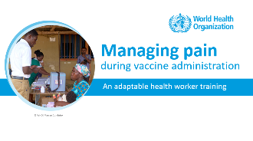
Communicating on multiple injections
It is safe and effective for multiple vaccines to be given at the same time.
This offers protection at the most important age and provides added convenience for the parent/caregivers in avoiding multiple visits to the health facility.
Refer to the module on “Managing pain during vaccine administration” for full practical guidance on multiple injections

Slide 20
Adverse Events following Immunization (AEFIs) (1 of 2)
Types of AEFIs
  Minor reactions are part of the body’s immune response to vaccination. They are mild, known side effects that can occur 1-2 days after vaccination. Examples are pain or swelling at the injection site, a slight fever. Minor reactions brought to the notice of the health system should be reported.
  Severe AEFIs, which are rarely life threatening, but can be disabling. Examples are non-hospitalized allergic reactions, or high fever. These must be reported.
  Serious AEFIs, which are life-threatening and could result in hospitalization, disability, or death. Serious AEFIs include anaphylaxis. All must be reported.
Notes:
Reference:
World Health Organization. Global Manual on Surveillance of Adverse Events Following Immunization. Geneva, 2014 (revised 2016). Available at http://www.who.int/vaccine_safety/publications/aefi_surveillance/en/
Please also refer to national policy in case of any differences.

Slide 21
Adverse Events following Immunization (AEFIs) (2 of 2)
Vaccines are very safe and effective, but there is the rare risk of a serious AEFI.
An AEFI may or may not be related to the vaccine, and can be an unwanted sign, abnormal laboratory finding, symptom, or disease.
All health workers should be ready to identify, respond and report AEFIs.
Most health workers will only encounter minor reactions to vaccination, but severe and serious AEFI do occur.
Notes:
Reference:
World Health Organization. Global Manual on Surveillance of Adverse Events Following Immunization. Geneva, 2014 (revised 2016). Available at http://www.who.int/vaccine_safety/publications/aefi_surveillance/en/
Please also refer to national policy in case of any differences.

Slide 22

Let’s practice!
Refer to the list of common questions on vaccine safety, which you have gathered from the previous exercise.
Participants then pair up – one takes the role of the health worker and the other, the parent/caregiver.
In a role play, the parent asks the health worker a question.
The participants provide feedback on the answer.
Other partners then take their turn.
© WHO / Mukhsin Abidzhanov

Slide 23
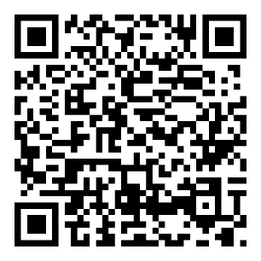
Resource:
Questions and answers on vaccination
The WHO Questions and Answers webpages
provide technically sound and easily understandable responses to commonly asked questions on vaccines.
https://www.who.int/news-room/questions-and-answers

Slide 24
Outline
    Introduction
    Communicating on vaccine safety
    Considerations for contraindications
  Valid and false contraindications
  How to discuss contraindications
    Considerations for precautions

Slide 25
What is a contraindication?
A contraindication to vaccination is a rare situation when a person’s health puts them at increased risk of having a serious adverse reaction.

Slide 26

Quick quiz!
True or False?
Anaphylaxis (a severe allergic reaction) following a previous dose or component of a vaccine is the only absolute and valid contraindication to vaccines.

Slide 27
Quick quiz!
Answer: True
Anaphylaxis is the only absolute and valid contraindication to all vaccines.
Note: A severe acute illness is temporary; the vaccine can be administered later.

Slide 28

Let’s discuss!
Many people have misconceptions about vaccination and believe they cannot vaccinate a child under certain conditions, when in fact it is safe to do so.
This is called a false contraindication.
Discuss with a partner: What are common false contraindications which you have heard from experience?
© WHO / Mukhsin Abidzhanov

Slide 29


It’s important to know what is and isn’t a valid contraindication
Some health workers may unknowingly give false contraindications on vaccination
Parents/caregivers may have heard of false or incorrect contraindications that could discourage them from fully vaccinating their children

Slide 30
Your role as health workers
Avoid false contraindications and vaccinate at every opportunity!
Know what is and isn’t a contraindication
Be skilled and confident in discussing contraindications and any misconceptions with parents/caregivers
Ensure the best protection for infants by vaccinating according to schedule
Help protect other children in the community who may not be vaccinated by making sure that any eligible infant receives the necessary doses
© WHO / Fanjan Combrink

Slide 31
  Always a contraindication: Had an anaphylactic reaction to a previous dose of the same vaccine or vaccine components
  Always a contraindication: If a child has a history of intestinal malformations or chronic gastrointestinal disease, rotavirus vaccination is not recommended.
  Temporary contraindication: Has a high fever or symptoms of moderate or serious illness – in which case the vaccine can be delayed
DO NOT
VACCINATE

Slide 32
You can vaccinate a child who:
  Has a mild illness (e.g. upset stomach, diarrhoea)
  Has a mild fever (below 38.5° C)
  Is being treated with antibiotics
  Is breastfeeding
  Is premature or low birthweight
  Has stable neurological conditions
  Is malnourished
  Has had recent or imminent surgery
  Has a chronic illness (heart, lung, kidney, or liver disease)
  Has allergies or asthma (except allergy to vaccine component)
  Had jaundice at birth
  Had recent or has upcoming surgery
  Has family history of AEFI
  Has family history of convulsions, seizures or fits
DO
VACCINATE

Slide 33

How to discuss contraindications (1 of 2)
Know what is a real contraindication (e.g. history of severe allergic reactions to vaccines or vaccine components)
Depending on the situation, offer parents the opportunity to ask questions. This is an opportunity to address misconceptions
© WHO / Fanjan Combrink

Slide 34
How to discuss contraindications (1 of 2)
Prior to an immunization session:
  Ask parents about any reactions to previous vaccinations or any known allergies
  Reassure the parents that if their child has a high fever or serious illness, they can safely vaccinate their child once the he/she is better. Agree on a convenient date for them to return for vaccination
If a child will miss a dose due to a high fever or illness, always agree on a specific date for the infant to return for their scheduled vaccine doses.
Explain that the risk of the disease that the vaccine prevents against is significantly higher than any risks associated with the vaccine

Slide 35
Outline
    Introduction
    Communicating on vaccine safety
    Considerations for contraindications
    Considerations for precautions
  Precautions, defined
  Considerations for immunocompromised people
  Conditions for pregnant women

Slide 36
What is a precaution?
A precaution is a specific condition that should be considered in determining if the benefits of the vaccine outweigh the risks.

Slide 37
Precautions
Pregnant women and immunocompromised people (depending on the type of immuno-deficiency) need special consideration prior to vaccination.
In this case, the health workers should discuss with the individuals concerned:
  The benefits of immunization, even for people in these special situations
  The possible risks of vaccination for immunocompromised people or pregnant women
Sometimes, the benefit of protection from the vaccine will easily outweigh the risk of an adverse reaction, so the health worker should recommend the vaccine.
Notes:
References:
World Health Organization. Global Manual on Surveillance of Adverse Events Following Immunization. Geneva, 2014 (revised 2016). Available at http://www.who.int/vaccine_safety/publications/aefi_surveillance/en/
Global Advisory Committee on Vaccine Safety, World Health Organization. Safety of immunization during pregnancy. A review of the evidence. Geneva, 2014. Available at http://www.who.int/vaccine_safety/publications/safety_immunization_pregnancy/en/
World Health Organization. Table 1: Summary of WHO Position Papers – Recommendations for Routine Immunization. Geneva, April 2018. Available at http://www.who.int/immunization/policy/Immunization_routine_table1.pdf?ua=1
Centers for Disease Control and Prevention. Guide to Vaccine Contraindications and Precautions. Accessed August 17, 2018. Available at www.bhsj.org/Clinic/immz/contraindications-guide-508.pdf

Slide 38
Considerations for immunocompromised people (1 of 2)
Vaccine | Conditions | Vaccinate: Yes, No, or Special Guidance
BCG | HIV infected individuals and children who are receiving ART, are well, and immunologically stable. | Yes
 | Neonates whose mother’s HIV status is unknown. | Yes
 | Neonates of unknown HIV status born to HIV infected mothers, and child shows no clinical evidence suggestive of HIV infection, regardless is receiving ART or not. | Yes
 | Neonates with HIV infection confirmed by early virological testing | Wait until ART has been started and infant is immunologically stable.
Measles | Potentially susceptive, asymptomatic HIV-infected children, adolescents, and young adults. | Yes
 | HIV-infected children should follow a different schedule for measles. | Doses at 6 months; 9 months and an additional dose (in time with MCV2 schedule in country)
Notes:
Reference:
World Health Organization. Table 1: Summary of WHO Position Papers – Recommendations for Routine Immunization. Geneva, April 2018. Available at http://www.who.int/immunization/policy/Immunization_routine_table1.pdf?ua=1

Slide 39
Considerations for immunocompromised people (1 of 2)
Vaccine | Conditions | Vaccinate: Yes, No, or Special Guidance
Yellow Fever | Not recommended for severely immunocompromised people. | No
HPV | HIV infected or immunocompromised girls should receive an additional third dose. | Yes, with additional third dose (0, 1-2, 6 months)
Rotavirus | Severe immunodeficiency, including severe combined immunodeficiency is a contraindication. | No
Inactivated JE vaccine | Can be used in immunocompromised people; HIV test not a prerequisite. | Yes, but may have lower immune response
Inactivated Vero cell-derived JE vaccines | Should be used preferentially over live attenuated or live recombinant vaccines in immunocompromised people; HIV test not a prerequisite. | Yes
Malaria | Can be used in immunocompromised people; HIV test not a prerequisite. | Yes, but may have lower immune response
Notes:
Reference:
World Health Organization. Table 1: Summary of WHO Position Papers – Recommendations for Routine Immunization. Geneva, April 2018. Available at http://www.who.int/immunization/policy/Immunization_routine_table1.pdf?ua=1

Slide 40
Considerations for pregnant women (1 of 2)
Vaccine | Conditions | Vaccinate: Yes, No, or Special Guidance
BCG | Not recommended for pregnant women. | No
Measles or MMR | Not recommended for pregnant women. | No
Rubella | Because of a theoretical, but never demonstrated, teratogenic risk rubella vaccination in pregnant women should be avoided in principal. | No
 | Those planning a pregnancy are advised to avoid pregnancy for 1 month following vaccination. | No
Td/Tdap | Vaccination with Td/Tdap is safe and effective. | Yes
Hepatitis B | Hepatitis B vaccine can be administered safely to pregnant and lactating women. | Yes
Notes:
Reference:
World Health Organization. Table 1: Summary of WHO Position Papers – Recommendations for Routine Immunization. Geneva, April 2018. Available at https://www.who.int/teams/immunization-vaccines-and-biologicals/policies/who-recommendations-for-routine-immunization---summary-tables

Slide 41
Considerations for pregnant women (2 of 2)
Vaccine | Conditions | Vaccinate: Yes, No, or Special Guidance
Inactivated JE | If JE is a risk during a pregnancy, it is preferential to use an inactivated vaccine, if available in your country, over a live attenuated or live recombinant vaccine. | Yes
Yellow Fever | Yellow fever is a live attenuated vaccine, so in theory it poses a risk. | Health workers should do a risk –benefit assessment with pregnant and lactating women
Notes:
Reference:
World Health Organization. Table 1: Summary of WHO Position Papers – Recommendations for Routine Immunization. Geneva, April 2018. Available at https://www.who.int/teams/immunization-vaccines-and-biologicals/policies/who-recommendations-for-routine-immunization---summary-tables

Slide 42
Outline
    Introduction
    Communicating on vaccine safety
    Considerations for contraindications
    Considerations for precautions

Slide 43
Key takeaways (1 of 2)
Benefits of vaccines
Vaccines protect against diseases that can harm your child. Some of these diseases can cause serious long-term health problems or death. Vaccines have saved more lives than any other medical intervention, including antibiotics or surgery.
Risks of vaccines
Vaccines can cause mild side effects that usually disappear within a couple of days, e.g. fever and soreness where the injection was given. Serious side effects are extremely rare. For example, one child in a million may have a severe allergic reaction to the DTP vaccine. The benefits of vaccines far outweigh the risks.

Slide 44
Key takeaways (2 of 2)
Vaccine safety and contraindications
Vaccine safety and any adverse events are extensively monitored. National and international agencies ensure that vaccines are effective, safe, and provide protection.
There are very few true contraindications and precautions to immunization.
Conversations about vaccination
Health workers are highly respected and usually the most trusted information source about vaccination. One-to-one discussions are the best way to listen and respond to any concerns, to build trust, and to help support a decision to vaccinate.

Slide 45
A quick survey before we close…
How well do you agree with the following statements? | Strongly Agree | Agree | Disagree | Strongly Disagree
I am confident about communicating on vaccine safety and vaccination benefits with parents/caregivers
I am confident about communicating contraindications to vaccination with parents/caregivers
I am confident about communicating precautions to vaccination with parents/caregivers

Slide 46
References
World Health Organization. Global Manual on Surveillance of Adverse Events Following Immunization. Geneva, 2014 (revised 2016). Available at http://www.who.int/vaccine_safety/publications/aefi_surveillance/en/
Global Advisory Committee on Vaccine Safety, World Health Organization. Safety of immunization during pregnancy. A review of the evidence. Geneva, 2014. Available at http://www.who.int/vaccine_safety/publications/safety_immunization_pregnancy/en/
World Health Organization. Table 1: Summary of WHO Position Papers – Recommendations for Routine Immunization. Geneva, April 2018. Available at http://www.who.int/immunization/policy/Immunization_routine_table1.pdf?ua=1

Slide 47
Acknowledgments
This training module was developed by the Demand and Behavioural Science Team, Department of Immunization, Vaccines and Biologicals, WHO Headquarters: Lisa Menning and Jun Ryan Orbina.
Appreciation also goes to the following reviewers from WHO Headquarters: Madhava Ram Balakrishnan, Shalini Desai (former staff), Tracey Goodman and Alba Vilajeliu.

Slide 48
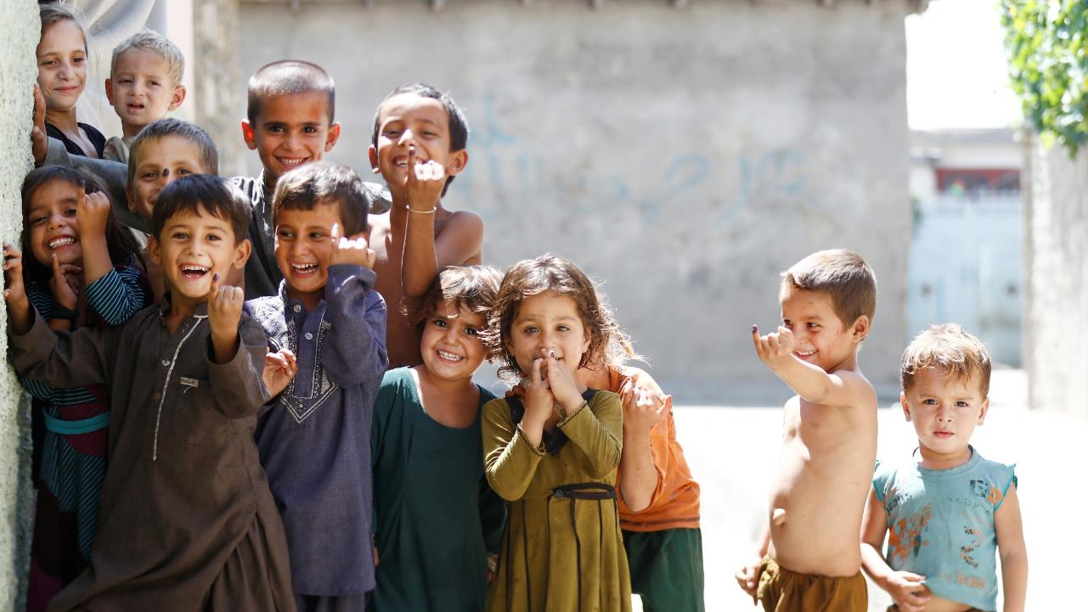

Thank you!
For more information please visit:
https://www.who.int/teams/immunization-vaccines-and-biologicals/essential-programme-on-immunization/demand
Notes:
Photo source: WHO Photo Library. Polio vaccination campaign in Kunar, Afghanistan. August 2016.

