Slide 1
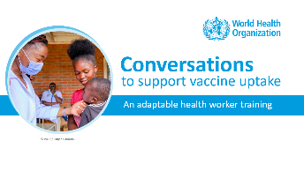
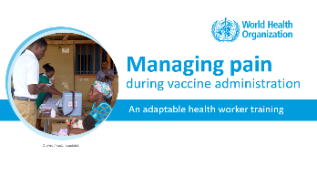
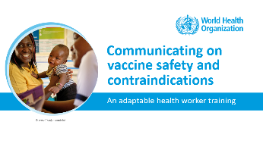
NOTES FOR FACILITATOR. REMOVE BEFORE SHARING.
How to use this resource
    About this resource: This resource is part of a package of training modules to strengthen health worker skills in communicating on vaccination.
    It is part of a series on the following topics:
    Suggested learning format: The modules are designed for peer-facilitated and interactive sessions. Each module can be completed in one session or can be divided across several sessions. The modules are best suited for small groups of up to 10 participants to encourage active participation.

Slide 2
NOTES FOR FACILITATOR. REMOVE BEFORE SHARING.
How to use this resource
    Adapt the modules for your local use. The contents of the modules are based on evidence and best practices. Please retain the main concepts as you make the deck your own. Customize this resource for your local needs by:
      Modifying examples, sample conversations and visuals,
      Translating to your local language,
      Tailoring the suggested exercises.
    Share your feedback. We would like to learn how you have been using these modules, what aspects have been helpful and in what ways we can improve the content and approach. After using the module, please fill out the online form linked below.
Link to Microsoft Forms
https://forms.microsoft.com/e/vJBakm3PCx

Slide 3

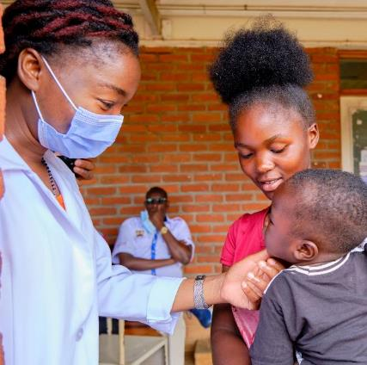
Conversations
.
to support vaccine uptake
An adaptable health worker training
© WHO / Fanjan Combrink

Slide 4
Training objectives
By the end of this training, participants will be able to
    Identify the main drivers of vaccine uptake
    Understand the importance of meaningful conversations in improving vaccination uptake
    Understand the communication goals and approaches according to a person’s intent to vaccinate, and
    Tailor conversations according to a person’s intent to vaccinate

Slide 5
A quick survey before we start…
How well do you agree with the following? | Strongly Agree | Agree | Disagree | Strongly Disagree
My conversation can influence someone’s decision to vaccinate.
I understand how to adjust my communication approach for individuals who are accepting, hesitant, or declining vaccination.
I am confident in guiding someone from vaccine hesitancy to greater acceptance through conversation.
Notes:
Facilitation Notes
Start the training session with this three-question survey to provide baseline measures on (1) one’s beliefs towards meaningful conversations, (2) knowledge of conversation style depending on intent, and (3) confidence in skills in tailoring conversations.
You may print the slide, and each participant ticks off their level of agreement on each statement.
At the end of the session, participants answer the survey again. Compare the changes in the measures.
Use the survey results to think of ways to improve content adaptation and delivery for future sessions.

Slide 6
Outline
    Understanding drivers and barriers to vaccine uptake
    Health workers and meaningful conversations
    Meaningful conversations about vaccination
    Tailoring vaccination conversations

Slide 7
Outline
    Understanding drivers and barriers to vaccine uptake
    Health workers and meaningful conversations
    Meaningful conversations about vaccination
    Tailoring vaccination conversations
Notes:
Discussion Notes
In this section, we will explore the key factors driving vaccine uptake and discuss how conversations can help point us to these barriers.
We will also clarify and agree on the definition of vaccine hesitancy
Key References
Understanding the behavioural and social drivers of vaccine uptake. WHO position paper – May 2022
Behavioural and social drivers of vaccine uptake: tools and practical guidance

Slide 8
What drives vaccine uptake?
Behavioural and Social Drivers (BeSD) of vaccination
Practical Issues
Availability
Affordability
Ease of access
Service quality
Respect from health worker
Thinking and Feeling
Perceived disease risk
Vaccine confidence
(includes perceived benefits,
safety and trust)
Motivation
Intention to get
recommended
vaccines
Vaccination
Uptake of recommended
vaccines
Social Processes
Social norms
(includes support of family
and religious leaders)
Health worker recommendation
Gender equity
Source: World Health Organization. Behavioural and social drivers of vaccination: tools and practical guidance for achieving high uptake. 2022. https://iris.who.int/handle/10665/354459
The behavioural and social drivers (BeSD) framework is based on the Increasing Vaccination Model (Brewer NT, et al. Psychol Sci Public Interest. 2017;18(3):149–207.)
Notes:
Discussion Notes
The Behavioral and Social Drivers, or BeSD framework, developed by experts convened by WHO, helps us understand why people choose to get vaccinated — or why they don’t get vaccinated.
The framework has four key groups of factors (or domains) that influence vaccine uptake: Thinking and Feeling, Social Processes, Motivation, and Practical Issues. We’ll go through each of these in detail in the following slides.
Our conversations with people in the community can help us identify what influences their decision to vaccinate. This helps tailor our conversations to support their decision to vaccinate, or address hesitancy if they are unsure.
On a broader scale, such as at the community, district, subnational, or national level, BeSD has tools like surveys and interview guides to measure the drivers for vaccination. Gathering and analyzing BeSD data helps immunization programmes design targeted interventions to address barriers and improve vaccine uptake.

Slide 9
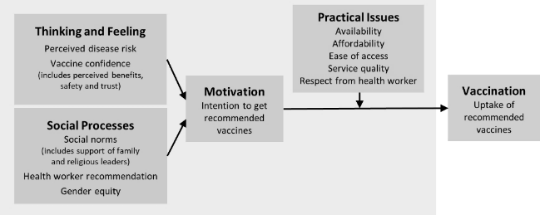
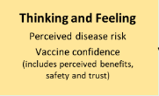
Barriers to vaccination uptake
Classifying possible reasons according to the BeSD framework
“ I worry the vaccines are not safe.”
“I don’t need vaccines, I’m healthy.”
“I’ve heard vaccines cause autism”
“Taking several vaccines at once
is bad for you”
Source: WHO. 2022. Behavioural and social drivers of vaccination: tools and practical guidance for achieving high uptake. Based on Brewer NT, et al. Psychol Sci Public Interest. 2017;18(3):149–207.
Notes:
Discussion Notes
In the BeSD framework, the Thinking and Feeling domain includes personal beliefs around vaccines and diseases, which may impact a person’s decision to vaccinate.
For example, some people may worry about vaccine safety, saying things like, 'I worry the vaccines are not safe.'
Others may underestimate their own risk of diseases, with statements like, 'I don’t need vaccines; I’m healthy,’
Some may have less vaccine confidence, fueled by misconceptions about how vaccines work, such as, 'Taking several vaccines at once is bad for you’, or by false information such as, 'I’ve heard vaccines cause autism.’
By understanding these concerns, health workers can further engage in conversations and offer accurate information in an empathetic manner.

Slide 10
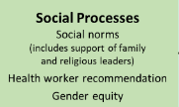
Barriers to vaccination uptake
Classifying possible reasons according to the BeSD framework
“ My family does not want me
/ my child to get vaccinated.”
“I have to ask my husband permission to take the children for their vaccination.”
“My village chief is against vaccination.”
“A health worker hasn’t recommended vaccination for me / my child.”
Source: WHO. 2022. Behavioural and social drivers of vaccination: tools and practical guidance for achieving high uptake. Based on Brewer NT, et al. Psychol Sci Public Interest. 2017;18(3):149–207.
Notes:
Discussion Notes
Social Processes refer to the influence of family, community, and cultural norms on vaccination decisions. Here are some conversation lines that refer to this domain.
Statements like 'My family does not want me or my child to get vaccinated’ is an example how family attitudes shape vaccination choices.
Cultural or community dynamics can also play a role. When one says, 'My village chief is against vaccination,’ it shows how community leaders can influence one’s vaccination decisions.
Statements such as 'I have to ask my husband’s permission to take the children for their vaccination' reflect the impact of gender issues on one’s decision-making.
Health worker recommendation is also critical in encouraging vaccine uptake, as highlighted by statements such as, 'A health worker hasn’t recommended vaccination for me or my child.'

Slide 11

Barriers to vaccination uptake
Classifying possible reasons according to the BeSD framework
“I’m not sure of getting vaccinated.”
“I don’t want to get vaccinated.”
Source: WHO. 2022. Behavioural and social drivers of vaccination: tools and practical guidance for achieving high uptake. Based on Brewer NT, et al. Psychol Sci Public Interest. 2017;18(3):149–207.
Notes:
Discussion Notes
Motivation refers to a person’s intention to get vaccinated
When people say things like, 'I’m not sure about getting vaccinated,' it reflects hesitation or uncertainty, indicating a weak motivation.
Statements like, 'I don’t want to get vaccinated,’ can indicate outright refusal.

Slide 12

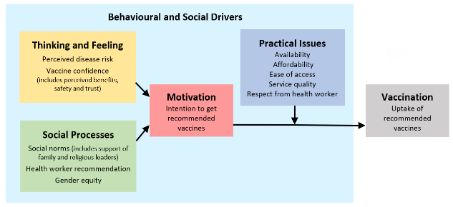
Vaccine hesitancy is part of the Motivation domain
Hesitancy is a motivational state of being conflicted about, or opposed to, getting vaccinated; includes intentions and willingness.
Confidence: Belief that vaccines are effective, safe, and part of a trustworthy medical system. Low vaccine confidence is distinct from but may contribute to vaccine hesitancy
Notes:
Discussion Notes
Let’s further understand and clarify what vaccine hesitancy means.
Vaccine hesitancy is part of the Motivation domain in the BeSD framework. It represents a motivational state where individuals feel conflicted, uncertain, or opposed to getting vaccinated.
Some individuals may hesitate even if they are not entirely against vaccines. Vaccine hesitancy is not outright refusal or denial of vaccines. Those who are hesitant may still get vaccinated if their concerns are addressed.
Vaccine hesitancy is not the same as low vaccine confidence, although a lack of confidence—such as doubts about vaccine safety or trust in the system—can contribute to hesitancy.
Understanding vaccine hesitancy as a motivational issue allows health workers to address the specific concerns or influences that might help move individuals toward vaccination.

Slide 13
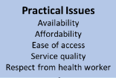
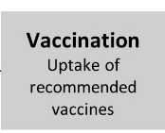
Barriers to vaccination uptake
Classifying possible reasons according to the BeSD framework
“The vaccination session schedules are not convenient.”
“Vaccination services are far away.”
“The bus to the clinic is expensive.”
“I got yelled at because I forgot my vaccination card.”
“I waited 3 hours for vaccination.”
Source: WHO. 2022. Behavioural and social drivers of vaccination: tools and practical guidance for achieving high uptake. Based on Brewer NT, et al. Psychol Sci Public Interest. 2017;18(3):149–207.
“They ran out of vaccines and I/my child couldn’t get vaccinated.”
Notes:
Discussion Notes
Practical Issues refer to challenges that make it difficult for people to access vaccination services.
Examples include logistical barriers like 'The vaccination session schedules are not convenient' or 'Vaccination services are far away,' which can discourage people from accessing services.
Cost can also be a factor, as highlighted by statements like, 'The bus to the clinic is expensive,' even if the vaccine itself is free.
Negative experiences at vaccination sites, such as long waits ('I waited 3 hours for vaccination’), disrespectful treatment ('I got yelled at because I forgot my vaccination card’) or vaccine stockouts ('They ran out of vaccines and I couldn’t get vaccinated'), can deter future visits.

Slide 14


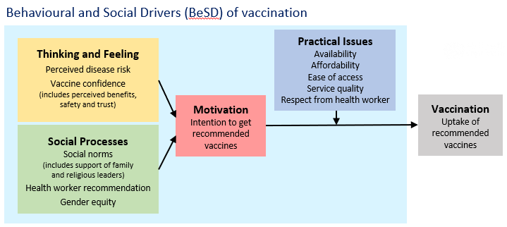
Let’s discuss!
In your experience, what have been the common reasons for low vaccine uptake?
© WHO / Mukhsin Abidzhanov
Notes:
Facilitation Notes
Participants briefly share their experiences on common reasons for low vaccine uptake in the community.
Discuss how these reasons map in the BeSD framework.

Slide 15
Outline
    Understanding drivers and barriers to vaccine uptake
    Health workers and meaningful conversations
    Meaningful conversations about vaccination
    Tailoring vaccination conversations
Notes:
Discussion Notes
In this section, we will discuss the critical role health workers play in building trust and shaping decisions towards vaccination.
We’ll explore what meaningful conversations on vaccination are.

Slide 16
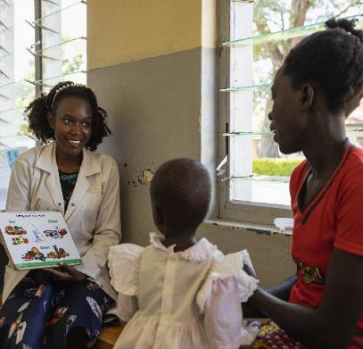
In many settings,
health workers are the most trusted influencers of vaccination decisions.
Sources:
Brewer NT, et al. Psychol Sci Public Interest. 2017;18(3):149–207.
Pandolfi E, et al. BMC Public Health. 2012;12:984.
© WHO / Esther Ruth Mbabazi
Notes:
Discussion Notes
Research highlights the importance of health worker recommendations in influencing vaccination decisions.
Among the important roles that health workers play in increasing vaccination rates is through effective communication on vaccination.

Slide 17

Health workers increase vaccine uptake and build trust by (1 of 2)
Reminding people when vaccines are due and explaining why they are important.
Listening to concerns and providing clear, empathetic answers.
Encouraging confidence by sharing the benefits and safety of vaccines.
© WHO / Fanjan Combrink
Notes:
Discussion Notes
Reminding people about vaccination schedules ensures they are aware when vaccines are due and helps them understand why staying on schedule is critical for protection.
Listening to concerns with empathy creates a safe space for people to express their doubts and allows health workers to provide clear, factual responses that build trust.
Encouraging confidence in vaccines by emphasizing their safety, effectiveness, and benefits helps individuals feel reassured and more likely to take action.

Slide 18
Health workers increase vaccine uptake and build trust by (2 of 2)
Helping people act immediately, such as guiding them to vaccination services or scheduling appointments.
Facilitating a positive health service experience, encouraging further visits for vaccination and other health services.
© WHO / Fanjan Combrink
Notes:
Discussion Notes
Health workers support immediate action by guiding individuals to vaccination services and helping them schedule appointments, ensuring they can act promptly and confidently to get vaccinated.
Facilitating a positive experience with health services strengthens trust in the healthcare system, making individuals more likely to return for future vaccinations and other health services.

Slide 19

Meaningful conversations strengthen trust and encourage vaccine acceptance
    Meaningful conversations shift from ….
    Just providing information to building relationships
    A transactional exchange to an empathetic discussion
    A one-time interaction to trust-building engagement
Meaningful conversations are rooted in empathy, transparency and a genuine concern for another’s well-being.
Notes:
Discussion Notes
Meaningful conversations are about understanding that people are more likely to accept vaccines when they feel respected, valued, and supported in their decision-making process.
Meaningful conversations go beyond just providing information—they focus on building genuine relationships and trust with individuals, which is key to encouraging vaccine confidence and uptake.
Shifting from transactional exchanges to empathetic discussions means actively listening, understanding concerns, and addressing them with compassion and clarity.
Trust-building engagement is long-term—it’s not just about a single interaction but about creating ongoing connections rooted in empathy, transparency, and genuine care for the person’s well-being.

Slide 20
Outline
    Understanding drivers and barriers to vaccine uptake
    Health workers and meaningful conversations
    Meaningful conversations about vaccination
    Tailoring vaccination conversations
Notes:
Discussion Notes
In this section, we will go into more detail on how to have meaningful conversations about vaccination.

Slide 21
3 Steps
for meaningful conversations
about vaccination
Step
1
Presume vaccination and elicit questions.
Identify intent to vaccinate.
Tailor your response.
Step
2
Step
3
Notes:
Discussion Notes
These are the three general steps in having meaningful conversations about vaccination.

Slide 22
3 Steps
for meaningful conversations
about vaccination
Step
1
Presume vaccination and elicit questions.
Identify intent to vaccinate.
Tailor your response.
Step
2
Step
3
Notes:
Discussion Notes
First, presume vaccination and elicit questions.

Slide 23

1
Step
Presume vaccination and elicit questions.
Start with a statement assuming vaccine acceptance. Then, invite for questions and concerns.
Why?
Assuming vaccination helps establish vaccination as a positive norm in the community. Inviting questions thereafter opens the conversation to explore one’s intent to vaccinate.
Sources:
Opel DJ, et al. Pediatrics. 2013;132(6):1037–46.
Brewer NT, et al. Pediatrics. 2017;139(1):e20161764.
Notes:
Discussion Notes
Begin the conversation by presuming the person plans to vaccinate. This establishes vaccination as the norm and sets a positive tone. (A couple of examples are on the next slide).
Invite the person to share any questions or hesitations. This approach makes them feel heard and opens the door for meaningful dialogue.
This step helps health workers gauge the individual’s intent and readiness to vaccinate, allowing for tailored responses to either support their decision or guide them toward acceptance.

Slide 24
1
Step
Presume vaccination and elicit questions.
Some examples:
“We’re ready to vaccinate. Do you have some questions before we proceed?”
“It’s time to protect baby Emma with a vaccine. Do you have some questions before we vaccinate her?”

Slide 25
3 Steps
for meaningful conversations
about vaccination
Step
1
Presume vaccination and elicit questions.
Identify intent to vaccinate.
Tailor your response.
Step
2
Step
3
Notes:
Discussion Notes
Second, identify their intent to vaccinate.

Slide 26

2
Identify intent to vaccinate
Step
Based on their response in the prior step, determine where the person sits on the spectrum of vaccination intentions
Why?
Identifying a person’s intent to vaccinate is important so we are aware of our communication goals and can tailor our responses accordingly.
Notes:
Discussion Notes
Based on the person’s response in Step 1, assess where they fall on the spectrum of vaccination intentions—declining, hesitant, or accepting. This helps tailor your approach to their specific needs and concerns. Identifying intent allows health workers to adjust their communication strategies effectively.
Recognize that a person’s position on the spectrum can change during the conversation. Empathy, respect, and tailored messaging can help shift individuals toward acceptance.

Slide 27
Spectrum of vaccination intentions
Declining
Hesitant
Accepting
Remember…
Most people accept vaccination.
Intentions can differ between vaccines.
Nobody is stuck in one position. People can change over time.
Good or bad health experiences with health services can influence people’s position on vaccination.
Source: Sharing Knowledge About Immunisation. (2023). skai.org.au
Notes:
Discussion Notes
Most people accept vaccination: It's important to remember that the majority of individuals are already inclined to vaccinate.
Intentions can vary by vaccine: A person may accept some vaccines but hesitate or decline others, depending on their perceptions or concerns.
Positions are not fixed: People can move along the spectrum over time, influenced by new information, experiences, or conversations.
Health worker interactions matter: Positive or negative experiences with health services can significantly impact where someone falls on the spectrum of vaccination intentions.
The following slides will help us further understand each intention.

Slide 28
Spectrum of vaccination intentions
Declining
Hesitant
Accepting
“Yes, let's go ahead with vaccination today."
Those who are accepting
Plan to vaccinate today
May have a question or two, but are mostly confident about vaccination
Source: Sharing Knowledge About Immunisation. (2023). skai.org.au
Notes:
Discussion Notes
Accepting individuals are ready to vaccinate: These are people who plan to proceed with vaccination today without hesitation.
Confidence is high but questions may arise: They might have a question or two for clarification, but they are generally confident about their decision to vaccinate.
Focus on support and encouragement: For those accepting, the role of the health worker is to provide reassurance, answer any questions briefly, and facilitate the vaccination process smoothly.

Slide 29
Spectrum of vaccination intentions
Declining
Hesitant
Accepting
“This is not the right choice for me.”
Those who are declining
Intend not to vaccinate today
May reject some or all vaccines for themselves or their child
May have had a previous negative experience with vaccination, beliefs that go against vaccination or a specific concern about (a) vaccine(s)
May try to avoid the vaccine conversation
Source: Sharing Knowledge About Immunisation. (2023). skai.org.au
Notes:
Discussion Notes
Declining individuals are not ready to vaccinate today: They usually express outright refusal.
Rejection of vaccines may be partial or complete: Some may reject specific vaccines while accepting others, or refuse all vaccinations for themselves or their children.
Underlying reasons vary: Reasons may stem from previous negative experiences, deeply held beliefs, or specific concerns about vaccines.
Avoidance of conversations: These individuals may try to steer clear of discussing vaccination, making it essential to approach them with empathy and openness. It is important to keep the door open: Even if they decline today, maintaining a respectful dialogue can encourage reconsideration in the future.

Slide 30
Spectrum of vaccination intentions
Declining
Hesitant
Accepting
“I still have some concerns I'd like to resolve"
Those who are hesitant
Are unsure whether they will vaccinate today, or are planning to vaccinate at all
May have less confidence in vaccination
May have had a previous negative experience with or after vaccination
Often will vaccinate with additional information, reassurance and support
Source: Sharing Knowledge About Immunisation. (2023). skai.org.au
Notes:
Discussion Notes
Hesitant individuals are uncertain: They are unsure whether they will vaccinate today or at all and may need time to decide.
Confidence may be low: Hesitancy often stems from doubts about vaccine safety, efficacy, or necessity.
Negative past experiences: Previous adverse experiences with vaccination or the healthcare system may contribute to their hesitation.
Reassurance is key: Many hesitant individuals can be guided toward vaccination with clear information, empathy, and supportive communication.
Opportunity for engagement: This group is often open to discussions, making it essential to address their specific concerns to build trust and confidence.

Slide 31

Declining or Hesitant?
Declining: Firmly refusing
Hesitant: Uncertain
“Natural immunity is better. I don't see the need for vaccines."
"I'm not sure if the vaccine is safe; I want to wait and see more long-term results."
"I'd consider getting the jab, but I'm worried about side effects."
“I had a very bad reaction once, and never will I take that risk again.
"I don’t want to decide now. I just need more information to make a comfortable decision."
"My body, my choice. I refuse to be forced into getting vaccinated."
“I’ve heard of many mistakes made at the clinic. How can I trust them with injecting something to my child?"
“The last time I went for vaccination, the health worker scolded me for missing my previous dose. I don’t want to be humiliated that way again.”
The body speaks: Observing one’s body language, facial expressions and tone of voice can provide more insights into a person’s stance on vaccination.
Notes:
Discussion Notes
Declining individuals are firmly refusing vaccination: Their concerns may be rooted in strong beliefs, previous negative experiences, or mistrust of healthcare systems, as reflected in statements like "Natural immunity is better" or "I refuse to be forced into getting vaccinated.“ They have a fixed mindset and are less likely to engage in conversation.
Hesitant individuals are uncertain and open to dialogue: They may seek more information, reassurance, or time to make a decision, as shown by statements like "I’m worried about side effects" or "I need more information to make a comfortable decision.“
Body language offers additional clues: Observing other cues such as tone of voice, facial expressions, gestures or posture can help health workers better understand a person’s stance. For example, an individual might say, "I don’t trust vaccines, and I’m not taking one," but their body language—such as avoiding eye contact, fidgeting, or a hesitant tone—may suggest uncertainty or discomfort, indicating they could be open to further dialogue if approached empathetically.

Slide 32
Outline
    Understanding drivers and barriers to vaccine uptake
    Health workers and meaningful conversations
    Meaningful conversations about vaccination
    Tailoring vaccination conversations
Notes:
Discussion Notes
In Steps 1 and 2, we learned how to presume vaccination and identify intent by understanding whether individuals are accepting, hesitant, or declining.
Now, we’ll focus on tailoring conversations to address their specific concerns and guide them effectively toward vaccination.

Slide 33
3 Steps
for effective conversations
about vaccination
Step
1
Presume vaccination and elicit questions.
Identify intent to vaccinate.
Tailor your response.
Step
2
Step
3
Ensure a culturally-sensitive approach
Notes:
Discussion Notes
Before we dive into general recommendations for tailoring conversations, it’s important to first emphasize the value of culturally-sensitive responses.
Every community is unique, so the recommendations in this deck should always be adapted to fit the local context, respecting cultural norms, traditions, and values.
A culturally-sensitive approach builds trust and ensures that vaccination messages resonate more effectively with the people you serve.

Slide 34
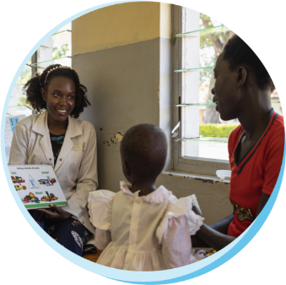
Ensuring a culturally sensitive approach
Understand local beliefs and practices
  Be aware of cultural norms, traditions, and values that may influence vaccination decisions. Speak in a way that resonates with their daily experiences.
Example: In a community where traditional healing practices are common, emphasize how vaccines complement, rather than replace, their existing health traditions.
© WHO / Esther Ruth Mbabazi
Notes:
Discussion Notes
Recognizing cultural norms, traditions, and values helps tailor vaccination messages that align with the community’s worldview.
Use language and examples that resonate with people’s everyday experiences to ensure your message is understood and trusted.
(The example may be modified to suit the local context).

Slide 35
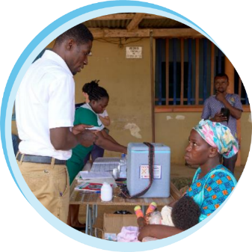
Ensuring a culturally sensitive approach
Respect decision-making dynamics
  Acknowledge family or community roles in healthcare decisions, such as consulting elders or gaining spousal agreement.
Example: In communities where men often make family health decisions, include them in conversations and highlight how vaccines benefit the entire family.
© WHO / Fanjan Combrink
Notes:
Discussion Notes
In many communities, health decisions are influenced by elders, spouses, or other family members. Respect these decision-making processes by including key influencers in vaccination discussions.
(The example may be modified to suit the local context).

Slide 36
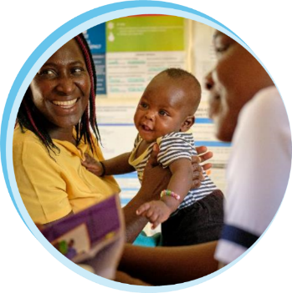
Ensuring a culturally sensitive approach
Avoid assumptions
  Each individual has unique concerns; listen actively and avoid generalizing based on stereotypes.
Example: In many communities, hesitancy or refusal may not be outright due to a lack of education or information. Instead, ask questions to understand the person’s concerns through open conversation.
© WHO / Fanjan Combrink
Notes:
Discussion Notes
Engage in meaningful conversations to uncover their specific concerns rather than relying on stereotypes.
(The example may be modified to suit the local context).

Slide 37
3
Step
Tailor your response
Establish conversation goals and tailor your response depending on where a person sits on the spectrum of vaccination intent.
Why?
Having a tailored response helps build trust in vaccines and health services by:
    Making people feel heard and understood
    Ushering people to information and services in a respectful manner
    Helping people connect with their own motivations for vaccinating
    Facilitating a positive health service experience

Slide 38

3
Tailor your response
Step
Declining
Hesitant
Accepting
Conversation goals with those who are accepting
Address their questions
Have them vaccinated today
Provide a positive vaccination experience
Source: Sharing Knowledge About Immunisation. (2023). skai.org.au

Slide 39
3
Tailor your response
Step
Declining
Hesitant
Accepting
Before vaccinating
Complete the recommended pre-vaccination check.
Answer any questions or point them to trusted sources.
After vaccinating
Congratulate them on their decision to vaccinate.
Provide them with information on side effects, how to manage them and when to seek further advice.
Remind them of their next schedule. Book appointment if applicable.
Explain necessary protective behaviours post-vaccination.

Slide 40

Role play
Accepting
In pairs, take turns playing the roles of a health worker and a person who is accepting.
Tailor your conversation based on the tips you’ve just learned.
© WHO / Mukhsin Abidzhanov
Notes:
Facilitation notes
ddd

Slide 41
3
Tailor your response
Step
Declining
Hesitant
Accepting
Conversation goals with those who are declining
Have a positive interaction.
Raise awareness of the risks of not vaccinating.
Maintain trust and engagement.
Source: Sharing Knowledge About Immunisation. (2023). skai.org.au
Notes:
Facilitation notes
ddd

Slide 42
3
Tailor your response
Step
Declining
Hesitant
Accepting
Respect autonomy for decision-making. Avoid debates, which can be perceived as coercive.
Be concise. Lengthy conversations rarely change fixed opinions.
Share key risks without overwhelming with details. Too much information can backfire.
Keep interactions positive. This encourages openness to future discussions.
Source: Sharing Knowledge About Immunisation. (2023). skai.org.au
Notes:
Discussion Notes
Respect for Autonomy: Prolonged conversations may feel intrusive or pressuring to someone who has already decided against vaccination. By keeping the interaction brief, we respect their autonomy and personal choice, which helps maintain a respectful and non-confrontational relationship.
Reducing Resistance: Long or intense discussions can increase resistance and entrench their current stance. A brief, positive interaction can leave the door open for future conversations without reinforcing their opposition.
Building Trust for Future Engagement: A concise and respectful approach shows that we’re here to support them without imposing. This can foster trust, making them more likely to return or reconsider vaccination in the future if their perspective changes.

Slide 43
Role play
Declining
In pairs, take turns playing the roles of a health worker and a person who is declining.
Tailor your conversation based on the tips you’ve just learned.
© WHO / Mukhsin Abidzhanov

Slide 44
3
Tailor your response
Step
Declining
Hesitant
Accepting
Conversation goals with those who are hesitant
Address concerns.
Increase vaccine confidence.
Encourage vaccination.
Source: Sharing Knowledge About Immunisation. (2023). skai.org.au

Slide 45



3
Tailor your response
Step
Declining
Hesitant
Accepting
Listen and understand
Get personal
Offer help

Slide 46



3
Tailor your response
Step
Declining
Hesitant
Accepting
Listen and understand
Take time to listen to the person and elicit information to support you in addressing their concerns and connecting with their motivation.
Ask open-ended questions
Tell me more about your concerns about the vaccine.
What are your thoughts about receiving the vaccine?
Acknowledge their experience
Having questions is very normal.
It sounds like you had a strong reaction to that vaccine.
Reflect and summarize
It sounds like you worry the most about side effects.
Source: Sharing Knowledge About Immunisation. (2023). skai.org.au
Notes:
Discussion Notes
Ask Open-Ended Questions: Encourage people to share their thoughts and concerns freely, which can reveal underlying worries or misconceptions. Open-ended questions help build a two-way dialogue.
Acknowledge Their Experience: Show empathy by validating their feelings and experiences. Acknowledgment of emotions fosters trust and assures them that their concerns are respected.
Reflect and Summarize: Reflect back what they've shared to ensure understanding and clarity before providing any information.

Slide 47
Question
    At your health center, a mother mentioned the following:
“They said the vaccine can cause severe side effects. I’m afraid something bad would happen to my child”.
Which of the following is the best immediate response?
“That is wrong information. Where did you hear of that?”
“That will not happen to your child. Don’t worry.”
“Having such concern is normal. Could you tell me more?”
“Vaccines are safe. Let me tell you about the minor side effects.”
Notes:
Facilitation Notes
Option A: “That is wrong information. Where did you hear of that?”
This response may feel confrontational or dismissive, as it immediately challenges the information source. It could make the person feel defensive or judged for their concerns.
Option B: “That will not happen to your child. Don’t worry.”
The response may come across as dismissive of the person’s concerns. By telling them “not to worry” without addressing their underlying fears, it risks minimizing their feelings. Acknowledging emotions and listening to concerns first helps the person feel validated before moving on to provide information or reassurance.
Option C: “Having such concern is normal. Could you tell me more?” – CORRECT RESPONSE
This is the most empathetic response, aligning closely with “Listen and Understand.” By normalizing their concerns and inviting them to share more, this response fosters an open and supportive environment. It shows that their feelings are valid and opens the door for a deeper conversation, helping to uncover specific fears that can be addressed with relevant information.
Option D: “Vaccines are safe. Let me tell you about the minor side effects.”
While this response provides information, it jumps directly to reassurance without first listening to the person’s specific concerns (also called the righting reflex). It’s essential to listen and understand first. After they feel heard, then you can offer tailored information that addresses their unique worries rather than providing general facts that may not feel relevant to them.

Slide 48


3
Tailor your response
Step
Declining
Hesitant
Accepting
Get personal
Help identify reasons to vaccinate
By getting personal, we open the possibility of identifying and speaking to the other person’s motivations.
Your lung condition makes you more at risk of a serious infection.
I can see you’re concerned with passing the virus to your family.
Share your knowledge / story
Can I tell you what I have learned about vaccines?
I also had some concerns with vaccines before. Can I share how I resolved these?
Recheck intentions
How are you feeling about vaccination now?
Notes:
Discussion Notes
Help Identify Reasons to Vaccinate: Encourage people to reflect on personal motivations, like protecting family or contributing to community health. Personal motivations resonate more deeply, making individuals feel a stronger connection to the decision to vaccinate.
Share Knowledge or Your Story: Offer relevant information (while noting consent) or share a personal experience to create a relatable and supportive conversation. Personal stories and trusted knowledge can make the benefits of vaccination feel more tangible and reassuring.
Recheck Intentions: After discussing motivations and information, gently confirm their feelings and intentions about vaccination. This step respects their autonomy, providing space to reflect and decide without pressure.

Slide 49
3
Tailor your response
Step
Declining
Hesitant
Accepting
Offer help
Encourage vaccination
By offering help, we can bring them closer to a decision to receive vaccines and make the vaccination itself easier to do.
“You can help reduce the risk of transmitting the illness to your family by getting vaccinated, too.”
Not vaccinating will leave you at risk of getting sick and being hospitalized.
Suggest next steps
You can always come back if you have questions or want to discuss vaccination again.
Assist within your capacity
If you like, I can help book your next vaccination appointment.
Notes:
Discussion Notes
Encourage Vaccination: Provide reassurance about the benefits of vaccination and gently encourage taking the step. Positive encouragement, framed with empathy, can strengthen confidence in the decision to vaccinate.
Suggest Next Steps: Offer clear guidance on what they can do next, such as scheduling an appointment or where to go for more information. Clear next steps make the process feel manageable.
Assist Within Your Capacity: Offer help within your role, such as providing additional information or connecting them to services, to support their journey. Practical support shows a commitment to their well-being.

Slide 50





3 Steps
for effective conversations
about vaccination
Recommend vaccination and elicit questions.
“We’re ready to vaccinate. Do you have questions I can help you with?”
Identify intent to vaccinate.
If hesitant:
Tailor your response.

Slide 51

Role play
Hesitant
In pairs, take turns playing the health worker and the person who is declining or hesitant.
Remember:
© WHO / Mukhsin Abidzhanov

Slide 52



Option: Let’s play Bingo!
 | Open-ended questions | Acknowledge experience | Reflect and summarize
 | Help identify reasons to vaccinate | Share knowledge/ story | Recheck intentions
 | Encourage vaccination | Suggest next steps | Assist
While the role-play is ongoing, observers mark on the card the techniques demonstrated.
The observer who ticks off all techniques shouts ‘Bingo’!
Listen and understand
Get personal
Source: Julie Leask, University of Sydney
Offer help

Slide 53
Reflections
What is something new that you have learned today?
How confident do you feel about applying the conversation skills in your work?
© WHO / Mukhsin Abidzhanov

Slide 54
Summary: Key actions along the spectrum of vaccination intentions
Declining
Hesitant
Accepting
Affirm decision and provide a positive vaccination experience
Listen proactively, understand
and engage with tailored strategies
Share key risks and keep the conversation short and positive

Slide 55
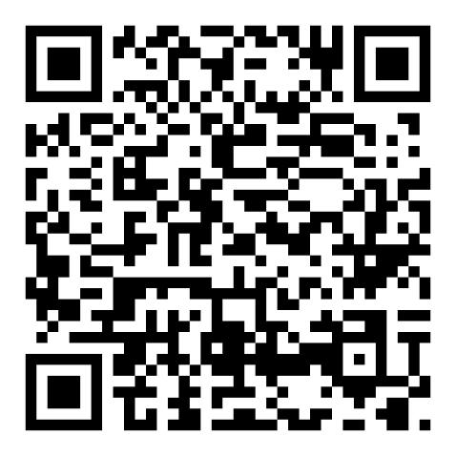
Questions and answers on vaccination
Search the WHO Questions and Answers webpages
for technically sound and easily understandable responses to commonly asked questions on vaccines.
https://www.who.int/news-room/questions-and-answers

Slide 56
A quick survey before we end…
How well do you agree with the following? | Strongly Agree | Agree | Disagree | Strongly Disagree
My conversation can influence someone’s decision to vaccinate.
I understand how to adjust my communication approach for individuals who are accepting, hesitant, or declining vaccination.
I am confident in guiding someone from vaccine hesitancy to greater acceptance through conversation.
Notes:
Discussion Notes
Compare the changes in the measures between the pre-session survey and this post-session survey.
Use the survey results to think of ways to improve content adaptation and delivery for future sessions.

Slide 57


Thank you!
For more information please visit:
https://www.who.int/teams/immunization-vaccines-and-biologicals/essential-programme-on-immunization/demand
Notes:
Photo source: WHO Photo Library. Polio vaccination campaign in Kunar, Afghanistan. August 2016.

Slide 58
References
World Health Organization. 2022‎. Behavioural and social drivers of vaccination: tools and practical guidance for achieving high uptake. World Health Organization. https://apps.who.int/iris/handle/10665/354459
World Health Organization. (2022). Understanding the behavioural and social drivers of vaccine uptake. WHO Position Paper – May 2022. Weekly Epidemiological Record, No 20, 2022, 97, 209–224. https://apps.who.int/iris/bitstream/handle/10665/354458/WER9720-eng-fre.pdf
Brewer NT, Chapman GB, Rothman AJ, Leask J, Kempe A. Increasing vaccination: putting psychological science into action. Psychol Sci Public Interest. 2017;18(3):149–207. DOI: 10.1177/1529100618760521
Sharing Knowledge About Immunisation (SKAI). 2023. Discussion Guides. https://skai.org.au/healthcare-professionals
Randall, S., Leask, J., Robinson, P., Danchin, M., Kinnersley, P., Witteman, H., Trevena, L., Berry, N. Underpinning of the sharing knowledge about immunisation (SKAI) communication approach: A qualitative study using recorded observations. Patient Education and Counseling 2020;103:1118-1124. https://doi.org/10.1016/j.pec.2019.12.014
Gagneur A. Motivational interviewing: A powerful tool to address vaccine hesitancy. Can Commun Dis Rep. 2020 Apr 2;46(4):93-97. DOI: 10.14745/ccdr.v46i04a06
Opel DJ, Heritage J, Taylor JA, Mangione-Smith R, Salas HS, Devere V, et al. The architecture of provider–parent vaccine discussions at health supervision visits. Pediatrics. 2013;132(6):1037–46. DOI: 10.1542/peds.2013-2037
Leask, J., Kinnersley, P., Jackson, C. et al. Communicating with parents about vaccination: a framework for health professionals. BMC Pediatr 12, 154 (2012). https://doi.org/10.1186/1471-2431-12-154

Slide 59
Acknowledgments
This training module was developed by the Demand and Behavioural Science Team, Department of Immunization, Vaccines and Biologicals, WHO Headquarters: Lisa Menning, Jun Ryan Orbina and Francine Ganter-Restrepo (former staff).
Special thanks for the technical review by collaborators from the University of Sydney, Australia: Professor Julie Leask, Ikram Abdi and Maria Christou-Ergos.

