Slide 1
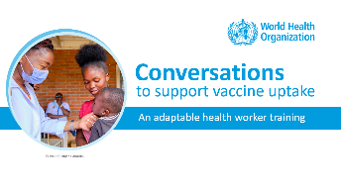
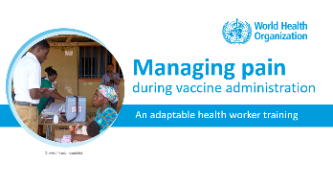

NOTES FOR FACILITATOR. REMOVE BEFORE SHARING.
How to use this resource
    About this resource: This resource is part of a package of training modules to strengthen health worker skills in communicating on vaccination.
    It is part of a series on the following topics:
    Suggested learning format: The modules are designed for peer-facilitated and interactive sessions. Each module can be completed in one session or can be divided across several sessions. The modules are best suited for small groups of up to 10 participants to encourage active participation.

Slide 2
NOTES FOR FACILITATOR. REMOVE BEFORE SHARING.
How to use this resource
    Adapt the modules for your local use. The contents of the modules are based on evidence and best practices. Please retain the main concepts as you make the deck your own. Customize this resource for your local needs by:
      Modifying examples, sample conversations and visuals,
      Translating to your local language,
      Tailoring the suggested exercises.
    Share your feedback. We would like to learn how you have been using these modules, what aspects have been helpful and in what ways we can improve the content and approach. After using the module, please fill out the online form linked below.
Link to Microsoft Forms
https://forms.microsoft.com/e/vJBakm3PCx

Slide 3

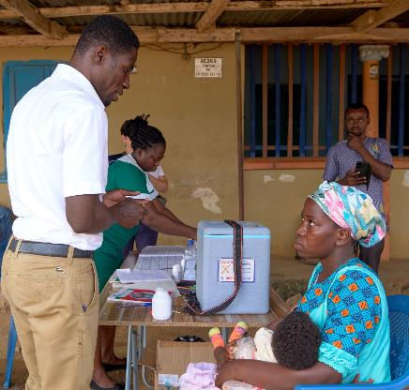
Managing pain
.
during vaccine administration
Lisa
An adaptable health worker training
© WHO / Fanjan Combrink

Slide 4
Training objectives
At the end of this training, you will be able to:
    Understand the impact of pain at the time of immunization
    Understand why it is important to manage pain well
    Outline the role of health workers in managing pain during vaccination
    Describe what health workers can say or do to reduce pain
    Identify important considerations for pain management

Slide 5
A quick survey before we start…
How well do you agree with the following statements? | Strongly Agree | Agree | Disagree | Strongly Disagree
I understand the importance of managing pain well during vaccination
I am confident in interacting with parents/caregivers in ways that could help manage pain during vaccination.
I am well aware of the different techniques to reduce pain during vaccination.
Notes:
Facilitation Notes
Start the training session with this three-question survey to provide baseline measures.
You may print the slide, and each participant ticks off their level of agreement on each statement.
At the end of the session, participants answer the survey again. Compare the changes in the measures.
Use the survey results to think of ways to improve content adaptation and delivery for future sessions.

Slide 6
Outline
    Why manage pain?
    Reducing pain during vaccination
    Important considerations

Slide 7
Outline
    Why manage pain?
    Reducing pain during vaccination
    Important considerations

Slide 8



Why manage pain?
Pain or fear of pain at the time of vaccination is common at any age and can become a barrier to uptake
Pain can be managed and reduced
Health workers have a responsibility to minimize anxiety and pain during vaccination
Sources:
McMurtry, C. et. al. (2015). Vaccine, 33(1), 18-26.
Taddio, A., et. al. (2018). Canadian Medical Association Journal, 190(45), E1274-E1282.

Slide 9
Pain at the time of vaccination
Perception of pain varies from person to person
Children often perceive needles to be more painful than adults
Anticipation of pain can cause fear and tensing of muscles, and lead to further discomfort
Pain may be associated with other immunization stress-related responses including dizziness or fainting

Slide 10
Minimizing and managing pain
Promotes safer vaccination delivery by:
    Encouraging a calm and stress-free immunization experience
    Supporting individuals to prevent or manage fear of needles
Improves vaccine confidence by:
    Helping individuals feel more comfortable with vaccination
    Creating a positive and reassuring vaccination experience
Source:
Immunization stress-related response. A manual for program managers and health professionals to prevent, identify and respond to stress related responses following immunization. Geneva: World Health Organization; 2019.

Slide 11

Pain after vaccination
Pain during vaccination is different from pain that develops after vaccination
Pain that develops after vaccination may be present with redness, tenderness and/or swelling at the injection site
    Can vary per person and vaccine
    Usually mild and not a serious cause of concern
    In some rare cases, can be more severe (i.e., severe local reactions)

Slide 12
Outline
    Why manage pain?
    Reducing pain during vaccination
    Important considerations

Slide 13



A health worker
can reduce pain during vaccination
These factors are modifiable by managing…
Interaction with health worker
What to say?
Technique of vaccine administration
What to do?
Comfort during the visit
How to act?
© WHO / Fanjan Combrink
Notes:
Discussion Notes
Health workers can help to reduce pain during vaccination by managing their interactions with clients, the vaccination techniques and by providing reassurance and comfort.
In this training we will explain what to say, what to do and how to act to help manage and reduce pain and fear of pain related to vaccination.

Slide 14





Specific pain management techniques vary by population groups and age
Babies up to 2 years old
2 to 17 years old
Adults, elderly, and pregnant women

Slide 15
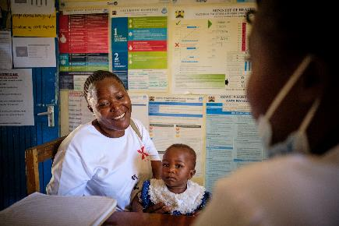
Creating the right environment
for vaccination
Vaccination must be discussed and administered in a setting which is:
Comfortable and private
Clean, quiet and calm
A well-designed and efficient service
© WHO / Fanjan Combrink
Source: Quality immunization services: a planning guide. Geneva: World Health Organization; 2022.
Notes:
Discussion Notes
Vaccination must be discussed and administered in a comfortable and private setting to protect people’s privacy, well-being and build trust
Ensure a clean, quiet and calm environment and timeliness of vaccination services

Slide 16
Outline
    Why manage pain?
    Reducing pain during vaccination
What to say | What to do | How to act
Before vaccination | Positioning of the patient | Calm, prepared, confident
During vaccination | Distraction/ active management | Respectful and supportive
After vaccination | Good technique
    Important considerations

Slide 17
What to say before vaccination
Use language appropriate to the person’s level of understanding
If giving vaccines to a young child, ask the caregiver if and how much the child understands about vaccination
If they are nervous, acknowledge and normalize their feelings:
“It is normal to feel nervous before getting a needle.”

Slide 18
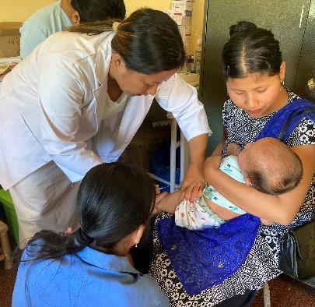
What to say before vaccination
Be honest that the needle may hurt. Pain is normal, happens briefly and resolves on its own.
  Do not say, “It doesn’t hurt.”
  Do not dismiss their feelings.
  These approaches are not helpful and may promote distrust or increase distress.
© WHO / Sanchita Sharma

Slide 19
What to say before vaccination
Prepare the person/caregiver for vaccination by explaining what to expect:
  What the vaccine(s) prevent against:
  “These vaccines provide important protection against…”
  Invite participation:
  “Do you have some questions?”
  Describe how the vaccination will feel using neutral language:
  “Some people say they feel a poke or pinch and some pushing for a few seconds, and others say they do not feel much at all.”

Slide 20
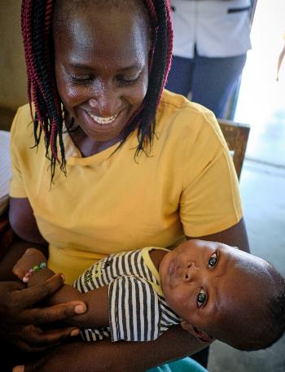
What to say before vaccination
Ask about preferred coping strategies. If offering distraction items in the clinic, let them know what options are available:
  “Tell me what can we do to make the vaccination more comfortable for you?
  “We have some books. Would you like to pick one to use as a distraction?”
© WHO / Fanjan Combrink

Slide 21
What to say during vaccination
Keep needles and frightening objects/equipment out of view
If vaccinating an infant, ask the caregiver to hold the infant in a position that is comfortable for both:
  Ask the mother if they would like the baby to have some sucrose, which has been shown to minimize pain
  Encourage breastfeeding at the time of vaccination (if appropriate) as it also helps with relaxation

Slide 22
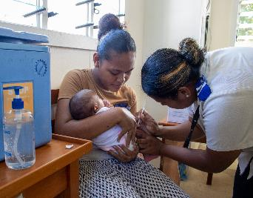
What to say during vaccination
Show caregivers how to hold infants and children in a manner that provides physical comfort, while exposing and securing limb(s) for injection
Ask older children and adults to relax their arm and sit upright
Give a neutral verbal signal before administering the vaccine: “I’m going to count 3,2,1.” or “Okay, I am going to give the vaccine now.”
© WHO / Faizza Tanggol

Slide 23
What to say after vaccination
Smile, encourage and praise them for their bravery:
“Well done, you read your book / stayed very still!”
Ask for feedback and use that to plan for next time:
“How did that feel?”
Provide instructions on aftercare:
“It is normal for your arm to feel sore. It shouldn’t prevent you from doing any activities that you normally do”

Slide 24
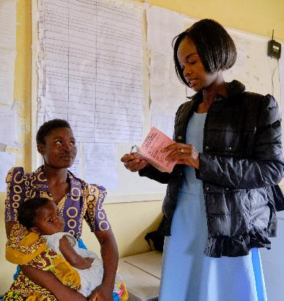
What to say after vaccination
Inform about signs and symptoms they should watch out for, i.e. adverse events following immunization (AEFI):
“It is normal to see some redness and swelling at the site of injection, and this should go away after a few days”
© WHO / Fanjan Combrink

Slide 25


Role play
In groups of 2 or more:
Person 1: A person who is nervous about pain from needles during vaccination
Person 2: A health worker who will vaccinate the patient
Other(s): Observers, who will take notes on the interaction
Practice the interaction with the aim of
addressing the concerns of the person due for vaccination
© WHO / Mukhsin Abidzhanov
5 min for role playing, 5 – 10 min for discussion with group

Slide 26
Outline
    Why manage pain?
    Reducing pain during vaccination
What to say | What to do | How to act
Before vaccination | Positioning of the patient | Calm, prepared, confident
During vaccination | Distraction/ active management | Respectful and supportive
After vaccination | Good technique
    Important considerations

Slide 27
Positioning for vaccination
A comfortable position reduces anxiety and allows for more control while administering vaccines. If the infant is held by the caregiver, it also helps the infant to feel secure and relaxed.

Slide 28
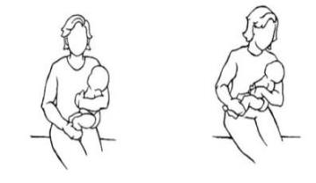
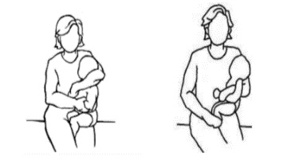
Positioning for vaccination
Newborn – caregiver can hold the infant skin to skin against their chest with leg exposed for vaccination
Infants and young children – should be held or sit on caregivers’ lap with limb exposed for vaccination
If injecting the upper thigh
If injecting the arm
Image credits: http://www.bccdc.ca/resource-gallery/Documents/Guidelines%20and%20Forms/Guidelines%20and%20Manuals/Epid/CD%20Manual/Chapter%202%20-%20Imms/SectionIVB_RIIP.pdf

Slide 29

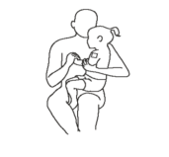

Positioning for vaccination
2 to 17 years old
Younger children: sitting on caregivers’ lap
Older children: sitting up in a chair
Or offer lying down if they have a history of fainting
Adults, elderly and pregnant persons
Sitting up in a chair
Offer lying down if they have a history of fainting
Image credits: http://www.bccdc.ca/resource-gallery/Documents/Guidelines%20and%20Forms/Guidelines%20and%20Manuals/Epid/CD%20Manual/Chapter%202%20-%20Imms/SectionIVB_RIIP.pdf

Slide 30


Distraction / Active management
This varies by the individual and setting. Some people may prefer to watch the procedure as it is their style of coping.
Babies to 2 years old
Breastfeed during vaccination (if appropriate) as it helps the baby to be well positioned and relaxed during injection, and reduces pain
Toys, books, or music, if available
2 to 17 years old and adults
Verbal distraction, e.g., talking, singing
Toys, books, music, videos, if available
If prone to fainting, can tense abdominal and leg muscles (but NOT the arm being vaccinated as this can increase pain)
Breathing. Ask adults to slightly cough or take deep breath in and hold during vaccination

Slide 31
Proper vaccination technique
Good technique helps minimize pain.
Use landmarks on the body to determine the injection site.
Be safe but also quick when vaccinating.
Improper technique can lead to short- as well as long-term pain, and even nerve damage.

Slide 32
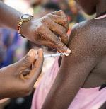

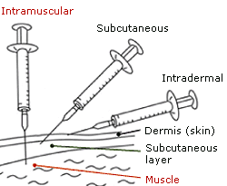
Proper vaccination technique
Use the correct needle and syringe
Locate the injection site where the vaccine will be administered
Upper shoulder
(right/left side)
Upper thigh
(right/left side)
Preferred for infants
Angle the needle according to type of vaccine administration

Slide 33
Proper vaccination technique
Avoid moving the needle once it has penetrated the skin and muscle.
Do NOT aspirate, i.e. do not pull back on the syringe after inserting in the injection site as it increases the pain:
  There are no large blood vessels at the recommended injection sites or injection into a large vessel, so no risk of major bleeding.
  Very minor bleeding at the site after injection is not a concern.
Notes:
Quick injection:
Taddio A, Wong H, Welkovics B, Ilersich AL, Cole M, Goldbach M, Ipp M. A randomized trial of the effect of vaccine injection speed on acute pain in infants. Vaccine. 2016;34(39):4672-4677.

Slide 34
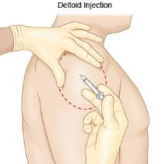
Proper vaccination technique
Retain light pressure on skin around the injection site with thumb and index finger. Avoid excessive pressure or rubbing the injection site after injection, as this can increase pain.
Use landmarks on the body to determine the
injection site
Insert vaccine quickly – i.e., less than 2 seconds.
Notes:
Quick injection:
Taddio A, Wong H, Welkovics B, Ilersich AL, Cole M, Goldbach M, Ipp M. A randomized trial of the effect of vaccine injection speed on acute pain in infants. Vaccine. 2016;34(39):4672-4677.

Slide 35
Outline
    Why manage pain?
    Reducing pain during vaccination
What to say | What to do | How to act
Before vaccination | Positioning of the patient | Calm, prepared, confident
During vaccination | Distraction/ active management | Respectful and supportive
After vaccination | Good technique
    Important considerations

Slide 36
Be calm, prepared and confident
Do not preload syringes. It increases risk of contamination and error.
Keep supplies nearby but out of view so they do not act as fear cues and that doses can be prepared quickly.
Ensure correct timing of preparations so materials are maintained at the right temperature.
Combined with skillful injection techniques, these strategies will allow you to feel and demonstrate confidence.

Slide 37
Be calm, prepared and confident
If giving multiple injections, administer the least painful vaccine first and the most painful last.
If due for oral rotavirus vaccine and injectable vaccines, give the rotavirus vaccine first as it contains sweetening agents (e.g., sucrose) which can help to decrease pain from injectable vaccines.

Slide 38
Be respectful and supportive
A respectful and supportive demeanor can demonstrate that a healthcare provider is positive, caring and approachable.
Respectful interactions include:
  Allowing the people to express their concerns without judgment
  Patiently listening
  Trying to understand and acknowledge concerns
  Offering options and working together to address concerns
  Honouring their decision
  Not using excessive force to restrain children

Slide 39
CARD vaccine delivery framework
Four evidence-based and simple steps can make vaccinations safer and a more positive experience, for all ages:
C
A
R
D
COMFORT
Create comfortable spaces for children and adults
ASK
Encourage them to ask any questions and choose coping strategies
RELAX
Stay calm and positive, reduce fear cues
DISTRACT
Provide distractions in waiting and vaccination areas
Notes:
CARD system (see also website: cardsystem.ca):
Taddio, A., Morrison, J., Gudzak, V., Logeman, C., McMurtry, C. M., Bucci, L. M., Shea, C., MacDonald, N. E., Yang, M. (2023). Integration of card (comfort ask relax distract) for covid-19 community pharmacy vaccination in children: effect on implementation outcomes. Canadian Pharmacists Journal, , 156(1 Suppl), 36S-47S. https://dx.doi.org/10.1177/17151635221139783
Taddio A, Alderman L, Freedman T, McDowall T, McMurtry CM, MacDonald N, deVlaming-Kot C, Alfieri-Maiolo A; Pain Pain Go Away Team. The CARD™ System for improving the vaccination experience at school: Results of a small-scale implementation project on program delivery. Paediatr Child Health. 2019 Apr;24(Suppl 1):S54-S67. doi: 10.1093/pch/pxz021.
Taddio, A., Morrison, J., Gudzak, V., Logeman, C., McMurtry, C. M., Bucci, L. M., Shea, C., MacDonald, N. E., Yang, M. (2023). Card (comfort ask relax distract) for community pharmacy vaccinations in children: effect on immunization stress-related responses and satisfaction. Canadian Pharmacists Journal, , 156(1 Suppl), 27S-35S. https://dx.doi.org/10.1177/17151635221137682
Freedman T, Taddio A, Alderman L, McDowall T, deVlaming-Kot C, McMurtry CM, MacDonald N, Alfieri-Maiolo A, Stephens D, Wong H, Boon H; Pain Pain Go Away Team. The CARD™ System for improving the vaccination experience at school: Results of a small-scale implementation project on student symptoms. Paediatr Child Health. 2019 Apr;24(Suppl 1):S42-S53. doi: 10.1093/pch/pxz020.
Taddio A, Gudzak V, Jantzi M, Logeman C, Bucci L, MacDonald N, Moineddin R. Impact of the CARD (Comfort Ask Relax Distract) system on school-based vaccinations: a cluster randomized trial. Vaccine 2022;26;40(19):2802-2809. doi.org/10.1016/j.vaccine.2022.02.069.
Tetui M, Grindrod K, Waite N, VanderDoes J, Taddio A. Integrating the CARD (Comfort Ask Relax Distract) system in a mass vaccination clinic to improve the experience of individuals during COVID-19 vaccination: a pre-post implementation study. Hum Vaccin Immunother. 2022 Jun 20:2089500. doi: 10.1080/21645515.2022.2089500.
Taddio, A., Ilersich, A. N. T., Bucci, L., McMurtry, C. M., Gudzak, V., Ipp, M., Zita, T., Tharmarajah, S., MacDonald, N. (2022). Letting kids play their cards (comfort, ask, relax, distract) to help cope with needle-related fear and pain: results from user testing.. Vaccine, , 40(52), 7667-7675. https://dx.doi.org/10.1016/j.vaccine.2022.09.035

Slide 40
Outline
    Why manage pain?
    Reducing pain during vaccination
    Important considerations
Breastfeeding during vaccination
Multiple injections
Vaccinating special populations

Slide 41
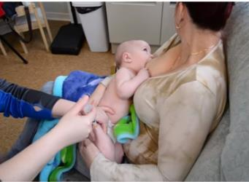
Breastfeeding during vaccination
If appropriate and feasible, encourage the breastfeeding mother to breastfeed before and during immunization
Try to ensure there is a good latch before proceeding with immunization for optimal effects
Vaccinating during breastfeeding does NOT increase the risk of aspiration

Slide 42

Multiple injections
Pain is perceived as a greater barrier with multiple injections in the same visit.
What to say | Acknowledge concerns about multiple injections and provide options for pain management Highlight advantages of multiple injections: early protection and fewer visits
What to do | Apply pain management techniques, and invite client participation to self-select their preferred coping strategies Give the oral vaccine(s) first and most painful injectable vaccine last Position them to so that sites for multiple vaccines are accessible If giving multiple injections in the same area, separate them as far apart as possible (preferably 2.5 cm) or give them in the other arm/leg

Slide 43
Multiple injections
How to act | Being prepared is especially important as it presents the health worker as both calm and confident Know what vaccines you are giving Obtain all supplies needed for the multiple vaccines Seek assistance from a colleague in preparing vaccines Set up vaccination spaces that promote positive experiences for individuals Showing people that you care about them is especially important as it helps build trust in health workers and vaccination Seek participation of clients and caregivers Answer client questions Support client in coping choices

Slide 44
Vaccinating special populations
Vaccinating persons with disabilities and disorders
(e.g., dementia, autism spectrum disorder)
CARD (comfort, ask, relax, distract): Create and support coping options during vaccination
  Invite carer participation (as applicable)
  Additional sensory support or a quieter environment may also be helpful
  Offer vaccination at home if possible
Dealing with needle phobia
Suggest exposure therapy to gradually face fear of needles
Vaccinate using usual pain management strategies after fear has been reduced
Ask them to tense abdominal and leg muscles (but NOT the arm being vaccinated as this can increase pain) if they have a history of fainting
Offer that they look away from the needle
Notes:
Exposure therapy:
McMurtry CM, Taddio A, Noel M, Antony MM, Chambers CT, Asmundson GJ, Pillai Riddell R, Shah V, MacDonald NE, Rogers J, Bucci LM, Mousmanis P, Lang E, Halperin S, Bowles S, Halpert C, Ipp M, Rieder MJ, Robson K, Uleryk E, Votta Bleeker E, Dubey V, Hanrahan A, Lockett D, Scott J. Exposure-based Interventions for the management of individuals with high levels of needle fear across the lifespan: a clinical practice guideline and call for further research. Cogn Behav Ther. 2016;45(3):217-235. doi: 10.1080/16506073.2016.1157204.

Slide 45

Exposure therapy for needle phobia
Most scary
Example list:
Create a list of everything you fear about the injection
Arrange them from the least scary to most. This is called a hierarchy.
Work your way up each step on the hierarchy from least scary to most. Stay with each experience (each step) until you can manage your fear (e.g., you realize that what you are most worried about won’t happen or if it does, you can survive it).
Receiving a vaccine injection
Watching someone else receive an injection
Holding a needle
Watching someone else hold a needle
Looking at drawings of needles
Exposure therapy is usually performed with guidance from a psychologist or mental health professional.
Driving by a vaccination clinic
Least scary
Notes:
First, you create a list of everything you fear about the injection, then arrange them from the least scary to most. This is called a hierarchy, which is like a ladder you work your way up. The idea is for you to stay in each experience or on each step until your fear comes down and/or you realise that what you are most worried about (catastrophic thought) won’t happen or if it does, you can survive. It’s really important to stay on each step until the fear comes way down. You may need to do each step more than once before you feel ready to move up the ladder to the next step.
Source: High Needle Fear and COVID-19 Vaccines | The Royal Society of Canada (rsc-src.ca)

Slide 46
Summary
Pain at the time of vaccination can be a concern for some. If pain and related immunization stress-related responses are not managed, it can lead to vaccination hesitancy and refusal.
Health workers have an important role to play in ensuring a positive immunization experience and increasing confidence in vaccination.
Acknowledge the concerns regarding pain and respond to them without judgement.
CARD (comfort, ask, relax, distract) provides useful steps to build confidence and deliver vaccinations in a way that minimizes pain.
When vaccinating children, caregivers should be involved to assist with implementing pain minimisation and management strategies.
Special pain management considerations need to be made when administering multiple injections.

Slide 47
Summary
What to say | What to do | How to act
Before vaccination Involve caregiver/vaccine recipient Ask about understanding Acknowledge feelings and previous experiences Provide realistic choices Be honest about pain | Positioning of the patient Skin to skin, holding Sitting on caregivers’ lap Sitting on chair Lying down if with history of fainting | Calm, prepared, confident Know what vaccines are to be administered Prepare supplies Ensure correct positioning for vaccination
During vaccination Ask to relax arm Provide neutral verbal signals Use verbal distraction Encourage breastfeeding, if appropriate | Distraction/ active management Toys, verbal, music, videos Holding deep breath Squeezing a ball | Respectful and supportive Invite participation Listen and address questions and concerns Understand and acknowledge fears Address coping preferences Honour decisions Do NOT use excessive force to restrain children
After vaccination Smile, encourage, praise Provide instructions on aftercare Inform about AEFI | Good technique Most painful last Locate the injection site Angle of needle Avoid movement of needle Do not aspirate; Quick injection Retain pressure with thumb and index finger

Slide 48
Reflection
Individually write down three things based on what you have learned today:
What you will continue doing
What you will start doing
What you will stop doing
Share your reflections in pairs or groups of three.
© WHO / Mukhsin Abidzhanov
5 min for individual work, 5 – 10 min for sharing

Slide 49
A quick survey before we close…
How well do you agree with the following statements? | Strongly Agree | Agree | Disagree | Strongly Disagree
I understand the importance of managing pain well during vaccination
I am confident in interacting with parents/caregivers in ways that could help manage pain during vaccination.
I am well aware of the different techniques to reduce pain during vaccination.

Slide 50


Thank you!
For more information please visit:
https://www.who.int/teams/immunization-vaccines-and-biologicals/essential-programme-on-immunization/demand
Notes:
Photo source: WHO Photo Library. Polio vaccination campaign in Kunar, Afghanistan. August 2016.

Slide 51
References
World Health Organization (2015). Reducing pain at the time of vaccination: WHO position paper, September 2015. Weekly Epidemiological Record, 2015, vol. 90, 39. [https://www.who.int/publications/i/item/who-wer9039]
Cwynar, C., Cairns, C., Eden, L., Vondracek, H., & Eller, B. (2021). Barriers to the use of pain prevention techniques during immunization. Journal of Pediatric Health Care, 35(2), e1-e3.
Freedman T, Taddio A, Alderman L, McDowall T, deVlaming-Kot C, McMurtry CM, MacDonald N, Alfieri-Maiolo A, Stephens D, Wong H, Boon H; Pain Pain Go Away Team. The CARD™ System for improving the vaccination experience at school: Results of a small-scale implementation project on student symptoms. Paediatr Child Health. 2019 Apr;24(Suppl 1):S42-S53. doi: 10.1093/pch/pxz020.
Leask, J., Williams, A., McIntyre, P., & O'Dea, D. (2004). Are general practice registrars prepared for immunisation? A cross sectional survey. Australian family physician, 33(8), 665-667.
MacKenzie, N. E., Tutelman, P. R., Chambers, C. T., Parker, J. A., MacDonald, N. E., McMurtry, C. M., ... & Boerner, K. E. (2021). Factors associated with parents’ experiences using a knowledge translation tool for vaccination pain management: a qualitative study. BMC Health Services Research, 21, 1-11.
Mbaeyi, S. A., Miller, E. R., Wallace, G. S., Messonnier, M., & Clark, T. A. (2018). Shoulder injury related to vaccine administration (SIRVA): Petitioner claims to the National Vaccine Injury Compensation Program, 2010–2016. Vaccine, 36(44), 6584-6588. https://doi.org/10.1016/j.vaccine.2018.08.082
McMurty, C. M. (2021, February 17). High needle fear and COVID-19 vaccines. Canadian Academy of Health Sciences. Retrieved from https://rsc-src.ca/en/voices/high-needle-fear-and-covid-19-vaccines
McMurtry, C. M., Taddio, A., Noel, M., Antony, M. M., Chambers, C. T., Asmundson, G. J., & Pillai Riddell, R. (2015). Exposure-based interventions for the management of individuals with high levels of needle fear across the lifespan: a systematic review and meta-analysis. Vaccine, 33(1), 18-26. https://doi.org/10.1016/j.vaccine.2014.10.016
McMurtry CM, Pillai Riddell R, Taddio A, Racine N, Asmundson GJG, Noel M, Chambers CT, Shah V, HELPinKids&Adults Team. Far from “just a poke”: common painful needle procedures and the development of needle fear. Clin J Pain. 2015;31:S2-S11.
Mithal, P., Simmons, P., Cornelissen, T., Wong, H., Pillai Riddell, R., McMurtry, C. M., ... & Taddio, A. (2018). To look or not to look during vaccination: A pilot randomized trial. Canadian Journal of Pain, 2(1), 1-8.
Taddio, A., Appleton, M., Bortolussi, R., Chambers, C., Dubey, V., Halperin, S., ... & Midmer, D. (2010). Reducing the pain of childhood vaccination: an evidence-based clinical practice guideline. Canadian Medical Association Journal, 182(18), E843-E855.

Slide 52
References
Taddio, A., Gudzak, V., Jantzi, M., Logeman, C., Bucci, L. M., MacDonald, N. E., & Moineddin, R. (2022). Impact of the CARD (Comfort Ask Relax Distract) system on school-based vaccinations: a cluster randomized trial. Vaccine, 40(19), 2802-2809. https://doi.org/10.1016/j.vaccine.2022.02.069.
Taddio, A., McMurtry, C. M., Logeman, C., Gudzak, V., de Boer, A., Constantin, K., Lee, S., Moline, R., Uleryk, E., Chera, T., MacDonald, N. E., Pham, B. (2022). Prevalence of pain and fear as barriers to vaccination in children - systematic review and meta-analysis. Vaccine, 40(52), 7526-7537. https://dx.doi.org/10.1016/j.vaccine.2022.10.026
Taddio, A., McMurtry, C. M., Shah, V., Riddell, R. P., Chambers, C. T., Noel, M., MacDonald, N. E., Rogers, J., Bucci, L. M., Mousmanis, P., Lang, E., Halperin, S. A., Bowles, S., Halpert, C., & Ipp, M. (2018). Reducing pain during vaccine injections: clinical practice guideline. Canadian Medical Association Journal, 190(45), E1274-E1282. https://doi.org/10.1503/cmaj.171391
Taddio, A., Morrison, J., Gudzak, V., Logeman, C., McMurtry, C. M., Bucci, L. M., Shea, C., MacDonald, N. E., Yang, M. (2023). Integration of card (comfort ask relax distract) for covid-19 community pharmacy vaccination in children: effect on implementation outcomes. Canadian Pharmacists Journal, , 156(1 Suppl), 36S-47S. https://dx.doi.org/10.1177/17151635221139783
Taddio, A., Morrison, J., Gudzak, V., Logeman, C., McMurtry, C. M., Bucci, L. M., Shea, C., MacDonald, N. E., Yang, M. (2023). Card (comfort ask relax distract) for community pharmacy vaccinations in children: effect on immunization stress-related responses and satisfaction. Canadian Pharmacists Journal, , 156(1 Suppl), 27S-35S. https://dx.doi.org/10.1177/17151635221137682
Taddio, A., McGilton, K. S., Zheng, N., Yeung, L., Lafleur, B., Fung, J. S., ... & Verschoor, C. P. (2022). COVID-19 vaccination delivery in long-term-care using the CARD (Comfort Ask Relax Distract) system: Mixed methods study of implementation drivers. Canadian Journal of Pain, 6(1), 173-184.
Taddio, A., Ilersich, A. N., Bucci, L., McMurtry, C. M., Gudzak, V., Ipp, M., ... & MacDonald, N. (2022). Letting kids play their CARDs (Comfort, Ask, Relax, Distract) to help cope with needle-related fear and pain: Results from user testing. Vaccine, 40(52), 7667-7675.
Taddio A, Wong H, Welkovics B, Ilersich AL, Cole M, Goldbach M, Ipp M. A randomized trial of the effect of vaccine injection speed on acute pain in infants. Vaccine. 2016;34(39):4672-4677.
Tetui M, Grindrod K, Waite N, VanderDoes J, Taddio A. Integrating the CARD (Comfort Ask Relax Distract) system in a mass vaccination clinic to improve the experience of individuals during COVID-19 vaccination: a pre-post implementation study. Hum Vaccin Immunother. 2022 Jun 20:2089500. doi: 10.1080/21645515.2022.2089500.
World Health Organization. Immunization stress-related response. A manual for program managers and health professionals to prevent, identify and respond to stress related responses following immunization. Geneva: World Health Organization; 2019. Licence: CC BY-NC-SA 3.0 IGO.

Slide 53
Acknowledgments
This training module was developed with thanks to Shweta Dhawan, (Dalhousie University, Canada), with updates from the Demand and Behavioural Science Team, Department of Immunization, Vaccines and Biologicals, WHO Headquarters: Lisa Menning, Jun Ryan Orbina and Francine Ganter-Restrepo (former staff).
Appreciation also goes to the following reviewers, listed alphabetically: Professor Margie Danchin (University of Melbourne, Australia); Professor Julie Leask and Maria Christou-Ergos (University of Sydney, Australia); Professor Noni Macdonald (Dalhousie University, Canada) and Professor Anna Taddio (University of Toronto, Canada).

