Slide 1
Measles/Measles-Rubella (M/MR)
Supplementary Immunization Activities (SIA)
Slide set for training of vaccinators
(Version 10 May 2021)
Notes:
Version 10 May 2021

Slide 2
Note for trainers (I)
The purpose of this training is to provide comprehensive information for vaccinators in the supplementary immunization activities (SIA). It is important to read the notes section of the slides.
The training is based on 1 work-day schedule (sessions in the morning and in the afternoon; the timing for lectures and activities is suggested and can be adapted).
The slide set is organized in 5 units with one additional session:
  Introduction (about the disease and the SIA)
  Preparation for vaccination sessions
  Organization of vaccination sessions
  Safe vaccine administration and adverse events following immunization (AEFI)
  Safe waste disposal and tasks after vaccination sessions
  Additional session: SIA in the context of COVID-19/Catch up vaccination sessions.
The training consists of presentation and discussions in plenary, and work in small groups (3-5 participants) to actively involve participants in the learning process. For a change of pace and depending on total number of participants ‘buzz-groups’ (i.e. mini clusters of 2-3 people) can be applied to engage the learners in free discussion on a given question. Suggested group methods are marked in slides/notes.
Some slides are animated to pace the flow of information and have more effective presentation (marked in the notes to the slide).
IMPORTANT: The notes sections of the slides provide instructions to the presenters as well as additional information, proposed discussion topics and training method to facilitate learning. We recommend these should be printed to serve as guidance/resource for trainers.
Notes:
Work in small and buzz group is recommended to ensure active involvement of participants. The group size will be adjusted according to the local context.
Buzz group is a very small group, a mini cluster of only 2 to 3 people to ensure that all are engaged in discussion. Groups of 5 or more tend to have a few people discussing and others only listening.

Slide 3
Note for trainers (II)
Be mindful of different learning styles and remember that adults learn best when the learning experience is active, through discussions and activities.
Begin discussions, encourage full participation, keep constructive atmosphere, and summarize and conclude the discussions.
The training content follows WHO guidance and recommendations, but the slides can be adapted to suit country and participants’ need and context.
The WHO Field Guide for planning and implementing high-quality SIAs is available in English and French at https://www.who.int/immunization/documents/9789241511254/en/
WHO position paper on measles is available at https://apps.who.int/iris/bitstream/handle/10665/255149/WER9217.pdf
WHO position paper on rubella is available at https://apps.who.int/iris/bitstream/handle/10665/332950/WER9527-eng-fre.pdf
Timely preparation is essential for successful training!
Notes:
Measles position paper April 2017
Rubella position paper June 2020

Slide 4
Note for participants
Welcome to the training for vaccinators in supplementary immunization activities (SIAs)!
This training is organized in 5 units which will take place in the morning and in the afternoon through presentations, discussions in plenary and groups, and small group activities (full schedule in the following slide).
Your active participation is expected; should you have questions or need additional explanation, do not hesitate to ask!
Time is also allotted for breaks and lunch (mid-morning and mid-afternoon coffee breaks and a lunch break).
To start, let us introduce ourselves: please stand up, say your name and where you are from.

Slide 5
Training schedule (suggested timing)
 | Time | Sessions (duration)
Morning | 09:00 – 09:30 | Welcome and introductions (30 min)
 | 09:30 – 10:10 | Unit 1 – Introduction: measles/rubellla and supplementary immunization activity (SIA) (30 min + 10 minutes for questions)
 | 10:10 – 10:50 | Unit 2 – Preparing for vaccination sessions (40 min)
 | 10:50 – 11:10 | Coffee-break (20 min)
 | 11:10 – 11:45 | Unit 2 continued – Preparing for vaccination sessions (20 min + 15 minutes for questions)
LUNCH BREAK
Afternoon | 13:00 – 13:30 | Unit 3 – Organization of vaccination sessions (20 min + 10 minutes for questions)
 | 13:30 – 14:30 | Unit 4 – Safe vaccine administration (30 min) and adverse events following immunization (AEFI) (20 min + 10 min for questions)
 | 14:30 – 14:50 | Coffee-break (20 min)
 | 14:50 – 15:30 | Unit 5 – Safe waste disposal and tasks after vaccination session (40 min)
 | 15:30 – 15:50 | Additional session: SIA in the context of COVID-19/Catch-up vaccination sessions
 | 15:50 – 16:30 | Questions and concluding remarks (30 min)
Notes:
Note: The timing for lectures and activities is suggested and can be adapted as shorter sessions over multiple days.
Talking points:
Contents of this training:
Welcome and introductions
Unit 1:
- Introduction: Short overview of measles disease and why do we need a measles/measles-rubella supplementary immunization activity (M/MR SIA)
Information about this SIA: dates, objective, strategies and organization
Unit 2:
- Preparation for the vaccination session: maintaining cold chain and vaccine management during SIA
Unit 3:
- Organization of vaccination session – ensuring efficient and safe sessions
Unit 4:
- Safe administration of vaccine
- Adverse events following immunization (AEFI) in SIAs and role of health workers in case of AEFI
Unit 5:
- Safe disposal of waste
- After-vaccination tasks
Final key points
Additional session: SIA in the context of COVID-19/Catch-up vaccination session
Questions and concluding remarks

Slide 6
Unit 1:
Introduction

Slide 7
Global context: from Global Vaccine Action Plan (GVAP) to Immunization Agenda 2030
2010-2018: 73% global decrease in mortality from measles, but regional elimination has not been achieved or sustained.
Lessons from GVAP included in Immunization Agenda 2030 (IA 2030)
IA 2030 envisions “A world where everyone, everywhere, at every age, fully benefits from vaccines for good health and well-being.”
Notes:
* Optional slide – Adapt to the regional context as needed.
Talking points:
The Global Vaccine Action Plan (GVAP) was the global immunization strategy of the “Decade of vaccines” (2011–2020). Developed through extensive global consultations, GVAP brought together existing goals to eradicate and eliminate diseases and set new global goals that accounted for the full spectrum of functions of immunization programmes.
GVAP drew together existing goals to eradicate polio and to eliminate measles, rubella and maternal and neonatal tetanus. After the World Health Assembly had endorsed GVAP, it approved additional disease-specific targets.
Between 2000 and 2018, stronger health systems and increased measles vaccination coverage resulted in a 73% global decrease in mortality. Regional elimination has not, however, been achieved or sustained, and an alarming resurgence in measles cases and deaths has been seen around the world.
The review of experience with GVAP in 2019 revealed important lessons for the decade to 2030, these are included in Immunization Agenda 2030.

Slide 8
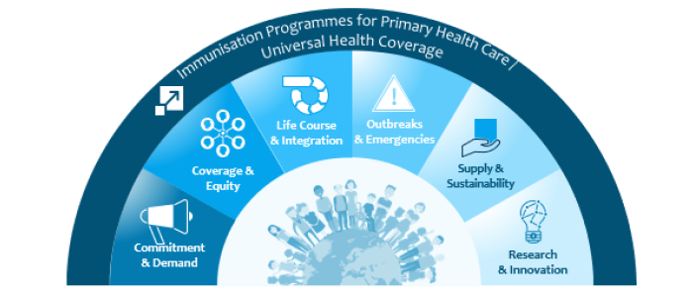
IA 2030 strategic priorities
Notes:
*Optional slide
Talking points:
IA2030 is based on a framework of seven strategic priorities Each strategic priority has defined goals and objectives and key areas of focus.
A framework for action includes:
Strategic priority 1. Immunization programmes for primary health care and universal health coverage
Strategic priority 2. Commitment and demand
Strategic priority 3. Coverage and equity
Strategic priority 4. Life-course and integration
Strategic priority 5. Outbreaks and emergencies
Strategic priority 6. Supply and sustainability
Strategic priority 7. Research and innovation

Slide 9
IA 2030 strategic priority 3: Coverage and equity
‘Measles as a tracer’: measles cases and outbreaks to:
  Identify weaknesses in immunization programmes
  Guide programmatic planning in addressing them.
Notes:
*Optional slide
Talking points:
The strategic priority 3, coverage and equity, ensures the delivery of immunization services, in the face of population growth, continuing urbanization, rising migration, cross-border movement and displacement of populations, conflict, political instability, natural disasters and climate change.
Goal: Everyone is protected by full immunization, regardless of location, age, socioeconomic status or gender-related barriers.
Objectives:
Extend immunization services to regularly reach “zero dose” and under-immunized children and communities.
Advance and sustain high and equitable immunization coverage nationally and in all districts.
Key areas of focus for strategic priority 3:
Disadvantaged populations
Barriers to vaccination
Gender-responsive strategies
Measles as a tracer
Learning from disease-specific initiatives
Context-specific interventions
Implementation research

Slide 10
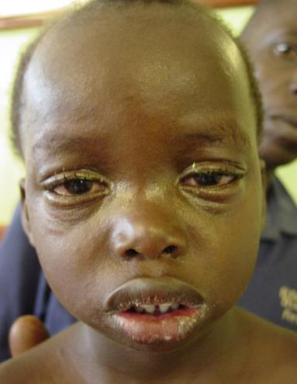
Measles disease
Cause: highly infectious measles virus
Transmission: person-to-person or direct contact with infected secretions
7 to 14 days after exposure:
  Fever (peaks at 39°– 40.5 °C)
  Rash (maculopapular)
  Cough, coryza (runny nose), conjunctivitis (red eyes)
Notes:
*Animated slide
Talking points:
Measles virus is highly infectious – in pre-vaccination era, ˃90% of individuals were infected by the age of 15 years. Humans are the only natural host.
Transmission is primarily person-to-person by airborne respiratory droplets that disperse within minutes, and transmission can also occur through direct contact with infected secretions.
Measles is characterized mainly by fever, rash and cough; coryza (runny nose) and/or conjunctivitis (red eyes) can also appear.

Slide 11
Clinical course of measles
What is the incubation period?
Ranges from 7 to 23 days
When is the person most infections?
4 days before rash and 4 days after rash onset
When does the rash appear?
2 to 4 days after the early symptoms appear (fever, cough, coryza, conjunctivitis)
When do the complications occur and what can they be?
During 30 days after the rash onset (mostly in the 2nd and 3rd week); complications include diarrhoea, otitis media, pneumonia, croup, post-infectious encephalitis
Notes:
*Animated slide
Note: Ask the participants to answer the questions (in plenary) OR just present the contents.
Talking points:
Rash is maculopapular, moves from face to trunk and then to arms and legs, and merges together. Rash lasts 5 to 6 days and fades in order of appearance.
In uncomplicated measles cases, patients improve by the third day after rash onset, and fully recover 7–10 days after onset of disease.
Relatively common complications (in 6 to 9% of cases) are diarrhoea, otitis media, pneumonia, croup, but severe complications such as blindness, post-infectious encephalitis, and subacute sclerosing panencephalitis (SSPE) can also appear. Post-infections encephalitis occurs after acute measles disease. SSPE may occur several years after acute measles infection as a result of measles virus persisting in the nervous system. It is slow progressive degenerative disease, and because its signs and symptoms are non-specific and appear late after the primary infection, it often goes undetected.

Slide 12
Measles complications
In about 30% of reported cases
Risk for severe complications greater in:
  children ˂5 years in overcrowded living conditions, if malnourished or with vitamin A deficiency;
  children with immunological disorders (e.g. advanced HIV infection);
  adults ˃20 years of age;
Case-fatality rate: usually 3–6%
  In developed countries rare, usually 0.01–0.1%
  In humanitarian emergencies up to 30%
Notes:
Talking points:
Complications occur in approximately 30% of reported cases depending on age and predisposing conditions. Infants and adults are at high risk of complications.
In comparison to developing countries, in industrialized countries death due to measles is rare (the case-fatality rate is 0.01–0.1%).
The greatest risk of death from measles is in children younger than 1 year and in adults older than 30 years.
In humanitarian emergencies (particularly among displaced or isolated, immunologically naive populations) the case fatality rate can be up to 30%.
In HIV-infected children, the case-fatality rate has been reported to be as high as 50%.
(Source: Measles vaccines: WHO position paper – April 2017, available at: https://apps.who.int/iris/bitstream/handle/10665/255149/WER9217.pdf )

Slide 13
Most severe measles complications
Pneumonia | 1st most common cause of death
Diarrhoea | 2nd most common cause of death
Blindness (due to scaring of cornea) | In areas with vitamin A deficiency
Post-infectious encephalitis | 1–4 per 1000–2000 cases
Subacute sclerosing panencephalitis (SSPE) | 1 per 10 000–100 000 cases (several years after the infection)
Death (CFR) | Usually 3–6% but can be up to 30% in humanitarian emergencies
Notes:
Talking points:
The table shows most severe measles complications: pneumonia and diarrhoea as most common causes of death, blindness and also post-infectious encephalitis (after acute measles). Persistent infection in the tissue of the central nervous system may occur following measles infection and may cause subacute sclerosing panencephalitis (SSPE). SSPE is degenerative and slowly progressing disease, and may develop several years after the initial measles infection in about 1/10 000 – 100 000 cases.
Death rates are high, especially in humanitarian emergencies.
Measles are preventable disease!

Slide 14

Clinical treatment of measles
For all suspected measles cases in children <5 years of age, irrespective of the timing of previous doses of vitamin A, administer:
  1 dose of vitamin A on diagnosis
  2nd dose of vitamin A the next day
  3rd dose of vitamin A 4-6 weeks later if signs of deficiency show
Careful care of eye, mouth and skin, necessary to prevent secondary infections
Ensure adequate nutrition
Complications: to be treated using the same standards used in non-measles patients
WHO guidance: https://www.who.int/immunization/documents/9789240002869/en/
Notes:
*Animated slide (optional)
Talking points:
Vitamin A should be administered to all acute measles patients under 5 years of age, irrespective of the timing of previous doses of vitamin A.
Low blood levels of vitamin A are associated with more severe measles illness and complications, especially eye disease.
Two doses of vitamin A are recommended for all suspected measles cases in children under 5 years of age: immediately on diagnosis and repeated the next day. The dosage should be adopted to the infant’s /child’s age, as shown in the table. This treatment has been shown to reduce overall mortality in children and pneumonia-specific mortality in children with measles under 2 years of age. If a patient has any clinical signs of vitamin A deficiency,
such as xerophthalmia and corneal ulceration, then a third same age-specific dose should be given 4–6 weeks later.
The guidance on practical clinical care interventions to reduce complications and mortality that can occur during measles outbreaks, intended primarily for front-line clinicians and health care workers in any health setting is available in English at the following link: https://www.who.int/immunization/documents/9789240002869/en/ .

Slide 15
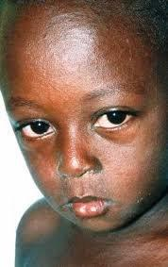
Rubella disease
Acute, usually mild disease in children and adults
Transmission: respiratory droplets
Manifestations (20-50% asymptomatic)
  Low grade fever ( ˂39 °C)
  Malaise
  Mild conjunctivitis (red eyes, more common in adults)
  Enlarged lymph nodes behind ears, in back of the head and neck
  Maculopapular rash, often itchy (in 50-80% rubella infected people)
  Joint symptoms (up to 70% in women, rare in men and children)
Complications: rare except when women get infected in early pregnancy (congenital rubella syndrome or CRS)
Notes:
*Animated slide
Rubella slides 10-13 optional (if MR vaccine is used)
Talking points:
Rubella virus is spread by the respiratory route and initially replicates in the mucosa of nose and pharynx and local lymph nodes. Rubella is highly contagious (but not as high as measles). Humans are the only known host.
Rubella is a mostly mild, self-limited illness that usually occurs during childhood. Prodromal illness consists of low fever less than 39.0º C, malaise and mild conjunctivitis, which is more common in adults. 20–50% of all rubella infections occur without a rash and fever (asymptomatic).
Enlarged lymphnodes behind ears and in the back of the head and neck appear before rash.
The rash is often difficult to detect on dark skin. It is maculopapular and often itchy and occurs in 50–80% of rubella-infected people. It starts on the face and neck before progressing down the body but without merging, and usually lasts 1–3 days. Joint symptoms (arthritis, arthralgia), usually of short duration, may occur in up to 70% of adult women with rubella but are less common in men and children.
Post-infectious encephalitis occurs in approximately 1/6000 rubella cases, but incidences as high as 1/500 and 1/1600 have been reported occasionally.
If a woman becomes infected with rubella virus just before pregnancy and up to the first 8–10 weeks, rubella infection can cause multiple anomalies of the baby (in up to 90% of infections) or can cause miscarriage or still birth.

Slide 16
Clinical course of rubella and virus transmission
Incubation period: ranges from 12 to 23 days
5 -7 days after exposure, rubella virus in the blood can spread to various organs (including foetus in pregnant women)
Rubella virus in nasopharyngeal secretions:
  From 1 week before to 2 weeks after rash onset
  Maximal shedding 1 to 5 days after rash onset
  Infants with congenital infection may shed virus for more than a year ( also in urine)
To interrupt the transmission of rubella virus: 83-91% population immunity is needed.
Where no vaccination: seasonal disease with epidemics every 5 to 9 years.
Notes:
*Animated slide
Talking points:
The incubation period ranges from 12 to 23 days.
Viraemia – presence of virus in the blood occurs 5–7 days after exposure and results in viral spread to various organs.
Rubella virus may be found in nasopharyngeal samples from 1 week before the onset of rash to 2 weeks after, with maximal shedding up to 5 days after rash onset (time when the infected person is most infectious). In pregnant women, the virus infects the placenta and developing foetus.
Infants with CRS may shed the virus for ≥1 year in pharyngeal secretions and urine.
In the pre-vaccination era, rubella usually occurred in a seasonal pattern, with epidemics every 5–9 years; however, the extent and periodicity of rubella epidemics are highly variable in both industrialized and developing countries.

Slide 17
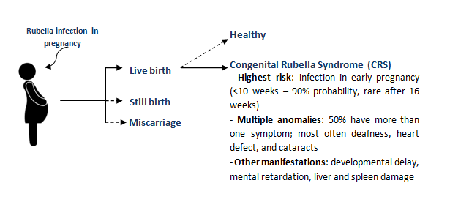
Rubella infection during pregnancy
Notes:
Talking points:
The aim of the rubella vaccination is to achieve high coverage to interrupt transmission of rubella virus and thereby reduce/eliminate rubella and CRS.
In a woman that becomes infected with rubella virus just before pregnancy and up to the first 8–10 weeks of gestation, rubella infection can cause multiple potentially devastating effects on developing foetus.
Up to 90% of infections and may result in miscarriage or stillbirth.
Congenital anomalies associated with maternal rubella infection are rare after the 16th week of pregnancy, although hearing impairment may occur if a pregnant woman gets infected up to 20 weeks of pregnancy.
The defects associated with CRS include eyes, hearing, heart defects most often.
CRS can also present with meningoencephalitis, enlarged liver and spleen, hepatitis, and thrombocytopenia.
Those who survive the neonatal period may have serious developmental disabilities (for example, autism, visual and hearing impairment) and developmental delay.

Slide 18
Measles and rubella comparison
Characteristic | Measles | Rubella
Infectiousness | Very highly infectious | Highly infectious
Incubation period | Range: 7 to 23 days | Range: 12 to 23 days
Infectious period | 4 days before to 4 days after rash | 7 days before to 7 days after rash
Duration of rash | 4 to 8 days | Typically 3 days
Complications | Pneumonia, diarrhoea, otitis media, corneal scarring, post-infectious encephalitis, SSPE, death | Joint pain, encephalitis; rubella infection in pregnancy
Timing of complications | 2nd and 3rd week after rash for most complications | Infections early in pregnancy can lead to severe anomalies in newborns
High risk groups | Infants and susceptible adults – highest risk of complications and death | Susceptible pregnant women
Population immunity to stop transmission | 92 – 95% | 83 – 91%
Minimum vaccine doses received for lifelong immunity | 2 doses | 1 dose (2 doses ok if using MR vaccine)

Slide 19
Can we stop measles?
At least 95% of the population immunity needed!
Immunity: naturally acquired (after measles disease) or through vaccination.
Two doses of M/MR vaccine are needed to ensure high population immunity because:
  After the 1st dose, 10-15% of infants do not develop protective immunity to measles (‘primary vaccine failure’)
  After the 2nd dose, 95% of infants who did not respond to the 1st dose develop protective immunity to measles.
Therefore, there will always be some individuals who remain susceptible to measles
BUT
When population immunity is high and transmission of measles virus is interrupted, susceptibles do not get measles.
Notes:
*Animated slide
Talking points:
Transmission of measles can be stopped when at least 95% of the population is immune to measles. Countries aiming at measles elimination should achieve ≥95% coverage with both doses equitably to all children in every district.
Vaccination coverage does not mean population immunity.
The second dose of M/MR vaccine reduces the accumulation of susceptible children by immunizing those who did not respond to the first M/MR vaccine dose or did not receive the first dose.
Infants can be protected by maternal antibodies, usually for 6–9 months. A large infective dose of measles virus may occasionally overcome this protection and measles has been observed in neonates and infants.

Slide 20
How can we achieve high population immunity to measles?
By reaching all children with two doses of M/MR vaccine through the routine programme
By finding children that are missed:
  ‘measles zero-dose’ children – did not receive any prior M/MR vaccine doses
  ‘under-vaccinated for measles’ or ‘defaulters’ – did not complete the two-dose schedule with M/MR vaccine
By tracking of all defaulters
By conducting supplementary immunization activities (SIAs) to rapidly increase population immunity and interrupt measles virus transmission
Notes:
*Animated slide
Talking points:
‘Defaulters’ is a common term for infants who started the routine EPI immunizations (had access to services) but failed to complete the schedule (did not return for subsequent immunization doses). This term is often used for children who receive only DTP1 (but among under-vaccinated/defaulters can be also those who received vaccine(s) other than DTP but no DTP).

Slide 21
Primary purpose of M/MR SIA
To reach and protect all children, especially those previously missed
To reach and protect children who did not develop immunity after the 1st dose of M/MR vaccine (‘primary vaccine failure’)
A high-quality M/MR SIA achieves 95% coverage in all districts (rapidly increases population immunity), BUT
If high coverage of two M/MR vaccine doses is not sustained in the routine programme, success of SIA is short-lived.
WHY?
Notes:
*Animated slide
Talking point:
For high-quality SIA, 95% national coverage should be determined by a post-campaign coverage survey.
Note: Ask the participants why the success of an SIA is short lived if high coverage in the routine programme is not sustained.

Slide 22
Answer: Why are SIAs unsuccessful in absence of high routine coverage?
Continued low and stagnating routine coverage results in accumulation of susceptibles and possible outbreaks which further divert resources away from routine immunization programme.
SIAs aim to immunize large populations in short time but cannot replace routine immunization programme.
M/MR vaccine dose obtained in SIA is considered a supplementary dose (doses given regardless of prior vaccination history).
Ideally, all children should receive two doses of M/MR vaccine through the routine programme.

Slide 23
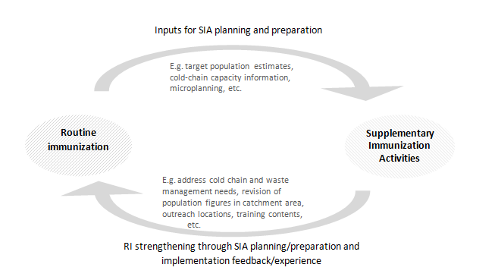
SIA as an opportunity to strengthen RI
Notes:
Add microplanning
Talking points:
SIA builds on good routine programme, and good SIA can help routine immunization programme.
Successful SIA planning and preparation needs important inputs from the RI programme, e.g. target population estimates, maps of vaccination posts,
cold-chain capacity (equipment inventory), etc.
During SIA planning and preparation some identified weaknesses can be addressed, e.g. cold chain needs, waste management plans, advocacy and communication plans, etc.
Information and experience of conducting the SIA should feed back to the RI programme to improve it. For example, the population figures in the catchment area can be revised, there can also be a revision of outreach post locations, update of training materials, RI programme can build on relationship with special population groups to generate vaccine acceptance and demand, etc.
Note: More information on SIAs as opportunities to strengthen RI and other health programmes can be found in the SIA Field Guide: https://www.who.int/immunization/documents/9789241511254/en/ .

Slide 24
Why do we need to conduct a M/MR SIA?
In [name of the country] there is a large number of children susceptible to measles :
  Vaccination coverage for M/MR1: [national and subnational data]
  Vaccination coverage for M/MR 2 (if applicable): [national and subnational data]
  Reported M/R cases and incidence rates
  Distribution of cases (age, vaccination status)
  Time and coverage of last SIA: [from post-campaign coverage survey]
To prevent an outbreak of measles, SIA needs to be conducted before the number of susceptible children under 5 years of age approaches one birth cohort.
Remember, to be successful, SIA needs to achieve at least 95% coverage in all districts!
Notes:
*Animated slide
Note:
This slide needs to be prepared /adapted before the training!
For the specific country show (graphic representation or just numbers):
vaccination coverage (preferably not administrative coverage but WUENIC estimate) for MCV1, MCV2 if applicable, and for previous campaigns (from survey if available) and, if applicable;
number or incidence rate of measles cases; map if available, distribution,
year and coverage of the previous SIA.
This can show that a large number of susceptibles in the country has built up– possibly due to low routine coverage, unsuccessful previous SIAs, or both.
Because the risk of measles outbreaks is determined by the rate of accumulation of susceptible people in the population (when the number of susceptible children under 5 years of age approaches the number of children of one birth cohort), programmes should use available good quality data on population immunity (i.e. vaccination coverage, surveillance, serological studies) to monitor the accumulation of susceptibles.

Slide 25
About this SIA

Slide 26
About this measles M/MR SIA
Dates: from ___ to ___ [month] [year]
  Local launching [date]
  Official start [date]
  Planned last day [date]
  Mop-up activities [dates]
Working hours: from ___ am to ___ pm
Objective: to vaccinate ALL children from [9] to [59] months of age/[9] months to [14] years of age, irrespective of their previous vaccination or measles disease history
Opportunity: to identify and vaccinate M/MR zero-dose and incompletely vaccinated children
Notes:
Note: When talking about implementation dates, mention the need for mop-ups: mop-ups should be conducted in all poorly covered areas as determined by the RCM – rapid convenience monitoring results, or other areas determined by the supervisor, to have missed children.
Talking point:
Measles SIA can be an opportunity to identify defaulters and to reinforce the message that they need to come to the health centre to catch up with their missed doses. However, the main objective remains to vaccinate all children in the designated age group, irrespective of vaccination history or disease history.
Additional point:
Follow-up M/MR SIAs are periodic and usually target children from 9 to 59 months of age.
Catch-up MR SIAs are one-time efforts, conducted in the context of rubella introduction into the national immunization schedule. They usually target wider age range such as 9 months to 14 years of age.
Note: If other interventions such as vitamin A supplementation or mebendazole treatment will be added to this SIA, list them.

Slide 27
How will this SIA be implemented? (country to adapt)
The following strategies will be used:
Fixed posts
  Permanent – all functioning health facilities and community health posts, will remain open throughout the campaign
  Temporary – vaccination posts which will be open 1 or more days during the campaign in facilities such as schools, community centres, or posts used as outreach clinics
Mobile posts
  Posts set up for the time needed to complete the task before moving on, required for remote, small, and/or sparsely populated villages
For more on SIA strategies and considerations for determining them, see the field guide Planning and implementing
high –quality SIAs (page 29): https://www.who.int/immunization/diseases/measles/SIA-Field-Guide.pdf .
Notes:
Note:
This slide is an overview of vaccination strategies and it can be adapted according to the country context.
If at all possible, it would be useful to present the map/microplan/graphic representation of the area which will include the relevant posts in their locations. Of note, by the time of the training (recommended at 2 weeks before SIA), microplanning should be finalized, therefore, detailed map for each day and team should be available.
Additional information that can be provided – talking points:
- Permanent posts also serve as depots for storage and distribution of vaccine to temporary sites and for mobile teams. At the beginning of the campaign these posts are usually manned with two teams.
Temporary posts – must be identified in advance, usually manned with one vaccination team.

Slide 28
Small group discussion: Who is in the vaccination team?
Vaccination teams may vary depending on the context
All vaccination teams must have the following:
  Skilled vaccinator (at least 1)
  Trained volunteer/team assistant (1–2)
  Announcer/social mobilizer (at least 1)
Discuss in small group:
  Who will be in your team and what will they do?
  How will the team be supervised?
  What do the supervisors do?
Notes:
Note: Ask the participants who they think needs to be in the vaccination team .
Talking points:
Teams usually have more than one trained volunteers/team assistant, as a person is needed for tallying but also for controlling the crowd and screen. More information on what the team members do is in the following slide.

Slide 29
Answers: What do the vaccination team members do?
Skilled vaccinator: staff trained and allowed to administer an subcutaneous injection independently (e.g. nurse, skilled vaccinator, etc.) – reconstitutes and vaccinates.
Trained volunteer/team assistant: registration/tallying, non-invasive interventions (e.g. vitamin A and mebendazol administration), finger-marking, crowd control.
Announcer/social mobilizer: mobilizes mothers/caregivers to bring their children to the nearest vaccination point; if trained, can be involved in house-to-house canvassing.
Notes:
Talking points:
Composition of teams depends on number of children in a specific geographic location and on the strategy (fixed – permanent and/or temporary, or mobile posts).
Good microplanning is important (if information is available, let the teams know their composition and tasks).
Social mobilizer can go from house to house to identify all eligible children in each household and encourages them/mothers/caregivers to come to the vaccination post. Social mobilizer must be trained to provide factual information about vaccination.

Slide 30
Answers: What do the supervisors do?
Vaccination team’s first level supervisor (usually the post coordinator) is responsible for assigning responsibilities to health workers and volunteers and for coordination of activities.
Supervisors should focus their activities on ensuring that all teams can conduct sessions and safely deliver vaccines.
In addition, they should:
  Observe vaccination, provide support and guidance to the vaccination team
  Ensure that teams do not run out of vaccines and supplies during the day
  Ensure that tally sheets are correctly completed and turned in
  Summarize the tally sheets, review the progress, ensure that the vaccination team is prepared and ready for the next day.
Notes:
Talking points:
Supervision is important to ensure that planned day-to-day operations are correctly executed. There is usually 1 supervisor assigned for up to 4 vaccination teams. Supervisors ensure that the posts are open on time and working.

Slide 31
How many children will you vaccinate in one day?
Type of post/strategy | Urban area (# children/1 vaccinator) | Rural area (# children/1 vaccinator)
Permanent post | 100-150 | 75-100
Temporary post | 100-150 | 75-100
Mobile post | up to 100 children
House-to house vaccination | 50-75 children
Notes:
Add to the table
Talking point:
The table shows WHO recommended norms per post, area, and per 1 vaccinator.
Notes:
The numbers and the strategies can be adapted based on the local context.
Emphasize the importance of realistic numbers of children to vaccinate: increase of numbers can decrease the SIA quality (increase the risk of programmatic errors).
Microplans should contain information on the location and type of the post, and daily norms.
If house-to-house vaccination strategy is applied, the norm per vaccinator per day is 50-75 children.

Slide 32
Important reminders
(optional and according to the local context)
Choose the mobile site where you can have a good crowd control!
If the vaccination post is necessary near the border crossing, set a temporary post (avoid setting a mobile post)!
… (any other important reminders)
Notes:
Note:
This is an optional slide – what activities are better avoided if poor practice and if proved not to work (or proved harmful) in previous SIA. This will need to be customized according to the local context and relates only to implementation strategies of the SIA.
The countries may decide that border crossings or bus stops are not suitable for temporary posts because mothers/caregivers may be in a hurry, it may be difficult to maintain safe vaccination practice, and it is difficult to keep the mother/caregiver and child for 15 minutes in the vicinity for observation (possible AEFI).

Slide 33
Unit 2:
Preparing for vaccination sessions

Slide 34
Maintaining cold chain and vaccine management during M/MR SIA
Why is cold chain and vaccine management important?
Adequate vaccine management and cold chain ensure potency, quality and safety of vaccines.
Cold chain must be maintained throughout the supply chain.
Notes:
*Animated slide
Note:
Start this section with the question and allow the participants to respond.
Talking point:
At all levels M/MR vaccines and diluents should be kept and transported at +2 to +8°C.

Slide 35
Cold chain of M/MR vaccines
Vaccine Manufacturer
Vaccination post
District stores
Provincial cold stores
National EPI cold stores
National Airport
Health centre
2
to
8
°C
Notes:
*Animated slide
Talking points:
In general, it is recommended that freeze-dried vaccine be stored in a refrigerated condition below +8 °C.
WHO no longer recommends that freeze-dried vaccines, including M/MR vaccine be stored between -70 °C and -20 °C for long-term preservation of viral potency the central store. This is not harmful, but it is unnecessary.
M/MR vaccines and diluents should be kept and transported at +2 to +8°C. The diluent must not be frozen and can be stored at ambient temperature; it should be cooled to 2–8 °C before reconstitution.

Slide 36
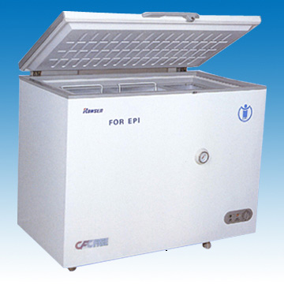
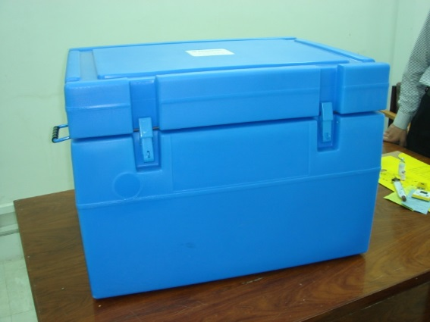
How do you store vaccines and diluents at the health facility?
Store M/MR vaccine vials and diluents in working refrigerators (e.g. ILR – ice-lined refrigerator), take temperature readings twice a day!
Cold box can also be used for storage: if handled properly, it can maintain the needed 2-8 °C temperature up to 6 days.
Notes:
Talking points:
Depending on availability of existing functional cold-chain equipment (inventory should be kept regularly regardless of SIA!), different solutions may have to be found to ensure additional cold-chain space demand during SIA.
Note: Question for the participants in the next slide.

Slide 37
When can you use cold boxes for storage of vaccines?
Cold boxes can be exceptionally used for temporary storage up to 6 days if:
  They are not opened as a regular refrigerator
  They are kept away from the sun.
When cold boxes are used for temporary vaccine storage, monitor temperature regularly to ensure the maintenance of the cold chain.
Source: https://www.who.int/immunization/diseases/measles/SIA-Field-Guide.pdf
Notes:
*Animated slide
Note:
Ask the participants under what circumstances cold boxes can be used for storage.
Source: https://www.who.int/immunization/documents/9789241511254/en/

Slide 38
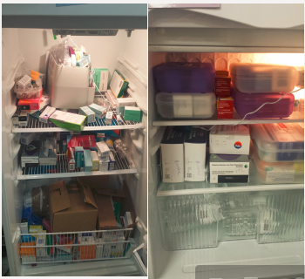
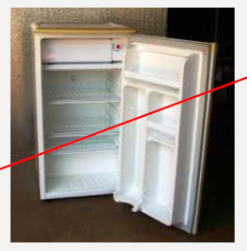
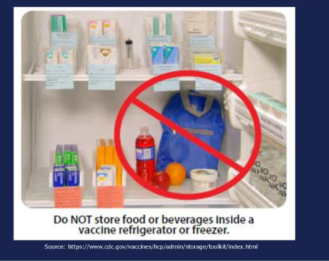
Plenary discussion:
Important “do not’s ”at the health facility
Do not overload the refrigerator!
Do not store vaccines in the domestic refrigerator!
Do not store food in the vaccine refrigerator!
Do not freeze the diluents!
Notes:
*Animated slide
Note:
Ask participants what what should not be done at the health facility. Their responses can be compared with the list in this slide. The list is not exhaustive and can be adapted based on the context.
Talking points:
The diluents should not be frozen – freezing them may cause micro-cracks on the vials which can then lead to contamination of the contents.

Slide 39
How do you prepare the vaccine carrier at the health facility?
In general, each team should have at least:
  One vaccine carrier
  Four frozen coolant packs
DO NOT FORGET: freezing of coolant-packs takes time!
Start preparing frozen coolant-packs at least one week before the start of the SIA!
DO NOT FORGET: re-freezing of coolant-packs takes time!
It takes at least 24 hours to re-freeze coolant-packs!
Notes:
*Animated slide
Note:
This slide can be adapted depending on the local context.
Talking points:
WHO recommends:
- 1 vaccine carrier per team at the permanent post
2 vaccine carriers per team at the temporary post
2 vaccine carriers per team at the mobile post
1 vaccine carrier per supervisor
WHO recommends to start freezing the coolant-packs 7 to 10 days before the SIA start.
Used coolant packs need to be replaced with frozen ones, therefore, enough of frozen coolant packs must be available because re-freezing takes at least 24 hours, depending on the type of the refrigerator and the outside temperatures.

Slide 40
Coolant-pack, water-pack, or ice-pack?
Glossary:
Coolant-pack: a purposely-designed leak-proof container, filled with tap water or phase-change material.
Water-pack: a coolant pack filled with tap water.
Ice-pack: a water pack that has been frozen to a temperature of between -5 °C and -25 °C before use; a frozen water-pack.
Notes:
Note:
WHO recommends avoiding the word ice-pack so that it would not be confused with ice blocks, use of which is highly discouraged. The general overall name is ‘coolant-packs’, and the ones that are filled with water and frozen are ‘frozen water-packs’.

Slide 41
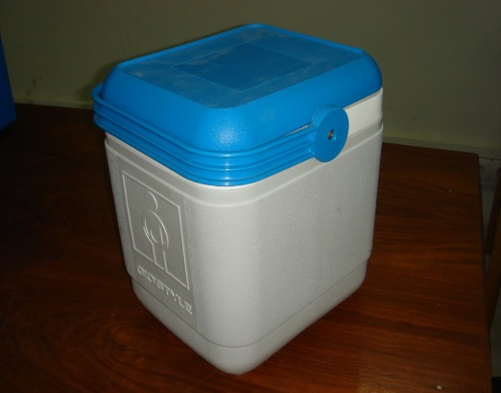
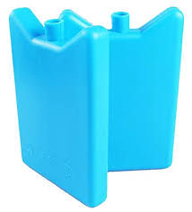
Use of vaccine carrier for M/MR SIA
During M/MR SIA use only standard vaccine carriers with four coolant-packs and a foam pad
Use only “conditioned” frozen coolant-packs to store and transport vaccine.
Notes:
Note:
Vaccine store-keeper or manager is usually responsible for packing of vaccine carrier, however, vaccinators need to know that conditioning is important as it prevents vials of vaccines/diluents to be frozen/damaged, or damaging vaccines that are freeze-sensitive.
Talking points:
The required number of coolant-packs for vaccine carriers may vary, most often 4 packs are needed. There should be 2 sets of frozen coolant-packs for each carrier: one set being used while the other is being frozen for the next day (reminder: re-freezing takes at least 24 hours).
Do not use any other container that is not a standard vaccine carrier.

Slide 42
How do you condition frozen coolant-packs?
Remove fully frozen coolant-packs from the refrigerator and lay them on the flat surface.
Allow them to sit at the room temperature and every few minutes check by shaking and listening for the sound of liquid and ice moving inside the coolant-pack.
Once the ice starts moving, the pack is conditioned and ready to use.
Notes:
*Animated slide
Note:
Allow the participants to respond the question, before showing the contents of the slide.
This can be a good opportunity to repeat why the coolant-packs should not be used frozen.

Slide 43
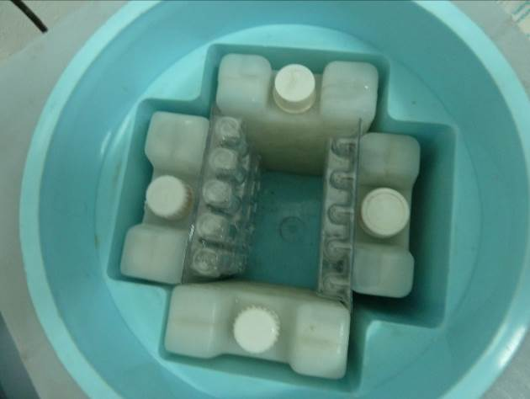
Packing the vaccine carrier (I)
Use standard vaccine carrier in good condition and without cracks.
Make sure that it is clean and dry.
Place conditioned coolant-packs inside the vaccine carrier, against the sides.

Slide 44
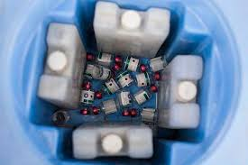
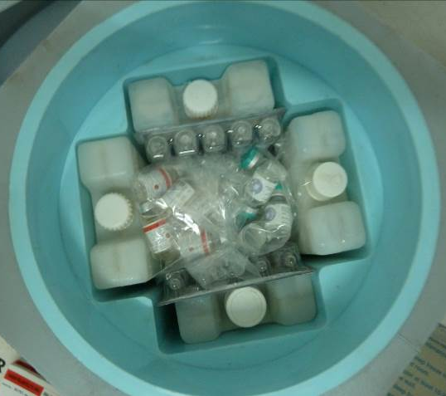
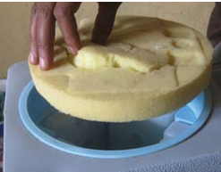
Packing the vaccine carrier (II)
Count the required number of vaccines and diluents.
Place the vials in the middle of the vaccine carrier carefully to avoid breaking fragile diluent vials, you may put vials in plastic bags to separate them.
Do not put AD syringes in the vaccine carrier.
Place the foam pad on top and close the lid.
Notes:
*Animated slide
Talking points:
A foam pad is a piece of soft foam that fits on top of the conditioned coolant packs in a vaccine carrier.
There are some cuts in the foam to allow vaccine vials to be inserted in the pad. During immunization sessions, the foam pad is used as a temporary lid to keep unopened vaccines inside the carrier cool, while providing a surface to hold and protect vials with reconstituted M/MR vaccine and keep them cool.

Slide 45
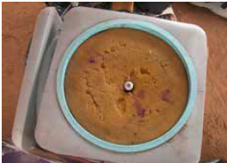
Maintaining cold chain at the vaccination post
While in transit, keep the lid of the vaccine carrier tightly closed.
Keep the vaccine carrier in the shade, never under direct sunlight.
Keep M/MR vaccines and diluents inside the vaccine carrier with the lid tightly closed until the first child to be vaccinated arrives.
Reconstitute only one vaccine at a time!
Keep reconstituted M/MR vaccine inserted in the foam–pad on top of the vaccine carrier.
Notes:
*Animated slide

Slide 46
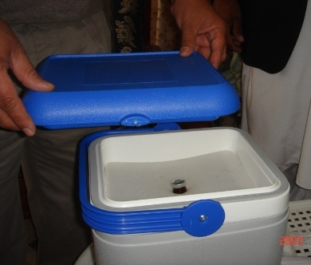
What is wrong in this photo?
Do not put the lid on the vaccine carrier while the vial with reconstituted vaccine is in the foam pad! This is to avoid contamination.
Notes:
*Animated slide
Note:
Ask the question and allow participants to respond before showing the response.
Talking points:
To avoid contamination, do not cover the vaccine carrier with the lid while reconstituted vaccine is in the foam pad.
Once the seal of the measles vaccine vial is removed, the rubber cap should not come in contact with any surface or be touched by hand!

Slide 47
Always remember:
All conditioned coolant-packs must remain inside the vaccine carrier.
Keep M/MR vaccine away from
  light, especially direct sunlight
  any source of heat.
Reconstituted M/MR vaccines quickly lose their potency if exposed to the room temperature or light:
  After 1 hour at 20 °C, it loses about 50% potency
  After 1 hour at 37 °C, it loses about 100% potency.
Reconstituted M/MR vaccine must be stored away from light (i.e. in the foam) at 2-8 °C and discarded after 6 hours or at the end of the vaccination session, whichever comes first.
Notes:
*Animated slide
Talking point:
Reconstituted vaccine should be kept in the slit of the foam-pad, on top of the vaccine carrier.

Slide 48
Plenary question
What can happen if a M/MR vaccine that was sitting at the desk for longer than an hour at 35 °C was administered to the child?
This needn’t harm the child BUT they would receive a vaccine that lost its potency, therefore they would be unprotected, remain susceptible, and could get sick.
Notes:
*Animated slide

Slide 49
Small group discussion: warm diluent
John is vaccinating at the health clinic. He has packed his vaccine carrier for the session: he put conditioned coolant packs in the carrier and the M/MR vaccines in the middle, but forgot to put the diluents in. It took an hour before the first child arrived for vaccination. It was only then that John realized that the diluent was not in the vaccine carrier and that it was warm.
Can the warm diluent that was sitting at the table be used to reconstitute the vaccine?
Can John use different diluent?
What should John do?
Notes:
Note:
Depending on the number of participants, form smaller groups (3 to 5 participants) to discuss the case. Allow 7-8 minutes for discussion, one member of the group should report the responses. Compare responses, allow the groups to clarify, and if needed provide corrections. The whole exercise should take not more than 10 to 15 minutes.
Talking points:
To reconstitute the measles vaccine, only diluents supplied by the manufacturers should be used.
Diluents can be stored at the room temperature but before reconstitution, they should be cooled to 2-8°C.
Answers (also on the next slide):
John must not reconstitute the vaccine with the warm diluent because it may damage the vaccine. John should not use the diluent for a different vaccine. He should use only the appropriate cooled diluent.
In the meanwhile, he has to explain to the mother/caregiver that he cannot use the diluent until it is cold and ask her to wait. He can inform his 1st level supervisor and ask if adequately cooled diluent is available. If adequately cooled diluent is not available, John should explain the situation to the mothers/caregivers and arrange for a return visit as soon as possible. This should be recorded, so that if the target is not met, the mop-up can be organized.
Note: Ask the participants if they have been in a similar situation before and what they have done.

Slide 50
Answers: warm diluent
John MUST NOT:
Reconstitute the vaccine with warm diluent
Use diluent for a different vaccine (even if cooled)
John MUST:
Inform 1st level supervisor and ask if cooled diluents are available
Explain to mother/caregiver to wait or arrange for a return visit
Record the event (so that mop-up can be organized)

Slide 51
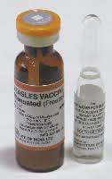
Vaccine Vial Monitor (VVM)
M/MR vaccine vials have the VVM on top.
VVM monitors cumulative exposure to heat and the colour of the inner square changes accordingly.
Always check VVM and vaccine expiration date!

Slide 52
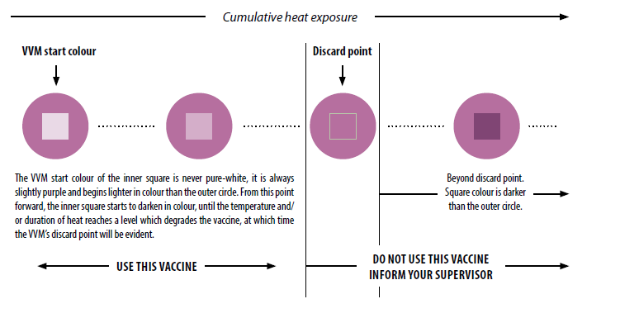
To use or not to use?
Notes:
Talking points:
If the expiry date has not been passed, use the vaccine when:
- The inner square is light (it is never pure-white)
- The inner square is grey
Regardless of expiry date, inform your supervisor and do not use the vaccine when:
- The inner square has the same colour
- The inner square is darker

Slide 53
Small group discussion: melted coolant-packs
It is the third day of the SIA and Mary is ready for another mobile post session. She leaves early in the morning; it is already hot. After 2-hour drive, the team arrives at the site and starts preparing for the vaccination session. Mary opens the vaccine carrier and sees that the coolant-packs have melted.
What do you think happened?
What should Mary do?
Notes:
Note: You can continue with the same group arrangement as in the previous exercise.
Talking points (answers on the next slide):
If the vaccine carrier was not broken, there is a possibility that Mary did not properly re-freeze the coolant packs. Depending on the type of the refrigerator and the outside temperatures, re-freezing of coolant packs can take 24-48 hours.
Mary should check VVM on the vaccine vials. VVM will indicate if the vaccines can be used for the vaccination session.
If VVM indicates that no vaccine can be used, Mary should explain the situation to the mothers/caregivers and arrange for a return visit as soon as possible.
Mary should record the number of vaccine vials she could not use, and who did not get vaccinated, and she should inform her 1st level supervisor so that the correction can be organized.
Note: Ask the participants if they have been in a similar situation before and what they have done.

Slide 54
Answers: melted coolant-packs
The coolant packs did not re-freeze properly.
Mary should check VVM on vaccine vials; if no vials can be used she should:
  Explain to mother/caregiver what happened and arrange for a return visit
  Record the number of vaccine vials that could not be used
  Record who did not get vaccinated
  Inform the 1st level supervisor so that re-visit/mop up can be organized.

Slide 55
What is needed for a vaccination session?
How many vaccine doses?
  Target number x 1.11 (wastage multiplication factor*)
How many vaccine vials?
  Vaccine doses ÷ 10 (if 10-dose vials)
How many diluent vials?
  1 per vaccine vial
How many reconstitution syringes (5 mL)?
  1 per vaccine vial
How many AD syringes (0.5 mL)?
  1 per vaccine dose
How many safety boxes?
  Total number of syringes (AD + reconstitution) ÷ 100
Notes:
*Animated slide
Note:
You can present this slide as is or use it for the exercise.
Scenario example (recommended WHO requirements used):
One team with one vaccinator is vaccinating at the health clinic in the city (fixed permanent post/urban); the target population is 750 persons.
How many days will they need to work as a minimum? – 5 days; calculation:750 total population÷150 persons (range 100-150 for urban area) = 5 days
How many vaccine doses will the team need? – 833 vaccine doses (750 x 1.11*)
How many vaccine vials will the tam need? – if 10-dose vials are used, 84 vials will be needed (833÷10=83.3)
How many diluent vials? – 84
How many reconstitution syringes? – 84
How many AD syringes for vaccination? – 833
How many safety boxes? - 10 (833+84 ÷ 100)
* If vaccine wastage rates are not available from previous campaigns, a rate of 10% can be used as an estimate. For a rate of 10%, wastage multiplication factor is 1.11: [100 ÷ (100 – wastage rate)]. Wastage rate can be higher for the sessions held in sparely populated areas.

Slide 56
Additional requirements for a vaccination session
Map showing microplan of the area
A vaccine carrier in good condition with 4 conditioned coolant-packs and clean foam pad with vaccines and diluents, and syringes
Safety boxes for disposal of sharps
Tally sheets (2-3 per session), marker pens
List with contact phone numbers of e.g.: supervisor, local AEFI focal person, AEFI treatment centre, local health facility, ambulance driver
AEFI kit, AEFI reporting forms
Waste bag
Notes:
Notes:
There may be other items depending on the context, such as tray (1/team), campaign flags, banners, other data tools (e.g. summary sheets), pens, folders, etc.
Suggest that vaccinators prepare a check list for the vaccines and supplies needed.

Slide 57
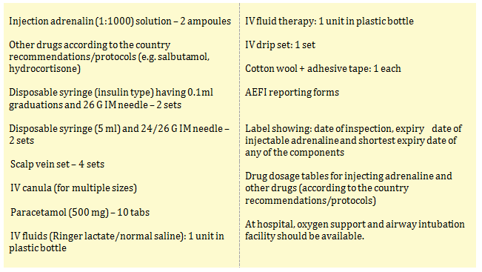
Contents of an AEFI kit (optional)
Notes:
Note:
This is an example of AEFI kit contents; contents may vary according to country protocols.

Slide 58
Unit 3:
Ensuring safe and efficient vaccination sessions
Notes:
Note:
This unit starts after lunch break. Ask the participants to draw a diagram of what they consider a good arrangement /set up for a vaccination session; they can compare it to what they will learn in the following slides.

Slide 59
How to ensure safe vaccinations?
To ensure safe vaccinations:
Vaccination site must be well prepared
Children must be screened for age and contraindications
Safe injection practices must be used
Vaccines must be reconstituted and administered correctly
Correct waste disposal must be respected
Notes:
Note:
Announce that these topics will be talked about in the following slides.

Slide 60
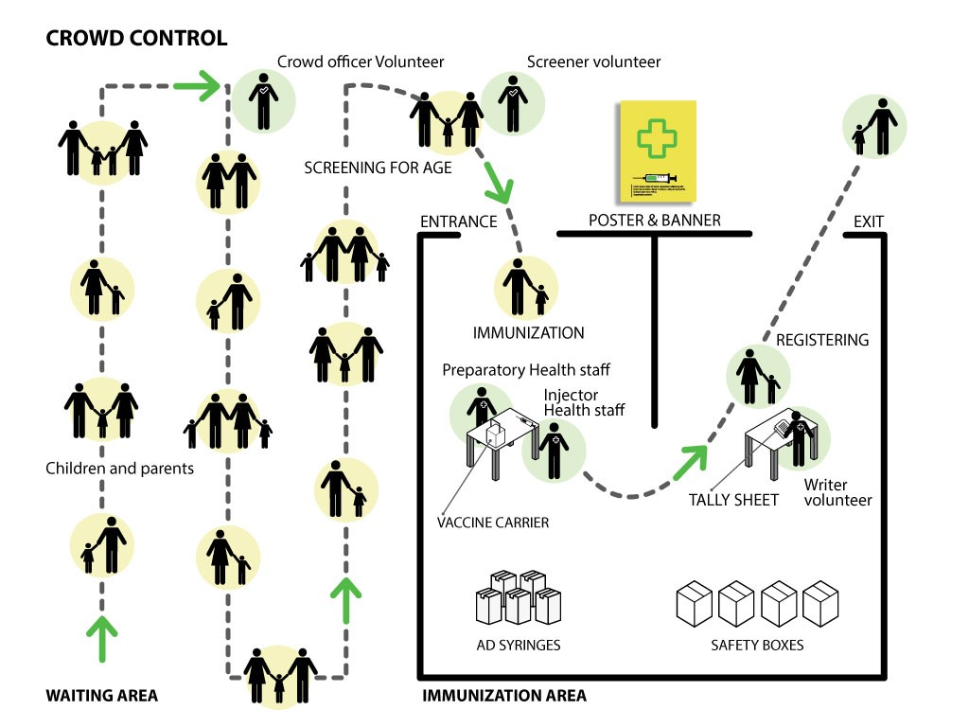
What is a good location for SIA vaccination session?
Easily accessible to local community
Adequate space in the shade for 3-5 health workers and volunteers to work
Adequate furniture (tables, chairs)
Separate entry and exit points
Shaded waiting area for parents (also for 15 min observation after vaccination – AEFI with rapid onset)
Well marked with flag, banner or poster

Slide 61
Client flow in a vaccination session (M/MR vaccine only)
Team Assistant/
Volunteer
REGISTRATION
Confirm age/screen
Entrance
VACCINATION
Check for contraindications Ask about previous AEFI
Vaccinate with M/MR
Educate: Inform on possible AEFI, next RI dose, etc.
RECORDING
Mark tally sheet and vaccination card
Finger marking
Advise to wait 15 min in case of AEFI
Exit
Vaccinator
Team Assistant/ Volunteer
Notes:
Note:
Adapt diagram as needed, depending on the tasks and context. Here we concentrate more on the flow and order of activities.
Talking points:
Skilled person/vaccinator informs mother/caregiver about the nature of possible AEFI and time of onset, and the team assistant/volunteer advises them to wait about 15-20 minutes, in case AEFI with rapid onset occur.
The bottlenecks often occur at screening and recording – it is advisable to have additional trained volunteers at very busy vaccination posts.
Note: Same slide repeats with alterations – standard option/ then MR with another intervention - / third slide integration – multiple vaccines

Slide 62
Client flow in a vaccination session (with other interventions)
Team Assistant/Volunteer (1–2)
REGISTRATION and OTHER INTERVENTION
Confirm age/screen
Administer/record e.g. Vitamin A, OPV, deworming
Entrance
RECORDING of other intervention
VACCINATION
Check for contraindications Ask about previous AEFI
Vaccinate with M/MR
Educate: Inform on possible AEFI, next RI dose, etc.
RECORDING
Mark tally sheet and vaccination card
Finger marking
Advise to wait 15 min in case of AEFI
Exit
Vaccinator
Team Assistant/Volunteer
Notes:
Note: Adapt the diagram as needed.
Talking points:
Other interventions (such as deworming, vitamin A supplementation but also giving oral vaccines) should given PRIOR to injectable vaccines. Trained volunteers can administer other interventions but only skilled person/vaccinator can administer injectable vaccines.
Separate tally sheets are used for each intervention so that all interventions provided may be recorded immediately after being delivered. To avoid bottlenecks, additional volunteer may be trained to help with tallying and recording.

Slide 63
Client flow in a vaccination session (M/MR plus other EPI vaccines and other interventions)
Team Assistant/
Volunteer (1–2)
REGISTRATION and
OTHER INTERVENTION
Confirm age/screen
Administer and record e.g. Vitamin A, oral vaccines, mebendazole
Entrance
VACCINATIONS
Check for contraindications
Ask about previous AEFI
Vaccinate with M/MR and other injectable vaccines
Inform on possible AEFI, next RI dose, etc.
RECORDING
Mark tally sheet and vaccination card
Finger marking
Advise to wait 15 min in case of AEFI
Exit
2 vaccinators
Team Assistant/
Volunteer
Notes:
Note: Adapt the diagram needed.
Talking points:
Other interventions (such as deworming, vitamin A supplementation but also giving oral vaccines) should given PRIOR to injectable vaccines. Trained volunteers can administer other interventions but only skilled person/vaccinator can administer injectable vaccines.
The decision to integrate other health interventions in a measles/measles–rubella SIA should be made on a case-by-case basis and will mainly depend on whether the added activities contribute to the SIA’s main objective of reaching the unvaccinated, and do so at an affordable cost. Other injectable vaccines (e.g. IPV, meningococcal vaccine, or if catch-up HPV vaccination at schools) should be integrated only after careful consideration, as this requires an increase in logistical (human resources), training and financial (and often cold-chain needs, and always waste disposal needs) needs both at the periphery and at the central level.
Separate tally sheets are used for each intervention so that all interventions provided may be recorded immediately after being delivered. To avoid bottlenecks and errors, additional volunteers may be trained to help with tallying and recording.

Slide 64
Setting up a vaccination site
Arrive early, display the banner so that it is well visible
Make sure that volunteer social mobilizers are ready
Keep the vaccine carrier closed and position it away from direct sunlight or heat
Prepare the safety box and keep within the easy reach of vaccinator
Complete the top of the tally sheet before starting with vaccinations
Let mothers/caregivers come in one by one, welcome them warmly and praise them for bringing the child for vaccination, let them sit on the chair holding the child firmly in correct position
Reconstitute one vaccine at a time
Vaccinate following the standard procedure
Notes:
*Animated slide
Note: Confirm what has already been said (keeping the vaccine away from direct sunlight or heat ), this slide will announce the next topics.

Slide 65
Screening before vaccine administration
Contraindications for M/MR vaccine
Screen all children for: eligible age and contraindications
Vaccination should not be postponed in presence of mild illness
The contraindications for M/MR vaccine are:
  History of anaphylaxis to a vaccine component
  Severe immunodeficiency (e.g. advanced HIV infection and AIDS, malignancies, congenital immune disorders)
  Acute severe illnesses, including those with severe fever and/or evolving neurological conditions (this is a precautionary measure – vaccination should be postponed until the illness resolve)
  Active untreated tuberculosis (vaccination should be postponed until the therapy is established)
  Pregnancy
Notes:
*Animated slide
Talking points:
Measles and rubella vaccination should not be postponed in the presence of mild illness (e.g. mild upper respiratory infections, otitis media, diarrhoea, low-grade fever 38.5 °C).
Symptomatic or asymptomatic HIV infection is NOT a contraindication, except in severely immunocompromised patients.
As a precautionary measure M, MR, and MMR vaccination should be avoided in pregnancy. Women planning pregnancy
should avoid it for one month after vaccination. Foetal damage has not been documented when measles- or mumps containing
vaccines have been administered to pregnant women.
No CRS cases have been reported in women inadvertently vaccinated in pregnancy and in identified foetal infections. Inadvertent administration of MR or MMR vaccines in pregnancy is not considered an indication for pregnancy termination.

Slide 66
Plenary questions and answers:
Screening before vaccine administration
Is the child eligible for vaccination during the SIA targeting children aged 9-59 months?
  10-month old child, running nose, no fever
    Yes, mild concurrent infection is not a contraindication for measles vaccination.
  3-year old child, cough, difficulties breathing, 39 °C temperature, history of seizures
    No, high fever and signs of acute illness are temporary contraindication.
  18-months old child, diarrhoea, no dehydration
    Yes, vaccination should not be postponed in the presence of mild conditions.
  8-month old child, never vaccinated before, healthy
    No, the child is not eligible by age.
Notes:
*Animated slide (answers will be shown on the slide)
Talking points:
Age eligibility is determined by the type of the SIA: follow-up (usually 9-59 months) or catch up (9 months-15 years).
Note: Ask the participants about the child eligibility for each of the examples, provide explanations as needed.
Mild infections (conditions such as mild upper respiratory infections, otitis media, diarrhoea, low-grade fever ≤38.5°C) are not considered a contraindication to vaccination and when present, measles vaccination should be given (should not be postponed).
In the presence of acute severe illness, measles vaccination should be postponed as a precautionary measure until the illness is resolved. Mother should be instructed where to go with the sick child.
When the child is not age-eligible, mother/caregiver should be instructed when to go for vaccinations.

Slide 67
Safe injection practice
Every injection must be safe.
Who must an injection be safe for?
  For the vaccinee – use sterile needle and sterile AD syringe of the appropriate size
  For the health worker – avoid needle-stick injuries
  For the community – dispose used injection equipment correctly
For M/MR SIA the following are used:
  For M/MR vaccine – AD syringe 0.5mL, needle 25mm, 23 gauge
  For reconstitution – AD syringe 5mL, needle 76mm, 18 gauge
When administering multiple injections use different limbs; if same limb is injected, separate injection site by 2.5 cm.
Notes:
*Animated slide

Slide 68
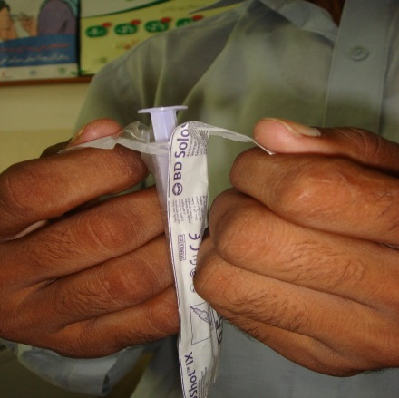
Safe handling of AD syringes and needles
Use only sterile, packed AD syringes.
Do not use if packaging is broken or if expiration date is passed!
Tear off the wrapping from the plunger end of the syringe.
Do not pre-fill syringes.
Take off the needle cap and drop it in the safety box – NEVER RECAP THE NEEDLE.
After use, place the syringe and needle immediately in the safety box.
Wash your hands with soap and water before and after the vaccination session.
Notes:
*Animated slide

Slide 69
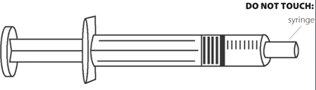
What can and what must not be touched?
Notes:
Talking points:
You may touch: the barrel and the plunger top.
You should not touch: the shaft of the needle, the bevel of the needle, the adaptor, the plunger seal and the plunger shaft of the syringe.

Slide 70
Steps for reconstitution of the M/MR vaccine (I )
Before reconstitution make sure that your hands are clean, wash them with running water and soap.
Reconstitute M/MR vaccine just before using it.
Steps for reconstitution:
1. Inspect the vaccine and diluent vials and make sure that:
  Diluent is for M/MR vaccine, from the same manufacturer as M/MR vaccine, the expiration date is not passed, and that vial is not cracked
  Vaccine is not passed the discard point - check expiration date and VVM
2. Tap the tip of the diluent vial so that none of it remains in the tip, tap the M/MR vial making sure that all powder is at the bottom of the vial.
3. Flip off with your thumb the coloured plastic cap with VVM on the M/MR vaccine.
Notes:
*Animated slide

Slide 71
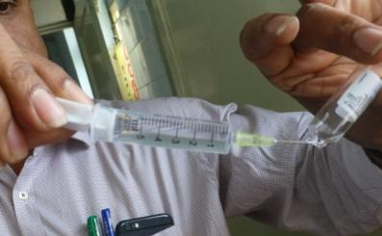
Steps for reconstitution of the M/MR vaccine (II)
4. Write down the time of reconstitution on the label
5. Open the diluent by breaking the tip of the vial
  In case of injury, discard the vial and cover your wound before opening a new one.
6. Draw whole amount of diluent using 5mL AD syringe
7. Insert the mixing syringe into the vaccine vial
8. Mix the diluent with the vaccine powder by gently pushing the plunger
9. Shake the vaccine vial gently (do not put finger on a vial top)
10. Put the mixing syringe and needle in the safety box without recapping
11. Put the vaccine vial in the foam pad of the vaccine carrier
Notes:
*Animated slide

Slide 72
Summary – key points
Vaccine should be reconstituted only with appropriate diluent, by the trained health worker.
Always use new, sterile, AD syringe to reconstitute each new vial.
Discard reconstituted vaccine if:
- Sterile procedures have not been observed
- There is suspicion or evidence of contamination (e.g. change in appearance, floating particles)
- More than 6 hours passed since reconstitution of vaccine or the session has ended.
Notes:
*Animated slide

Slide 73
Unit 4:
Safe vaccine administration and AEFI in M/MR SIA

Slide 74
Safe injection technique
The injection site for M/MR vaccine is the outer part of the upper arm
Injection site should be clean before injecting a vaccine
If visibly dirty, wash it with plain water and wait to dry: do not use swab or soap
Draw the reconstituted vaccine in the AD syringe (0.5mL) just before injection (make sure 6 hours had not passed since reconstitution)
The mother/caregiver should be instructed how to hold the child
What is, in your experience, the best way for the mother/caregiver to hold the child?
Notes:
*Animated slide
Note:
Start a small group discussion on secure and correct position of the child – continues on the following slide.

Slide 75
Small group discussion:
How to hold the child correctly
How should the child be positioned during vaccination and why is this important?
Mothers/caregivers should be seated and hold babies and small children on their laps
It can help to tuck the child’s legs between the mother’s/caregiver’s thighs
Vaccinators should anticipate and try to prevent sudden movements of the child during and after the injection
This is important to ensure safely and correctly administered vaccine and to avoid injury and contamination
Notes:
*Animated slide
Talking points:
Child should be positioned still so that the vaccinator can concentrate on administering the vaccine properly. If child is kicking and trying to push the vaccinator away, the needle may touch something/somebody and become contaminated, injection may be administered in the wrong way or in the inadequate site. This is important to avoid contamination and injury.
If vaccination is provided to older children, vaccinators should make effort to block the view to the vaccination procedure from the children waiting to get vaccinated (children wait outside, or if available – vaccinations happen behind a screen, or vaccinator makes sure that the children are positioned behind his/hers back so that they do not have the direct view to vaccination process).

Slide 76
Subcutaneous injection technique
Hold the child’s upper arm underneath and reach around the arm with your fingers to pinch up the skin, or pinch from the top
If visibly dirty, clean the injection site with clean water
Gently push the needle into the pinched-up skin keeping the bevelled end up to a depth of not more than 1 cm. The needle should go in at a sloping angle (45 degrees).
Press the plunger with your thumb to inject the vaccine
Withdraw the needle and drop it into the safety box
If bleeding, press the injection site with a dry swab but do not rub
Notes:
*Animated slide
Note: Some images are in the following slide.

Slide 77
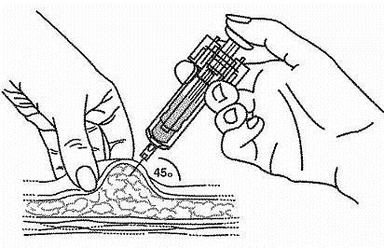
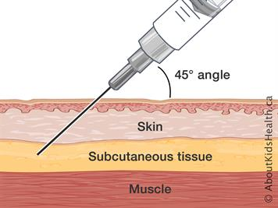
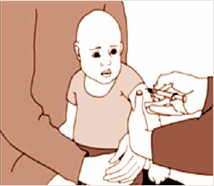
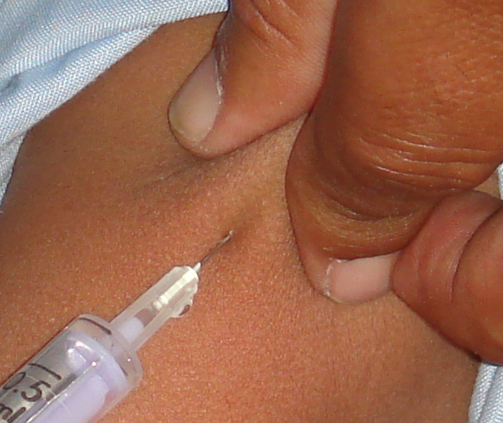
Administration of subcutaneous injection
Notes:
Note:
While looking at the images, ask the participants to describe the proper procedure and to repeat important elements of sc injection technique.

Slide 78
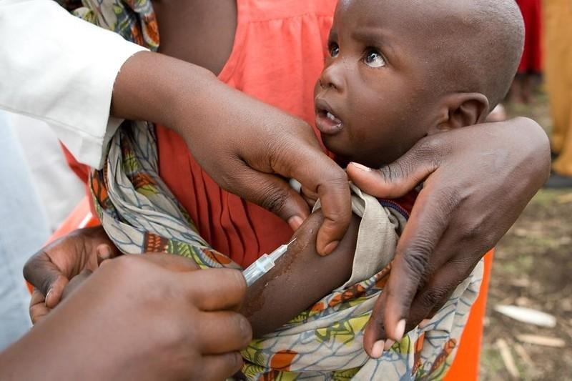
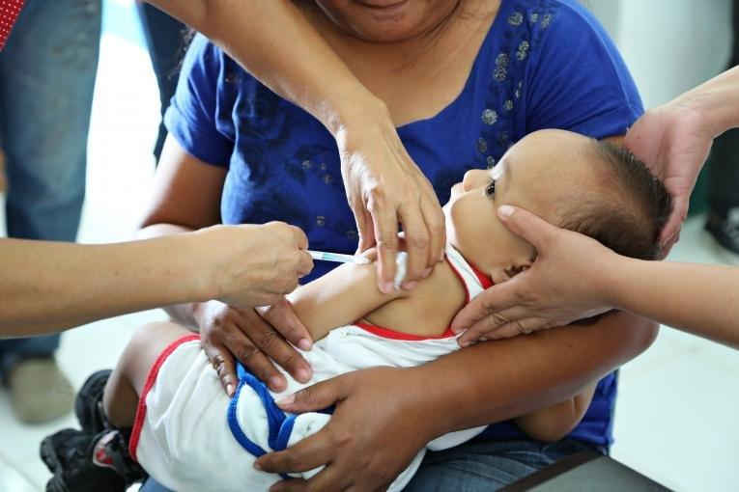
Administration of subcutaneous injection

Slide 79
Pain reduction at the time of vaccination
Pain at the time of vaccination can be reduced with following strategies:
  Speak calmly, and together with the caregiver properly position the vaccinee.
  Breastfeeding during or shortly after the procedure for infants if culturally acceptable.
  If multiple vaccines are administered, ensure to administer less painful vaccines first (i.e. oral vaccine before injectable).
  When administering intra-muscular injection, do not aspirate.
WHO does not recommend the following:
  Do not warm the vaccine (e.g. by rubbing it between hands)
  Do not manually stimulate injection site by rubbing or pinching
  Do not administer painkillers before or at the time of vaccination
Notes:
Talking point:
For the pain occurring during the days after vaccination, oral analgesics (e.g. paracetamol, ibuprofen) can be used to mitigate the symptoms.

Slide 80
Important communication points
All caregivers and community members deserve respect, empathy, and appropriate service regardless of who they are or where they are from
Remember to:
  Be warm and friendly
  Praise and encourage the mother/caregiver
  Give clear and simple messages relevant for the SIA (what vaccine is given and what disease it protects against, what possible AEFI may occur)
  Make sure that mother/caretaker understands and encourage them to keep bringing children to routine vaccinations
Listen actively and allow the mothers/caregivers to speak and ask questions
Respond clearly and if needed, seek help from supervisors and/or co-workers to address issues
Notes:
*Animated slide
Note: Complete package on interpersonal communication (with job aids – audio and video, manuals, reference cards, frequently asked questions) is available here: https://ipc.unicef.org/package-components
Talking points:
You will demonstrate care and respect for mothers/caregivers through:
Being polite and pleasant – thank the mothers/caregiver for coming and bringing the child; acknowledge their effort – use pleasant facial expressions and appropriate body language (Note: you can list locally appropriate gestures and respectful terms of address in advance).
Encouraging and praising the mother/caregiver because they care and are doing the right thing for the health of their child (e.g. You baby will be healthy if you bring him/her for all his/hers vaccines.)
Making your messages clear and positive ( e.g. talk about safety of vaccines rather than adverse events following it; Note: more on how to frame AEFI messages on the next slide)
Asking mother/caregiver if they understood your messages; for better understanding visual aids (posters, counselling cards or similar) can be used, making sure that they are appropriate to the local customs
Listening actively and avoiding interrupting mothers/caregivers when they speak
Showing compassion if they have issue or concerns, and answer their questions in a clear and simple way.
Seeking help from supervisors and/or co-workers to address problems/issues that may arise. It is important that these are addressed as they may impact mothers/caregivers and uptake of immunization.
If you identify problems/issues that are causing mothers/caregivers not to return for vaccinations, write them down and report to your supervisor so they can address them.
If well planned, inter-personal communication efforts can contribute to strengthening routine programme.

Slide 81
AEFI in M/MR SIA and role of the health worker

Slide 82
Adverse Events Following Immunization (AEFI)
What can cause AEFI?
  Mishandling of the vaccine and injection equipment (e.g. contamination of vaccine or syringe
  Fear of injection (e.g. fainting/stress reaction)
  Chemical or biological characteristic of the measles vaccine’s antigen or other ingredients (e.g. fever, rash 7-12 days after vaccination)
Immunization error related reactions (‘programmatic errors’) may lead to serious AEFI – preventable
AEFI can be coincidental: events that happen after vaccination but not caused by vaccine or vaccination process (unrelated)
Notes:
Talking point:
Formerly called ‘programmatic errors’ now are called ‘immunization error related reactions’.

Slide 83
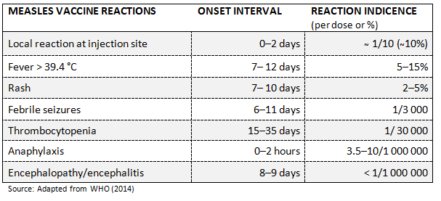
Adverse events following measles vaccination
Measles vaccine is very safe
Most AEFI observed after measles vaccination are mild
Serious AEFI are extremely rare
Notes:
Talking point:
Although serious AEFI with injectable vaccines are very rare, vaccines are biologic products and such events may occur.

Slide 84
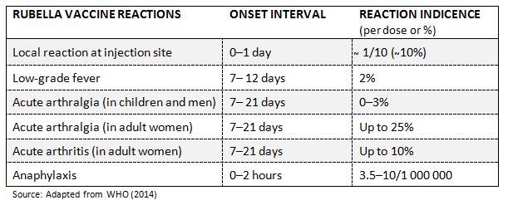
Adverse events following rubella vaccination
Rubella vaccine is very safe
AEFI observed following rubella vaccination alone or in combinations are generally mild and transient
No association between rubella vaccine and chronic joint disease found

Slide 85
Immunization error related reactions (‘programmatic errors’)
Can cause severe reactions, and may also lead to serious AEFI and result in death
These errors are PREVENTABLE!
Notes:
Talking points:
Errors are avoidable!
Toxic Shock Syndrome often leads to death because it does not get recognized and does not get treated immediately and adequately.
If the diluent for example for meningococcal vaccine is mistakenly used to reconstitute measles vaccine, the measles vaccine will be inactivated because the diluent for meningococcal vaccine contains thiomersal. This will result with vaccinated but not protected child.

Slide 86
Plenary question:
How would you prevent programmatic errors?
Discard the vaccine if it was reconstituted 6 hours before.
Draw the AD syringe just before vaccination.
Never carry vaccines from one site to another.
Do not touch the needle, do not cover the vaccine carrier with the lid while the reconstituted vaccine vial is in the foam. Do not touch the rubber cap of the vaccine vial.
Do not store and/or pack other diluents or drugs together with the M/MR vaccine.
Discard the vaccine at the end of the session.
Notes:
*Animated slide
Note: Allow several minutes for statements in plenary, then show the contents of the slide and compare. Discuss any questions that may arise.

Slide 87
AEFI in SIAs: challenges and possible outcomes
Vaccinating large numbers of people over a short period may result in higher number of observed AEFI
The rate of AEFI may remain as expected, but AEFI become more noticeable to health workers and to public
This may result with the loss of trust in vaccine and vaccination programme and increased resistance to or even refusal of vaccination
If not adequately dealt with, hesitancy and refusals will lead to decreased coverage, and consequently to accumulation of susceptible population and outbreaks
In a high-quality SIA the crisis management plan and communication plan/mechanism are set in place to deal with crisis should it arise
Notes:
*Animated slide

Slide 88
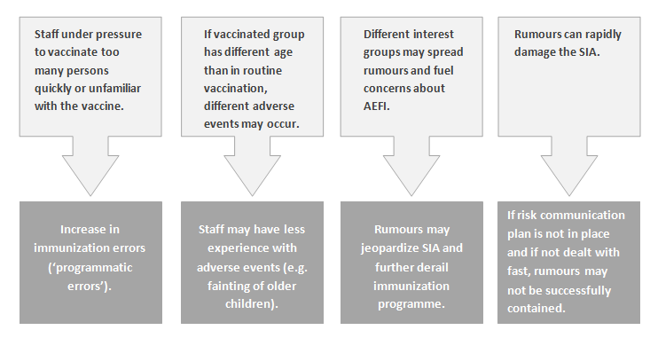
AEFI in SIAs

Slide 89
How will you distinguish fainting from anaphylaxis?
 | Fainting/stress reaction | Anaphylaxis
At onset | At time of or soon after injection | Seconds to minutes after exposure, almost all cases within 1 hour
Skin | Pale, cold, sweaty/clammy | Red, raised itchy rash, swollen eyes and face, generalized rash
Respiratory | Normal to deep breaths | Noisy breathing, wheeze or stridor
Heart | Slow pulse, transient hypotension | Fast pulse, hypotension
Gastro-intestinal | Nausea, vomiting | Abdominal cramps, vomiting
Neurologic | Transient loss of consciousness reversed by supine position | May develop loss of consciousness not relieved by supine position
Notes:
Talking points:
Health workers should be able to recognize anaphylaxis and differentiate it from common benign stress reactions such as anxiety, fainting, breath holding spells.
Anaphylaxis usually has skin manifestations such as rash or edema, but may also present without skin changes.
The most severe reactions are usually sudden in onset and progress rapidly, for this reason clients are requested to remain in the immunization post for at least 15 minutes after injection.
The more rapid appearance and progression of symptoms, the more serious condition it is.

Slide 90
Treatment of anaphylaxis (WHO recommended)
Drug, site and route of administration | Frequency of administration | Dose (child)
Adrenaline (epinephrine)1:1000, immediate IM injection to the midpoint of anterolateral aspect of the middle third of the thigh | Repeat every 5 to 10 or 15 minutes if symptoms are ongoing, up to a maximum of three doses Note: Persisting or worsening cough associated with pulmonary oedema is an important sign of adrenaline overdose and toxicity. | According to age/weight* <1years: 0.05mL 1 year: 0.1 ml 18 months to 4 years: 0.15 ml 5 years: 0.20 ml 6 to 9 years: 0.30 ml 10 to 13 years: 0.40 ml 14 years and older: 0.50 ml
* The dose for children is based on 0.01 ml/kg per dose up to 0.5 ml
Source: https://www.who.int/publications/m/item/anaphylaxis-guidance
Notes:
Note: This treatment instruction is optional. Countries may have and use their own country-specific protocols for treatment of anaphylaxis with drugs of choice, steps to be followed and etc.
For overview of anaphylaxis in the context of adverse event following immunization see Brief overview of anaphylaxis as AEFI and practical guidance on its identification, case management and response in a primary care setting, available at https://www.who.int/publications/m/item/anaphylaxis-guidance.
Short videos on recognizing anaphylaxis vs immunization-related stress response and on identifying and managing anaphylaxis are available at: https://watch.immunizationacademy.com/en/videos/760 and https://watch.immunizationacademy.com/en/videos/772.
Talking points:
Generally, the steps are as follows:
- Place patient in supine or semi supine position
- If patent is unconscious, place in recovery position (supine) and ensure airway clear
- Assess airway/breathing/circulation (ABC), if appropriate give CPR
- Give Adrenaline (1:1000) .01ml/kg in deep IM injection. For children give in upper lateral thigh.
- Give oxygen if available
- Call ambulance or arrange transport to hospital
- Do not leave patient alone
- Record vital signs and document medicines/treatment given
- Repeat dose of adrenaline in 5-10/15 minutes IF symptoms not relieved

Slide 91
What should health worker do in case of AEFI?
Every health worker/vaccination team should have
  Name and contact of the 1st level supervisor/AEFI focal person (local and district)
  Name and contact number of the ambulance service/driver
  Contact number of the local AEFI management centre
Move the child to a quiet place and away from other children
Assess the child
  If in doubt or the event seems serious, call ambulance and arrange immediate referral to nearest AEFI management centre
  If in doubt about anaphylaxis, treat according to the country-specific or WHO protocol
Inform your supervisor and/or AEFI local focal person
Inform the AEFI management centre about patient’s condition
Complete and submit the AEFI report form to the 1st level supervisor at the end of the day
Notes:
*Animated slides
Talking points:
The role of health workers in AEFI management can be context specific. As a minimum, the health worker should know whom to contact with regard to AEFI and the necessary contact information.
Note: Prepare the standard AEFI reporting form examples that the health workers should use in case of AEFI and share with the participants so that they can familiarize themselves with them. This is a good opportunity to emphasize the importance of AEFI reporting in the routine programme and strengthen this often neglected activity, as the standard procedures and the reporting forms are the same for both SIA and routine.

Slide 92
Important points when informing about potential AEFI
Ensure that mother/caregivers understands that:
  M/MR vaccines are very safe, most adverse events are mild and transient; serious events are very rare
  It is advised to wait 15-20 minutes after vaccination in case adverse events with rapid onset occur
  If a child gets very sick quickly following vaccination, the child should be immediately brought to a health-worker for advice and/or treatment
  The occurrence of AEFI does not mean that the M/MR vaccines are unsafe
Listen carefully to mother’s/caregiver’s concerns and respond using clear and simple language
If you identify negative rumours about vaccinations, and/or groups that are involved in spreading them, inform your supervisor and/or other health staff
If health education sessions in the facility and/or community will take place, inform the mothers/caregivers of time and place, and invite them to attend.
Notes:
*Animated slide

Slide 93
Unit 5:
After vaccine administration

Slide 94
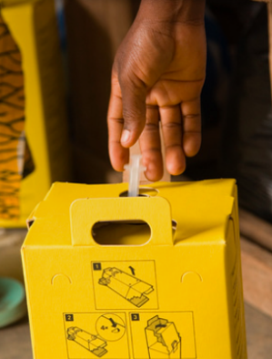
Safe injection disposal
Drop the used AD syringe needle-end down into the safety box, immediately after use.
Never recap the needle.

Slide 95
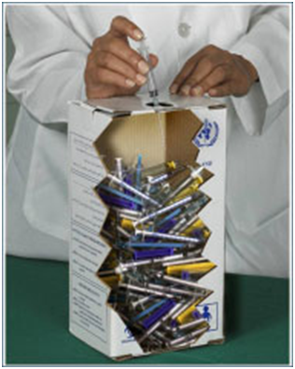
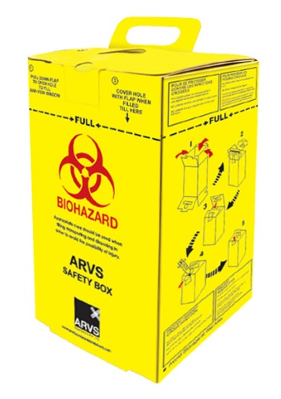
Safe waste disposal
Safety box MUST be used for sharp waste disposal in every vaccination site
Fill up to (¾ of a safety box), or up to the ‘fill line’
Never empty the contents of safety box
Keep the safety box out of reach of children
When the safety box is full, close it and keep in a secured place until final disposal
Dispose of empty vaccine and diluent vials and other waste in a separate container or a waste bag
Notes:
*Animated slide

Slide 96
Small group exercise: safety box replacement
It is the 3rd day of the SIA and John is running short of safety boxes: he has only one safety box left. In the two remaining days of the SIA he will need to vaccinate about 300 children. However, he has at hand 2 ordinary cardboard boxes that he can put together and use, making sure to keep them out of anybody’s reach in a very secure area. Also, he thinks that it may help to open already used safety boxes as they are only ¾ full.
What would you recommend to John?
What should he do?
Notes:
Note: Allow the group/small groups to discuss for 7-8 minutes, and then report to the plenary.
Talking points: (answer in the following slide)
Ordinary cardboard boxes should NOT be used as they are not puncture-resistant.
Also, John should not re-open already used safety boxes and try to pack more sharps in.
John should immediately inform his supervisor about the lack of safety boxes and request more, based on the number of expected children. The same problem may also occur at other vaccination posts so it is good that the supervisor knows about the lack of essential supplies in order to correct.
If, for any reason, capacity of safety boxes supply is reached, other puncture resistant containers such as metal cans or thick plastic containers may be exceptionally used for injection equipment disposal.

Slide 97
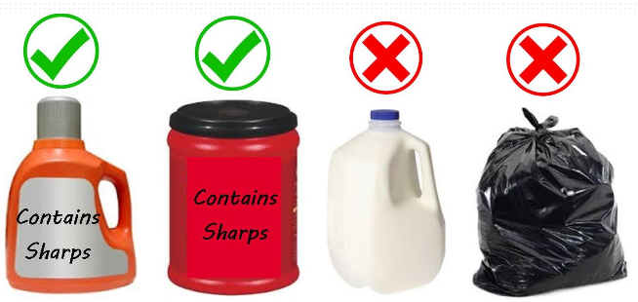
Answer: safety box replacement
John should not re-open already used safety boxes and try to pack more sharps in
John should inform his supervisor about the lack and request more safety boxes
Exceptionally, other puncture resistant containers (e.g. thick plastic containers) can be used – ensure they are properly marked
Notes:
Talking points:
Ordinary cardboard boxes should NOT be used as they are not puncture-resistant.
Also, John should not re-open already used safety boxes and try to pack more sharps in.
John should immediately inform his supervisor about the lack of safety boxes and request more, based on the number of expected children. The same problem may also occur at other vaccination posts so it is good that the supervisor knows about the lack of essential supplies in order to correct.
If, for any reason, capacity of safety boxes supply is reached, other puncture resistant containers such as metal cans or thick plastic containers may be exceptionally used for injection equipment disposal.

Slide 98
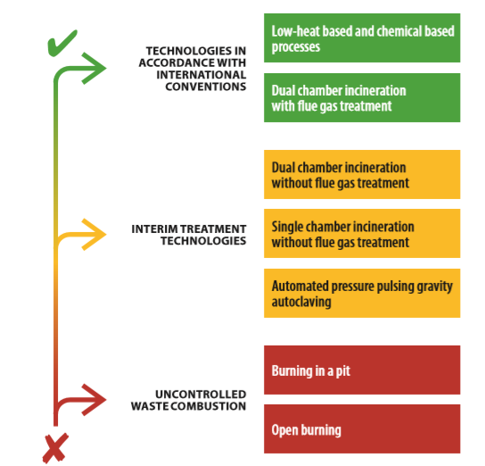
Treatment of infectious and sharps waste
WHO prefers the use of technologies which do not form and release chemicals or hazardous emissions:
  high temperature incineration
  autoclaving
  microwaving
In low-resource or emergency settings, transitional methods can be used BUT…
…efforts should be made to incrementally improve waste management systems and engage in multi-sectoral partners.
Resource: https://www.who.int/water_sanitation_health/publications/technologies-for-the-treatment-of-infectious-and-sharp-waste/en
Notes:
Note:
Resource:
https://www.who.int/water_sanitation_health/publications/technologies-for-the-treatment-of-infectious-and-sharp-waste/en

Slide 99
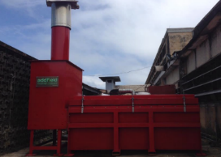
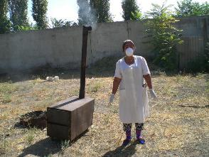
Preferred and interim solutions
Preferred solution: high temperature incineration
  Two burning chambers (1st chamber 850 °C and 2nd 1 100 °C)
  Auxiliary burners
  Sufficient resident time of air in the 2nd chamber
  Flue gas treatment
Interim solution: small scale incinerators
  Commonly used in low resource settings
  Low cost, easy to install
  It is important to preheat the incinerator before feeding with waste to reduce emissions
  Disadvantage: generation of hazardous emissions like dioxin and furans
Notes:
Talking points:
Flue gas: mixture of gases produced by the burning of fuel or other materials in power stations and industrial plants which is exiting to the atmosphere via a flue (a pipe or channel for conveying exhaust gases).
Dioxin and furans causes negative effects on the environment and health of humans including:
skin toxicity,
immunotoxicity, neurotoxicity,
negative effects on reproduction,
teratogenicity,
endocrine disruption, and a predisposition to cancer.

Slide 100
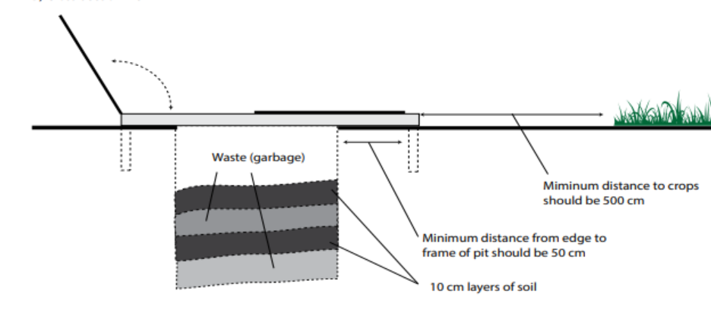
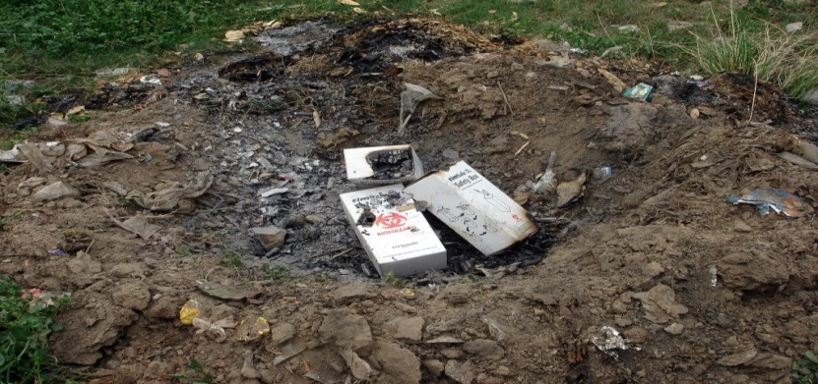
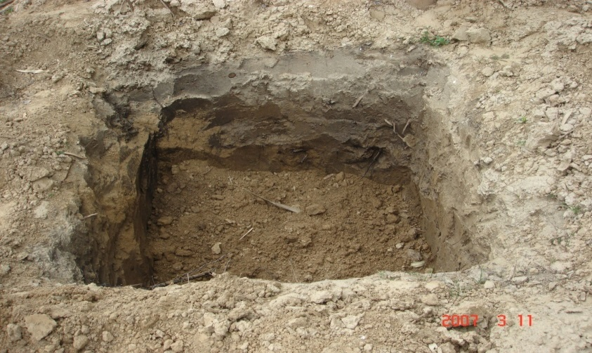
Last resort solutions for waste treatment and disposal
Where high temperature incinerators or autoclaves are not available and cannot be installed, alternative treatment/disposal measures, such as burning in a pit or burying, must be put in place
Last resort solution: pit burning
A standard pit should be
  In an isolated place, away from reach of children or animals
  Away from houses
  At least 2 meters deep and proportionately wide
When burning is complete it should be covered with soil (at least 30 cm)
Maintain the register with date and number of burnt boxes – to be under direct supervision
Notes:
*Animated slide
Talking points:
The preferred method of waste treatment which minimizes the formation and release of chemicals or hazardous emissions like high temperature incineration or autoclaving should be given priority over other technologies. But in areas where incinerators are not available and cannot be constructed, alternative treatment /disposal methods must be put in place.
Regardless of the method selected, the area in which the waste disposal takes place must be secured.
Burning of waste in a metal drum or in an open pit is NOT in line with WHO policy for the treatment of waste and it is NOT recommended by WHO since it produces toxic emissions and presents a public health and environmental hazard.

Slide 101
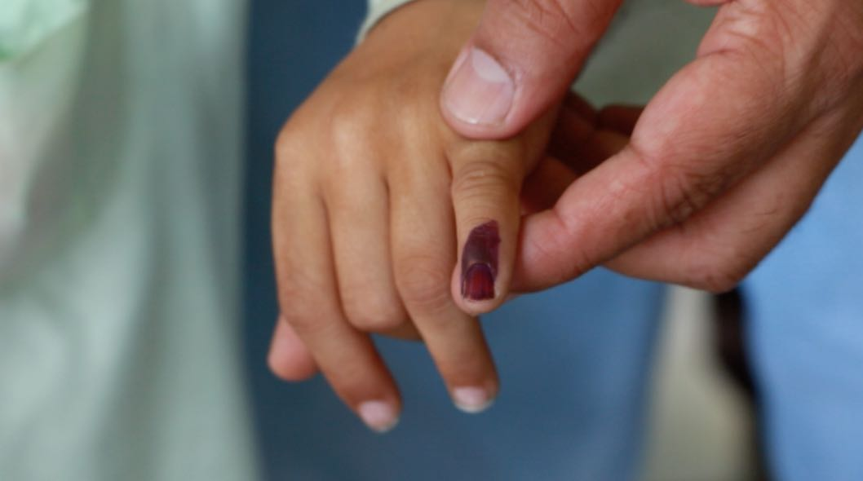
After vaccine administration
Vaccinator should:
  Inform the mother/caregiver about possible adverse reaction and when they may occur
  Advise the mother/caregiver about child’s next routine vaccinations
Volunteer/team assistant should:
  Mark tally (cross the circle in the tally sheet Ø)
  Mark left little finger with indelible ink pen
  Mark vaccination card or home-based record, if applicable
  Advise the mother/caregiver to remain at the session site for 15-20 minutes, preferably seated, in case of AEFI with rapid onset
Notes:
*Animated slides
Note:
Every opportunity should be used to remind mothers/caregivers of routine vaccinations, identify the defaulters if at all possible and advise them when and where to return for missed doses.
Mothers/caregivers should be given adequate information about possible adverse reactions after vaccination.

Slide 102
Small group review:
Record keeping/data collection – using tally sheets
Each M/MR vaccine dose administered is recorded on tally sheet
If other interventions are integrated in the SIA, these should be recorded also
Complete date, location, team number and team members
Mark the tallies correctly, without skipping rows
Keep count of used and unused vaccine vials, including those that were damaged. The number should add up to the total of number of vials received.
At the end of each day, when the team returns to the health facility, the tally sheets should be reviewed for completeness by the health worker and the team supervisor. Each day of the SIA should be started with a new tally sheet.
Notes:
Notes:
Show the participants tally sheets that they will be using during the campaign, to familiarize themselves with them. Discuss any questions that arise (up to 10 minutes).
Depending on the nature of the SIA, tally sheets may vary. Some examples are proposed in the WHO Field guide (Annex 9 – 9d,9e,9f) available at https://www.who.int/immunization/documents/9789241511254/en/ .

Slide 103
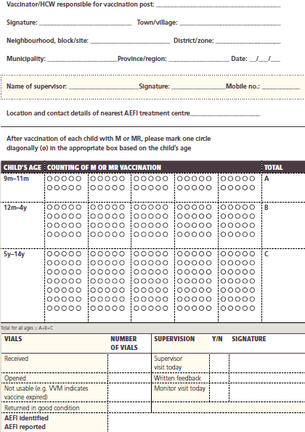
Examples of tally sheets
Notes:
Optional slide
Note:
- Sample tally sheet to record doses during M/MR SIA for the target group range 9 months to 14 years
- Tally sheets can be designed for the SIA in which vaccination cards are checked for routine M/MR vaccinations (when the objective also is to identify number of measles zero-dose children)

Slide 104
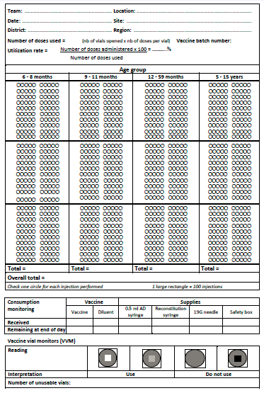

Slide 105
Plenary discussion: Closing the vaccination site
What will you do with unused reconstituted M/MR vaccine vials, if any?
Discard in a separate waste bag or container.
What will you do with unopened M/MR vaccine vials and diluents?
Count the unopened M/MR vaccine vials and diluents in the vaccine carrier and write down the number on the tally sheet.
Return unused M/MR vaccines and diluents to the distribution point along with the vaccine carrier and coolant packs.
How will you report on unused M/MR vaccine vials and to whom?
Calculate on the tally sheet the number of vials received, opened, discarded, and returned; submit the tally sheet to the 1st level supervisor.
Notes:
*Animated slide

Slide 106
Identify and record measles zero-dose children during SIA
Definition: measles zero-dose children are children with no previous history of M/MR vaccination.
Look at the vaccination card and establish if a child received the 1st dose of M/MR vaccine through the routine programme.
Record all children vaccinated in the SIA in a column (A) stratified by age.
Record children who are 12 months and older and who have proof (i.e. vaccination card) of previous M/MR vaccination in a separate column (B).
Calculate measles zero-dose dose children by subtracting column B from the column A.
Question for group discussion:
Why is it important to identify measles zero-dose children?
Notes:
Note: Allow 7 to 8 minutes for group discussion on how identifying zero dose children can help routine programme and why it is important.
The following slide has an example of tally sheet which you can use to better explain how to record measles zero-dose children during SIA.
Talking points:
Identifying measles zero-dose children during the SIA identifies communities at risk for low routine vaccination coverage and at risk of outbreaks.
However, not recording any measles zero-dose children on a tally sheet does not necessarily mean that routine immunization coverage in that community/area is strong , because the same children missed by routine services may also be missed during the SIA.
If an area with high number of measles zero-dose children is identified during the SIA, further actions to strengthen RI services need to be undertaken after the SIA.

Slide 107
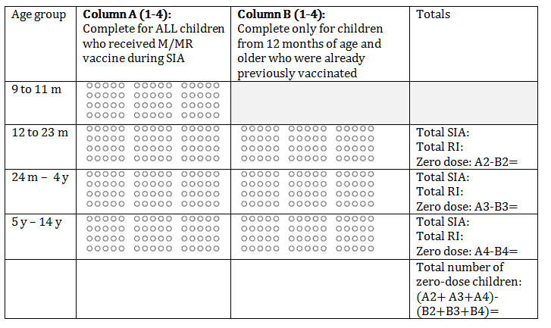
Example of tally sheet stratified by age and prior M/MR RI dose to identify measles zero-dose children

Slide 108
10 key points for health workers and vaccination team

Slide 109
10 key points for health workers and vaccination team
Freeze coolant-packs early enough (one week before SIA).
Keep the diluent cool 24 hours prior to use (2-8 °C).
Use conditioned coolant packs for the vaccine carrier.
Check the expiration date of vaccine and diluent and the VVM.
Reconstitute 1 vaccine vial at a time using the correct technique.
Keep reconstituted vaccine vials in foam pad of vaccine carrier, away from heat and light. Do not close the lid.
Draw one AD syringe at a time. Do not pre-fill. Do not touch the needle.
Administer vaccine subcutaneously in the upper left arm.
Do not recap any needle and always dispose in the safety box.
Never move reconstituted vaccine vial from one site to another. Discard it 6 hours after reconstitution or at the end of the vaccination session, whatever comes first.

Slide 110
Additional but not any less important point
How can SIAs strengthen the routine immunization programme?
  By identifying M/MR zero-dose children and defaulters to help identify low coverage areas
  By updating RI microplans with target population and maps of catchment areas, especially if missed populations are detected during SIA
  By reminding mothers/caregivers to bring the children back for routine vaccination
  By refreshing health workers’ knowledge on safe and correct vaccine administration techniques and waste management
  By strengthening AEFI reporting
Notes:
*Animated slide
Notes:
Ask the participants what they think are the areas where they can contribute to the routine immunization programme practices.

Slide 111
Questions?
Notes:
Allow time for questions and answers.

Slide 112
Additional session:
SIA in the context of COVID-19
Catch-up vaccination sessions

Slide 113
Best practice in the context of COVID-19: vaccinator
Standard infection prevention and control (IPC) strategies:
Hand hygiene: use clean water and soap (40 to 60 seconds) or alcohol-based hand rub (20 to 30 seconds):
  before putting and removing the mask
  before preparing the vaccine
  between each vaccine administration.
Personal protective equipment (PPE):
  wear a medical mask throughout the vaccination session;
  gloves are not required for injectable vaccine administration; if used they do not replace the need for performing hand hygiene;
  applying alcohol-based hand rub on gloved hands is strongly discouraged.

Slide 114
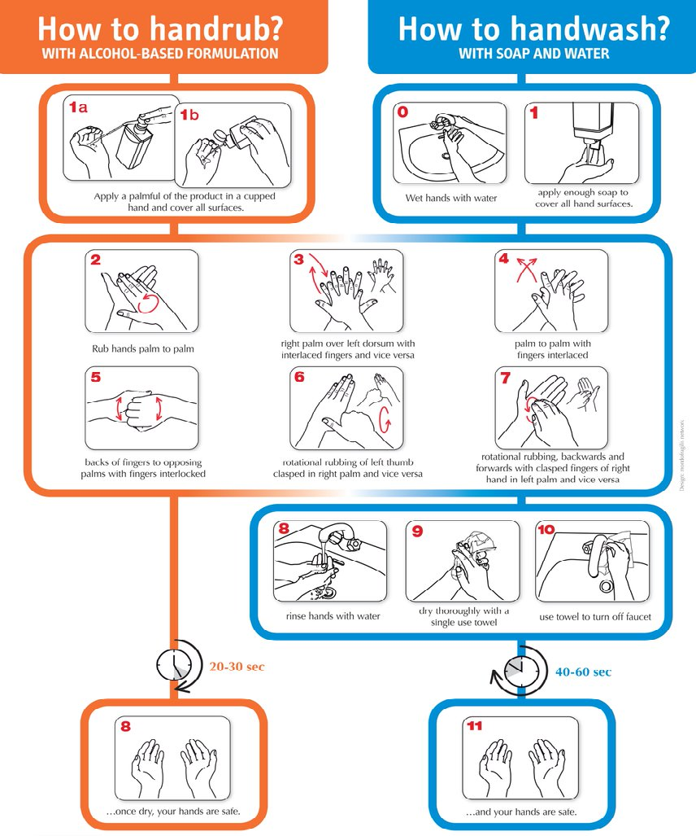
Source:
https://www.who.int/gpsc/tools/GPSC-HandRub-Wash.pdf
Notes:
Source: https://www.who.int/gpsc/tools/GPSC-HandRub-Wash.pdf
Use appropriate product and hand cleaning technique.
An alcohol-based hand rub product is preferable, if hands are not visibly soiled.
Rub hands for 20-30 seconds.
Use soap, running water and single use towel when hands are visibly dirty or contaminated
Wash hands for 40-60 seconds.

Slide 115
How to wear a mask properly
Clean your hands properly before putting on mask.
Place mask carefully, ensure it covers mouth and nose, and tie securely to minimize any gaps.
Do not touch mask while wearing it. If you inadvertently touch a used mask, clean your hands with alcohol-based hand rub or soap and water.
Remove and replace masks as soon as they become damp.
When removing mask, do not touch the front of the mask; untie from behind or pull away from the straps.
Discard mask after each use, dispose adequately immediately upon removal, and perform hand hygiene.
Do not re-use single-use masks.

Slide 116
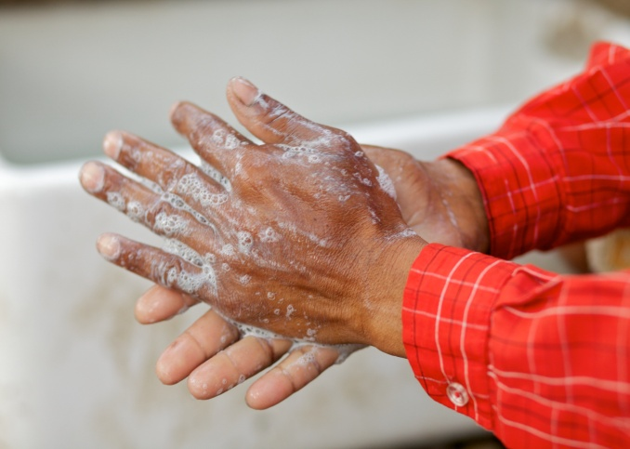



How to safely put on and remove the medical mask
Step 1. Perform hand hygiene.
Step 2. Place the loops around the ears. Ensure the mask fits over your nose, mouth and chin. Avoid touching it.
Step 3. Perform hand hygiene before removing or touching the mask.
Step 4. Remove by the straps and pull away from your face.
Step 6. After discarding, perform hand hygiene again.
Step 5. Discard in a closed bin.

Slide 117


Best practice in the context of COVID-19: vaccination site
Good ventilation – open the windows in indoor space and if outdoors, pick well ventilated area
Hand hygiene resources – must be available for both health workers and persons coming to get vaccinated.

Slide 118


Best practice in the context of COVID-19: vaccination site
Adequate physical distancing – ensure 1-meter distance in all directions between each person
One-way flow through the vaccination site
Limited number of individuals to avoid crowding and long waiting times
Environmental cleaning: clean high-touch surfaces (e.g. chairs, tables, door-handles)

Slide 119

Best practice in the context of COVID-19: vaccination session
Screening for respiratory symptoms before caregivers and vaccinees enter the vaccination site
Masks: medical masks for vaccinators, medical or fabric masks for caregivers
Sideways positioning – avoid positioning yourself face-to-face with the caregiver and the vaccinee
It is important that safety measures are communicated to the community prior and during the SIA.

Slide 120
Infection prevention and control (IPC) kit for outreach/campaign vaccination posts
IPC kits for outreach and campaign vaccination sessions should as a minimum include:
  Products for hand hygiene: soap/clean water/Veronica buckets (if sinks not available)/disposable or clean towels or alcohol-based hand rub products
  Medical masks (several for replacement – mask should be replaced with a clean one as soon as it becomes damp)
  Waste bins/garbage bags
Special considerations:
  Eye protection, gown and gloves are not routinely required, they should be used if dealing with suspected COVID-19 patient.
Gowns and gloves, if used, should be discarded after single use.
Notes:
* Optional slide

Slide 121

Disposal of PPE
Contaminated PPE is infectious waste and should be disposed of in a separate container or a waste bag as all other hazardous waste.
Remove PPE away from the vaccination area,
After safely removing PPE, place them into a special waste container or a bag for infectious waste (yellow or red).
The container/bag should be properly labelled with the infectious substances symbol.
Seal the container before transporting to the treatment site.
Notes:
Note:
Consult the national guidelines to follow special procedures for removing PPE.

Slide 122

Catch-up vaccination strategies in the context of COVID-19
https://www.who.int/immunization/programmes_systems/policies_strategies/catch-up_vaccination/en/

Slide 123
COVID-19 pandemic and catch-up vaccination
COVID-19 pandemic causes routine immunization delivery disruptions and suspensions of SIAs.
Many children missed their vaccination and need to be caught up
Catch-up vaccination refers to vaccinating an individual who, for whatever reason (e.g. delays, stockouts, access, hesitancy, service interruptions, etc.) is missing doses for which they are eligible per the immunization schedule.

Slide 124
Catch-up vaccination: what do you need to know?
It is always “better to vaccinate late than never!”
Current vaccination policies and schedule
How to check for vaccination card and screen for eligibility
Minimal intervals between vaccine doses
How to administer multiple injections and techniques for pain reduction
How to record late doses – all doses should be recorded and reported

Slide 125
Communicate and engage the community
Good communication is critical to:
  Increase awareness that missed dose does not necessarily mean that the child is no longer eligible for vaccination
  Reinforce importance of prevention through vaccination
  Promote the practice of bringing personal records (home-based records or similar) to every health visit
Efforts should be intensified to reach missed or incompletely vaccinated children through:
  Information campaigns/mass call-backs
  Phone calls, emails, text messaging
  Notices on official government and professional societies websites
  Media and social media
  Community mobilizers
  Etc.

Slide 126
Questions?

