Slide 1

Maintaining Maternal & Neonatal Tetanus Elimination in Country X Post-validation Assessment
Country X, XX Month 20XX

Slide 2
Overview
MNTE post-validation monitoring
Data sets reviewed
Field assessment and findings
Conclusion
Recommendations

Slide 3
Assessment teams
District 1 | District 2 | District 3
Name X, affiliation X

Slide 4
Neonatal tetanus (NT) elimination
“public health problem”
To achieve elimination:
<1 NT case per 1,000 live births in a year in every district of a country
If NT is eliminated,
maternal tetanus (MT) is also considered eliminated
= MNTE

Slide 5
Neonatal tetanus affects the vulnerable …
Women with no antenatal care (ANC) and no TT, home delivery and untrained attendance
Women who went for ANC but received no TT
Women who deliver at health center but practices may not be clean
Women attended by midwife but unclean practices
Critical role of surveillance and sharing of findings for corrective actions with both, EPI and Maternal, Neonatal and Child Health (MNCH)

Slide 6
MNTE post-validation monitoring
Objective: maintain MNTE status (<1 NT case /1000 live births in every district)
Country to conduct annual MNTE risk assessment as part of EPI and MCH reviews and undertake necessary corrective measures based on findings
Conduct post-validation assessments
  Review available district data for 3 past years
  Undertake field visit to selected poor and medium performing districts for clarification using standardized tools
  Make appropriate recommendations to sustain the elimination status based on the consolidated findings

Slide 7
Data sets reviewed
Desk review
  Core indicators – NT rates, TT2+, clean delivery/skilled birth attendants coverage
  Surrogate indicators – ANC, Penta1, Penta3, urban/rural
  Administrative vs survey (DHS) data
Field assessment
  District and health facility level performance
  Community level survey of women who delivered a child within last 2 years

Slide 8
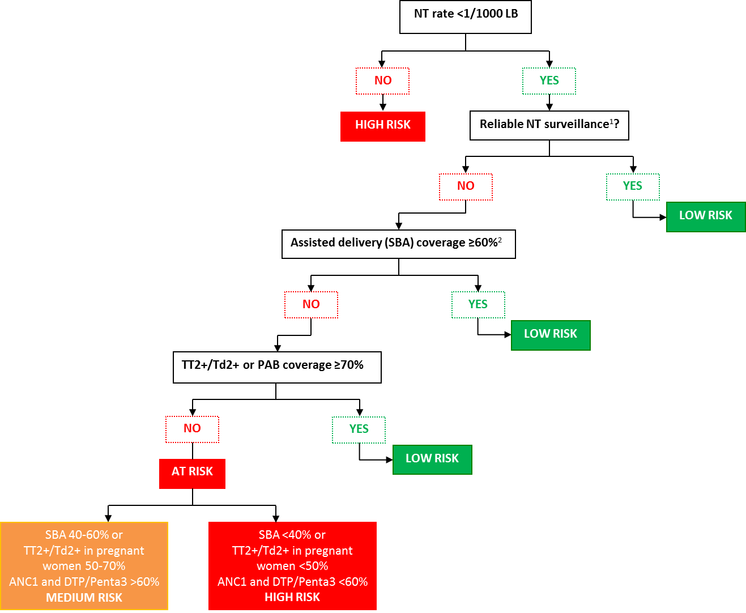
Algorithm – to determine NT risk status
Reliable NT surveillance: a) zero reporting in operation, b) completeness of district health facility surveillance reporting ≥80%, c) adequate distribution of reporting sites (subjective), d) review of hospital records at least once a year.
Delivery by a health staff or as defined by the national policy.

Slide 9
Findings from desk review
District | Coverage Data |  |  |  |  | Surveillance |  | System indicators
 | Target Population under 1 | DTP1 | DTP3 | TT2+ coverage pregnant Women | PAB | Reported NT cases | Reported NT rate per 1000 LBs | Hospital delivery rate | SBA | Urban or rural (majority of pop'n)?
 | number | % | % | % | % | number | rate | % | % | Urban / Rural
 | 2016 | 2016 | 2016 | 2016 | 2016* | 2016 | 2016 | 2016 | 2016* | 2016
District 1
District 2
District 3
District 4
District 5
District 6
District 7
District 8
District 9
District 10

Slide 10
Admin and coverage survey data
Municipality | District 1 |  | District 2 |  | District 3
2016 | Admin | DHS | Admin | DHS | Admin | DHS
Penta3
TT2+
ANC1
SBA
NT rate / 1000 LB

Slide 11
Findings from field visits
Key indicators | District 1 | District 2 | District 3
# women interviewed
TT2+ coverage (%)
TT5+ coverage (%)
% of births in health facilities
% putting traditional substance on cord
% of women protected against tetanus by combined TT and skilled birth attendance

Slide 12
Findings from field visits
Area | Strengths | Weaknesses
Planning, monitoring & data use

Slide 13
Findings from field visits
Area | Strengths | Weaknesses
Human resources and capacity

Slide 14
Findings from field visits
Area | Strengths | Weaknesses
Immunization service delivery

Slide 15
Findings from field visits
Area | Strengths | Weaknesses
Vaccine, supply stock and cold chain management

Slide 16
Findings from field visits
Area | Strengths | Weaknesses
ANC and clean delivery (SBA, clean cord practices)
Notes:
Adminstrative and DHS 2016 data also support.

Slide 17
Findings from field visits
Area | Strengths | Weaknesses
NT Surveillance and reliability

Slide 18
Conclusions

Slide 19
Recommendations

