Slide 1

CD-JEV Japanese Encephalitis Vaccine Introduction Training Modules for Health Care Workers
Module 2
CD-JEV attributes and storage conditions

Slide 2


Learning objectives
At the end of the module, the participant will be able to:
  Describe the main attributes of CD-JEV.
  Describe storage conditions of CD-JEV.
Duration:
  15 minutes

Slide 3
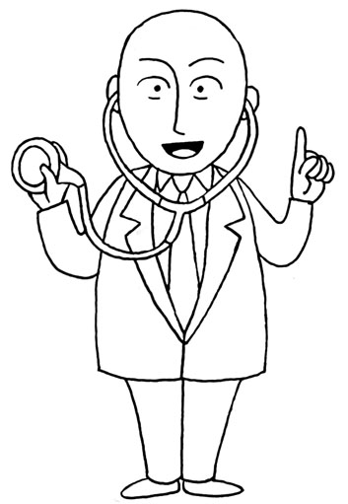
Key issues
1
What is the presentation of
CD-JEV?
2
How safe is CD-JEV?
3
At which temperature should CD-JEV be stored?
4
Where should the vaccine be stored?
Notes:
To the facilitator:
Explain to the participants the key issues raised in this module.
This module will explain how to store the vaccine.
We will provide you with answers to the following questions:
What is CD-JEVvaccine presentation?
How safe is CD-JEVvaccine?
At which temperature should the vaccine be stored?
Where should the vaccine be stored?

Slide 4
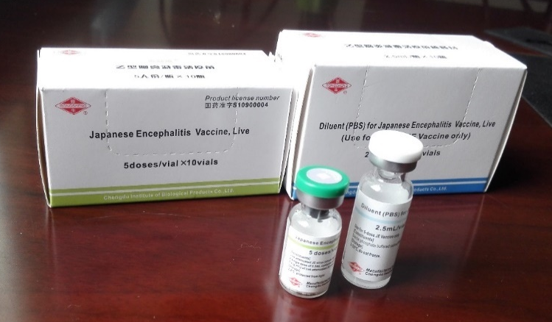
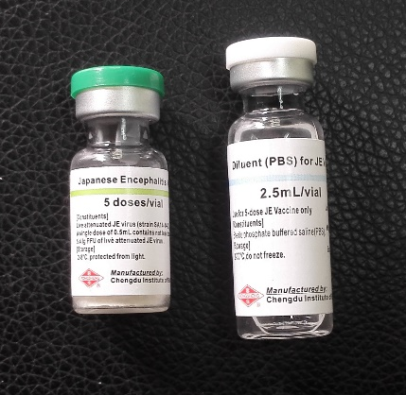
What is the CD-JEV presentation?
  Provided in 1-dose or 5-dose vials; dosage is 0.5 mL for all ages.
  CD-JEV is a freeze-dried (lyophilized) vaccine that needs to be mixed with diluent before use (reconstitution).
  Prior to reconstitution it is a milky-white caked powder.
  After mixing with diluent it becomes a transparent pink liquid.
  NOTE: Packaging may differ by country according to licensure and regulatory policy. CD-JEV may also be labeled as “CD.JEVAX®” or “RS.JEV®,” but it is the same product.
Notes:
To the facilitator:
Describe to the participants the CD-JEV presentation.
Provided in 1-dose or 5-dose vials; dosage is 0.5 mL for all ages.
CD-JEV is a freeze-dried (lyophilized) vaccine that needs to be mixed with diluent before use (reconstitution).
Prior to reconstitution it is a milky-white caked powder.
After mixing with diluent it becomes a transparent pink liquid.
Emphasize that packaging may differ by country according to licensure and regulatory policy. CD-JEV may also be labelled as “CD.JEVAX®” or “RS.JEV®”, but it is the same product.
4

Slide 5
How safe is CD-JEV?
CD-JEV is “prequalified” by WHO, which means the vaccine has been assessed by the WHO and successfully meets quality, safety and efficacy standards for the target population.
CD-JEV has been widely used for over 10 years throughout Asia without safety concerns identified.
In 2015, the WHO stated that JE vaccination “should be integrated into all national immunization schedules where JE is recognized as a public health priority.”
Possible side effects: Some children may experience mild symptoms such as tenderness or swelling at the injection site, rash, mild fever, nausea, or dizziness.
  These side effects are not serious and will not last more than a few days.
  Like any vaccine, there is always the possibility of serious side effects in association with vaccination, but serious adverse events are rare.
Notes:
To the facilitator:
Explain to the participants that the CD-JEV is safe.
CD-JEV is “prequalified” by WHO, which means the vaccine has been assessed by the WHO and successfully meets quality, safety and efficacy standards for the target population.
CD-JEV has been widely used for over 10 years throughout Asia without safety concerns identified.
In 2015, the WHO stated that JE vaccination “should be integrated into all national immunization schedules where JE is recognized as a public health priority.”
Possible side effects: Some children may experience mild symptoms such as tenderness or swelling at the injection site, rash, mild fever, nausea, or dizziness.
These side effects are not serious and will not last more than a few days.
Like any vaccine, there is always the possibility of serious side effects in association with vaccination, but serious adverse events are rare.
Any adverse events and other problems related to the vaccines should be reported through the existing AEFI Reporting System established by the National Immunization Program (more details in Module 6).
5

Slide 6
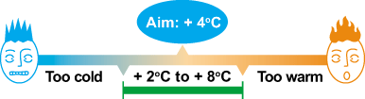
At which temperature must
CD-JEV be stored?
CD-JEV should be stored between + 2⁰C and + 8⁰C and protected from light.
Diluent must not be frozen but should be stored between + 2⁰C and + 8⁰C before reconstitution.
Notes:
To the facilitator:
Explain to the participants at which temperature the vaccine should be stored.
Handling vaccines requires great care. Some vaccines are sensitive to heat and some to freezing.
Careful storage and transport conditions are needed to protect vaccines from becoming ineffective and unusable.
CD-JEV must be transported and stored at + 2°C to + 8°C.
Diluent must not be frozen but should be stored between + 2⁰C and + 8⁰C before reconstitution.
It is important to ensure that the vaccine is not frozen.
If vaccines are frozen, they lose their potency and they would not provide adequate protection against the disease.
6

Slide 7
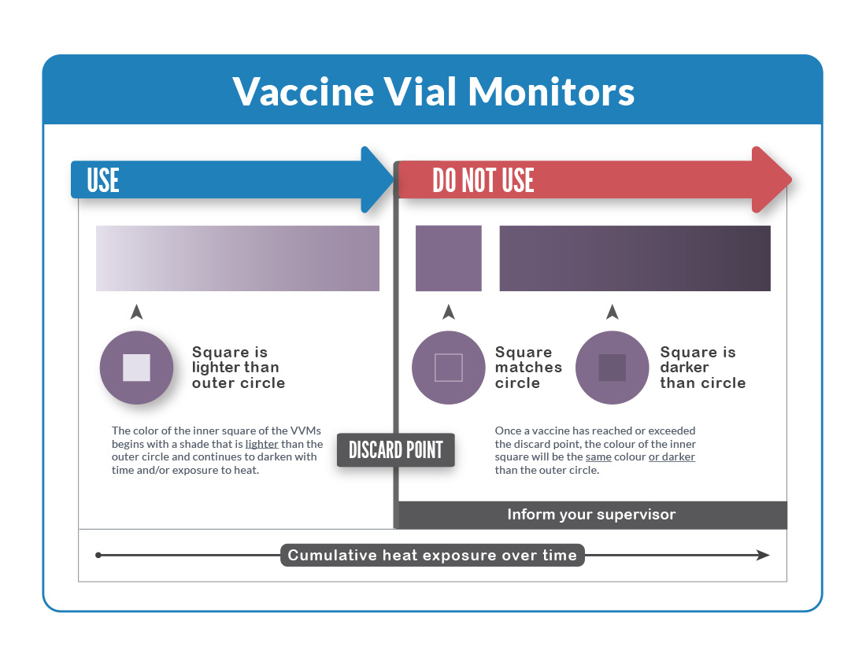
What is a vaccine vial monitor?
  CD-JEV vaccine comes with a vaccine vial monitor (VVM) sticker with an inner square that will darken if the vaccine has been exposed to higher temperatures long enough to affect its potency.
  The VVM is on the cap of the vial and can be seen before the vial is opened. However, once the vial is opened and the vaccine is reconstituted, the VVM is no longer effective to monitor temperature.
  Any vial with a VVM darkened beyond the discard point should be discarded.
Notes:
To the facilitator:
Explain to the participants at which temperature the vaccine should be stored.
CD-JEV vaccine comes with a vaccine vial monitor (VVM) sticker with an inner square that will darken if the vaccine has been exposed to higher temperatures long enough to affect its potency.
The VVM is on the cap of the vial and can be seen before the vial is opened. However, once the vial is opened and the vaccine is reconstituted, the VVM is no longer effective to monitor temperature.
Any vial with a VVM darkened beyond the discard point should be discarded and reported to your supervisor.
7

Slide 8
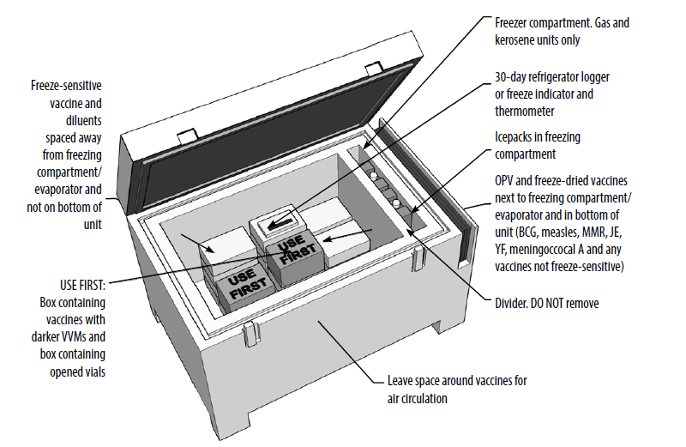
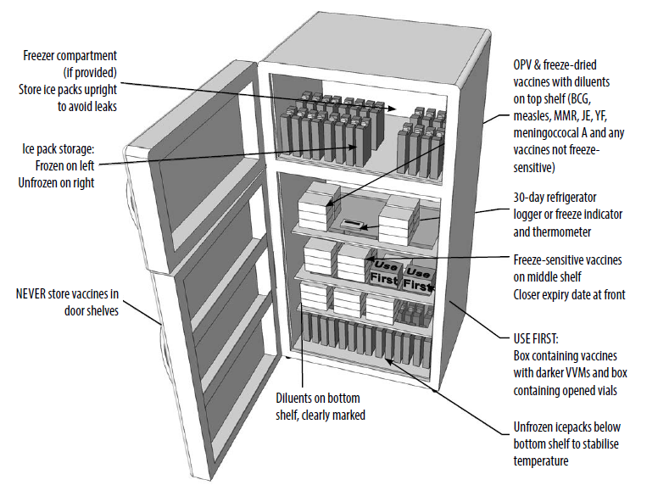
Where do you store the vaccine?
CD-JEV should be stored in a refrigerator
  Please be sure to have a thermometer in the fridge and check it daily to ensure the
  vaccine is kept within the correct temperature range.
Notes:
To the facilitator:
Explain to the participants where to store the vaccine.
Good temperature control during the storage and transport of vaccines is critical to ensure their potency and safety. Monitor the temperature of the refrigerator regularly.
As we have mentioned before, CD-JEVshould be stored between + 2°C and + 8°C .
Do not put CD-JEV in the freezer.
The vaccine should be administered as soon as possible after being removed from the refrigerator.
In top-loading refrigerators: Store CD-JEV vaccine in the bottom or middle of the refrigerator.
In front-loading refrigerators, the top shelf is directly under the freezer and can be very cold, but CD-JEV vaccine can be stored there.
8

Slide 9
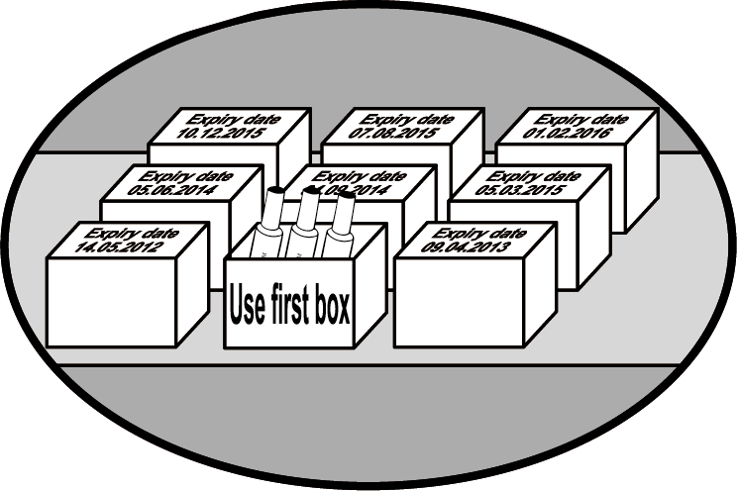
Which vaccine should be stored in front?
Vaccines with early expiry dates should be kept in front
to be used first
Further expiry date in back
Closer expiry date in front
Notes:
To the facilitator:
Explain to the participants, how to store the vaccine.
Vaccines with early expiry dates should be kept in front for first use.
Vaccines with the Vaccine Vial Monitor (VVM) at or near stage 2 should be used first. Vaccines with VVM beyond stage 2 should not be used even if the expiry date is valid (more detail in Module 4).
Keep a “use first box” in the refrigerator to put vaccine vials that were taken out of the refrigerator (for fixed or outreach session) and were brought back unused. Vaccines in the “use first box” must be used first in the next session.
Do not open the refrigerator door often and regularly monitor the temperature of the refrigerator.
9

Slide 10
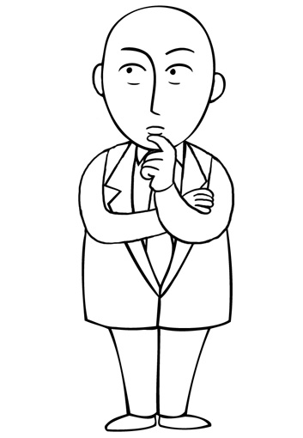
What should you do?
The refrigerator stops functioning.
What should you do?
Notes:
To the facilitator:
The question will test if participants understand what to do if the refrigerator stops functioning.
Answer:
Find another refrigerator or cold room to store vaccines (be sure that the temperature is maintained between + 2°C and + 8°C).
If another refrigerator is unavailable, line coolant packs or water packs in cold box(es) or vaccine carrier(s) then put vaccines in the box(es) (Be careful not to put JE vaccines or other freeze-sensitive vaccines near frozen ice packs, as it may affect vaccine potency).
Inform supervisor immediately.
10

Slide 11
What do you do with CD-JEV after it has been reconstituted?
For 5-dose vials, after JE vaccine has been reconstituted, opened vials can be used for up to 6 hours as long as they are kept within + 2⁰C and + 8⁰C. Any remaining reconstituted vaccine should be discarded after 6 hours or at the end of the immunization session, whichever comes first.
  If there is a break in time between children coming in for vaccination, please return the vaccine to the refrigerator or cold box so that it is not left out and exposed to heat.
  If you return reconstituted vaccine to a cold box, be cautious if there is melted ice in the carrier. The stopper should not be contaminated with water, so make sure there is a foam pad or other means to keep the stopper dry (but the vaccine cool).
  Do not freeze reconstituted vaccine.
For 1-dose vials, after JE vaccine has been reconstituted, opened vials can be used for up to 30 minutes as long as they are kept within + 2⁰C and + 8⁰C. Any remaining reconstituted vaccine should be discarded after 30 minutes or at the end of the immunization session, whichever comes first.

Slide 12
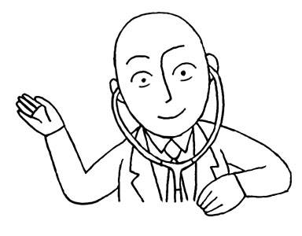
Key messages (1/2)
CD-JEV comes in 1-dose or 5-dose vials.
CD-JEV needs to be reconstituted (mixed with diluent) before use.
CD-JEV is “prequalified” by WHO, which means the vaccine has been assessed by the WHO and successfully meets quality, safety and efficacy standards for the target population.
Some children may experience mild symptoms after vaccination, such as tenderness at the injection site or mild fever.
Notes:
To the facilitator:
Explain to the participants that these are the important things to keep in mind.

Slide 13
Key messages (2/2)
Powdered, lyophilized JE vaccine vials should be stored between + 2⁰C and + 8⁰C and protected from light; diluent should be stored between + 2⁰C and + 8⁰C.
Do not freeze diluent or reconstituted CD-JEV vaccine.
Any vial with a VVM darkened beyond the discard point should be discarded.
For 5-dose vials: Reconstituted CD-JEV can be used for up to 6 hours as long as it is kept within + 2⁰C and + 8⁰C; any remaining reconstituted vaccine should be discarded after 6 hours or at the end of the immunization session, whichever comes first.
For 1-dose vials: Reconstituted CD-JEV can be used for up to 30 minutes; any remaining reconstituted vaccine should be discarded after 30 minutes or at the end of the immunization session, whichever comes first.
Notes:
To the facilitator:
Explain to the participants that these are the important things to keep in mind.

Slide 14
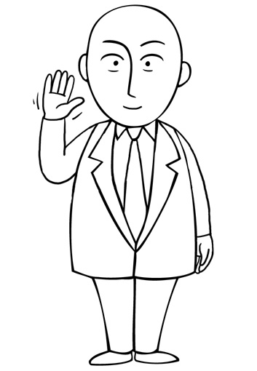
End of module
Thank you
for your attention!
Next is Module 3:
CD-JEV eligibility
Notes:
To the facilitator:
This is the end of the module.
You have been introduced to “CD-JEV vaccine attributes and storage conditions”.
The following module is titled “CD-JEV vaccine eligibility”.
Thank you for your attention!

