Slide 1
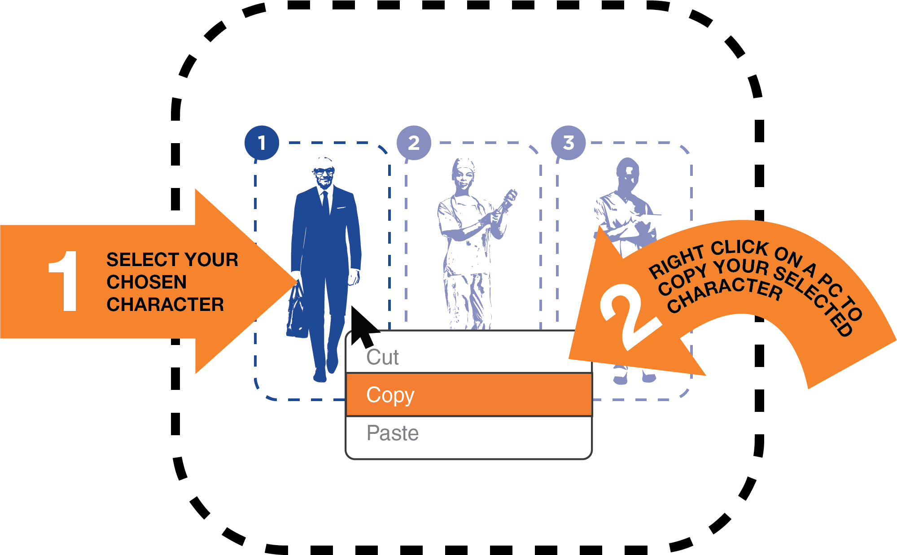

Step 1. Select a character from pages 3-4
COPYING THE CHARACTER
Right click on your selected character to copy or use this keyboard shortcut

Slide 2

Step 2. Paste your selection on top of the text on pages 6-9
SCALING THE CHARACTER
Don’t forget that you can ‘scale’ a character to give it a sense of perspective.

Slide 3

Step 3. Promote the Campaign
SHARE SOCIALLY
Choose FILE and then EXPORT to save your image as a picture and then share on all Social Media
Make sure to use the following #Hashtags
OR share it simply on
www.cleanhandssavelives.org/
#SupportNursesAndMidwives #HandHygiene #InfectionPrevention

