Slide 1
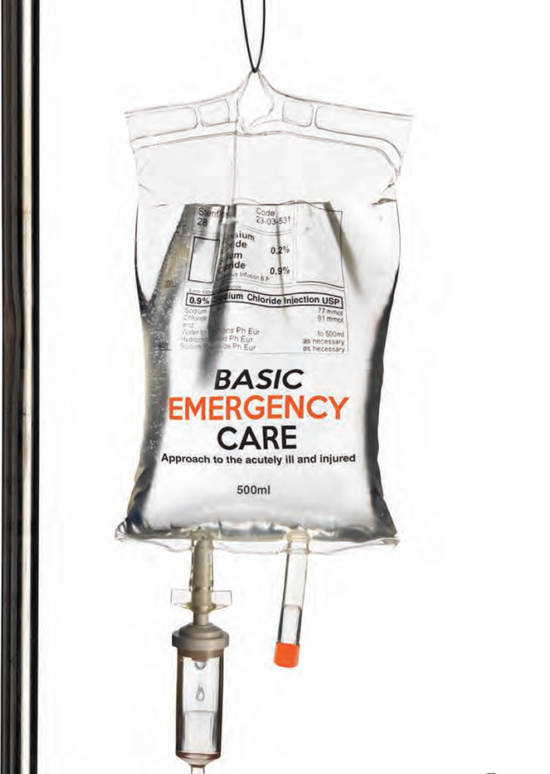
Basic Emergency Care
Approach to the acutely ill and injured
Conflict Related Injury module
Penetrating Injuries
Notes:
Welcome to the Basic Emergency Care Course – Portable Learning Laboratory.

Slide 2
Objectives
By the end of this presentation, you will be able to:
Describe the trauma primary survey approach for conflict-related injury
Identify signs and symptoms of acute life-threatening conditions
Identify critical CABCDE actions for penetrating injuries
Notes:
By the end of this presentation, you will be able to: describe the trauma primary survey approach for conflict trauma, identify signs and symptoms of acute life-threatening injuries and identify critical CABCDE actions for penetrating injuries.

Slide 3
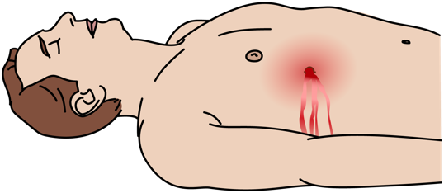
Penetrating Injuries in Conflict Settings
Penetrating injuries are common in conflict trauma.
Injuries can be caused by gunshot, missiles, fragments or shrapnel. The object/s can pass through the body or remain inside.
There may be single or multiple penetrating wounds.
The location of the wound/s does not accurately predict the path of the projectile.
Patients with penetrating injury may have sustained additional serious trauma (e.g., blast injury or burns).
A systematic CABCDE approach is required for all patients with any penetrating injuries!​
Notes:
Penetrating injuries are common in conflict trauma. These injuries can be caused by gunshot, missiles, fragments or shrapnel. The object or objects can pass through the body or remain inside. There may be single or multiple penetrating wounds. The location of the wound or wounds does not accurately predict the path of the projectile. Patients with penetrating injury may have sustained additional serious trauma, for example blast injury of burns. A systematic CABCDE approach is required for all patients with any penetrating injuries.

Slide 4




Life-Threatening Conditions
These life-threatening conditions may be caused by penetrating trauma!
CatastrophicBleeding | Obstruction: foreign body Obstruction: trauma Obstruction: neck haematoma | Tension pneumothorax Large haemothorax | Cardiac arrest Shock Major bleeding Pericardial Tamponade | Increased pressure on the brain (head injury) Seizures/ convulsions (head injury) Cervical spine injury
Notes:
These life-threatening conditions may be caused by penetrating trauma. Let’s look at each element of CABCDE. For C, there may be major bleeding. For A, there may be obstruction by a foreign body, traumatic injury or a neck haematoma. For B, there may be a tension pneumothorax or large haemothorax. For C there may be pulselessness, shock, major bleeding or pericardial tamponade. For D, there may be increased pressure on the brain or seizures / convulsions. Penetrating trauma can cause cervical spine injury. Remember there may be more than one life-threatening condition. These are some examples, and you can revise the assessment and management of these conditions in the core BEC course modules.

Slide 5
Trauma Primary Survey
REMEMBER …………
People who initially appear uninjured may have hidden life-threatening injuries such as internal bleeding.
It is very important to reassess trauma patients frequently using the primary survey (repeat often).
Vital signs should be checked at the end of the primary survey but do not delay interventions for vital signs.
!
Notes:
People who initially appear well may have hidden life-threatening injuries, such as internal bleeding.
It is very important to re-assess trauma patients frequently using the primary survey.
Once you find a primary survey problem and manage it, go back and repeat the primary survey to identify any new problems and make sure that the management worked. Ideally, the CABCDE approach should be rechecked every 15 minutes and with any change in condition.

Slide 6
Injury Patterns and Conditions
Notes:
Now we will look at penetrating injury patterns and common conditions.

Slide 7
High energy-transfer injury
High energy projectiles can cause injury through:
Direct effects of penetration on structures
Indirect effects of shockwaves transmitted to adjacent structures e.g., to liver, spleen, brain, muscles or vessels
Cavitation effects as the projectile passes through tissue
Higher mass, higher velocity projectiles usually have more kinetic energy which causes more tissue damage.
Signs of high energy-transfer injury include:
Swollen or tense limbs with poor perfusion distal to the wound
Signs of internal chest / abdomen / pelvic / head injury
Bullet fragmentation and bony fracture fragments seen on imaging (resuscitate patient before obtaining imaging)
Wounds with extensive underlying tissue damage must be explored surgically.
CONSULT a surgeon or arrange for rapid HANDOVER/TRANSFER.
Notes:
High energy-transfer projectiles can cause injury through the direct effects of penetration on structures, the indirect effects of shockwaves transmitted to adjacent structures for example to liver, spleen, brain, muscles or vessels, or cavitation effects as the projectile passes through tissue.
Higher mass, higher velocity projectiles usually have more kinetic energy which causes more tissue damage.
Signs of high energy-transfer injury include swollen or tense limbs with poor perfusion distal to the wound, signs of internal chest, abdomen, pelvic or head injury, and bullet fragmentation and bony fracture fragments seen on imaging. Resuscitate a patient before obtaining imaging.
Wounds with extensive underlying tissue damage must be explored surgically. Consult a surgeon or arrange for rapid handover / transfer.

Slide 8
Low energy-transfer injury
Low energy projectiles cause injury through:
Direct effects of penetration on structures e.g., open fracture
Lower mass, lower velocity projectiles e.g., knives or shotgun pellets, usually have less kinetic energy and so generally cause less tissue damage.
This depends on factors including the location of the wound and the type of penetrating object.
Check carefully for any signs of tissue damage away from the main path of the projectile.
Discuss management with a surgeon or arrange for HANDOVER/TRANSFER.
Notes:
Low energy projectiles cause injury through direct effects of penetration on structures e.g., open fracture.
Lower mass, lower velocity projectiles for example knives or shotgun pellets, usually have less kinetic energy and so generally cause less tissue damage. This depends on factors including the location of the wound and the type of penetrating object.
Check carefully for any signs of tissue damage away from the main path of the projectile.
Discuss management with a surgeon or arrange for handover / transfer.

Slide 9
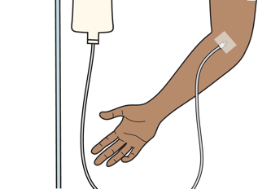
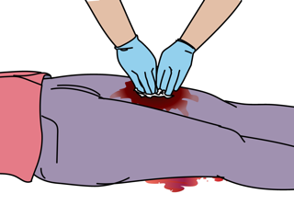
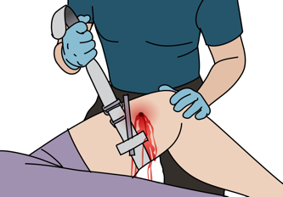
Catastrophic Haemorrhage (external)
Signs and symptoms | Management
Catastrophic*haemorrhage is blood that is spraying, pouring or pooling Signs of shock: Pale, sweating Delayed capillary refill, hypotension Altered mental status *massive or catastrophic | Apply DIRECT PRESSURE or DEEP WOUND PACKING to control active bleeding. If bleeding not controlled with direct pressure→ apply a tourniquet. If signs of shock → Give IV FLUIDS and arrange for blood transfusion Plan for rapid HANDOVER/TRANSFER to a surgeon.
Notes:
Open wounds, such as lacerations and abrasions, should be assessed for rapid or pulsating bleeding. Check for blood pooling under the patient around the axillae, genital area, buttocks or back. Pumping or squirting blood suggests arterial bleeding. Control external bleeding with direct pressure.
Signs of major, also known as massive or catastrophic haemorrhage, is blood that is spraying, pouring or pooling. Assess for signs and symptoms of shock. The patient may be pale, sweating, have delayed capillary refill, hypotension and altered mental status. For management, immediately apply direct pressure or deep wound packing to control active bleeding. If the bleeding from a limb and not controllable with direct pressure, apply a tourniquet noting the time of application. If signs of shock, gain IV access and give IV fluids. Plan for rapid handover/transfer to a surgeon, and for blood transfusion.

Slide 10
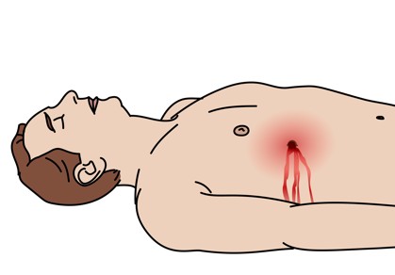
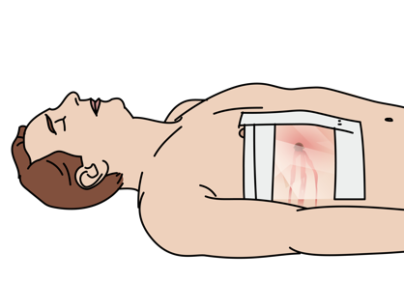
Sucking Chest Wound
Signs and Symptoms | Management
Open wound to chest wall with air passing through. Bubbling or sucking noises from chest Difficulty in breathing Chest pain | Give OXYGEN. Place a THREE-SIDED DRESSING. Observe continuously to prevent dressing occlusion (tension pneumothorax). Plan for rapid HANDOVER/TRANSFER for placement of a chest tube.
Notes:
Sucking chest wounds are an open wound to the chest wall with air passing though. You may notice bubbling or sucking noises. The patient will have difficulty breathing and chest pain. Give oxygen to the patient and place a three-sided dressing over the wound. Observe continuously to prevent occlusion of the dressing, which can lead to tension pneumothorax. Plan for rapid transfer for placement of a chest tube.

Slide 11
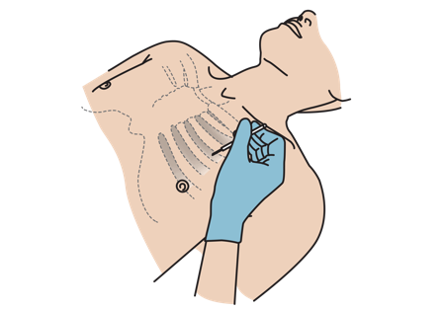
Tension Pneumothorax
Signs and Symptoms | Management
Hypotension with difficulty breathing and any of the following: Distended neck veins Absent breath sounds on affected side Hyperresonance with percussion on affected side May have tracheal shift away from affected side | Perform NEEDLE DECOMPRESSION Give OXYGEN and IV FLUIDS. Plan for HANDOVER/TRANSFER. Arrange for urgent chest tube.
Any pneumothorax can become a tension pneumothorax!
Notes:
Tension pneumothorax is a life-threatening condition. Air in the space between the lungs and the chest wall can expand to collapse the lung, and place tension on the contents of the chest. Any pneumothorax can become a tension pneumothorax so remember to re-evaluate all patients with suspected pneumothorax regularly. Signs and symptoms are hypotension with difficulty breathing and any of the following: distended neck veins, absent breath sounds on affected side, hyper-resonance with percussion on affected side. Patients may have tracheal shift away from the affected side, although this is a late sign. Initial management includes performing needle decompression and giving oxygen and IV fluids. Patients should be transferred to a centre that can perform definitive chest thoracostomy (placement of a chest tube).

Slide 12
Major Haemorrhage (internal)
Signs and symptoms | Management
Wounds to chest, abdomen, back, pelvis Tachypnoea, decreased air entry, dull to percussion (haemothorax) Pain Signs of shock e.g., pale, sweating, delayed cap. refill, tachycardia, hypotension, altered mental status. | Apply DIRECT PRESSURE or DEEP WOUND PACKING to control active bleeding from wounds. If haemothorax → Give OXYGEN and refer for chest tube. If signs of shock → Give IV FLUIDS and arrange for blood transfusion. Plan for rapid HANDOVER/ TRANSFER to a surgeon.
REMEMBER! Always check the front and back of the patient, and look for multiple wounds
Notes:
There may be major internal bleeding in the chest (large haemothorax), abdomen, pelvis, back or long bones. Check for wounds to the chest, abdomen, back and pelvis. Tachypnoea, decreased air entry, and dullness to percussion can indicate large haemothorax. Examine the abdomen, pelvis, back and limbs. Look for signs of shock, e.g. pale, sweating, delayed capillary refill, tachycardia, hypotension, altered mental status.
Apply direct pressure or deep wound packing to control active bleeding from wounds. If haemothorax, give oxygen and refer for chest drain. If signs of shock, gain IV access and give IV fluids. Plan for rapid handover/transfusion to a surgeon and initiate process for blood transfusion.

Slide 13
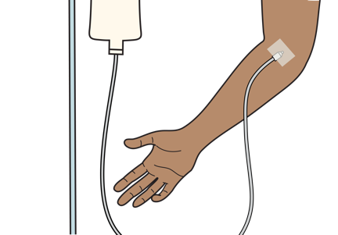
Pericardial Tamponade
Signs and Symptoms | Management
Wound to the chest, back or abdomen Signs of poor perfusion Tachycardia, tachypnoea, hypotension, pale skin, cold extremities, capillary refill >3 seconds Distended neck veins Muffled heart sounds Dizziness, confusion, altered mental status | Give IV FLUIDS to improve heart filling. Plan for rapid HANDOVER/TRANSFER to provider capable of draining the fluid.
Pericardial tamponade occurs when fluid builds up in the sac around the heart.​
This can collapse the chambers and prevent the heart from filling. ​
Notes:
Pericardial tamponade occurs when fluid builds up in the sac around the heart. The amount of fluid and the associated pressure can collapse the chambers of the heart, preventing the heart from filling. This leads to signs of poor perfusion or shock. Associated symptoms include tachycardia, tachypnoea, hypotension, pale skin, cold extremities, and capillary refill time greater than three seconds. Additional signs include distended neck veins caused by the back pressure exerted on the heart and veins, muffled heart sounds from the fluid decreasing the ability of sound to resonate, as well as dizziness, confusion and altered mental status. Check for wounds to the chest, back and abdomen. The initial management includes intravenous fluids to improve heart filling and rapid handover and transfer to a centre capable of draining the fluid via a procure called a pericardiocentesis.

Slide 14
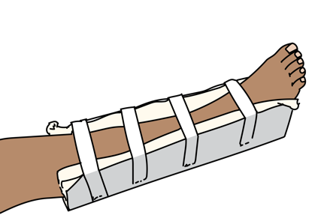
Threatened limb with fracture
Signs and symptoms | Management
Deformity or crepitus of the bone Absent pulses beyond the fracture Capillary refill time of greater than 3 seconds beyond fracture Cold extremities with blue or gray coloration of skin beyond the fracture | If weak pulses or poor perfusion →consider vascular injury and REDUCE the fracture immediately and apply a splint. Always check pulses, capillary refill and sensation before and after any reduction Give PAIN RELIEF. Plan for rapid HANDOVER/TRANSFER to a surgeon.
Consider compartment syndrome. Danger signs include severe pain, tight skin, loss of sensation and loss of pulses. Refer urgently!
Notes:
Threatened limb with fracture is a limb-threatening condition. Signs and symptoms include deformity or crepitus of the bone, absent pulses beyond the fracture, capillary refill time of greater than three seconds beyond the fracture, and cold extremities with blue or grey discolouration of the skin beyond the fracture. There be altered sensation in the limb. If there are weak or absent pulses, or signs of poor perfusion, consider vascular injury and reduce the fracture immediately and apply a splint. Always check pulses, capillary refill and sensation before and after any reduction. Give pain relief. Plan for rapid handover/transfer to a surgeon. Remember to consider compartment syndrome. Danger signs included severe pain, tight skin, loss of sensation and loss of pulses as a late sign. Refer urgently.

Slide 15
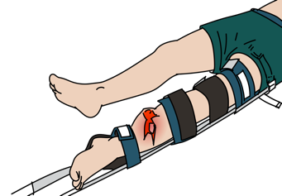
Simple and open fractures
Injury | Management
Simple fracture | SPLINT for comfort and consider straightening (reduction). Give PAIN RELIEF.
Open fracture | Control bleeding with DIRECT PRESSURE. Wound should be IRRIGATED with saline or clean water. SPLINT for comfort and consider straightening. Perform immediate REDUCTION and SPLINTING if poor perfusion. Give ANTIBIOTICS and TETANUS VACCINATION early. Give PAIN RELIEF. Plan for HANDOVER / TRANSFER to a surgeon.
Consider any patient to have an open fracture if there is a wound
(more than just a skin abrasion) near a fracture site.
Notes:
If there is a simple fracture, splint for comfort and consider straightening. Give pain relief.
Consider any patient to have an open fracture if there is a wound, more than just a skin abrasion, near a fracture site.
If there is an open fracture, control any external bleeding with direct pressure. The wound should be irrigated with saline or clean water. Splint for comfort and consider straightening.
If there is poor perfusion to the limb, perform immediate reduction and splinting.
Give antibiotics and update tetanus vaccination early. Give pain relief and plan for handover / transfer to a surgeon. If available, obtain x-rays of the affected body regions including the joint above and below the affected side.

Slide 16
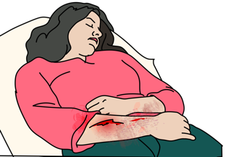
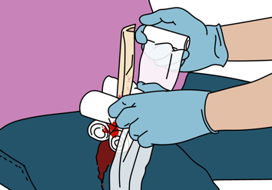
Wounds
Signs and symptoms | Management
Wounds | CLEAN wounds with saline or clean water. DRESS wounds with sterile gauze. CHECK perfusion beyond the wound before and after dressing. SPLINT extremity wounds. Stabilize but do NOT remove penetrating objects. COVER abdominal evisceration wounds with sterile, saline soaked gauze Give TETANUS vaccination if needed. Give ANTIBIOTICS per local protocol for open fractures, penetrating abdominal and chest injuries.
REMEMBER! Check for reduced perfusion distal to the wound, and look for any decrease in strength or sensation.
Notes:
To manage wounds: clean with saline or with clean water. Dress with sterile gauze. Always remember to check perfusion beyond the wound before and after any dressing. Splint extremity wounds. Stabilise but do not remove any penetrating objects which are still in the wound, as shown in the picture. Give tetanus vaccination if needed. Give antibiotics as per local protocol for open fractures, penetrating abdominal and chest injuries. Remember to always check for perfusion distal to the wound and look for any decrease in strength or sensation.

Slide 17
Disposition Considerations
Trauma patients can have complex injuries and get worse or die very quickly.
High-risk conditions always require HANDOVER/TRANSFER to a specialist unit for ongoing care.
Remember that if a patient required OXYGEN arrange to continue it during transport and handover.
Ensure bleeding is controlled and arrange for early blood transfusion.
If an injured person is displaying signs of shock, ensure treatment with IV FLUIDS or blood is continued on transfer.
Communicate injuries, important medical problems and what has been done for the patient during handover/transfer.
Notes:
Trauma patients can have complex injuries and get worse or die very quickly. High-risk conditions always require handover / transfer to a specialist unit for ongoing care.
Remember that if a patient required oxygen, arrange to continue it during transport and handover. Ensure bleeding is controlled. If an injured person is displaying signs of shock, ensure treatment with IV fluids is continued on transfer. Communicate injuries, important medical problems and what has been done for the patient during handover/transfer.

Slide 18
REMEMBER
The goal of initial assessment is to manage CABCDE and identify life-threatening conditions.
The goal of acute management is to prevent secondary injury from poor oxygenation and decreased perfusion, control pain and plan ongoing care.
Notes:
Remember the goal of initial assessment is to manage CABCDE and identify life-threatening conditions. The goal of acute management is to prevent secondary injury from poor oxygenation and decreased perfusion, control pain and plan ongoing care.

Slide 19
Summary
In this presentation, we have covered:
The trauma primary survey approach for conflict-related injury
The signs and symptoms of acute life-threatening conditions caused by penetrating trauma
Critical CABCDE actions for acute life-threatening conditions caused by penetrating trauma
Notes:
In this presentation we have covered the trauma primary survey for conflict trauma, the signs and symptoms of acute life-threatening conditions caused by penetrating trauma and critical CABCDE actions for acute life-threatening conditions caused by penetrating trauma. This is the end of the Penetrating Injuries module.

