Slide 1
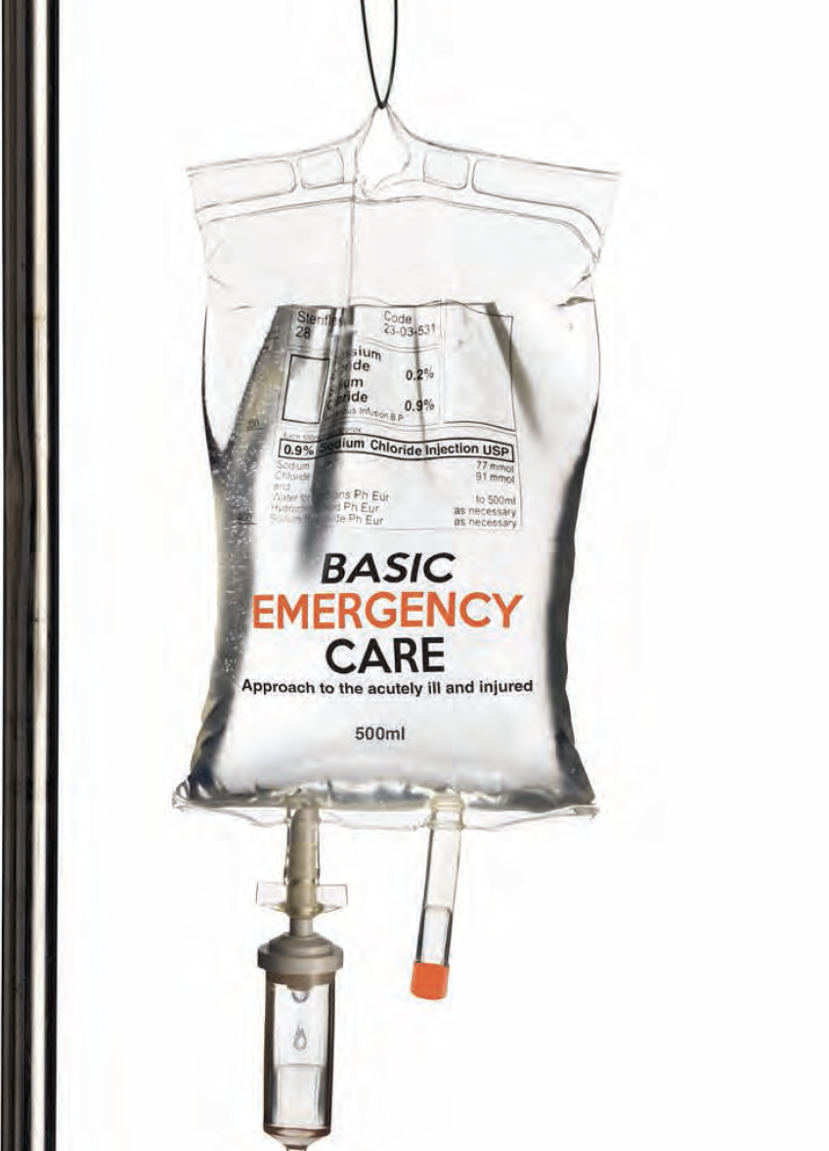
Basic Emergency Care
Approach to the acutely ill and injured
Conflict Related Injury module
Primary Survey
Notes:
Welcome to the Basic Emergency Care Course – Portable Learning Laboratory.

Slide 2
Objectives
By the end of this presentation, you will be able to:
Describe the trauma primary survey approach for conflict-related injury
Identify signs and symptoms of acute life and limb-threatening conditions
Identify critical CABCDE actions for conflict-related injury
Notes:
By the end of this presentation, you will be able to: describe the trauma primary survey approach for conflict-related injury, identify signs and symptoms of acute life and limb-threatening conditions and identify critical CABCDE actions for conflict-related injury.

Slide 3
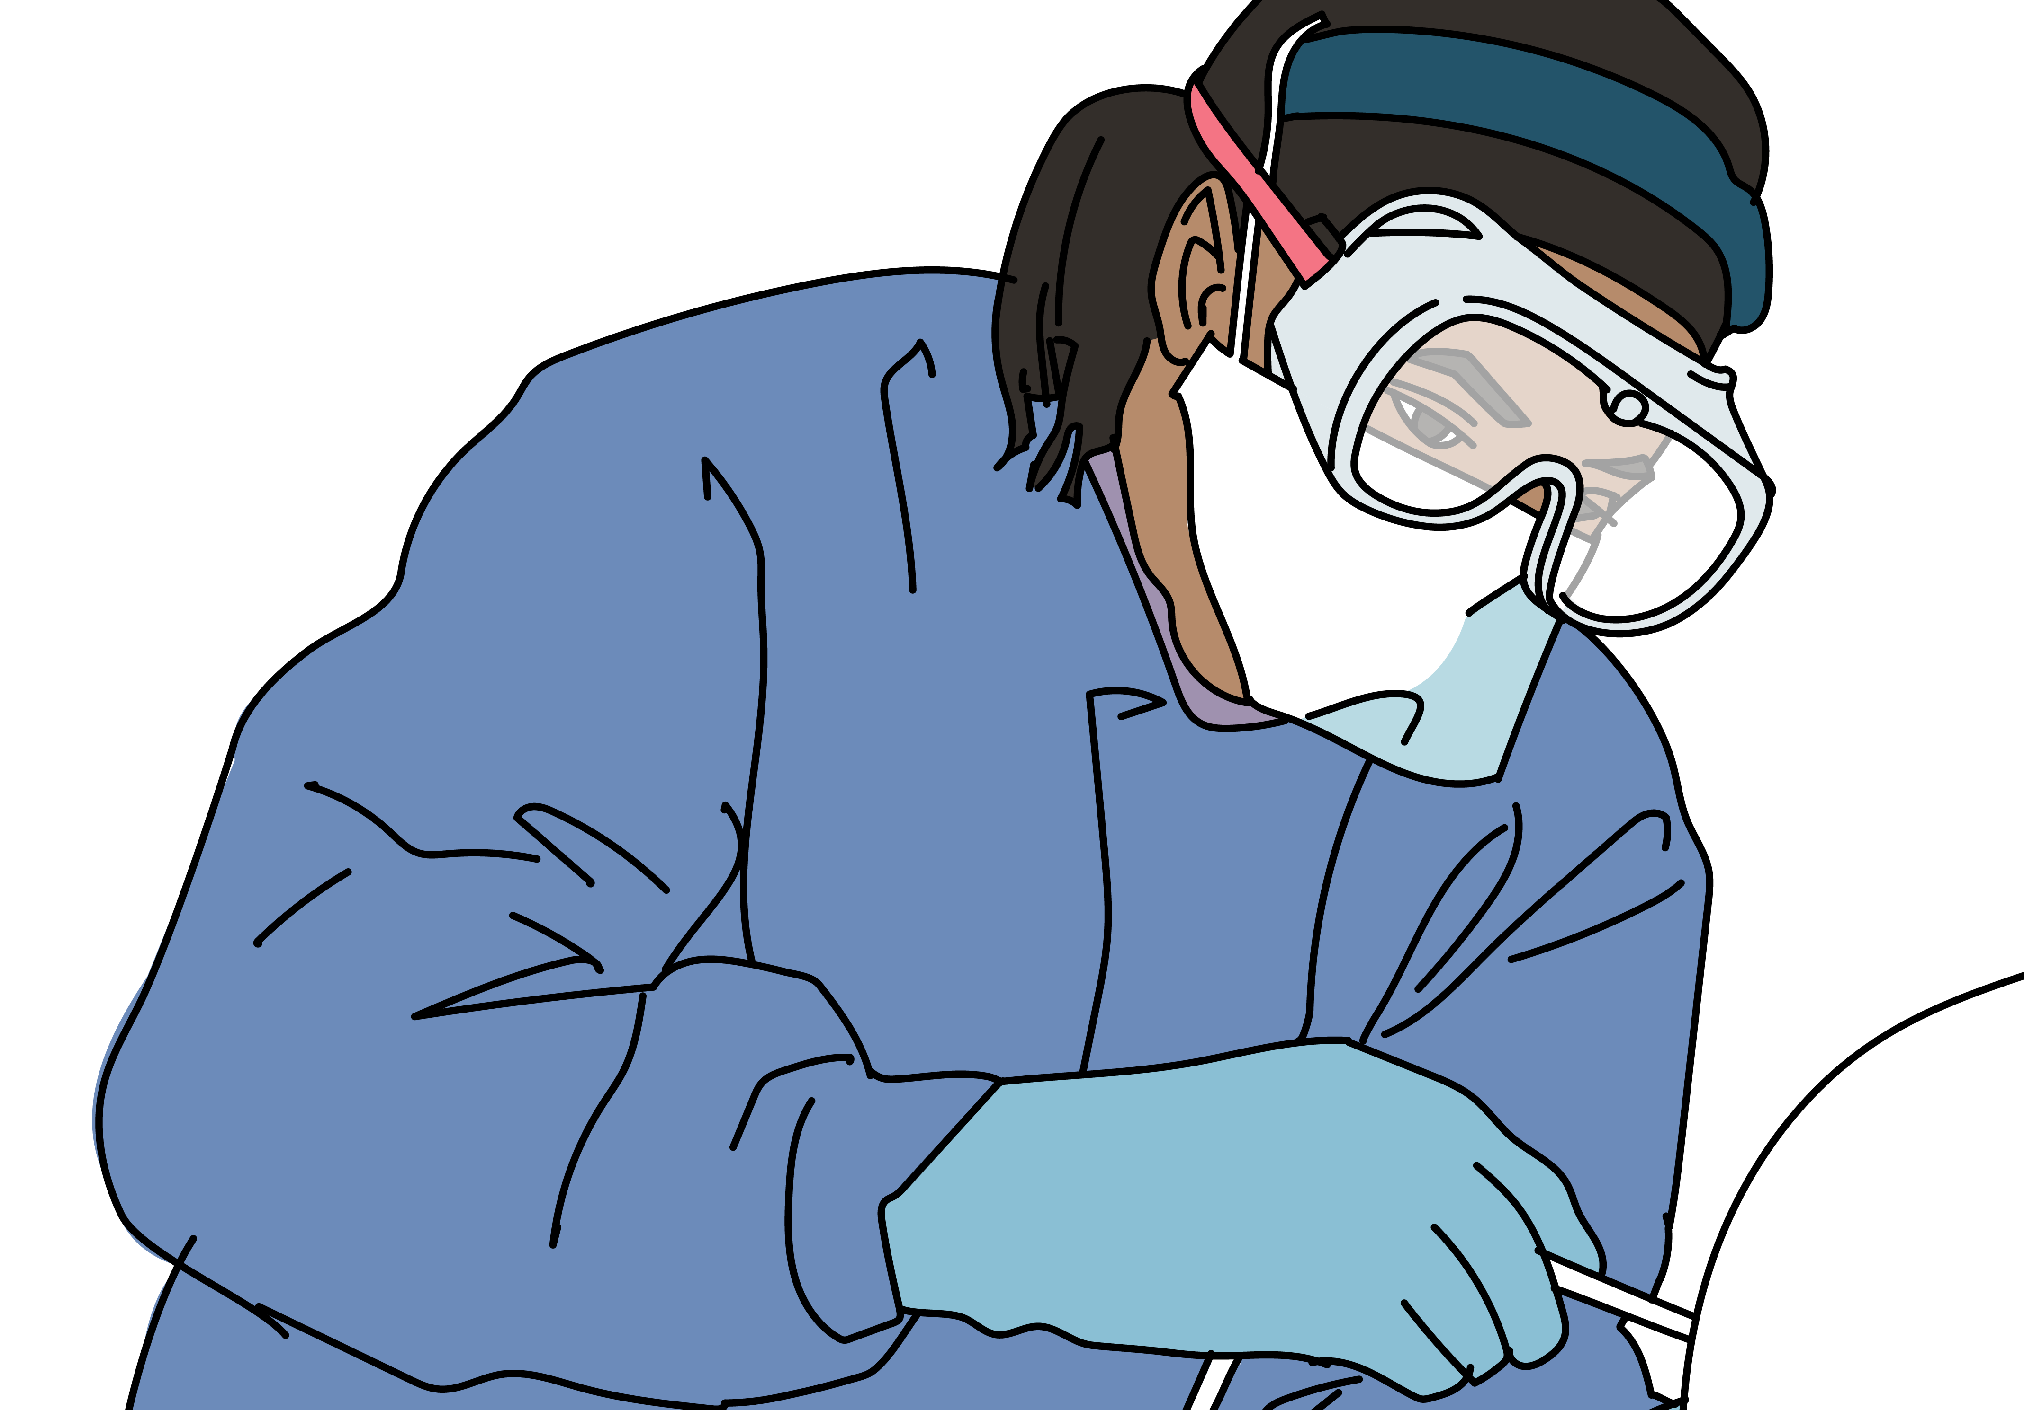
Safety considerations
Although this can be challenging in conflict settings, the most important step is to stay safe. Before approaching the patient, consider scene safety including conflict specific hazards such as chemical, toxin or radiologic (follow local decontamination protocols). Consider violence and infectious disease risk.
Call for help early especially if receiving multiple patients.
Personal protective equipment
Cleaning and decontamination
Consider appropriate PPE for situation
  Hand washing
  Gloves
  Gown
  Mask
  Goggles
  Use PPE and wash your hands before and after every patient contact (or alcohol gel cleanser).
  Clean/disinfect surfaces
  Refer to local decontamination protocols for chemical exposures and know who to call for advice.
Notes:
Although this can be challenging in conflict situations, the most important step is to stay safe. Before approaching the patient, consider scene safety including conflict specific hazards, violence and infectious disease risk. Call for help early, especially if receiving multiple patients. To protect yourself from infectious risks, put on appropriate personal protective equipment before assessing the patient. Consider the appropriate personal protective equipment for each situation. This could include gloves, eye protection, a gown and mask. Cleaning and decontamination are important. Use PPE and wash your hands before and after every patient contact or use alcohol gel cleanser. Clean or disinfect surfaces. Refer to local decontamination protocols for chemical exposures and know who to contact for advice.

Slide 4
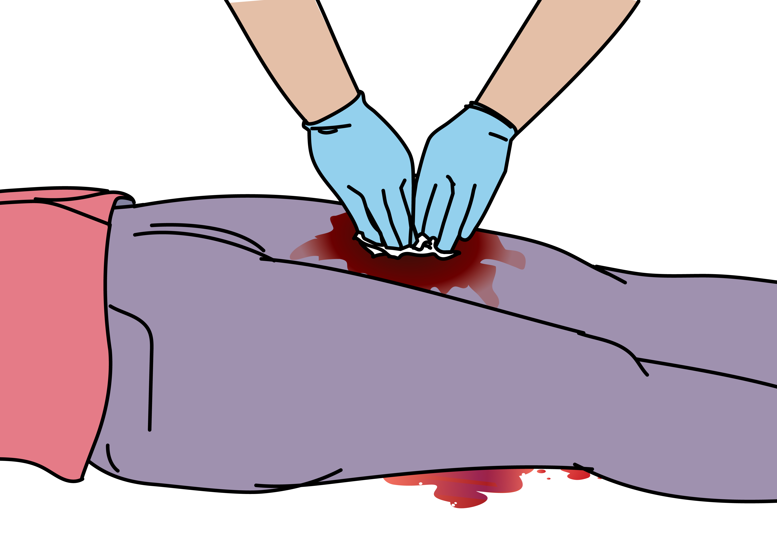

Trauma Primary Survey
The Primary Survey for conflict trauma follows similar steps as ALL trauma! ​
For conflict trauma, a ‘C’ is added in front of the ABCDE framework to ensure checking for catastrophic external bleeding
If life-threatening problems are identified,
stop and manage them first!
 | Assessment | Management of Critical Conditions
Catastrophic Bleeding | Is there any sign of catastrophic external bleeding? (blood spraying, pouring or pooling) *major or massive bleeding | Apply DIRECT PRESSURE or DEEP WOUND PACKING to control active bleeding. Apply TOURNIQUET to amputated limbs or uncontrolled bleeding from limbs.
Notes:
The first phase is the trauma primary survey which should be done in ALL trauma patients immediately upon the patient’s arrival. The Primary Survey for conflict trauma follows similar steps as for all trauma patients. A ‘C’ is added in front of the ABCDE framework to ensure checking for major external bleeding (catastrophic bleeding). If life-threatening problems are identified, stop and manage them first before moving on.
First, look for any sign of catastrophic or massive bleeding; blood that is spraying, pouring or pooling. Apply direct pressure to control active bleeding. If the wound is deep, perform deep wound packing and apply direct pressure. Apply a tourniquet to amputated limbs or uncontrolled bleeding from limbs.

Slide 5

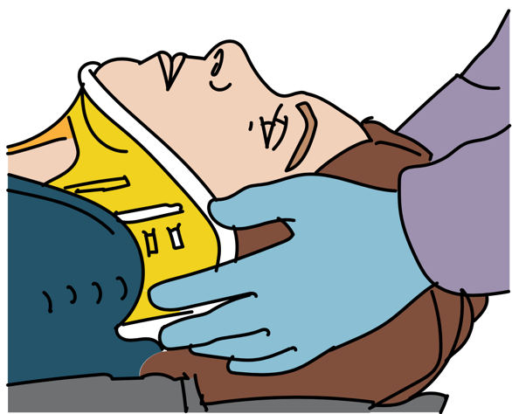
Trauma Primary Survey
 | Assessment | Management of Critical Conditions
Airway | Can the patient talk? Any neck swelling or injuries? Any gurgling, snoring, stridor or noisy breathing? Is there risk of cervical spine injury? | Stabilize cervical spine. Open airway using JAW THRUST. SUCTION airway secretions. Place ORAL/NASAL AIRWAY if necessary (avoid NASAL AIRWAY in facial trauma).
Notes:
The next element of the trauma ABCDE primary survey is the airway assessment. The first step is to assess if the patient can talk. Speak to your patient and see if they can talk to you. Look for any neck swelling or injury. Look for an expanding neck hematoma, or significant swelling of the neck tissues. Look for any vomit, blood or saliva in the mouth or nose, burned nasal hairs or soot around the nose or the mouth, and signs of head, or neck trauma. Listen for any gurgling, snoring, stridor or noisy breathing. Think, is there any risk of cervical spine injury?
Management follows any abnormal assessment finding. Stabilize the cervical spine using available local materials. If needed, open the airway, using the jaw thrust. Remember the head tilt chin lift should not be used in trauma patients, as this can cause further injury to the cervical spine Suction any airway secretions and remove any visible foreign objects. If necessary, place an oral or a nasal airway. Remember, if the patient has significant facial trauma, you should not use a nasal airway. Plan for rapid handover/transfer if significant airway problems.

Slide 6

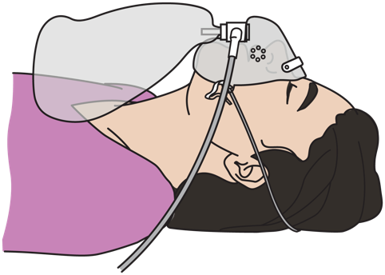
Trauma Primary Survey
 | Assessment | Management of Critical Conditions
Breathing | Any increased work of breathing? Any sucking chest wounds or bruising? Any abnormal breath sounds? Is the trachea midline? Any crepitus with palpation? Any circumferential deep torso burns? | Give OXYGEN. If tension pneumothorax → perform NEEDLE DECOMPRESSION, give OXYGEN, IV FLUIDS and arrange for emergency chest tube. If sucking chest wound → apply THREE-SIDED DRESSING. If breathing is not adequate→ assist with BAG-VALVE-MASK VENTILATION. If circumferential deep torso burns → emergency HANDOVER /TRANSFER to surgeon
Notes:
As part of the initial breathing assessment, look, listen and feel. Look for increased work of breathing and abnormal chest wall movement. Look for sucking chest wounds, cyanosis, bruising or other signs of injury to the chest. Next, listen for abnormal breath sounds, for example, absent or decreased breath sounds. Check if the trachea is midline. Feel for crepitus, which is a cracking or popping sensation under the skin caused by air in the skin. Listen for dull sounds or hyperresonance with percussion of the lung fields. Look for any circumferential deep torso burns.
The first step in breathing management is to give oxygen. If you identify signs of a tension pneumothorax, perform a needle decompression, give oxygen, give IV fluids and arrange for emergency handover / transfer for a chest tube.
If you identify any penetrating and sucking chest wounds, cover the wound with a 3-sided dressing. If during your breathing assessment you find the breathing is inadequate, or the patient remains hypoxic, assist their breathing with bag –valve- mask ventilation. If there are circumferential deep torso burns, arrange emergency handover / transfer to a surgeon.

Slide 7
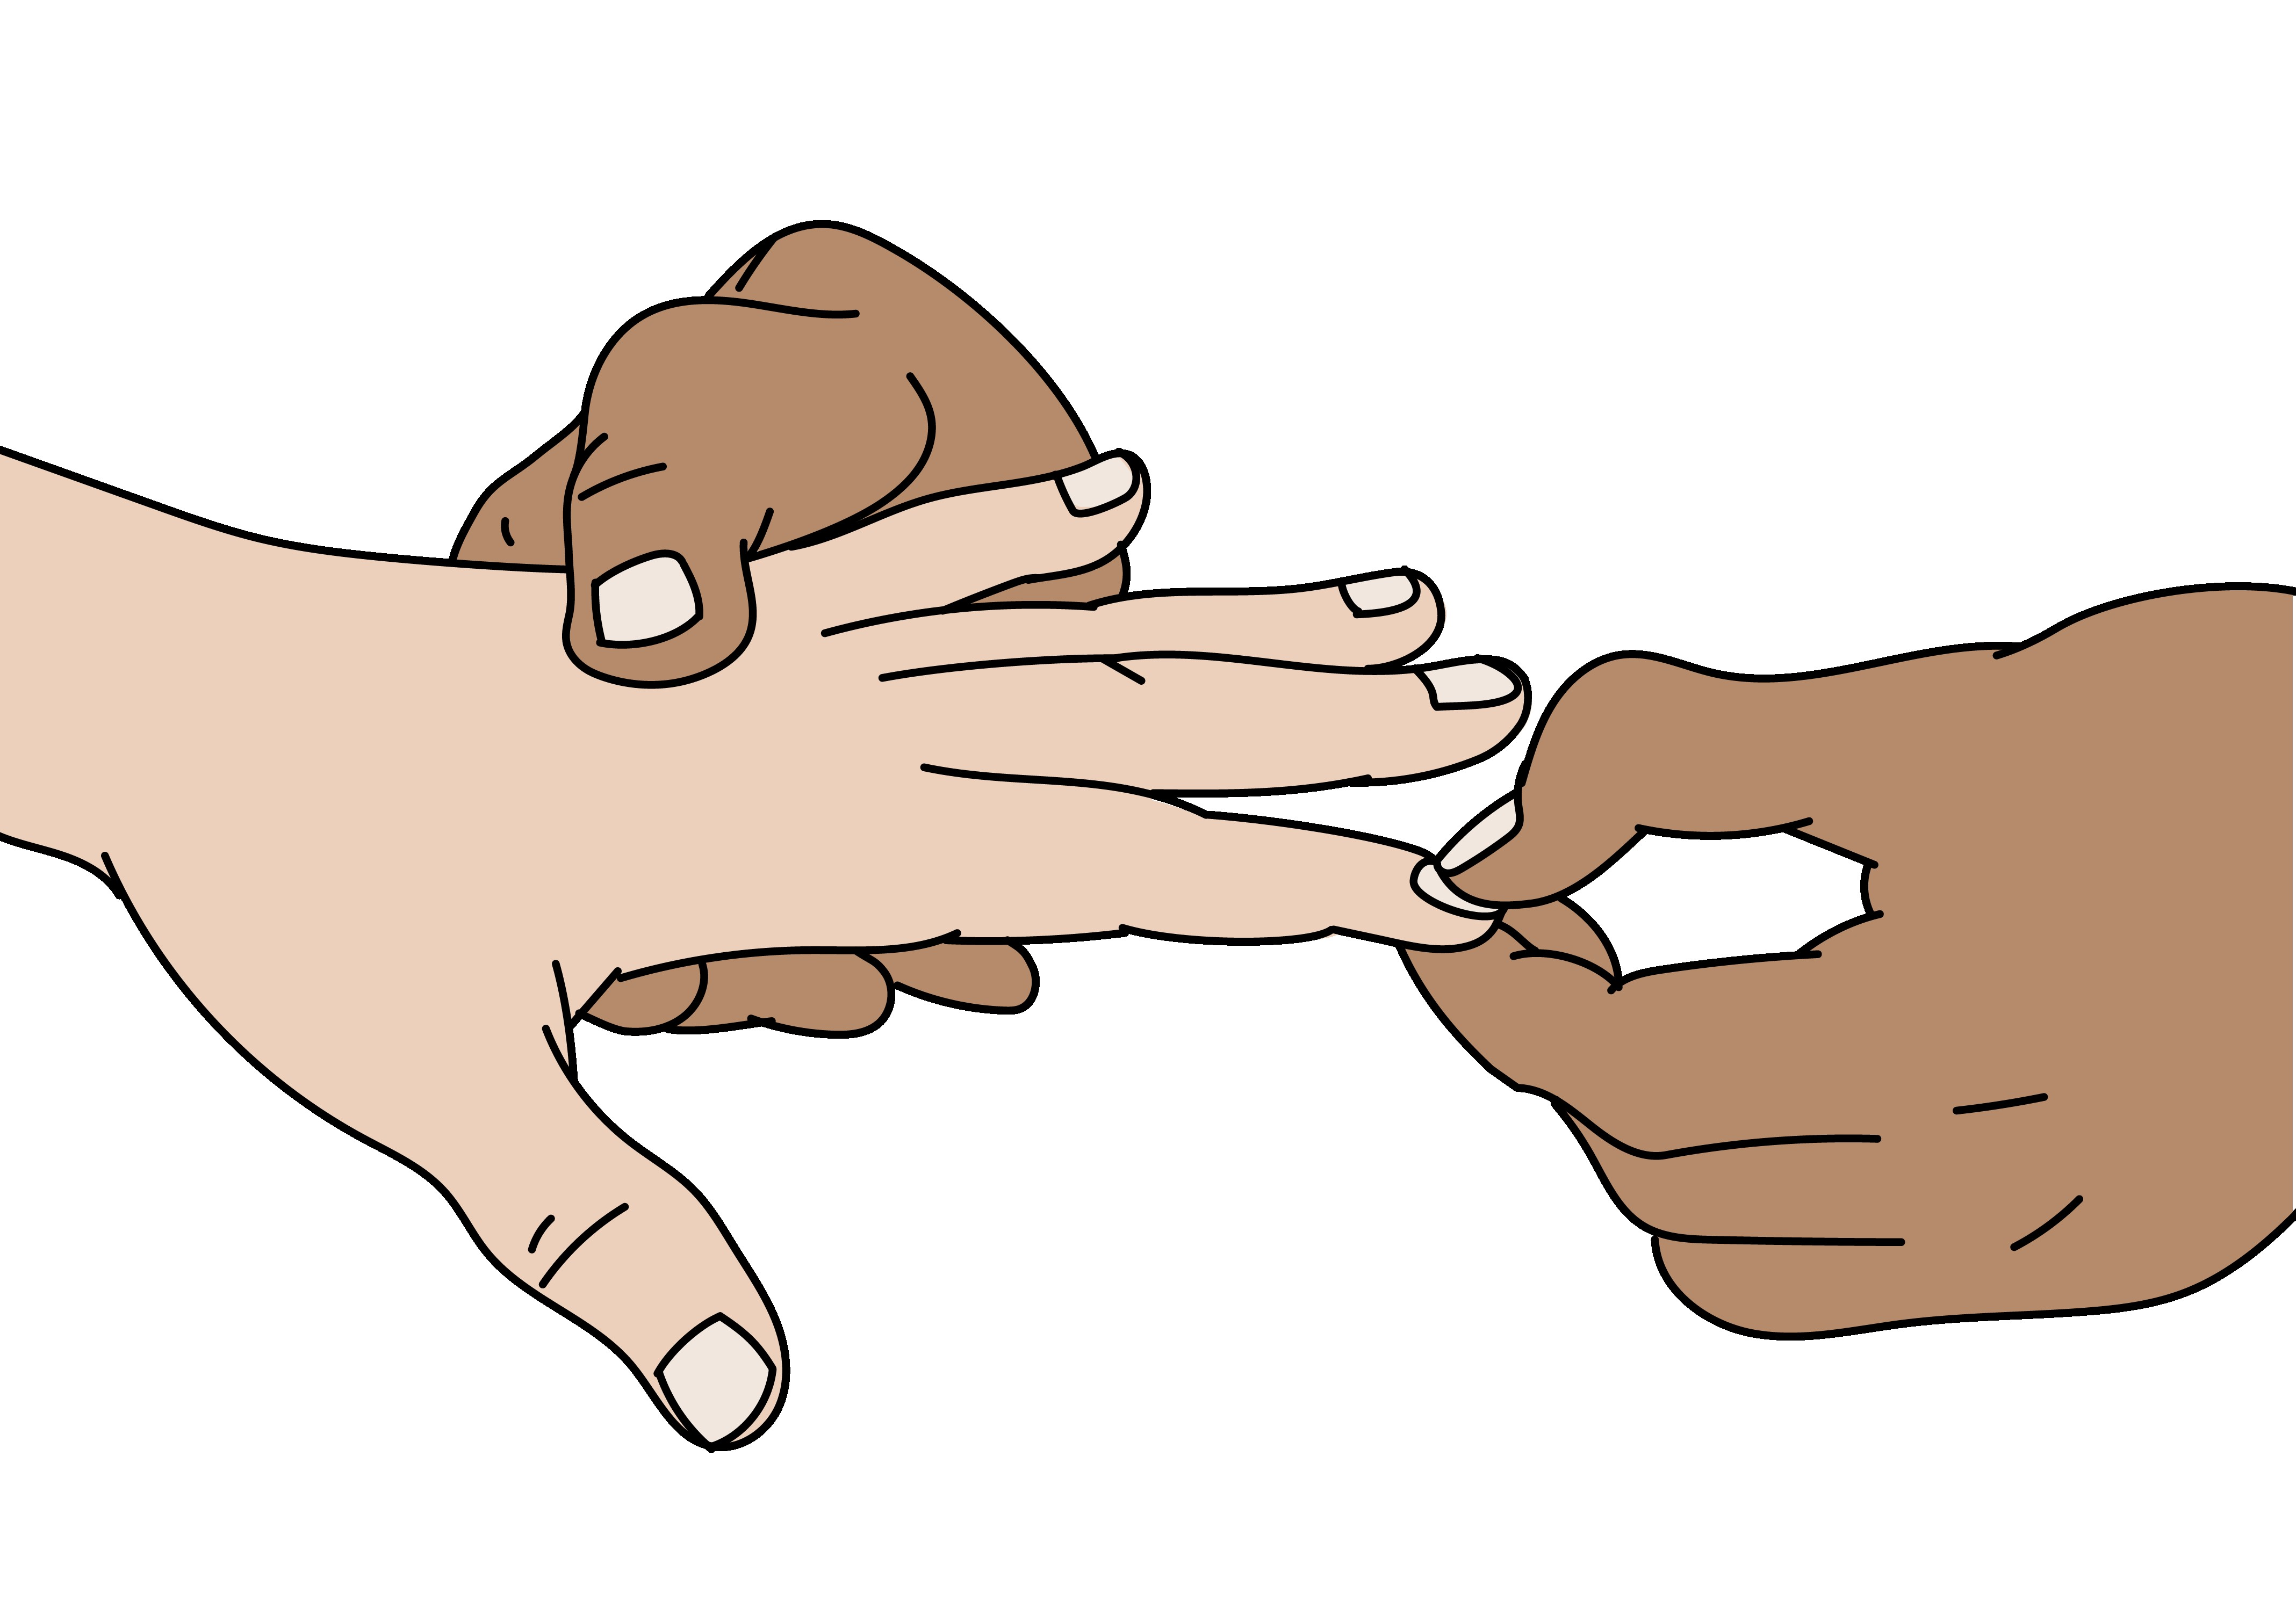
Trauma Primary Survey
 | Assessment | Management of Critical Conditions
Circulation | Is there any external bleeding? Is the pulse fast or weak? Is the patient pale?Is the skin cold? Is the capillary refill > 3 sec.? Are the neck veins distended? Any signs of internal bleeding? Any circumferential deep limb burns? | Apply DIRECT PRESSURE or DEEP WOUND PACKING to control active bleeding. Apply TOURNIQUET to amputated limbs or uncontrolled bleeding. If poor perfusion → insert 2 large bore IV cannula and give IV FLUID. Initiate process for blood transfusion. SPLINT suspected femur fracture. BIND suspected pelvic fracture. If circumferential deep limb burns →emergency HANDOVER/TRANSFER to surgeon
Notes:
For the circulation assessment, look, listen, and feel. Look again for external bleeding. Feel for a fast or weak pulse and check for a capillary refill time greater than 3 seconds. Check if the patient is pale, if the skin is cool and if neck veins are distended. Check for signs of internal bleeding.
Common sites of internal bleeding include the chest, abdomen, pelvis and long bones. Also look for any circumferential deep limb burns.
If you find any abnormal circulation assessments, be sure to manage the problem immediately. Apply direct, firm pressure to any active bleeding. If you are unable to control bleeding with direct pressure and the wound is deep, perform deep wound packing. Apply a tourniquet to amputated limbs or if uncontrolled bleeding from a limb.
If the patient has signs of poor perfusion or shock, or has ongoing blood loss, start 2 large IVs and give intravenous fluid. Initiate process for blood transfusion.
If there is a suspected femur fracture, apply a splint to reduce internal bleeding from the fracture. If you suspect a pelvic fracture, apply a pelvic binder. If there are circumferential deep limb burns, arrange emergency handover / transfer to a surgeon.

Slide 8

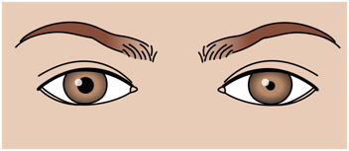
Trauma Primary Survey
 | Assessment | Management of Critical Conditions
Disability | Is the patient confused or agitated? What is the GCS or AVPU? Are the pupils equal? Can the patient feel and move all extremities? | If patient is lethargic or unconscious → RE-ASSESS airway frequently THINK of closed head injury with altered mental status. Give OXYGEN. If low blood glucose or unable to check→ give GLUCOSE
REMEMBER! Confused or unresponsive patients may have a severe head injury or have deafness from the blast.
Notes:
For disability, assess if the patient confused or agitated. Check the level of consciousness with the GCS or AVPU scale. Check if the pupils are equal and reactive, and if the patient can feel and move all extremities.
To manage critical disability conditions: if the patient is lethargic or unconscious, re-assess their airway frequently and provide airway management as required. If there is altered mental status, think about a closed head injury. Give oxygen. Do not forget to check the glucose and if there is low blood glucose or you are unable to check, give glucose.

Slide 9

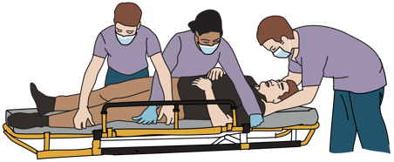
Trauma Primary Survey
 | Assessment | Management of Critical Conditions
Exposure | Remove all clothing. Examine entire body for injury, including back, groin and underarms. Use the log-roll manoeuvre to assess the back and spine (if necessary to identify penetrating wounds, may perform in B or C). | Remove restrictive clothing and all jewellery. Remove any wet clothes and dry patient thoroughly. Cover the patient as soon as possible to prevent hypothermia.
Notes:
For exposure, remove all clothing and examine the entire body for injury including the back, groin and underarms. This is very important as there may be hidden injuries or multiple injuries. Use the log-roll manoeuvre to access the back and spine. If necessary to identify penetrating wounds causing life-threatening conditions, the log-roll may be performed in B or C.
To manage critical exposure conditions: remove restrictive clothing and all jewellery. Remove any wet clothes and dry the patient thoroughly. Cover the patient as soon as possible to prevent hypothermia.

Slide 10
Trauma Primary Survey
REMEMBER …………
People who initially appear uninjured may have hidden life-threatening injuries such as internal bleeding.
It is very important to reassess trauma patients frequently using the primary survey (repeat often).
Vital signs should be checked at the end of the primary survey but do not delay interventions for vital signs.
!
Notes:
Remember, people who initially appear uninjured may have hidden, life-threatening problems such as internal bleeding. It is very important to reassess trauma patients frequently using the primary survey. Vital signs should be checked at the end of the primary survey, if not already done, but do not delay interventions for vital signs. If you find a problem with any of the CABCDE elements, you must stop, correct the problem and then go back to the beginning and reassess CABCDE again.

Slide 11
The SAMPLE history
S | Signs and symptoms | Patient/family’s report of signs and symptoms is an essential part of assessment.
A | Allergies | Important to prevent harm
M | Medications | Obtain a full list and note recent medication or dose changes.
P | Past medical history | May help in understanding current illness and change management choices.
L | Last oral intake | Note whether solid or liquid; vomiting/choking risk for sedation, intubation or surgical procedures.
E | Events surrounding the injury/illness | Helpful clues to the cause, progression and severity of current illness. REMEMBER there may be other mechanisms of injury (e.g., penetrating trauma, burns).
Notes:
The CABCDE should be followed by a rapid history taking using the SAMPLE approach. The SAMPLE approach is a standard way of gathering the key history related to an illness or injury. Sources of information include: the ill/injured person, family members, friends, bystanders, or prior providers.
S is for signs and symptoms, as reported by the patient or others. This is essential to assessment and management. A is for allergies. It is important to be aware of medication allergies so that treatments do not cause harm. Allergies may also suggest anaphylaxis as the cause of acute symptoms. M is for Medications. Obtain a full list of medications that the person currently takes and ask about recent medication or dose changes. These may affect treatment decisions and are important to understanding the person’s chronic conditions. P is for Past medical history. Knowing prior medical conditions may help in understanding the current illness and may change management choices. Also ask about pregnancy. L is for last oral intake. Record the time of last oral intake and whether solid or liquid. A full stomach increases the risk of vomiting and subsequent choking, especially with sedation or intubation that might be required for surgical procedures. E is for the events surrounding the injury or illness.
Using the standard SAMPLE approach allows healthcare providers to collect key information quickly and to easily communicate about acutely ill or injured patients.

Slide 12
Trauma Secondary Survey
Look, listen and feel
Remember you should have ALREADY completed the CABCDE Exam and treated life-threatening conditions BEFORE doing this extensive examination.
Perform a detailed head-to-toe examination of the patient.
Remember that very painful or frightening injuries may distract from others.
!
    Always check the entire body for wounds.
      Consider injury to air-filled organs (lung, stomach and bowel) if the patient has been exposed to blast.
Notes:
The secondary survey is a detailed head-to-toe examination designed to identify any additional injuries or issues requiring intervention. Remember you should have ALREADY completed the CABCDE Exam and treated life-threatening conditions BEFORE doing this extensive examination.
The secondary survey gives the provider an organized way to assess the entire body for signs of trauma that may not have been obvious on the primary survey or immediately life-threatening. Remember that very painful or frightening injuries may distract both patients and providers from recognizing other injuries. Always examine the entire body. Consider injury to air-filled organs if the patient has been exposed to blast. Don’t forget to consider if the patient could have experienced sexual violence. If the secondary survey identifies a CABCDE condition, stop and return immediately to the primary survey to manage it.

Slide 13
Special considerations
Children, Pregnancy and Older Adults
The CABCDE exam follows the same sequence for special population groups. Consider any:
Anatomical differences
Physiological differences e.g., vital signs
Specific vulnerability to injury
Remember:
Children may have significant internal injuries even if no/minimal external sign of injury.
Resuscitation of the pregnant woman gives the best chance of survival for the woman and the foetus.
Older adults have less physiological reserve and may decompensate faster from traumatic injuries.
!
Notes:
The CABCDE exam follows the same sequence for special population groups such as children, pregnancy and older adults. Consider any: anatomical difference, physiological differences e.g., in vital signs, and specific vulnerability to injury.​
Remember that children may have significant internal injuries even if there is no or minimal external sign of injury. Resuscitation of the pregnant woman gives the best chance of survival for the woman and the foetus. ​
Older adults have less physiological reserve and may decompensate faster from traumatic injuries. ​

Slide 14
Disposition Considerations
Trauma patients can have complex injuries and get worse or die very quickly.
High-risk conditions always require HANDOVER/TRANSFER to a specialist unit for ongoing care.
Remember that if a patient required OXYGEN arrange to continue it during transport and handover.
Ensure bleeding is controlled and arrange for early blood transfusion.
If an injured person is displaying signs of shock, ensure treatment with IV FLUIDS or blood is continued on transfer.
Communicate injuries, important medical problems and what has been done for the patient during handover/transfer.
Notes:
Trauma patients can have complex injuries and get worse or die very quickly. High-risk conditions always require handover / transfer to a specialist unit for ongoing care.
Remember that if a patient required oxygen, arrange to continue it during transport and handover. Ensure bleeding is controlled. If an injured person is displaying signs of shock, ensure treatment with IV fluids is continued on transfer. Communicate injuries, important medical problems and what has been done for the patient during handover/transfer.

Slide 15
REMEMBER
The goal of initial assessment is to manage CABCDE and identify life-threatening conditions.
The goal of acute management is to prevent secondary injury from poor oxygenation and decreased perfusion, control pain and plan ongoing care.
Notes:
Remember the goal of initial assessment is to manage CABCDE and identify life-threatening conditions. The goal of acute management is to prevent secondary injury from poor oxygenation and decreased perfusion, control pain and plan ongoing care.

Slide 16
Summary
In this presentation, we have covered:
The trauma primary survey approach for conflict-related injury
The signs and symptoms of acute life- and limb- threatening conditions
Critical CABCDE actions for conflict-related injury
Notes:
In this presentation, we have covered: the trauma primary survey approach for conflict-related injury, the signs and symptoms of acute life-and limb-threatening conditions, and critical CABCDE actions for conflict-related injury. This is the end of the Primary Survey module.

