Slide 1
Module 1: Introduction
Community First Aid Response Course
Notes:
Welcome to the introduction to the Community First Aid Response Course

Slide 2
Community First Aid Response Course
By the end of this course, CFARs will have learned how to:
  Provide ethical care
  Maintain scene, personal, and patient safety
  Recognize traumatic and medical emergency conditions
  Apply a systematic to the initial treatment for emergency conditions
  Recognize when patients require a higher level of care
  Safely transport patients
  Give a patient handover
  Integrate with the emergency care systems
Notes:
By the end of this course, CFARs will have learned or reviewed how to:
Provide ethical care
Maintain scene, personal, and patient safety
Recognize traumatic and medical emergency conditions
Apply a systematic to the initial treatment for emergency conditions
Recognize when patients require a higher level of care
Safely transport patients
Give a patient handover
Integrate with the emergency care systems

Slide 3
How this course was developed
We used existing WHO guidance to develop the core content for this course. This was further refined and developed through expert consensus and international expert consultations, followed by technical advisory group for integrated clinical care (TAG IC2) review and expert peer review. Appropriate structured literature reviews accompanied the development and review process throughout. All 6 regional offices were involved in course development, along with CRS/CRR, CRS/HCR MCA/MAH and HWF/HWP.
A multi-round development, review and consensus process was used amongst subject matter experts. Participants were prehospital or emergency care experts from geographically and diverse settings, with extensive experience of prehospital care, first aid, emergency care, mass casualty incidents, road traffic incidents and conflict. Participants were identified through WHO’s existing networks. WHO staff maintained overall control of the process and made final decisions. Content was developed and reviewed through the expert group. All content was reviewed by TAG IC2 and underwent external peer review. WHO staff maintained the final decision on content.

Slide 4
How this course was developed
While the Basic Emergency Care course was the main source for all content, clinical content has been taken from existing WHO guidance, including:
WHO-ICRC Basic Emergency Care https://iris.who.int/handle/10665/275635
MAI district clinician manual: hospital care for adolescents and adults: guidelines for the management of illnesses with limited-resources https://iris.who.int/handle/10665/77751
Integrated management of childhood illness. Pocket book of hospital care for children. Second ed. 2013 https://iris.who.int/bitstream/handle/10665/81170/9789241548373_eng.pdf?sequence=1
Integrated Management in Primary and Acute Care Training (IMPACT): Primary Care. TULIP ID HQ-2024-04006
Emergency Triage Assessment and Treatment (ETAT) course https://iris.who.int/bitstream/handle/10665/43386/9241546875_eng.pdf
Other directly relevant WHO sources that were used to inform the development include:
Framework for the care of acute coronary syndrome and stroke https://iris.who.int/handle/10665/380065
WHO mhGAP Guideline Update. https://iris.who.int/handle/10665/204132
WHO Standards and recommendations for burns care in mass casualty incidents https://iris.who.int/handle/10665/379543
World Health Organization. Managing complications in pregnancy and childbirth: a guide for midwives and doctors – 2nd ed. https://iris.who.int/handle/10665/255760

Slide 5
Managing declarations of interest and conflicts of interest
The responsible officers followed the current Compliance, Risk Management and Ethics (CRE) policy.
All contributing experts were asked to fill in the standard WHO Declaration of Interest (DOI) forms, which were reviewed. The WHO Secretariat reviewed the curriculum vitae of each potential participant and conducted internet searches (PubMed, Open Payments Data, Google Scholar) for information on potential financial and academic conflicts of interest related to the subject of the meeting. All DOIs are on file at the WHO Department of Integrated Health Services.
None of the declared interests was judged sufficient to affect any of the experts’ objective judgement during the guidance development process or on the content, or therefore to preclude their full participation in the development of this product.
All contributing experts were required to sign a confidentiality agreement before participating in the process.

Slide 6
Module 1: Learning Objectives
By the end of this session, the participant will be able to:
  Discuss the goals of Community First Aid Response training
  Define an emergency condition, emergency care, and emergency care systems
  Explain how the course can help emergency care systems
  Identify the role of ethics in patient care
Notes:
Before we dive into the content of this module, let’s outline the learning objectives:
On completing this module, you should be able to:
Discuss the goals of Community First Aid Response training
Define an emergency condition, emergency care, and emergency care systems
Explain how CFAR can help emergency care systems
Identify the role of ethics in patient care

Slide 7
Key Terms
On completing this module, you should be able to define the following terms:
  CFAR
  Health facility
  Emergency condition
  Emergency care
  Emergency care system
  Ethical care
  Informed consent
  Implied consent​
  Consent for children​
  Patient privacy​
  Confidentiality​
  Chaperone​
  Higher level of care​
Notes:
Now, take a moment to review the list of key terms that you are expected to be able to define by the end of this module.

Slide 8
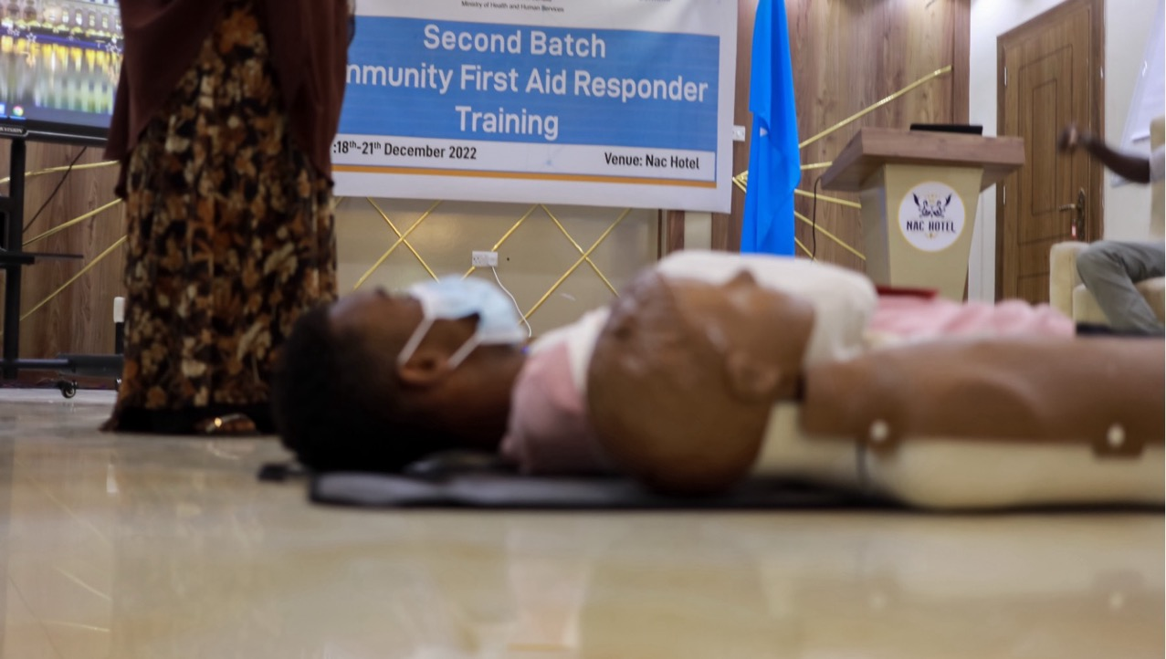
What is a CFAR?
CFAR = Community First Aid Responder
WHO / Ismail Taxta
Notes:
What is a CFAR?
A CFAR is a Community First Aid Responder
WHO / Ismail Taxta

Slide 9



What is the Community First Aid Response Course?
The course trains community members to use a systematic approach to:
identify emergency conditions,
provide initial emergency care for patients, and
link (mobilize & transport) patients to the care they need.
Notes:
The Community First Aid Response course trains community members to identify emergency conditions, provide initial emergency care for patients, and link patients to the care they need.
In order to do that, the course trains community members to provide immediate care to people where they become ill or injured and provides guidance on when and how to safely transfer patients to receive further care in the larger health system, including transportation and handover care to health providers.

Slide 10
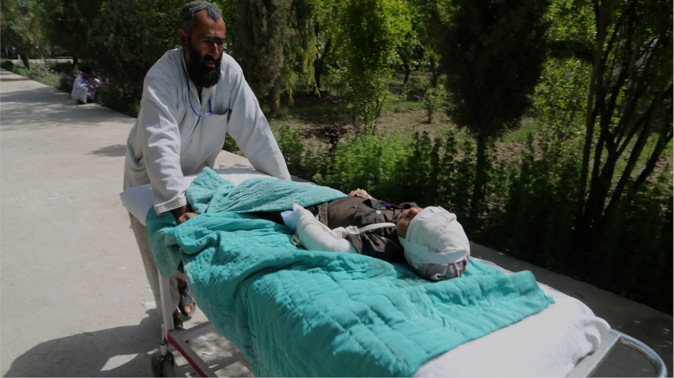
What is an emergency condition?

Slide 11

Emergency Conditions
An acute injury or illness that poses an immediate risk to a patient’s life or long-term health.
Any situation that is risking the patient’s “life or limb”
Notes:
An emergency condition is an acute injury or illness that poses an immediate risk to a patient’s life or long-term health.
It is sometimes referred to as any situation that is risking the patient’s “life or limb”. If the patient’s life is at risk meaning that there is a risk that they die, or the patient may become disabled by the injury, such as losing an arm or leg, then it is an emergency.

Slide 12
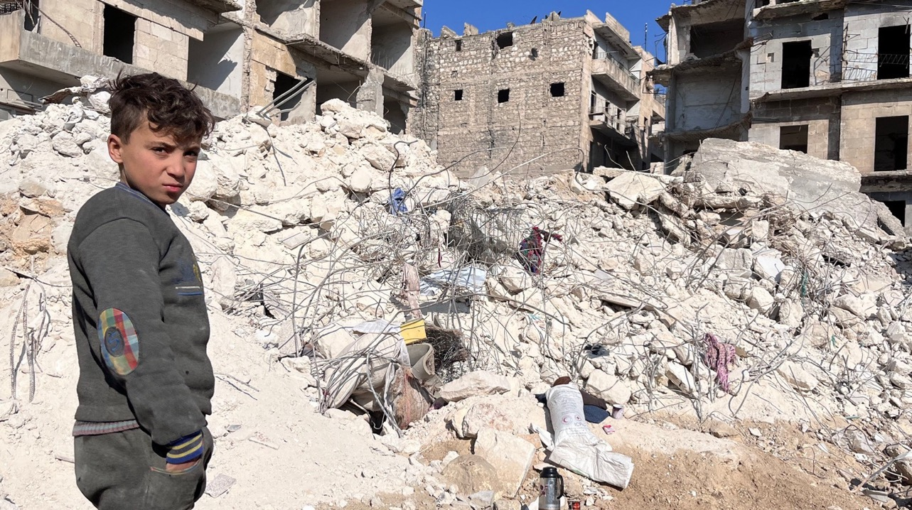
What is emergency care?
Notes:
Then what is emergency care?

Slide 13


Emergency Care
The prompt aid of …
acute conditions that must be treated within minutes to hours to avoid death or disability.
Conditions in which delays of hours could lead to worse outcomes or less effective treatment.
Notes:
Emergency care refers to the prompt aid of patients who suffer from acute conditions that must be treated at once, often within minutes to hours, to avoid death or disability. It also includes treatment of conditions in which delays of hours could worsen health or make treatment less effective.

Slide 14



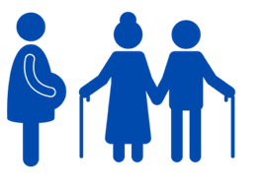

Emergency Care
Range of settings
All types of patients
Immediate help!
Notes:
Patients experiencing emergency conditions often need immediate help, even before reaching a healthcare facility.
Emergency care is provided across a range of settings, including on the scene, during transport, and at health facilities.
It includes care all types of patients across the life course, including women who are pregnant, people who are elderly, and children.

Slide 15

Remember
Emergency care is a critical part of a health system; providing timely emergency care can greatly reduce death and disability.
Notes:
Emergency care is provided across a range of settings, including on the scene, during transport, and at health facilities. It includes care all types of patients across the life course, including women who are pregnant, people who are elderly, and children.

Slide 16

What are emergency care systems?
Notes:
Then what are emergency care systems?

Slide 17



Emergency Care Systems
Emergency care systems (ECS) aim to ensure emergency conditions are recognized and treated wherever the patient seeks care.
ECS rely on health workers in communities, health facilities and during transport.
CFARs have an important role, as they are often the first person with training to arrive to treat patients in need.
Notes:
These are systems that are designed to no matter where the patient seeks care, health emergencies are recognized and treated. They rely on health workers in communities, during transport, and in health facilities.
Community First Aid Responders are often the first person with training to arrive to treat patients in need, this is why they have an important role in emergency care systems.
Image: Canva Pro (Roger Brown)

Slide 18
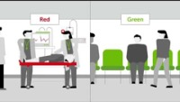
Notes:
https://www.youtube.com/watch?v=td0AJjUWIpc&t=1s

Slide 19
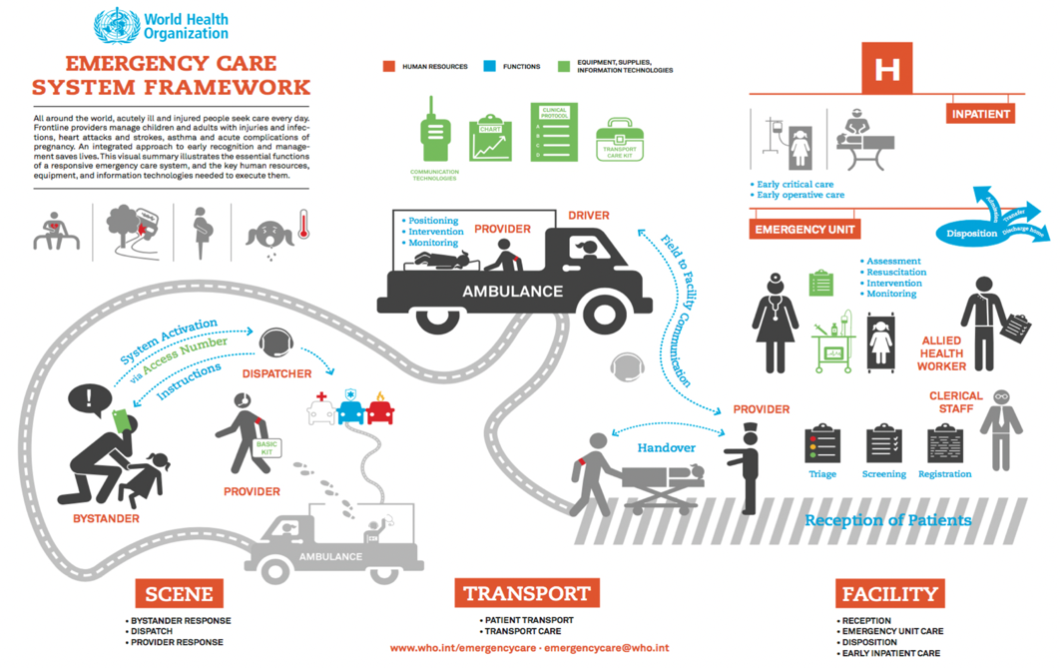
Notes:
This infographic is a visual representation of the WHO Emergency Care System Framework, designed to support policy-makers wishing to assess or strengthen national emergency care systems. It is the result of global consultations with policy-makers and emergency care providers across all regions, and provides a reference framework to characterize system capacity, set planning and funding priorities, and establish monitoring and evaluation strategies.
The Framework captures essential emergency care functions at the scene of injury or illness, during transport, and through to emergency unit and early inpatient care. The encircled part depicts the care provided at the scene.

Slide 20
CFARs in Emergency Care Systems
Notes:
CFARs are trained to recognize medical and traumatic emergency conditions, to provide immediate treatment for emergency conditions, and to mobilize patients to other parts of the emergency care system to obtain a higher level of care.

Slide 21


CFARs in Emergency Care Systems
We can think of the ECS as a chain that allows individuals in our communities to survive emergency conditions….
CFARs can serve as one of the first
important links in the
chain of survival.
Notes:
If we think of emergency care systems as a chain that allows individuals in our communities to survive emergency conditions, CFARs can serve as one of the first links in that chain of survival .

Slide 22



CFAR Role
Community First Aid Responders
Notes:
However, they must be connected to both their community, so that people call for and trust them to provide first aid, and to other health workers with advanced training in emergency care, so that they can provide a safe handover to a facility capable of treating the patient.

Slide 23

CFAR Duty to Provide Ethical Care
Ethical care is care that is consistent with what society and individuals typically believe are good values.
Fairness
Equality
Dignity
Diversity
Individual rights
Notes:
What is ethical care? This underpin everything that we do to be consistent with what society and individuals typically believe are good values.
These actions respect moral principles such as fairness, equality, dignity, diversity, and individual rights.

Slide 24
Ethical Care
No Harm
Free Choice
Fairness
Notes:
Ethical Care
Ethical actions do not harm patients and give them the right to choose freely. Ethical care promotes fairness, including freedom from discrimination. Patients should not be treated any differently based on sex, gender, disability, political affiliation, or any other factor.

Slide 25

Consent
Inform about what happens, how you will help, and their right to refuse treatment.
Allows free choice
Receive permission for treatment.
Notes:
Consent
Consent is the process of informing a person about how you will help them and receiving their permission for treatment. Consent allows a person to choose freely whether they want the evaluation and care you are willing to give. Consent generally means that the person is saying, “yes” and agreeing to being treated.

Slide 26



Types of Consent
Informed consent
Implied consent
Consent for children
Alert, mentally competent adult
Unconscious or confused
Child with parent or guardian
*If no parent or guardian is present, consent may be implied
Notes:
The type of consent obtained in emergency conditions can vary at times because people might be unconscious, unable to speak/make decisions, or be children (who legally cannot make their own decisions).
As a result of this, different situations may call for different types of consent, as follows:
Informed consent, which is a consent that is expressed by a conscious, mentally competent (alert and aware) adult.
Implied consent, which is a consent that is assumed when a patient is unconscious or unable to make a rational decision but in obvious need of medical help, and
Consent for children, which is a consent that is expressed by a parent or guardian of a patient below the age of adulthood. The age of consent for children can vary based on different contexts. If no parents or guardians are present, then consent may be implied.

Slide 27

Consider: Ethical Care & Consent
How might our right to choose freely be different in the setting of a large-scale emergency, such as an Ebola or COVID-19 outbreak?
What is our ethical obligation to provide care to such patients?
Notes:
Can remove based on context and relevance
Photo: CanvaPro by Matilda Wormwood from Pexels

Slide 28





Privacy
Ask questions privately
Use same sex chaperone
Cover exposed patients
Respect cultural/religious norms
Respect patient privacy
Notes:
Privacy
Part of ethical care during community first aid response is ensuring that patient privacy is maintained throughout. Patients have the right to privacy of both information and the physical body during an evaluation. An important part of evaluating patients is asking personal questions about what happened and past health history. You should be careful and aware of what you are saying in front of other people and assume the patient does not always want people listening to what is being said.
You may need to examine patients to make certain they do not have signs of serious injury or to clarify their medical need, However, it is important to respect cultural norms and be aware of how your actions may be seen by others in the community. You should cover patients appropriately and avoid undressing them in front of others. You should also have a same-sex chaperone (who is a witness for the patient and the CFAR during an exam) if possible, to help the patient feel comfortable during your evaluation.
To sum it up, Community First Aid Responders must maintain patient by informing the patient that you will protect their privacy; asking questions privately whenever possible; covering exposed patients in public areas whenever possible; understanding cultural and/or religious expectations; and using same-sex chaperone for patient exams.

Slide 29


Confidentiality
Maintain confidentiality of patient information at all times.
Do not share patient information without their permission.
Notes:
Inform the patient that you will maintain confidentiality at all times.
Maintain confidentiality of patient information by not discussing private information with other community members and not leaving written notes with identifying information, such as their name, address, medical problems, etc., in public places.
A patient’s personal and health information should not be shared with others without patient’s permission, it belongs to them and should not be shared, except with other health and care providers directly involved in helping the patient. Ask for permission (or consent) before sharing patient health information

Slide 30
Remember
To provide ethical care, CFARs must:
Always act in the best interest of the patient;
Do no harm;
Not discriminate based on sex, gender, disability, political affiliation, or any other factor;
Ensure fairness;
Obtain consent to provide care, giving the patient the right to choose freely; and
Maintain patient privacy and confidentiality.
Notes:
Remember, To provide ethical care, CFARs must always act in the best interest of the patient; They should be cautious not to introduce harm to the patient; they should not discriminate based on sex, gender, disability, political affiliation, or any other factor; and they should ensure fairness. CFARs must obtain consent to provide care, giving the patient the right to choose freely and maintain patient privacy and confidentiality.

Slide 31




Legal Considerations
What laws exist in your community that impact your ability to provide care.
Are you protected if something goes wrong?
Laws vary by locations!
Notes:
Legal considerations
Laws impacting the ability of CFARs to provide care to people experiencing emergency conditions vary by locations, make sure to consider such laws in your community while performing your role as a CFAR.
Legal consideration to take into account include whether there are legal protections for people who try to help? In other words, can you be held responsible if there is a bad outcome or the patient is further injured during transport? Be aware of these types of laws so that you can make decisions that preserve your safety and protect patients.

Slide 32
Questions?
Notes:
Do you have any questions?

Slide 33
Summary
The training you receive in the course can be used to help the communities in which you live and work.
With a basic understanding of emergency care and the health system, you will be able to help people and save lives.
To be effective and trusted you must:
  Maintain ethical standards,
  Ask for consent,
  Maintain patient privacy,
  Be mindful of confidentiality, and
  Adhere to local laws and standards.
Notes:
As we reach the end of this module, let's summarize the key points that we've covered:
The training that you receive in this course can be used to help the communities in which you live and work.
With a basic understanding of emergency care and the health system, CFARs can help people and save lives.
In order to be effective and trusted, CFARs must maintain ethical standards, ask for consent, maintain patient privacy, be mindful of confidentiality, and adhere to local laws and standards.

