Slide 1
Module 2: Safety During Response
Community First Aid Response Course
Notes:
Welcome to the second module of the Community First Aid Response course: Scene Safety

Slide 2
Module 2: Learning Objectives
By the end of this session, the participant will be able to:
  Identify hazards on the scene of a medical or trauma emergency
  Perform critical actions upon initially approaching a scene to ensure safety
  Recognize special considerations to maintain personal and patient safety
  Describe how to avoid infectious disease exposure by using personal protective equipment (PPE) and handwashing
  List steps to take if exposed to blood or another body fluid
Notes:
Before we dive into the content of this module, let’s outline the learning objectives:
By the end of this session, the you will be able to:
Identify hazards on the scene of a medical or trauma emergency
Perform critical actions upon initially approaching a scene to ensure safety
Recognize special considerations to maintain personal and patient safety
Describe how to avoid infectious disease exposure by using personal protective equipment (PPE) and handwashing
List steps to take if exposed to blood or another body fluid

Slide 3

Essential Skills
By the end of this module, the CFAR will be able to demonstrate the following skills:
  Demonstrate a scene safety approach
  Demonstrate proper hand hygiene

Slide 4
Key Terms
On completing this module, you should be able to define the following terms:
  Scene safety
  Personal safety
  Patient safety
  Personal protective equipment (PPE)
  Germs
  Body fluids
  Handwashing
  Decontamination
Notes:
Now, take a moment to review the list of key terms that you are expected to be able to define by the end of this module.

Slide 5
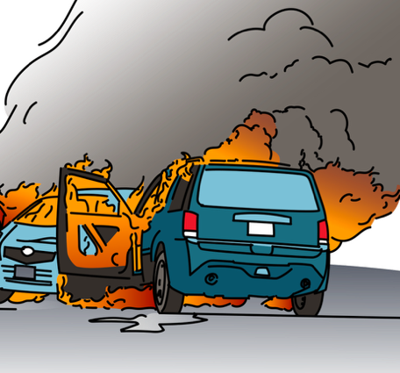
Overview
Emergency conditions can occur anytime, anywhere.
Safety is the top priority—you can’t help others if you become injured.
It is crucial to understand scene, personal, and patient safety.
Notes:
Emergency conditions can happen unexpectedly in any place and at any time. While the goal of community first aid response is to help people experiencing emergency conditions, safety is the top priority! If a CFAR becomes ill or injured while providing care, they will no longer be able to help current and future patients. Therefore, it is crucial that CFARs understand the concepts of scene safety, personal safety, and patient safety.
Photo: Canva Pro by AleksandarGeorgiev from Getty Images Signature

Slide 6

Scene Safety
STOP and assess scene safety before you help a person experiencing an emergency condition.
Notes:
Scene Safety
Before you help a person experiencing an emergency condition, you must STOP and assess if the scene is safe from hazards and dangers.

Slide 7




Scene Safety
Scene safety is the first step
Continuously re-assess
Stay alert!
Notes:
This is always the first step during any community first aid response. Scene safety must be continually reassessed throughout a CFAR’s response.
The purpose of assessing the scene is to identify any hazards that could affect you and the patient. A scene is safe when you can safely approach a person, or it is safe for them to approach you without risking injury.

Slide 8




Scene Safety
Location
Time of day
Environment
Notes:
To assess scene safety, CFARs must ask themselves the following questions before approaching a patient:
Location: Is the location of the scene unsafe? Am I at risk of being injured in this location, such as being close to or in the middle of conflict, traffic flow, unstable building, fire?
Time of day: Is it light or dark? Will I be able to see the dangers? Will others be able to see me?
Environment: Is it raining, lightning, flooding, extremely hot, or extremely cold? Are there other dangerous weather or environmental conditions?

Slide 9
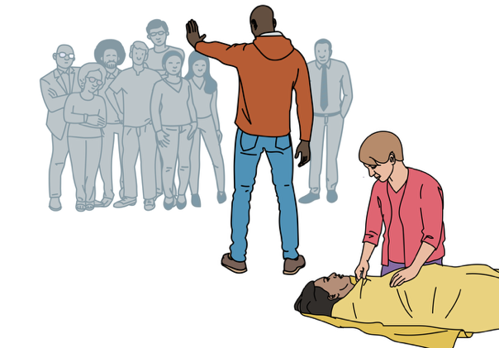
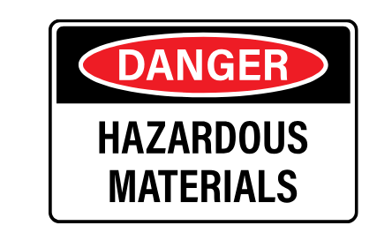
Scene Safety
Hazardous exposures
Bystanders and crowd control
Notes:
Hazardous exposures: Are there hazardous materials, examples of hazardous materials are pesticides, poisons, chemicals, are there animals such as snakes or other dangerous animal on the scene?
Bystanders: Are you alone? Is there a crowd? Was there violence involved?

Slide 10
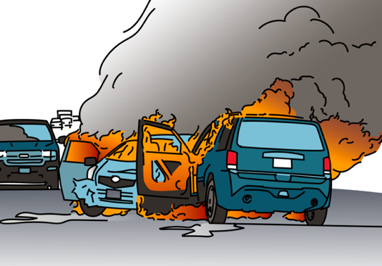
Initial Approach
Actively assess the scene as you approach.
Do you see anything that could make the scene unsafe?
You can help control scene safety.
Notes:
Initial Approach
Actively assess the scene as you approach. Observe anything that could make the scene unsafe? Things compromising scene safety may be obvious such as gunfire, warehouse fire, or car on fire, but sometimes they’re not as obvious such as electrical wires, smoke, flooding, or gas or petrol. CFARs can help take steps to increase the safety or keep a safe scene, they should feel empowered to help control the scene of an emergency.

Slide 11
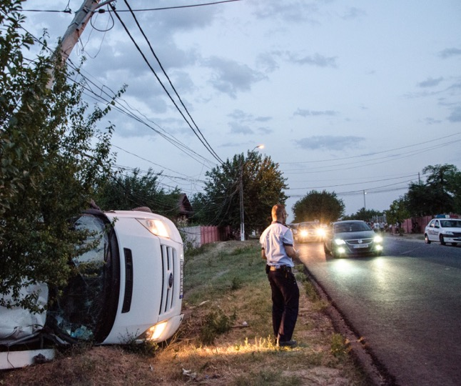
Scene Safety
What hazards are present that could make this scene unsafe?
© WHO/ Malin Bring
Notes:
Pause for a moment and look at this image, can you identify any hazards that could make this scene unsafe?
Photo (top): Canva Pro/by photospirit
Photo (bottom): Canva Pro/by arodsje from pixabay
You may use this time to discuss the scene safety cases that are provided in the facilitator guide.

Slide 12






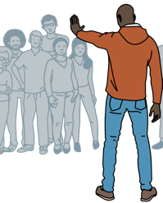

Increasing Scene Safety
Identify yourself as a Community First Aid Responder
Call for help
PPE
If unsafe risk, do not approach the scene until help arrives
Ask others to move back
Move the patient to a safer area
Notes:
Here are some instructions to increase the safety of a scene?
Call for help
Use personal protective equipment
Ask non-injured people to move back, use a loud firm voice. Remember that as a CFAR, you might be the most trained person there, so be confident.
Choose people in the crowd for help keep a perimeter, control traffic, and control crowds
When safe, move the patient to a safer area
If you find an unsafe risk, do not approach the scene until help arrives

Slide 13

Safety Reassessment
Constantly reassess the scene.
Scenes which are safe at first can become dangerous later.
Notes:
CFARs can never stop assessing the scene as scenes which are safe at first can become dangerous later. For example, a car with spilled petrol can later ignite and start a fire.

Slide 14
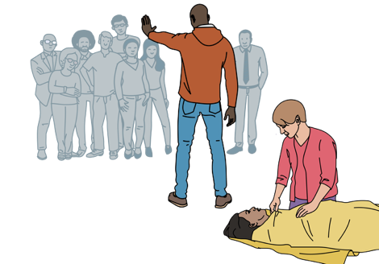
Crowds and Violence
Emergencies draw attention and onlookers.
Be continuously aware of the crowd.
Stay away from anyone hostile, angry or violent.
Remove yourself if the crowd is becoming unsafe.
Notes:
Emergencies draw attention, onlookers will gather. CFARs should continue to assess and be aware of the mood of the crowd. Crowds can become violent, and the feel of a crowd can change very rapidly. It is important to maintain safety on scene by staying away from anyone who is hostile, angry, or violent and removing yourself from the situation at once if you feel that the crowd is becoming unsafe.
Photo: Canva Pro/by mbbirdy from Getty Images Signature

Slide 15



Crowds and Violence
Warning signs of violence can include
Fighting or loud voices or,
Visible weapons.
Drugs and alcohol can often lead to violent situations.
Notes:
Warning signs of violence can include fighting or loud voices. Be aware of visible weapons. Drug use and alcohol can often lead to violent situations.

Slide 16

Conflict Consideration
Consider the safety of the scene before any emergency care.
Move patients to a safer location if the initial scene is unsafe.
Protect both the patient and yourself if possible.
Notes:
Keep in mind the following consideration for conflict settings:
When a CFAR is responding to emergency conditions in conflict zones, the safety of the scene must be considered before any patient care can occur. Patients may need to be moved to a safer location before any care can be provided to protect both the patient and the CFAR from further harm.

Slide 17
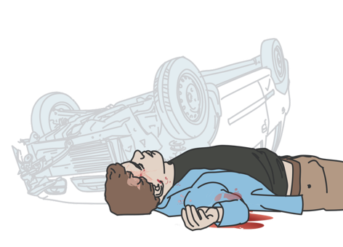
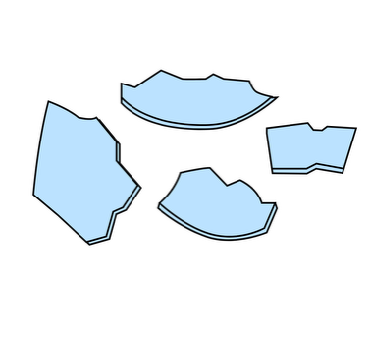

Road Traffic Incidents
Approach with extreme caution and be aware of:
  Sharp glass or metal wreckage
  Oncoming traffic
  Petrol spills
Notes:
Road traffic incidents can be especially dangerous and must be approached with extreme caution. You must be aware of oncoming traffic, petrol spills , or sharp glass or metal wreckage.

Slide 18



Road Traffic Incidents
Steps to improve scene safety
  Turn on vehicle hazard lights
  Put on bright coloured vest or clothing
  Place traffic cones or leaves/branches
Notes:
If approaching a road traffic incident in one’s own vehicle, there are some steps you can take to improve scene safety: turn on vehicle hazard lights, put on bright colored vest or clothing, and place traffic cones or leaves or branches in the road to notify oncoming traffic to slow.

Slide 19



Road Traffic Incidents Special Considerations
Fuel or petrol spill:
  Do not walk through fuel.
  Use dirt and sand to cover the spill.
  Keep all sources of fire away from fuel, including cigarettes.
Notes:
There are some special considerations to take into account in Road Traffic Incidents:
If there is fuel or petrol spill, do not walk through the fuel. Use dirt and sand to cover the spill and keep all sources of fire away from fuel, including cigarettes. Never smoke and ask others not to smoke either.

Slide 20
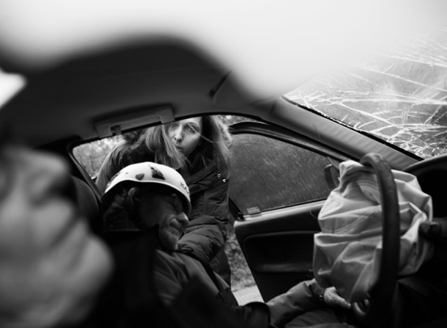
Road Traffic Incidents: Special Considerations
Airbags:
  Can cause injury on deploying.
  Can be anywhere in newer vehicles.
  May deploy after a crash.
  Can redeploy a second time.
© WHO
Notes:
Airbags can cause injury upon deploying. Remember that they are typically in the front of the vehicles but can be anywhere in the newer vehicles. Airbags may not deploy during the accident, but they can still deploy after, and deployed airbags can deploy a second time.

Slide 21
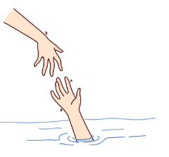


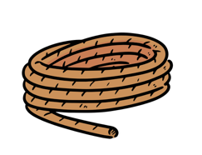
Drowning
Drowning can occur in any body of water.
NEVER go in the water if not trained to rescue drowning people.
  Reach out with a stick or throw a rope
  Remain on land
  Call for help
Notes:
Drowning can occur in rivers, lakes, or any body of water.
If a CFAR is not trained to rescue drowning people and does not know how to swim they must never go in the water. Instead, remain on land, call for help, and reach out a stick or throw a rope if possible.

Slide 22
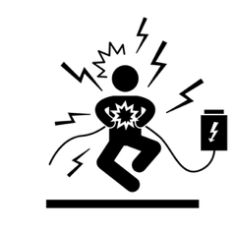




Electrocution
Electrocution is associated with power supply or with lightning.
Wear rubber gloves and boots if possible
Do not touch the patient
  Turn off the power supply, if possible
  Call authorities to handle larger electric lines
Notes:
Electrocution might occur due to contact with a power supply or being struck by lightning. It is dangerous to touch a patient who is in the area where they were electrocuted by a power supply, unless you are certain there is no active electricity. If possible, turn off the power supply. If unable to do so, call authorities for help shutting off larger electric lines. Gloves are less likely to conduct electricity, if possible, wear rubber gloves and boots when touching the patient.
Be aware that water can conduct electricity!

Slide 23
Personal & Patient Safety
Personal safety is a critical component of the response to emergency conditions.
You cannot help others if you become ill or injured.
Prioritize patient’s safety to prevent further harm.
Notes:
If a CFAR become ill or injured, they cannot continue to provide aid, therefore, personal safety is a critical component of a CFAR’s response to emergency conditions. The patient’s safety must also be prioritized to prevent further harm.

Slide 24
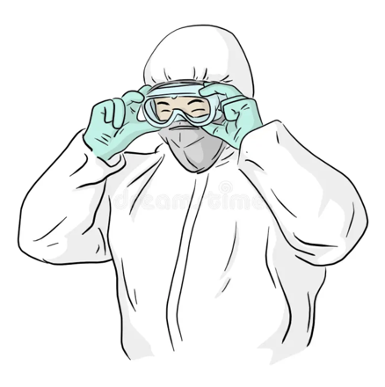
Personal Protective Equipment (PPE)
PPE is equipment to protect you from infections and other hazards.
Notes:
In addition to the elements of scene safety necessary to maintain personal and patient safety, as a CFAR, you must consider how and when to use personal protective equipment (or PPE) to protect you from infections and other hazards.

Slide 25

Personal Protective Equipment (PPE)
You may be infected if not wearing masks or gloves.
  Germs may be in blood, body fluids, or infected or broken skin.
  Patients may have an illness that can transmit through the air or direct contact.
Chemical or toxin exposure can be transferred to CFARs without PPE.
Notes:
Emergency conditions can pose dangers to care providers as patients may be infected with diseases that can be contagious if a mask or gloves are not worn. Germs that cause infection may be present in blood, body fluids, and on infected or broken skin. Germs are not visible if you look at a patient and CFARs may not know if patients have an illness that can transmit through the air or through direct contact.
Patients may have been exposed to chemical or other toxins that can be transferred to CFARs if PPE is not used.

Slide 26
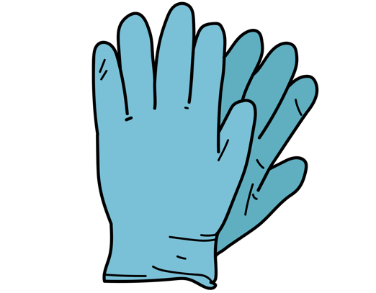
PPE Considerations
Consider alternatives if gloves, masks, or goggles are unavailable.
Single-use gloves are NOT reusable.
Notes:
Sometimes, you may not have gloves, masks, or goggles available. Consider alternatives such as plastic bags to be used instead of gloves, a scarf may be used for face and mouth protection, and sunglasses can be used for eye protection. Although not preferred and less effective, the alternatives may offer some protection.
Be aware that Single-use gloves are NOT reusable. Reusing gloves can spread germs. To prevent spread of germs, change gloves after every patient and dispose of used gloves safely and put on new gloves if they are dirty or ripped.

Slide 27
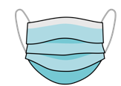
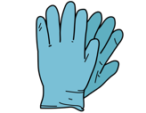

PPE Types
 | Why? | When?
Masks | Decrease the risk of spreading infection that travels in air or in droplets of body fluids. | Any time a CFAR has contact with a patient.
Gloves | Prevent exposure to blood or body fluids during patient care. | Any time a CFAR has contact with a patient.
Eye Protection/ Goggles | Prevents exposure to blood or body fluids that can spread disease through contact with the eyes. | Any time blood or body fluids are present.
Notes:
There are several types of personal protective equipment including masks, gloves, and eye protection. Masks decrease the risk of spreading infection that travels in air or in droplets of body fluids and should be used at any time as CFAR has contact with a patient. Gloves prevent exposure to blood or body fluids during patient care and should be used at any time as CFAR has contact with a patient. Eye protection prevents exposure to blood or body fluids that can spread disease through contact with the eyes and should be use at any time blood or body fluids are present.

Slide 28




Limited Resources
You may not have gloves, masks, or goggles limiting your ability to safely care for patients.
Consider alternatives
Notes:
At times, you may not have gloves, masks, or goggles. The ability to have the best possible supplies can limit your ability to safely care for patients. If you cannot get gloves, masks, or goggles, you may have to consider alternatives. Alternatives can include plastic bags instead of gloves, a scarf for face and mouth protection, and sunglasses for eye protection. Although not preferred and less effective, the alternatives may offer some protection.

Slide 29

Handwashing
Before and after every patient contact, even if you were wearing gloves.
Helps prevent the spread of germs and can remove other dangerous substances.
© WHO/ Sue Price
Notes:
It is important to wash your hands before and after every patient contact, even if you were wearing gloves. This helps prevent the spread of germs that can cause illness and can remove other dangerous substances.

Slide 30
Handwashing
Handwashing protocol:
  Wash hands with soap and clean water for at least 40 seconds.
  Rub the fronts and backs of hands vigorously and scrub under fingernails.
  Use an alcohol-based sanitizer if no appropriate water available.
© WHO/ Sue Price
Notes:
Make sure to wash hands with soap and clean water for at least 20 seconds. Rub the fronts and backs of hands vigorously and scrub under fingernails. If no appropriate water is available, use an alcohol-based sanitizer.

Slide 31
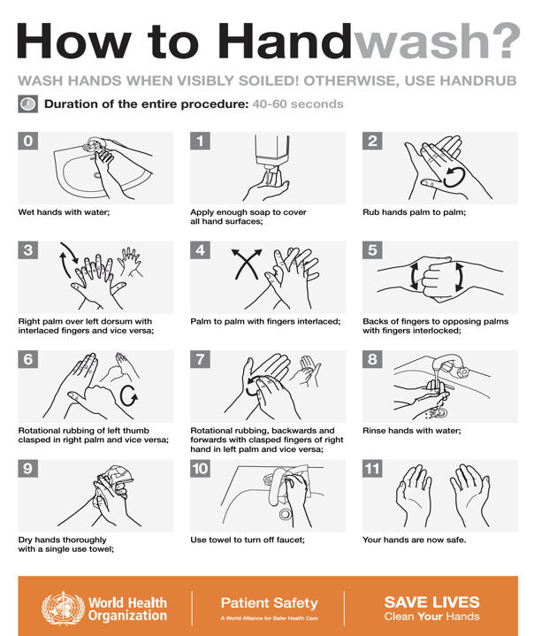
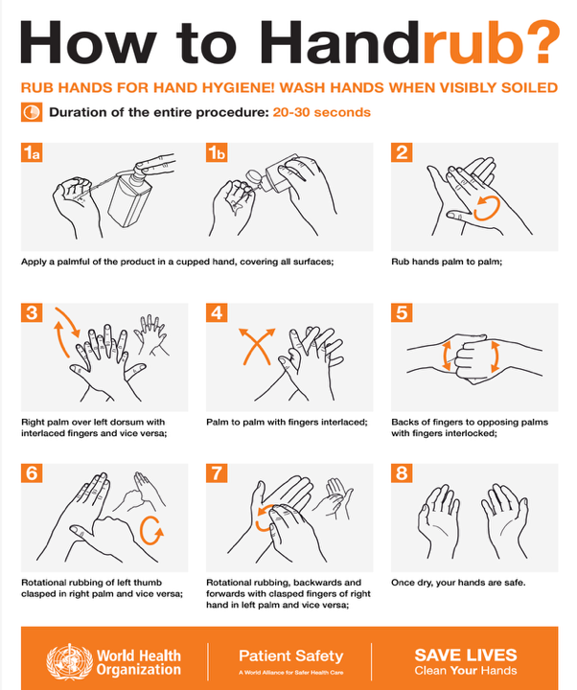
Notes:
Take a moment to review the WHO guidelines to handwash and to handrub.

Slide 32

Handwashing
Handwashing protocol:
  Wash hands with soap and clean water for at least 40 seconds.
  Rub the fronts and backs of hands vigorously and scrub under fingernails.
  Use an alcohol-based sanitizer if no appropriate water available.
© WHO/ Sue Price
Notes:
Practice Mode:
Take a few minutes to guide the large group through handwashing practice.
If you haven’t already done so, first demonstrate and explain each step. Then allow the group time to practice the steps together.

Slide 33
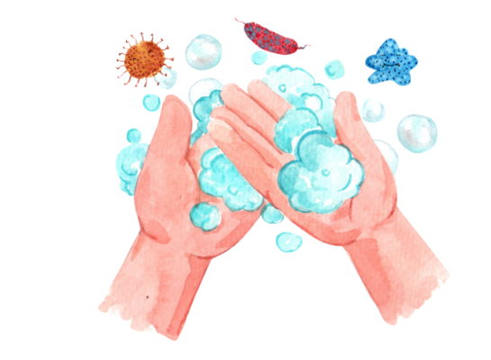
Blood or Body Fluid Exposure
You may be exposed to infections from blood or body fluids.
Wash hands, skin, or eyes thoroughly right after any exposure.
Notes:
CFARs might be exposed to infectious agents while providing care for patients, which most likely happen when a person’s blood or body fluids contact a CFAR’s skin or eyes.
To prevent spread of disease, CFARs must always wash their hands or other affected skin or eyes copiously as soon as possible after any potential exposure to blood or body fluids.

Slide 34
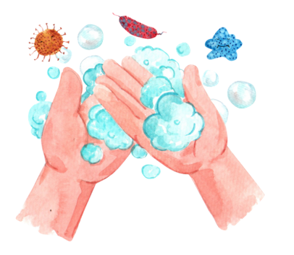
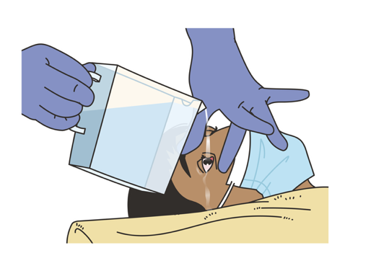

Blood or Body Fluid Exposure
Seek care at a health facility for testing & prevention treatment.
Wash hands or skin
Flush eyes with clean water
Notes:
In case of blood or body fluid exposure, wash the exposed hands or skin for at least 40 seconds with soap and clean water or alcohol-based sanitizer. Flush eyes with clean water if exposed or irritated. Seek care and advice at a health facility where they can test for disease or begin preventative treatment for HIV.

Slide 35

Sharp Objects
Observe for sharp objects and carefully place them in a safe place.
Notes:
When examining a patient, be careful to observe for sharp objects, such as needles, glass, or blades, which may injure you or the patient. If you encounter any sharp objects, carefully place them in a safe place so no further injury can occur.

Slide 36
Cleaning and Decontamination
Infections are a real risk when helping patients.
Clean and disinfect all surfaces and reusable equipment between patients.
If needed, decontaminate the patient first to protect yourself and others.
Notes:
Infectious disease exposure is a significant risk when caring for patients. Clean and disinfect all facility and vehicle surfaces and all reusable equipment as possible between patients.
It may be required to decontaminate a patient prior to treatment to keep you and others safe.

Slide 37
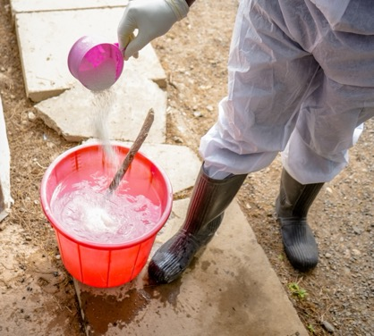
Cleaning and Decontamination
Do not approach a chemically contaminated patient without proper PPE.
  Some chemicals require specific handling to be removed.
  Wear suitable PPE to prevent further injury or exposure.
© WHO/ Billy Miaron
Notes:
If chemical contamination is suspected, do not approach a patient unless you have appropriate PPE. Depending on the chemical, washing or brushing may be required to remove the substance from the patient. Not all chemicals can be safely washed away, and some must be removed in specific ways to avoid further injury. You must wear suitable PPE for this process.

Slide 38
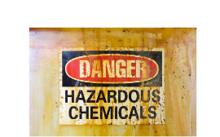
Cleaning and Decontamination
Contact your local health facility for decontamination protocols if available.
Know how to decontaminate yourself if exposed before wearing proper PPE.
Notes:
If chemical contamination is suspected, do not approach a patient unless you have appropriate PPE. Depending on the chemical, washing or brushing may be required to remove the substance from the patient. Not all chemicals can be safely washed away, and some must be removed in specific ways to avoid further injury. You must wear suitable PPE for this process. You may also need to be prepared on how to decontaminate yourself in case you were exposed before using appropriate PPE.

Slide 39

Agitated and Violent Patients
Some patients may be agitated or violent due to a serious condition like drug use, poisoning or head injury.
While they need medical help, your safety comes first.
If the patient seems dangerous or too confused to follow instructions, stay back and call for help.
Notes:
Some patients may be agitated or violent which may be a sign of experiencing an emergency condition! Aggression can be due to drug or alcohol intoxication, poisoning, head injury, or other severe illness. While it is important that these patients get to a health facility for evaluation by a health provider, remember that safety comes first.
If the patient is too confused to follow instructions and appears dangerous, do not approach the patient and call for help from the authorities.

Slide 40

Personal Health and Wellness
Community First Aid Responders often face challenging situations that can affect their own well-being.
It is important to care for yourself.
Notes:
CFARs are likely to experience challenging situations dealing with emergency conditions and injuries, which can impact their health. As a CFAR, it is important to care for yourself to be able to help your patients.
Community First Aid Responders often face challenging situations that can affect their own well-being.

Slide 41


Personal Health and Wellness
An unhealthy CFAR cannot help their community.
Mental health
Physical health
Notes:
Therefore, in order to pay attention to your mental health, find ways for stress relief, rest and consider ways in which your mind can gain strength after exposure to challenging situations. For your physical health, get enough sleep, eat well, and remain hydrated.

Slide 42

Personal Health and Wellness
If you find yourself affected, reach out to professionals for help.
Your wellness and physical health take priority!
Notes:
If you find yourself affected reach out to professionals for help. Remember that your wellness and physical health takes priority!

Slide 43
Questions?
Notes:
Do you have any questions?

Slide 44
Summary
You cannot do your job if you become ill or injured. Your health and safety are always the priority.
Evaluate the scene for dangerous situations and use PPE for all patient care to prevent spreading of disease.
Do your best to find proper PPE but also have ideas for acceptable substitutes.
If exposed to blood, body fluids or a disease, irrigate exposed areas and seek medical care for yourself as soon as possible.
Notes:
As we reach the end of this module, let's summarize the key points that we've covered:
Never forget how safety is important as a CFAR. If you become ill or injured, you won’t be able to do your job. Your health and safety are always priorities. Remember to evaluate the scene for dangerous situations and to use PPE for all patient care to prevent spreading of disease.

