Slide 1
Module 4: Approach to Trauma Emergencies
Community First Aid Response Course
Notes:
Welcome to the fourth module of the Community First Aid Reponse Course: Approach to Trauma Emergencies

Slide 2
Module 4: Learning Objectives
Perform the CABCDE approach to the evaluation of people with traumatic injuries
Demonstrate critical interventions for high-risk injuries
Identify key history findings of high-risk injuries.
Assess special considerations in the care of high-risk injuries in children and pregnant women
Recognize key considerations in the care of common traumatic injuries
Notes:
Before we dive into the content of this module, let’s outline the learning objectives:
On completing this module, you should be able to:
Perform the CABCDE approach to the evaluation of people with traumatic injuries
Demonstrate critical interventions for high-risk injuries
Identify key history findings of high-risk injuries.
Assess special considerations in the care of high-risk injuries in children and pregnant women
Recognize key considerations in the care of common traumatic injuries

Slide 3
Module 4: Key Terms
Amputation
Cervical Spine
Foreign Body
Left Lateral Position
Convulsion/Seizure
Cervical spine immobilisation
Log-roll manoeuvre
Pelvic binding
CABCDE
Difficulty in breathing
Shock
Altered mental status
Circumferential burn
Fracture
Dislocation
Splint
Haemorrhage (severe bleeding)
Notes:
Now, take a moment to review the list of key terms that you are expected to understand by the end of this module.

Slide 4



Approach: CABCDE
Ensure the scene is safe.
Use CABCDE to find and treat life-threatening injuries — look, listen, and feel at each step.
Notes:
As with all initial evaluations, the approach to a person with a medical emergency should begin with the CABCDE approach.
This should be done as soon as it is safe.
The trauma-specific CABCDE approach includes the initial assessment and management for life-threatening injuries from trauma.
Look, listen, and feel during each step.
This initial evaluation should be done as soon as it is safe, ideally, within the first 5 minutes and repeated anytime their condition worsens.

Slide 5
Approach: CABCDE
Early priorities: Check for major bleeding, manage airway and breathing, and immobilize the spine.
Remember to manage injuries in order of CABCDE priority.
Notes:
Early priorities for an injured person include:
Check for major bleeding,
Managing airway and breathing emergencies, and
Keeping the spine from moving (immobilising the spine).
Remember to manage injuries in order of CABCDE priority.
Remember: You should not move forward in the CABCDE approach until you have assessed and treated any life and/or limb threats.

Slide 6
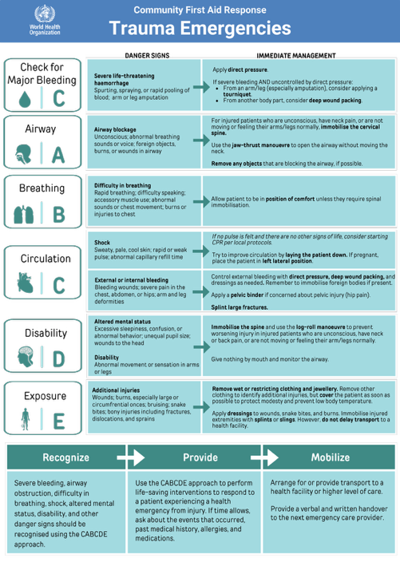
Notes:
Reference yorur CFAR Pocket Guide for more details.

Slide 7
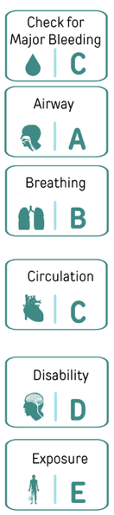
Review: What are we looking for in each step?
Major bleeding
Airway obstruction
Difficulty in breathing
Shock or other bleeding
Altered mental status or disability
Other danger signs
Notes:
Let's review what we are looking for in each step:
In the first step, C or check for major bleeding, obviously we are looking for major bleeding. In A, we are looking for airway obstruction. In B, we are looking for difficulty in breathing. In C, we are looking for shock or other bleeding. In D, we are looking for altered mental status or disability. While in E, we are looking for any other danger signs.

Slide 8
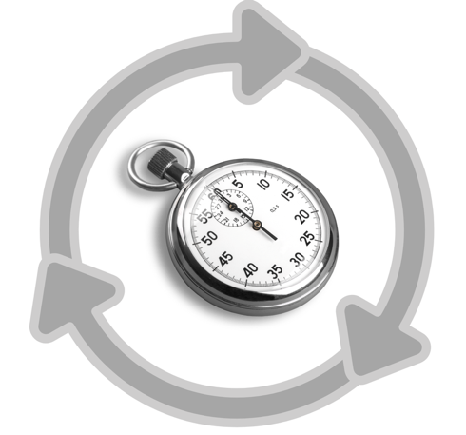
Remember
Hidden and life-threatening injuries can appear later — reassess CABCDE every 15 minutes until transfer.
Notes:
People who initially appear uninjured may have hidden, life-threatening injuries. These injuries might not become obvious for some minutes or hours after the trauma.
Ideally, the CABCDE survey should be repeated every 15 minutes until they are transferred to a higher level of care.

Slide 9
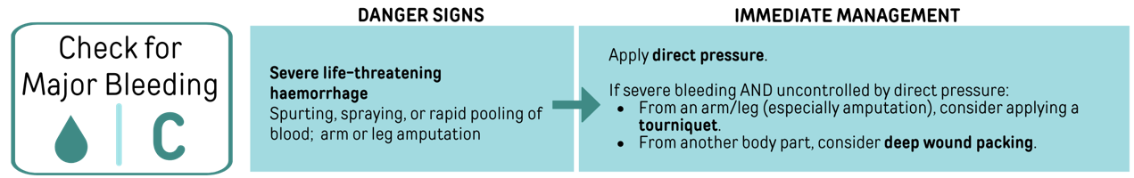

Slide 10
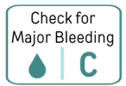
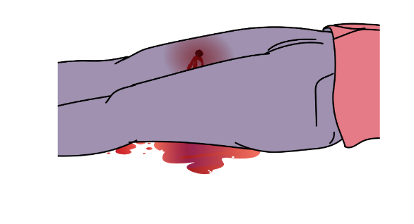
Look
Blood coming out fast
Blood spraying or making a puddle
Notes:
In trauma, an injured person may have signs of severe external bleeding (haemorrhage) from their head, body, arms, or legs.
Look for blood flowing rapidly, spraying, or pooling. Large amounts of bleeding can cause death very quickly.

Slide 11
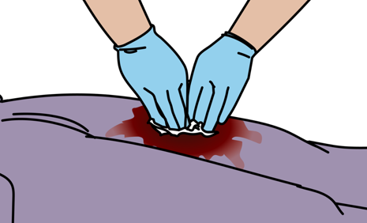
DO
Apply direct pressure.
Notes:
Check for major bleeding: DO​
Apply direct pressure to any obvious external bleeding.​
​

Slide 12
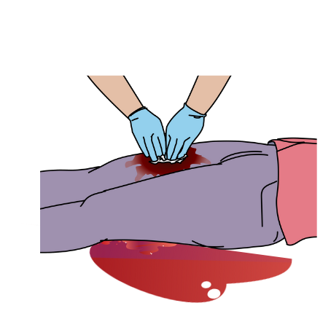
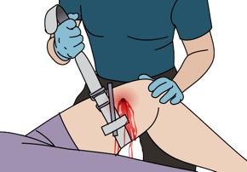
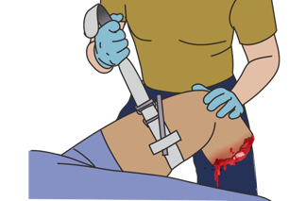
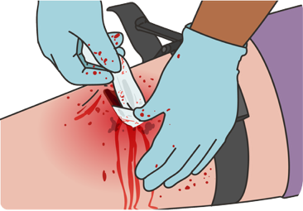

DO
From a limb or amputation–Apply a tourniquet
Uncontrolled with direct pressure
Not from a limb–use Deep Wound Packing
Prepare for rapid transfer to a health facility.
Notes:
If life-threatening, excessive bleeding from an arm or leg cannot be controlled by direct pressure (still spraying or rapidly pooling) or an amputation is present, apply a tourniquet.​
If severe bleeding from a body part other than arm or leg (especially the armpit or groin) cannot be controlled by direct pressure, use deep wound packing. ​
Stopping or slowing major bleeding is the priority in a critically injured patient. If signs of major bleeding are found, prepare for rapid transfer to a health facility. ​

Slide 13
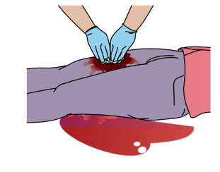

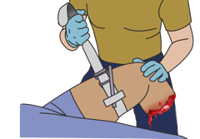
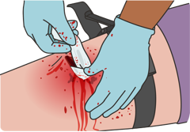

Look
DO
Notes:
Review of “Check for Major Bleeding” for patients with emergency trauma conditions.

Slide 14




Conflict Consideration
Catastrophic bleeding is the first priority.
Act immediately to control bleeding if the scene is safe.
Tourniquet needed but not available? Improvise!
Notes:
Catastrophic bleeding should always be addressed first in patients who have experienced traumatic injury.
Be prepared to address this life threat immediately, particularly in environments with ongoing conflict.
Consider what materials you can use to improvise a tourniquet.

Slide 15
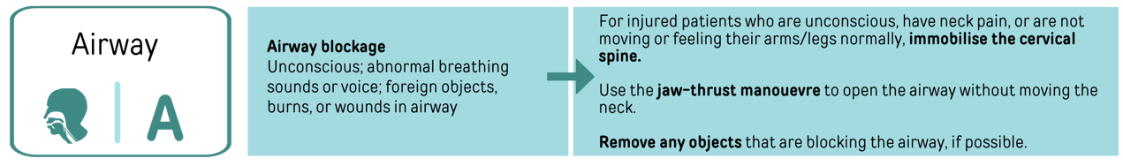

Slide 16

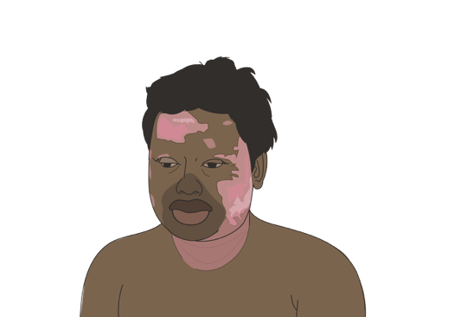
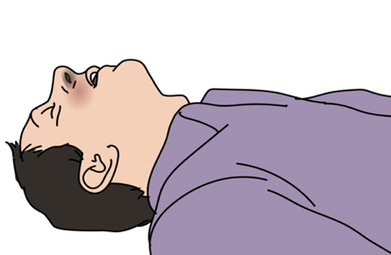
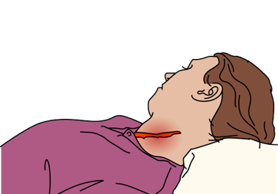
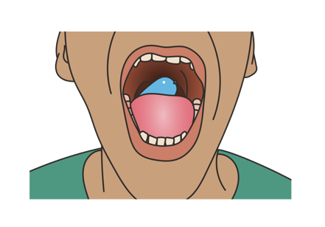
Look
Not waking up
Burn
Open wounds in mouth or neck
Obstructions
Notes:
Look for:
After a severe injury, a person may be unconscious or have altered mental status. An altered person is at high risk for an airway problem from the tongue or vomit blocking the airway.
Look for these and any other potential objects blocking the airway but avoid inserting your fingers into the mouth to prevent being bitten.
Look for any signs of burns, including soot or singed nasal hairs, as burns can cause severe swelling that blocks the airways.
Look for open wounds in the mouth or neck as they can also cause bleeding or swelling that can block the airways.
Look for any signs of burns, including soot or singed nasal hairs, as burns can cause severe swelling that blocks the airways.
Open wounds in the mouth or neck can also cause bleeding or swelling that can block the airways.

Slide 17

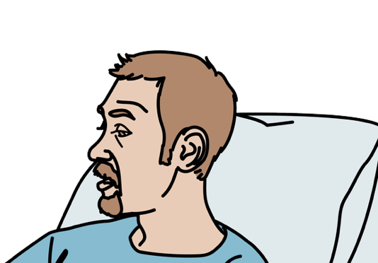
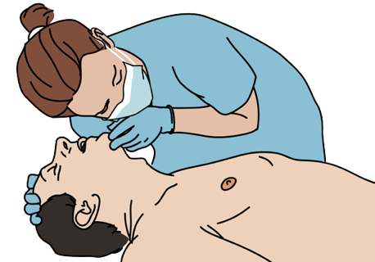

Listen
Changes in voice or no breathing
Notes:
Airway: Listen:
Listen to any changes in voice, gurgling, snoring, high-pitched, or noisy breathing can be a sign of blockage in the airway.
Absence of breathing sounds may also indicate a blockage.

Slide 18

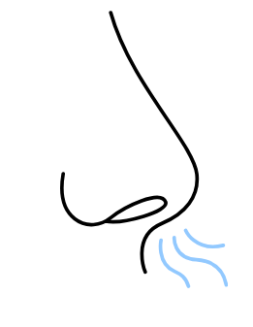
Feel
  Air movement in front of nose or mouse
Notes:
If you are unable to hear any air movement and the person is unresponsive, Place your hand in front of the nose and mouth to feel air movement.

Slide 19
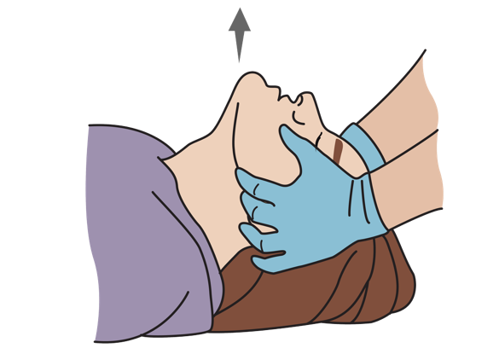
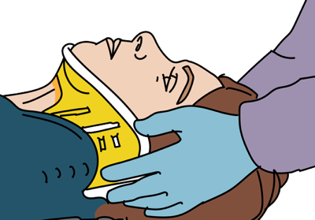
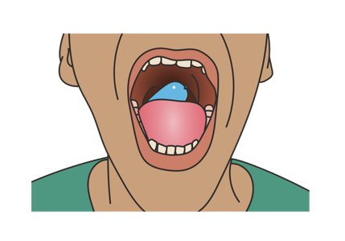
DO
Immobilize the cervical spine
Jaw-Thrust
If you see something in the mouth or throat — remove it if possible
Prepare for rapid transfer to a health facility.
Notes:
So, what should you do?​
Open the airway using jaw thrust in patients with airway blockage to allow breathing to deliver adequate oxygen to the lungs without moving the neck. If possible, remove any objects blocking the airway.​
​
Immobilise the cervical spine (neck) to prevent further injury in patients with severe trauma, especially in patients with neck pain and in patients with altered mental status or unable to move or feel their arms or legs. ​
If other danger signs of airway obstruction are found, prepare for rapid transfer to a higher level of care.​

Slide 20
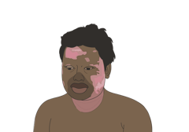
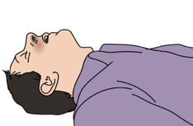
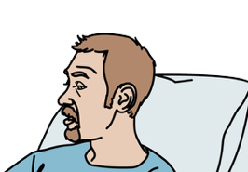
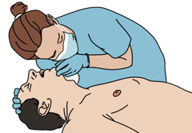
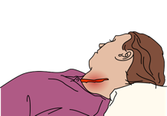

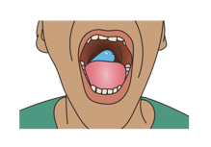



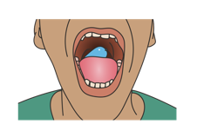

Look
Listen
Feel
DO
Notes:
Review of “Airway” for patients with emergency trauma conditions.

Slide 21
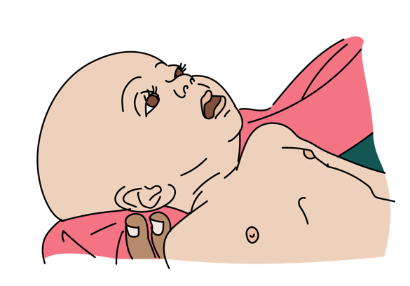
Special Considerations for Children
Use jaw-thrust if neck injury is suspected.
Children’s relatively big heads and tongues can block the airway.
Notes:
Keep in mind the following consideration for children:
When neck trauma or cervical spine injury is suspected, use the Jaw-Thrust Manoeuvre to manually open the airway while maintaining cervical spine immobilization and minimizing all movement of the neck.
Children have relatively big heads and large tongues and may obstruct their airways more easily.

Slide 22
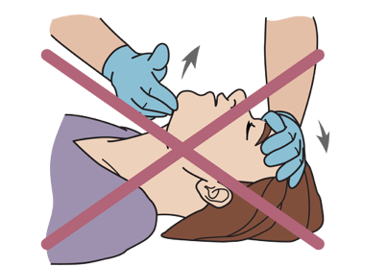
REMEMBER
Do not use head-tilt / chin-lift in a severely injured person, as there may be an injury to the neck or spine.
Notes:
Remember: In a severely injured person, there may be an injury to the neck or spine. Do not use the head-tilt / chin-lift technique to open the airway, as it could worsen the injury and lead to serious complications.

Slide 23
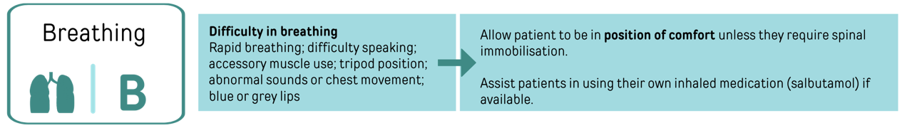

Slide 24

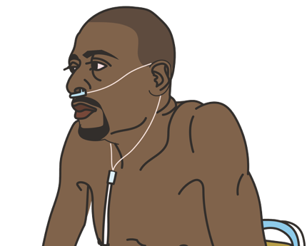
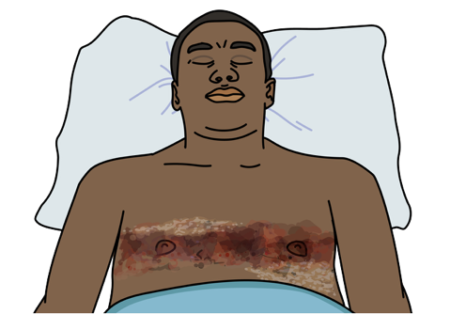
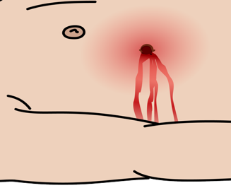
Look
Serious Injury
Burn
Difficulty in Breathing
Notes:
Breathing: Look:
After a traumatic event, it is very important to assess and manage any difficulty in breathing.
If the person is breathing rapidly, using extra muscles to breathe, or appears short of breath, this would suggest concern for difficulty in breathing.
If the chest is not moving normally, this could be a sign of more severe injury. Any bruising or wounds to the chest can be signs of dangerous injuries inside the chest.
Burns to the chest, particularly burns that circle the entire chest, are very important to identify as they can prevent normal breathing.

Slide 25

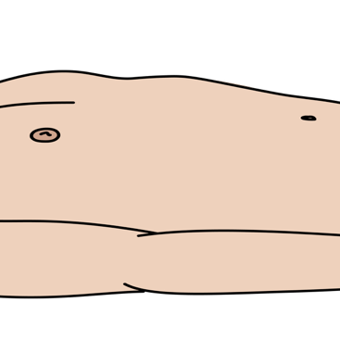
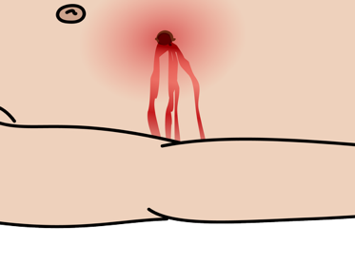
Listen
Gurgling or sucking sound from a chest wound
Strange noises
Notes:
Breathing: Listen:
Listen for any abnormal sounds when the person breathes.
Gurgling or sucking sounds during breathing can be a sign of a significant injury to the chest and a life-threatening emergency.

Slide 26
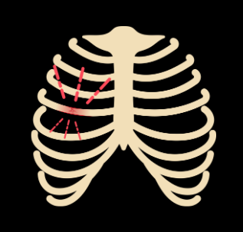
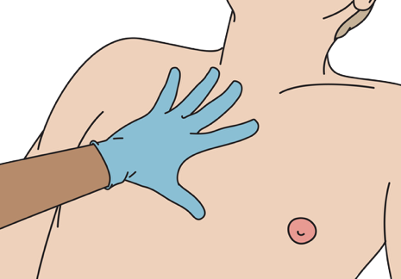
Feel
Chest movement
Cracking or popping
Notes:
Breathing: Feel:
Simply putting your hands on the chest wall will allow you to feel movement of the chest when the person is breathing.
If you feel strange cracking and popping when touching the skin, this can be a sign that ribs are broken or that air is outside of the lung and into the tissues of the chest. In these cases, the lung may be collapsed (this is called a pneumothorax) and breathing may worsen rapidly.

Slide 27
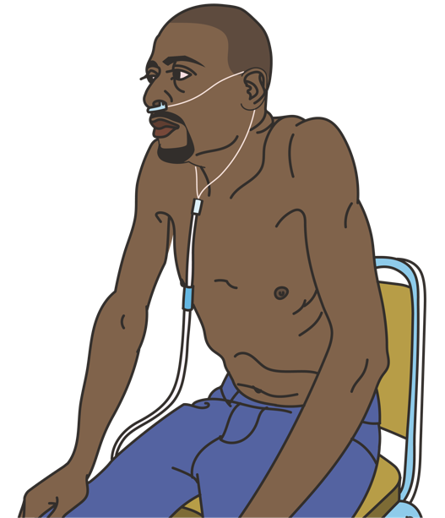
DO
Help them sit up or sit in a comfortable position.
Don’t move them if you think they hurt their neck or back.
Prepare for rapid transfer to a health facility.
Notes:
Breathing: What to do?
Patients with severe difficulty in breathing should be allowed to sit upright or in any other position of comfort that allows them to best move air into their lungs unless they require spinal immobilization.
The goal of the breathing assessment during the CABCDE approach for CFARs is to identify signs of life-threatening difficulty in breathing and prepare for rapid transfer to an appropriate higher level of care.

Slide 28

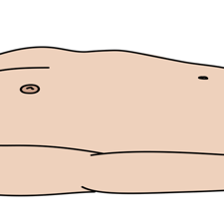
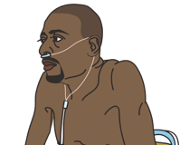
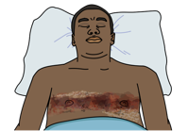
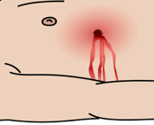
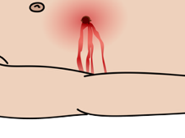
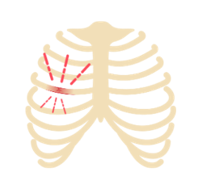
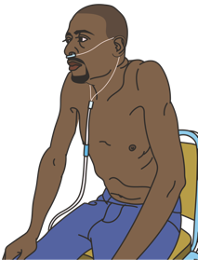


Look
Listen
Feel
DO
Notes:
Review of “Breathing” for patients with emergency trauma conditions.

Slide 29

Special Considerations for Pregnant Women
Pregnancy pushes the abdomen up toward the head less space for the lungs to expand in late pregnancy.
Difficulty in breathing can worsen rapidly.
Notes:
Special considerations for pregnant women:
Pregnancy pushes everything up toward the head, so there is less space for the lungs to expand in late pregnancy.
Difficulty in breathing can worsen rapidly.

Slide 30


Slide 31




Look
Significant bleeding–External or Internal
Signs of poor circulation
Burn–esp. circumferential
Bruising on the chest or abdomen
Notes:
Circulation: Look:
You may see significant external bleeding after a trauma.
External bleeding can sometimes be missed from injuries on the back of the head or the body that will not be found without looking over the person carefully.
When bleeding is internal, you will have to look for other signs of blood loss and shock.
Bruising on the chest or abdomen may also be signs of internal bleeding. Severe pain in the chest or abdomen may also indicate internal injury.
Signs that blood loss is leading to poor circulation include cold, sweaty/damp, and pale skin. The person may feel dizzy, confused, or restless.
Be aware of burns and note whether there are any burns are circling around an entire area of the body, these are called circumferential burns and they can lead to constriction, preventing normal blood flow.

Slide 32






Feel
Pain when you gently touch the chest, abdomen, or hips
Too fast/weak/slow or no pulse
Capillary Refill Time
Cold or sweaty hands or feet
Notes:
Feel for cold or damp limbs, as the loss of blood internally or externally will often lead to less blood flow in the arms or legs first.
Feel the person's pulse (or heart rate) in their neck or wrist to see if it is very fast, very slow, very weak, or even absent.
Check the capillary refill time by pressing on the nail of the person, it may be greater than 3 seconds.
Severe pain when the chest, abdomen, or pelvis (or hips) are gently touched can also be a sign of internal bleeding or other severe injury.

Slide 33





DO
Direct pressure or Deep Wound Packing for any remaining bleeding.
Lay a patient in shock down to improve circulation.
Splint large fractures and foreign bodies
Apply a pelvic binder for pelvic injuries
Prepare for rapid transfer to a health facility.
Notes:
What to do?
Major bleeding should be controlled in the first step of the CABCDE approach. Control any remaining bleeding in the circulation step with direct pressure or deep wound packing.
Bleeding control
While you have already controlled major bleeding in the first step of your CABCDE approach, attempt to stop or slow any other bleeding that you see by applying direct pressure using a gloved hand.
If you do not have gloves, use plastic bags to protect yourself. You can use clean clothing or other available materials as a dressing to control bleeding.
Deep wound packing can be used for any ongoing bleeding not controlled by direct pressure.
If signs of shock are found, try to improve circulation by laying the patient down.
If you are concerned that the patients has pelvis injury, apply a pelvic binder.
Sometimes, after a major injury, the pelvis (or hip bones) can be broken. These bones protect many of the vital organs that are in your pelvis and abdomen.
If fractured, there is a chance that these bones might puncture an organ or blood vessel, leading to serious and severe internal bleeding.
Splint large fractures and stabilise foreign bodies to prevent bleeding.
Immobilize suspected large bone fractures (particularly the femur or thigh bone), as this can help control bleeding by preventing movement of the broken pieces.
A splint is a device used for support or immobilization of injured limbs. Be sure to check for signs of continued or worsening bleeding even if a splint is placed.
A splint should only be placed during circulation assessment if there is concern for ongoing active bleeding, such as thighbone fracture.
Otherwise splinting smaller bones such as in the forearm can wait until after the CABCDE assessment.
If no pulse is felt and there are no other signs of life, consider starting CPR per your local protocols. However, the goal of the circulation assessment is to identify signs of life-threatening shock and prepare for rapid transfer to an appropriate higher level of care.

Slide 34















Look
DO
Feel
Notes:
Review of “Circulation” for patients with emergency trauma conditions.

Slide 35

Stabilizing a Foreign Body
Do NOT remove the object!
  Apply dressings to stabilize it.
  Apply pressure to control any bleeding around it.
  Transport to the hospital.
Notes:
Stabilising foreign bodies
A foreign body is something in the human body that does not belong there. It can be inserted or penetrating into the body such as a knife in the arm or a nail in the foot or swallowed or inhaled such as a small toy. This can happen accidentally or intentionally.
As a CFAR, if you encounter a penetrating foreign body, do NOT remove the object! Apply dressings to stabilise the object and prevent movement. Control any bleeding with pressure around the object and transport the person to the hospital.

Slide 36


Special Considerations for Pregnant Women
  Transport to a hospital capable of handling obstetric patients.
  If after trauma, even if not pregnant–Transport to a health facility
  If no concern for spinal injury, lay her on her left side.
Notes:
Keep in mind the following special considerations for pregnancy women:
Check for vaginal bleeding.
If a woman is pregnant and experiencing vaginal bleeding, this is an emergency requiring transportation to a hospital capable of handling obstetric patients.
If a woman is experiencing vaginal bleeding after a trauma even if not pregnant, there still may be a very serious injury that needs to be treated at a health facility.
If a pregnant woman appears to be in shock, and without findings concerning for spinal injury, lay her on her left side if possible, as this allows more blood to return to the heart to improve circulation.

Slide 37


Slide 38










Look
Unequal pupil sizes
Abnormal or lack of extremities movement
Excessive sleepiness, confusion, or abnormal behaviour.
Vomiting
Repetitive shaking
Head wound or skull deformity
Blood or fluid from the ears or nose
Notes:
Look for excessive sleepiness, confusion, or abnormal behaviour. Keep in mind that repetitive shaking movements, this could indicate a seizure or convulsion.
Abnormal or lack of movement in any of the extremities could be a sign of an injury to the brain or spinal cord.
Pupils are black circles in the centre of the eyes, unequal pupils sizes may indicate dangerously high levels of pressure within the brain.
Look for wounds on the head, deformity of the skull, vomiting, blood or fluid coming from the ears or nose are concerning.

Slide 39

Listen
?
Confused or disoriented when you speak to them.
Notes:
Listen for evidence of confusion or disorientation when speaking with a responsive person.

Slide 40




Feel
Bumps, indentations, other skull injuries
Movement & strength
Feeling to touch in arms & legs
Notes:
Feel for bumps, indentations, or other injuries to the skull. Touch the arms and legs to assess if the person is able to feel your touch in all of them.
Ask the person to squeeze your hands or push their toes against your hands to see if they are able to move all of their extremities strongly.

Slide 41
How to assess Alertness?
Who are you?
?
Where are you?
What day is it?
Alert
Vs
Altered
Respond to voice
Respond to pain
Unresponsive
Notes:
The evaluation of disability should include assessing alertness.
Patients who are fully awake and interactive are alert.
In an alert and responsive person, ask the following questions to look for signs of confusion:
Who are you?
Where are you?
What day is it?
If the person is not fully alert, does the person respond to voice? This means they respond with sounds or movement when you call their name or ask them questions.
If not, do they respond to pain? This means they respond with sounds or movement when you pinch them or rub their chest.
Is the person completely unresponsive?
If the person is confused or not fully alert, they are altered.

Slide 42



DO
Suspected spinal injury
Do not give anything to eat or drink.
Move using a Log-Roll & stiff board.
Immobilize the spinal cord.
Prepare for rapid transfer to a health facility.
Notes:
What to do?
Prevent injury or worsening condition in patients with a suspected spinal injury by immobilizing them. Move patients using a log-roll and stiff board to prevent further injury.
In general, do not give a person with suspected brain or spine injury anything to eat or drink and plan for rapid transfer to a hospital.

Slide 43


DO
Provide first aid for possible low blood sugar.
Provide first aid for convulsions
Prepare for rapid transfer to a health facility.
Notes:
However, altered mental status can be caused by hypoglycaemia (low blood sugar) – particularly in people who have diabetes. If there is a concern for hypoglycaemia, provide first aid.
If the injured person is having a seizure/convulsions, provide first aid.
Providing first aid for hypoglycaemia and for seizure (or convulsion) will be addressed in the Medical Emergencies module.The goal of the disability assessment is to identify signs of life-threatening altered mental status or disability and prepare for rapid transfer to an appropriate higher level of care.

Slide 44















Look
Listen
?
Feel
DO
Notes:
Review of “Disability” for patients with emergency trauma conditions.

Slide 45

Conflict Consideration
Confusion or unresponsiveness after a blast injury
Can mean head injury or deafness
Immediately transfer to a health facility.
Notes:
Keep in mind the following consideration for Conflict settings
Confusion or unresponsive patients after a blast injury may have severe head injury or may have deafness (inability to hear) from the blast. These patients need immediate transfer to an appropriate health facility.

Slide 46

What are the signs of a spinal injury?
Not controlling urine or stool
Inability to move or weakness
Inability to feel or tingling sensation
Pain down the middle of the neck and back
Abnormally prolonged erection of the penis
Notes:
Immobilising the spine
CFARs must consider spinal injury in any injured person with disability.
The spine is a series of bones that protects the nerves necessary for vital functions like movement, sensation, and breathing, hence spine injury can cause damage to these nerves resulting in paralysis or even death.
Immobilization of the spine is necessary for any person with a possible spinal injury to prevent worsening injury, including paralysis, at all times during evaluation, management, and transport.
Let's review the signs of Spinal Injury:
· Loss of control of urine or stool
· Inability to move or weakness
· Inability to feel or tingling sensation
· Pain down the middle of the neck and back
· Abnormally prolonged erection of the penis
The cervical spine (neck) should be immobilised using one of the approaches noted in the airway section.
A log-roll manoeuvre is used to turn a person with concerning injury. This manoeuvre can be used to assess the back for injuries, as well as to place the person on a board, stretcher, or other rigid material for transport.

Slide 47

Special Considerations for Children
Ask if behaviour is normal.
Consider and manage hypoglycaemia in altered children.
Signs of head injury with trauma
Prepare for rapid transfer to a health facility.
Notes:
Keep in mind the following special considerations for disability evaluation and management in children:
Small children may not be able to answer questions, but a parent, family member, or other caregiver may be able to tell you if they are behaving normally.
Head injuries in children are a common cause of death from trauma. If a child has signs of head injury with trauma, plan for rapid transfer to an appropriate hospital.
Consider and manage hypoglycaemia (or low blood sugar) in altered children. Remember that children are more likely to have low blood sugar when critically ill or injured.

Slide 48


Slide 49





Look
Consider the need of a chaperone.
Wound or burns
Parts of the body that appear out of place
Assess the back and spine using the log-roll manoeuvre.
Notes:
Let's move now to the last part of the CABCDE Approach which is Exposure.
Exposure instructs us to expose a person’s body to look for any signs of injury after a traumatic event that may not have been otherwise assessed and may require emergent treatment.
It is important to expose the person by examining the entire body for evidence of injury, including the back, underarms, and groin (while maintaining respect for the dignity and privacy of the individual).
The person should be inspected for any signs of further injury.
Remove all clothing as appropriate to find injury. Look for swelling or bruising.
Remember, the back, underarms and groin can be places where injuries are missed.
Always consider the need for a chaperone and if it is culturally appropriate to examine certain locations.
Bruising along the hips, pelvis, back, and abdomen can all be signs of significant internal bleeding.
Look for parts of the body that appear out of place.
Look for wounds or burns.
Assess the person’s back and spine using the log-roll manoeuvre.

Slide 50


Feel
Additional injuries (e.g., wounds or deformed bones)
Fractures, dislocations, or sprains
Notes:
You may identify additional injuries during exposure, such as wounds or deformed bones. Injured arms and legs may have fractures, dislocations (which are abnormal separation of two bones at a joint), or sprains (which are injuries to muscles or tendons).

Slide 51

What are the signs of fractures?
  Abnormal shape
  Severe pain, bruising, or swelling
  Can’t stand or walk
  Unnatural movement or grinding sounds
  Exposed bone
  Other injuries with broken bones:
  Open wounds infection risk
  Blood vessels damage feel for pulses
Notes:
Signs of fractures include deformity or abnormal shape, or severe pain, bruising, or swelling, inability to use limb or stand or walk, unnatural movement or grinding sounds, and exposed bone fragments.
Broken bones can be associated with other injuries. Open wounds around the broken bone may signal an open fracture. Open fracture is an emergency as it puts the patient at risk of severe infection. Feel for pulses, as some breaks can cause bleeding or cause damage to blood vessels.

Slide 52






DO
Cover quickly to prevent hypothermia
Remove restricting jewellery
Provide first aid for wounds, bites or burns
Splints or slings for limb injuries
Prepare for rapid transfer to a health facility.
Notes:
What to do?
Remove restricting clothing and jewellery. Make sure to cover the injured person as soon as possible to prevent hypothermia. Respect the patient’s privacy and protect modesty during exposure. If time allows, immobilise injuries to limbs with splints or slings and provide first aids for wounds. Remember that the priority for all significant injuries is to prepare for rapid transfer to a health facility.

Slide 53













Look
DO
Feel
Notes:
Review of “Exposure” for patients with emergency trauma conditions.

Slide 54

Special Considerations for Children
Undress fully but prevent hypothermia!
Notes:
Keep in mind that for children, undress them completely, but always be concerned about potential hypothermia, especially in infants.

Slide 55

Special Considerations for Pregnant Women
seizures/convulsions
Always consider eclampsia
Rapid transfer to a specialist centre with advanced obstetric care.
Notes:
Always consider eclampsia if seizures/convulsions are present in a pregnant woman. This is a life-threatening emergency that requires rapid transfer to a specialist centre with advanced obstetric care.

Slide 56

Ask: History in Trauma
Ask about:
  Events
  Past Medical History
  Allergies
  Medications
Patients may become unresponsive when they reach the hospital—record answers early or ask a bystander to do so.
Notes:
There are a few specific questions that should be asked of persons who sustained trauma. Ask about events, past medical history, allergies, and medications.
Write down answers or, if you are not able to, ask a bystander to help record.
The answers to these questions can be very useful for facility-based providers.
Ask about the events surrounding the injury
Remember to ask questions about the pain. Is there any pain? Where is the pain? What does it feel like and how severe is it?
Remember, pain is a sign of underlying injury.
A headache may indicate a person has an injury to the skull or brain. Pain may be the first suggestion of injury even if there is no external sign.
Ask about the mechanism of injury (how did it happen). Ask about wearing of seatbelts in road traffic incidents. For assault victims, ask about the type of weapon.
Inquire whether there were drugs or alcohol involved, as this may mask an injury. For burns, ask about what caused the burn.
Ask others if the patient was found in or near water that might suggest drowning.
Ask about past medical history.
Important information can be found by asking the person if they have any history of other medical problems, such as diabetes, high blood pressure, stroke, and more.
When appropriate, remember to ask if the injured person is pregnant.
Ask about allergies.
Remember to ask patients (or their friends or family if they are unable to respond) if they are allergic to any medications or other substances.
This information will be very important for providers at the receiving health facility.
All patients are at risk of worsening, and they may not be able to tell this information later.
Ask about medications.
Always ask whether the person is taking any medications. Certain medications can be very important for health workers to know.
For example, if they are taking blood thinning medications, it can make bleeding very difficult to control.
Blood pressure medications can mask a fast heart rate and complicate the evaluation of trauma.

Slide 57

High-Risk Injuries
Notes:
Consider higher risk for serious injuries even in well appearing patients.
Consider hidden injuries and observe closely.
What do you think are injuries. That can be high-risk?
Certain types of trauma are higher risk for serious injuries. Even if the person does not appear to be significantly injured, consider hidden injuries and observe closely in such cases. This includes:
Falls greater twice the patient’s height
Penetrating trauma proximal to the knee/elbow or any penetrating trauma with uncontrolled bleeding
Crush or blast injury
High speed motor vehicle crash
Pedestrian or a cyclist hit by a vehicle
Motor vehicle crash without seatbelt or other person in the same vehicle died
Trapped or thrown from vehicle (including motorcycle)

Slide 58



Special Considerations for Pregnant Women
Minor trauma = Risk to mother and baby
Ask how far along the pregnancy is and if there are any complications.
Uterus is felt at the umbilicus = $≥$20 week
Notes:
In Pregnant women, it is important to highlight that:
Pregnancy causes many changes in the mother's body. Because of this, even minor trauma may result in harm to both mother and baby.
When taking your history, ask about how far along the pregnancy is (which is called the gestational age) and whether there have been any complications. If the uterus can be felt at the level of the umbilicus, the pregnancy is at least 20 weeks.

Slide 59

Special Considerations for Children
Less force
May look stable
Unclear cause
Serious injury
Can worsen quickly
consider possible violence and ensure child safety.
Notes:
For children, keep in mind the following special considerations:
Children require less force to sustain more serious injuries. This means that trauma that might not hurt an adult can easily hurt a child.
Children can look well for a long time and then become worse very quickly. Because of these things, any trauma in a child is an emergency. Children must be stabilized and transported at once.
Consider violence against children when assessing any child with injuries that have unclear history and/or presentation. Be certain that child is safe even if the injury is not that serious.

Slide 60







Conflict Considerations
Mechanisms of injury
Blast
Burns
Shrapnel
Chemicals and toxins
Gunshot
Thrown body
Always ask and document how the injury happened. Mechanisms matter for care decisions!
Notes:
It is important to keep in mind the following considerations in conflict settings:
Ask about and record the events that caused the injury. Health facilities may change their approach to caring for the patient once transferred to a higher level of care if they know that their wounds were sustained during a blast or other specific high-risk trauma mechanism.
Blast injuries from explosions can affect all systems of the body.
Blasts can cause direct injury from shrapnel or other objects that strike the body in an explosion, as well as from exposure to burns, chemicals, toxins, or harmful radiation.
The pressure changes caused by explosion can also cause injury to important internal organs like the lungs, intestines, and ears.
Additional injuries can occur when the body itself is thrown from the blast. Penetrating injuries are also common in conflict trauma.

Slide 61




Conflict Considerations
Blast can injure internal organs without visible wounds.
Ear
Lungs
Intestine
Notes:
The pressure changes caused by explosion can also cause injury to important internal organs like the lungs, intestines, and ears.

Slide 62

Conflict Considerations
Wound Location = Organ Damage
Check for hidden injuries
Notes:
The pressure changes caused by explosion can also cause injury to important internal organs like the lungs, intestines, and ears.

Slide 63






Handover: SBAR
Situation
Introduce yourself
Who is the patient?
Background
What happened?
When? Where? Why?
Assessment
Information about CABCDE assessment
Recommendation
Explain the patient’s need for further emergency care
Next steps in the transport plan
Any additional concerns
Notes:
Instructions for Handover and Documentation:
Situation: Introduce yourself to the health worker receiving the handover. Explain that you are a CFAR and have provided first aid for this patient experiencing a health emergency.
Who is the patient? Share the patient’s name, gender, age, and pregnancy status, if known.
It is helpful to clarify if this is a medical or a trauma health emergency.
Background: Provide information about the patient and any events leading up to the illness or injury.
What happened to the patient? What is the patient complaining of? When did the patient become ill or injured? Where did the patient become ill or injured? How did the patient become ill or injured?
Share any other information, such as any past medical history, medications, allergies, or anything else you are concerned about.
Assessment: Provide information about what you found during your CABCDE assessment, as well as any first aid provided.
Was there any major bleeding? If so, was any first aid provided?
Was there any problem or danger signs with the airway? If so, was any first aid provided?
Was there any problem or danger signs with breathing? If so, was any first aid provided?
Was there any problem or danger signs with circulation? If so, was any first aid provided?
Was there any problem or danger signs with disability? If so, was any first aid provided?
Was there any problem or danger signs with exposure? If so, was any first aid provided?
Recommendation: Explain that you believe this patient requires further emergency care.
Recommend next steps in a transport plan.
Share any additional concerns or specific precautions that should be taken. For example, tell the next provider if you are worried about a highly infectious disease.
Document this information as a short handover note. Include the date and time that you cared for the patient.

Slide 64
Questions?
Notes:
Do you have any questions?

Slide 65

Summary
Prioritize your personal safety and continually assess the scene for hazards.
Notes:
As we reach the end of this module, let's summarize the key points that we've covered:
Accidents and other scenes of injuries can be dangerous.
Always prioritise your personal safety and continually assess the scene for hazards. Injuries can be scary for the patient and the provider.
Remember to follow the CABCDE approach. If a CABCDE problem is found, address it immediately. Repeat the CABCDE assessment at regular intervals during management.
If a CABCDE injury is found, be prepared to transfer for further care from a health facility.

