Slide 1
Module 5: Approach to Medical Emergencies
Community First Aid Response Course
Notes:
Welcome to Module 5 of the Community First Aid Response Course: Medical Emergencies

Slide 2
Module 5: Learning Objectives
Perform the CABCDE approach for the evaluation of people with medical emergencies
Demonstrate critical interventions for life-threatening
illness
Identify key history findings for life-threatening illness
Assess special considerations in the care of medical emergencies in children and pregnant women
Recognize key considerations in the care of common medical emergencies
Notes:
Before we dive into the content, let’s outline this module's learning objectives:
On completing this module, you should be able to:
Perform the CABCDE approach for the evaluation of people with medical emergencies
Demonstrate critical interventions for life-threatening illness
Identify key history findings for life-threatening illness
Assess special considerations in the care of medical emergencies in children and pregnant women
Recognize key considerations in the care of common medical emergencies

Slide 3
Key Terms
Difficulty in Breathing (DIB)
Shock
Altered Mental Status
Choking
Foreign Body
Tripod position
Anaphylaxis
Wheezing
Haemorrhage
Dehydration
Sepsis
Pulse
Capillary Refill Time
Oral Rehydration Solution (ORS)
Convulsion/Seizure
Low blood sugar
Notes:
Now, take a moment to review the list of key terms that you are expected to be able to define by the end of this module.

Slide 4

Approach: CABCDE
Begin evaluation with the CABCDE approach.
Ensure scene safety before proceeding.
Ideally within the first 5 minutes and repeat anytime their condition worsens.​
  Do not move forward in the CABCDE approach until you have assessed and treated any life threats.
Notes:
As with all initial evaluations, the approach to a person with a medical emergency should begin with the CABCDE approach. This should be done as soon as it is safe.
The CABCDE approach includes the initial assessment and management for life-threatening medical conditions, including airway obstruction, difficulty in breathing, shock, and altered mental status/disability.
Look, listen, and feel during each step.

Slide 5
Approach: CABCDE
CABCDE approach addresses life-threatening conditions, including airway obstruction, difficulty in breathing, shock, and altered mental status/disability.
Look, listen, and feel during each step.
Notes:
As with all initial evaluations, the approach to a person with a medical emergency should begin with the CABCDE approach. This should be done as soon as it is safe.
The CABCDE approach includes the initial assessment and management for life-threatening medical conditions, including airway obstruction, difficulty in breathing, shock, and altered mental status/disability.
Look, listen, and feel during each step.

Slide 6
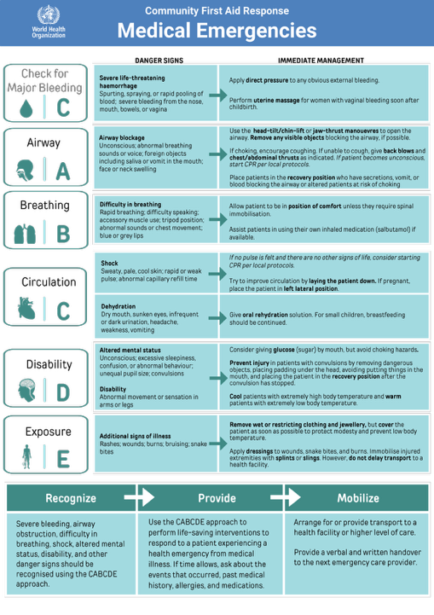

Slide 7
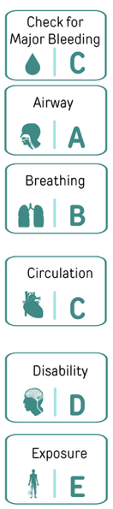
Review: What are we looking for in each step?
Major bleeding
Airway obstruction
Difficulty in breathing
Shock or other bleeding
Altered mental status or disability
Other danger signs
Notes:
Let's review what we are looking for in each step:
In the first step, C or check for major bleeding, obviously we are looking for major bleeding. In A, we are looking for airway obstruction. In B, we are looking for difficulty in breathing,. In C, we are looking for shock or other bleeding. In D, we are looking for altered mental status or disability. While in E, we are looking for any other danger signs.

Slide 8
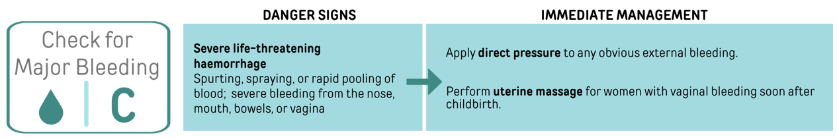

Slide 9
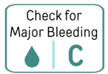

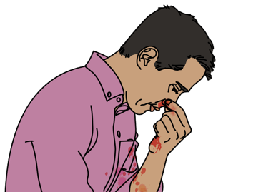
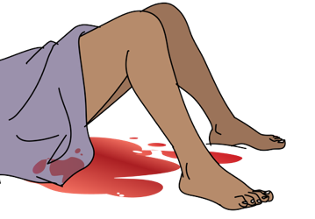
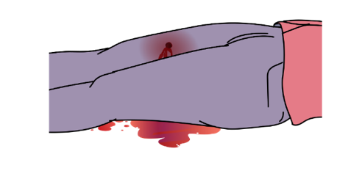
Look
Blood coming out fast
Blood spraying or making a puddle
Severe bleeding from nose, mouth,
bowels, or vagina.
Bleeding from the vagina soon after childbirth
Notes:
In medical emergencies, a person may have signs of severe bleeding (or haemorrhage) from their body, mouth or nose. Look for blood flowing rapidly, spraying, or pooling. Large amounts of bleeding can cause death very quickly. Severe bleeding can come from nose, mouth, bowels (intestines), or vagina. Bleeding from the vagina soon after childbirth is a major cause of death for new mothers.

Slide 10

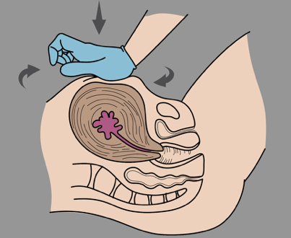

DO
Apply direct pressure.
Perform uterine massage for vaginal bleeding soon after childbirth.
Bleeding from inside of the body can be hard to control
Prepare for rapid transfer to a health facility
Notes:
Apply direct pressure to any obvious external bleeding using a gloved hand.
If you do not have gloves, you can use clean clothing or other available materials to control bleeding.
Woman with vaginal bleeding soon after childbirth can develop life-threatening shock. This severe vaginal bleeding after childbirth can be slowed in some cases by massaging the uterus.
Bleeding from inside of the body, such as the intestines, can be hard to control, so rapid transfer is the priority.

Slide 11




Look
DO
Notes:
Review of “Check for Major Bleeding” for patients with emergency medical conditions.

Slide 12
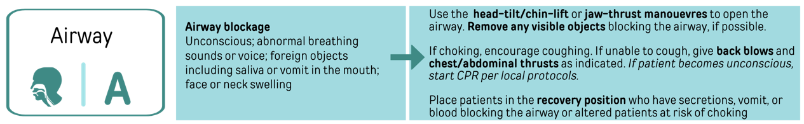

Slide 13

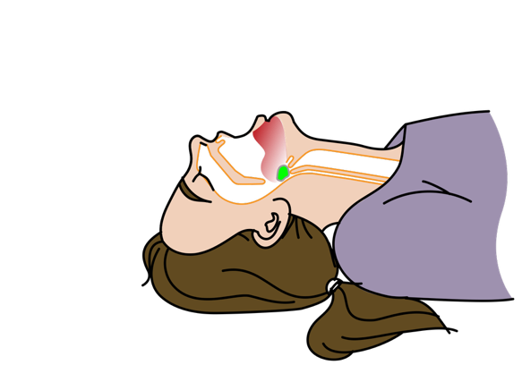
Airway Obstruction or Blockage Difficulty in Breathing
Remember
What is Difficulty in Breathing (DIB)?
What are the causes of DIB?
Notes:
In a medical emergency, a person may have an obstruction or a blockage in the airway that can cause difficulty in breathing.
In a normal unobstructed airway, the mouth, nose, and throat are clearly visible, air passes freely, speech is clear, and there are no abnormal sounds during breathing.
Remember:
Difficulty in breathing (or DIB) is used to describe a range of conditions that cause a feeling of shortness of breath, abnormal breathing movements, or any increased effort needed to breathe.
DIB can result from problems in the mouth, throat, lungs, heart, or muscles used for breathing or from conditions that cause increased breathing rate
DIB Causes:
Upper or lower airway obstruction
Blockage by an object
Constriction of the airways, such as with asthma
Swelling due to allergy
Infection
Injury
Fluid inside the lungs
Pneumonia
Heart failure
Air or fluid outside the lung causing collapse
Blood clots in the vessels supplying the lungs
Any other cause of decreased oxygen carried in the blood such as Anaemia
Conditions that increase breathing rate such as Ingestion of toxin or poison, Chemical imbalance (diabetic ketoacidosis), Shock, and Anxiety or stress

Slide 14
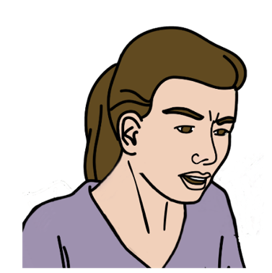
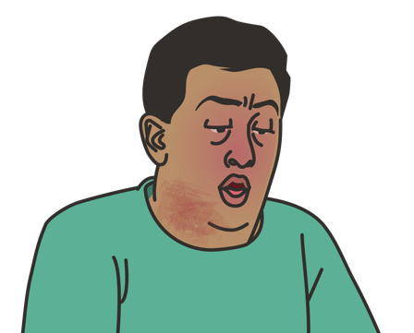
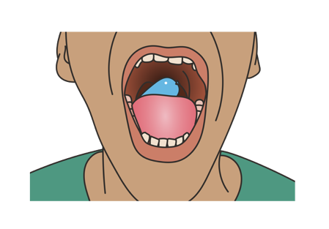
Look
Signs of fast breathing
Foreign body, vomit or saliva in mouth
Swelling in face, mouth or neck
Notes:
Look, listen, and feel for signs of airway blockage that may cause difficulty in breathing.
Look for any signs of rapid or fast breathing.
If an object is blocking the mouth, this is called a foreign body.
In an unresponsive patient, you may find vomit or saliva in the mouth that may be causing obstruction of the airway.
If there is any facial, mouth, or neck swelling, this could be a sign of an allergic reaction or infection that may require immediate treatment.

Slide 15

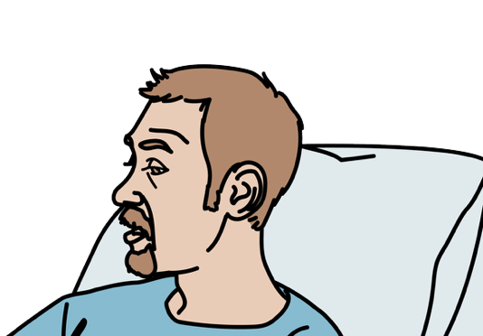

Listen
Changes in voice or no breathing
Notes:
Listen
If the patient is talking, this is a sign that there is at least some air movement.
If the patient is quiet, first see if they can talk. When they talk, assess whether the speech is clear. Listen for extra sounds.
Gurgling (Which is a low-pitched bubbling) may be a sign of mucous or fluid in the airway. A whistling or high-pitched sound can indicate a blockage in the upper airway.

Slide 16


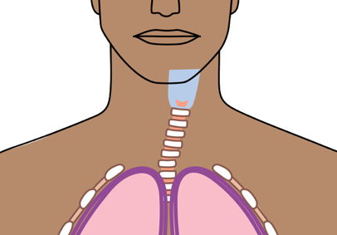
Feel
Deviated airway
Air movement in front of nose or mouse
The airway should be in the middle of the neck
Notes:
Feel
If you are unable to hear any air movement, sometimes you can still feel air moving by placing your hand in front of the nose and mouth.
The airway should be centred in the middle of the neck. If it is off to one side, this may be a sign of something in the neck blocking the airway or a severe breathing problem.

Slide 17
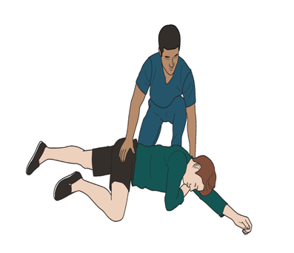
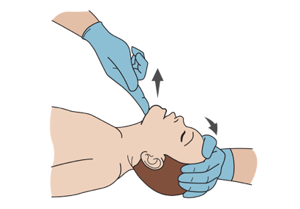
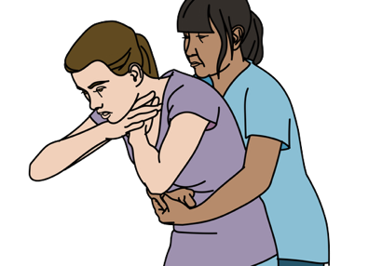
DO
Head Tilt/Chin Lift or Jaw-Thrust
Remove obstruction if possible.
Recovery position.
Prepare for rapid transfer to a health facility.
Notes:
So, what to do for the airway?
Open the airway (using head-tilt/chin-lift or jaw thrust) in patients with airway blockage to allow breathing to deliver adequate oxygen to the lungs.
If possible, remove any objects blocking the airway.
Use the recovery position for people with secretions, vomit, or blood blocking the airway or those with altered mental status at risk of choking.
If other danger signs of airway obstruction are found, prepare for rapid transfer to a higher level of care
At times, a patient’s tongue and soft tissues of the mouth can cause a blockage of the airway. The Head-Tilt/Chin-Lift Manoeuvre is used to open airways of patients who are unconscious or too drowsy to protect their own airway during a medical emergency but have not been injured or suffered trauma.

Slide 18
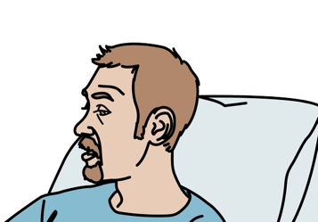
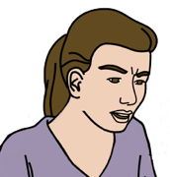
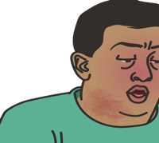
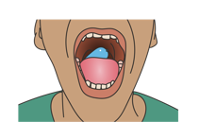




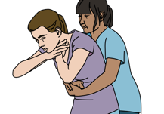


Look
Listen
Feel
DO
Notes:
Review of “Airway” for patients with emergency medical conditions.

Slide 19
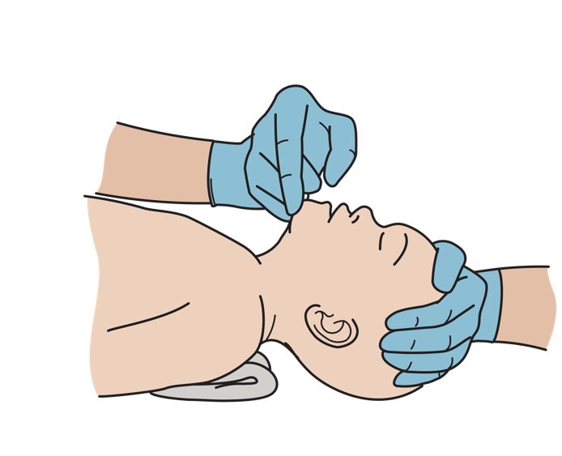
Special Considerations for Children
Children’s airways block easily — place a towel under the shoulders and slightly rotate the head to neutral position.
Notes:
Infants have bigger tongues, shorter necks, softer airways, and bigger heads, which make them more likely to have an obstructed airway if they are not positioned correctly.
place a folded towel or piece of cloth under the shoulders and only rotate the head slightly to put it in a neutral position.
Placing padding under the shoulders can ensure that the neck is not overextended or over-flexed and the airway stays open.

Slide 20
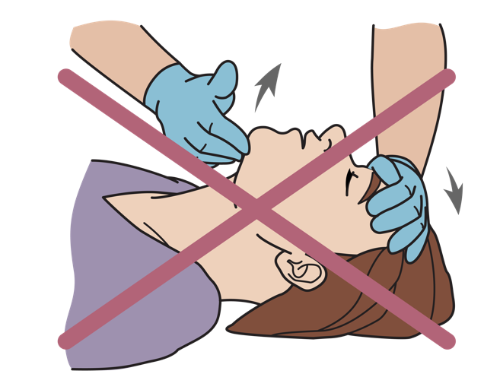
REMEMBER
Use head-tilt/chin-lift ONLY if no concern for trauma.
Jaw thrust is safe for adults and children.
Notes:
Remember: The Head-Tilt/Chin-Lift Manoeuvre can only be used in patients where there is no concern for injury or trauma.
However, the jaw thrust can be safely used in all adults and children.

Slide 21
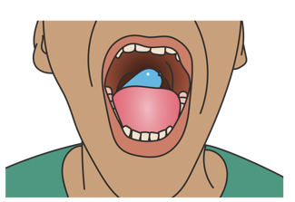
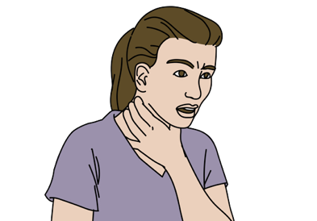

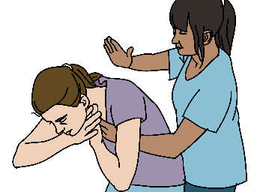
Opening the Airway: Foreign Body
If visible consider removing only if easily accessible
use choking management to clear the airway.
If not clearly visible
Notes:
What to do in case of the presence of a foreign body blocking the airway?
If an object is blocking the airway, the object is referred to as a foreign body. A foreign body can be a piece of food, candy, toy, coin, or any other object that is not supposed to be there.
Foreign bodies can cause difficulty talking, abnormal sounds, or difficulty in breathing. Patients may become drowsy or unresponsive if they are not able to get
enough oxygen to their lungs.
If a foreign body is obviously visible – consider removing it.
However, beware that if you do not get a hold of the object, there is a risk that you can push it further into the airway causing a more severe obstruction. Also, you are at risk of being bitten or exposed to body fluids. Never reach in without a gloved hand.
If not clearly visible - use choking management to clear the airway.
If the patient can cough or make noise, keep the patient calm and encourage them to keep coughing.
If the patient is unable to cough or make sounds/talk, use abdominal thrusts and back blows until the obstruction is relieved.

Slide 22
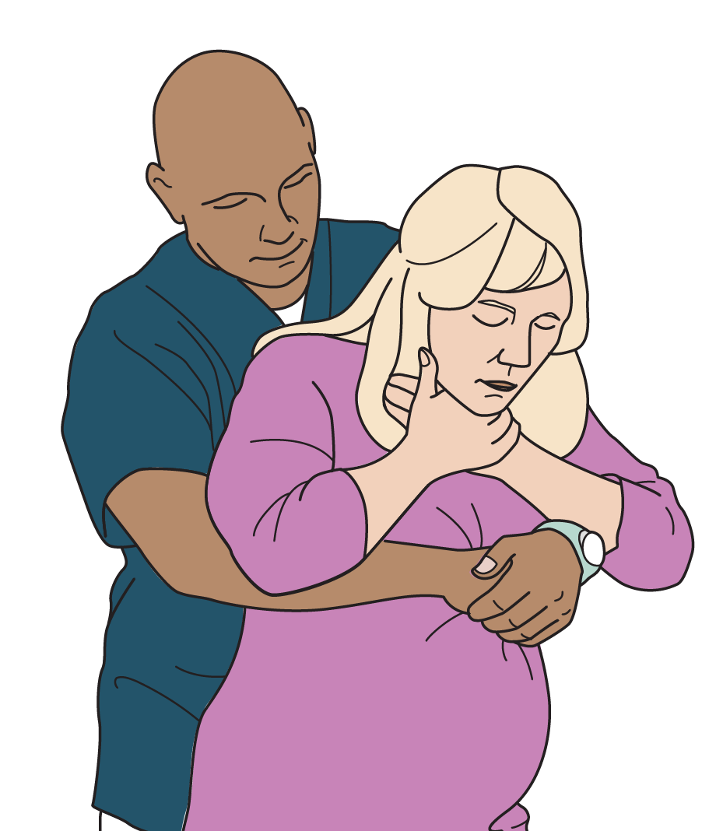
Special Considerations for Pregnant Women
Use chest thrusts and back blows.
Chest thrusts are also acceptable for obese patients.
Notes:
In a pregnant patient, perform chest thrusts (over the centre of the chest) instead of abdominal thrusts.
Chest thrusts are also acceptable for obese patients whose bodies may be too large to wrap your arms around at stomach level.

Slide 23
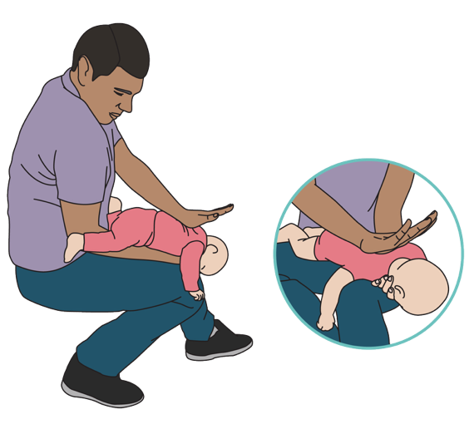
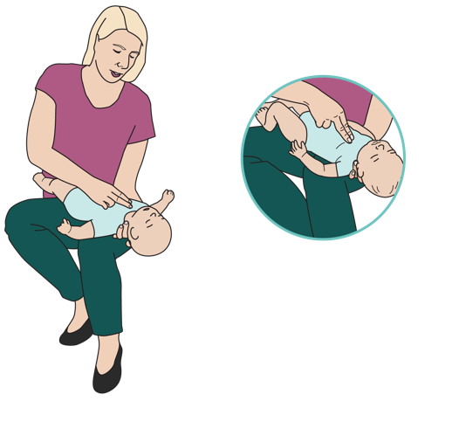
Special Considerations for Children
Because of infants’ small size, use different technique for back blows and chest thrusts.
Notes:
In infants, you will also back blows and chest thrusts, but with slightly different technique because of their small size.

Slide 24
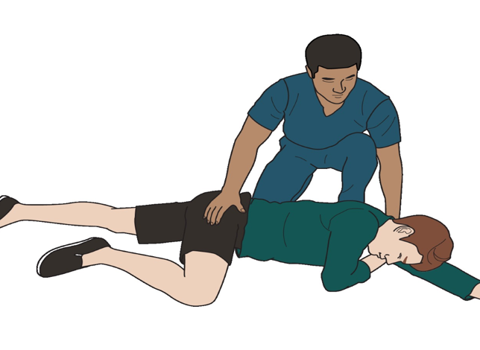
Airway: Unresponsive Patient
When alone, put the unresponsive patient in the recovery position to prevent choking
Prepare for rapid transfer to a health facility.
Notes:
How to maintain an open airway in an unresponsive patient?
When a CFAR is alone, they may need their hands to attend to other life threats or to arrange for rapid transportation to a higher level of care, which make it unrealistic to use the Head-Tilt/Chin-Lift Manoeuvre or Jaw-Thrust Manoeuvre to continuously maintain the airway
In such case, CFARs can put the patient in the recovery position.
The recovery position is also good for unresponsive patients who are at risk of choking from secretions (vomit or blood) or those with altered mental status (such as those who are severely intoxicated or have just had a convulsion).

Slide 25
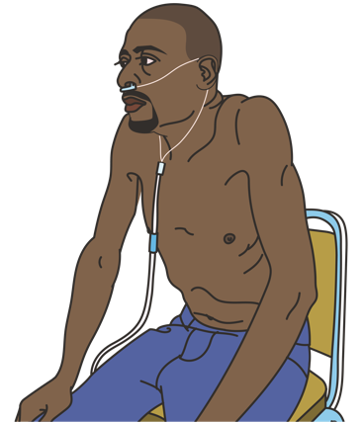
Airway: Alert Patient with DIB
Allow patients to sit upright or in any other position of comfort.
Prepare for rapid transfer to a health facility.
Notes:
How to maintain an open airway in an awake patients with difficulty in breathing?
Some patients may have difficulty in breathing due to another cause of airway obstruction other than choking, such as severe allergic reaction or infection. Unlike patient with altered mental status or unconscious patients, these patients should be allowed to sit upright or in any other position of comfort that allows them to best move air into their lungs. You should plan for rapid transfer to a hospital or health facility that is able to provide emergency care.

Slide 26
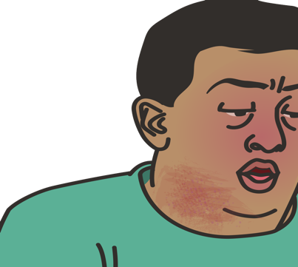

Airway: Severe Allergy (Anaphylaxis)
Help patients with airway obstruction due to severe allergy use their own emergency medication.
Prepare for rapid transfer to a health facility.
Notes:
How to act with patients with airway obstruction due to severe allergy (or anaphylaxis)?
A patient with severe allergy (anaphylaxis) may have airway obstruction (from swelling of the throat), DIB (from airway obstruction in both the upper and lower airways) with wheezing or cough, vomiting, diarrhoea, abdominal pain, itchy rash, lip or tongue swelling, and signs of shock.
Plan for immediate transfer to a hospital or clinic for treatment with medications.
The patient may have their own medication, and you can help take them use it.

Slide 27

REMEMBER
Abnormal sounds or DIB Reassess the airway often as a partial obstruction may worsen to completely block the airway.
Notes:
How to act with patients with airway obstruction due to severe allergy (or anaphylaxis)?
A patient with severe allergy (anaphylaxis) may have airway obstruction (from swelling of the throat), DIB (from airway obstruction in both the upper and lower airways) with wheezing or cough, vomiting, diarrhoea, abdominal pain, itchy rash, lip or tongue swelling, and signs of shock.
Plan for immediate transfer to a hospital or clinic for treatment with medications.
The patient may have their own medication, and you can help take them use it.

Slide 28
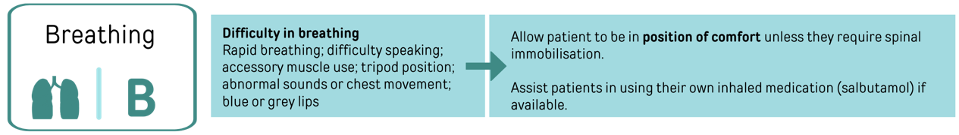

Slide 29

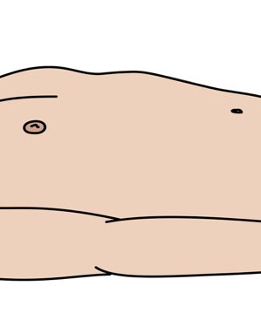
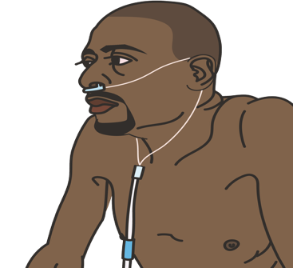
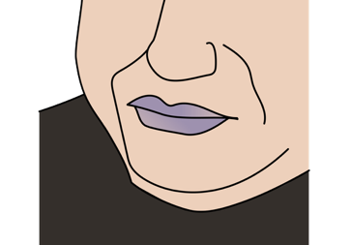
Look
Chest movement
Increased work of breathing
Tripod position
Blue or grey colour around the lips
Fast, slow or absent Breathing
Notes:
If the airway is open and a person is still experiencing difficulty in breathing, the problem may be due to a condition that is impacting the lungs directly (infection, collapse, fluid, asthma, allergy) or a condition impacting the whole body (such as anemia, poisoning, or seizures/convulsions). So you have to check by Look, Listen, and Feel for signs of life-threatening conditions impacting breathing.
Look for any signs of rapid or fast breathing, as well as very slow or absent breathing.
Looking at the movement of the chest can help to evaluate if breaths are very shallow or very deep.
If the body cannot get enough oxygen for any reason, a patient may use extra muscles in the neck, chest, and abdomen to draw more air into the body. This is called increased work of breathing.
At times, patients with breathing problems may lean forward with their hands on their knees in a position known as “tripod”.
The patient may have a blue or grey colour around the lips (which is called cyanosis), which can indicate low oxygen levels in the body.

Slide 30


Listen
Air movement and any abnormal sounds
Wheezing or gurgling
Notes:
Listen
Listen for air movement and any abnormal sounds.
A patient with wheezing (high-pitched sound during exhalation) may have asthma, COPD, or a severe allergy.
A gurgling sound (low-pitched bubbling) may be heard as a result of fluid build-up in the airways or lungs.

Slide 31
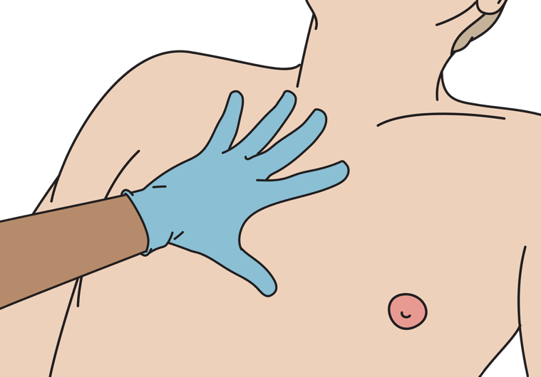
Feel
Assess breathing when very slow or shallow
Notes:
Feel
Sometimes feeling the chest wall can help to assess breathing when it is very shallow or slow.

Slide 32
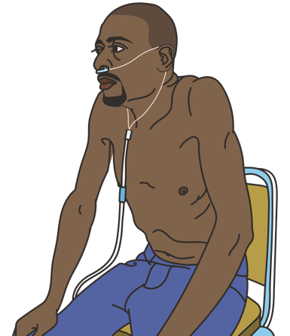
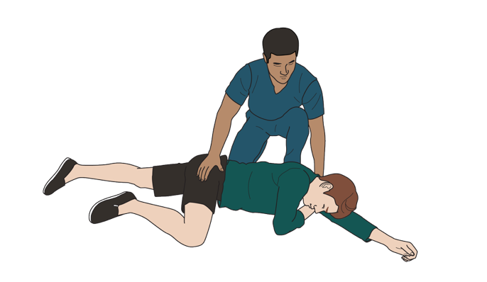
DO
Place unconscious patients in the recovery position
Help patients with DIB sit up or sit in a comfortable position.
Prepare for rapid transfer to a health facility.
Notes:
DO
Patients with severe difficulty in breathing should be allowed to sit upright or in any other position that allows them to best move air into their lungs. Those who are unconscious or drowsy can be placed in the recovery position as described above.
The goal of the breathing assessment during the CABCDE approach for CFARs is to identify signs of life-threatening difficulty in breathing and prepare for rapid transfer to an appropriate higher level of care.

Slide 33

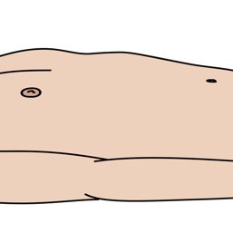

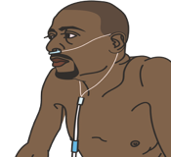

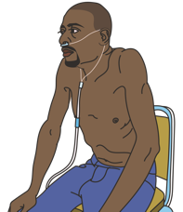
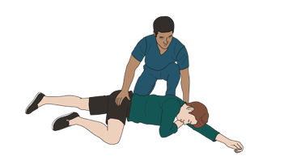


Look
Listen
Feel
DO
Notes:
Review of “Breathing” for patients with emergency medical conditions.

Slide 34

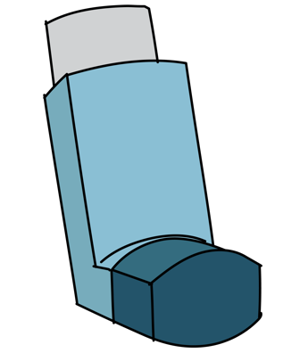
Difficulty in Breathing: Wheezing
Wheezing or cough with DIB can be caused by asthma or chronic obstructive pulmonary disease (COPD)
Extra muscles use
History of allergies or smoking.
Help them use their own medication if they have it.
Tripod position or position of comfort.
Prepare for rapid transfer to a health facility.
Notes:
Let's review some important medical emergency conditions that cause difficulty in breathing:
Asthma or Chronic Obstructive Pulmonary Disease (or COPD)
A patient with Asthma or COPD can have wheezing and cough in the setting of difficulty in breathing.
Such patients may be using extra muscles of the neck, chest, and abdomen to help in draw more air to breathe. they may have a history of allergies or smoking.
Allow asthma/COPD patients to sit in a position of comfort that allows them to best move air while they await transfer. Often, the patients will want to sit in what is called the "tripod" position.
Patients with asthma or COPD as the cause of difficulty in breathing will need immediate transfer to a hospital or clinic for treatment with medications that help breathing.
At times, a patient may have their own medication, and you can help take them use their own inhaler. A common medication for treatment of asthma/COPD is salbutamol.

Slide 35
Special Considerations for children
Rapid breathing
Extra muscle use
Retractions
Blue or grey discolouration of lips
Excessive sleepiness
Drooling
Abnormal sounds during breathing
DIB Danger Signs!
Notes:
Consider the following danger signs in children with difficulty in breathing:
rapid breathing
increased work of breathing (or extra muscle use)
pulling inward between the upper chest and neck or under the ribs when breathing (or retractions)
blue or grey discolouration of lips (which is called cyanosis)
excessive sleepiness
drooling
abnormal sounds during breathing as they can indicate an infection, asthma, a foreign body, swelling of the airway, and more.

Slide 36
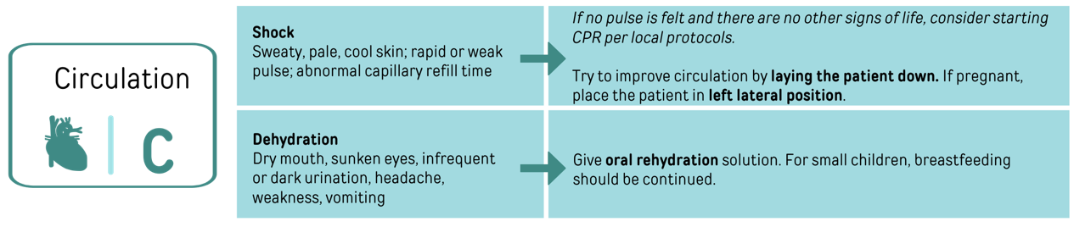

Slide 37

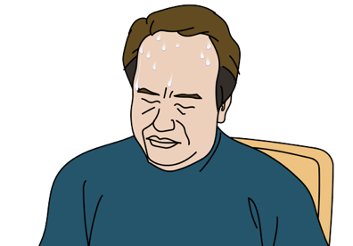
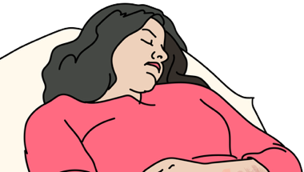
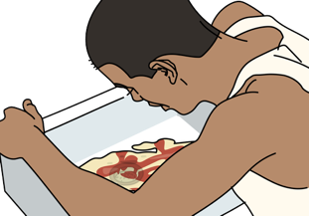
Look
Signs of poor circulation
Confusion, fainting or brief loss of consciousness.
Evidence of bleeding
Notes:
To check circulation, look and feel for signs of shock.
Look for cold, sweaty, or pale skin, which may suggest poor circulation. Because the brain is not receiving sufficient oxygen-carrying blood in shock, patients may become dizzy, restless, anxious, confused, or weak. They may even faint or briefly lose consciousness. Look for evidence of bleeding (sometimes intestinal bleeding can cause red or black, tarry stools, as well as red or dark vomit that can look like coffee-grounds).

Slide 38





Feel
Skin pinch
Too fast/weak/slow or no pulse
Delay to return to normal
Capillary refill time
Notes:
Feel for a pulse, or the heart rate, by placing two fingers inside of the wrist or against the neck. In shock, a pulse may become very fast, very slow, or very weak. CFARs can also check the capillary refill time to see if adequate blood is flowing to the arms and legs.

Slide 39




DO
ORS for dehydration
Lay a patient in shock down to improve circulation.
Control bleeding
No pulse & no signs of life Consider CPR
Prepare for rapid transfer to a health facility.
Notes:
What to do for circulation?
Control any bleeding.
If there are signs of shock, try to improve circulation by laying the patient down.
If you are concerned for dehydration, you can try to give oral rehydration solution. Remember not put liquid into the mouth of a patient who is sleepy or unconscious. This can cause choking.
If no pulse is felt and there are no other signs of life, consider starting CPR per your local protocols. However, the goal of the circulation assessment is to identify signs of life-threatening shock and prepare for rapid transfer to an appropriate higher level of care.
REVIEW HOW TO GIVE ORS VIA THE SKILL TEACHING CARD

Slide 40












Look
DO
Feel
Notes:
Review of “Circulation” for patients with emergency medical conditions.

Slide 41

High Blood Sugar
Consider in a patient with diabetes who has not taken their medications!
  Rapid and deep breathing
  Sweet smelling breath
  Signs of dehydration, shock and AMS
Prepare for rapid transfer to a health facility.
Notes:
Another condition that may result in shock is hyperglycaemia or high blood sugars.
A patient with a history of diabetes can have signs of shock from very high blood glucose causing fluid loss. The very high blood sugars cause the patient to urinate more often and loose fluids.
Patients may show rapid and deep breathing with their breath smelling sweet (this is a condition known as diabetic ketoacidosis), signs of shock, and, even, altered mental status in severe cases.
Consider hyperglycaemia in a patient with history of diabetes who has not been able to take their medications.
Prepare a patient with suspected diabetic problems (or blood sugar problems) for rapid transfer.

Slide 42

Special Considerations for Children
Why are they at higher risk?
Shock can happen with even small fluid loss
Shock from dehydration is fast and dangerous
They can’t ask for water or drink alone.
They lose heat quickly
Do
Ask how often the child urinates.
Ask to continue breastfeeding
Encourage kangaroo care
kangaroo care
Notes:
Let's review some special consideration for children:
Children develop shock after much smaller amounts of blood or fluid loss because they have less blood in their bodies. Shock from dehydration (such as from diarrhoea or vomiting) can occur rapidly in children and is life-threatening. Infants and young children are particularly at risk, as they are unable to say when they are thirsty and cannot drink more on their own. When assessing shock in a child, ask the parents how much the child is urinating.
Breastfeeding should be continued!
Small children and babies are at high risk for low body temperature, which can worsen shock.
Encouraging kangaroo care, or skin-to-skin contact with parents or other caretakers, can prevent or treat low body temperature.

Slide 43

Special Considerations for children
Sunken fontanelle
Pale skin
Sunken eyes
Very dry mouth
Rapid pulse
Rapid breathing
Excessive sleepiness
Abnormal skin pinch
Slow capillary refill
Decreased urine
Shock Danger Signs!
Notes:
Danger signs for children with shock include:
very dry mouth or lips
excessive sleepiness (the child will not interactive or slow to respond)
sunken eyes
production of small amounts of dark urine
rapid breathing
rapid pulse (or heart rate)
slow capillary refill time
abnormal skin pinch
pale skin
Sunken fontanelle (which is the soft spot on top of their head)

Slide 44


Special Considerations for Pregnant Women
At high risk for shock both before childbirth (infection) & after childbirth (vaginal bleeding).
  Lay her on her left side.
  If in shock with vaginal bleeding
Prepare for rapid transfer to a health facility.
Notes:
Now let's review some special consideration for pregnant women:
Pregnant women are at high risk for shock both before childbirth due to infection and after childbirth due to vaginal bleeding.
Severe bleeding (or haemorrhage) after birth can rapidly lead to shock if too much blood is lost.
Keep in mind that even if a woman does not know she is pregnant, any woman in shock with vaginal bleeding may be suffering a pregnancy complication and requires rapid transfer to a health facility that can provide obstetric care.
If a pregnant woman appears to be in shock, lay her on her left side if possible, as this allows more blood to return to the heart to improve circulation.

Slide 45


Slide 46




Look
Abnormal or lack of extremities movement
Unequal pupil sizes
Excessive sleepiness, confusion, or abnormal behaviour.
Repetitive shaking
Notes:
Look, listen, and feel for signs of disability and altered mental status.
Look
Look for excessive sleepiness, confusion, or abnormal behaviour. Repetitive shaking movements could indicate a seizure or convulsion. Look for abnormal or lack of movement in any of the extremities, which could be a sign of a stroke. Unequal sizes of the pupils (which are the black circles in the centre of the eyes) may indicate dangerously high levels of pressure within the brain.

Slide 47

Listen
?
Confused or disoriented when you speak to them.
Notes:
Listen for evidence of confusion or disorientation when speaking with a responsive person.

Slide 48




Feel
Bumps, indentations, other skull injuries
Feeling to touch in arms & legs
Movement & strength
Notes:
Feel for bumps, indentations, or other injuries to the skull. Touch the arms and legs to assess if the person is able to feel your touch in all of them. Ask the person to squeeze your hands or push their toes against your hands to see if they are able to move all of their extremities strongly.

Slide 49
How to assess Alertness?
Who are you?
?
Where are you?
What day is it?
Alert
Vs
Altered
Respond to voice
Respond to pain
Unresponsive
Notes:
The evaluation of disability should include assessing alertness.
Patients who are fully awake and interactive are alert.
In an alert and responsive person, ask the following questions to look for signs of confusion:
Who are you?
Where are you?
What day is it?
If the person is not fully alert, does the person respond to voice? This means they respond with sounds or movement when you call their name or ask them questions.
If not, do they respond to pain? This means they respond with sounds or movement when you pinch them or rub their chest.
Is the person completely unresponsive?
If the person is confused or not fully alert, they are altered.

Slide 50




DO
Prevent injury or worsening condition for seizure
Improve conditions for very high or low temp.
Glucose for AMS
Prepare for rapid transfer to a health facility.
Notes:
What to DO?
Prevent injury or worsening condition in patients with convulsions.
Consider giving glucose (or sugar) in patients who have altered mental status.
Try to improve the condition of patients with very high or low temperature.
Remember, the goal of the acute management of disability or altered mental status is to prevent worsening of the condition, consider reversible causes such as low blood sugar, and plan for rapid transportation to a higher level of care.
REVIEW HOW TO GIVE FIRST AID FOR SEIZURE VIA THE SKILL TEACHING CARD

Slide 51













Look
Listen
?
Feel
DO
Notes:
Review of “Disability” for patients with emergency medical conditions.

Slide 52

Special Considerations for Pregnant Women
seizures/convulsions
Always consider eclampsia
Prepare for rapid transfer to a health facility that can provide advanced obstetric care. .
Notes:
In a pregnant woman with a seizure or convulsion, this may indicate a condition called eclampsia. Eclampsia is life-threatening for both mother and baby. Do not delay in transporting the patient for further care.

Slide 53


Low Blood Sugar
Very low blood sugar can lead to seizure or unconsciousness!
Prepare for rapid transfer to a health facility.
Notes:
Low blood sugar is a common cause of altered mental status. Signs of low blood sugar include sweating, anxiety, and confusion.
If the blood sugar gets critically low, patients can have a seizure (or convulsion), or become unconsciousness.
Keep in mind that children, patients with diabetes, patients with malnutrition, and patients with severe infections are at increased risk of experiencing low blood sugar.
Oral glucose (or sugar) can be given to treat low blood sugar, but do not put anything in the mouth that could cause a person to choke!.
REVIEW HOW TO GIVE GLUCOSE VIA THE SKILL TEACHING CARD

Slide 54
Special Considerations for Children
At higher risk of malnutrition and for low blood sugar!
Notes:
Keep in mind the following consideration for children:
Children are at higher risk for malnutrition.
A malnourished patient needs a specialized rehydration plan, so make sure to ask about recent weight changes.
Malnourished patients are at an especially high risk for hypoglycaemia (or low blood sugar) and need sugar in addition to fluids.
All children are at higher risk for low blood sugar than adults.
Always consider low blood sugar should always in children with altered mental status, as it occurs more commonly in severe illness in children compared to adults.

Slide 55

High or low body temperature
Extremely high or low temperatures can also cause AMS!
Notes:
Altered mental status can also be caused by extremely high or low temperatures.
A patient with a high temperature (or fever) may have a serious infection or may be overheated from the environment.
REVIEW HOW TO GIVE FIRST AID FOR HIGH AND LOW TEMPERATURE VIA THE SKILL TEACHING CARD

Slide 56

Sepsis
Sepsis is a serious illness that can lead to shock and even death.
Global Sepsis Alliance factsheet
Prepare for rapid transfer to a health facility.
Notes:
As previously mentioned, a patient with a high temperature (fever) may have a serious infection.
Sepsis is a condition that arises when the body’s response to an infection injures its own tissues and organs. It may lead to shock and death – especially if not recognized early and treated promptly.
Signs of sepsis include slurred speech or confusion, extreme shivering or muscle pain, passing no urine all day, severe breathlessness, feeling that the person is going to die, and mottled or discoloured skin. Take a moment to review the mnemonic SEPSIS on the slide, summarizing the key signs of sepsis.
Patients with sepsis need to be transferred to a health facility immediately.

Slide 57


Slide 58




Look
Consider the need of a chaperone.
Look for signs of life-threatening illness
Remove all clothing as appropriate
Swelling
Bruising, wound or burns
Notes:
Moving to exposure.
Exposure instructs us to expose a person’s body to look for any signs of illness or injury that may not have been otherwise assessed and may require emergent treatment.
It is important to expose the person by examining the entire body for evidence of illness or injury, including the back, underarms, and groin (while maintaining respect for the dignity and privacy of the individual).
Look for any signs of life-threatening illness. Remove all clothing as appropriate. Look for swelling, bruising, wounds, or burns.

Slide 59



DO
Remove restricting clothing or jewellery
Cover quickly
Hidden trauma
Prepare for rapid transfer to a health facility.
Notes:
If a new significant finding is discovered during exposure, note it and prepare for rapid transfer to a health facility. If you find evidence of hidden trauma, treat according to the chapter on Trauma Emergencies.
Remove restricting clothing and jewellery and cover the patient as soon as possible.
Remember to respect the patient’s privacy and protect modesty during exposure.

Slide 60







Look
DO
Prepare for rapid transfer to a health facility.
Notes:
Review of “Exposure” for patients with emergency medical conditions.

Slide 61



Special Considerations for Children
At higher risk of infection!
Asses for bulging fontanelle in <1yr-old
Seizure can be cause by fever alone, infection or hypoglycaemia
seizures/convulsions
Always consider eclampsia
Notes:
It is important to keep in mind that children are at higher for infection.
Although a child can suffer a seizure (or convulsion) from a fever alone, you must also consider an infection or hypoglycaemia as a cause of the seizure. You can assess for a bulging fontanelle on a child under 1 year old.
High fever, convulsions, and a rash on the legs and lower abdomen may indicate a more serious infection that needs immediate care.
Do not delay transfer to hospital in children with suspected serious infection.

Slide 62

Ask: History in Medical Emergencies
Ask about:
  Events
  Past Medical History
  Allergies
  Medications
Patients may become unresponsive when they reach the hospital—record answers early or ask a bystander to do so.
Notes:
There are a few specific questions that should be asked of persons who sustained a medical emergency to figure out what happened prior to the emergency
condition. Ask about events, past medical history, allergies, and medications.
EVENTS
Ask questions about symptoms.
Ask about when did the problem start? how long has it lasted? Are the symptoms constant or do they come and go? Have the symptoms been changing over time?
Also ask whether the symptoms are associated with anything else.
Has the patient had similar symptoms in the past?
It can be very valuable to know what the patient was doing when symptoms started and can help you figure out what is going on. As an example, a patient having difficulty in breathing after eating may be choking. A patient having shock after vomiting a large amount of blood may be suffering from intetsinal bleeding. And a patient with altered mental status who took his diabetes medication but did not eat make you think of ow blood sugar levels or diabetic crisis.
An important symptom to ask about is pain. Is there any pain? Where is the pain? Chest pain may suggest a heart attack. Severe abdominal pain may suggest a problem that could require surgery.
Other key questions include questions about bleeding, fever, mental status, and exposure.
Ask about recent bleeding, especially severe vaginal bleeding or evidence of bleeding in vomit or stool. Excessive bleeding is a worrisome sign that requires further evaluation at a health facility.
Ask about any recent fever, which may indicate infection. How long has the patient had a fever? Did it start at the same time as any other symptoms (such as pain in a specific body part, diarrhoea, vomiting, etc.)?
Ask questions about dizziness, weakness, fatigue, or fainting, as these could be signs of shock. Reporting confusion, sleepiness, or altered mental status may suggest a life-threatening illness.
Ask about exposure, ask if the patient has been exposed to any toxins, chemicals, insects or animals, which could cause allergy or poisoning. Exposure to smoke from a fire can cause airway swelling, exposure to extreme temperature (very hot or very cold) can affect the body temperature and cause altered mental status, and recent alcohol or drug use can cause abnormal behaviours or alertness.
PAST MEDICAL HISTORY
Ask about past medical history.
Important information can be found by asking the person if they have any history of other medical problems, such as heart or lung problems, liver or kidney failure, diabetes, stroke, seizures, and more.
It is also important to ask about any history of alcohol or drug use.
Remember to ask if the person is pregnant, when appropriate.
ALLERGY
Ask about allergies.
Remember to ask patients (or their friends or family if they are unable to respond) if they are allergic to any medications or other substances.
This information will be very important for providers at the receiving health facility.
All patients are at risk of worsening and they may not be able to tell this information later.
MEDICATIONS
Always ask whether the person is taking any medications. Certain medications can be very important to know. For example, if the patient takes salbutamol for asthma and is now having difficulty in breathing, they may likey be having an asthma attack. Furthermore, new medications can have severe allergies or side effects in some cases.
Write down answers or, if you are not able to, ask a bystander to help record.
The answers to these questions can be very useful for facility-based providers.

Slide 63







Special Considerations for Children
Poisoning is common across the world!
Take photos
How many pills?
Which poison?
What happened?
Others exposed?
When?
Notes:
Be aware that children often get into things that they should not.
Ingestion of chemicals or drugs is unfortunately common across the world.
As the CFAR, do your best to name the poison. Get the package or take photographs to allow information to be given to other health and care workers. Talk to the family about what happened. Examine bottles for how many pills or how much substance might have been taken. Figure out what time it took place. Ensure that no other people were involved or were also exposed.

Slide 64






Handover: SBAR
Situation
Introduce yourself
Who is the patient?
Background
What happened?
When? Where? Why?
Assessment
Information about CABCDE assessment
Recommendation
Explain the patient’s need for further emergency care
Next steps in the transport plan
Any additional concerns
Notes:
Instructions for Handover and Documentation:
Situation: Introduce yourself to the health worker receiving the handover. Explain that you are a CFAR and have provided first aid for this patient experiencing a health emergency.
Who is the patient? Share the patient’s name, gender, age, and pregnancy status, if known.
It is helpful to clarify if this is a medical or a trauma health emergency.
Background: Provide information about the patient and any events leading up to the illness or injury.
What happened to the patient? What is the patient complaining of? When did the patient become ill or injured? Where did the patient become ill or injured? How did the patient become ill or injured?
Share any other information, such as any past medical history, medications, allergies, or anything else you are concerned about.
Assessment: Provide information about what you found during your CABCDE assessment, as well as any first aid provided.
Was there any major bleeding? If so, was any first aid provided?
Was there any problem or danger signs with the airway? If so, was any first aid provided?
Was there any problem or danger signs with breathing? If so, was any first aid provided?
Was there any problem or danger signs with circulation? If so, was any first aid provided?
Was there any problem or danger signs with disability? If so, was any first aid provided?
Was there any problem or danger signs with exposure? If so, was any first aid provided?
Recommendation: Explain that you believe this patient requires further emergency care.
Recommend next steps in a transport plan.
Share any additional concerns or specific precautions that should be taken. For example, tell the next provider if you are worried about a highly infectious disease.
Document this information as a short handover note. Include the date and time that you cared for the patient.

Slide 65
Questions?
Notes:
Do you have any questions?

Slide 66

Summary
Notes:
As we reach the end of this module, let's summarize the key points that we've covered:
CFARs should follow the CABCDE approach to all persons experiencing medical emergencies to identify life-threatening illness.
Important findings include difficulty in breathing, shock, altered mental status and disability, and severe pain.
Even if you do not know the diagnosis, you can still help the patient. Remember to treat life-threatening airway obstruction, choking, bleeding, and hypoglycaemia.
Provide first aid during convulsions/seizures and fever.
Position patients to prevent worsening condition while preparing for rapid transportation to a higher level of care.
Do not delay in calling for help and preparing for transport.

