Slide 1
Frontline service readiness assessments
Orientation session
Strengthening real-time health services tracking and monitoring in the context of the COVID-19 pandemic
4 March 2021

Slide 2
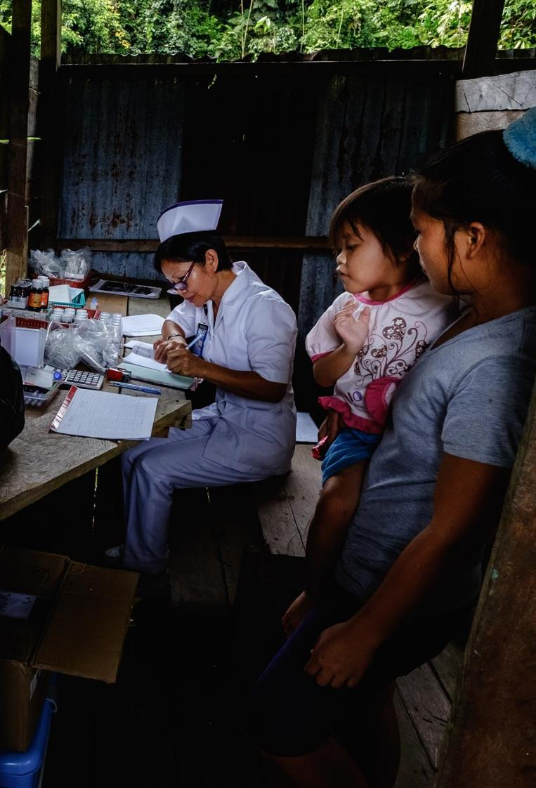
Context
Health systems are being challenged by the COVID-19 pandemic, with surges in demand affecting health workforce capacities & protection, supply chain readiness, essential health service delivery and utilization, and community trust (among others)
Countries are facing major gaps & challenges in data systems
  Few countries have basic data on existing & surge HS capacities (e.g beds, staff, essential supplies, PPE)
  Fewer still can track and monitor extent of disruptions on essential health service, inform mitigation strategies, assess evolving community needs & access
There is an urgent need at country level for “real-time” data and evidence
to identify bottlenecks to rapidly deploy essential COVID-19 tools
++ monitoring and tracking of essential health services

Slide 3
Aim: Improve data, evidence and knowledge throughout the course of the COVID-19 pandemic
To strengthen tracking and monitoring of health services to respond to COVID-19 while maintaining other essential health services
1. Generate understanding and evidence
to identify health systems bottlenecks through rapid readiness assessment tools (national, facility community levels)
2. Guide country responses to deliver COVID-19 tools & maintain EHS
by strengthening country capacities & platforms in health services monitoring, analysis & use of data
3. Scale to sustainable health services monitoring systems
through implementation, documentation and learning

Slide 4
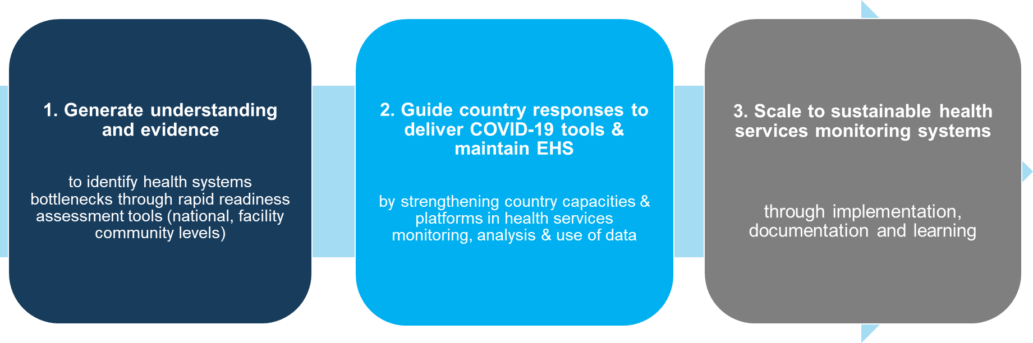

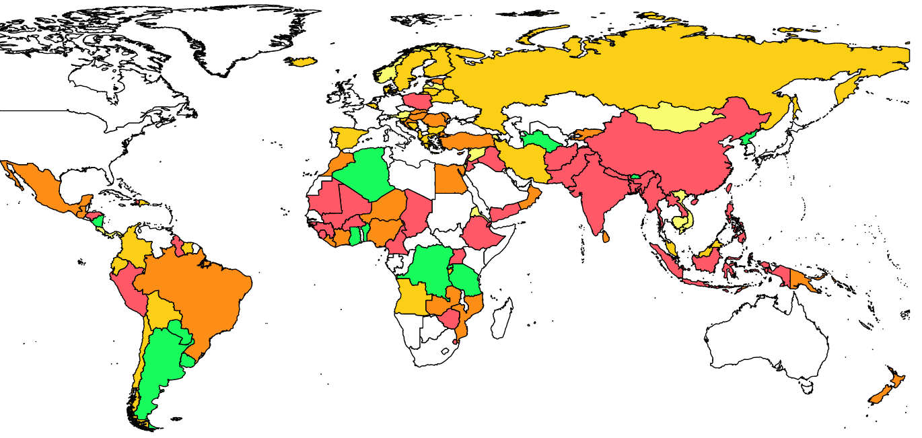





WHO national pulse survey on continuity of essential health services in the context of COVID-19
2nd round: Integration of all WHO national pulse surveys on service disruptions
Use: Gain rapid snapshot of changes and challenges in service delivery/utilization to inform policy dialogues and guide resource investments as pandemic progresses.
Contributes to quarterly SPRP monitoring: Pillar 9 Health services indicators on maintaining essential health services
Second round: January-February 2021
Modular approach: Each module completed by appropriate key informant.
Results used at country level to support policy and planning dialogue to comprehensively assess full extent of disruptions, critical bottlenecks, and recommend mitigation approaches/solutions.
Pulse survey round 1: Percentage of 25 tracer services disrupted across countries (n=129)

Slide 5









Introducing WHO suite of frontline service readiness assessments
Goal | Support countries through rapid and accurate assessments of the current and surge capacities of health facilities throughout the different phases of the COVID-19 pandemic
  Use of evidence and adherence
  to standards
  Content specificity
  Actionable results
  Feasibility and scale-ability
Compatibility
Country Context
Focus of specific content area
Targets users (national planners, hospitals, IMST)
Executed in rapid time frame with minimum effort
Paper based methods
WHO Guidances
Ensure complementarity across modules
Practical time-sensitive decisions and actions
Electronic platforms

Slide 6





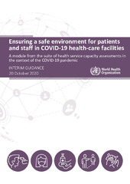

Modules in WHO suite of frontline service readiness assessments
To track, monitor and guide deployment and scale up of essential clinical tools and supplies for COVID-19 and other essential health services (view modules)
Health facility and community assessment tools (core modules)
 | COVID-19 case management capacities: Diagnostics, therapeutics, and vaccine readiness | Assess present and surge capacities for the treatment of COVID-19 in health facilities
 | Continuity of essential health services | Assess health facility and health workforce capacities to maintain the safe provision of essential health services
 | Community needs, perceptions and demand – community assessment tool | Assess community needs, changes in care-seeking behaviours, and barriers to accessing care
In-depth assessment tools/modules
 | Rapid hospital readiness checklist | Assess overall hospital readiness to identify priority actions to prepare for, be ready for and respond to COVID-19
 | Biomedical equipment for COVID-19 case management – inventory tool | Conduct an in-depth facility inventory of biomedical equipment re-allocation, procurement and planning measures for COVID-19
 | Ensuring a safe environment for patients and staff in COVID-19 health-care facilities | Assess structural capacities of health facilities to allow safe service delivery and enable surge capacity planning
 | Infection prevention and control health care facility response for COVID-19 | Assess infection prevention and control capacities to respond to COVID-19

Slide 7

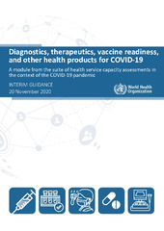

COVID-19 case management capacities module
To guide delivery and scale of essential COVID-19 tools, including diagnostics, therapeutics, vaccine capacity and other essential supplies
Do facilities have sufficient bed and space capacities to manage COVID-19 patients?
Do facilities have the necessary medicines and medical supplies for the management of COVID-19 patients?
Do facilities have necessary PPE for health workers?
Do facilities have the necessary IPC supplies?
Do facilities have necessary COVID-19 diagnostic supplies for COVID-19 testing?
Do facilities have the necessary medical equipment for COVID-19 patient diagnosis, monitoring and case management?
Have facilities adopted and activated IMST protocols
Do facilities have a functioning cold chain ready to support COVID-19 vaccine introduction?
view
(for use in hospitals and COVID-19 treatment centres)

Slide 8
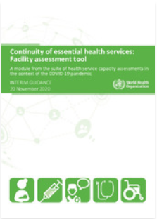



Continuity of essential health services module
Track and monitor health worker capacities and protection, changes in utilization, service delivery and disruptions
How many staff are available?
How many staff have been diagnosed with COVID-19?
Is additional training and support being provided to staff?
Are facilities continuing to charge user fees?
Are facilities receiving additional funding for essential health services?
Are staff salaries and overtime pay being paid on time?
Are safety processes and protocols in place to ensure safe delivery of services?
Do facilities have triage and isolation capacities?
Do staff have sufficient PPE to deliver essential services safely?
Do facilities have available therapeutics, diagnostic tests and supplies for essential health services?
Which COVID-19 primary care services are being delivered in the facility?
What support is being provided to deliver these services?
Do facilities have functioning cold chain capacity?
Has delivery of services unrelated to COVID-19 changed?
Has service utilization increased/decreased and what are the reasons?
Has the facility implemented community communication campaigns?
Has the facility made catch-up plans for missed routine appoints?
Have facilities experienced unplanned closures?
view
(for use in hospitals and primary care settings)

Slide 9
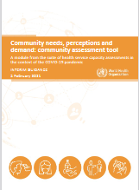

Community needs, perceptions and demand module
Assess and respond to community perceptions and needs including vaccine acceptance and barriers to care
Have community health workers been able to continue their work in the COVID-19 pandemic context?
Have community health workers experienced stigma in pursuing their functions?
How has the COVID-19 pandemic affected utilization of essential health services?
What are the current unmet needs for health services in the community?
What are community attitudes towards potential COVID-19 vaccination?
What are main barriers for people to use essential health services during the COVID-19 pandemic?
Are there marginalized group more affected during the COVID-19 pandemic?
Where/what are the first points of contact of care during COVID-19 pandemic?
view
(for use in communities - by community leaders and CHWs)

Slide 10
Key performance indicators for national dashboards on service readiness
Health facility and community level
COVID-19 case management capacities module | COVID-19 facility readiness | % facilities with IMST protocols adopted and activated
 | COVID-19 patient capacities | Total # of beds for COVID patients (moderate, severe, critical) # of beds currently occupied by COVID patients Total # of beds available for surge (ICU, respiratory isolation)
 | COVID-19 essential clinical tools and supplies | % of facilities with available tracer medicines:100%/≥50% of tracers, mean availability % of facilities with laboratory diagnostic capacities with tracer items: 100%/≥50% of tracers, mean availability, timeliness of results % of facilities with available/functional medical equipment onsite for COVID-19 diagnosis, monitoring, and case management (e.g. x-ray, pulse oximeters, ventilators, oxygen, etc.): 100%/≥50% of tracers, mean availability % of facilities with available PPE for staff (e.g. masks, gowns, goggles, etc.): 100%/≥50% of tracers, mean availability % of facilities with available IPC supplies (e.g. soap, biohazard bags, sanitizer stations, etc.): 100%/≥50% of tracers, mean availability % facilities with functional cold chain capacity to deliver COVID-19 vaccines (vaccine fridge with continuous temperature recorder, vaccine carriers/cold boxes, ice packs): 100%/≥50% of tracers, mean availability
Continuity of essential health services module | Staffing | % of staff (by occupation) diagnosed with COVID-19 % of facilities providing staff training, support, supervision (by type)
 | Financial management | % of facilities that waived/increased user fees % of facilities receiving additional funding for essential health services and sources % of facilities maintaining on-time salary/overtime payments
 | Service delivery and utilization | % facilities with observed increases/decreases in tracer service (OPD, IPD, emergency) and reasons % communities with increases/decreases in community-based services (from community needs/demand module) % of facilities with service delivery modifications % change in service utilization (record review)
 | COVID-19 IPC and PPE | % of facilities with safe environment measures % of facilities with IPC guidelines in place % of facilities with adequate PPE for staff
 | COVID-19 case management in primary care facilities | % of primary care facilities with measures to manage COVID-19 (mild cases) % of facilities with capacity to provide COVID-19 services in primary care (e.g. collecting specimens for diagnosis, onsite testing, referrals)
 | Health products | Availability of essential tracer medicines, diagnostics, vaccines and supplies % of facilities with cold chain capacities to deliver vaccines
Community needs, perceptions and demand module | Community needs | % of CHW’s who believe that community has unmet health needs % of CHW’s who believe that community faced barriers to seeking care pre-COVID and % who believe it has gotten worse
 | Demand for COVID-19 vaccination | % of CHW’s who believe community has demand for COVID-19 vaccine (adults, children) and reasons for lack of demand

Slide 11
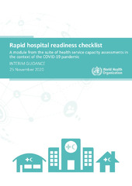



Rapid hospital readiness assessment module
Assess overall hospital readiness to identify priority actions to prepare for, be ready for and respond to COVID-19
Do facilities have the necessary arrangements and backup arrangements in place and the functioning capacity to respond to COVID-19 (including safe and quality care of COVID-19 and non-COVID-19 patients and the continued provision of safe and essential public health functions)?
Which recommended actions need to be given priority and investment to make the facility fully functional?
What are the ‘to do’ priority actions in case of surge?
view
(for use in hospitals)

Slide 12
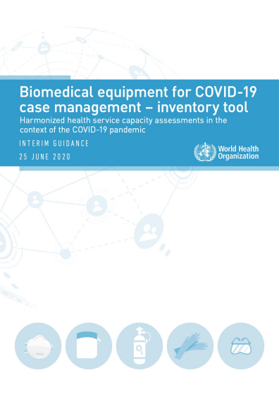

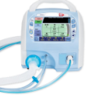


Biomedical equipment for COVID-19 case management - inventory tool
Conduct an in-depth facility inventory of biomedical equipment re-allocation, procurement and planning measures for COVID-19
Do facilities have adequate supplies to administer oxygen and ventilation to severe and critical COVID-19 patients?
What is the current capacity for the production of biomedical equipment?
What are the causes of equipment malfunctioning?
What resources need to be procured, reassigned or redistributed?
view
(for use in hospitals and COVID-19 treatment centres)

Slide 13
Ensuring a safe environment for patients and staff in COVID-19 health-care facilities
Assess structural capacities of health facilities to allow safe service delivery and enable surge capacity planning
Does the facility provide a safe environment with adequate engineering and administrative controls to promote safe patient care for COVID‑19?
Does the facility provide a safe environment with adequate engineering and administrative controls to protect the health and well-being of the staff?
view
(for use in hospitals and COVID-19 treatment centres)

Slide 14

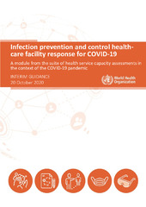




Infection prevention and control health-care facility response for COVID-19
Assess infection prevention and control capacities to respond to COVID-19
Are facilities adequately equipped with critical IPC supplies and infrastructure to support a robust COVID‑19 response or resurgence?
Are facilities providing baseline IPC training in standard precautions and COVID‑19-related guidelines and protocols as per international guidance?
Are facilities performing IPC monitoring of COVID‑19 infections in patients/residents, residents and staff?
Do facilities have appropriate flow and visitor restrictions in place?
Do facilities have a minimum IPC programme or focal point assisting in their COVID‑19 response?
view
(for use in hospitals and COVID-19 treatment centres)

Slide 15
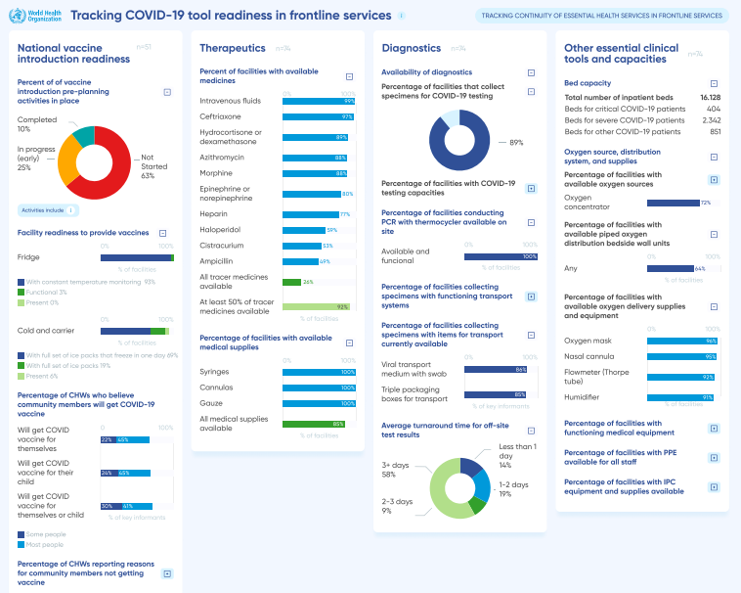
Strengthening country analysis and evidence for action
Automated dashboards for national, regional and global level
Data feeds into country and partner intelligence platforms
Results triangulated and analysed (HMIS, VIRAT, pulse surveys, epidemiological surveillance data, mortality data, etc)
Evidence base for policy dialogues and development of action plans
Supports continuous monitoring for real-time update to action plan as situation evolves
Potential to integrate and scale to health system and service readiness alert system
Mock up

Slide 16



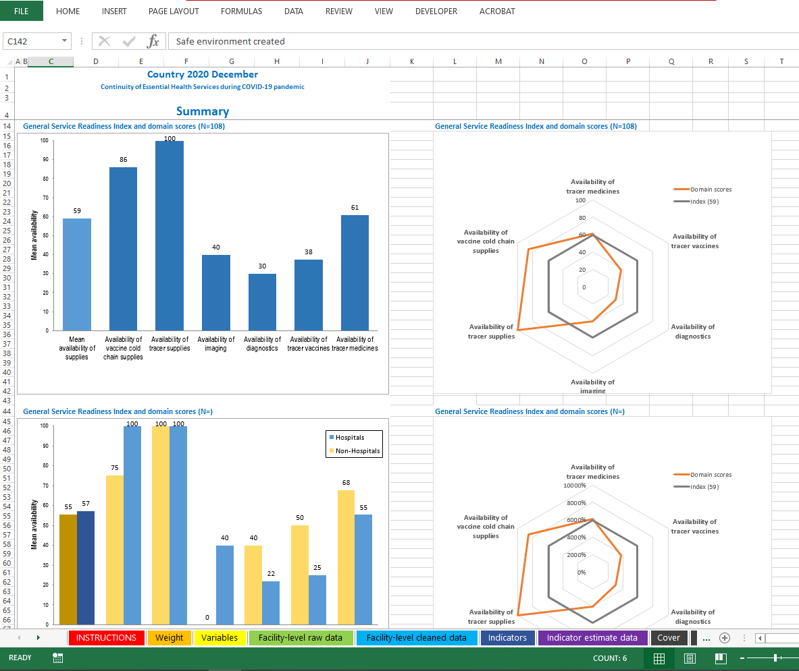
Recommended approach
To rapidly detect bottlenecks and track and monitor health services:
Low cost, safe, near to real-time data
  Rapid and high-frequency phone surveys
  On-line interviews with facility managers & CHWs using electronic data collection tools
  Sample of sentinel facilities and their communities (public/private, urban/rural, hospital/primary care facilities, geography)
  Training and data collection = approx. 7 days
  Real-time data through automated analyses chartbooks and dashboards
  Repeated at least quarterly (or monthly) to allow national planners to track health service capacities throughout the pandemic
Inform action plans and policy dialogues
Phone interviews with online data entry
Daily data download and database consolidation
Data feeds into automated chartbooks/ dashboard
Continuous monitoring and learning

Slide 17
Key steps for survey implementation
Governance and coordination
MoH request for support
Sampling
Obtain master facility list and list of eligible facilities
Survey planning and preparation
Review and adapt modules and survey materials
Conduct telephone interviews
Data collection and reporting
Data analysis and use
Update database and automated outputs daily
Establish coordinating group
Determine scope and frequency of survey
Identify survey implementation team
Prepare overall survey plan
Identify resource requirement and prepare budget
Procure equipment and coordinate logistics
Plan and conduct interviewer training
Pilot test
Complete pre-interview outreach
Download survey data from the online server
Develop roadmap/action plan to mitigate disruptions and address priority bottlenecks
Integrate/scale to national preparedness and performance monitoring dashboard (long-term)
Determine sample based on sampling approach
Prepare interview schedule
Incorporate feedback into next round of survey

Slide 18
Supporting implementation of country readiness tracking and monitoring
To guide the delivery of COVID-19 essential tools and health services
(national and subnational authorities, IMST, partners)
National checklists/pulse surveys
National
COVID-19 vaccine introduction readiness assessment tool (VIRAT)
Prepare for allocation and deployment of large-scale COVID-19 vaccine introduction
National pulse survey on continuity of essential health services
Guide urgent actions and decisions to mitigate service disruptions across health system
Frontline service readiness assessments – health facility tracking & monitoring (demand-side)
Hospital
COVID-19 case management capacities – facility assessment
Guide delivery and scale of essential COVID-19 tools (diagnostics, therapeutics (including oxygen), PPE, cold chain)
Primary care
Continuity of essential health services – facility assessment
Track and monitor health worker capacities and protection, changes in utilization, service delivery and disruptions
Community
Community needs, perceptions, and demand – community assessment
Assess and respond to community perceptions and needs, including vaccine acceptance and barriers to care
Plus in-depth checklists and inventory tools: Rapid hospital readiness checklist; Biomedical equipment for COVID-19 case management – inventory tool; Ensuring a safe environment for patients and staff in COVID-19 health-care facilities; Infection prevention and control health care facility response for COVID-19

Slide 19
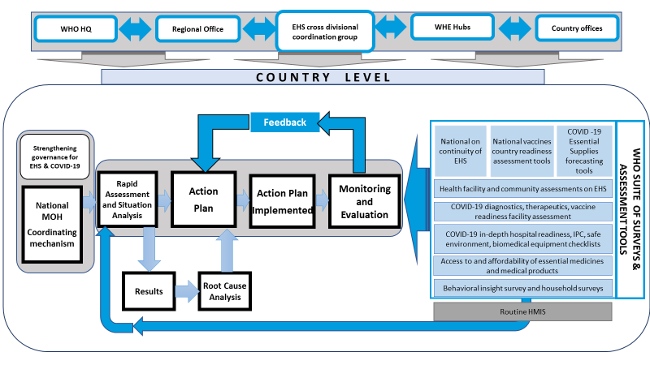





WHO support to countries: essential health services during COVID-19
3 level approach with WHO regional offices, country offices and UHC-P/PHC SP country coordination platform
Country led, country owned, country tailored
Embedded into national planning & coordination mechanism
Based on country needs, supporting rapid assessment and situation analysis
Supporting action plans and policy dialogues to prioritise mitigation strategies, resource allocation, deployment of COVID-19 essential tools
Supporting implementation of plans (e.g strengthening essential health services, HWF capacities and training, quality & safety, including IPC)
Building towards sustainable early warning systems for health services for future crises
Continuous monitoring and evaluation, adaptation, learning

Slide 20
WHO HQ
Regional Office
EHS cross divisional coordination group
WHE Hubs
Country offices
C O U N T R Y L E V E L
Feedback
WHO SUITE OF SURVEYS & ASSESSMENT TOOLS
National on continuity of EHS
National vaccines country readiness assessment tools
COVID -19 Essential Supplies forecasting tools
Strengthening governance for EHS & COVID-19
Rapid
Assessment and Situation Analysis
Action
Plan
Action Plan
Implemented
Monitoring
and
Evaluation
Health facility and community assessments on EHS
National MOH
Coordinating mechanism
COVID-19 diagnostics, therapeutics, vaccine readiness facility assessment
COVID-19 in-depth hospital readiness, IPC, safe environment, biomedical equipment checklists
Access to and affordability of essential medicines and medical products
Results
Root Cause Analysis
Behavioral insight survey and household surveys
Routine HMIS

Slide 21
WHO Country implementation
Leverage existing global, regional and national capacities in a phased training and implementation approach
Phase 1: Strengthen global and regional capacities to support country implementation
  Demonstration country (ies) to validate tools, approach, training materials
  Establish global and regional/sub-regional technical support teams
  Online webinar series to train regional/sub-regional technical support team
Phase 2: Strengthen country implementation capacities
  Country orientation webinars to introduce survey tools and approach
  MoH initiation of survey and selection of survey implementation team (e.g. national institute, academic institution, etc.)
  Country-specific/multi-country online webinars to train survey implementation teams
  MoH + survey implementation team co-implement survey (regular data collection, analysis, dissemination of findings)
  Policy dialogue + development of action plan to mitigate service disruptions and address priority health systems bottlenecks
Phase 3: Country implementation of survey and response
Phase 4: Learning and scale
  Document cross-country learning to scale to real-time health service readiness monitoring and alert systems for future health emergencies

Slide 22
Thank you
Questions and discussion
2 March 2021

