Slide 1

Frontline service readiness assessments
Strengthening real-time health services tracking and monitoring in the context of the COVID-19 pandemic
Overview and implementation guidance, working slideset
27 November 2020

Slide 2
Frontline service readiness assessments: Session overview
Session 1 | Introduction to frontline service readiness assessments and approach Context Introduction to frontline service readiness assessments Overview of survey modules and key performance indicators Key features of the assessment
Session 2 | Overall planning for the assessments Survey coordination and planning Survey design Preparation for implementation
Session 3 | Methodology and sampling
Session 4 | Detailed planning for implementation Survey manager’s roles and responsibilities Country-specific adaptation of standard modules Interviewer training Logistics preparation
Session 5 | Country adaptation of modules Required adaptation Elective adaptation
Session 6 | Interviewer training Main responsibilities Skills and tips for successful interviews Review of paper questionnaire and practice using online tool Using and updating interview call log
Session 7 | Data management and analysis for automated results – for survey and data managers Data flow Data manager’s roles and responsibilities Use the automated excel chartbooks
Session 8 | Data management and analysis for automated results – for data managers Adapt data management/analysis code based on finalized modules in the country

Slide 3
Frontline service readiness assessments
Session 1: Introduction to frontline service readiness assessments and approach

Slide 4
Session 1: Introduction to frontline service readiness assessments and approach
Purpose and learning outcomes
Session 1 | Introduction to frontline service readiness assessments and approach Context Introduction to frontline service readiness assessments Overview of survey modules and key performance indicators Methodology and sampling Data entry and automated analyses
Session 2 | Prepare for implementation
Session 3 | Methodology and sampling
Session 4 | Detailed planning for implementation
Session 5 | Country adaptation of modules
Session 6 | Interviewer training
Sessions 7-8 | Data management and analysis for automated results
Purpose: This session will provide an overview of the proposed objectives of the WHO’s frontline service readiness assessments and approach. Participants will be introduced to assessment tools, implementation approaches, key performance indicators, and automated analysis tools.
Expected outcomes:
Familiarity with WHO’s suite of frontline service readiness assessment tools, including its three core modules:
  COVID-19 case management capacities: Diagnostics, therapeutics, vaccine readiness, and other health products
  Continuity of essential health services – facility assessment tool
  Community needs, perceptions, and demand – community assessment tool
Understanding the methodology for data collection and sampling
Knowledge of key performance indicators that can be reported from the core modules in the automated analysis chartbooks

Slide 5
Context

Slide 6
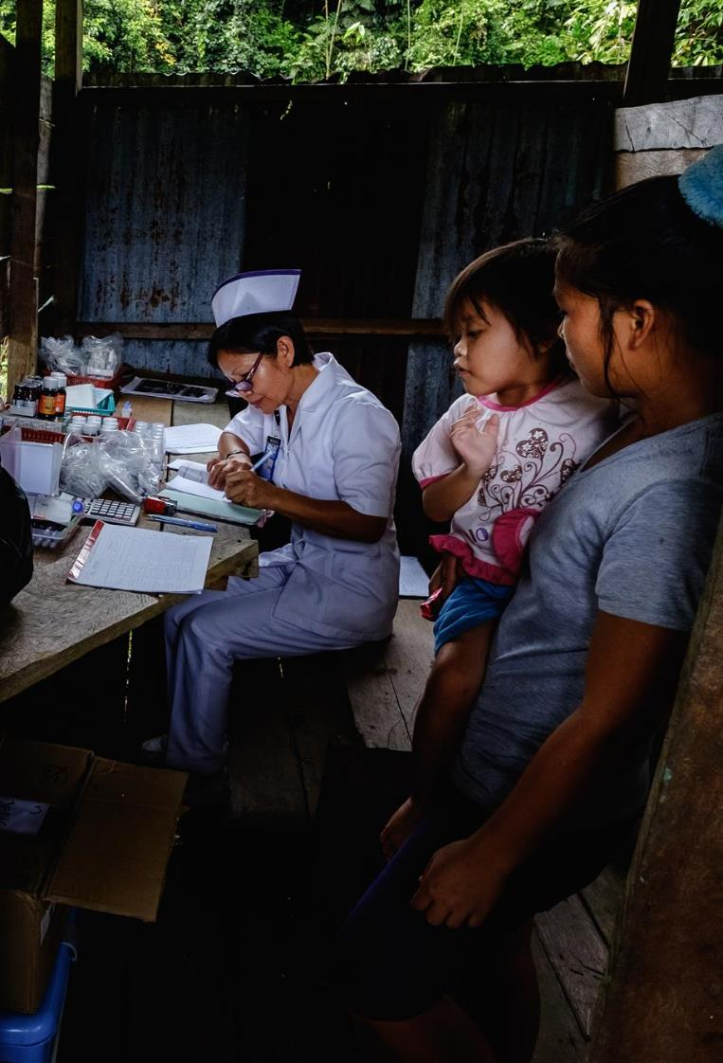
Context
The COVID-19 pandemic has challenged public health systems and health services globally, revealing that even robust health systems can be quickly overwhelmed and compromised by an outbreak.
Every day we are confronting a multitude of questions concerning COVID-19, while trying to maintain the delivery of regular health services.

Slide 7
Context
Against this rapidly evolving situation, many countries face challenges securing accurate and timely data on the capacities of frontline health services, as well as facilities to deliver essential COVID-19 tools.
At the same time, routine data systems are falling short in their ability to detect and track the extent of disruptions across essential health services to inform mitigation strategies and respond to evolving community needs and barriers to accessing care.

Slide 8
Context
Because of this, countries need to consider implementing regular and rapid assessments in facilities and communities to determine priority need for: service availability, workforce capacities, training and protection, availability of essential health products and supplies, vaccine readiness, infection prevention and control (IPC) capacities, and safety measures.

Slide 9
Context
There is a need for reliable, timely data to scale up delivery of essential COVID-19 tools to frontline services, and to track, monitor and understand service disruptions.

Slide 10
Context
In response to this need, the WHO has developed a new and innovative suite of health facility and community assessment tools to rapidly generate the data required to address this dual track challenge. The primary objectives of the new tools are threefold:
Generate understanding and evidence
Identify bottlenecks through rapid and regular assessments at national, health facility and community level
Guide country responses and solutions
Strengthen country intelligence platforms and automated dashboards for real-time analysis and use
Better resilient health services & systems
Use learning to scale to sustainable real-time monitoring and early warning systems for future health emergencies

Slide 11
Context
The WHO's approach is committed to strengthening global and regional capacities to scale up a country's implementation. The WHO's approach uses existing regional and country capacities as much as possible to fill any remaining resource gaps. This includes:
  Establishing global and regional/sub-regional technical support teams to lead survey implementation
  Using online webinar series to train regional/sub-regional technical support teams
  Country introductions to survey tools, approach, and available WHO support
  MoH initiated requests for support and establishment of survey coordination mechanisms and implementation teams
  Country-specific or multi-country online webinars to train survey implementation teams
  Country implementations of surveys

Slide 12
Introduction to frontline service readiness assessments

Slide 13
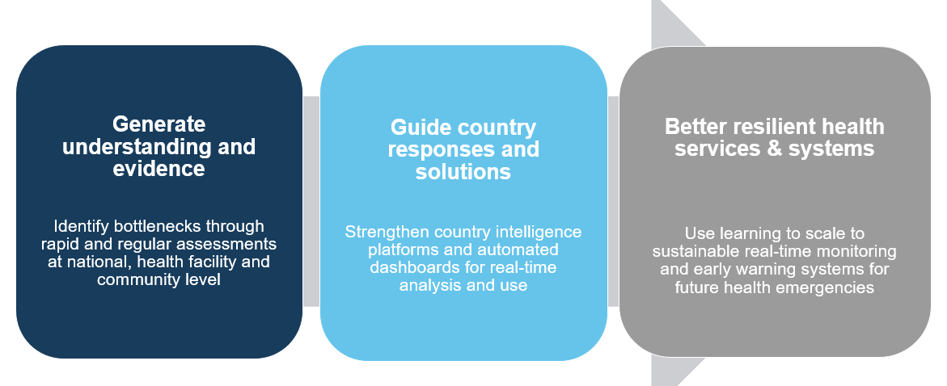



WHO’s suite of frontline service readiness assessments
When looking at how to generate evidence to fill critical data gaps, WHO’s suite of frontline service readiness assessments can provide the following:
Rapid health facility and community assessments on current and surge capacities of frontline services and community needs throughout the course of pandemic
Response to country needs to address the dual-track challenge of responding to COVID-19 while maintaining essential health services
Used by national authorities, IMST, and facility managers to inform urgent priorities and actions at national, subnational, and local levels

Slide 14
WHO’s suite of frontline service readiness assessments
WHO’s suite of frontline service readiness assessments will:
Respond to country demand
Provide a flexible, modular approach allowing countries to choose modules based on objectives priorities
Develop tools through broad scientific review
Offer tools based on recommended WHO guidance and standards
Review and align with key partners (ACT-A)
Provide data feeds into country intelligence platforms and partner platforms
Offer potential for scaling to real time health services, tracking, and monitoring as an early warning for future crises

Slide 15
WHO’s suite of frontline service readiness assessments
The WHO’s suite of frontline service readiness assessments tools is designed to detect and monitor health systems bottlenecks, health facility capacity, and readiness gaps throughout this evolving pandemic. The core tools are:
    COVID-19 case management capacities module: Diagnostics, therapeutics, and vaccine readiness module aims to assess hospital and COVID-19 treatment facility capacities in COVID-19 case management, including the availability of diagnostics, therapeutics and other essential health products such as oxygen and PPE, as well as cold chain capacities.
    Continuity of essential health services module: This facility assessment modules aims to assess capacities of primary care and hospital facilities to deliver essential health services (e.g. health worker availability and infections, isolation and triage capacities, adherence to IPC standards, and availability of essential medicines and supplies) and helps to track changes in service utilisation and service delivery modifications.
    Community needs, perceptions and demand module: This community assessment modules aims to collect information on unmet health needs, changes in care-seeking behaviours, and barriers to care affecting service demand.

Slide 16
Scope of this training: 3 modules
Health facility and community assessment tools (core modules)
1 | COVID-19 case management capacities: Diagnostics, therapeutics, and vaccine readiness | Assess present and surge capacities for the treatment of COVID-19 in health facilities | Hospitals COVID-19 treatment centres
2 | Continuity of essential health services | Assess health facility and health workforce capacities to maintain the safe provision of essential health services | Hospitals Primary care facilities
3 | Community needs, perceptions and demand – community assessment tool | Assess community needs, changes in care-seeking behaviours, and barriers to accessing care | Communities (community health workers, community leaders, civil society organization leaders)
In-depth assessment tools/modules
4 | Rapid hospital readiness checklist | Assess overall hospital readiness to identify priority actions to prepare for, be ready for and respond to COVID-19 | Hospitals COVID-19 treatment centres Long-term care facilities
5 | Biomedical equipment for COVID-19 case management – inventory tool | Conduct an in-depth facility inventory of biomedical equipment re-allocation, procurement and planning measures for COVID-19 | Hospitals COVID-19 treatment centres
6 | Ensuring a safe environment for patients and staff in COVID-19 health-care facilities | Assess structural capacities of health facilities to allow safe service delivery and enable surge capacity planning | Hospitals COVID-19 treatment centres Primary care facilities
7 | Infection prevention and control health care facility response for COVID-19 | Assess infection prevention and control capacities to respond to COVID-19 | Hospitals COVID-19 treatment centres Primary care facilities Long-term care facilities

Slide 17
WHO’s suite of frontline service readiness assessments
To guide the delivery of COVID-19 essential tools and health services
(national and subnational authorities, IMST, partners)
National checklists/pulse surveys
National
COVID-19 vaccine introduction readiness assessment tool (VIRAT)
Prepare for allocation and deployment of large-scale COVID-19 vaccine introduction
National pulse survey on continuity of essential health services
Guide urgent actions and decisions to mitigate service disruptions across health system
Frontline service readiness assessments – health facility tracking & monitoring (demand-side)
Hospital
COVID-19 case management capacities – facility assessment
Guide delivery and scale of essential COVID-19 tools (diagnostics, therapeutics (including oxygen), PPE, cold chain)
Primary care
Continuity of essential health services – facility assessment
Track and monitor health worker capacities and protection, changes in utilization, service delivery and disruptions
Community
Community needs, perceptions, and demand – community assessment
Assess and respond to community perceptions and needs, including vaccine acceptance and barriers to care
Routine health information system (ongoing monitoring)

Slide 18
Survey modules and key performance indicators

Slide 19
Survey modules and key performance indicators
Examples of the survey modules and key performance indicators for:
    COVID-19 case management capacities module
    Continuity of essential health services module
    Community needs, perceptions and demand module
These examples illustrate the objectives, use, and content areas for each of these core survey modules, the key questions and indicators keys, and provide an example of performance indicators for national dashboards.

Slide 20






Survey modules and key performance indicators
COVID-19 case management capacities module: Objectives, use and content areas
COVID-19 case management capacities: diagnostics, therapeutics, vaccine readiness, and other health products
Objective: | Assess current and surge capacities of health facilities for COVID-19 management (clinical tools ad essential supplies)
Use: | Guide rapid deployment and scale up of essential COVID-19 clinical tools and supplies
Facility type: | Hospitals and COVID-19 treatment centres treating moderate, severe and critical COVID-19 cases
Respondents: | Facility managers and/or facility management team members
Content: | Section 1: Health facility ID and description Section 2: Hospital incident management support team Section 3: Case management and bed capacities for COVID-19 Section 4: Selected medicines and supplies for COVID-19 case management Section 5: Personal protective equipment and infection prevention and control Section 6: COVID-19 laboratory diagnostics Section 7: Medical equipment for diagnosis, patient monitoring and case management Section 8: COVID-19 vaccine readiness (optional) Section 9: Interview result

Slide 21
Survey modules and key performance indicators
COVID-19 case management capacities module: Key questions and indicators
For use in hospitals and COVID-19 treatment centres (moderate, severe, critical cases)
Sections |  | Key questions | Key performance Indicators
1 | Health facility type and description | What are the facility characteristics? | All KPIs can be disaggregated by facility type, residence area (rural/urban), managing authority (public/private)
2 | Hospital IMST | Have facilities adopted and activated incident management support (IMST) team protocols? | % of facilities with IMST protocols adopted and activated
3 | Case management and bed capacity | Do facilities have sufficient bed and space capacities to manage COVID-19 patients? | Total # of beds for COVID patients (moderate, severe, critical) # of beds currently occupied by COVID patients Total # of beds available for surge (ICU, respiratory isolation)
4 | Medicines and supplies | Do facilities have the necesarry medicines and medical supplies for the management of COVID-19 patients? | % of facilities with available tracer medicines % of facilities participating in the Solidarity Clinical trial (and availability of trial medications)
5 | PPE and IPC | Do facilities have necessary PPE for health workers? Do facilities have the necesarry IPC supplies? | % of facilities with available personal protective equipment for staff (e.g. masks, gowns, goggles, etc.) % of facilities with available infection prevention and control supplies (e.g. soap, biohazard bags, sanitizer stations, etc.)
6 | COVID-19 laboratory diagnostics | Do facilities have necessary COVID-19 diagnostic supplies for COVID-19 testing? | % of facilities with laboratory diagnostic capacities with tracer items (e.g. specimen collection, onsite PCR/ RDTs, system for offsite testing) % of facilities receiving timely results
7 | Medical equipment | Do facilities have the necesarry medical equipment for COVID-19 patient diagnosis, monitoring and case management? | % of facilities with available/functional medical equipment onsite for COVID-19 diagnosis, monitoring, and case management (e.g. x-ray, pulse oximeters, ventilators, oxygen, etc.) % of facilities with malfunctions (and reasons)
8 | COVID-19 vaccine readiness | Do facilities have a functioning cold chain ready to support COVID-19 vaccine introduction? | % of facilities with functional cold chain capacity to deliver COVID-19 vaccines (vaccine fridge with continuous temperature recorder, vaccine carriers/cold boxes, ice packs)

Slide 22






Survey modules and key performance indicators
Continuity of essential health services module: Objectives, use, and content areas
Continuity of essential health services module
Objective: | Assess health facility and health workforce capacities to maintain safe provision of essential health services throughout the pandemic
Use: | Detect and track changes in service utilization, service delivery modifications, staff capacities and protection to guide strategies and plans to mitigate disruptions and maintain essential health services
Facility type: | Hospitals, primary care centres/clinics
Respondents: | Facility managers and/or facility management team members
Content: | Section 1: Health facility ID and description Section 2: Staffing Section 3: Financial management Section 4: Service delivery and utilization* Section 5: COVID-19 infection prevention and control and personal protective equipment Section 6: Management of suspected and confirmed COVID-19 cases in primary care centres Section 7: Availability of selected tracer therapeutics (optional) Section 8: Availability of diagnostics (optional) Section 9: Vaccine readiness (optional) Section 10: Facility infrastructure (optional) Section 11: Interview result Annex: Routine data record review
*Section 4: Service delivery and utilization section assesses a set of tracer services including for: undifferentiated symptoms; family planning and contraception; antenatal care; postnatal care; immunization; care for sick children; HIV; TB; STIs; malaria; chronic cardiovascular disease; chronic respiratory disease; diabetes; cancer; mental health; intimate partner and sexual violence; NTDs; and rehabilitation

Slide 23
Survey modules and key performance indicators
Continuity of essential health services module: Key questions and indicators
For use in hospitals and primary care facilities
Sections |  | Key questions | Performance Indicators
1 | Health facility type and description | What are the facility characteristics? | All KPIs can be disaggregated by facility type, residence area (rural/urban), managing authority (public/private)
2 | Staffing | How many staff are available? How many staff have been diagnosed with COVID-19? Is additional training and support being provided to staff? | % of staff (by occupation) diagnosed with COVID-19 % of facilities with staff leave/absences and reasons/changes in staff management % of facilities providing staff training, support, supervision (by type)
3 | Financial management | Are facilities continuing to charge user fees during the pandemic? Are facilities receiving additional funding for essential health services? Are staff salaries and overtime pay being paid on time? | % of facilities that waived/increased user fees % of facilities receiving additional funding for essential health services and sources % of facilities maintaining on-time salary/overtime payments
4 | Service delivery & utilization | Has delivery of services unrelated to COVID-19 changed? Has service utilization increased/decreased and what are the reasons? Has the facility implemented community communication campaigns? Has the facility made catch-up plans for missed routine appoints? | % of facilities with service delivery modifications % facilities with observed increases/decreases in tracer service (OPD, IPD, emergency) and reasons % of facilities with service restoration plans % change in service utilization (record review)
5 | IPC & PPE | Are safety processes and protocols in place to ensure the safe delivery of health services? Do facilities have triage and isolation capacities? Do staff have sufficient PPE to deliver essential services safely? | % of facilities with safe environment measures (triage capacity, isolation capacity) % of facilities with IPC guidelines in place % of facilities with adequate PPE for staff
6 | Management of COVID-19 in PC | Which COVID-19 primary care services are being delivered in the facility? What support is being provided to deliver these services? | % of primary care facilities with measures to manage COVID-19 (mild cases) % of facilities with capacity to provide COVID-19 services in primary care (e.g. collecting specimens for diagnosis, onsite testing, referrals)
7 | Therapeutics | Do facilities have available therapeutics for essential health services? | % of facilities with available tracer therapeutics, supplies and vaccines
8 | Diagnostics | Do facilities have available diagnostic tests and supplies for essential health services? | % of facilities with available tracer diagnostics
9 | Vaccine readiness | Do facilities have functioning cold chain capacity? | % of facilities with cold chain capacities
10 | Facility infrastructure | Have facilities experienced unplanned closures? Have facilities experienced infrastructure-related issues? | % of facilities that have experiences unplanned closures % of facilities with infrastructure-related issues

Slide 24






Survey modules and key performance indicators
Community needs, perceptions and demand module: Objectives, use and content areas
Community needs, perceptions and demand module
Objective: | Assess community health needs, changes in care-seeking behaviours, barriers to care affecting services demand, and disruptions to community-based care
Use: | Guide strategies and plans to address unmet health needs and eliminate barriers to care
Assessment type: | Community
Respondents: | Community health workers, community leaders, civil society organization leaders
Content: | Section 1: Identification and informed consent Section 2: Community needs and use of essential health services Section 3: Barriers to seeking essential health services in the community Section 4: Attitudes towards COVID-19 vaccination Section 5: Barriers in delivery of community-based services Section 6: Interview result

Slide 25
Survey modules and key performance indicators
Community needs, perceptions and demand module: Key questions and indicators
For use in communities
Section |  | Key questions | Key performance indicators
1 | Identification and informed consent | Who is the key informant providing responses? What is the residence setting of the community? | All KPIs can be disaggregated by type of key informant (CHW, community leader, CSO, etc.) and residence area (rural/urban)
2 | Community needs and use of essential health services | How has the COVID-19 pandemic affected utilization of essential health services? What are the current unmet needs for health services in the community? | % of CHW’s who believe that community has unmet health needs
3 | Barriers to seeking care | What are main barriers for people to use essential health services during the COVID-19 pandemic? Are there marginalized groups more affected during the COVID-19 pandemic? Where/what are the first points of contact during COVID-19 pandemic? | % of CHW’s who believe that community faced barriers to seeking care pre-COVID and % who believe it has gotten worse % of CHW’s who believe there are disadvantaged groups in the community Distribution of first point of care/information in the community
4 | Attitudes towards COVID-19 vaccination | What are the perceived attitudes towards potential COVID-19 vaccines? | % of CHW’s who believe community has demand for COVID-19 vaccine (adults, children) Distribution of reasons for low demand
5 | Barriers in delivery of community-based services | Have community health workers been able to continue their work in the COVID-19 pandemic context? Have community health workers experienced stigma in pursuing their functions? | Distribution of perceived risk (moderate, high, very high) reported by CHWs and reasons % of CHWs lacking support to perform work % of communities with change in service volume by service (e.g., malaria prevention, social support for TB patients)

Slide 26
Survey modules and key performance indicators
Frontline service readiness assessments: Key performance indicators for national dashboards
COVID-19 case management capacities module | COVID-19 facility readiness | % facilities with IMST protocols adopted and activated
 | COVID-19 patient capacities | Total # of beds for COVID patients (moderate, severe, critical) # of beds currently occupied by COVID patients Total # of beds available for surge (ICU, respiratory isolation)
 | COVID-19 essential clinical tools and supplies | % of facilities with available tracer medicines:100%/≥50% of tracers, mean availability % of facilities with laboratory diagnostic capacities with tracer items: 100%/≥50% of tracers, mean availability, timeliness of results % of facilities with available/functional medical equipment onsite for COVID-19 diagnosis, monitoring, and case management (e.g. x-ray, pulse oximeters, ventilators, oxygen, etc.): 100%/≥50% of tracers, mean availability % of facilities with available PPE for staff (e.g., masks, gowns, goggles, etc.): 100%/≥50% of tracers, mean availability % of facilities with available IPC supplies (e.g., soap, biohazard bags, sanitizer stations, etc.): 100%/≥50% of tracers, mean availability % facilities with functional cold chain capacity to deliver COVID-19 vaccines (vaccine fridge with continuous temperature recorder, vaccine carriers/cold boxes, ice packs): 100%/≥50% of tracers, mean availability
Continuity of essential health services module | Staffing | % of staff (by occupation) diagnosed with COVID-19 % of facilities providing staff training, support, supervision (by type)
 | Financial management | % of facilities that waived/increased user fees % of facilities receiving additional funding for essential health services and sources % of facilities maintaining on-time salary/overtime payments
 | Service delivery and utilization | % facilities with observed increases/decreases in tracer service (OPD, IPD, emergency) and reasons % communities with increases/decreases in community-based services (from community needs/demand module) % of facilities with service delivery modifications % change in service utilization (record review)
 | COVID-19 IPC and PPE | % of facilities with safe environment measures (triage capacity, isolation capacity) % of facilities with IPC guidelines in place % of facilities with adequate PPE for staff
 | COVID-19 case management in primary care facilities | % of primary care facilities with measures to manage COVID-19 (mild cases) % of facilities with capacity to provide COVID-19 services in primary care (e.g., collecting specimens for diagnosis, onsite testing, referrals)
 | Health products | Availability of essential tracer medicines, diagnostics, vaccines and supplies % of facilities with cold chain capacities to deliver vaccines
Community needs, perceptions and demand module | Community needs | % of CHW’s who believe that the community has unmet health needs % of CHW’s who believe that the community faced barriers to seeking care pre-COVID and % who believe it has gotten worse
 | Demand for COVID-19 vaccination | % of CHW’s who believe that the community has demand for COVID-19 vaccine (adults, children) and reasons for lack of demand

Slide 27
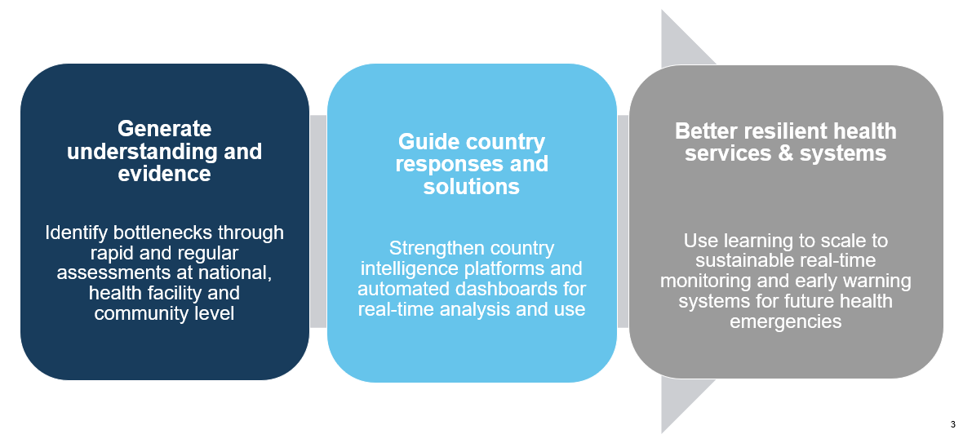
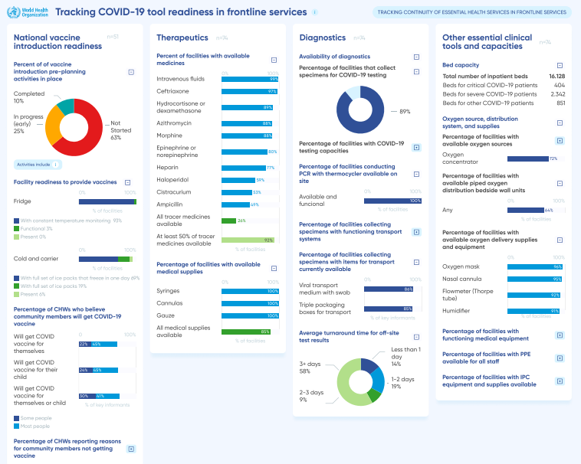
Strengthening country analysis and evidence for action
Automated dashboards for national, regional and global level
Data feeds into country and partner intelligence platforms
Results triangulated and analysed (HMIS, VIRAT, pulse surveys, epidemiological surveillance data, mortality data, etc)
Evidence base for policy dialogues and development of action plans
Supports continuous monitoring for real-time update to action plan as situation evolves
Potential to integrate and scale to health system and service readiness alert system
Mock up

Slide 28
Data entry and automated analyses

Slide 29
Data entry and automated analyses
Through documentation, adaptation, and learning, the aim is to integrate these tools and dashboards into routine data systems that will allow countries to support sustainable real-time monitoring and early warning systems for health services in the event of future crises.

Slide 30


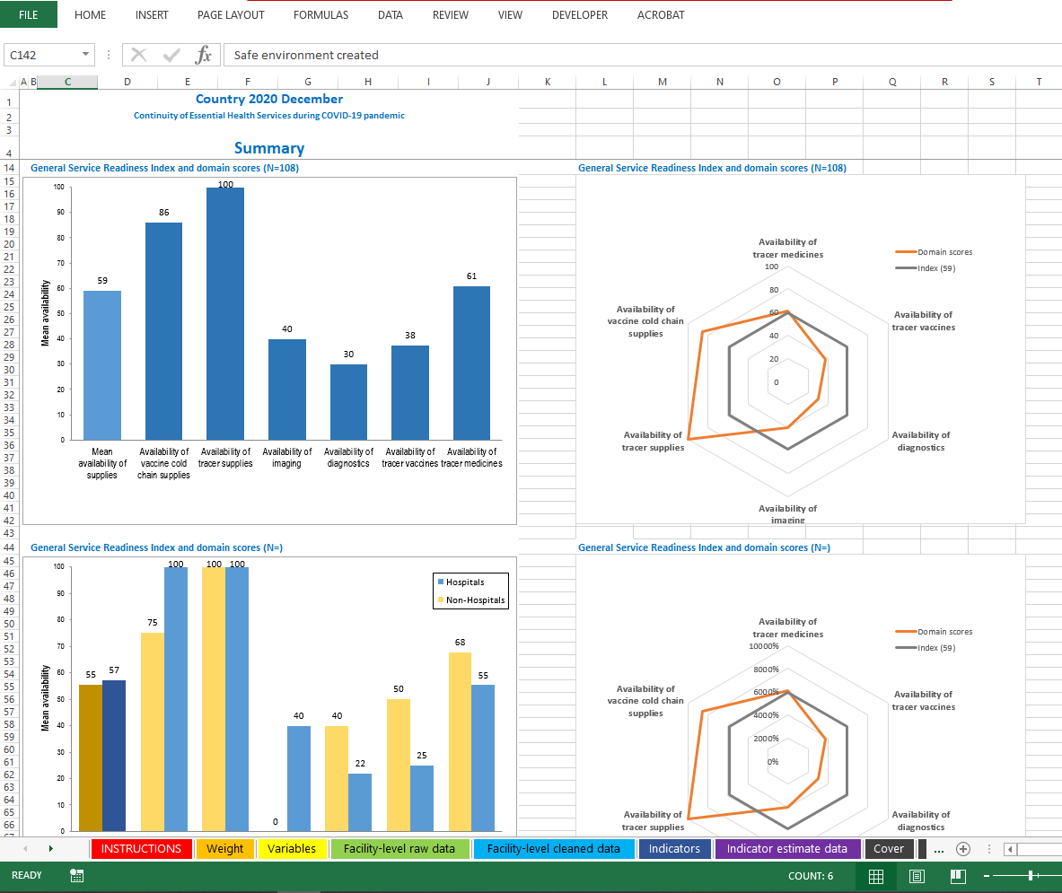



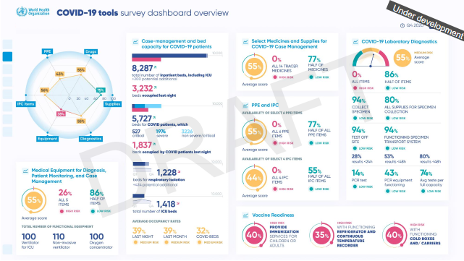
Data entry and automated analysis
Interview
Server
Excel chartbook:
automated presentation of detailed results
Raw data
Data download, cleaning, management and
analysis using a software
Field check tables
For monitoring
Clean data
Country dashboard
Summary indicator
data

Slide 31
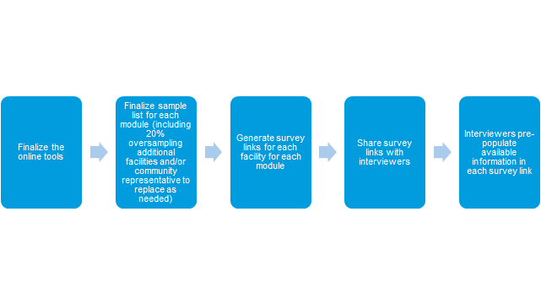

Data entry and automated analyses
Surveys are conducted through a Lime Survey online tool where an individual link will be generated for every interview (per module, per facility and/or community representative).
Finalizing the online tool and generating tokens will require some basic knowledge of the Lime Survey software

Slide 32
Data entry and automated analyses
Two main aspects of data sharing must be reviewed and confirmed prior to starting data collection:
  At the national level*: Countries must confirm that they have read and understood WHO’s data sharing agreement (included in every assessment), through which countries confirm that:
    All data must be collected in accordance with national applicable laws, including data protection laws
    WHO shall be entitled to:
      Publish the data, stripped of any personal identifiers
      Use, compile, aggregate, evaluate, and analyse the data and publish and disseminate the results
    To opt out of the data sharing agreement for any certain data, the country should notify WHO and clearly identify the data in question, the scope of the opt-out, and the reasons for the opt out by email to EHSmonitoring@who.int
  At the facility/community level: Respondents must provide consent to participate in the assessment. To obtain consent and agreement to collect data, interviewers must:
    Provide a brief introduction to the survey and the selection of the facility/community to participate in the survey
    Confirm that all personal and facility identifier data will not be reported in any dataset or findings
    Provide an opportunity for the facility managers and/or community leaders to ask any questions
    Confirm agreement to proceed with the assessment.
* At the national level: countries may additionally need local ethics committee approval depending on local law and guidelines

Slide 33
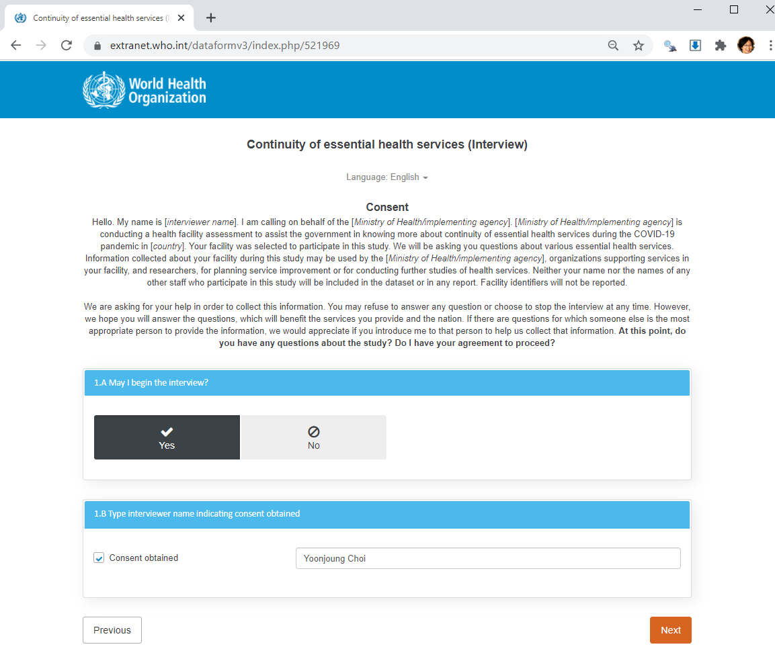
Data entry and automated analyses
Data sharing and facility consent​:

Slide 34

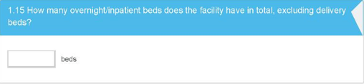
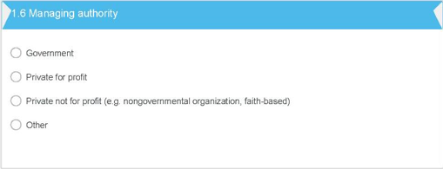

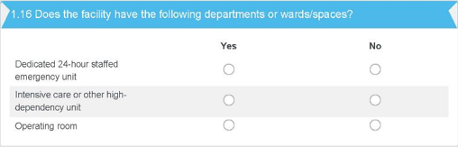
Data entry and automated analyses
Sample data entry sections:
Select one of the available answers (most common)
Enter a number (rare)
Enter a text answer (few)

Slide 35
Data entry and automated analyses
The tools are available in paper and electronic online formats, so if countries choose to use the WHO online survey tools, automated analysis chartbooks and dashboards will also be available for real-time decision making and use.
The dashboards can provide an alert function for specific bottlenecks and challenges, such as stock outs, changes in utilization, service disruptions, and staff shortages, to inform mitigation strategies and protocols for maintaining essential health services, as well as for planning and redistribution of resources at national, subnational and local levels.
Countries have access to their country database locally. It is recommended that these results are triangulated with HMIS data on service provision and utilisation, and feed into existing country data and intelligence platforms to guide the response. A policy dialogue will be organized with key country stakeholders to review findings, alert critical bottlenecks, and co-develop an action plan to mitigate challenges and disruptions.

Slide 36
Examples of Summary Results tabs in Chartbook - COVID-19 case management capacities module

Slide 37
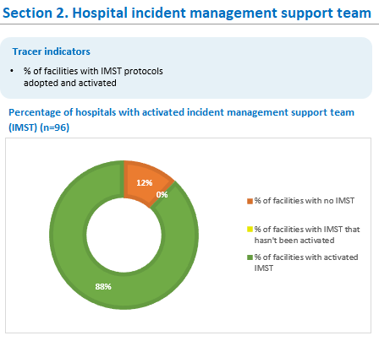
Summary results from COVID-19 case management capacities chartbook

Slide 38
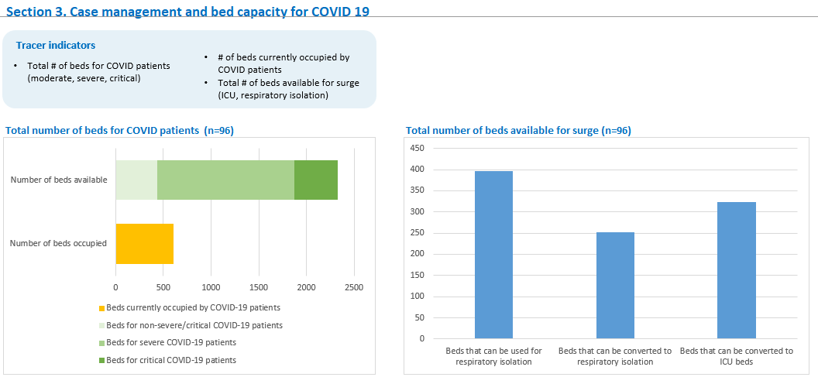
Summary results from COVID-19 case management capacities chartbook

Slide 39
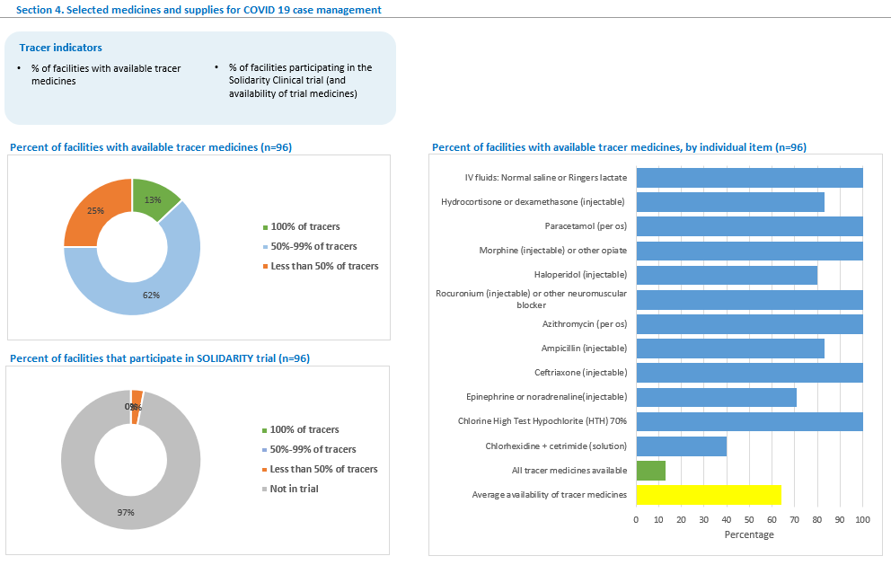
Summary results from COVID-19 case management capacities chartbook

Slide 40
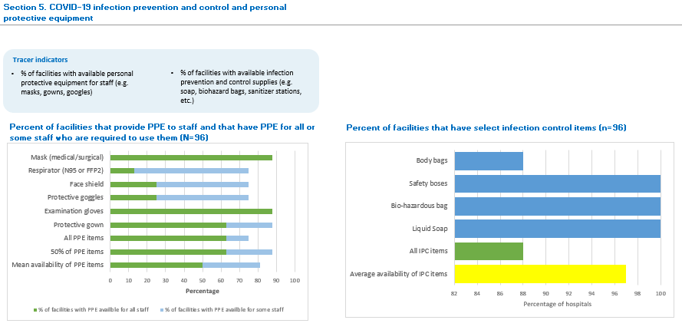
Summary results from COVID-19 case management capacities chartbook

Slide 41
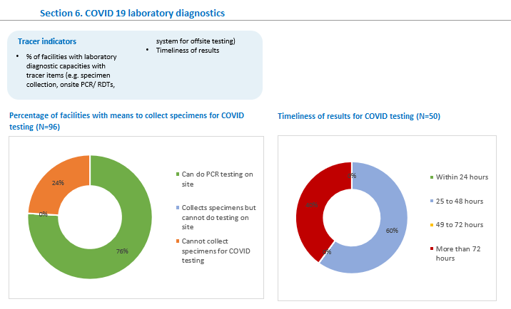
Summary results from COVID-19 case management capacities chartbook

Slide 42
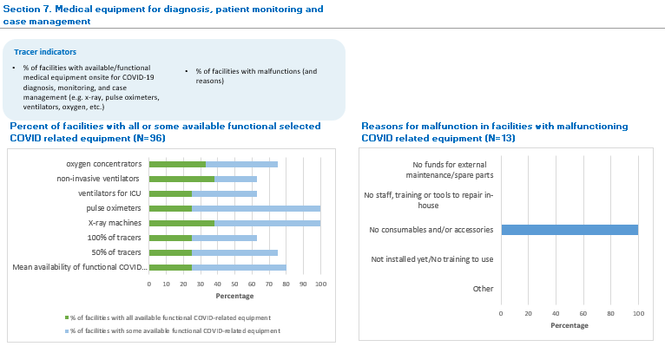
Summary results from COVID-19 case management capacities chartbook

Slide 43
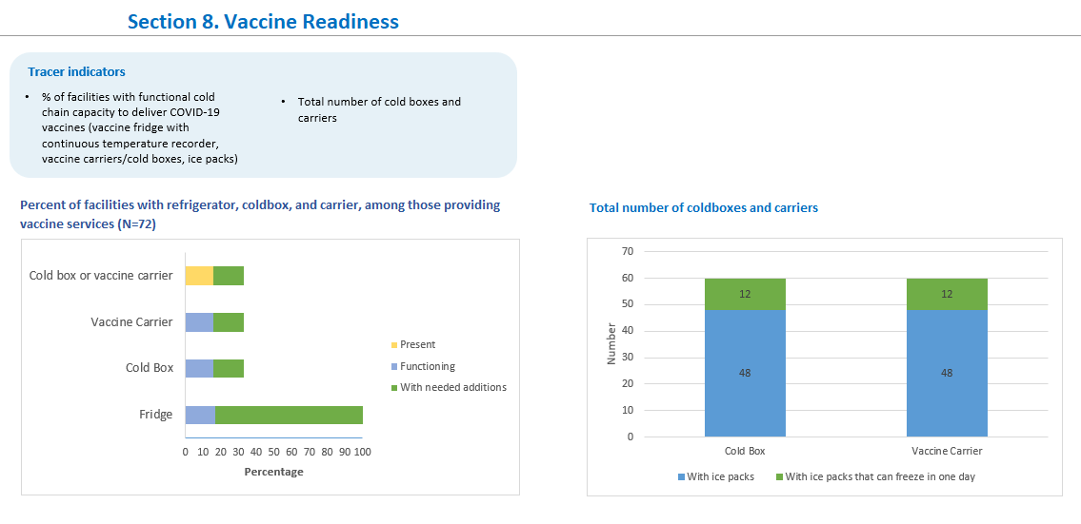
Summary results from COVID-19 case management capacities chartbook

Slide 44
Examples of Summary Results tabs in Chartbook - Continuity of essential health services module

Slide 45
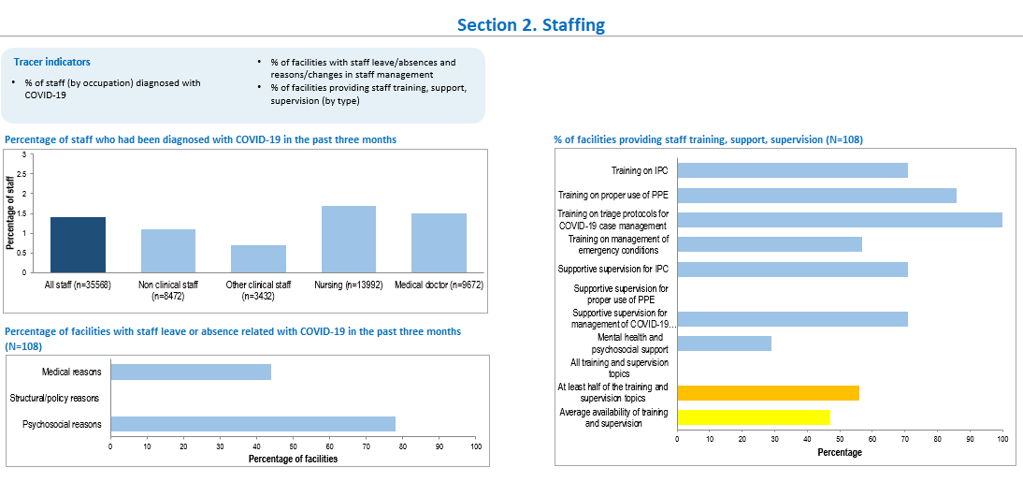
Summary results from Continuity of essential health services chartbook

Slide 46
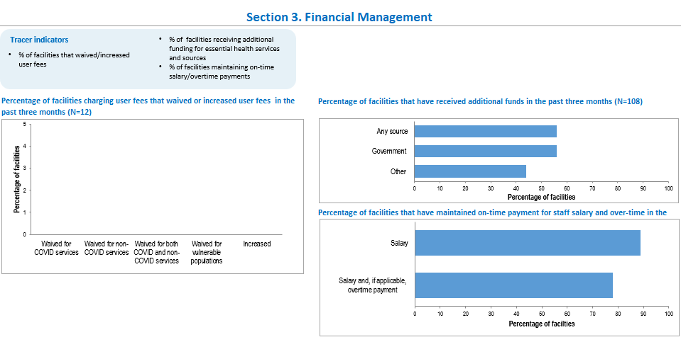
Summary results from Continuity of essential health services chartbook

Slide 47
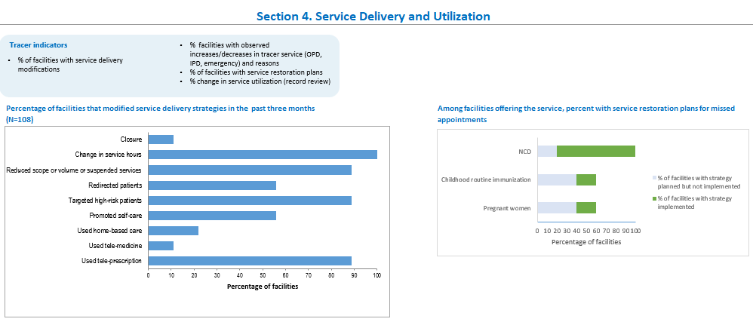
Summary results from Continuity of essential health services chartbook

Slide 48
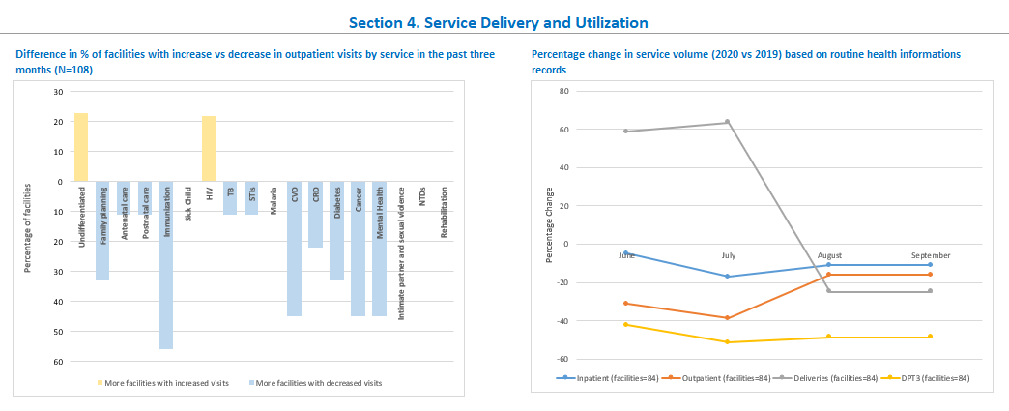
Summary results from Continuity of essential health services chartbook

Slide 49
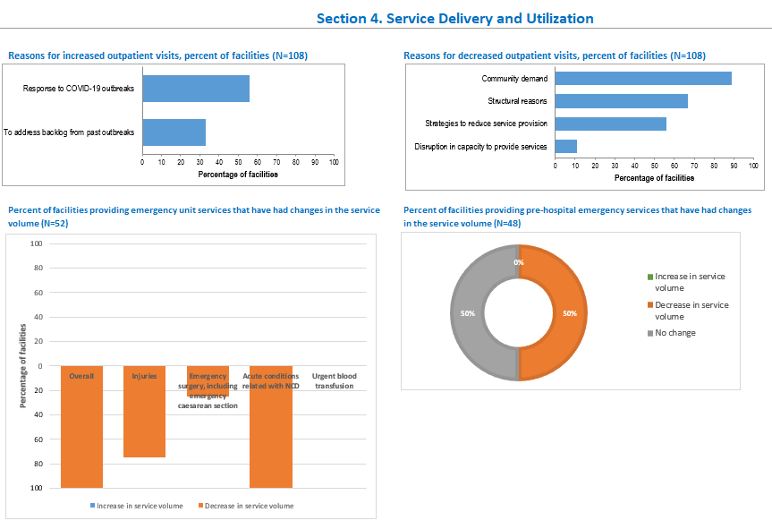
Summary results from Continuity of essential health services chartbook

Slide 50
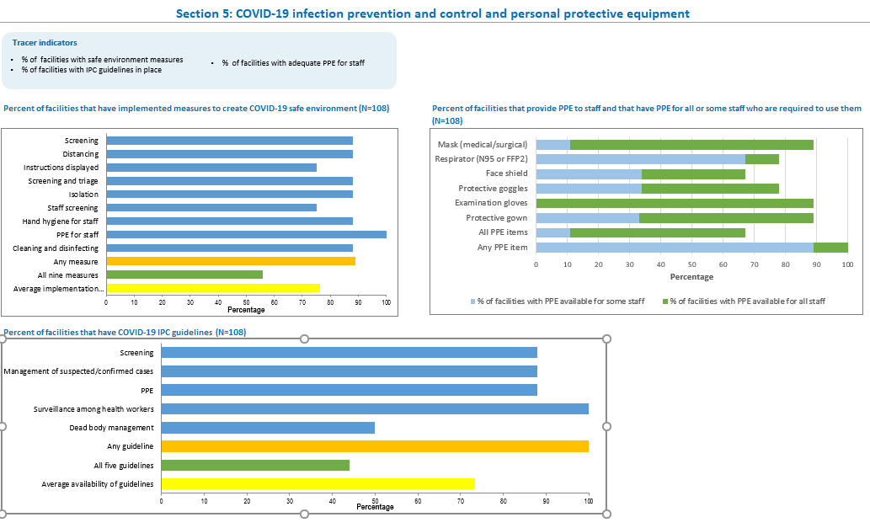
Summary results from Continuity of essential health services chartbook

Slide 51
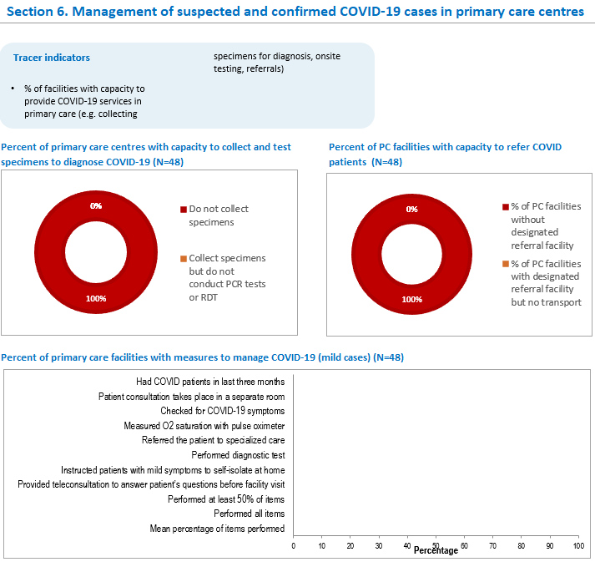
Summary results from Continuity of essential health services chartbook

Slide 52
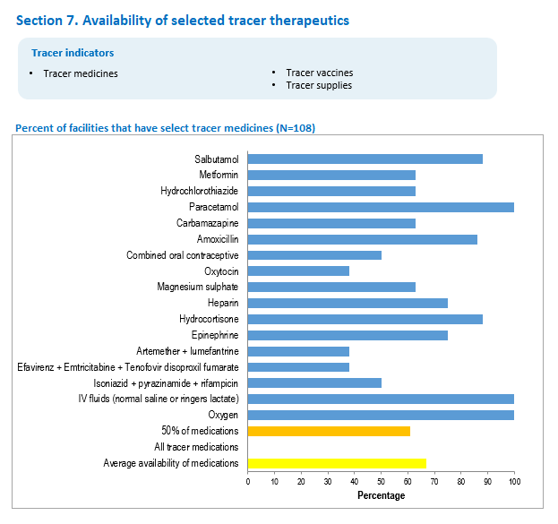
Summary results from Continuity of essential health services chartbook

Slide 53
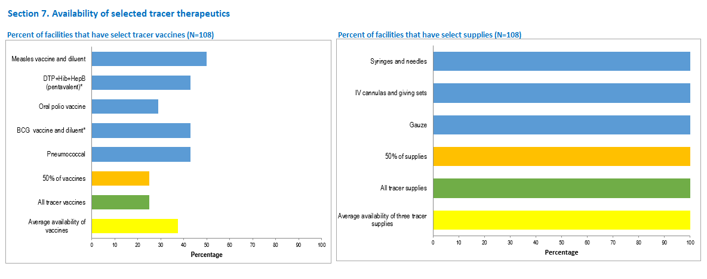
Summary results from Continuity of essential health services chartbook

Slide 54
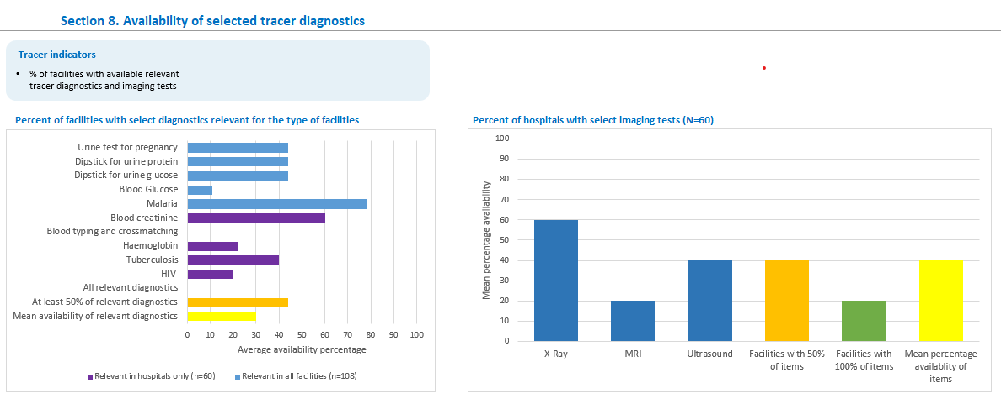
Summary results from Continuity of essential health services chartbook

Slide 55
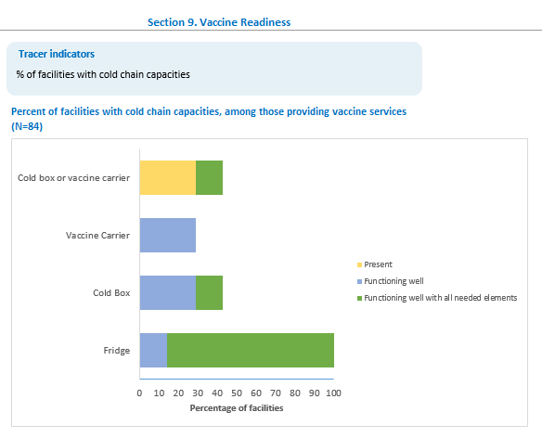
Summary results from Continuity of essential health services chartbook

Slide 56
Examples of Summary Results tabs in Chartbook - Community needs, demand, and perceptions module

Slide 57
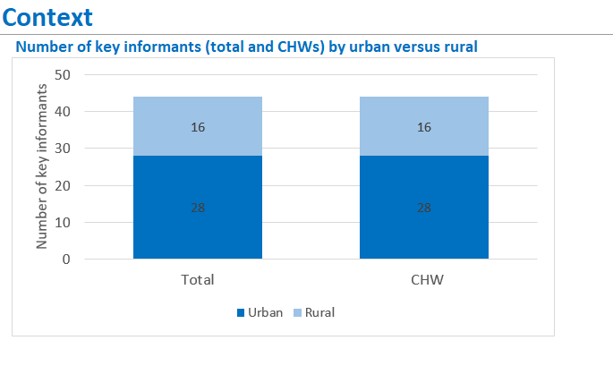
Summary results from Community needs, perceptions, and demand chartbook

Slide 58
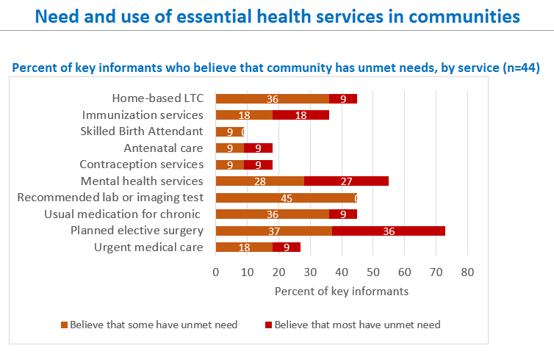
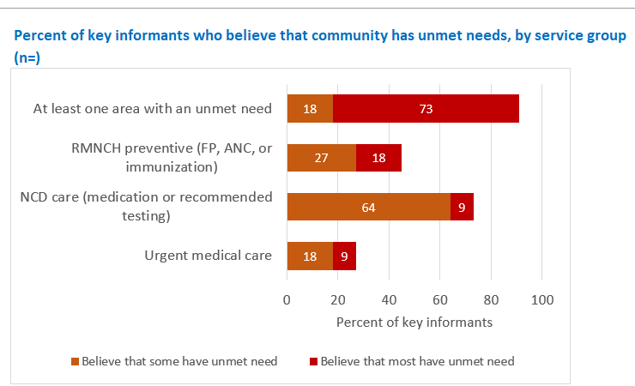
Summary results from Community needs, perceptions, and demand chartbook

Slide 59
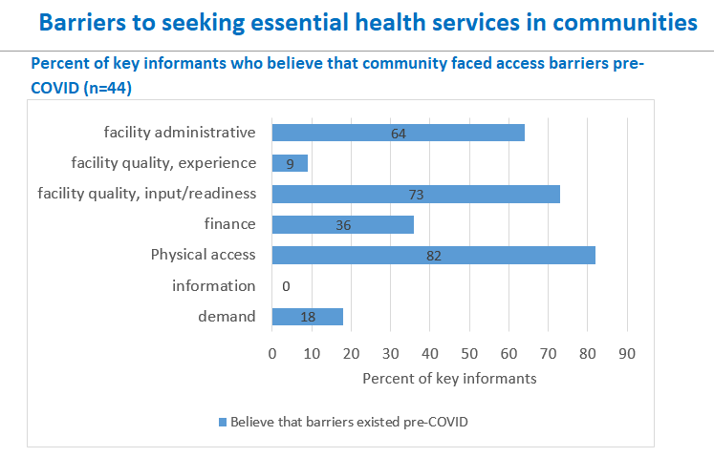
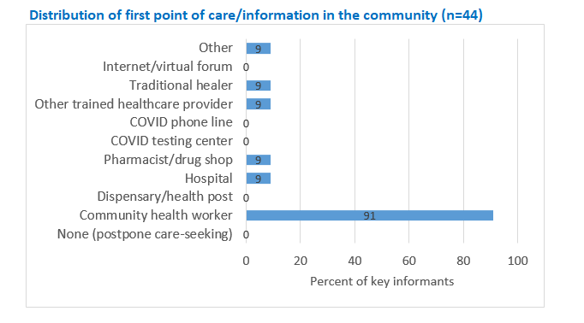
Summary results from Community needs, perceptions, and demands chartbook

Slide 60
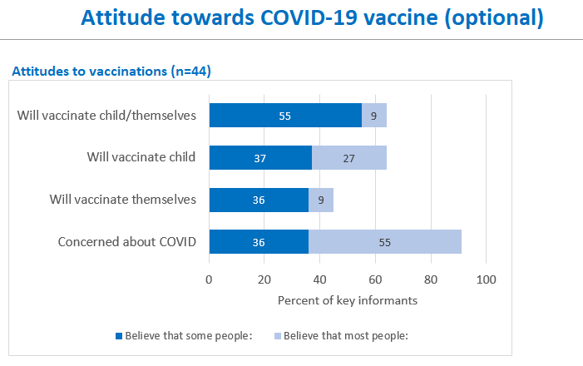
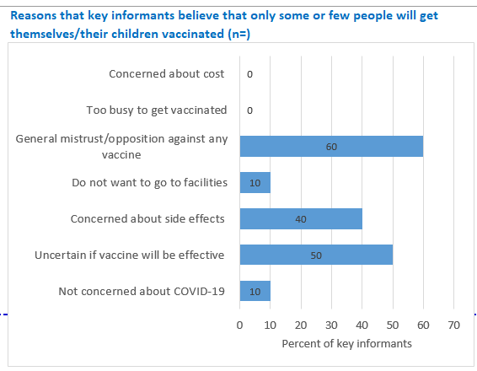
Summary results from Community needs, perceptions, and demands chartbook

Slide 61
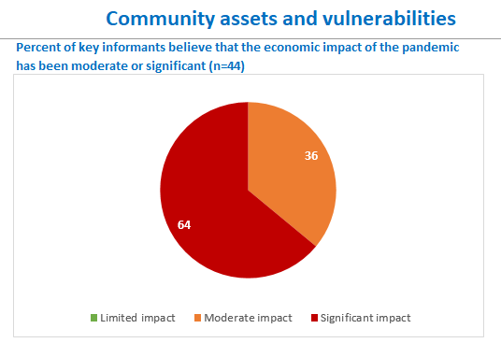
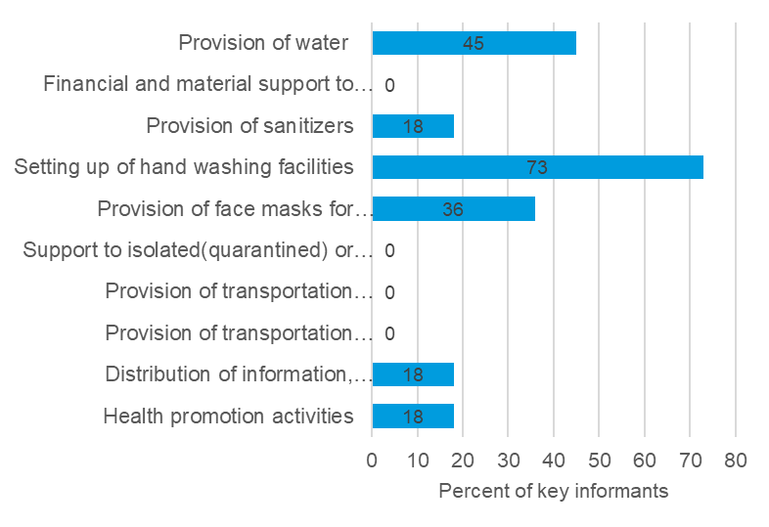
Summary results from Community needs, perceptions, and demands chartbook

Slide 62
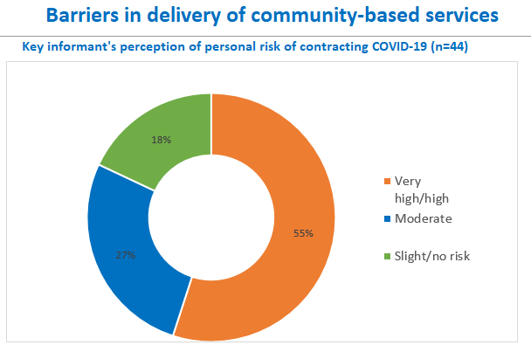
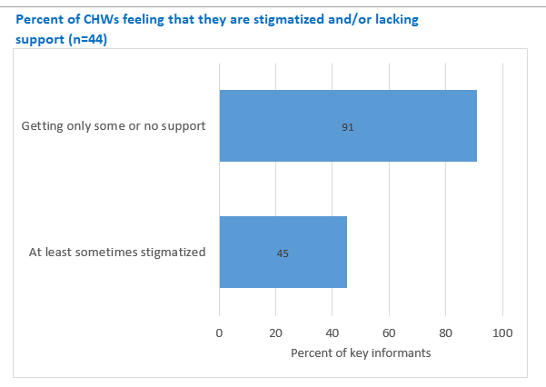
Summary results from Community needs, perceptions, and demands chartbook

Slide 63
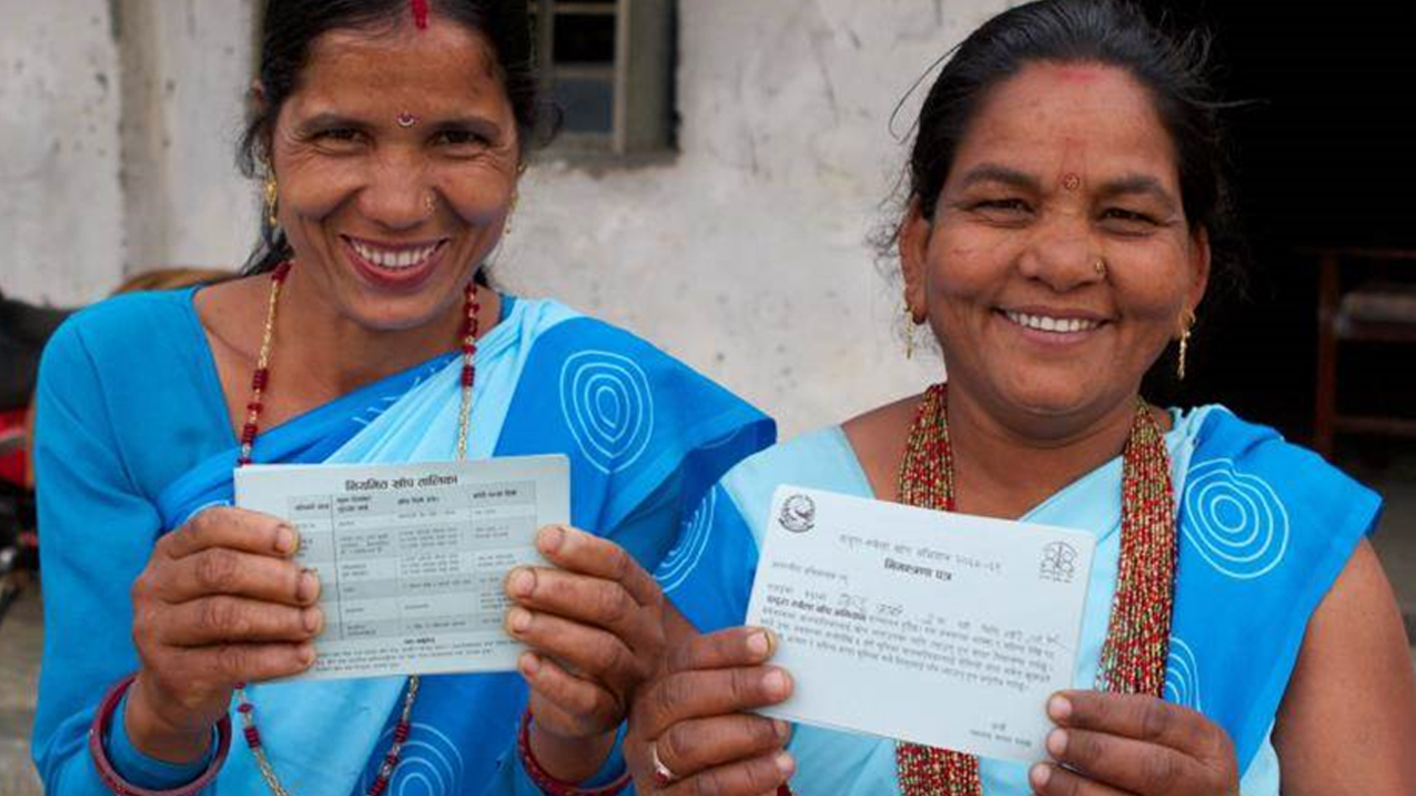
Closing slide

