Slide 1

Frontline service readiness assessments
Strengthening real-time health services tracking and monitoring in the context of the COVID-19 pandemic
Overview and implementation guidance, working slideset
27 November 2020

Slide 2
Frontline service readiness assessments: Session overview
Session 1 | Introduction to frontline service readiness assessments and approach Context Introduction to frontline service readiness assessments Overview of survey modules and key performance indicators Key features of the assessment
Session 2 | Overall planning for the assessments Survey coordination and planning Survey design Preparation for implementation
Session 3 | Methodology and sampling
Session 4 | Detailed planning for implementation Survey manager’s roles and responsibilities Country-specific adaptation of standard modules Interviewer training Logistics preparation
Session 5 | Country adaptation of modules Required adaptation Elective adaptation
Session 6 | Interviewer training Main responsibilities Skills and tips for successful interviews Review of paper questionnaire and practice using online tool Using and updating interview call log
Session 7 | Data management and analysis for automated results – for survey and data managers Data flow Data manager’s roles and responsibilities Use the automated excel chartbooks
Session 8 | Data management and analysis for automated results – for data managers Adapt data management/analysis code based on finalized modules in the country

Slide 3
Frontline service readiness assessments
Session 2: Overall planning for the assessments

Slide 4
Session 2: Overall planning for the assessments
Purpose: To provide an overview of key steps for survey implementation.
Expected outcomes: Following this session, participants will:
Understand key steps needed for survey coordination and planning, including:
  Identifying key steps for survey implementation
  Assigning roles and responsibilities
  Establishing a survey coordination group
  Determining the survey design: scope, frequency, and sample
  Preparing the overall operational plan and timeline
  Identifying survey implementation team
  Identifying resource requirements and prepare the budget
Session 1 | Introduction to frontline service readiness assessments and approach
Session 2 | Overall planning for the assessments Survey coordination and planning Prepare for data collection
Session 3 | Methodology and sampling
Session 4 | Detailed planning for implementation
Session 5 | Country adaptation of modules
Session 6 | Interviewer training
Sessions 7-8 | Data management and analysis for automated results

Slide 5
Survey coordination and planning

Slide 6
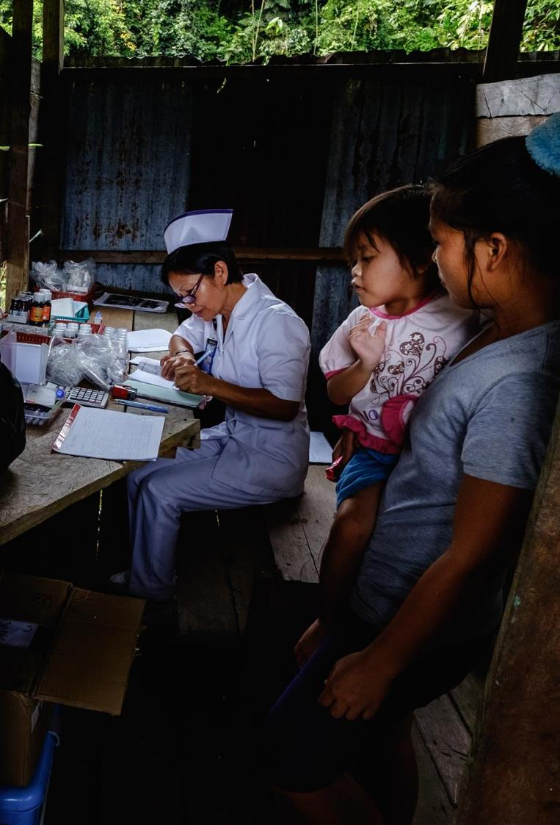
Survey coordination and planning
Before looking at the details of key steps needed for survey coordination and planning, it is helpful to have an overview of the survey implementation and the roles of each player in the initial phases.
The MoH initiates the survey by formally requesting WHO support for survey implementation. Once secured, MoH and WHO CO colleagues, with support from the technical support team, establishes key governance and coordination mechanisms. These mechanisms include establishing the survey coordinating group (involving MoH and key partners as relevant) and the survey implementation team.
While the survey implementation team is being established, the survey coordinating group begins the planning steps. This includes:
determining scope and frequency of survey,
preparing an overall survey plan and budget.
Notes:
Before looking at the details of key steps needed for survey coordination and planning, it is helpful to have an overview of the survey implementation and the roles of each player in the initial phases.
The MoH initiates the survey by formally requesting WHO support for survey implementation. Once secured, MoH and WHO CO colleagues, with support from the technical support team, establishes key governance and coordination mechanisms. These mechanisms include establishing the survey coordinating group (involving MoH and key partners as relevant) and the survey implementation team.
While the survey implementation team is being established, the SCG begins the planning steps. Specifically,
determining scope and frequency of survey, and
preparing an overall survey plan and budget.
The technical support team can assist these processes as needed.

Slide 7
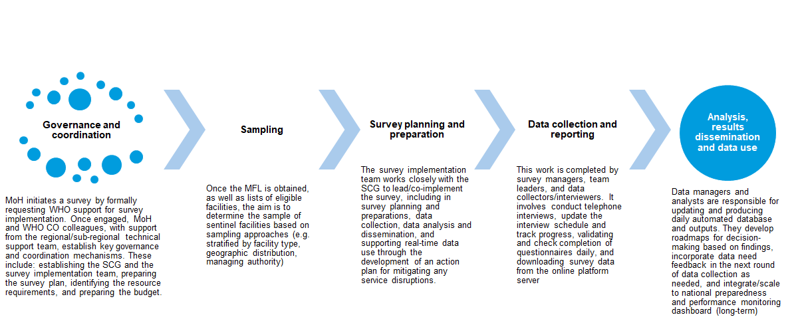
Overview of the key steps for survey implementation

Slide 8
Key steps for survey implementation
Governance and coordination
MoH request for support
Sampling
Obtain master facility list and list of eligible facilities
Survey planning and preparation
Review and adapt modules and survey materials
Conduct telephone interviews
Data collection and reporting
Data analysis and use
Update database and automated outputs daily
Establish coordinating group
Determine scope and frequency of survey
Identify survey implementation team
Prepare overall survey plan
Identify resource requirement and prepare budget
Procure equipment and coordinate logistics
Plan and conduct interviewer training
Pilot test
Complete pre-interview outreach
Download survey data from the online server
Develop roadmap/action plan to mitigate disruptions and address priority bottlenecks
Integrate/scale to national preparedness and performance monitoring dashboard (long-term)
Determine sample based on sampling approach
Prepare interview schedule
Incorporate feedback into next round of survey
Notes:
During the overall planning, as you can see some key high level decisions are made – such as survey scope, frequency, key personnel for the survey implementation team, and importantly the budget.
Based on these decisions, further detail technical work will proceed – such as sampling, questionnaire adaptation, and data analysis preparation. Shown in the second and third columns in this figure.

Slide 9
Survey coordination and planning
Survey Coordinating Group (SCG)
The SCG provides overall support for the survey implementation through technical and/or potential financial assistance. Support is provided throughout the entire survey process by:
  Defining the scope and frequency of the survey
  Input on survey tools adaptation
  Development of survey protocols
  Interpretation and use of results
  Policy dialogue and planning
Notes:
Also, the Survey Coordinating Group (SCG) provides overall support for the survey implementation through technical and/or potential financial assistance. Support is provided throughout the entire survey process by:
Defining the scope and frequency of the survey (which we just discussed)
Input on survey tools adaptation
Development of survey protocols
Interpretation and use of results
Policy dialogue and planning
In cases where a SCG cannot be established, the WHO and other partners can:
Provide input into survey review process
Provide technical and/or financial support for the implementation of the survey
Support interpretation and use of results
Support policy dialogue and planning processes

Slide 10
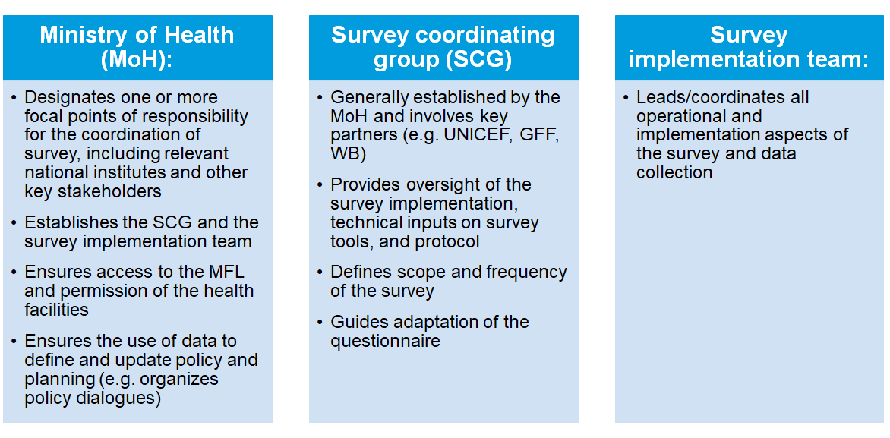
Survey coordination and planning
Notes:
Let’s understand different roles and responsibilities among three groups.
Please note that often these groups are not mutually exclusive.

Slide 11
Survey scope and frequency
Survey methods
In response to the urgent need for high-frequency real-time data, the WHO offers an efficient and safe approach in an emergency setting that makes use of limited resources with high returns and seeks to lower the burden on facilities as much as possible.
This approach involves rapid and regular phone interviews with facility managers using an electronic questionnaire among select sentinel facilities.
Frequency of phone interviews can range from monthly to quarterly, in order to provide trend data and allow national planners and stakeholders to track the impact on health service capacities throughout the pandemic.
Notes:
For undertaking surveys, the WHO recommends rapid and regular phone interviews with facility managers, using online data entry, among select sentinel facilities. Survey methods are presented more in detail in Session 2A.
This is an efficient and safe approach in an emergency setting that makes use of limited resources with high returns and seeks to lower the burden on facilities as much as possible.

Slide 12
Survey scope and frequency
Determine survey design
  When designing surveys using the frontline service readiness assessment suite, the WHO recommends countries begin by:
    Defining the scope of the survey and select modules from the suite to implement, according to urgent data needs and priorities
    Defining the frequency of data collection for each module (at least quarterly, but could be as frequent as monthly according to need)
    Confirming the mode of data collection. Depending on the local COVID-19 epidemiology, interviewers may conduct phone interviews from their homes. Where the situation is safe, interviewers may complete data collection from an office setting.
    Determining survey sample
Notes:
One of the key roles of the survey coordinating group is to determine survey scope and frequency.
For the frontline service readiness assessment, the WHO recommends countries begin by:
Defining the scope of the survey and select modules to implement from the assessment suite, according to urgent data needs and priorities
Defining the frequency of data collection for each module (at least quarterly, but could be as frequent as monthly according to need and resources)
Confirming the mode of data collection. Depending on the local COVID-19 epidemiology, interviewers may conduct phone interviews from their homes. Where the situation is safe, interviewers may complete data collection from an office setting.
Determining survey sample

Slide 13
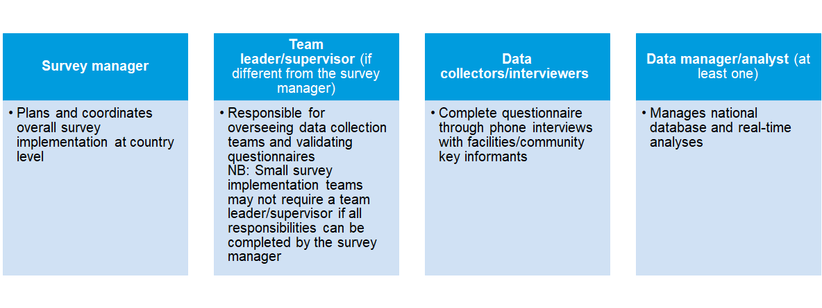
Survey implementation team
An overview of the survey implementation team:
Notes:
The survey implementation team consists of:
Survey manager
Team leader/supervisor
Data collectors/interviewers
Data manager/analyst
We will look at roles and responsibilities of a survey manager more closely in the next session.
Supervisors or team lead may be needed depending on the size and organization of the team.
Interviewers are back bone of the team – as in any surveys. We have a separate session on interviewer training and their roles and responsibilities.
Lastly, data managers. Data managers play a critical role, but even more up-front preparation is required in this assessment, because of the strong emphasis on rapid data analysis and review. Even though they are listed at the end of this slide, data managers need to start actually as soon as the questionnaire adaptation is completed. Preparation

Slide 14
Survey implementation team
  A country may find that the number of data collectors/interviewers depends on the survey plan and schedule. Nevertheless, the data collection period for the modules should not exceed 7 days, and it is expected that an interviewer can complete 4-5 interviews on any given day. With that in mind, the recommendation is to recruit 1 data collector per ±20 facilities.
  If multiple modules are implemented, countries may use the same data collection team for all modules (extending the timeline potentially), or train different data collection teams for each module (for more rapid deployment).
Notes:
We want to share a note about the interviewers for the budgeting purposes.
A country may find that the number of data collectors/interviewers depends on the survey plan and schedule. Nevertheless, the data collection period for the modules should not exceed 7 days, and it is expected that an interviewer can complete 4-5 interviews on any given day. With that in mind, the recommendation is to recruit 1 data collector per ±20 facilities.
If multiple modules are implemented, countries may use the same data collection team for all modules (which may extend the timeline), or train different data collection teams for each module (for more rapid deployment).

Slide 15
Survey implementation team
Team leader/supervisor
Oversees data collection team (for regional area or module) and validates questionnaires
Organizes/schedules data collection telephone interviews
Prepares the necessary materials for data collection
Ensure data collectors/interviewers are ready for data collection
Supervises data collection activities
Ensures data collection protocols are followed
Checks submitted interview results at the end of each day for completeness /errors
Inform the survey manager if facilities could not be contacted (to provide alternative site)
Reports to survey manager and data manager/analyst at the end of each day
Notes:
Survey managers

Slide 16
Survey coordination and planning
Data collectors/interviewers
Completes questionnaire through phone interviews with facilities/community key informants
Calls facility contact person
Collects data and inputs through electronic questionnaire
Takes coordinates of facility (if none exist)
Ensures questionnaires are complete and correct prior to submission
Submits final questionnaires through electronic instrument
Reports to the team leader/ supervisor at the end of each day of data collection

Slide 17
Prepare for data collection and budget

Slide 18
Prepare for data collection and budget
Preparing overall timeline. An illustrative example of activities (for survey planning and preparations)
Activity | Weeks
 | 1 | 2 | 3 | 4 | 5 | 6 | 7 | 8 | 9 | 10 | 11 | 12 | 13 | 14 | 15 | 16 | 17 | 18 | 19 | 20 | 21 | 22 | 23 | 24 | 25 | 26 | 27 | 28 | 29
Round 1
Survey coordination and planning | X | X
Adaptation of modules and preparation for analysis |  | X | X
Logistics planning |  |  | X | X
Interviewers training |  |  |  | X
Data collection |  |  |  |  | X
Results review and data use |  |  |  |  | X | X | X | X | X | X | X | X | X | X
Round 2
Module and analysis update, as needed |  |  |  |  |  |  |  |  |  |  |  |  |  | X | X
Logistics planning |  |  |  |  |  |  |  |  |  |  |  |  |  |  | X | X
Refresh training |  |  |  |  |  |  |  |  |  |  |  |  |  |  |  | X
Data collection |  |  |  |  |  |  |  |  |  |  |  |  |  |  |  |  | X
Results review and data use |  |  |  |  |  |  |  |  |  |  |  |  |  |  |  |  | X | X | X | X | X | X | X | X | X | X
Round 3
Module and analysis update, as needed |  |  |  |  |  |  |  |  |  |  |  |  |  |  |  |  |  |  |  |  |  |  |  |  |  | X | X
Logistics planning |  |  |  |  |  |  |  |  |  |  |  |  |  |  |  |  |  |  |  |  |  |  |  |  |  |  | X | X
Refresh training |  |  |  |  |  |  |  |  |  |  |  |  |  |  |  |  |  |  |  |  |  |  |  |  |  |  |  | X
Data collection |  |  |  |  |  |  |  |  |  |  |  |  |  |  |  |  |  |  |  |  |  |  |  |  |  |  |  |  | X
Results review and data use |  |  |  |  |  |  |  |  |  |  |  |  |  |  |  |  |  |  |  |  |  |  |  |  |  |  |  |  | X
EXAMPLE
Notes:
This slides demonstrate an example of quarterly data collection.
Data collection takes one week in each round.
Results are available for review immediately after data collection.
Dissemination and use of data is a continuous process throughout the whole time.

Slide 19
Prepare for data collection and budget
Resource requirements for consideration while preparing the budget
Technical documents/resources
Human resources
Equipment/infrastructure
MFL
Country adapted questionnaire (paper based and digital)
Data collection protocol and interviewer training guide
Survey interview schedule
Country database, automated chartbook and country intelligence dashboard
Analysis and data product plan – forthcoming guidance
Data use plan for key audience – forthcoming guidance
Survey manager
Team leader/supervisor (if applicable)
Data collectors/interviewers
Data manager/analyst(s)
Phone and headset/earphone
Laptop/tablet (the form can be used on smart phones, but data entry on tablets/computers is easier)
Location from where interview will be conducted
Stable internet connection at a central location or each interviewer’s home.
Phone time top-up credit
Additional equipment may be needed to strengthen internet/wifi (e.g., router, wifi signal enhancer) if calls are made from a central location.
Notes:
For budgeting purposes, let’s review required materials, human resources, and equipment.
In terms of technical resources are available, standard questionnaire, data analysis code, and automated chartbook are available. In each country, these need to be adapted based on the finalized questionnaires.
In terms of human resources, we reviewed the implementation team earlier.
Finally, there are required equipment and logistics related to conducting phone interviews.
In summary, depending on the magnitude of country specific adaptation, sample size, and logistics, survey budget will be determined.

Slide 20
Prepare for data collection and budget
Illustrative example for calculating interviewer requirements and budget needs
Multiple context-specific factors will determine the budget.
It is recommended to leverage existing resources as much as possible.
A main resource requirement will be human resources:
  For interviewers, the budget should cover training days, 2-3 days for pre-interview outreach, and data collection days.
  The number of interviewers needed will depend on sample size.
  Data managers’ LOE will depend on the level of country specific adaptation.
Example | Interviews completed | Budget calculation
Illustrative example 1: 100 health facilities (assumption 1 interviewer can cover 4 facilities per day) | 1 surveyor can cover 20 facilities per week 5 surveyors can cover 100 facilities per week | Training: 5 surveyors x [daily rate] x [training days per year] Pre-interview outreach: 5 surveyors x [daily rate] x [outreach days per year] Data collection: 5 surveyors x [daily rate] x [5 working days] x [frequency per year]
Illustrative example 2: 50 community interviews (assumption 1 interviewer can cover 5 communities per day) | 1 surveyor can complete 25 community interviews per week 2 surveyors can complete 50 community interviews per week | Training: 2 surveyors x [daily rate] x [training days per year] Pre-interview outreach: 2 surveyors x [daily rate] x [outreach days per year] Data collection: 2 surveyors x [daily rate] x [5 working days] x [frequency per year]
Notes:
It is recommended to leverage existing resources as much as possible.
A main resource requirement will be human resources:
For interviewers, the budget should cover training days, 2-3 days for pre-interview outreach, and data collection days.
The number of interviewers needed will depend on sample size.
Data managers’ LOE will depend on the level of country specific adaptation.

Slide 21
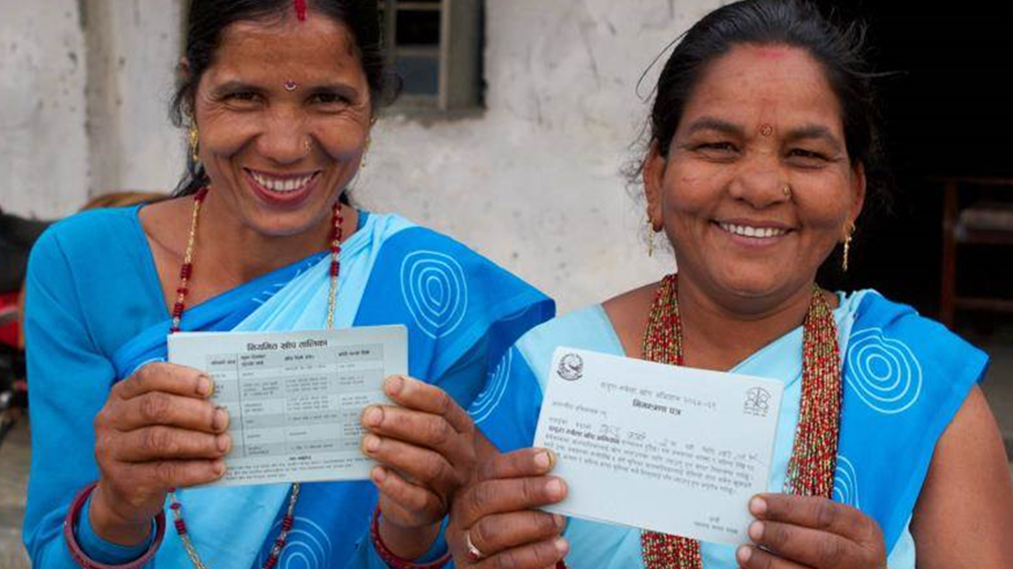
Closing slide

