Slide 1

Frontline service readiness assessments
Strengthening real-time health services tracking and monitoring in the context of the COVID-19 pandemic
Overview and implementation guidance, working slideset
27 November 2020

Slide 2
Frontline service readiness assessments: Session overview
Session 1 | Introduction to frontline service readiness assessments and approach Context Introduction to frontline service readiness assessments Overview of survey modules and key performance indicators Key features of the assessment
Session 2 | Overall planning for the assessments Survey coordination and planning Survey design Preparation for implementation
Session 3 | Methodology and sampling
Session 4 | Detailed planning for implementation Survey manager’s roles and responsibilities Country-specific adaptation of standard modules Interviewer training Logistics preparation
Session 5 | Country adaptation of modules Required adaptation Elective adaptation
Session 6 | Interviewer training Main responsibilities Skills and tips for successful interviews Review of paper questionnaire and practice using online tool Using and updating interview call log
Session 7 | Data management and analysis for automated results – for survey and data managers Data flow Data manager’s roles and responsibilities Use the automated excel chartbooks
Session 8 | Data management and analysis for automated results – for data managers Adapt data management/analysis code based on finalized modules in the country

Slide 3
Frontline service readiness assessments
Session 3: Methodology and sampling

Slide 4
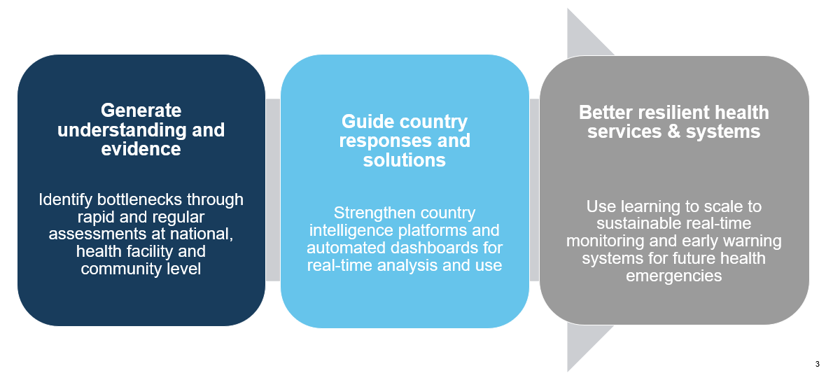



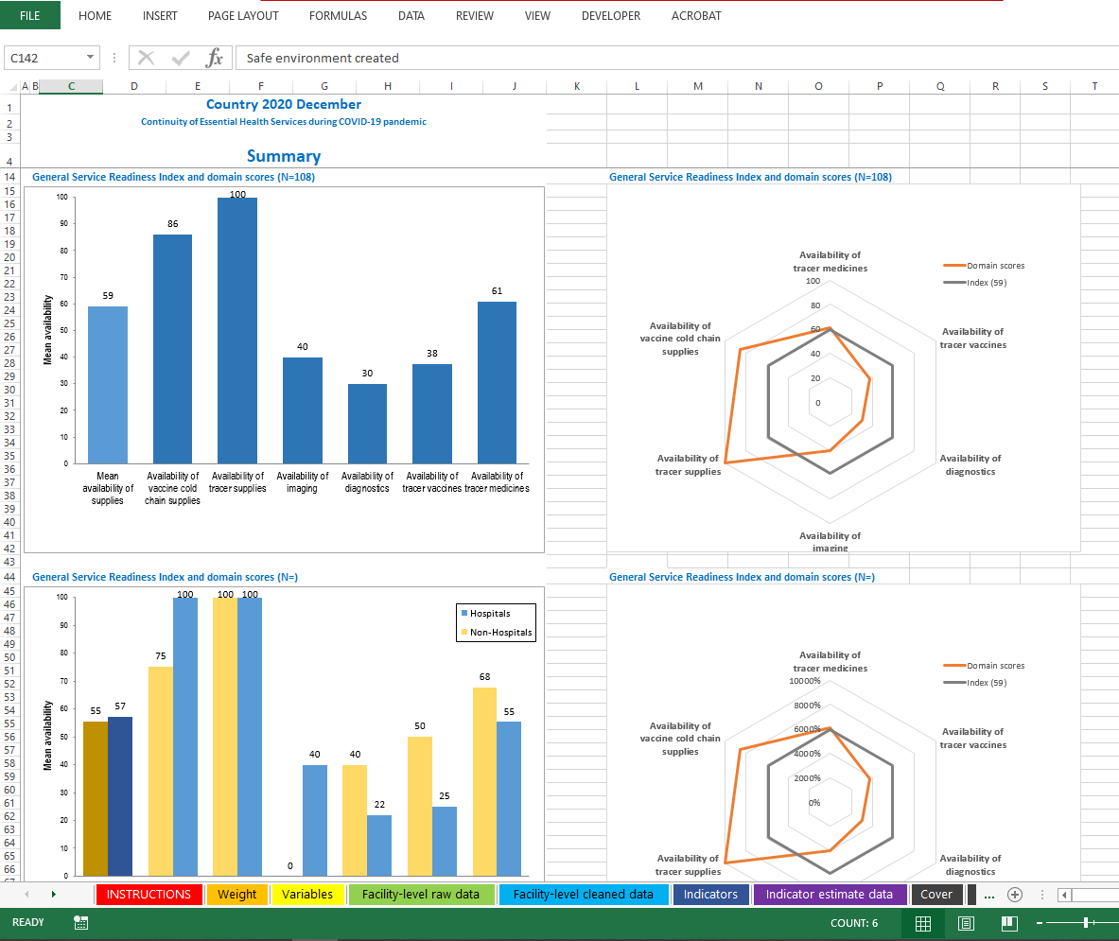
Recommended approach
To rapidly detect bottlenecks and track and monitor health services:
Low cost, safe, near to real-time data
  Rapid and high-frequency phone surveys
  On-line interviews with facility managers & CHWs using electronic data collection tools
  Sample of sentinel facilities and their communities (public/private, urban/rural, hospital/primary care facilities, geography)
  Real-time data through automated analyses chartbooks and dashboards
  Repeated at least quarterly (or monthly) to allow national planners to track health service capacities throughout the pandemic
Inform action plans and policy dialogues
Phone interviews with online data entry
Daily data download and database consolidation
Data feeds into automated chartbooks/ dashboard
Continuous monitoring and learning
Notes:
This assessment has kea features:
Phone interviews for low cost & safety in data collection during the pandemic
Following sample of sentinel facilities and their community key informants
Automated data management
These three enable two characteristics of this assessment: rapid data collection and rapid data review and use.
And then we repeat this periodically for continuous monitoring and learning.

Slide 5
Assessment methodology
Based on survey objectives and needs
Objectives and needs
Recommended method
Given the objectives to rapidly detect and monitor health systems bottlenecks, health service capacity, and readiness gaps in a rapidly changing contexts, the data collection methodology must respond to urgent needs for:
High-frequency, near to “real-time” data
Rapid and safe implementation in an emergency setting
Use of limited resources with high return
  High-frequency phone interviews with facility managers and online questionnaire completion
  Data collection in select sentinel facilities, that are sampled based on analysis domain by facility type (hospital, primary care, long-term care), managing authority (public/private) or geographic area (rural/urban)
  Frequency ranging from monthly to quarterly to allow national planners to track service capacities throughout the pandemic
  Daily upload of data to country database to feed into automated analyses chartbooks
  Findings fed into country intelligence platforms and partner platforms
  Key performance indicators shared with WHO and key partners

Slide 6
Rapid timeframe
The approach allows for rapid implementation in a short timeframe providing real-time data collection and analysis of sentinel facilities.
With this approach, a single round of data collection can be completed in a single week.
This table illustrates the human resource requirements needed to support this rapid completion of data collection.
Module | Sample size | Interview timing | Illustrative examples
COVID-19 case management capacities | 50 hospitals or COVID-19 designated treatment centres | Estimated: 30 minute interview 1 interviewer can cover 5 facilities per day | 1 interviewer can cover 25 facilities per week 2 interviewers can cover 50 facilities per week
Continuity of essential health services | 100 health facilities (50 hospitals + 50 primary care facilities) | Estimated: 30-45 minute interview 1 interviewer can cover 4 facilities per day | 1 interviewer can cover 20 facilities per week 5 interviewers can cover 100 facilities per week
Community needs, perceptions and demand | 50 community interviews | Estimated: 15 minute interview 1 interviewer can cover 5 communities per day | 1 interviewer can complete 25 community interviews per week 2 interviewers can complete 50 community interviews per week
Notes:
The approach allows for rapid implementation in a short timeframe, providing real-time data collection and analysis of sentinel facilities.
With this approach, a single round of data collection can be completed in a single week, with a relatively small number of interviewers – if the sample size is between 100-150.
In this table, the last columns illustrate the human resource requirements needed to support this approach.

Slide 7
Recommended approach to sample sentinel sites
Strategies to select the sample may vary according to resource availability as well as each module.
  If a MFL is available, a stratified sampling approach is recommended for the facility assessments
  A convenience sampling approach is recommended for the community assessment
Where a MFL is not available, alternative approaches may be considered, especially in cases where:
  Selecting facilities with known high quality in data reporting
  Targeting districts with poor service provision prior to the pandemic
  Utilizing existing sentinel facility networks
OR
Module | Recommended approach
COVID-19 case management capacities | Simple random sample stratified by a combination of limited sampling strata If the total number of eligible facilities is limited: census of all tertiary-level facilities/hospitals/treatment centres
Continuity of essential health services | Simple random sample of the lower-level facilities stratified by a combination of limited sampling strata
Community needs, perceptions and demands | Convenience sample of 1-5 community key informants per sampled lower-level facility (depending on the Continuity of essential health services sample design)
Notes:
For the community assessment, if the tool is used, we recommend a convenience sampling, linked to sentinel facilities.
The sample of sentinel facilities can be selected using different approaches.
One is to use a stratified equal probability sample, as in a typical health facility survey.
If a reasonably updated master facility list is not available, purposeful sampling based on known data quality strength, targeting, or existing sentinel networks.

Slide 8
Stratified sampling of sentinel facilities
A guide through the key steps
1. Determine the sample frame (eligible facilities)
2. Determine the sampling domains and strata
3. Determine the sample size
4. Select sentinel facilities
Notes:
This slide present steps for stratified equal probability sample of facilities.

Slide 9



Stratified sampling of sentinel facilities
Step 1: Determine the sample frame (eligible facilities)
The sample frame should include all eligible facilities that meet all pre-defined criteria.
It is recommended that an existing MFL in the country serve as the basis for the sampling frame and not updating or constructing a MFL for this assessment.
Any facilities that do not meet the criteria should be excluded from the sampling frame.
Pre-defined criteria:
Facilities must be one of the agreed facility types (e.g. hospitals, COVID-19 treatment centres, primary care facilities, etc.)
    Facilities must be in the agreed geographic settings of the survey
    Facilities must have valid telephone contact details
Notes:
Sample frame for this assessment is all facilities in the master facility list that meet assessment criteria with known phone numbers – because we’re doing phone interviews.
For COVID-19 case management module, eligible facilities are hospitals and COVID-19 treatment centres. Exclude non COVID-19 facilities.
For Continuity of EHS modules: Any specialized health facilities (e.g., dental clinics) should be excluded. We also recommend to exclude tertiary level hospitals.

Slide 10
Stratified sampling of sentinel facilities
  Step 2: Determine sampling domains and strata
  Identify the key sampling domains for analysis. These may include identifying:
    Managing authority: public or private
    Type of facility: hospitals, primary care facilities, long-term care facilities, etc.
    Type of residential area: rural or urban
    Select administrative units by COVID-19 transmission status: regions more greatly affected by COVID-19
Notes:
Next, we determine sampling domains. The number of strata determines the sample size and budget. Inversely, it will be considered within the available budget.
Examples of domains include managing authority, type of facility, and type of residential areas.
Select administrative units by COVID-19 transmission status or need can be also used as a sampling domain.
Again, we recommend keeping the number of strata small.

Slide 11
Stratified sampling of sentinel facilities
Step 3: Determine the sample size
The sample size will depend on the identified strata and domains. Each analysis domain should include at least 35 facilities to ensure a minimum sample size of at least 25 facilities for key indicators (helps ensure a stable estimate). The domain with the highest number of strata determines the total sample size. At a given level/type of indicator, expected precision of the national/aggregate-level estimates depends on sampling weight, which is calculated from stratified design.
Illustrative example
Scenario | Sampling/analysis domain | Highest number of strata | Calculation | Sample size
A | Facility location (urban vs. rural) Managing authority (public vs. private) Facility type (hospitals, health centres vs. primary care facilities) | Three strata (by facility type) | 35 x 3 | 105
B | Facility location (urban vs. rural) Managing authority (public vs. private) Facility type (hospitals, health centers vs. primary care facilities) Four administrative units purposely selected | Four strata (by administrative unit) | 35 x 4 | 140
C | Facility location (urban vs. rural) Managing authority (public vs. private) Facility type (only primary care facilities) | Two strata (by facility location and managing authority) | 35 x 2 | 70
Notes:
Each sampling or analysis domain should include at least 35 facilities - to ensure that key indicators are calculated with at least 25 facilities in the denominators.
When there are multiple sampling domains, the highest number of strata in a domain determines the total sample size.

Slide 12
Stratified sampling of sentinel facilities
Step 4: Select sentinel facilities
Once the sampling domains, strata, and sample size have been defined, the sentinel facilities need to be selected:
  Partition the sampling frame into identified strata
  Randomly select facilities within each stratum
  Calculate sampling weight to provide national/aggregate estimates
Notes:
Then, finally, within each strata, we select facilities from the sampling frame.
Specifically:
Partition the sampling frame into identified strata
Randomly select facilities within each stratum
Calculate sampling weight to provide national/aggregate estimates

Slide 13
Interpreting results from sentinel sites
A stratified sampling approach will provide sentinel facilities that are representative for each domain and, when adjusted for analytical weight, for the country at the baseline.
Observed trends should be interpreted among the sentinel sites without sampling error.
Notes:
A stratified sampling approach will provide sentinel facilities that are representative for each domain and, when adjusted for analytical weight, for the country at the baseline.
Observed trends should be interpreted among the sentinel sites without sampling error.
Depending on the level of acceptable margin of error, these trends may be interpreted to be representative for all facilities in the country.

Slide 14
Methodology annex: sampling approach
Important considerations to inform the sampling approach
1. | Objectives of the assessment | The assessment aims to monitor signals/alerts of service disruptions among sentinel sites. While not fully representative of the national context, sentinel facilities and communities can provide early evidence of changes in health service provision and utilization.
2. | Type and level of estimates for key indicators | Some indicators will be calculated only among a subset of facilities, which affects the number of facilities required for each domain Indicators where the results are expected to be extreme (e.g., it is expected to be observed in a high or low percentage of facilities) require a smaller sample size than those where responses are expected to be more evenly divided
3. | Required/ acceptable precision | Given the objectives of the survey, statistical inference about point estimates and their trends (as in typical sample surveys) are neither critical nor feasible. So, though unconventional, a sample size can be simply determined to provide stable estimates among the sentinel facilities.
4. | Resources for data collection and data use | The number of analysis domains and categories within each domain will need to be determined strategically based on available resources and implementation timelines, in order to ensure rapid data collection, analysis, and use.

Slide 15
Methodology annex: potential methods
Domains of estimation | Sampling method | Sample size (estimate) | Frequency
Sentinel surveillance with aim of identifying trends (not national representation) | Stratified sampling of sentinel facilities | Small size: 50-100 facilities | More frequent information (monthly to quarterly)
Continuous survey with national and subnational representation | Stratified sampling divided by phases during a period of time | 1st phase: 50% of sampling 2nd phase: 50% of sampling 3rd phase: 50% of sampling (1st phase) 4th phase: 50% of sampling (2nd phase) | More frequent information (partial), including national and subnational across a long period of time (2-4 years)
National estimates | Small country: Stratification by identified domains Simple/systematic random sampling within each stratum | 150 – 250 facilities | Usually 2 to 3 years, different sampling across collecting periods.
 | Medium country: Blend of list and area sampling | 250 – 500 facilities
Subnational estimates | Small country: Stratification by identified domains and regions Simple/systematic random sampling within each stratum | 5 regions: 250 – 500 facilities 10 regions: 500 – 800 facilities | Usually 2 to 3 years, different sampling across collecting periods.
 | Medium country: Blend of list and area sampling | 4 regions: 300 – 500 facilities
 | Large country: Purposive sample of regions Simple/systematic random sampling for each region | 4 regions: 400 – 800 facilities

Slide 16
Methodology annex: sample size and margin of error
This table demonstrates example margins of error by key indicator estimates and sample size (% point), with a 95% confidence interval.
With a sample size 100, if the key indicator is estimated to be 20%, the true value is between 12.4% (20-7.6) and 27.6% (20+7.6).
With a sample size 100, if the key indicator is estimated to be 50%, the true value is between 40.4% (50-9.6) and 59.6% (50+9.6).
Note: Even at the national level, the total sample size will most likely be too small and the margin of error will be too large to make statistical inference about the trends, unless the change is substantial.
Estimate for a key indicator (%) | Illustrative margin of error
 | sample size 30 | sample size 50 | sample size 100
10 | 10.5 | 8.1 | 5.7
20 | 14.0 | 10.8 | 7.6
30 | 16.0 | 12.4 | 8.8
40 | 17.1 | 13.2 | 9.4
50 | 17.4 | 13.5 | 9.6
60 | 17.1 | 13.2 | 9.4
70 | 16.0 | 12.4 | 8.8
80 | 14.0 | 10.8 | 7.6
90 | 10.5 | 8.1 | 5.7
Notes:
PPT: look at training - from page 50 - that section
(like slige 55 & 56)
make it training: step 1, step 2, step 3...
e.g.
1. frame
2. sample size
3. get size of sample - do this with a) and then b)

Slide 17
Methodology annex: sampling steps
Obtain MFL (if available)
Identify sample
Determine the sample frame
Determine the sample size
Select sentinel facilities (stratified sampling)
Partition the sampling frame into identified strata
Randomly select facilities within each stratum
Calculate sampling weight to provide national/aggregate estimates

Slide 18
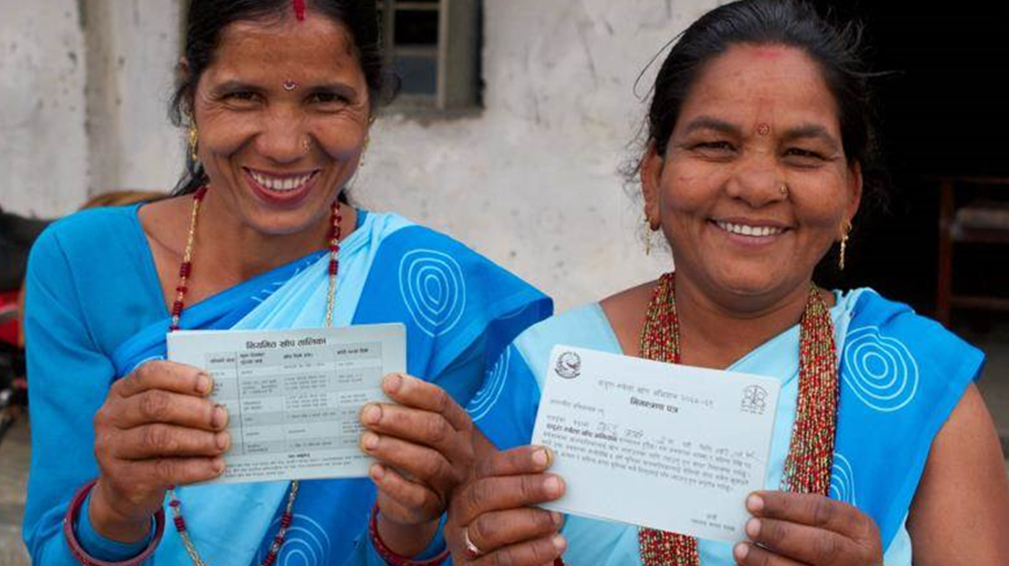
Closing slide

