Slide 1

Frontline service readiness assessments
Strengthening real-time health services tracking and monitoring in the context of the COVID-19 pandemic
Overview and implementation guidance, working slideset
27 November 2020

Slide 2
Frontline service readiness assessments: Session overview
Session 1 | Introduction to frontline service readiness assessments and approach Context Introduction to frontline service readiness assessments Overview of survey modules and key performance indicators Key features of the assessment
Session 2 | Overall planning for the assessments Survey coordination and planning Survey design Preparation for implementation
Session 3 | Methodology and sampling
Session 4 | Detailed planning for implementation Survey manager’s roles and responsibilities Country-specific adaptation of standard modules Interviewer training Logistics preparation
Session 5 | Country adaptation of modules Required adaptation Elective adaptation
Session 6 | Interviewer training Main responsibilities Skills and tips for successful interviews Review of paper questionnaire and practice using online tool Using and updating interview call log
Session 7 | Data management and analysis for automated results – for survey and data managers Data flow Data manager’s roles and responsibilities Use the automated excel chartbooks
Session 8 | Data management and analysis for automated results – for data managers Adapt data management/analysis code based on finalized modules in the country

Slide 3
Frontline service readiness assessments
Session 4: Detailed planning for implementation

Slide 4
Session 4: Detailed planning for implementation
Purpose and learning outcomes
Session 1 | Introduction to frontline service readiness assessments and approach
Session 2 | Overall planning for the assessments
Session 3 | Methodology and sampling
Session 4 | Detailed planning for implementation Survey manager’s roles and responsibilities Country-specific adaptation of standard modules Interviewer training Logistics preparation
Session 5 | Country adaptation of modules
Session 6 | Interviewer training
Sessions 7-8 | Data management and analysis for automated results
Purpose: To guide detailed implementation planning for the assessment
Expected outcomes: Following this session, participants will:
Understand roles and responsibilities of survey manager who will oversee the entire implementation
Be equipped to prepare and conduct country-specific adaptation of standard modules
Be equipped to prepare and conduct interviewer training
Be equipped to prepare other logistics for implementation

Slide 5
Roles and responsibilities of survey manager

Slide 6
Roles and responsibilities of the survey manager
For the survey implementation to be a success, the survey manager and data manager will need to work closely together. So, it is important they understand each other’s responsibilities.
Survey manager:
  Develops and executes overall survey implementation plan
  Coordinate to finalize sampling
  Conducts or manages pre-data collection outreach
  Trains, supervises, and manages interviewers
  Develops detailed schedule for data collection
  Secures and manages functioning equipment and resources
  Manages day-to-day operation, including trouble shooting
  With data manager, monitors survey progress and data quality
  Participates in results interpretation
  Participates in results dissemination and data use
Data manager:
  Downloads and cleans data
  Produces basic field check data daily
  With survey manager, monitors survey progress and data quality
  Creates an analysis dataset
  Calculates estimates for key indicators
  Updates chartbook and produces survey results
  Participates in results interpretation
  Assists results dissemination and data use
Notes:
Detailed and methodical planning is critical for successful survey implementation, and should be led by the survey manager. Survey manger also works closely with data mangers. It is important to understand roles and responsibilities of the survey manger. She/he:
Develops and executes overall survey implementation plan​
Coordinate to finalize sampling ​
Conducts or manages pre-data collection outreach ​
Trains, supervises, and manages interviewers ​
Develops detailed schedule for data collection​
Secures and manages functioning equipment and resources​
Manages day-to-day operation, including trouble shooting ​
And, with data manger, the survey manager also:
Monitors survey progress and data quality ​
Participates in results interpretation ​
Participates in results dissemination and data use

Slide 7
Country-specific adaptation of standard modules

Slide 8
Country-specific adaptation of standard modules
Survey managers will organize and lead country-specific adaptation of standard modules, where the survey module selection is based on the survey objectives and scope. They will:
    Review modules per country need and context
    Convene and guide technical experts for adaptation. Session 3A provides slides that can be used for an adaptation workshop.
    Consolidate, review, and determine changes
    Update both paper and online tools
    Coordinate with data manager for testing
    Finalize both paper and online tools for interviewer training
Notes:
One of the first tasks is to conduct country-specific adaptation of standard modules – the questionnaires.
Based on the determined survey objectives and scope, survey modules have been selected during the overall planning.
Now, survey managers will organize and lead country-specific adaptation of standard modules. Specifically, they will:
Review modules per country need and context
Convene and guide technical experts for adaptation. Technical experts must review the module in advance before the workshop. It is important for the survey manger to manage the questionnaire revision within the specific survey objectives. A large amount of changes also means more preparation time for questionnaire testing and preparation for data analysis. Session 3A provides slides and more tips that can be used for an adaptation workshop.
Consolidate, review, and determine changes
Update both paper and online tools
Coordinate with data manager for testing
Finalize both paper and online tools for interviewer training

Slide 9
Test and finalize country-specific modules
Prior to interviewer training, the modules should be tested and finalized
Survey manager should coordinate a small group of survey implementation team members to conduct mock interviews, using the country-specific online tools.
  Content issues (e.g. questions causing confusion or misunderstandings)
  Flow issues in skip patterns
  Logistical issues (e.g., issues with connectivity/device)
Data manager will adapt the standard code for data management and analysis. Test the code using the mock interview dataset.
Survey manager will:
  Evaluate test results,
  Make amendments as needed to instrument, training content, and logistics
  Finalize both paper and online tools, including translation if needed
Notes:
Once adaptation is completed, survey manager should coordinate a small group of survey implementation team members to conduct mock interviews, using the country-specific online tools.
During the testing, mock interviewers complete questionnaires and submit through online tool. It is recommended to mock-interview different types of facilities in mind. Mock interviewers should record:
Content issues (e.g. questions causing confusion or misunderstandings).
Content issues often mean clarification is needed during interviewer training. Please note that in the annotated questionnaires, which can be used as a reference for training as well as data collection.
In some cases, it may be need to rephrase questions or response options. However, we recommended not to rephrase standard questions.
Flow issues in skip patterns. Especially, please pay attention to new or changed skip patterns introduced during the adaptation.
Logistical issues (e.g., issues with connectivity/device)
Data manager will adapt the standard code for data management and analysis. Test the code using the mock interview dataset. This is a very important step in survey preparation – to ensure rapid data analysis and results production, a key features of this assessment. The more adaptation, the more time and effort is needed for this testing. More details will be discussed in session 4.
Survey manager will:
Consolidate all feedback from survey implementation team and evaluate test results,
Make amendments as needed to instrument, interviewer training content, and logistics
Finalize both paper and online tools, including translation if needed

Slide 10
Training

Slide 11
Training
On recruiting and training interviewers:
A successful interviewer's performance is one of the most critical parts of a successful survey. So, it is important that all survey managers/supervisors conduct engaging training and provide supportive supervision during data collection.
Interviewer training includes both “classroom” and “field” practice, so survey mangers will need to:
  Prepare interviewers for classroom practice by:
    Organizing interviewers into pairs, where each pair will conduct mock interviews and alternate roles
  Prepare interviewers for field practice by:
    Identifying pilot facilities that are not included in the sample
    Organizing interviewers into teams (3-4 interviewers per team) and assigning pilot facilities to each team. Each team should interview 1-2 facilities per module (in 2 different facility types as feasible)
    Instructing interviewers on content and logistical issues to record
    Consolidating and address all feedback from the practice.
Practice provides opportunities to clarify and emphasize interview directions again.
Notes:
A successful interviewer's performance is one of the most critical parts of a successful survey. So, it is important that all survey managers/supervisors conduct engaging training and provide supportive supervision during data collection.
The training should starts with select skills for successful interviews, which we included in template slides that can be adapted and used in each country.
Then the paper modules should be reviewed once, followed by both “classroom” and “field” practice.
For the classroom practice: organize interviewers into pairs, where each pair will conduct mock interviews and alternate roles.
For the field practice:
Survey managers should identify pilot facilities that are not included in the sample.
Organize interviewers into teams (3-4 interviewers per team) and assign pilot facilities to each team. Each team should interview 1-2 facilities per module (in 2 different facility types as feasible).
Instruct interviewers to record content as well as logistical issues during the practice.
Survey managers consolidate and address feedback. This is an opportunity to clarify and emphasize interview directions.

Slide 12
Prepare for data collection

Slide 13
Secure equipment and resources
Survey managers/supervisors need to ensure all necessary equipment to conduct data collection is secured and ready for the interviewers, including:
  Laptop/tablet (the form can be used on smart phones, but data entry on tablets/computers is easier)
  Phone and headset
  Phone time top-up credit (if interviewers’ personal cell phones are used)
  Stable internet connection at a central location or each interviewer’s home
  Additional equipment maybe needed to strengthen internet/wifi (e.g., router, wifi signal enhancer) if calls are made from a central location.
Notes:
Survey managers/supervisors need to ensure all necessary equipment to conduct data collection is secured and ready for the interviewers, including:
Laptop/tablet (the form can be used on smart phones, but data entry on tablets/computers is easier)
Phone and headset
Phone time top-up credit (if interviewers’ personal cell phones are used)
Stable internet connection at a central location or each interviewer’s home
Additional equipment maybe needed to strengthen internet/wifi (e.g., router, wifi signal enhancer) if calls are made from a central location.

Slide 14
Secure venue – as appropriate
Survey managers/supervisors need to decide and organize a location where data collectors will conduct phone interviews and enter data. They will need to make sure there is:
  Good phone/internet signal coverage
  Central location (institute or conference facility) or from individual location (office or home)
  If in a central location, assure COVID-19 preventive measures as per country guidance (social distancing, hygiene, etc.) are in place
  Conference facility might need hiring (and included in the budget)
Notes:
Survey managers/supervisors need to decide and organize a location where data collectors will conduct phone interviews and enter data. They will need to make sure there is:
Good phone/internet signal coverage
Central location (institute or conference facility) or from individual location (office or home)
If in a central location, assure COVID-19 preventive measures as per country guidance (social distancing, hygiene, etc.) are in place
Conference facility might need hiring (and included in the budget)

Slide 15
Develop sentinel facility list
Survey statistician samples sentinel facilities per survey scope and design.
Survey manager will:
  Confirm sampled sentinel facilities for each module.
  Consolidate facility details and develop sentinel facility list
  If feasible, include facility details pertaining to analysis domains to facilitate pre-populating facility details for the interview
Notes:
Survey statistician samples sentinel facilities based on survey scope and design.
Survey manager will:
Confirm sampled sentinel facilities for each module, because the sentinel facility is very likely different for different modules, based on the country context.
Consolidate facility details and develop sentinel facility list, for pre-interview outreach which will be discussed shortly.
If feasible, include facility details pertaining to analysis domains to facilitate pre-populating facility details for the interview

Slide 16
Develop sentinel facility list (continued)
Example of sentinel facility list and background information in Kenya
No. | County | FACILITY CODE | Facility name | Facility address | Facility phone number | Sub-county | Facility type | Managing authority
1 | BARINGO | 14242 | BARTOLIMO DISP |  |  |  | DISPENSARY
2 | BARINGO | 14211 | AIC ELDAMA RAVINE HOSPITAL |  |  |  | ISOLATION CENTER
3 | BOMET | 14628 | KABOSON HEALTH CENTRE |  |  |  | BASIC HEALTH CENTRE
4 | BOMET | 14741 | KAPLONG MISSION HOSPITAL |  |  |  | ISOLATION CENTER
5 | BUNGOMA | 18584 | CHEMSES DISPENSARY |  |  |  | DISPENSARY
6 | BUNGOMA | 15825 | BUMULA SUB COUNTY HOSPITAL |  |  |  | ISOLATION CENTER
7 | BUSIA | 21034 | AKIRIAMASI DISPENSARY |  |  |  | DISPENSARY
8 | BUSIA | 16091 | PORT VICTORIA HOSPITAL |  |  |  | Primary care hospitals
9 | ELGEYO MARAKWET | 14774 | KAPTALAMWA HEALTH CENTRE |  |  |  | BASIC HEALTH CENTRE
10 | ELGEYO MARAKWET | 14206 | TAMBACH SUB-COUNTY |  |  |  | ISOLATION CENTER
11 | EMBU | 12114 | JOYKIM NURSING HOME |  |  |  | COMPREHENSIVE HEALTH CENTRE
12 | EMBU | 16464 | ISHIARA HOSPITAL |  |  |  | ISOLATION CENTER
13 | EMBU | 12004 | EMBU PROVINCIAL GENERAL HOSPITAL |  |  |  | SECONDARY CARE HOSPITALS
14 | GARISSA | 18999 | ALLIANCE MEDICAL CENTRE |  |  |  | MEDICAL CLINIC
15 | GARISSA | 13368 | IFO TWO HOSPITAL |  |  |  | ISOLATION CENTER
16 | GARISSA | 13346 | GARISSA COUNTY REFERRAL HOSPITAL |  |  |  | SECONDARY CARE HOSPITALS
17 | HOMA BAY | 24576 | COMMUNITY APHALINK MEDICAL CENTRE |  |  |  | DISPENSARY
18 | HOMA BAY | 13761 | MALELA SUB COUNTY |  |  |  | ISOLATION CENTER
Unique ID number
from MFL
For pre-interview
outreach
Analysis domain
Background information can be
pre-populated in the online tool
Notes:
This is an example of a sentinel facility list.
There are essential information that must be included:
Facility ID from the master facility list and facility name
Telephone numbers – as facilities are interviewed over the phone
Facility type and managing authority
And, if possible, other background information such as the first administrative-level name can be included and pre-populated to the online tool.

Slide 17
Conduct pre-interview outreach
The next step is to complete the pre-interview outreach to sentinel facilities. The survey manager/supervisor should use the details in the facility list to call every facility (and additionally mail/email an official letter of introduction as feasible) to:
  Identify any facilities that need to be replaced (after two attempts to reach them without confirmation)
  Identify the main respondent in the facility
  Schedule an interview appointment: fill the blank cells in the below table
  Introduce and sensitize the facility manager/respondent about the survey
  In large facilities, the respondent should be encouraged to pre-collect information about specific sections before the interview or introduce staff who can answer questions for specific sections.
    Note: In the Continuity of EHS tool, if Annex 3 (HMIS record review) will be completed, the respondent should be asked to collect data before the call.
Information on sampled facilities |  |  |  |  |  | Information to be verified/ obtained during the outreach call
Facility code | Facility name | Facility type | Facility address | Facility phone number | Module | Outreach call date | Main respondent | Main respondent phone number | Date and time of appointment | Outreach note
123 | AA Hospital | Hospital | ABC | 123-456-789 | Continuity of essential health services
 |  |  |  |  | COVID case management capacity
456 | XX health centre | Health centre | XYZ | 789-123-456 | Continuity of essential health services
In some higher-level facilities, two interviews need to be scheduled,
depending on the country-specific design
Notes:
The next step is to complete the pre-interview outreach to sentinel facilities – a critical preparation for this assessment. The survey manager/supervisor should use the details in the sentinel facility list to call every facility to:
Identify any facilities that need to be replaced (after two attempts to reach them without confirmation)
Identify the main respondent in the facility
Schedule an interview appointment and fill the blank cells in the below table
Introduce and sensitize the facility manager/respondent about the survey
In large facilities, the respondent should be encouraged to pre-collect information about specific sections before the interview or introduce staff who can answer questions for specific sections.
Note: In the Continuity of EHS tool, if Annex 3 (HMIS record review) will be completed, the respondent should be asked to collect data before the call.

Slide 18
Develop interview call schedule
The survey manager/supervisor should develop a master/overall interview schedule to ensure that data collection proceeds accordingly. Facilities need to be assigned to interviewers systematically, based on pre-arranged appointment dates/times.
The survey manager/supervisor should allocate sufficient time, estimated according to the module and facility type, as the schedule will likely need to be updated continuously because of various contingencies such as: rescheduled interviews, dropped calls, and/or interviews that lasted longer than allocated time. It is recommended the same interviewer be assigned to complete those missed interviews.
If two modules are used in a facility, consider assigning one interviewer both interviews.
Information on sampled facilities |  |  |  |  |  | Information to be verified/ obtained during the outreach call |  |  |  |  | Interviewer assignment
Facility ID | Facility name | Facility type | Facility address | Facility phone number | Module | Outreach call date | Main respondent | Main respondent phone number | Date and time of appointment | Outreach note | Interviewer
123 | AA Hospital | Hospital | ABC | 123-456-789 | Continuity of essential health services | 12/9/2020 | Mary Doe | 123-456-777 | 12/16/2020 2PM | Respondent number is different from the main number | A
 |  |  |  |  | COVID case management capacity | 12/9/2020 | Jane Mwagi | 123-456-756 | 12/17/2020 2PM | Respondent number is different from the main number | A
456 | XX health center | Health center | XYZ | 789-123-456 | Continuity of essential health services | 12/7/2020 | John Smith | 789-123-456 | 12/17/2020 3PM | Need to email the tool again – DONE (12/8/2020) | B
Notes:
Based on the appointment made during the pre-interview outreach, an overall survey interview schedule should be developed to ensure that data collection is proceeding accordingly.
The survey manager should develop a master/overall interview schedule. There are a number of factors to consider:
Facilities should be assigned to interviewers systematically, based on the pre-arranged appointment date/time.
Allocate sufficient time, estimated according to the module and facility type.
The schedule may need to be updated continuously because of: rescheduled interviews, dropped calls, and/or interviews that lasted longer than allocated time. It is recommended to assign the same interviewer to complete those interviews.
If multiple modules are used in a facility, consider assigning one interviewer to complete both interviews.

Slide 19
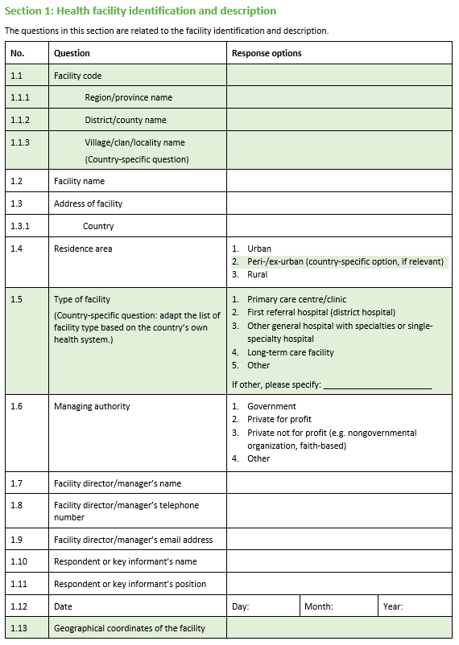
Pre-populate questionnaires prior to starting each interview
Select background characteristics can be pre-populated ahead of data collection.
Many questions in the “Health facility identification and description” section of each module can be pre-populated with details from the sentinel facility list, and these details should then be confirmed at the time of the interview.
Notes:
To facilitate questionnaire completion, select background characteristics can be pre-populated ahead of data collection.
Many questions in the “Health facility identification and description” section of each module can be pre-populated with details from the sentinel facility list. These details should then be confirmed at the time of the interview.

Slide 20
Data collection

Slide 21
Management of daily operations
Use checklists to ensure all materials and equipment are ready each day. Materials and equipment include:
  List of interviewers and contact information
  Overall interview schedule, updated daily
  Daily list of facilities with online tool links for each interviewer
  Annotated paper questionnaires for reference
  Inventory of interviewer equipment (laptop, phone, headset, etc.)
  Stable internet and phone signal
  Daily team briefing
The survey manager/supervisor should work with data manager/analyst to ensure everything is running smoothly, and update and track the overall survey interview schedule.
Notes:
Now, let’s go over data collection itself.
Use checklists to ensure all materials and equipment are ready each day. Materials and equipment include:
List of interviewers and contact information
Overall interview schedule, updated daily
Daily list of facilities with online tool links for each interviewer – This is a map for interviewers, and we will talk about this more in detail briefly.
Annotated paper questionnaires for reference
Inventory of interviewer equipment (laptop, phone, headset, etc.)
Functioning and stable internet and phone signal
Daily team briefing
The survey manager/supervisor should work with data manager/analyst to ensure everything is running smoothly, and update and track the overall survey interview schedule.

Slide 22
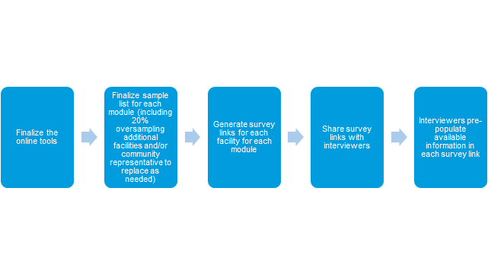

Generate survey links
Online survey link and tokens
Surveys are conducted through a Lime Survey online tool where an individual link will be generated for every interview (per module, per facility, and/or community representative).
Steps for link generation and dissemination:
Finalizing the online tool and generating tokens will require some basic knowledge of the Lime Survey software

Slide 23
Generate survey links
Online survey link and tokens
The survey link consists of two important codes:
  A module-specific number: Each survey links for a specific module and has a module-specific number
  Tokens: Individual tokens must be generated for every facility and/or community representative in the sample Tokens will:
      Consolidate and link facility data in cases where the same facility is completing multiple modules.
      Track module completion/progress by facility and/or community representative
Interviewers need to confirm they are using the correct link before pre-populating facility information and starting each interview
Illustrative example from Kenya: Continuity of essential health services module
Survey link (includes token) | Facility code | Facility name | County name | Level | Token number
https://extranet.who.int/dataformv3/index.php/769747/lang/en/token/X4Fcg2ncEi | 21208 | Mainga Health Centre | Kisumu | Level 3 | X4Fcg2ncEi
https://extranet.who.int/dataformv3/index.php/769747/lang/en/token/fZwz1rEFBh | 13465 | AGA KHAN HOSPITAL Kisumu | Kisumu | Level 4 | fZwz1rEFBh
Illustrative example from Kenya: COVID-19 case management capacities module
Survey link (includes token) | Facility code | Facility name | County name | Level | Token number
https://extranet.who.int/dataformv3/index.php/447349/lang/en/token/blIXM1ElUL | 12867 | Aga Khan Hospital | Nairobi | Level 5 | blIXM1ElUL
https://extranet.who.int/dataformv3/index.php/447349/lang/en/token/fZwz1rEFBh | 13465 | AGA KHAN HOSPITAL Kisumu | Kisumu | Level 4 | fZwz1rEFBh
Module-specific number
Token
Token

Slide 24
Daily list of facilities for interviewers
Interviewers will be provided with a daily list of facilities based on the overall survey interview schedule. The list should include:
  Module (if multiple modules are used in the country)
  Date and time of interview
  Respondent name and phone number
  Background information about the facility and any note from outreach or previous calls
  Results/status for interviewers to complete for every call
  Unique online tool link and token, specific to each module and facility
    https://extranet.who.int/dataformv3/index.php/198466/lang/en/token/A293BnEdnD
    https://extranet.who.int/dataformv3/index.php/198466/lang/en/token/PJaH6nNzH1
    https://extranet.who.int/dataformv3/index.php/521969/lang/en/token/jzyQH2qn92_Kenya
    https://extranet.who.int/dataformv3/index.php/521969/lang/en/token/08zTmhDnG5_Kenya
Facility-specific code/token
Module-specific number
Notes:
Each day, interviewers will receive a list of facilities to call with appointment time. This schedule has been developed from the pre-interview outreach.
The list will have:
What module to use (if multiple modules are used in the country)
Date and time of interview
Respondent name and phone number
Background information about the facility and any note from outreach or previous calls
Unique online tool link and token, specific to each module and facility.

Slide 25
Daily list of facilities for interviewers (continued)
Example of a daily list of facilities for interviewers
Facility ID | Facility name | Facility type | Facility address | Facility phone number | Module | Online tool link | Outreach call date | Main respondent | Main respondent phone number | Date and time of appointment | Note | Interviewer | Status
890 | CC Hospital | Hospital | … | 456-456-789 | COVID case management capacity | https://extranet.who.int/dataformv3/index.php/198466/lang/en/token/A293BnEdnD | 12/9/2020 | Peter Baressi | 456-456-789 | 12/18/2020 10AM | … | A
159 | ZZ health caneter | Health center | … | 234-567-561 | Continuity of EHS | https://extranet.who.int/dataformv3/index.php/521969/lang/en/token/jzyQH2qn92_Kenya | 12/7/2020 | Chelsea Park | 234-567-561 | 12/18/2020 12PM | … | A
456 | XX health center | Health center | … | 789-123-456 | Continuity of EHS | https://extranet.who.int/dataformv3/index.php/521969/lang/en/token/jzyQH2qn92_Kenya | 12/7/2020 | John Smith | 789-123-456 | 12/18/2020 2PM | Rescheduled from 12/17/2020. start from Section 7 | A
567 | YYY health center | Health center | … | 987-987-564 | Continuity of EHS | https://extranet.who.int/dataformv3/index.php/521969/lang/en/token/erz3ag1sta_Kenya | 12/7/2020 | Thomas Gichangi | 987-987-564 | 12/18/2020 4PM | … | A
Notes:
This is an example of the list.
We should note that last column: interview results/status.
At the end of each interview – even when the interview was not completed – interviewers must record the result/status. During interviewer training, this should be emphasized. Survey managers will then use this information to update remaining schedule.

Slide 26
Monitoring survey progress
The survey manager/supervisor should work with data manager/analyst to track the survey progress. This includes updating the overall survey interview schedule at the end of each day and make necessary adjustment to meet the target timeline. These adjustments should be reflected in daily facility list for interviewers.
Notes:
Overall, the survey manager and supervisors should work with data managers to track the survey progress. This includes updating the overall survey interview schedule at the end of each day and make necessary adjustment to meet the target timeline.
Again, these adjustments should be reflected in daily facility list for interviewers, which we discussed previous slides.

Slide 27
Supervision
The survey manager/supervisor should monitor the interviewers’ performance and provide feedback. Interviewers should be provided with daily briefings that help keep them motivated and engaged. This feedback can include:
  Daily data updated, using daily filed check tables provided by the data manager
  Group feedback
  Exchanging tips among interviewers
  Questions and answers
Provide supportive supervision to individual interviewers as needed.
Notes:
The survey manager/supervisor also need to monitor the interviewers’ performance and provide feedback. Interviewers should be provided with daily briefings that help keep them motivated and engaged. This feedback can include:
Daily data updated, using daily filed check tables provided by the data manager
Group feedback
Exchanging tips among interviewers
Questions and answers
Provide supportive supervision to individual interviewers as needed.

Slide 28
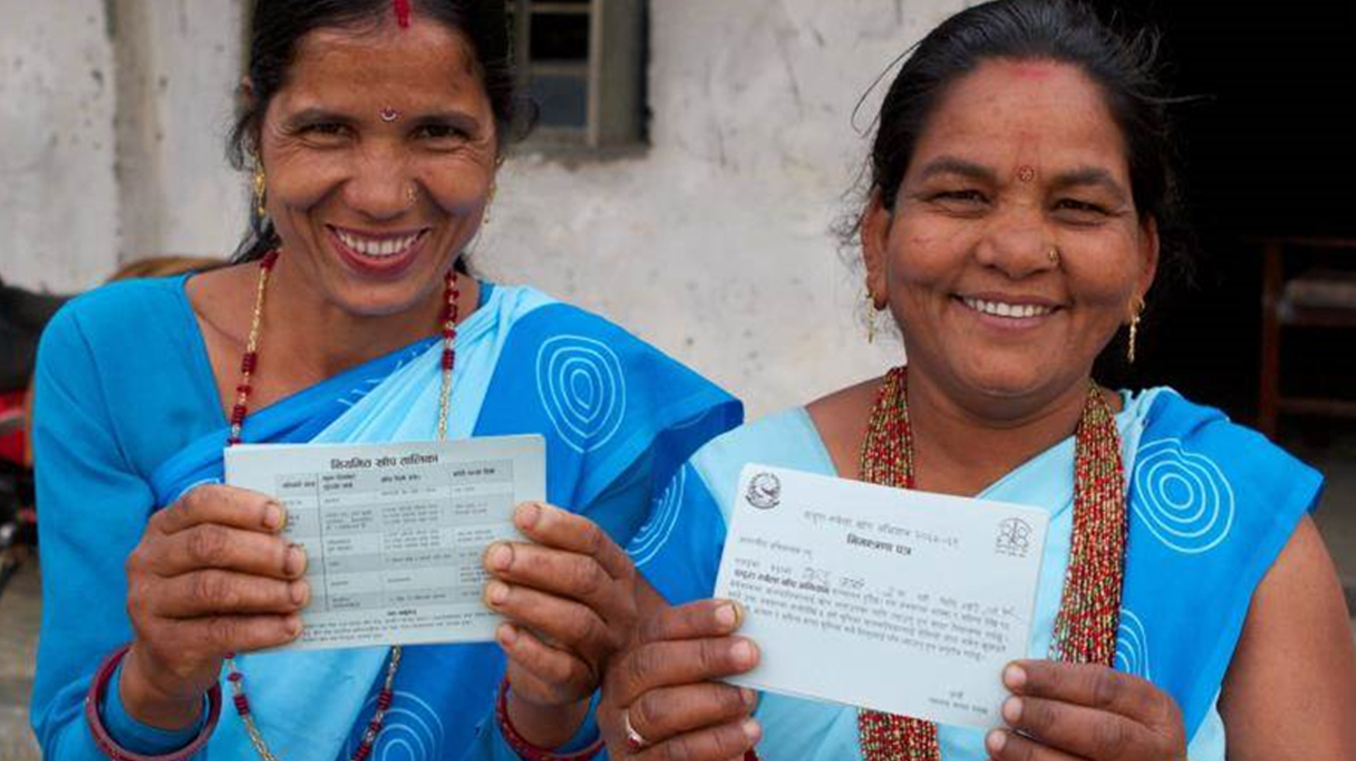
Closing slide

