Slide 1

Frontline service readiness assessments
Strengthening real-time health services tracking and monitoring in the context of the COVID-19 pandemic
Overview and implementation guidance, working slideset
27 November 2020

Slide 2
Frontline service readiness assessments: Session overview
Session 1 | Introduction to frontline service readiness assessments and approach Context Introduction to frontline service readiness assessments Overview of survey modules and key performance indicators Key features of the assessment
Session 2 | Overall planning for the assessments Survey coordination and planning Survey design Preparation for implementation
Session 3 | Methodology and sampling
Session 4 | Detailed planning for implementation Survey manager’s roles and responsibilities Country-specific adaptation of standard modules Interviewer training Logistics preparation
Session 5 | Country adaptation of modules Required adaptation Elective adaptation
Session 6 | Interviewer training Main responsibilities Skills and tips for successful interviews Review of paper questionnaire and practice using online tool Using and updating interview call log
Session 7 | Data management and analysis for automated results – for survey and data managers Data flow Data manager’s roles and responsibilities Use the automated excel chartbooks
Session 8 | Data management and analysis for automated results – for data managers Adapt data management/analysis code based on finalized modules in the country

Slide 3
Frontline service readiness assessments
Session 5: Country adaptation of modules

Slide 4
Session 5: Country adaptation of modules
Purpose and learning outcomes
Session 1 | Introduction to frontline service readiness assessments and approach
Session 2 | Overall planning for the assessments
Session 3 | Methodology and sampling
Session 4 | Detailed planning for implementation
Session 5 | Country adaptation of modules Module selection Section selection in each module Required adaptation Elective adaptation
Session 6 | Interviewer training
Sessions 7-8 | Data management and analysis for automated results
Purpose: To guide the adaptation and tailoring of frontline service readiness assessment tools for country-specific context and use
Expected outcomes: Following this session, participants will:
Be equipped to adapt and tailor the suite of frontline service readiness assessment tools, including:
  Inclusion or exclusion of optional sections in a module
  Adaptation and tailoring of country-specific questions or response options in the modules
  Inclusion or exclusion of country-specific optional questions

Slide 5


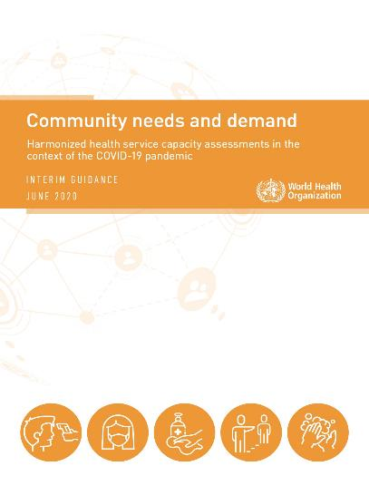

Overview of country adaptation needs
Based on objectives of the assessment, specific modules have been chosen.
Within each module, there are 4 types of adaptations:
decide whether or not optional sections will be included
Customize questions or response options based on country context: Minimum required customization is noted
Decide whether or not to include optional questions or optional response choices
Depending on available time and human resources, make further changes (e.g., potential inclusion of a limited number of additional questions)
Note: Countries will need to:
Implement one or a combination of modules from the suite according to survey objectives
Consider objectives required and the necessary time needed to complete each module
Notes:
Based on objectives of the assessment, specific modules were chosen to be used in the country during the overall survey planning,
Regardless of the number and type of the modules selected. There are four types of adaptations:
Within each module, we need to decide whether or not optional sections will be included
We also customize questions or response options based on country context – such as facility types and name of administrative units in the country: These are Minimum required customization, and noted in the paper questionnaires.
We then decide whether or not to include optional questions or optional response choices
Finally, depending on available time and human resources, make further changes (e.g., potential inclusion of a limited number of additional questions)
This country-specific adaptation of questionnaires will have cascading impact for data management, training, and data use. So, we have to prioritize critically optional sections, optional questions as well as requests for new questions. We have to keep in mind realistic timeline and human resources available not only to collect but also use the data meaningfully.

Slide 6
Choose optional sections within each module
Within the modules, countries can choose to include or exclude optional sections. The decision to include these sections is based on the availability of information from other data sources and data needs.
Countries can choose to:
  Include all or certain sections in every round of the survey
  Include all or certain sections only at certain intervals of the survey
  Exclude all sections from the survey
COVID-19 case management capacities module includes 1 optional section:
Continuity of essential health services module includes 4 optional sections:
Sections | Section 1: Health facility ID and description Section 2: Hospital incident management support teams Section 3: Case management and bed capacities for COVID-19 Section 4: Selected medicines and supplies for COVID-19 case management Section 5: Personal protective equipment and infection prevention and control Section 6: COVID-19 laboratory diagnostics Section 7: Medical equipment for diagnosis, patient monitoring, and case management Section 8: General vaccine readiness (optional) Section 9: COVID-10 vaccine readiness (optional) Section 9: Interview result
Sections | Section 1: Health facility ID and description Section 2: Staffing Section 3: Financial management Section 4: Service delivery and utilization Section 5: COVID-19 infection prevention, control, and PPE Section 6: Management of suspected and confirmed COVID-19 cases in primary care centres Section 7: Availability of selected tracer therapeutics (optional) Section 8: Availability of diagnostics (optional) Section 9: General vaccine readiness (optional) Section 10: COVID-19 vaccine readiness (optional) Section 11: Facility infrastructure (optional) Section 12: Interview result Annex: Routine data record review
Notes:
For example:
Vaccine readiness may be assessed only once, not at every round of the survey
Infrastructure may be excluded if there was a recent assessment that covered infrastructure, as changes in infrastructure are unlikely over a short period of time.

Slide 7
Customize specific questions and response options
  Each module includes country-specific questions and response options to be adapted and tailored.
Questions and/or response options requiring country-specific adaptation and tailoring.
In the standard tool these are highlighted and marked as Country-specific question adaptation or Country-specific response adaptation.
Questions and/or response options intended for use only in applicable settings.
In the standard tool these are highlighted and marked as Country-specific optional question or Country-specific optional response.
Additional questions or response options in the survey to fill urgent data needs.
To protect data quality and given the timeframe and intended scope of the survey, this should be limited as possible.
These questions should be deleted unless they are directly relevant.
If included, these questions and/or response options should be considered relevant to country context, and it should be feasible to collect and analyse the data meaningfully.
Consider having only required adaptations in the first round, and then include a limited number of questions in later rounds.
Notes:
Basic adaptation is to customize specific words in questions and response options, based on country context. The minimum required adaptation is color coded in the paper questionnaires.
Second adaptation is to decide inclusion of optional questions. Unless a topic addressed by the optional question is critical for the country (much more than good information to have), a rule should be exclusion.
And, new questions can be added, but to protect data quality and given the timeframe and intended scope of the survey, this should be limited as possible. We should consider adding new questions only from the second round, after the survey team becomes really familiar with the implementation and be able to manage country-specific changes more efficiently.

Slide 8
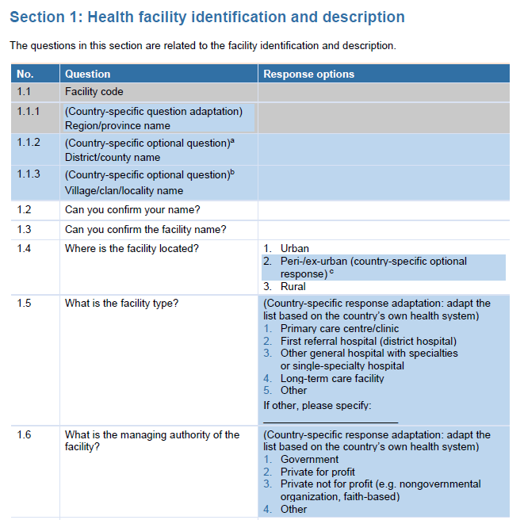
Examples of country-specific question/response adaptation
(required adaptation)
Name of the administrative unit to be adapted to country-specific classification
Health facility types to be adapted to country-specific designations/terminology
Managing authority types to be adapted to country-specific designations/terminology
Notes:
Here, we have examples of country-specific questions and response options that must be adapted.

Slide 9
Examples of country-specific optional questions/response
Delete the question unless relevant for the country context or survey design
Deleted the response option if not relevant to country
Notes:
These are examples of country-specific optional questions and responses. Default is exclusion, unless the questions and responses are clearly relevant for the country.

Slide 10
Adapt the COVID-19 case management capacities module

Slide 11






COVID-19 case management capacities module
Objectives, use and content areas
COVID-19 case management capacities: diagnostics, therapeutics, vaccine readiness, and other health products
Objective: | Assess current and surge capacities of health facilities for COVID-19 management (clinical tools and essential supplies)
Use: | Guide rapid deployment and scale up of essential COVID-19 clinical tools and supplies
Facility type: | Hospitals and COVID-19 treatment centres treating moderate, severe, and critical COVID-19 cases
Respondents: | Facility managers and/or facility management team members
Content: | Section 1: Health facility ID and description Section 2: Hospital incident management support team Section 3: Case management and bed capacities for COVID-19 Section 4: Selected medicines and supplies for COVID-19 case management Section 5: Personal protective equipment, infection prevention, and control Section 6: COVID-19 laboratory diagnostics Section 7: Medical equipment for diagnosis, patient monitoring, and case management Section 8: COVID-19 vaccine readiness Section 9: Interview result
Notes:
Before we start adaptation, this provides objectives, intended use, and content areas for the module: COVID-19 case management

Slide 12
COVID-19 case management capacities module
Key questions and indicators
For use in hospitals and COVID-19 treatment centres (moderate, severe, critical cases)
Sections |  | Key questions | Key performance Indicators
1 | Health facility type and description | What are the facility characteristics? | All KPIs can be disaggregated by facility type, residence area (rural/urban), managing authority (public/private)
2 | Hospital IMST | Have facilities adopted and activated incident management support (IMST) team protocols? | % of facilities with IMST protocols adopted and activated
3 | Case management and bed capacity | Do facilities have sufficient bed and space capacities to manage COVID-19 patients? | Total # of beds for COVID patients (moderate, severe, critical) # of beds currently occupied by COVID patients Total # of beds available for surge (ICU, respiratory isolation)
4 | Medicines and supplies | Do facilities have the necesarry medicines and medical supplies for the management of COVID-19 patients? | % of facilities with available tracer medicines % of facilities participating in the Solidarity Clinical trial (and availability of trial medications)
5 | PPE and IPC | Do facilities have the necessary PPE for health workers? Do facilities have the necesarry IPC supplies? | % of facilities with available PPE for staff (e.g., masks, gowns, goggles, etc.) % of facilities with available infection prevention and control supplies (e.g., soap, biohazard bags, sanitizer stations, etc.)
6 | COVID-19 laboratory diagnostics | Do facilities have the necessary COVID-19 diagnostic supplies for COVID-19 testing? | % of facilities with laboratory diagnostic capacities with tracer items (e.g., specimen collection, onsite PCR/ RDTs, system for offsite testing) % of facilities receiving timely results
7 | Medical equipment | Do facilities have the necesarry medical equipment for COVID-19 patient diagnosis, monitoring, and case management? | % of facilities with available/functional medical equipment onsite for COVID-19 diagnosis, monitoring, and case management (e.g., x-ray, pulse oximeters, ventilators, oxygen, etc.) % of facilities with malfunctions (and reasons)
8 | COVID-19 vaccine readiness | Do facilities have a functioning cold chain ready to support COVID-19 vaccine introduction? | % of facilities with functional cold chain capacity to deliver COVID-19 vaccines (vaccine fridge with continuous temperature recorder, vaccine carriers/cold boxes, ice packs)
Notes:
And, this table presents main questions and key indicators answered by the data.

Slide 13
Review of paper tool and adaptation
Open the tool in word file and proceed

Slide 14
Adapt the continuity of essential health services module

Slide 15






Continuity of essential health services module
Objectives, use, and content areas
Continuity of essential health services module
Objective: | Assess health facility and health workforce capacities to maintain safe provision of essential health services throughout the pandemic
Use: | Detect and track changes in service utilization, service delivery modifications, staff capacities and protection to guide strategies and plans to mitigate disruptions and maintain essential health services
Facility type: | Hospitals, primary care centres/clinics
Respondents: | Facility managers and/or facility management team members
Content: | Section 1: Health facility ID and description Section 2: Staffing Section 3: Financial management Section 4: Service delivery and utilization* Section 5: COVID-19 infection, prevention and control, and PPE Section 6: Management of suspected and confirmed COVID-19 cases in primary care centres Section 7: Availability of selected tracer therapeutics (optional) Section 8: Availability of diagnostics (optional) Section 9: Vaccine readiness (optional) Section 10: Facility infrastructure (optional) Section 11: Interview result Annex: Routine data record review
*Section 4: Service delivery and utilization section assesses a set of tracer services including for: undifferentiated symptoms; family planning and contraception; antenatal care; postnatal care; immunization; care for sick children; HIV; TB; STIs; malaria; chronic cardiovascular disease; chronic respiratory disease; diabetes; cancer; mental health; intimate partner and sexual violence; NTDs; and rehabilitation
Notes:
Before we start adaptation, this provides objectives, intended use, and content areas for the module: COVID-19 case management

Slide 16
Continuity of essential health services module
Key questions and indicators
For use in hospitals and primary care facilities
Sections |  | Key questions | Performance Indicators
1 | Health facility type and description | What are the facility characteristics? | All KPIs can be disaggregated by facility type, residence area (rural/urban), managing authority (public/private)
2 | Staffing | How many staff are available? How many staff have been diagnosed with COVID-19? Is additional training and support being provided to staff? | % of staff (by occupation) diagnosed with COVID-19 % of facilities with staff leave/absences and reasons/changes in staff management % of facilities providing staff training, support, supervision (by type)
3 | Financial management | Are facilities continuing to charge user fees during the pandemic? Are facilities receiving additional funding for essential health services? Are staff salaries and overtime pay being paid on time? | % of facilities that waived/increased user fees % of facilities receiving additional funding for essential health services and sources % of facilities maintaining on-time salary/overtime payments
4 | Service delivery and utilization | Has delivery of services unrelated to COVID-19 changed? Has service utilization increased/decreased and what are the reasons? Has the facility implemented community communication campaigns? Has the facility made catch-up plans for missed routine appoints? | % of facilities with service delivery modifications % facilities with observed increases/decreases in tracer service (OPD, IPD, emergency) and reasons % of facilities with service restoration plans % change in service utilization (record review)
5 | IPC and PPE | Are safety processes and protocols in place to ensure the safe delivery of health services? Do facilities have triage and isolation capacities? Do staff have sufficient PPE to deliver essential services safely? | % of facilities with safe environment measures (triage capacity, isolation capacity) % of facilities with IPC guidelines in place % of facilities with adequate PPE for staff
6 | Management of COVID-19 in PC | Which COVID-19 primary care services are being delivered in the facility? What support is being provided to deliver these services? | % of primary care facilities with measures to manage COVID-19 (mild cases) % of facilities with capacity to provide COVID-19 services in primary care (e.g., collecting specimens for diagnosis, onsite testing, referrals)
7 | Therapeutics | Do facilities have available therapeutics for essential health services? | % of facilities with available tracer therapeutics, supplies and vaccines
8 | Diagnostics | Do facilities have available diagnostic tests and supplies for essential health services? | % of facilities with available tracer diagnostics
9 | Vaccine readiness | Do facilities have functioning cold chain capacity? | % of facilities with cold chain capacities
10 | Facility infrastructure | Have facilities experienced unplanned closures? Have facilities experienced infrastructure-related issues? | % of facilities that have experiences unplanned closures % of facilities with infrastructure-related issues (electricity,
Notes:
And, this table presents main questions and key indicators answered by the data.

Slide 17
Review of paper tool and adaptation
Open the tool in word file and proceed

Slide 18
Adapt the community needs, perceptions, and demand module

Slide 19






Community needs, perceptions and demand module
Objectives, use and content areas
Community needs, perceptions and demand module
Objective: | Assess community health needs, changes in care-seeking behaviours, barriers to care affecting services demand, and disruptions to community-based care
Use: | Guide strategies and plans to address unmet health needs and eliminate barriers to care
Assessment type: | Community
Respondents: | Community health workers, community leaders, civil society organization leaders
Content: | Section 1: Identification and informed consent Section 2: Community needs and use of essential health services Section 3: Barriers to seeking essential health services in the community Section 4: Attitudes towards COVID-19 vaccination Section 5: Barriers in delivery of community-based services Section 6: Interview result
Notes:
Before we start adaptation, this provides objectives, intended use, and content areas for the module: COVID-19 case management

Slide 20
Community needs, perceptions and demand module:
Key questions and indicators
For use in communities
Section |  | Key questions | Key performance indicators
1 | Identification and informed consent | Who is the key informant providing responses? What is the residence setting of the community? | All KPIs can be disaggregated by type of key informant (CHW, community leader, CSO, etc.) and residence area (rural/urban)
2 | Community needs and use of essential health services | How has the COVID-19 pandemic affected utilization of essential health services? What are the current unmet needs for health services in the community? | % of CHWs who believe that community has unmet health needs
3 | Barriers to seeking care | What are main barriers for people to use essential health services during the COVID-19 pandemic? Are there marginalized groups more affected during the COVID-19 pandemic? Where/what are the first points of contact during COVID-19 pandemic? | % of CHWs who believe that community faced barriers to seeking care pre-COVID and % who believe it has gotten worse % of CHWs who believe there are disadvantaged groups in the community Distribution of first point of care/information in the community
4 | Attitudes towards COVID-19 vaccination | What are perceived attitudes towards potential COVID-19 vaccine? | % of CHWs who believe community has demand for COVID-19 vaccine (adults, children) Distribution of reasons for low demand
5 | Barriers in delivery of community-based services | Have community health workers been able to continue their work in the COVID-19 pandemic context? Have community health workers experienced stigma in pursuing their functions? | Distribution of perceived risk (moderate, high, very high) reported by CHWs and reasons % of CHWs lacking support to perform work % of communities with change in service volume by service (e.g., malaria prevention, social support for TB patients)
Notes:
And, this table presents main questions and key indicators answered by the data.

Slide 21
Review of paper tool and adaptation
Open the tool in word file and proceed

Slide 22
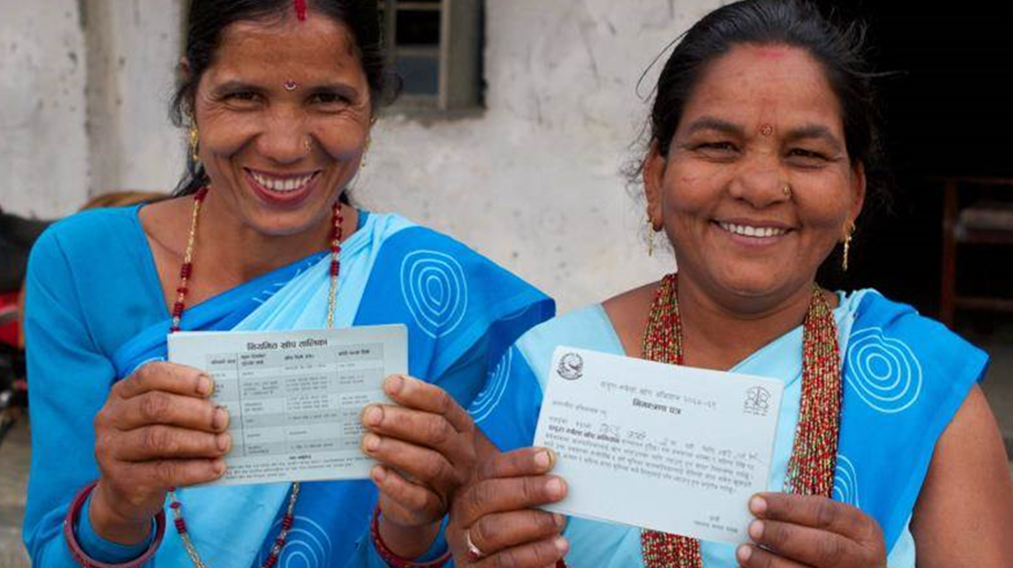
Closing slide

