Slide 1

Frontline service readiness assessments
Strengthening real-time health services tracking and monitoring in the context of the COVID-19 pandemic
Overview and implementation guidance, working slideset
27 November 2020

Slide 2
Frontline service readiness assessments: Session overview
Session 1 | Introduction to frontline service readiness assessments and approach Context Introduction to frontline service readiness assessments Overview of survey modules and key performance indicators Key features of the assessment
Session 2 | Overall planning for the assessments Survey coordination and planning Survey design Preparation for implementation
Session 3 | Methodology and sampling
Session 4 | Detailed planning for implementation Survey manager’s roles and responsibilities Country-specific adaptation of standard modules Interviewer training Logistics preparation
Session 5 | Country adaptation of modules Required adaptation Elective adaptation
Session 6 | Interviewer training Main responsibilities Skills and tips for successful interviews Review of paper questionnaire and practice using online tool Using and updating interview call log
Session 7 | Data management and analysis for automated results – for survey and data managers Data flow Data manager’s roles and responsibilities Use the automated excel chartbooks
Session 8 | Data management and analysis for automated results – for data managers Adapt data management/analysis code based on finalized modules in the country

Slide 3
Frontline service readiness assessments
Session 6: Interviewer training

Slide 4
Session 6: Interviewer training
Purpose and learning outcomes
Session 1 | Introduction to frontline service readiness assessments and approach
Session 2 | Overall planning for the assessments
Session 3 | Methodology and sampling
Session 4 | Detailed planning for implementation
Session 5 | Country adaptation of modules
Session 6 | Interviewer training Main responsibilities Skills and tips for successful interviews Review of paper questionnaire and practice using online tool Using and updating interview call log
Sessions 7-8 | Data management and analysis for automated results
Purpose: To prepare the interviewer/data collectors to complete data collection.
Expected outcomes: Following this session, participants will:
Understand main responsibilities of interviewers/data collectors
Be equipped with the skills needed for successful interviews
Be familiar with paper and on-line versions of the modules
Be prepared to conduct and log phone interviews

Slide 5
Responsibilities and implementation overview
This section should be country specific. Suggested contents:
Organization of the team and roles/responsibilities
Timeline of data collection
Daily schedule and operations overview

Slide 6
Organization of survey implementation team
Roles and responsibilities
Survey manager
Interviewers
Data manager/analyst
Develops and executes overall survey implementation plan
Conducts or manages pre-data collection outreach
Trains, supervises, and manages interviewers
Develops detailed schedule for data collection
Secures and maintains functioning equipment
Manages day-to-day operations, including trouble shooting
With data manager, monitors survey progress and data quality
Participates in results interpretation
Assists results dissemination and use
Call facility contact people
Collect data and inputs through electronic questionnaires
Ensure questionnaires are complete and correct prior to submission
Submit final questionnaires through electronic instrument
Record results of all calls
Track re-scheduled or dropped calls
Report to the team leader/supervisor at the end of each day of data collection
Downloads and cleans data, and produces basic field check data daily
With survey manager, monitors survey progress and data quality
Creates an analysis dataset
Calculates estimates for key indicators
Updates chartbook and produces survey results
Participates in results interpretation
Assists results dissemination and data use
Notes:
Interviewers are back bone of any surveys, and important part of the survey implementation team. You will work closely with the survey manger, supervisors and others who support the manager – shown on the left panel.
You will also work with a data manger, who will provide updates on survey progress and data quality updates.
The middle panel shows specific roles and responsibilities for interviewers.
Call facility contact persons
Collect data and inputs through electronic questionnaire
Ensure questionnaires are complete and correct prior to submission
Submit final questionnaires through electronic instrument
Record results of all calls in a log
Track and follow up for re-scheduled or dropped calls
Report to the team leader/ supervisor at the end of each day of data collection

Slide 7
Main responsibilities
Data collection timeline:
Suggested contents
Data collection, analysis, and use timeline, which can help interviewers understand context, rapid timeline, and importance of their work
Data collection
XX- XX
Data management and analysis
XX- XX
Interpretation and use of
survey results for
programmatic action and response to the COVID-19 pandemic
Notes:
This is a rapid assessment of facilities. The ultimate goal is to collect and analyse data rapidly, which will inform MOH’s responses during the COVID-19.
Our data collection takes place between XX and XX.
Data management starts together, and all key analysis will be finalized within a week after the data collection.
And the survey data and results - collected thanks to your hard work - will be used by MOH.

Slide 8
Main responsibilities
Daily schedule and operation
Suggested contents
Daily morning briefing to cover data updates, questions and answers, and group feedback.
NOTE: it is recommended to start each day by sharing some fun and important data from the previous day (e.g., Total number of facilities interviewed, shortest and longest interview time, and % of interviews that have missing responses). These daily summary facts can be generated by the country's data manager using a standard code. This time can also be used to provide group feedback.
Distribution of the daily assigned facilities.
NOTE: It is helpful to determine how to track and determine which facilities need to be interviewed based on the scheduled appointments, and to determine how the list will be distributed each day. There are many possibilities, including an email with online attachment or circulating a hard copy print out.
Notes:
INFORMATION FOR FACILITATORS:
This slide will be country specific, depending on the context. The following is suggested contents:
Daily morning briefing, covering data updates, questions & answers, and individual and/or group feedback.
NOTE: it is recommend to start each day by sharing some fun and important data from the previous day (e.g., Total number of facilities interviewed, shortest and longest interview time, and % of interviews that have missing responses in select tracer questions). These daily summary facts can be generated by a country data manager, per a standard code. Use this time to provide feedback as needed.
Distribution of the daily assigned facilities.
NOTE: determine how to track and determine facilities to be interviewed each day – based on the scheduled appointments. Determine how the list will be distributed each day – email with online attachment? Paper print?
Random and targeted monitoring and supervision of interviewers.
NOTE: If repeated data collection is planned, motivate the interviewers for participation/employment in later rounds, which can be based on their current performance.

Slide 9
Skills for successful interviews
NOTE: This section applies to both CEHS and hospital case management capacity. Common questions from section 1 are used as examples. These slides do not have the questionnaire cover pictures.
For topics/slides that do not have common questions, slides are made using example questions from each tool. These slides have the questionnaire cover picture.
If only one tool is used, use (1) all slides without the questionnaire cover pictures and (2) slides with the cover picture that is used in the country.
Notes:
Findings of this assessment are only as good as the data from which they are calculated.
Data quality relies on a large extent on the interviewers.
There are core interview skills in any kind of interview. In telephone interviews, additional and specific skills and practice are required. We will go over key skills.

Slide 10
Skills for successful interviews
Key skills for phone interviews​:
Principles for interviews
Additional critical skills for phone interviews
Build rapport over the phone
Read verbatim with the appropriate emphasis
Maintain neutrality
Record information accurately
Thank respondents
Pay attention to voice clarity
Control the tempo and tenor of the engagement – subtly but firmly
Listen closely
Pronounce clearly and correctly
Notes:
On the left, we have basic skills for any type of interviews. Some of you may have worked as interviewers in the past, and think about that experience. There are no easy or automatic ways to achieve each of these. But we will cover some tips that can help you.
First, build rapport, in this case over the phone. Greet the respondent in a confident, sincere, and hearty manner. A respondent's first impression of the interviewer will strongly affect their willingness to fully participate in the interview. All respondents should be treated respectfully and politely. The respondents should know that their cooperation and the time they are taking to help make the survey successful is very much appreciated.
Read verbatim with the appropriate emphasis. Respondents only hear the questions during the interview. Reading a questionnaire exactly as written is critical and requires great concentration. The wording of each question has been carefully chosen and, for that reason, it is important that interviewers read each question to the respondent exactly as it is written, in the same manner to all respondents. We will practice this later.
At times, the interviewer may need to repeat a question in order to be sure the respondent understands it. In these cases, the interviewer should not paraphrase the question but repeat it exactly as it is written.
Maintain neutrality. Refrain from making conversational grunts (like hm, h-nmm, a-ha, uuh). Respondents may interpret them as as approval or disapproval of their answers. And, if respondents want to give answer that interviewers approve, it can results in unintended biases.
Also, do not read response options in such a way that can convey the interviewers own opinions or thoughts.
Do not express surprise or astonishment at any answers.
Record information accurately. Always verify keyed/typed answers on the screen. Sometimes, the respondent appears to understand the question but the response may still deemed inconsistent: the interviewer must record the response as given by the respondent.
Never leave a response blank – record responses as given – negative or not, including “not applicable” and “I don’t know.”
Thank respondents. Ensure that the participant is appreciated for their efforts and time out of their busy schedule. This should be acknowledged at least at the beginning and end of the survey, and possibly during the survey as well (as appropriate).
On the right, there are additional skills needed for phone interviews. As you all know, communication without seeing each other’s face is more difficult.
Pay attention to voice clarity. Pay attention to speed, especially when reading an introduction, and throughout the interview. When you feel nervous, you can read it too fast or even inflect up at the ends of sentences that are not questions – making them sound like questions.
Also, pay attention to the position of the mouthpiece. If it is too close to interviewer’s mouth, respondents may become distracted by the breathing sound.
Control the tempo and tenor of the engagement – subtly but firmly. This is especially important if the respondent is confused, frustrated or rushed, which can be verbally or more often non-verbally expressed. For example, if a respondent starts speeding up their answers, it can be a sign that they are growing impatient, bored, or are getting annoyed.
Listen closely. Listening carefully is as important as asking the questions.
Occasionally, a respondent may answer a question incompletely, or seems to have misunderstood the question. The first step is simply to repeat the question as written. If this does not help, the interviewer needs to ask for further information without influencing the response – probe for a response. For example, “Could you explain that a little more?” or “Could you be more specific about that?” The interviewer must never interpret a respondent's answer and then ask the respondent if the interpretation is correct.
Finally, listen closely for when respondents are not listening, which can be signalled when respondents rush, say “I don’t know”, give inconsistent or irrelevant answers, or ask for questions repeatedly. This happens most when the respondent is concerned about their other responsibilities and wants to return to work duties. In these cases the interviewer must try to re-interest the respondent in the conversation. For example, if the interviewer senses that the respondent is growing restless, they should be reassured that there are not many more questions and that their responses are very valuable.
Pronounce clearly and correctly. Ensure all words in the questionnaire, including medical terminology, can be read clearly and confidently.

Slide 11
Skills for successful interviews
Three tips for successful interviews! ​
1
Read all introduction, questions and response options, unless directed otherwise
2
Select or enter one response, except in the case of a few questions
3
Follow skip patterns
Notes:
Now interview tips: always remember three things!
One. Read all introduction, questions and response options – unless directed otherwise
Two. Select or enter one response – except a few questions
Three. Follow skip patterns
We will go over each of them.

Slide 12
Skills for successful interviews​
The interviewer should read aloud the full introduction, questions, and response options, unless directed otherwise. They should read aloud everything except :
  Section title and question number
  Written direction for interviewers (e.g., “Select all applicable answers”)
  Skip pattern (hidden in the online tool)
  Units of numeric responses (e.g., ___ beds, percent)
  Acronym footnotes provided for the interviewer's information
Notes:
Read everything except:
Title of the section
Question number
Directions for interviewers – which we will see shortly
Skip patterns (which are hidden in the online tool)
Units of numeric responses such as beds, percent, etc.
Acronym footnote that are provided for interviewers’ information

Slide 13
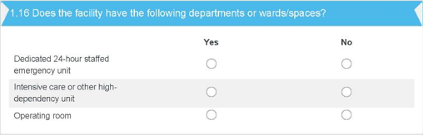
Skills for successful interviews​
What is written in the questionnaire:
What interviewers need to read:
    “Does the facility have the following departments or wards/spaces?
    Dedicated 24-hour staffed emergency unit
      Yes
      No
    Operating room
      Yes
      No”
Notes:
SO, what does this mean in a real interview?
On the left, you see questions that will appear on the screen for interviewers.
In this example, interviewers need to read the following:
Does the facility have the following departments or wards/spaces?​ [trainer: pause for an answer]
Dedicated 24-hour staffed emergency unit​
Yes​
No​ [trainer: pause for an answer]
Intensive care or other high-dependency unit​
Yes​
No​ [trainer: pause for an answer]
Operating room​
Yes​
No [trainer: pause for an answer]
Yes, you will need to read response options for all questions, unless there is a specific direction not to read them. We will see examples later.

Slide 14
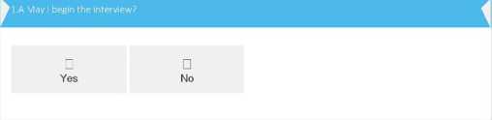
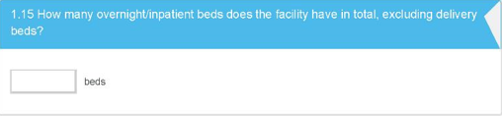
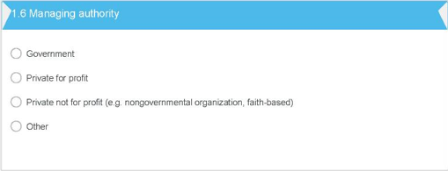

Skills for successful interviews​
Examples where you select or enter one response:
Select one of the available answers (most common)
Enter a number (rare)
Enter a text answer (few)
Notes:
Second, select or enter ONE response.
In most questions, you will select one of the pre-coded responses. These questions typically have radio buttons (small circles) or yes/no check box, as shown in examples on the left side. In these types of data entry, if you select one, and then click another one by mistake, the first – which is the real answer – will be un-selected. Please pay attention when you select an answer.
Sometimes, responses must be entered in the response grid/rows – as shown in the left bottom corner. When recording a response in one of these grids, make sure the answer is entered in the correct row. In the online tool, the row will be highlighted when you hover over. We will practice this shortly.
In only a few questions, there is a response option of “Do not know.” If “don’t know” is not one of the response options, then interviewers must probe further.
Relatively rare, but you may need to enter a numeric answer or a text answer. For numeric answers, warning messages will appear based one certain conditions that have been programmed. You will get an error message if you type an unlikely number: such as
negative 50 (-50) instead of 50 beds,
2.5 people instead of 25 people,
0 beds instead of 20.

Slide 15

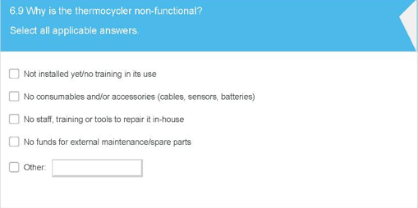
Skills for successful interviews​
An example of a question that involves five possible responses and interviewers do not have to select and enter only one response. Instead, interviewers need to:
Listen to a narrative answer
Select all applicable pre-coded responses that best describe the answer
Notes:
INFORMATION FOR FACILITATORS: this speaks’ note is relevant for two tools – shown above. Depending on the tool(s) used in your country, adapt the last two bullet points.
But, there are a small number of exceptions.
Some questions require the interviewer to listen to what the respondent describes and select all applicable answers among the pre-codded responses. In the electronic form, these will have checkboxes instead of radio buttons. So, you can check as many answers as the respondent provide.
Interviewers should not rush into checking categories before they finished listening to the respondent completely, otherwise interviewers are at risk of attributing their own biased response categories to their respondents.
In the COVID-19 case management capacity tool (blue one), there are four questions.
In the continuity of EHS tool (green one), there are five such questions. In four of them, we ask you NOT to read response options aloud. They are open questions. The direction will appear in the screen, as shown in this example.

Slide 16
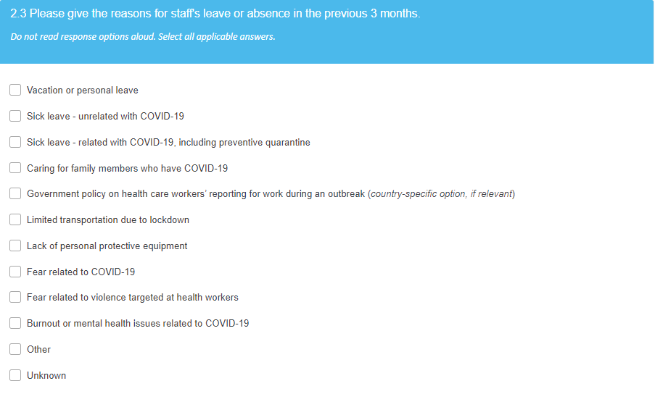
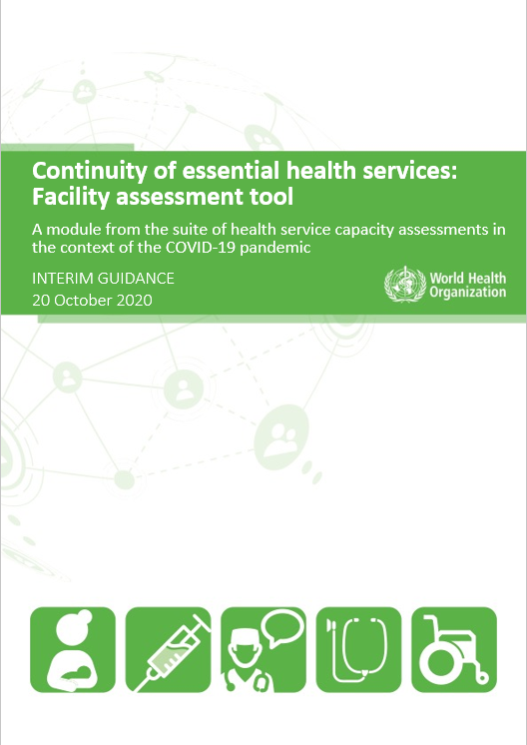
Skills for successful interviews​
An example of a question that involves multiple possible responses and interviewers do not have to select and enter only one response. Instead, interviewers need to:
Listen to a narrative answer
Select all applicable pre-coded responses that best describe the answer

Slide 17
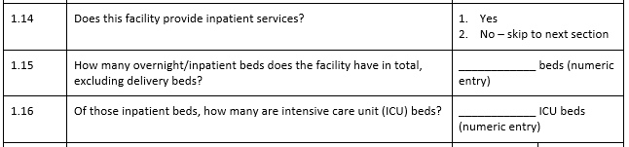
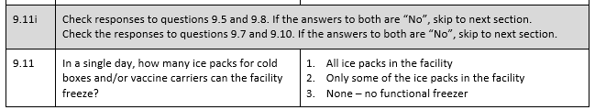
Skills for successful interviews​
There are two types of skip patterns based on:
Response in the current question
Response in past question(s). Skip pattern in gray background.
Skip patterns are pre-programmed and not shown in the online tool. However, it is important for interviewers to understand the flow.
Notes:
Finally, three, follow skip patterns.
Certain questions are asked to only a subset of facilities, depending on their answers in past questions.
In the online tool, all skip patterns have been already programmed. So, you will just need to follow the questions that appear.
However, it is very important for interviewers to understand the flow.

Slide 18
Review of paper questionnaire and practice using online tool

Slide 19
Note to trainer/facilitator
This training is critical but can be long and tedious for interviewers. Please provide engaging and creative training as much as possible!
In order to engage interviewers, if possible, go over the paper questionnaire and practice using the online tool section by section, rather than completing the paper questionnaire review all at once. Have two windows ready on the computer, one for the annotated paper questionnaire and the other for the online tool. Alternate them accordingly on the screen.
Read and review the paper questionnaire, led by a facilitator. It helps to provide a brief purpose for each section or to break up a group of questions in longer sections, and it is recommended for the facilitator to read the first 2 sections. For later sections, feel free to invite interviewers to read a group of questions.
For practice, pair interviewers and have them choose a hypothetical facility for practicing the methods (e.g., primary care center, district hospital), and choose a role (respondent vs. interviewer), and have them alternate roles by section.

Slide 20
Review of paper questionnaire and practice using online tool
Example: Hospital COVID-19 case management capacity
Paper questionnaire review
Have the paper questionnaire ready
Practice with the online tool
Pair with your partner
Choose a role (respondent vs. interviewer)
Alternate roles by section
Notes:
INFORMATION FOR FACILITATORS: Before interviewers starts practicing with the online tool (i.e., after reviewing the Section 1 of the paper questionnaire), this and the following two slides should be used.
Now to practice interviewing using the online tool, I will cover two things: how to start the tool, and getting informed consent.

Slide 21
Review of paper questionnaire and practice using online tool
Example: Continuity of Essential Health Services
Paper questionnaire review
Have the paper questionnaire ready
Practice with the online tool
Pair with your partner
Choose a role (respondent vs. interviewer)
Alternate roles by section
Notes:
INFORMATION FOR FACILITATORS: Before interviewers starts practicing with the online tool (i.e., after reviewing the Section 1 of the paper questionnaire), this and the following two slides should be used.
Now to practice interviewing using the online tool, I will cover two things: how to start the tool, and getting informed consent.

Slide 22
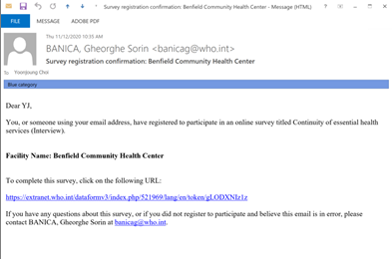
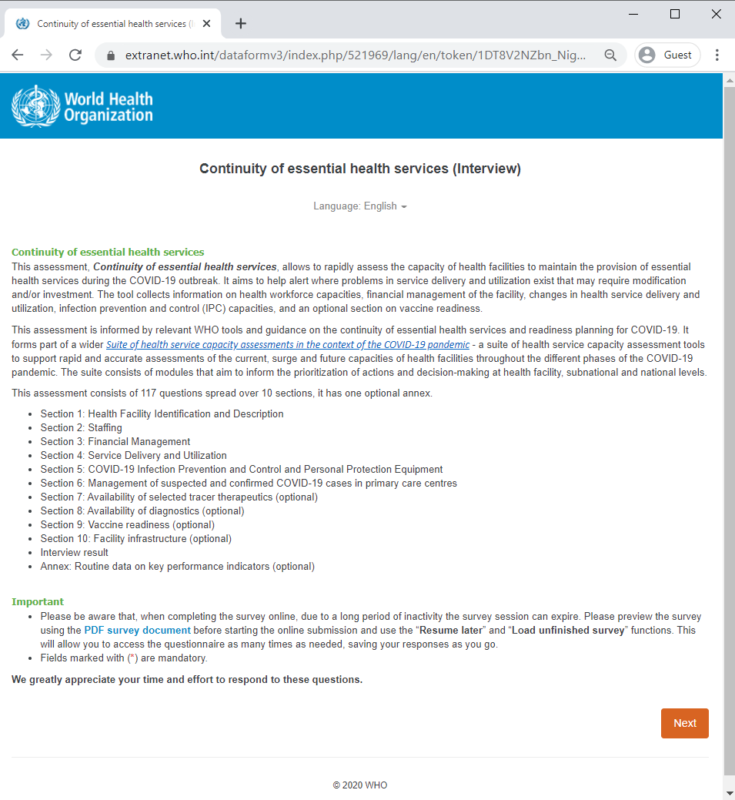
Review of paper questionnaire and practice using online tool
Starting the tool:
1
Click facility link either in your email or on your assigned list [COUNTRY-SPECIFIC]
2
Select language

Slide 23
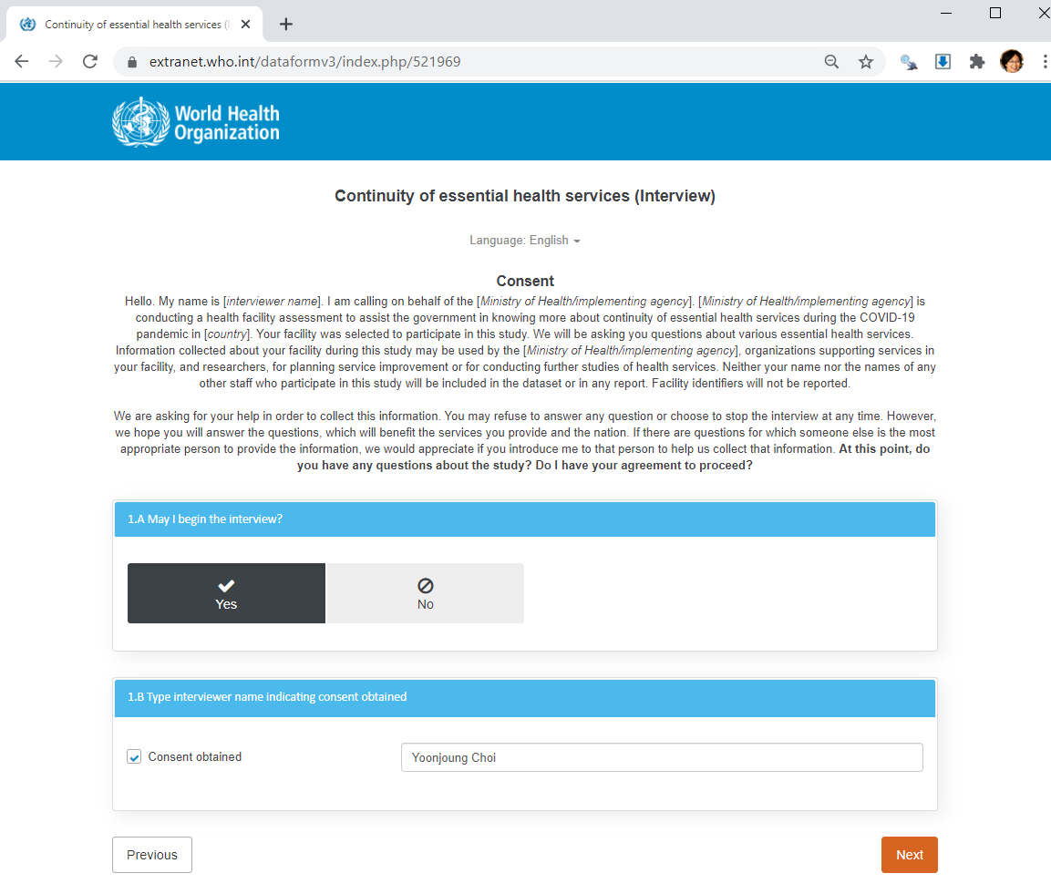
Review of paper questionnaire and practice using online tool
Obtain informed consent:
Notes:
Then, for each facility, you will need to obtain informed consent. The interviewer is required to read the information in its entirety to the respondent and then request his/her consent before starting to ask questions. Once you receive consent, click yes, and type your name.

Slide 24
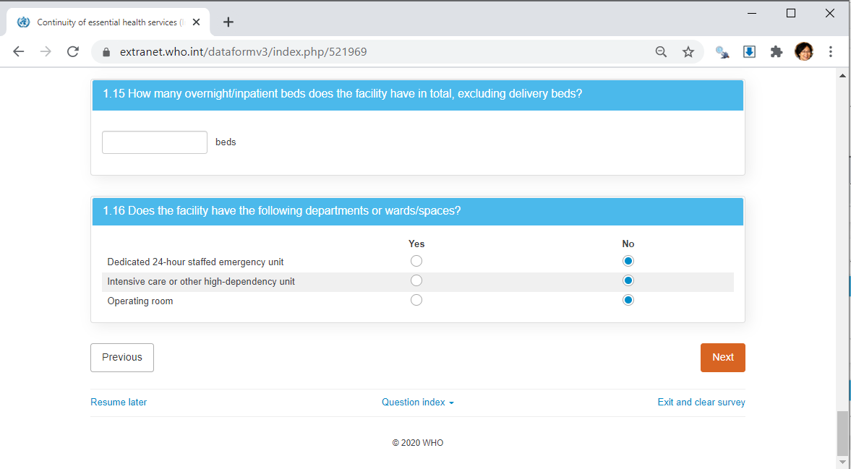
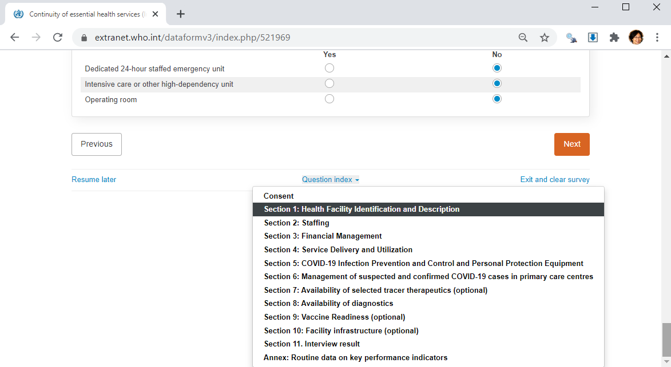
Review of paper questionnaire and practice using online tool
Navigating the online tool:
Go back to the previous page
Go to the next page
In some cases, interview may not be completed in one call.
If so, save the results and resume later
Use dropdown menu to move to different sections.
Notes:
You already know “previous” and “next” buttons.
The button in the bottom center, “question index” is for a situation when you have to move to a section or skip a section.
In a large facility, the main respondent may need to ask other staff about a certain section. Instead of talking to the other staff and coming back to the main respondent, you may want to skip the section and continue the interview with the main respondent. Just make sure you do come back for the skipped section to complete the interview.
Also, you may use the question index to record call results which is at the end of the tool, even though the interview is not completed yet. There are two cases for this: rescheduled call and dropped call.
Although it is strongly encouraged to complete the interview during one call, respondents may request a call back at another time or day for reasons not under their control, including seeing patients. Acknowledge their time and efforts, and respectfully accommodate the request.
Another situation is a breakout/dropped call. Interviewers must call back immediately after a breakout. If the respondent cannot be reached back on the same day for any reasons, call back the respondent again on the following day. Meanwhile, just like the re-scheduled interview:
In both cases, it is very important to record the call results which is at the end of the online tool.

Slide 25
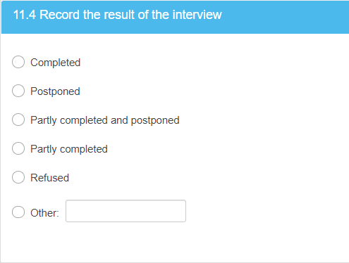
Review of paper questionnaire and practice using online tool
Record call results for all interviews:
Final question: Record the result of the interview
Interviewer’s daily log (discussed shortly)
An example of rescheduled or dropped call
Facility ID | Facility name | Facility type | Facility address | Facility phone number | Outreach call date | Main respondent | Main respondent phone number | Date and time of appointment | Outreach note | Interviewer | Status
123 | AA Hospital | Hospital | … | 123-456-789 | 12/9/2020 | Mary Doe | 123-456-777 | 12/17/2020 10 AM | … | A | Completed
456 | XX health center | Health center | … | 789-123-456 | 12/7/2020 | John Smith | 789-123-456 | 12/17/2020 1PM | … | A | Incomplete, rescheduled 12/18/2020 2PM
234 | BB Hospital | Hospital | … | 456-789-123 | 12/6/2020 | Jane Mwangi | 456-789-123 | 12/17/2020 2PM | … | A | Incomplete, breakout
567 | YY health center | Health center | … | 123-123-456 | 12/7/2020 | Peter Makumbi | 123-123-456 | 12/17/2020 3PM | … | A | Completed
Notes:
Let me talk about recording call results little more. Recording the result is required for ALL and EVERY calls. This is very important to track progress, and understand and manage the survey process better.
You will be sked to record the results in two places:
The last question in the online tool
Interviewer’s daily log [country specific, but likely on a paper or in an excel file]. We will talk about the log soon.
In a case of rescheduled or dropped call,
In the online tool, go to the last section,
record a result for the call, which would be “partly completed and postponed”,
save the results to resume later, and
in the log, record the status. Note what questions/sections you need to start from. We will talk about how to use the log more in detail shortly.

Slide 26
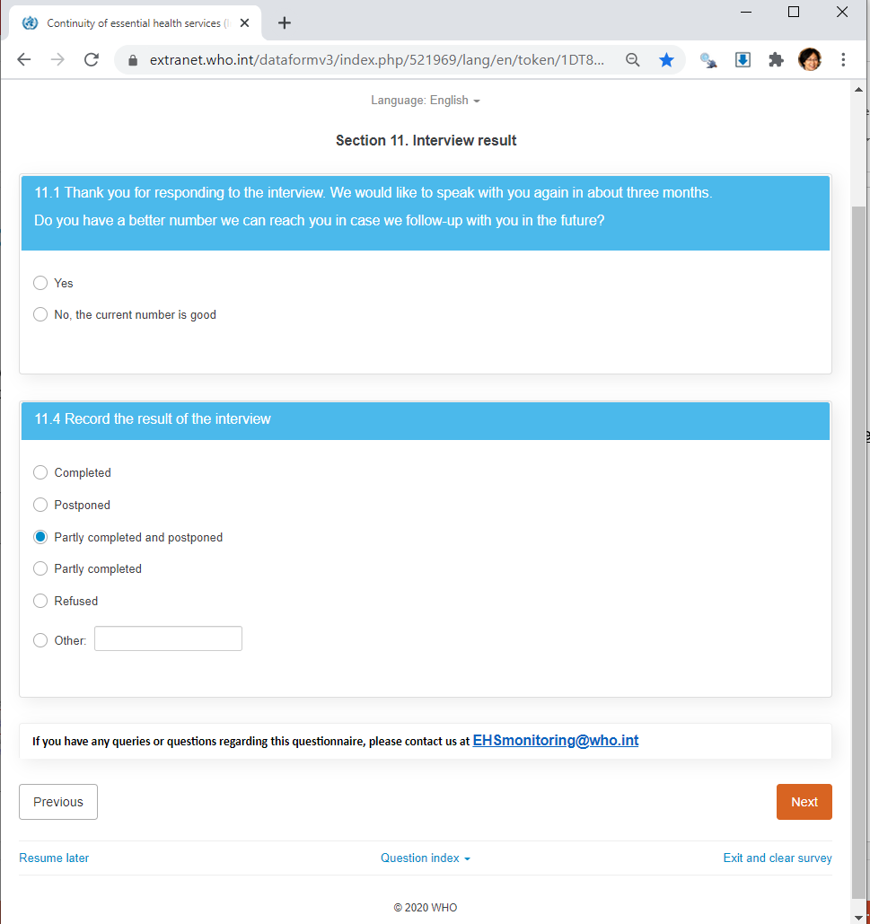
Review of paper questionnaire and practice using online tool
Resume incomplete interviews:
Always refer to the list of unique facility links that are assigned to you. Identify the incomplete or skipped facility based on their ID or name at the end of the link.
1
Identify the facility based on facility ID or name at the end of the link.
Click the link.
2
The last page that you left will appear
Notes:
Finally, when you resume an incomplete interview (either re-scheduled or dropped),
Find the facility’s link in the list of assigned facilities that was emailed to you. When you click the link, it will bring you to the last page that you left – which will be the last section.
Go to the section or page where you need to start (based on your note in the log), and then
Call the respondent and resume the interview.

Slide 27
Interviewer call log
Notes:
INFORMATION FOR FACILITATORS:
Adapt this section depending on how the assigned facilities will be shared – paper vs. excel file.

Slide 28
Interviewer call log
Each day the interviewer will receive a list of facilities to call for that day. This is a list of basic information about the facility.
The final column “status” is the column that needs to be filled in for every row.
Example of call log completed by Interviewer A on December 17, 2020
Facility ID | Facility name | Facility type | Facility address | Facility phone number | Outreach call date | Main respondent | Main respondent phone number | Date and time of appointment | Note | Interviewer | Status
123 | AA Hospital | Hospital | … | 123-456-789 | 12/9/2020 | Mary Doe | 123-456-777 | 12/17/2020 10AM | phone number different from facility number | A | Completed
456 | XX health center | Health center | … | 789-123-456 | 12/7/2020 | John Smith | 789-123-456 | 12/17/2020 1PM | … | A | Incomplete, rescheduled 12/18/2020 2PM. start from Section 7
234 | BB Hospital | Hospital | … | 456-789-123 | 12/6/2020 | Jane Mwangi | 456-789-123 | 12/17/2020 2PM | … | A | Incomplete, breakout Couldn’t reach back immediately. Start from Question 5.8
567 | YY health center | Health center | … | 123-123-456 | 12/7/2020 | Peter Makumbi | 123-123-456 | 12/17/2020 3PM | … | A | Completed
Notes:
Lastly, we will go over the interviewer call log.
Survey manager will generated call schedule for each day based on appointments that have been already made before the data collection.
You will receive a list of facilities that you need to call on each day. It will have basic information about facilities such as name, address, the main respondent whom you will talk to, and his/her phone number. There may be even some note from the pre-interview outreach, which may be helpful for you to know.
At the end of each call, you must record the call results – as we discussed earlier. Do make sure to include new appointment date and time for a rescheduled call.

Slide 29
Interviewer call log
Example of call log for Interviewer A on the next day, December 18, 2020
Facility ID | Facility name | Facility type | Facility address | Facility phone number | Outreach call date | Main respondent | Main respondent phone number | Date and time of appointment | Note | Interviewer | Status
234 | BB Hospital | Hospital | … | 456-789-123 | 12/6/2020 | Jane Mwangi | 456-789-123 | 12/18/2020 | Breakout from 12/17/2020 start from Question 5.8 | A
890 | CC Hospital | Hospital | … | 456-456-789 | 12/9/2020 | Peter Baressi | 456-456-789 | 12/18/2020 10AM | … | A
159 | ZZ health caneter | Health center | … | 234-567-561 | 12/7/2020 | Chelsea Park | 234-567-561 | 12/18/2020 12PM | … | A
456 | XX health center | Health center | … | 789-123-456 | 12/7/2020 | John Smith | 789-123-456 | 12/18/2020 2PM | Rescheduled from 12/17/2020. start from Section 7 | A
567 | YYY health center | Health center | … | 987-987-564 | 12/7/2020 | Thomas Gichangi | 987-987-564 | 12/18/2020 4PM | … | A
Notes:
Then, the survey manager will create a new log for the next date, based on the appointments.
In this example, you will see note about the facilities that were dropped but could not be reached back previous day. There is no appointment time, and you should try to call the respondents early in the day. Complete the interview or make an appointment as needed. This should be a rare situation, because interviewers should try to reach back the respondent immediately after a breakout.
It also has a facility that the interviewer rescheduled from a previous call.
At the end of each call, you must record the call results.
Return the log to the survey manager each day.

Slide 30
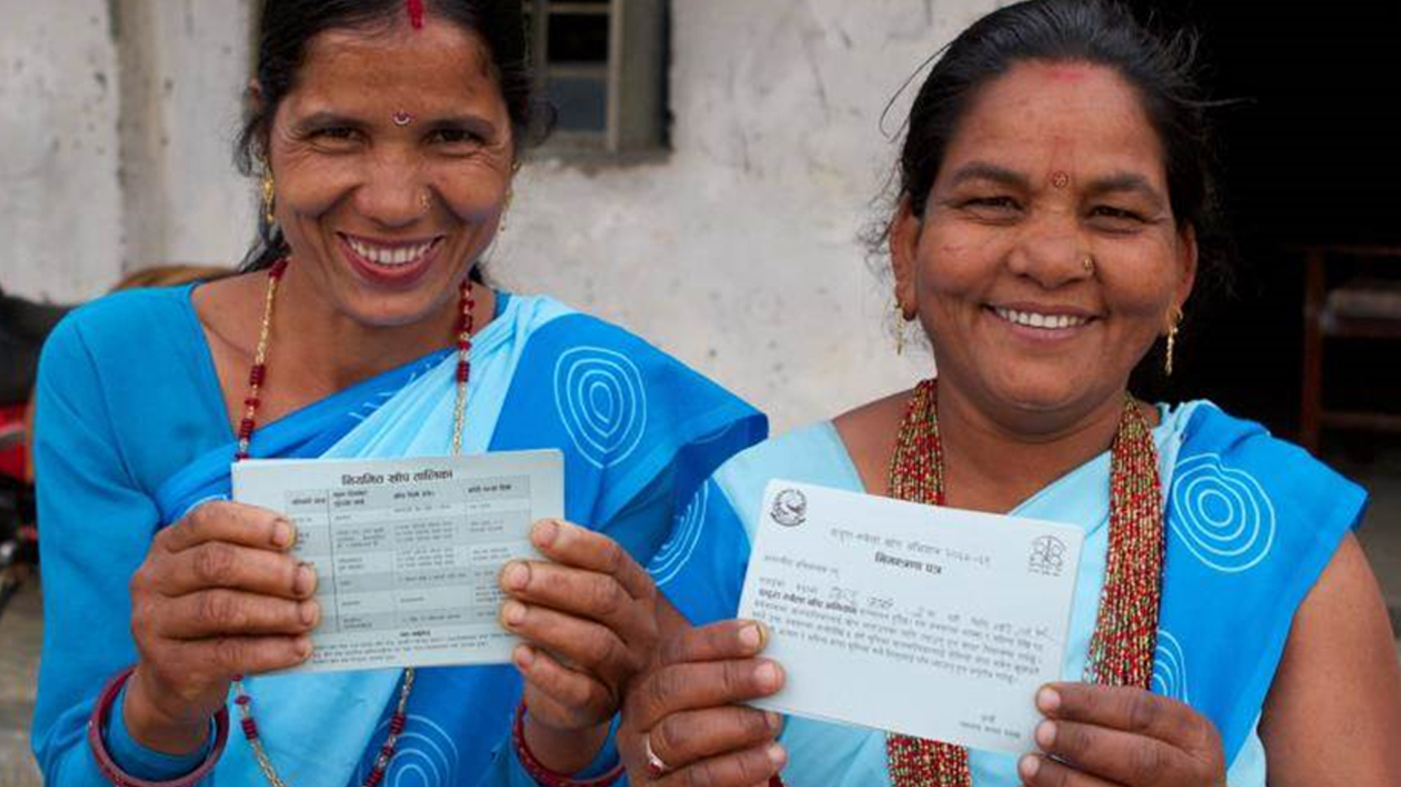
Closing slide

