Slide 1

Advanced Infection Prevention and Control (IPC) Training
Prevention of catheter-associated urinary tract infection (CAUTI)
2018
WHO Global IPC Unit 2018

Slide 2
Module outline
Prevention of catheter-associated urinary tract infection (CAUTI)
Session 1. The problem of CAUTI
Session 2. Catheter use, occurrence of CAUTI and related risk factors
Session 3. Recognizing CAUTI and understanding management principles
Session 4. Explaining evidence-based (multimodal) implementation strategies for CAUTI prevention including appropriate catheter insertion, maintenance and removal
30 mins
60 mins
60 mins
60 mins

Slide 3
The symbols explained
You are encouraged to participate in discussion questions, where you can use your own experience and prior knowledge
Interactive question
Some suggested answers to activities/group work
Answers
Group work
You are encouraged to participate in group activities to drill into key topics
In-depth case study applying learning into practice
Case study
Key resource
Essential content (not to be missed!)
Video material to supplement learning
Video
Reference/reading
Key reference for consolidating learning
Required reading or reflection outside of the classroom
Homework

Slide 4
Competencies
At the end of this module, the IPC focal point should be able to:
advocate the importance of addressing CAUTI and its burden;
identify IPC risk factors and moments during catheter insertion, management and removal that need improvement;
promote and use evidence-based (multimodal) strategies for CAUTI prevention during catheter insertion, maintenance and removal.

Slide 5
Learning objectives
On completion of this module, the student should be able to:
explain the problem of CAUTI;
explain catheter use, occurrence of CAUTI and related risk factors;
recognize CAUTI and understand management principles;
Implement evidence-based (multimodal) strategies for CAUTI prevention during catheter insertion, maintenance and removal.

Slide 6
Session 1
The problem of CAUTI

Slide 7

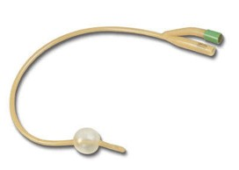
The catheter’s lament*
by Martin Kiernan, former President, Infection Prevention Society, United Kingdom
I am a urinary catheter
Dark places I must go
My job is clear
I have no fear
I need to ease the flow…
* “Lament” means complaint or expression of grief.
Page 1 of 3

Slide 8
…You are the one I am inside
It enters not your head
That if I’m left in
(a mortal sin)
You could just end up dead…
Page 2 of 3

Slide 9
…At times, I am a useful aide
But my use you should not flout
On every day
Someone should say
“It’s time to take me out!”
Page 3 of 3

Slide 10
Key points to note (1)
Refer to handout 1 in the student handbook
Avoid urinary catheterization if possible!
When feasible, use a two-person team to perform insertion.
Use sterile equipment and aseptic technique during insertion and aftercare/maintenance.
Review the need for the catheter daily and remove as soon as possible when no longer needed (ideally within 48 hours).
Hand hygiene is critical (especially moment 2 before an aseptic/clean procedure and moment 3 after blood and body fluid exposure).
Key resource

Slide 11
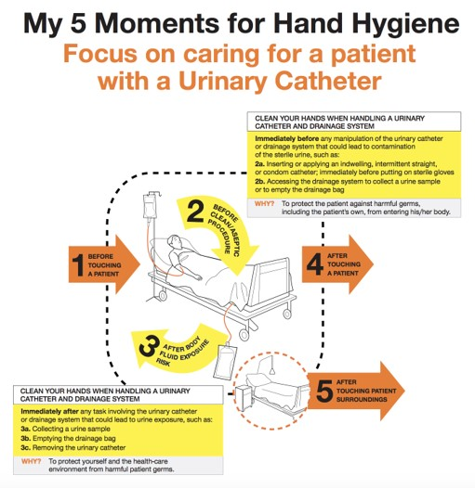
The critical role of hand hygiene
Refer to handout 2 in the student handbook
Five key additional considerations for a patient with a urinary catheter
Make sure that there is an appropriate indication for the indwelling urinary catheter.
Use a closed urinary drainage system, and keep it closed.
Insert the catheter aseptically using sterile gloves.
Assess the patient at least daily to determine whether the catheter is still necessary.
Patients with indwelling urinary catheters do not need antibiotics (including for asymptomatic bacteriuria), unless they have a documented infection.
Key resource
Source: http://www.who.int/gpsc/5may/hh-urinary-catheter_poster.pdf?ua=1

Slide 12
Key points to note (2)
Refer to handout 1 in the student handbook
Don’t change the catheter routinely if it is functioning properly.
Maintain closed drainage.
Bladder irrigation/washout and use of antiseptics/antimicrobial agents does not prevent CAUTI: do not use!
Empty drainage bag regularly into a clean receptacle used only on one patient.
The clean receptacle should be changed daily.
Key resource

Slide 13
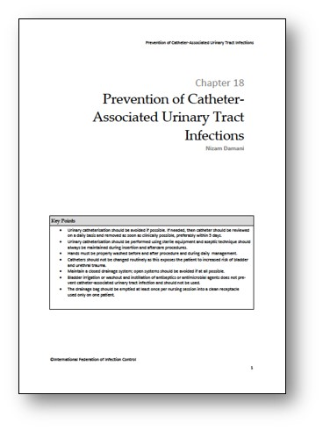
Supplementary information
Refer to handout 3 in the student handbook
Source: Damani N. Prevention of catheter-associated urinary tract infections. In: Friedman C, Newsom SWB, editors, IFIC basic concepts of infection control, 3rd edition. Craigavon: International Federation of Infection Control; 2016 (http://theific.org/basic-concepts-english-version-2016/).
Reference/reading

Slide 14
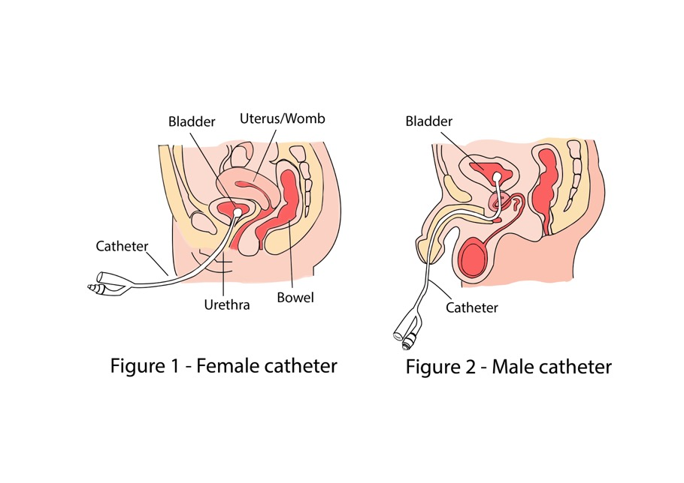
Questions on the use of indwelling urinary catheters
1. Who has inserted a catheter before?
2. When is catheterization necessary?
3. How frequently are catheters used in your facility?
4. What are the potential complications?
Interactive question
Source: Your indwelling urinary catheter [website]. Perth: Department of Health, Government of Western Australia; 2018 (http://healthywa.wa.gov.au/Articles/U_Z/Your-indwelling-urinary-catheter)

Slide 15
Epidemiology of CAUTI
In low- and middle-income countries (LMICs), CAUTIs are one of the major health care-associated infections (HAIs) but are largely preventable.
As many as 65–70% of CAUTI cases are preventable.
Sources:
Report on the burden of endemic healthcare-associated infections worldwide. Geneva: World Health Organization; 2011 (http://apps.who.int/iris/handle/10665/80135);
Umscheid CA, Mitchell MD, Doshi JA, Agarwal R, Williams K, Brennan PJ. Estimating the proportion of healthcare-associated infections that are reasonably preventable and the related mortality and costs. Infect Control Hosp Epidemiol. 2011;32(2):101–14.

Slide 16
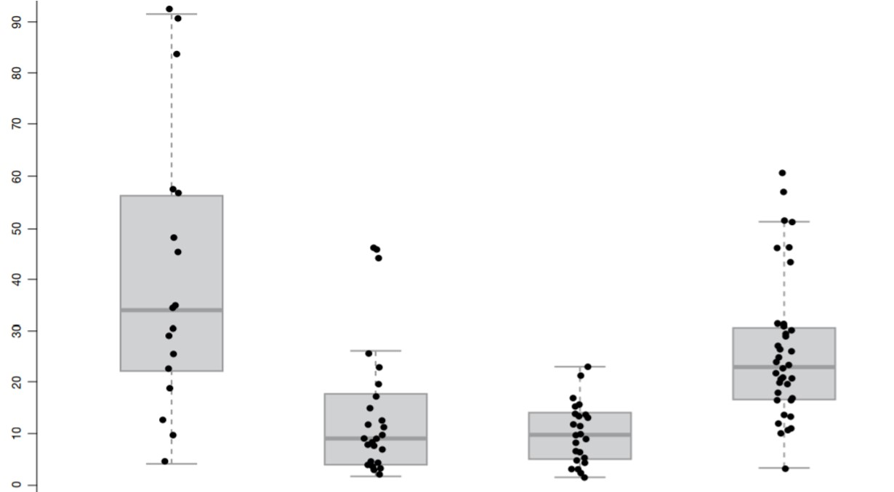
Incidence of HAIs in LMICs among high-risk patients
Notes:
CR-BSI = catheter-related bloodstream infection
VAP = ventilator-associated pneumonia
Incidence of infection 1995–2010
CR-BSI per 1000 device-days
CAUTI per 1000 device-days
VAP per 1000 device-days
HAI per 1000 patient-days
Source: Report on the burden of endemic healthcare-associated infections worldwide. Geneva: World Health Organization; 2011 (http://apps.who.int/iris/handle/10665/80135).

Slide 17
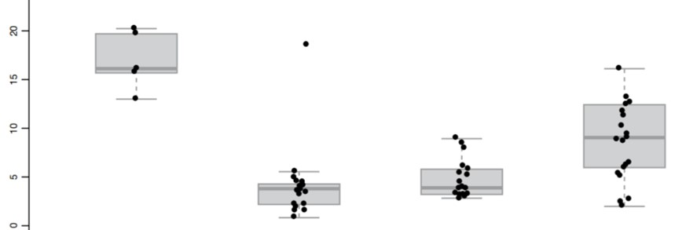
Incidence of HAIs in high-income countries among high-risk patients
Incidence of infection from 1995–2010
HAI per 1000 patient-days
CR-BSI per 1000 device-days
CAUTI per 1000 device-days
VAP per 1000 device-days
Report on the burden of endemic HAIs worldwide. Geneva: WHO, 2011
Source: Report on the burden of endemic healthcare-associated infections worldwide. Geneva: World Health Organization; 2011 (http://apps.who.int/iris/handle/10665/80135).

Slide 18
Overall incidence of HAIs and device-associated infections in high-risk patients (1995–2010): meta-analysis
High-income countries
HAI: 17.0/1000 patient days
CR-BSI: 3.5/1000 catheter days
CAUTI: 4.1/1000 urinary catheter days
VAP: 7.9 /1000 ventilation days
LMICs
HAI: 47.9/1000 patient days
CR-BSI: 12.2 /1000 catheter days
CAUTI: 8.8/1000 urinary catheter days
VAP: 23.9/1000 ventilation days
Incidence is at least twice as high in LMICs
REMEMBER:
CAUTI is a major causes of bloodstream infection and sepsis
Source: Report on the burden of endemic healthcare-associated infections worldwide. Geneva: World Health Organization; 2011 (http://apps.who.int/iris/handle/10665/80135).

Slide 19
Impact of CAUTI – Complications of indwelling catheters to patients
Associated with increased morbidity and mortality
  70–80% of urinary tract infections (UTIs) are attributable to indwelling urethral catheter use.
  CAUTI has been reported to be associated with mortality but the data may be biased (with confounding by unmeasured clinical variables).
In addition, inappropriate treatment with antibiotics promotes antimicrobial resistance.
Complications of CAUTI
CAUTI can lead to prostatitis, epididymitis and orchitis (in males); and cystitis, pyelonephritis, Gram-negative bacteraemia, endocarditis, vertebral osteomyelitis, septic arthritis, endophthalmitis and meningitis in patients.
Sources:
Chenoweth CE, Gould CV, Saint S. Diagnosis, management and prevention of catheter-associated urinary tract infections. Infect Dis Clin N Am. 2014;28(1):105–19;
Lo E, Nicolle LE, Coffin SE, Gould C, Maragakis LL, Meddings J et al. Strategies to prevent catheter-associated urinary tract infections in acute care hospitals: 2014 update. Infect Control Hosp Epidemiol. 2014;35(5):464–79.

Slide 20
Impact of CAUTI – Health services
Associated with excess health care costs
  CAUTI leads to increased length of stay in hospital and additional diagnostics/treatment.
  It places a larger burden on intensive care units
  In the United States of America, CAUTIs resulted in an estimated $131 million in annual excess medical costs.
Summary
  Complications associated with CAUTI cause discomfort to the patient and prolonged hospital stays, and increase costs and mortality.
Sources:
Chenoweth CE, Gould CV, Saint S. Diagnosis, management and prevention of catheter-associated urinary tract infections. Infect Dis Clin N Am. 2014;28(1):105–19;
Lo E, Nicolle LE, Coffin SE, Gould C, Maragakis LL, Meddings J et al. Strategies to prevent catheter-associated urinary tract infections in acute care hospitals: 2014 update. Infect Control Hosp Epidemiol. 2014;35(5):464–79.

Slide 21
Session 2
Catheter use, occurrence of CAUTI and related risk factors

Slide 22
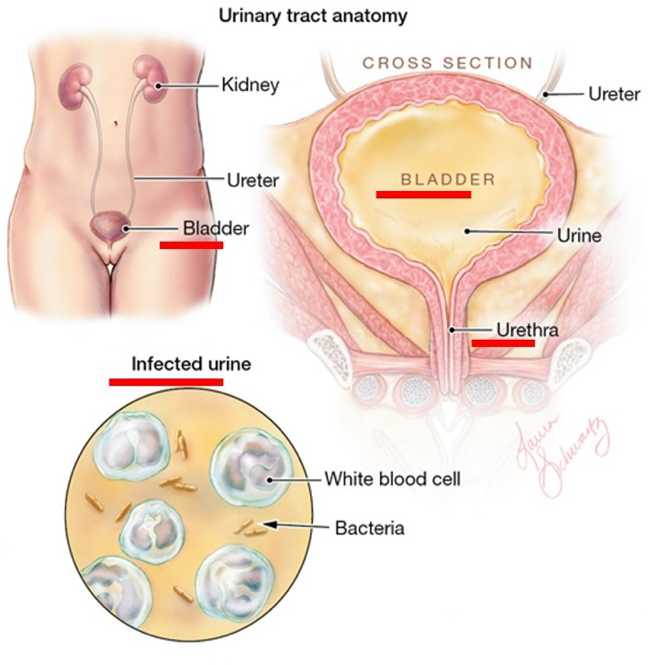
Urinary tract pathophysiology – Quiz 1
Refer to handout 4 in the student handbook
Interactive question
Source: Torpy JM, Schwartz LA, Golub RM. Urinary tract infection. JAMA. 2012;307(17):1877.

Slide 23
Quiz 1
Refer to handout 4 in the student handbook
The bladder is sterile – TRUE/FALSE
The urethra is usually sterile in healthy non-catheterized people – TRUE/FALSE
In healthy non-catheterized people urine flow flushes out any invading bacteria – TRUE/FALSE
A urinary catheter is a foreign body – TRUE/FALSE
Reflux of contaminated urine from collecting bag is not an infection risk – TRUE/FALSE
A urinary catheter (tick all correct responses):
  is a foreign body allowing potentially harmful uropathogens to enter the bladder ☐
  disrupts the protective mechanisms against infection – e.g. urine flow ☐
  causes damage during insertion that exposes the urinary tract to colonisation and infection ☐
  can result in incomplete voiding of urine from the bladder because of retention of residual urine due to catheter balloon providing a medium for bacterial growth ☐
Bacteria can only ascend into the urinary tract on the outside of the catheter (i.e. extraluminal route) – between catheter and ureter epithelial surface – TRUE/FALSE
CAUTI can only be caused via contaminated equipment and/or the hands of health care workers (exogenous infection) – TRUE/FALSE

Slide 24
Quiz 1 – Supplementary information
Refer to handout 5 in the student handbook
Reference/reading

Slide 25
Uropathogens: routes of entry
Bacteria enter the urinary tract via two possible routes:
  the extraluminal route – between the urinary catheter and the surface epithelium of the urethra;
  the intraluminal route – this can occur during a rupture in the closed drainage system and/or defective asepsis, such as when collecting specimens or if the bag is disconnected.
Infections can be:
  endogenous (self-infection): typically by colonization of the urethral meatus, rectum or vagina;
  exogenous (cross-infection): via contaminated equipment and/or the hands of health personnel.
Sources:
Maki D, Tambyah P. Engineering out the risk of infection with urinary catheters. Emerg Infect Dis 2001;7(2): 342–7;
Damani N. Prevention of catheter-associated urinary tract infections. In: Friedman C, Newsom SWB, editors, IFIC basic concepts of infection control, 3rd edition. International Federation of Infection Control, 2016 (http://theific.org/basic-concepts-english-version-2016/).

Slide 26
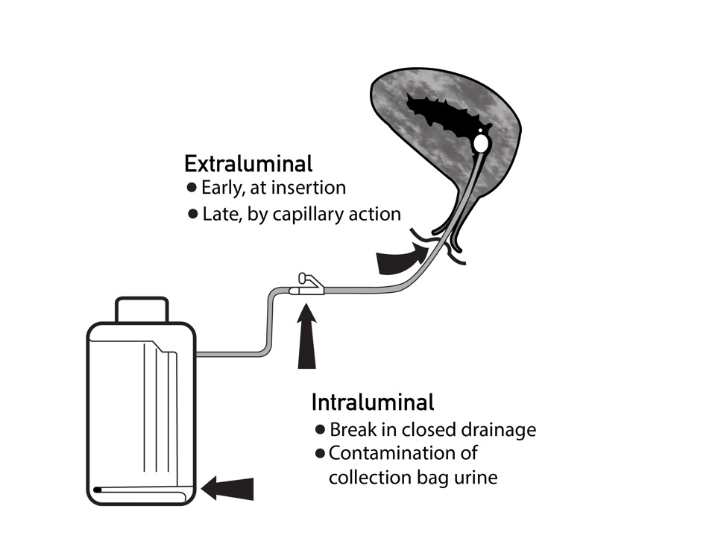
Routes of entry and path of uropathogens
Source: Maki D, Tambyah P. Engineering out the risk of infection with urinary catheters. Emerg Infect Dis 2001;7(2): 342–7;

Slide 27
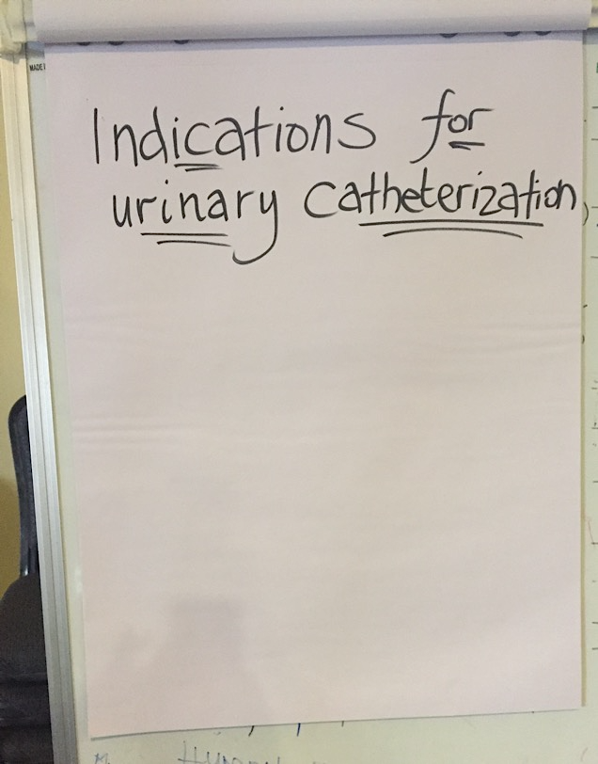
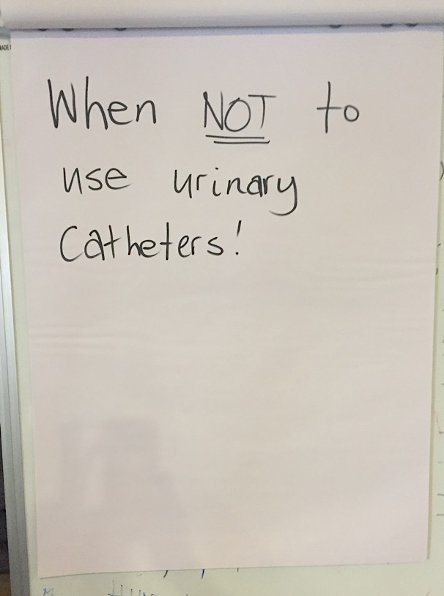
Group work 1. Indications for urinary catheter use
Group work
Notes:
Participants split into groups and write on 2xflipchart papers:
As many indications for catheterisation as they can think
As many reasons for not using a urinary catheter as they can think of
10 mins plus 10 mins plenary feedback

Slide 28
Appropriate indications – for use in hospitalized medical patients (1)
Refer to handout 6 in the student handbook
1. Acute urinary retention without bladder outlet obstruction (e.g. medication-related urinary retention)
2. Acute urinary retention with bladder outlet obstruction due to non-infectious, nontraumatic diagnosis (e.g. exacerbation of benign prostatic hyperplasia)
  Note: consider urology consultation for catheter type and/or placement for conditions, such as acute prostatitis and urethral trauma.
3. Chronic urinary retention with bladder outlet obstruction
  Note: it is unclear whether a Foley catheter is appropriate for chronic urinary retention without bladder outlet obstruction (e.g. neurogenic bladder) when an intermittent straight catheter is feasible and adequate.
Sources:
Meddings J, Saint S, Fowler KE, Gaies E, Hickner A, Krein SL et al. The Ann Arbor criteria for appropriate urinary catheter use in hospitalized
medical patients: results obtained by using the RAND/UCLA appropriateness method. Ann Intern Med. 2015;162(9 Suppl):S1–S34;
Guideline for prevention of catheter-associated urinary tract infections (2009). Atlanta, GA: Centers for Disease Control and
Prevention; 2009 (https://www.cdc.gov/infectioncontrol/guidelines/cauti/index.html).
Key resource
Answers

Slide 29
Appropriate indications – for use in hospitalized medical patients (2)
4. Severe pressure ulcers or similarly severe wounds
  Note: this includes stage III or IV or unstageable pressure ulcers or skin grafts of other types that cannot be kept clear of urinary incontinence despite wound care; other urinary management strategies (e.g. barrier creams, absorbent pads, prompted toileting and non-indwelling catheters) should be considered.
5. Urinary incontinence in patients for whom nurses find it difficult to provide skin care despite other urinary management strategies and available resources, such as lift teams and mechanical lift devices – e.g. if turning causes hemodynamic or respiratory instability, strict prolonged immobility (such as in unstable spine or pelvic fractures), strict temporary immobility after a procedure (such as after vascular catheterization) or excess weight (>300 lb) from severe oedema or obesity
Key resource
Answers

Slide 30
Appropriate indications – for use in hospitalized medical patients (3)
6. Hourly measurement of urine volume required to provide treatment – e.g. for management of hemodynamic instability, hourly titration of fluids, drips (such as vasopressors or inotropes) or life-supportive therapy
7. Daily measurement of urine volume that is required to provide treatment and cannot be assessed by other volume and urine collection strategies (e.g. acute renal failure work-up, or acute intravenous or oral diuretic management, intravenous fluid management in respiratory or heart failure)
8. Single 24-hour urine sample for diagnostic test that cannot be obtained by other urine collection strategies (e.g. urinal, bedside commode, bedpan, external catheter or intermittent straight catheter)
Key resource
Answers

Slide 31
Appropriate indications – for use in hospitalized medical patients (4)
9. To reduce acute, severe pain with movement when other urine management strategies are difficult (e.g. acute unrepaired fracture).
Note: consider other urine collection strategies (e.g. urinal, bedside commode, bedpan, external catheter or intermittent straight catheter).
10. Improvement in comfort when urine collection by catheter addresses patient and family goals in a dying patient
11. Management of gross haematuria with blood clots in urine
12. Clinical condition for which an intermittent straight catheter or external catheter would be appropriate but placement by experienced nurse or physician was difficult or for a patient for whom bladder emptying was inadequate with non-indwelling strategies during this admission
Key resource
Answers

Slide 32
Inappropriate uses – in hospitalized medical patients (1)
Urinary incontinence when nurses can turn/provide skin care with available resources, including patients with intact skin, incontinence-associated dermatitis, stage I and II pressure ulcers and closed deep-tissue surgery
Routine use of Foley catheter in intensive care unit without an appropriate indication
Foley placement to reduce risk of falls by minimizing the need to get up to urinate
Post-void residual urine volume assessment
Sources:
Meddings J, Saint S, Fowler KE, Gaies E, Hickner A, Krein SL et al. The Ann Arbor criteria for appropriate urinary catheter use in hospitalized medical patients: results obtained by using the RAND/UCLA appropriateness method. Ann Intern Med. 2015;162(9 Suppl):S1–S34;
Guideline for prevention of catheter-associated urinary tract infections (2009). Atlanta, GA: Centers for Disease Control and Prevention; 2009 (https://www.cdc.gov/infectioncontrol/guidelines/cauti/index.html).
Key resource
Answers

Slide 33
Inappropriate uses – in hospitalized medical patients (2)
Random or 24-hour urine sample collection for sterile or nonsterile specimens if possible by other collection strategies (e.g. barrier creams, absorbent pads, prompted toileting or non-indwelling catheters)
Patient or family request when there are no expected difficulties managing urine otherwise in non-dying patient, including during patient transport
Patient ordered for “bed rest” without strict immobility requirement (e.g. lower-extremity cellulitis)
Preventing urinary tract infection (UTI) in patient with faecal incontinence or diarrhoea or management of frequent, painful urination in patients with UTI
Key resource
Answers

Slide 34
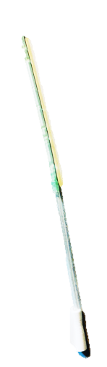
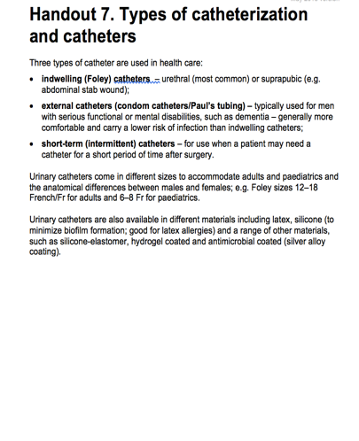
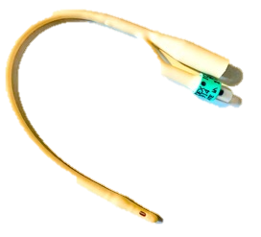
Types of catheterization and catheters
Refer to handout 7 in the student handbook
Indwelling (Foley) catheter
Intermittent straight catheter
Images © WHO/ Nizam Damani

Slide 35
Role of biofilms in CAUTI
https://www.youtube.com/watch?v=be-mjOGiquk
Biofilms are clusters of microorganisms and extracellular polymeric matrix.
They can form on internal/external surfaces of catheters shortly after insertion and ascend to the bladder in 1–3 days.
Shedding of bacterial cells from biofilms can lead to infection.
Some biofilms block catheters, leading to bladder/kidney stones (e.g. crystalline biofilms form from bacteria that produce urea, such as Proteus spp.).
They prevent penetration of antimicrobial agents and result in failure of treatment.
Video

Slide 36
Common microorganisms causing CAUTI
Refer to handout 8 in the student handbook
Escherichia coli
Klebsiella spp.
Proteus spp.
Pseudomonas aeruginosa
Staphylococcus aureus
Coagulase-negative staphylococci
Enterococcus faecalis
Candida albicans
(yeast often seen due to antibiotic use)
Sources:
National Healthcare Safety Network (NHSN) [website]. Atlanta, GA: Centers for Disease Control and Prevention; 2018 (https://www.cdc.gov/nhsn/datastat/index.html);
Most frequently isolated microorganisms in HAIs [website]. Solna: European Centre for Disease Prevention and Control; 2018 (https://ecdc.europa.eu/en/publications-data/point-prevalency-survey-database/microorganisms-and-antimicrobial-resistance-1).

Slide 37

Questions: risk factors for CAUTI
  Three questions:
  Patient risk factors – which patients are at risk?
  Health care worker risk factors – how does the health worker affect risk of CAUTI?
  System-related factors – what are the health system factors that affect risk of UTI? (Think multimodal!)
Interactive question
Source: Risk factors that increase the risk of hypertension [website]. Milan: Hypertension Network; 2018
(http://www.hypertensionetwork.com/en/know-hta/risk-factors-that-increase-the-risk-of-hypertension.html)

Slide 38
Patient-related risk factors (1)
The key risk factor is duration of catheterization.
Unnecessary catheter placement should be reduced and duration minimized.
Sources:
Guide to preventing catheter-associated urinary tract infections: implementation guide. Arlington, VA: Association for Professionals in Infection Control and Epidemiology; 2014 (https://apic.org/Resources/Topic-specific-infection-prevention/Catheter-associated-urinary-tract-infection);
Chenoweth C, Saint S. Preventing catheter-associated urinary tract infections in the intensive care unit. Crit Care Clin. 2013;29(1):19–32;
Mangukiya JD, KD Patel, MM Vegad. Study of incidence and risk factors of urinary tract infection in catheterised patients admitted at tertiary care hospital. Int J Res Med Sci. 2015;3(12):3808–11.
Answers

Slide 39
Patient-related risk factors (2)
Factors that alter the physiology (e.g. pregnancy)
Impaired immunity (e.g. diabetes, HIV, chemotherapy)
Severity of illness, other infections
Female gender
Older age (>50 years)
Malnutrition, dehydration
Faecal incontinence, incomplete emptying of bladder
Answers

Slide 40
Health care worker-related risk factors – defective IPC practices (1)
Failure to remove catheter in a timely way (>2 days – remember the biofilm!)
  3–7% increased risk with each day a catheter remains
Lack of documentation and record-keeping – no review/removal plan
Absence of routine checks
Sources:
Guide to preventing catheter-associated urinary tract infections: implementation guide. Arlington, VA: Association for Professionals in Infection Control and Epidemiology; 2014 (https://apic.org/Resources/Topic-specific-infection-prevention/Catheter-associated-urinary-tract-infection);
Chenoweth C, Saint S. Preventing catheter-associated urinary tract infections in the intensive care unit. Crit Care Clin. 2013;29(1):19–32;
Dougnon TV, Bankole HS, Johnson RC, Hounmanou G, Toure IM, Houessou C et al. Catheter-associated urinary tract infections at a hospital in Zinvie, Benin. Int J Infect. 2016; 3(2):e34141.
Manojlovich M, Saint S, Meddings J, Ratz D, Havey R, Bickmann J et al. Indwelling urinary catheter insertion practices in the emergency department: an observational study. Infect Control Hosp Epidemiol. 2016;37(1):117–9.
Answers

Slide 41
Health care worker-related risk factors – defective IPC practices (2)
Overuse/inappropriate use of catheters (e.g. for specimen collection/nursing convenience)
Lack of asepsis during insertion and maintenance (including defective hand hygiene at moments 2 and 3)
Reuse of catheters
Emptying of bags from different patients into a communal container
Incorrect positioning of urine bag (e.g. on floor; raising above the level of the bladder, causing back-flushing) and drainage tubing
Putting antiseptic solution in urinary bag
Routine flushing of catheter
Inappropriate urine specimen collection (no sampling ports)
Contamination during disconnection of drainage system
Answers

Slide 42
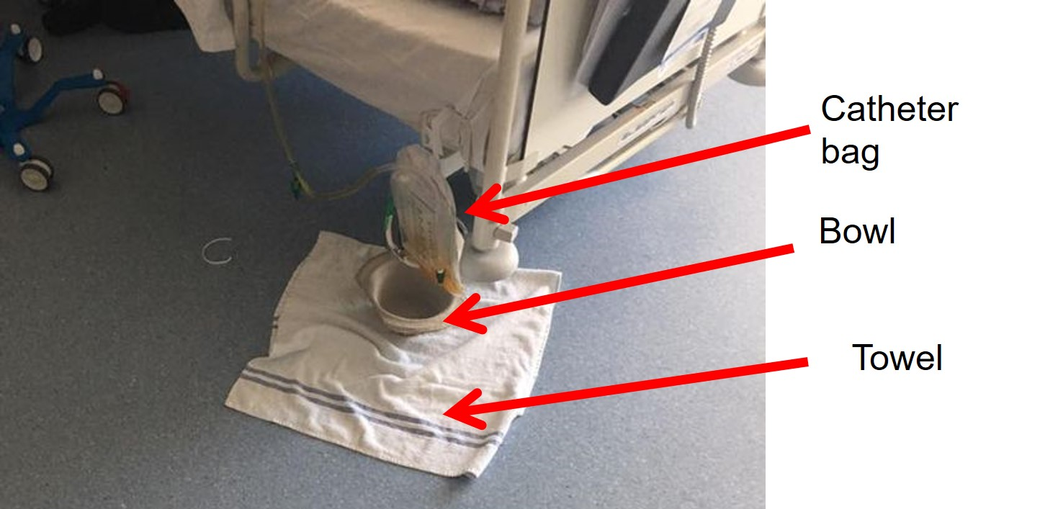
What is the problem here?
Interactive question
© WHO/Nizam Damani

Slide 43
Leaking urine bag
© WHO/Nizam Damani
Answers

Slide 44
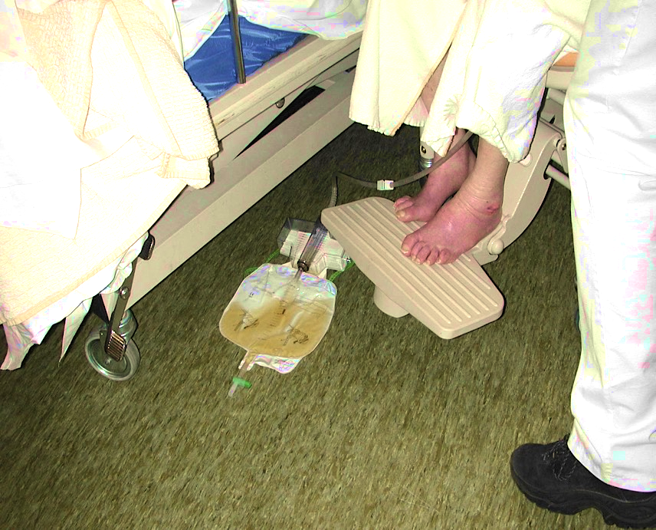
What is the problem here?
Patient in wheelchair
Catheter bag
Interactive question
© WHO/Nizam Damani

Slide 45
Catheter urine bag on the floor
Patient in wheelchair
Catheter bag
Answers
© WHO/Nizam Damani

Slide 46
System-related risk factors – think multimodal!
Availability of equipment and infrastructure
    Appropriate catheter material and type
    Lack of resources – e.g. urinals, bedpans, catheter securing devices, lubricating gel (single- vs multi-use), gloves, hand hygiene consumables
  Availability of adequate staffing
  Availability/promotion of guidelines, policies and procedures
  Availability of training
  Monitoring and feedback
  Institutional safety culture not valued (e.g. quality improvement, monitoring and feedback)
Sources:
Guide to preventing catheter-associated urinary tract infections: implementation guide. Arlington, VA: Association for Professionals in Infection Control and Epidemiology; 2014 (https://apic.org/Resources/Topic-specific-infection-prevention/Catheter-associated-urinary-tract-infection);
Chenoweth C, Saint S. Preventing catheter-associated urinary tract infections in the intensive care unit. Crit Care Clin. 2013;29(1):19–32;
Dougnon TV, Bankole HS, Johnson RC, Hounmanou G, Toure IM, Houessou C et al. Catheter-associated urinary tract infections at a hospital in Zinvie, Benin. Int J Infect. 2016; 3(2):e34141.
Answers

Slide 47
Session 3
Recognizing CAUTI and understanding management principles

Slide 48
Key principles of CAUTI recognition (1)
  Diagnosis of CAUTI is challenging because bacteriuria is often present and is not a reliable indicator alone for infection (i.e. it does not differentiate between colonization and infection).
  Thus, both bacteriuria and clinical signs or symptoms are needed.
  Patients with long-term catheters will often have high concentrations of bacteria in the urine without having an infection – asymptomatic bacteriuria.
  Indwelling urinary catheters often interfere with classic signs/symptoms of UTIs (e.g. urgency, frequency). This therefore leads to overdiagnosis, as costovertebral angle tenderness (aka Murphy’s punch sign, Pasternacki’s sign or Goldflam’s sign) is tricky to uncover.

Slide 49
Key principles of CAUTI recognition (2)
Standardized definitions are important to determine the true infection burden (refer to training module on HAI surveillance for additional information)
    Centers for Disease Control and Prevention (CDC)
    European Centre for Disease Prevention and Control (ECDC)
Surveillance definition versus clinical diagnosis
  Surveillance definitions are designed to study and identify trends in a population. They apply standardized criteria in a consistent manner.
  Clinical diagnoses are patient-specific. Therefore a clinical diagnosis may be made even when a surveillance definition may not be made.

Slide 50
CDC definition of CAUTI (1)
  Patient must meet criteria 1, 2 and 3 below:
  Patient had an indwelling urinary catheter in place for over two days on the date of event AND it was either:
    present for any portion of the calendar day on the date of event
    OR
    removed the day before the date of event.
Source: National Healthcare Safety Network (NHSN) patient safety component manual. Atlanta, GA: Centers for Disease Control and Prevention; 2018 (https://www.cdc.gov/nhsn/training/patient-safety-component/index.html).

Slide 51
CDC definition of CAUTI (2)
  Patient has at least one of the following signs or symptoms:
    fever (>38.0°C) – to use fever in a patient aged over 65 years, the indwelling urinary catheter needs to be in place for more than two calendar days on date of event;
    suprapubic tenderness (with no other recognized cause);
    costovertebral angle pain/tenderness (with no other recognized cause);
    urinary urgency (cannot be used when catheter is in place);
    urinary frequency (cannot be used when catheter is in place);
    dysuria (cannot be used when catheter is in place).

Slide 52
CDC definition of CAUTI (3)
  Patient has a urine culture with no more than two species of organism identified, at least one of which is a bacterium of ≥10⁵ CFU/ml (refer to CDC comments in the manual for details).

Slide 53
ECDC definition of UTI
UTI-A Microbiologically confirmed symptomatic UTI | UTI-B Microbiologically unconfirmed symptomatic UTI | UTI-C Asymptomatic bacteriuria
≥1 of the following (no other cause): fever (>38ºC) urgency frequency suprapubic tenderness AND | 2 of the following (no other cause): fever (>38ºC) urgency frequency suprapubic tenderness AND | Do not report
Positive urine culture (≥10⁵ microorganisms (≤2 species)/ml) | ≥1 of following positive dipstick urine pyuria (≥10 white blood cells/ml) Organisms/gram of unspun urine ≥2 urine cultures same uropathogen ≥10² organisms/ml physician diagnosis of UTI physician treatment of UTI
Note:
Urinary catheter present in situ within seven days of the onset of signs and symptoms
Source: Point prevalence survey of healthcare-associated infections and antimicrobial use in European acute care hospitals; 2012 (http://www.ecdc.europa.eu/en/publications/Publications/0512-TED-PPS-HAI-antimicrobial-use-protocol.pdf).

Slide 54
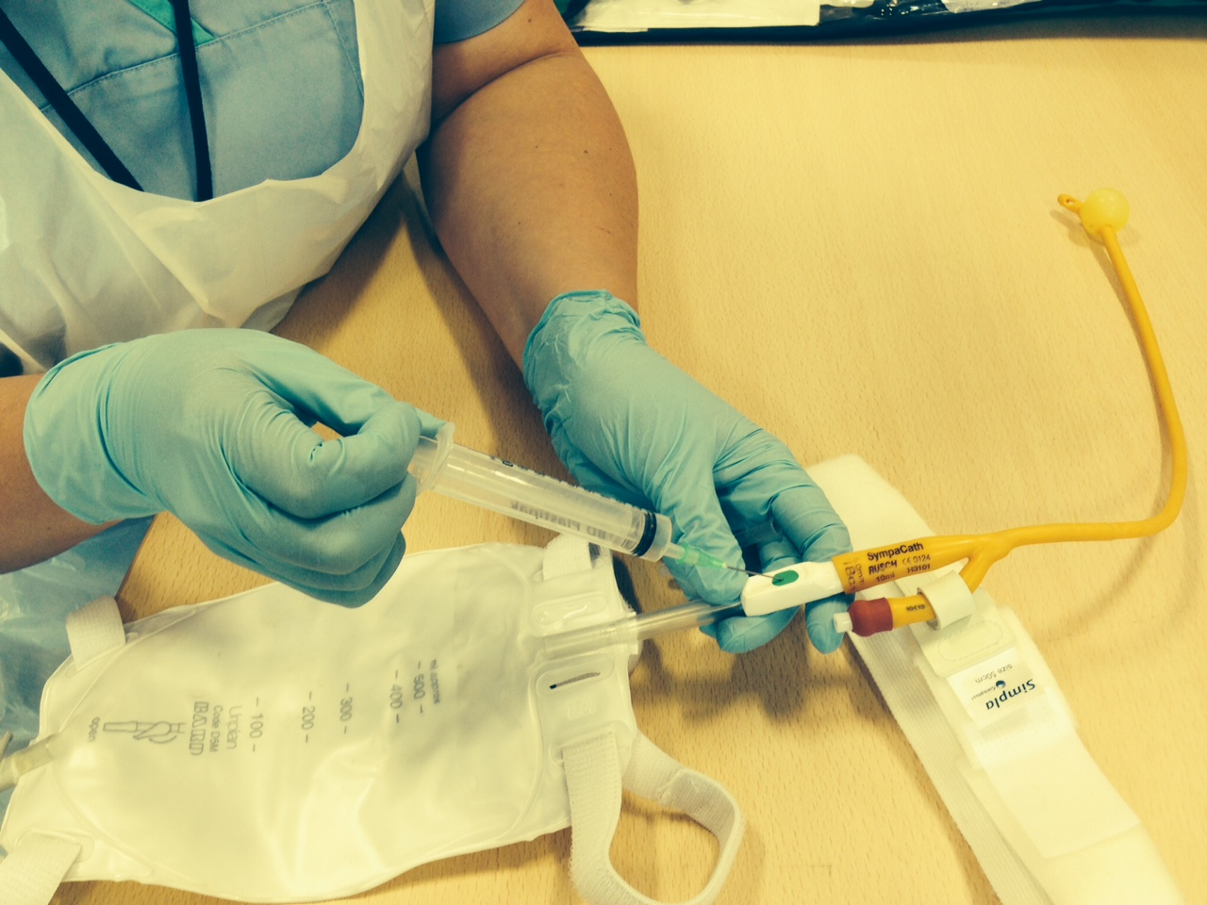
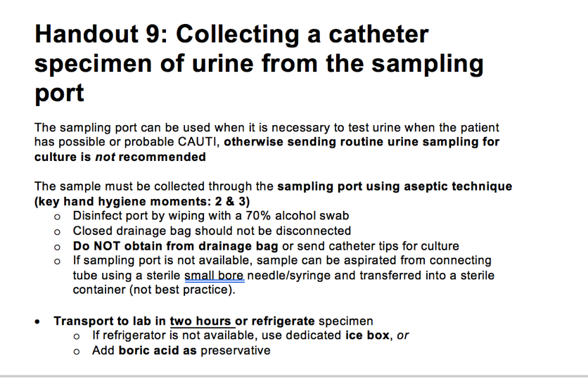
Collecting a catheter specimen of urine from the sampling port
Sampling port on catheter leg bag
Sampling port for collection of
urine (CSU) specimen
Refer to handout 9 in the student handbook
Interactive question
Photograph © WHO/Nizam Damani

Slide 55
Sending a urine sample
The urine sample must be collected using aseptic technique, as outlined in previous slides.
The sample must be sent in a sterile container as soon as possible (within two hours of collection).
If delay is anticipated, the sample must be put into a designated refrigerator or ice box: an ice box can be used to transport the sample to prevent overgrowth of bacteria.
Alternatively, use of boric acid is recommended.

Slide 56

Urine container with preservative boric acid
  Using accurate concentrations of boric acid is essential, as it may affect the viability of the bacteria and therefore the bacteriology culture result.
  Use a marked bottle to achieve 1% w/v or 0.1g/10ml.
  The sample should be sent to the laboratory within 4 hours or stored in the fridge until transport to the laboratory is available

Slide 57
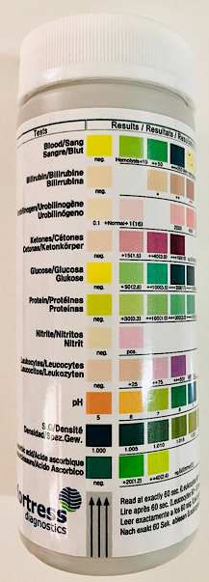
Urine test strip or dipstick test
Urine dipstick tests are a valuable screening tool
for UTIs to guide empiric treatment.
Nevertheless, results should be interpreted with
microscopy and clinical information.
Both test strips and dipstick tests may detect nitrites
(metabolic product of typical pathogens of urinary tract),
leukocyte esterase from white blood cells/neutrophils.
Advantages | Disadvantages
Convenient Easy to interpret Cost-effective Short turn-around time Can be performed at point of care | Results are time- and storage-sensitive Specified time between specimen collection and test reading False positive/negative results Qualitative

Slide 58
Nitrites and leukocyte esterase
  Detection of nitrites
    relies on breakdown of urinary nitrates to nitrites (not in normal urine but with many Gram-negative and some Gram-positive bacteria)
    can give false negative results due to shortened (<4 hours) bladder incubation time, pH<6.0, presence of nitrate reductase-negative organisms, urobilinogen or urinary vitamin C
  Detection of leukocyte esterase
    relies on reaction of leukocyte esterase produced by neutrophils
    can give a positive result, suggesting pyuria associated with UTI
    can be hindered, as leukocytes may disintegrate in transit
    can give false positive results due to contamination with vaginal discharge
    can result in reduced sensitivity due to elevated urine glucose (e.g. diabetes)

Slide 59
Treating CAUTI with antibiotics
Antibiotics are only indicated if there is evidence of clinical or symptomatic infection.
Routine use of antibiotic prophylaxis whilst a catheter is in situ to prevent CAUTI is not recommended.
For patients with infections related to long-term urinary catheters, treatment may be difficult because of biofilm formation; so consider replacement if the catheter has been in place for more than seven days before an appropriate antibiotic is given.
Treatment of asymptomatic catheter-associated bacteriuria or candiduria is usually* not indicated; bacteriuria and candiduria frequently resolve following removal of catheter.
Type and duration of treatment depends on causative pathogen(s), severity of clinical symptoms and local guidelines.
* It can be considered for treatment in pregnant women.

Slide 60
Session 4
Explain evidence-based (multimodal) implementation strategies for CAUTI prevention including appropriate catheter insertion, maintenance and removal

Slide 61
Four key IPC principles and practices
  Avoid unnecessary urinary catheters.
  Insert urinary catheters using aseptic technique, including hand hygiene at the right moments.
  Maintain urinary catheters based on recommended guidelines.
  Review urinary catheter necessity daily and remove promptly.
Refer to handout 10 in the student handbook
Key resource

Slide 62
Insertion packs and items required
A clinical waste bag
An appropriately sized sterile catheter
Two pairs of appropriately sized sterile gloves
A sterile pack containing a gallipot, cotton balls, forceps, a kidney tray, two sterile drapes and one sterile fenestrated drape
A sachet of single-use sterile normal saline solution
A syringe containing 10ml of sterile water
A syringe containing single-use sterile anaesthetic lubricant
Hypoallergenic tape or a leg strap to secure the catheter
A drainage bag
A sterile specimen container, if a urine sample is required
A disposable plastic apron
http://www.bardmedical.com/products/urological-drainage/foley-trays-and-kits/
Interactive question
Video

Slide 63
Insertion packs and items – essential equipment for urinary catheterization
Alcohol-based hand rub to disinfect hands
Sterile pack containing gallipot, receiver, gauze swabs, disposable towel
Hypoallergenic tape or leg strap for tethering
Two pairs of gloves: one sterile and one nonsterile
0.9% sodium chloride solution
Sterile water
Sterile lubricant
Selection of appropriate catheters
Sterile syringe and needle (to obtain urine sample if required)
Disposable plastic apron
Sterile container for urine sample
Drainage bag and stand or holder
Sources:
Loveday HP, Wilson JA, Pratt RJ, Golsorkhi M, Tingle A, Bak A et al. epic3: national evidence-based guidelines for preventing healthcare-associated infections in NHS hospitals in England. J Hosp Infect. 2014;86 Suppl 1:S1–70 (https://improvement.nhs.uk/documents/847/epic3_National_Evidence-Based_Guidelines_for_Preventing_HCAI_in_NHSE.pdf);
Dougherty L, Lister S, editors. The Royal Marsden manual of clinical nursing procedures, ninth edition. London: Wiley-Blackwell; 2015.
Video
Interactive question

Slide 64

Aseptic technique for catheter insertion – additional video resources
NEJM Videos in Clinical Medicine:
  Male urethral catheterization
  Thomsen TW, Setnik GS – 25 May 2006 https://www.nejm.org/doi/full/10.1056/nejmvcm054648
  Female urethral catheterization
  Ortega R, Ng L, Sekhar P, Song M – 3 April 2008 https://www.nejm.org/doi/full/10.1056/NEJMvcm0706671
The goal is to avoid contamination of the sterile catheter during the insertion process.
It should not be assumed that health care workers inserting urinary catheters know how to do so.
Source: Manojlovich M, Saint S, Meddings J, Ratz D, Havey R, Bickmann J et al. Indwelling urinary catheter insertion practices in the emergency department: an observational study. Infect Control Hosp Epidemiol. 2016;37(1):117–9.

Slide 65





Multimodal strategies for CAUTI prevention
What infrastructure, equipment and supplies are needed?
Who needs training? What type? How frequently?
How can you identify gaps to prioritize actions, track progress and feed back to drive change?
How do you promote and reinforce the appropriate messages?
Do senior managers support the intervention? Are others willing to be champions?
Refer to handout 11 in the student handbook
Interactive question

Slide 66

Build it
System change
Ensure that the health facility has the necessary infrastructure and resources to enable measures to prevent CAUTI.
Good infrastructure and available resources can streamline interventions for consistent care and make implementation easier and safer.
Examples:
Pre-prepared CAUTI insertion kits
Personal protective equipment
Hand hygiene supplies
* Procurement vs local production

Slide 67

Teach it
Training and education
Ensure that practical training and education methods are aligned with the recommendations for CAUTI prevention.
Insufficient knowledge – particularly of CAUTI recommendations based on scientific evidence and why they are important – is a major obstacle to change.
Examples:
Onsite courses
Use of simulations and videos
Group discussions
Bedside training
Training support materials (handouts, e-learning, etc.)

Slide 68
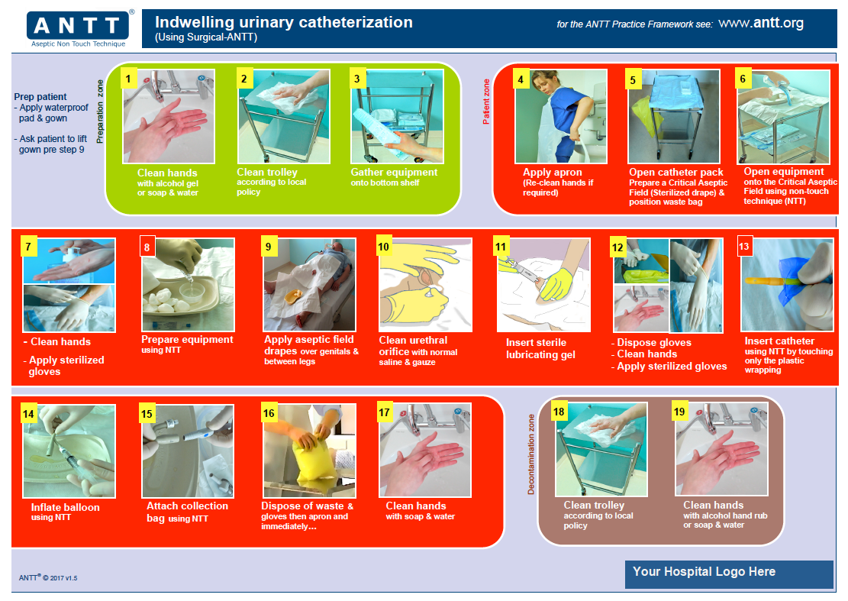
Refer to handout 12 in the student handbook
Key resource
Image kindly reproduced with permission from the Association for Safe Aseptic Practice (www.antt.org)

Slide 69

Check it
Evaluation and feedback
Choose the tool/method to document the insertion and ongoing management of a urinary catheter.
Evaluate procedures regularly and report results in a timely manner.
Examples:
Checklists
Algorithms
Monitoring forms (see next slide) – e.g. WHO hand hygiene observation tools
CAUTI surveillance systems
Stop orders

Slide 70
Sample insertion and monitoring form
FRONT
BACK
Patient demographics
Indications for catheter
CATHETER INFORMATION
Name ………………………..
DOB………………………….
Address………………………
Ward………………………….
Etc……………………………
Urinary retention □
Result of bladder scan □
To maintain skin integrity □
Urinary input/output monitoring □
Type: Male □ Female □ Short term □ Long term □
Make……………………………………………………………
Lot number:…….. Size:…….. Expiry date:……….............
Amount of water used to inflate balloon…………………..
Type of gel used……………………………………………..
CATHETER INSERTION
Patient consent: Yes/No
Operator name & designation:……………………………
Insertion bundle (tick appropriate boxes)
Clean hands before & after insertion as per 5 Moments □ Sterile pack used □
Sterile gloves used □ Sterile items used □ Water/saline/antiseptic □ Aseptic non-touch technique □
Easy Insertion: Yes/No If no, why?...............................
Description of urine….....................................................
Residual volume after 30 mins…………………………..
CSU collected? Yes/No If yes, why?..............................
Closed drainage system used? □
Date catheter removed............................................................
If patient is going home with catheter inform:
General practitioner □
Community nursing team □
Continence team □
Document in discharge letter □
Patient information leaflet provided □
Photocopy of this form sent to general practitioner □

Slide 71

Sell it
Reminders and communications
This element is to remind and encourage health professionals to recognize the importance of CAUTI prevention practices through visual methods and good communication.
It also involves communication with patients and their visitors.
Communications to senior leaders and decision-makers about CAUTI and prevention strategies should be considered.
Examples:
Posters
Brochures
Organizational charts
Infographics
Sample letters
Advocacy messages

Slide 72
Example of a reminder
Source: http://www.who.int/gpsc/5may/hh-urinary-catheter_poster.pdf?ua=1

Slide 73

Live it
Culture change
Create an environment and perceptions that facilitate awareness of prevention at all levels.
Nurture a climate that understands and prioritizes safety and IPC issues.
The culture of a hospital influences how teams work together and how valued people feel – and how they perform day to day.
It can influence staff perceptions of their ability to make a change – e.g. to safer, evidence-based practices.
Examples:
Motivated, empowered and multidisciplinary teams
Champions
Role models
Leadership
Morbidity and mortality rounds – learning from past outcomes
Advocacy messages

Slide 74
Two case studies – Kenya and United States of America
Refer to handout 13 in the student handbook
Case study

Slide 75
References/information sources
CDC/NHSN surveillance definitions for specific types of infections. Atlanta, GA: Centers for Disease Control and Prevention; 2018 (https://www.cdc.gov/nhsn/pdfs/pscmanual/17pscnosinfdef_current.pdf).
Point prevalence survey of healthcare-associated infections and antimicrobial use in European acute care hospitals – protocol version 5.3. Stockholm: European Centre for Disease Prevention and Control; 2016
(https://ecdc.europa.eu/sites/portal/files/media/en/publications/Publications/PPS-HAI-antimicrobial-use-EU-acute-care-hospitals-V5-3.pdf).
Gould CV, Umscheid CA, Agarwal RK, Kuntz G, Pegues DA; Healthcare Infection Control Practices Advisory Committee. Guideline for prevention of catheter-associated urinary tract infections 2009. Infect Control Hosp Epidemiol. 2010;31(4):319–26.
Saint S, Greene MT, Krein SL, Rogers MA1, Ratz D, Fowler KE et al. A program to prevent catheter-associated urinary tract infection in acute care. N Engl J Med. 2016;374:2111–9.
Chenoweth CE, Saint S. Urinary tract infections. Infect Dis Clin N Am. 2016;30(4):869–85.
Meddings J, Saint S, Fowler KE, Gaies E, Hickner A, Krein SL et al. The Ann Arbor criteria for appropriate urinary catheter use in hospitalized medical patients: results obtained by using the RAND/UCLA appropriateness method. Ann Intern Med. 2015;162 (9 Suppl):S1–S34.
Loveday HP, Wilson JA, Pratt RJ, Golsorkhi M, Tingle A, Bak A et al. epic3: national evidence-based guidelines for preventing healthcare-associated infections in NHS hospitals in England. J Hosp Infect. 2014;86 Suppl 1:S1–70.
Lo E, Nicolle LE, Coffin SE, Gould C, Maragakis LL, Meddings J et al. Strategies to prevent catheter-associated urinary tract infections in acute care hospitals: 2014 update. Infect Control Hosp Epidemiol. 2014;35(5):464–79.
How-to guide: prevent catheter-associated urinary tract infections. Cambridge, MA: Institute for Healthcare Improvement; 2011 (http://www.ihi.org/resources/Pages/Tools/HowtoGuidePreventCatheterAssociatedUrinaryTractInfection.aspx).
High impact interventions: care processes to prevent infection, fourth edition. Seafield: Infection Prevention Society in association with NHS Improvement; 2017.
Dougherty L, Lister S, editors. The Royal Marsden manual of clinical nursing procedures, ninth edition. London: Wiley-Blackwell; 2015.

Slide 76
Acknowledgements
The Zimbabwe Infection Prevention and Control Project led the original development of this module.
Benedetta Allegranzi, Nizam Damani and Julie Storr (Department of Service Delivery and Safety, WHO) led the overall coordination and refinement.
Anthony Twyman (Department of Service Delivery and Safety, WHO) contributed to the development.
Sanjay Saint, Jennifer Meddings, Milisa Manojlovich, Debbie Zawol and Russel Olmsted (University of Michigan) provided a detailed review for technical accuracy.

Slide 77

WHO Infection Prevention and Control Global Unit

