Slide 1

Advanced Infection Prevention and Control (IPC) Training
Decontamination and reprocessing of medical devices
2019
WHO Global IPC Unit 2018

Slide 2
Module outline
Session 1. Introduction to decontamination 20 minutes
Session 2. Decontamination unit layout, flow and workforce 30 minutes
Session 3. Receipt, storage and transport 15 minutes
Session 4. Cleaning of medical devices 25 minutes
Session 5. Inspection, assembly and packaging 10 minutes
Session 6. Disinfection and sterilization 30 minutes
Note: the source publication for all slides, unless otherwise indicated, is Decontamination and reprocessing of medical devices for health-care facilities. Geneva: World Health Organization; 2016 (https://www.who.int/infection-prevention/publications/decontamination/en/, accessed 21 February 2019).

Slide 3
The symbols explained
You are encouraged to participate in discussion questions, where you can use your own experience and prior knowledge
Interactive question
Some suggested answers to activities/group work
Answers
Group work
You are encouraged to participate in group activities to drill into key topics
In-depth case study applying learning into practice
Case study
Key resource
Essential content (not to be missed!)
Video material to supplement learning
Video
Reference/reading
Key reference for consolidating learning
Required reading or reflection outside of the classroom
Homework

Slide 4
Competencies
At the end of this module, the IPC focal point should be able to:
perform risk assessments of medical devices using the Spaulding classification;
plan the workspace and flow of a decontamination area in all settings;
recognize the need for staff safety and appropriate use of personal protective equipment (PPE) in work areas within the decontamination unit;
correctly establish and supervise proper receipt, storage and safe transportation of sterile medical devices;
make recommendations on various aspects of decontamination and appropriate inspection, assembly and packaging of medical supplies;
educate health workers on the importance and principles of decontamination and validation procedures.

Slide 5
Learning objectives
On completion of this module, the student should be able to:
describe decontamination and Spaulding classification;
describe the layout and flow of the decontamination unit;
list the steps for proper receipt, storage and transportation of sterile medical devices;
outline best practices for inspection, assembly and packaging of medical devices;
describe the importance of and appropriate methods for cleaning medical devices;
describe the various methods of disinfection and sterilization.

Slide 6
Session 1
Introduction to decontamination

Slide 7
What is a medical device?
Any instrument, apparatus, appliance, material or other article, whether used alone or in combination, intended by the manufacturer to be used in humans for the purpose of the diagnosis, prevention, monitoring, treatment or alleviation of – or compensation for – an injury or handicap.

Slide 8
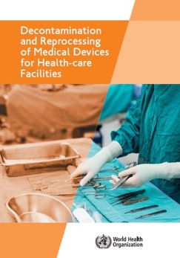
What is decontamination?
Decontamination
Removes soil and pathogenic microorganisms from
objects so they are safe to handle,
subject to further processing, use or discard
Cleaning
Disinfecting
Sterilization
It is important to point out that in the United States the term “decontamination” does not include cleaning, but refers only to all reprocessing following thereafter. In the United Kingdom and Europe, “decontamination” relates to the entire process, including cleaning, disinfection and/or sterilization; this is the definition used in this module.
Additional source: Guideline for disinfection and sterilization in healthcare facilities. Atlanta, GA: Centers for Disease Control and Prevention; 2008.
Key resource

Slide 9
Definitions (1)
Cleaning
The first step required to remove contamination by foreign material, e.g. dust, soil. It will also remove organic material, such as blood, secretions, excretions and micro-organisms, to prepare a medical device for disinfection or sterilization.
Disinfection
A process to reduce the number of viable micro-organisms to a less harmful level. This process may not inactivate bacterial spores, prions and some viruses.
Sterilization
A validated process used to render an object free from viable micro-organisms, including viruses and bacterial spores, but not prions.

Slide 10
Factors to consider
TYPE OF ITEM/DEVICE Critical, semi-critical or non-critical | PRESENCE OF MICRO-ORGANISMS Number (bioload) and ability to cause infection
TYPE OF MICRO-ORGANISM Bacteria, spores, viruses or prions | PATIENT SUSCEPTIBILITY Type of procedure: invasive or non-invasive

Slide 11
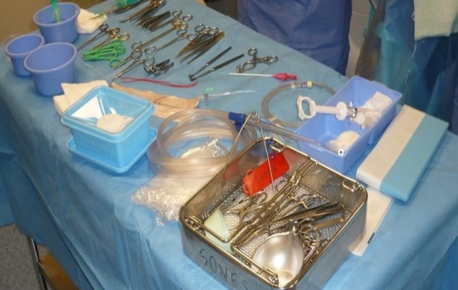
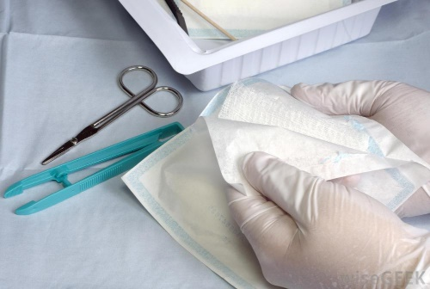
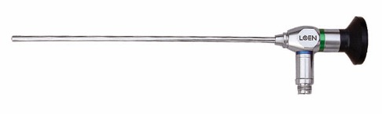
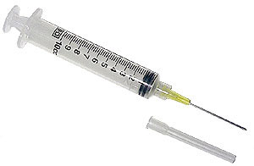
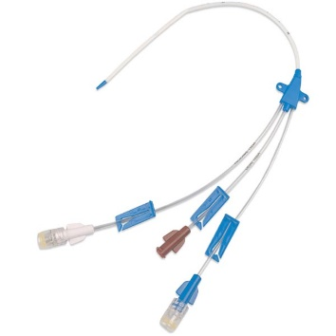
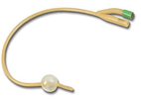
Risk assessment: Spaulding classification (1)
CATEGORY | DEFINITION | METHOD OF DECONTAMINATION | EXAMPLES OF COMMON ITEMS/EQUIPMENT
High risk (critical) | Medical devices that are involved with a break in the skin or mucous membrane or enter a sterile body cavity. | Sterilization Usually heat, if heat-stable, or chemical, if heat-sensitive. Heat-stable items may be treated with low-temperature steam and formaldehyde or ethylene oxide, or by irradiation. | Surgical instruments, implants, prostheses and devices, needles and syringes, and rigid endoscopes.
Rigid endoscopes

Slide 12
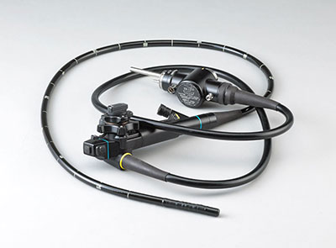
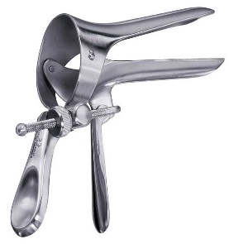
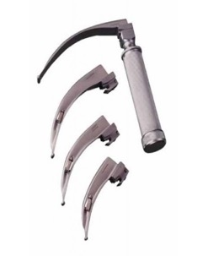
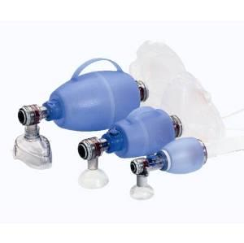
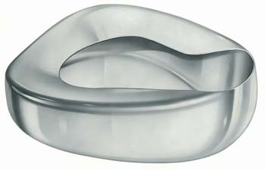
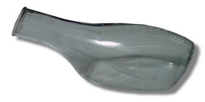
Risk assessment: Spaulding classification (2)
CATEGORY | DEFINITION | METHOD OF DECONTAMINATION | EXAMPLES OF COMMON ITEMS/EQUIPMENT
Intermediate risk (semi-critical) | Medical devices in contact with mucous membranes or body fluids. | High-level disinfection by heat or chemicals (under controlled conditions with minimum toxicity to humans). | Respiratory therapy and anaesthetic equipment, flexible endoscopes, vaginal specula, reusable bedpans and urinals, urine bottles, patient bowls.

Slide 13
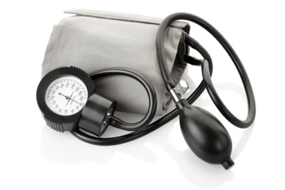
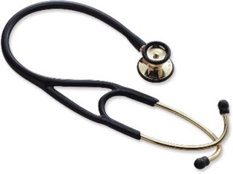
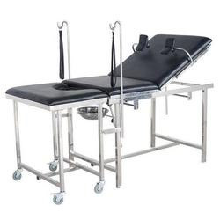
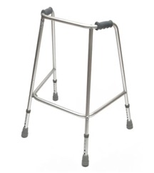

Risk assessment: Spaulding classification (3)
CATEGORY | DEFINITION | METHOD OF DECONTAMINATION | EXAMPLES OF COMMON ITEMS/EQUIPMENT
Low risk (non-critical) | Items in contact with intact skin | Low-level disinfection i.e. cleaning | Blood pressure cuffs, stethoscopes, electrocardiogram leads, environmental surfaces, including occupational therapy tables

Slide 14
Single-use devices: questions
What is a single-use medical device?
Can you give an example?
Can single-use medical devices be reprocessed?
Do you reprocess single-use devices in your facilities?
Interactive question

Slide 15
Single-use devices: answers
What is a single-use medical device?
A medical device used on a single patient only
Can you give an example?
Needles and syringes, intravenous and central venous and urinary catheters
Can single-use medical devices be reprocessed?
Reuse of single-use medical devices must be avoided at all times and thus, they should NOT be reprocessed but appropriately disposed of is not recommended
Do you reprocess single-use devices in your facilities?
Answers

Slide 16
Common challenges in low- and middle-income countries (LMICs)
Lack of appropriate supplies
Poor/infrequent procurement
Expensive equipment
Donated equipment – unclear how to reprocess safely or discard
Reuse of single-use medical devices
is not recommended

Slide 17

Symbol for single-use items
Class 1: very high risk
  Examples include intravascular, intraventricular, intraoptic devices; needles and syringes.
  Reuse can cause serious infections, e.g. endocarditis, meningitis, endophthalmitis, transmission of blood-borne viral infections.
  They are difficult to clean and heat-labile
  These are the most common single-use items
Class 2: high risk
  These are usually cleanable and heat-tolerant.
  Sterilization is necessary, e.g. for surgical instruments.
  If appropriately cleaned and sterilized they can be reused
Any person who reprocesses or reuses a device intended by the manufacturer for single use bears full responsibility for its safety and effectiveness.

Slide 18
Reuse of single-use items
Risks | Reasons
Safety | Reuse of single-use items may compromise the item’s intended function and performance. Some single-use items may not be designed for thorough and proper decontamination . Reuse of a single-use item may alter its characteristics so that it no longer complies with the original manufacturer’s specifications. Single-use items have not undergone extensive testing, validation and documentation to ensure that they are safe to reuse.
Transmission of infection | Reuse of single-use items poses risks for transmitting health care-associated infections (this is of greatest concern). The risk of transmission increases when reusing single-use items due to the inability to access all microorganisms when decontaminating – often a result of poor design; e.g. narrow lumens and materials that are difficult to decontaminate entirely.
Inability to decontaminate | It can be difficult to access all surfaces for single-use items – e.g. acute angles, coils, long or narrow lumens – and use of specialist surface coatings may not be possible. It is not possible to have complete validation of removal of all microorganisms.

Slide 19
If you happen to be in situations where some single-use devices must be exceptionally reused,
always ensure that:
  no alternative is available;
  the device is solid (without a hollow lumen);
  the method of reprocessing is compatible with the device;
  written reprocessing procedures are available for each type of single-use device;
  validation of the effectiveness of reprocessing procedures is undertaken to ensure both sterility and functionality of the device;
  records are kept of how often that particular device is recycled;
  the device is inspected each time for fractures, stress and loss of integrity, and discarded if not fit for purpose;
  a record is kept in the patient’s notes that a reprocessed single-use device was used.

Slide 20
Session 2
Sterile services department unit layout, flow and workforce

Slide 21
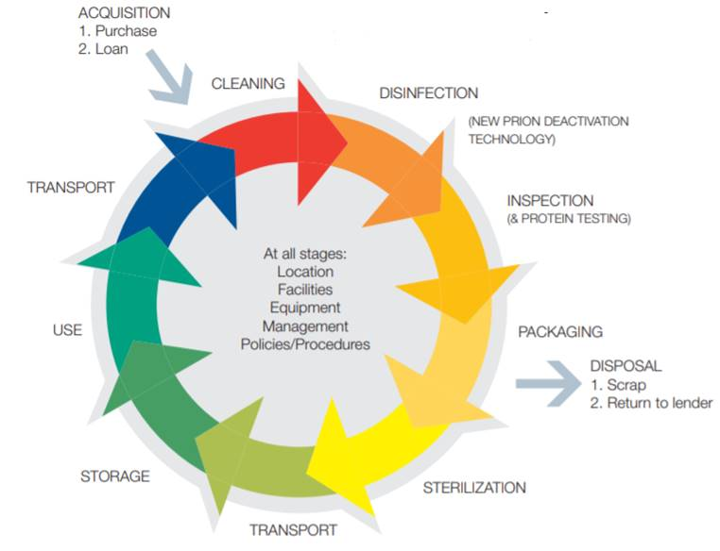
The sterile supply cycle
Sources: Health Technical Memorandum 01-01: management and decontamination of surgical instruments (medical devices) used in acute care. Part A: management and provision. London: Department of Health; 2016. © Crown copyright 2016.
WHO. Implementation manual to support prevention of surgical site infections at the facility level; turning recommendations into practice. Geneva: World Health Organization; 2018. (https://www.who.int/infection-prevention/tools/surgical/en/)

Slide 22
Sterilization unit layout (1)
Basic requirements for the unit entrance area:
  Access must be restricted.
  A dedicated changing area must be available for staff prior to entering.
  Places to put on PPE prior to entering specific work areas must be available.

Slide 23
Sterilization unit layout (2)
Segregation of the following decontamination unit areas is essential:
  dirty area for receiving and cleaning used medical devices
  clean area for inspection, assembly and packing
  sterilization area for loading and unloading the instruments
  sterile store for cooling and short-term storage
  dispatch area where items are dispatched to the wards and clinical areas
  storage area for devices, chemicals and packaging materials
  offices and break rooms for staff; changing areas.
For new construction or renovation of sterilization units, national and international regulations must be followed.

Slide 24
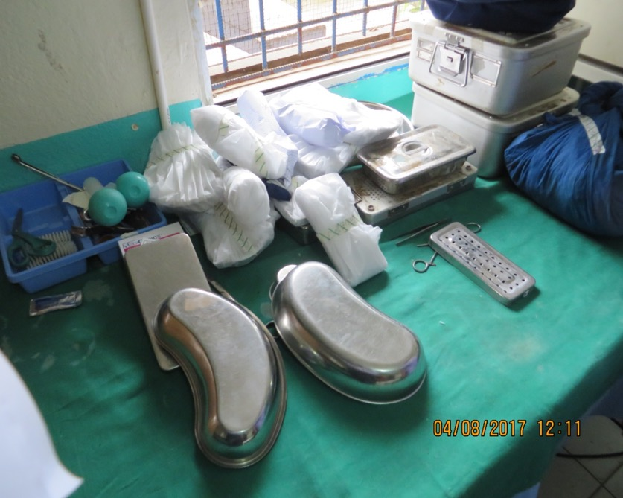
Decontamination unit environment (1)
What differences do you see between these two pictures?
© WHO/Nizam Damani
Interactive question

Slide 25
Decontamination unit environment (2)
Surfaces should be smooth, straight and easy to clean.
Ceilings should be smooth and straight, without cracks, and should be moisture-proof.
Walls should be smooth (no peeling of paint), straight and coated with washable paint or material.
Floors should be smooth and straight, without cracks, and able to withstand heavy loads.
All spaces used for reprocessing of medical devices must have hand hygiene facilities at the entrance and exit points.
Answers

Slide 26
Environmental controls (1)
Air
  Air supplied to the sterile service department should be of medical quality (free of bacteria, chemicals and large particles of dirt).
Water
  Soft water (low mineral and salt content) should be used.
  Water-softening methods include filtration, distilling, ion exchange and reverse osmosis.

Slide 27
Environmental controls (2)
Ventilation
  The dirty area should be under negative-pressure ventilation in relation to the clean area.
  The clean areas should be under positive-pressure ventilation.
Humidity
  The recommended relative humidity level is 40–50%.
Ambient temperature
  The following temperatures are recommended:
    decontamination areas: 18–20 °C
    clean areas: 18–23 °C
    sterile storage areas: 15–25 °C.
Notes:
Pressure relative to the surrounding areas
In the dirty area or dirty area, the air should be extracted towards the outside so that it is under negative pressure compared with the clean area. The clean areas will be under positive pressure so that air flows away from clean surfaces towards the dirty area dirty area or the outside. Air from the SSD can be vented outside to the atmosphere with minimal risk to the surrounding area because of the dilution. If recycled, it has to be filtered and well maintained.
Relative humidity
The relative humidity is recommended to be 40-50%, but in hot and humid tropical countries it may rise to 70%, which can adversely affect the sterile barrier system. In the absence of controlled ventilation, working conditions become unbearable, affecting also the integrity of the sterile barrier. Where possible, humidity in the SSD must be mechanically controlled.
Ambient temperature
Comfortable ambient temperatures are essential for the staff to function efficiently and to ensure that the heat generated by the processing equipment is dissipated to prevent an increase in temperature. The above temperatures have been recommended in temperate countries and cooler storage is required in hot countries where the ambient temperatures are higher:

Slide 28
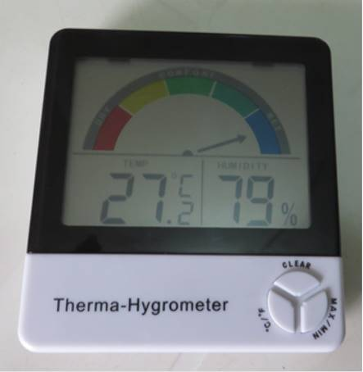
Therma-hygrometer
Measures both temperature and humidity
Ideal – provides real-time measurements
Alternate solutions exist, such as individual thermometers and humidity readers
© WHO/Nizam Damani

Slide 29
Workflow overview
Flow: red (dirty) to green (sterile)
To clinical
Clean pack store
Linen store
Dispatch
Inspection, assembly and packaging area
Processing (sterilizing) area
Packing area
Receiving area
Changing rooms/tea room
Toilets/showers
Store
Dirty
area

Slide 30
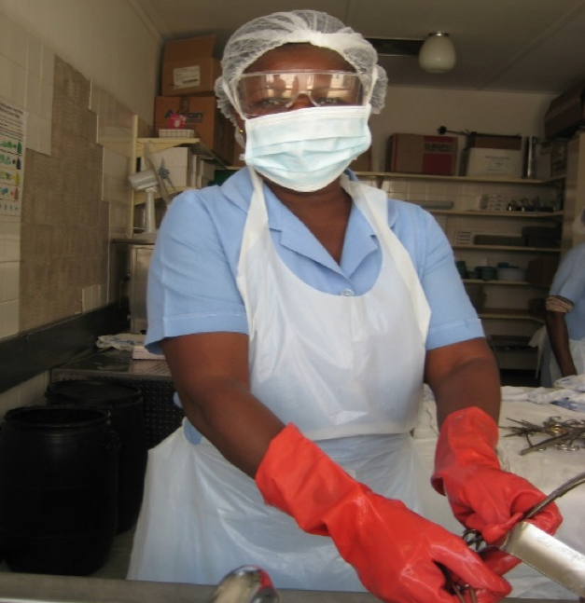
Staff requirements
All staff must be trained at the appropriate level of activity in the decontamination unit, including in appropriate use of PPE and how to handle chemicals safely.
Training should cover all aspects of the decontamination cycle.
Technical training should be given on all reprocessing equipment.
Staff must also be trained to recognize problems and interpret validation tests (i.e. failed results)
© ICAN/Shaheen Mehtar

Slide 31
Staff training (1)
Staff should:
be trained to the appropriate level of knowledge for the grade of work to ensure both self-protection and patient safety;
learn to handle sharps appropriately;
understand the risks of blood-borne viruses and transmission of other pathogens;
know how to deal with accidents in the sterile service department;
document all accidents, no matter how minor;
be immunized against hepatitis B.

Slide 32
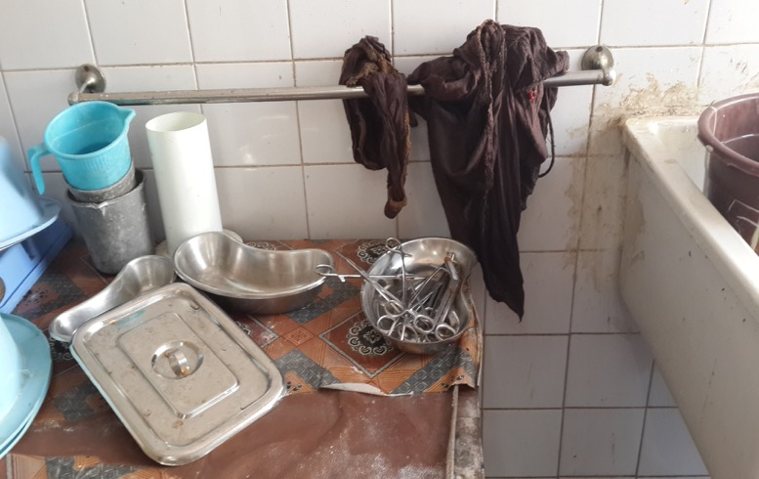
Staff training (2)
Staff should receive induction training and regular updates, to include information on:
  procedures to follow;
  the anatomy/construction of
  instruments;
  the use of washer disinfectors/sterilizers;
  traceability systems;
  the importance of record keeping.
© ICAN/Shaheen Mehtar

Slide 33
Environmental cleaning (1)
The environmental cleaning policy in the decontamination unit must be clearly defined by the health care facility, with clear standard operating procedures.
The procedures and responsibilities for cleaning practices and cleaning frequency must be clearly identified.
Cleaning should be frequent, moving from the clean to the dirty area, and keeping the environment dry and dust-free.

Slide 34
Environmental cleaning (2)
Separate cleaning equipment should be used for the clean and dirty areas.
The use of disinfectants for routine cleaning is strongly discouraged.
Disinfectants are only recommended when dealing with spills.
All leaks and spillages must be cleaned up immediately.

Slide 35
Session 3
Receipt, storage and transport

Slide 36
Receipt and storage (1)
Before sending instruments to the sterile service department for cleaning, the following are essential.
Wear appropriate PPE to protect yourself.
Remove any linen and disposable items and dispose of these appropriately:
  sharps, such as knife blades and needles, should be correctly discarded;
  sharps that can cause injury to health care workers should be segregated.
Do not use saline or hypochlorite solution as a soaking solution as it damages some medical devices.
Notes:
Page 44

Slide 37
Why not to soak instruments in disinfectant prior to cleaning
Soaking of instruments in 0.5% chlorine solution or any other disinfectant before cleaning is not recommended for the following reasons.
  It may damage/corrode the instruments.
  The disinfectant may be inactivated by blood and body fluids, which could become a source of microbial contamination and formation of biofilm.
  Transportation of contaminated items soaked in chemical disinfectant to the decontamination area may pose a risk to health care workers and result in inappropriate handling and accidental damage.
  Soaking in disinfectant could contribute to the development of antimicrobial resistance to disinfectants.

Slide 38
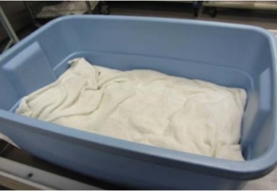
Receipt and storage (2)
Soiled instruments should be opened and kept moist.
  Spray with an enzymatic spray (using PPE).
  Cover with a towel moistened with water (not saline) or foam, spray or gel specifically intended for this purpose.
  Do not transport in containers with water, as water is a splash hazard.
Example of a prepared tray with surgical instruments ready for transportation to the sterile service department
Source: Decontamination and reprocessing of medical devices for health-care facilities. Geneva: World Health Organization; 2016 (https://www.who.int/infection-prevention/publications/decontamination/en/, accessed 21 February 2019).

Slide 39
Transportation of instruments
Contaminated items should be contained in dedicated, fully enclosed, leak-proof and puncture-proof containers prior to transport to the sterile service department/decontamination area in a transportation trolley.

Slide 40
Session 4
Cleaning of medical devices

Slide 41
Why must medical equipment be cleaned?
Cleaning protects:
  the equipment from organic matter that can damage equipment
  staff from the risk posed by inappropriately cleaned medical devices.
It removes:
  potentially infectious micro-organisms
  the organic material on which micro-organisms thrive
  soil that protects micro-organisms during disinfection and sterilization
  soil that can inactivate disinfectants.
REMEMBER:
you can clean without sterilizing but you
cannot sterilize or disinfect without cleaning.

Slide 42
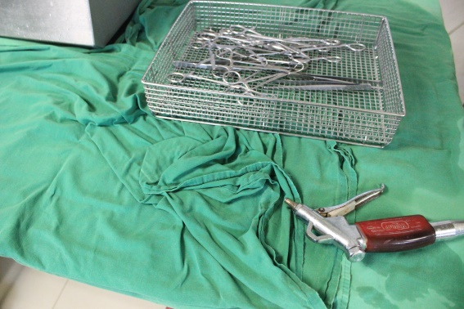
Manual cleaning
The following equipment must be prepared before starting the cleaning process:
  cloths
  brushes
  spray guns
  flushing devices.
© ICAN/Shaheen Mehtar

Slide 43
Staff protection
It is essential to protect the health care worker with:
  gloves – long domestic rubber gloves
  apron (plastic/waterproof)
  visor (eye cover)
  closed-toe shoes or boots
  clearly defined protocols for all stages of medical device reprocessing
  immunization for hepatitis B.
© ICAN/Shaheen Mehtar

Slide 44
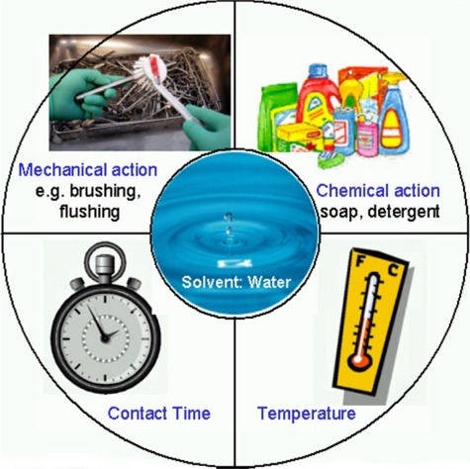
Essential requirements of cleaning: the Sinner Cycle
Type of detergent
Source: Decontamination and reprocessing of medical devices for health-care facilities. Geneva: World Health Organization; 2016 (https://www.who.int/infection-prevention/publications/decontamination/en/, accessed 21 February 2019).

Slide 45
Cleaning requirements (1)
Water
  Availability of high-quality water is essential: it should be soft water (with low mineral and salt content).
Mechanical action
  Use wiping, flushing, brushing and spraying actions.
Chemical action
  A an enzymatic detergent or detergent compatible with medical devices is essential.
  Never use domestic-grade detergent.
  The correct dosage must be used.
Brush
  Use a soft nylon brush that will not damage the surface of the medical device.
  Do not use a metal or wire brush.

Slide 46
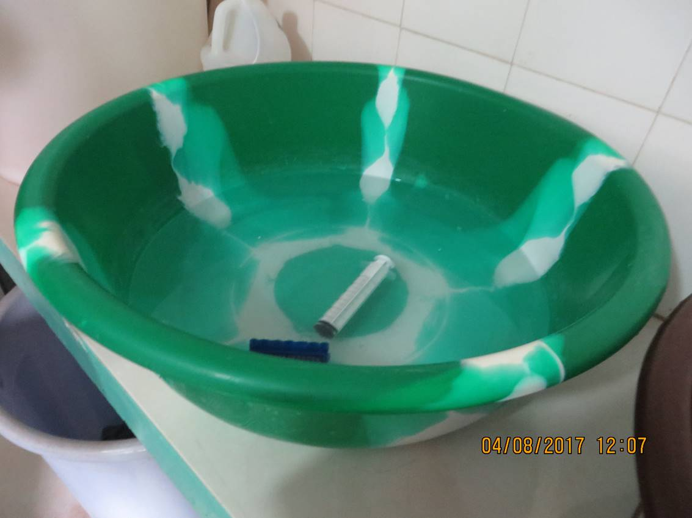
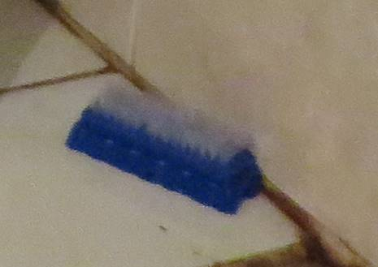
Soft brush for cleaning
© WHO/Nizam Damani

Slide 47
Cleaning requirements (2)
Heat
Heat improves detergent performance, but not at temperatures over 45 °C.
Time
The recommended contact time for detergent to interact with the various surfaces must be adhered to.
Access to all surfaces
All hinged devices must be opened.
More complex devices must be disassembled.
Lumens must be cleaned with a brush.

Slide 48
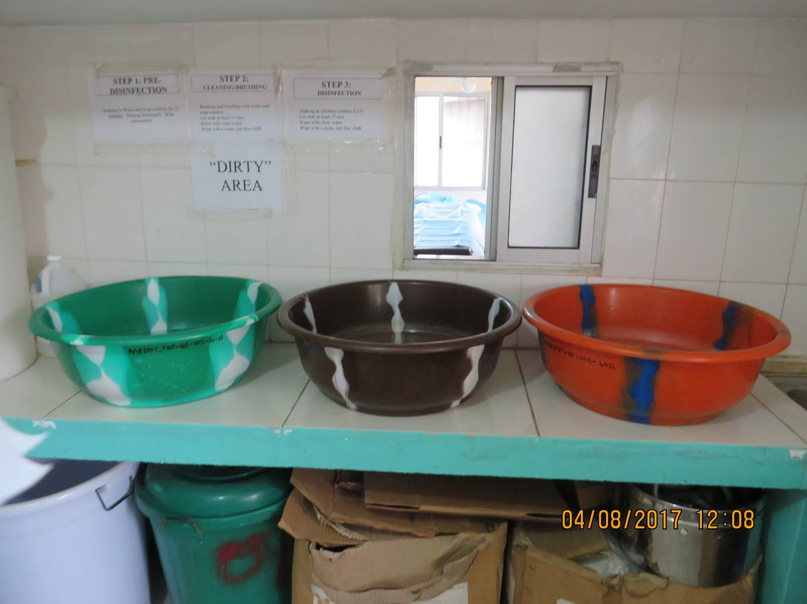
1: Cleaning with
enzymatic
detergent
2: Soaking in
‘Bleach’ solution
detergent
3: Final rinse with
water
© WHO/Nizam Damani

Slide 49
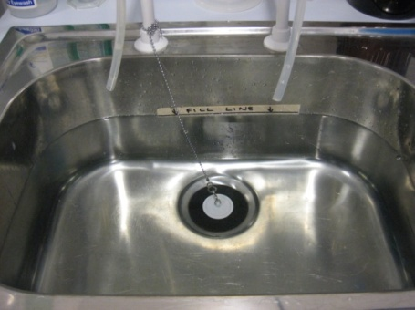
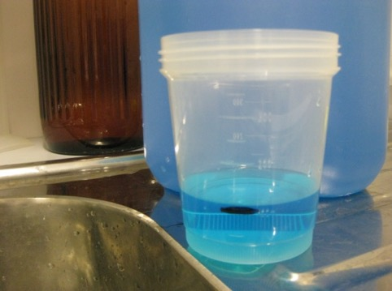
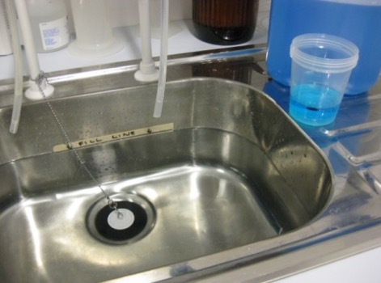
Detergent preparation
Formula for preparation of the correct strength of detergent:
Volume of detergent = required (ml)
Concentration required × capacity of the sink/bowl (ml)
Concentration supplied
Put a marker in the sink and fill with clean tepid water.
Take a clean container and mark the level for the amount of detergent.
Add concentrated detergent to the clean water and mix well.
Notes:
It is essential to make up the right detergent in the correct dilution for maximum effect. These are the steps
Therefore, 100 ml is used and made up to 10 litres to achieve a 1% solution. The detergent does not have to be measured precisely each time, but a fill line can be placed on the sink/bowl as shown in Figure 10 and a galipot or jug used to measure the detergent.

Slide 50
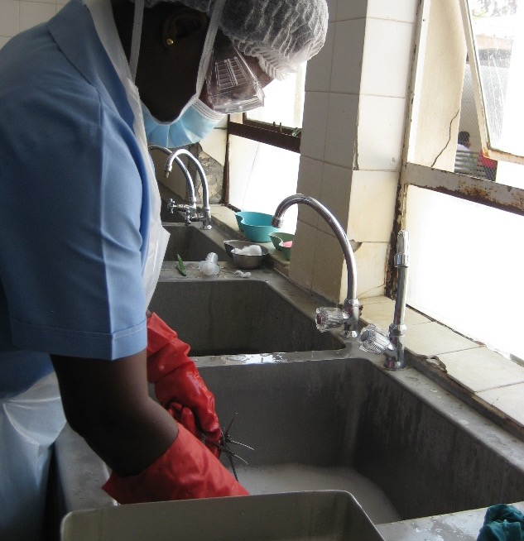
Manual cleaning: immersion method (1)
Fill sink or appropriate basin with sufficient warm water and detergent (see previous slide) for complete immersion of the device.
Fully immerse the opened or disassembled medical device.
Keep below the level of the water and scrub with a soft nylon brush.
© IFIC/Christina Bradley

Slide 51
Manual cleaning: immersion method (2)
Inspect frequently to ensure all surfaces are clean.
In another sink or basin, completely immerse the device in clean, purified water and rinse the device thoroughly.
Mechanically dry; if this not available or not recommended by the manufacturer, air-dry or hand-dry using a disposable clean, non-linting cloth.
© IFIC/Christina Bradley

Slide 52
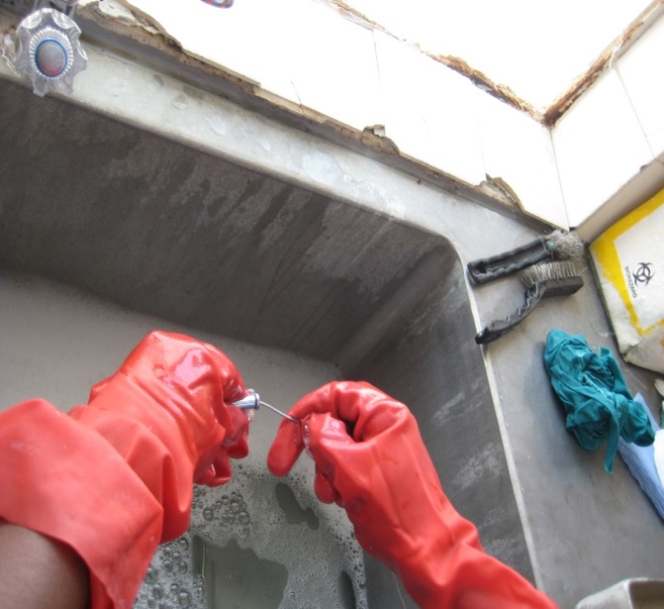
Cleaning lumen devices
It is not possible to clean inside a lumen with just a soft brush.
Make sure all lumen devices are well cleaned with a bottle brush and then flush through under pressure with either water or air.
© ICAN/Shaheen Mehtar

Slide 53
Cleaning medical devices: do (1)
Wear appropriate PPE because of the risk of splashes (creating aerosols) during manual cleaning and flushing of a medical device.
Ensure detergent is prepared at the correct concentration and temperature and used for the recommended contact time.
Keep instruments moist, and clean as soon as possible after the procedure.
Disassemble instruments prior to cleaning.
Open hinged/jointed instruments to ensure access to all surfaces.

Slide 54
Cleaning medical devices: do (2)
Use appropriately sized brushes to clean lumen devices.
Use soft-bristle brushes to clean serrations and box locks.
Inspect instruments after cleaning.
Clean instruments under the surface of the water to reduce the risk of aerosol production.
Follow the manufacturer’s instructions for the cleaning of all medical devices.

Slide 55
Cleaning medical devices: don’t
Never soak a medical device in any disinfectant prior to cleaning
Disinfectants, especially bleach:
are corrosive and may destroy the medical device;
leave a residue that could cause harm to the patient;
are inactivated by organic matter so are a waste of resources;
can cause toxic reactions in staff if used incorrectly.
Do not use water over 45 ºC as it coagulates the protein, making it difficult to clean.
Never use a hard or abrasive item when cleaning medical devices.
Don’t scrub under a running tap because this produces aerosols.

Slide 56
Quality systems
Develop standard operating procedures for the sterile service department or decontamination unit, and review regularly.
The procedures must have a date of implementation and expected review date.
Keep :
  records of staff training (both induction and regular updates);
  a logbook for each occurrence of equipment testing and maintenance;
  a record of system failures and remedial action.

Slide 57
Record-keeping
It is vital to keep a record of instruments that are decontaminated and then used on patients.
Tracking is essential, including records of stock control and schemes for identifying the location of items (e.g. in storage, sterile service department/decontamination unit or similar).
Traceability is required, including a scheme for identifying all stages of process and use.

Slide 58
Key questions
Based on what you have learned so far, what are the key steps of an appropriate decontamination process?
List the steps you think need improvement in your facility/context.
Interactive question

Slide 59
Key steps (1)
Declutter and keep your area clean, dry and dust-free.
Don’t pre-soak instruments.
Improve cleaning of instruments.
Improve inspection, assembly and packing.
Make sure a dedicated area is available for decontamination.
Improve workflow from dirty (receipt/cleaning of contaminated instruments) to clean (sterilized items) areas.
Answers

Slide 60
Key steps (2)
Ensure appropriate validation of the sterilization process.
Maintain temperature and humidity control.
Provide a sink for hand-washing.
Develop and follow standard operating procedures.
Provide suitable education and training of staff.
Answers

Slide 61
Session 5
Inspection, assembly and packaging

Slide 62
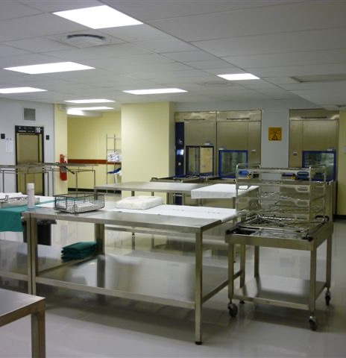
Inspection, assembly and packaging area (1)
This area is used for:
inspection and function-testing of cleaned medical devices before re-assembly and packaging for sterilization;
maintenance of quality/traceability records.
© ICAN/Shaheen Mehtar

Slide 63
Inspection, assembly and packaging area (2)
Inspection
  To ensure all devices are present, visibly clean and functioning correctly prior to assembly
Assembly
  To ensure all component parts are present and are correctly reassembled (when necessary)
Packaging
  To allow penetration of the sterilization agent (i.e. steam, gas or similar)
  To maintain the sterility of the contents of the pack from the sterilization process
  To allow aseptic removal of the contents

Slide 64
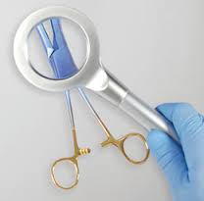
Inspection
You will need:
  the original packaging checklist – to verify the presence of all devices in a tray;
  good lighting – to aid inspection;
  magnification – to aid inspection;
  standard operating procedures – for reference to ensure that the procedure is followed correctly.

Slide 65
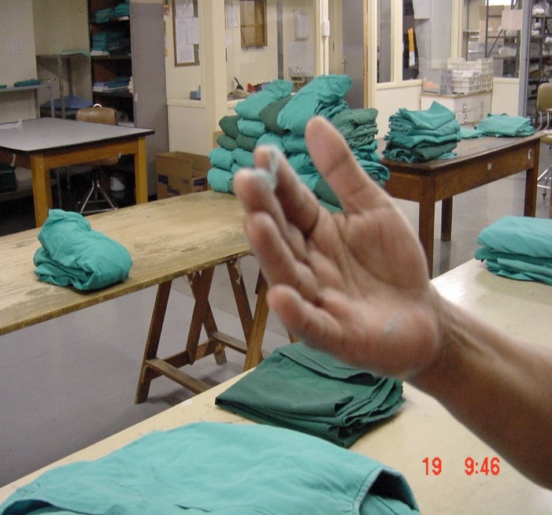
Most common types of packaging: cotton or linen
Advantages
  Can be used as inner wrapper or outer dust cover
  Strong, easy to work with, can be reused
Disadvantages
  Does not provide adequate microbial barrier
  Can release particles and/or lint
© ICAN/Shaheen Mehtar
The lint from cotton wraps can be introduced into wounds and cause infection or foreign body reaction in the patient.

Slide 66
Session 6
Disinfection and sterilization
Part A: methods of decontamination using heat

Slide 67
Methods of decontamination using heat
Steam sterilization: steam sterilization is a process that uses saturated steam under pressure as the sterilant.
  Preferred method for heat-resistant critical devices
  The removal of air is essential to ensure an efficient sterilization process – sterilization cannot occur in the presence of air (pre-vacuum sterilization is preferred).
Dry heat: also known as hot air or oven sterilizers
  Sterilizes by conduction (transfer of heat)
  Not recommended as a best practice for the sterilization of medical devices.
  Used to sterilize items that might be damaged by moist heat or that are impenetrable to moist heat.

Slide 68
Sterilization by moist heat/steam
Steam is the best sterilizer for heat-stable devices.
Steam can be heated to temperatures above 100 ºC only by increasing the pressure to above that of normal atmosphere at sea level.
By removing the air (required) from the chamber (gravity or vacuum) pressurized saturated steam penetrates the packages in the chamber and is held there (holding time).
Steam is extracted by reintroducing air to the chamber.

Slide 69
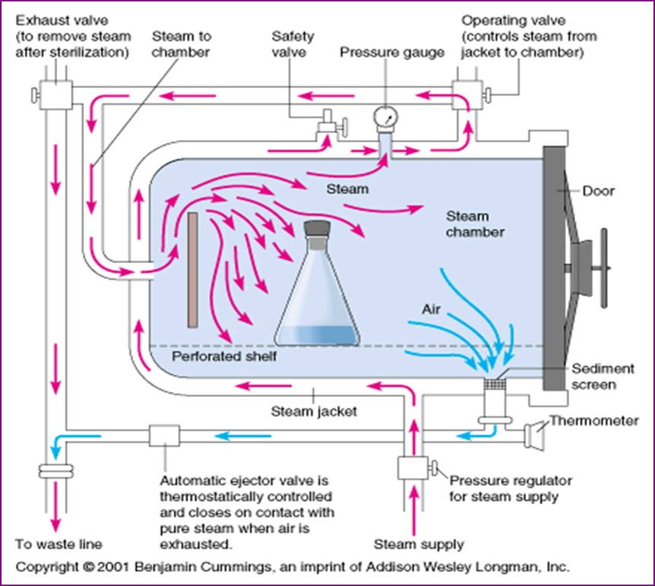
Autoclave or sterilizer
Copyright © 2001 Benjamin Cummins, an imprint of Addison Wesley Longman, Inc.
Video of how an autoclave works also available on YouTube: Harrington C. Animated autoclave [video]. San Bruno, CA: YouTube; 2014 (https://en.wikipedia.org/wiki/File:Animated_autoclave.webm). This file is licensed under the Creative Commons Attribution 3.0 Unported license.

Slide 70
Factors to consider before steam sterilization
Whether the device can be steam sterilized will depend upon:
  whether the item is cleaned before sterilization;
  its tolerance to heat, moisture and pressure;
  its design:
    if it is solid so that all surfaces are exposed to steam;
    if it has a hollow lumen (depending on the length/diameter) that may affect accessibility of the sterilizing agent and penetration of steam into the lumen;
  the use of wrapped material and type of packaging material;
  the manufacturer’s directions on the right method for reprocessing.

Slide 71

Low-temperature sterilization options
Ethylene
oxide gas
vaporized hydrogen peroxide
(VHP)
Low-temperature
plasma sterilization
Chemical disinfectants
e.g. glutaraldehyde, peracetic acid
HEAT SENSITIVE ITEMS
H₂ O₂ gas
plasma
Ultraviolet
These are low-temperature alternatives for heat-sensitive items. Some of them require additional special handling for safe use. Sterilization with gaseous chemical methods, such as ethylene oxide, should be carried out in chambers with automated cycles that provide safety for the user and guarantee the process.

Slide 72
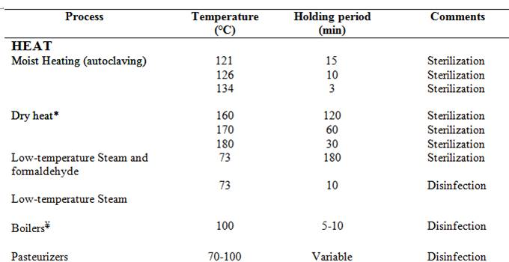
Time–temperature relationships in thermal sterilization procedure
.
*All temperature and times quoted for dry heat are minimum.
¥At higher altitude, a longer time is required because the boiling point of water gets lower the higher one gets from sea-level
Source: Fraise AP. Decontamination of the environment and medical equipment in hospitals. In: Principles and practice of disinfection, preservation, and sterilization, 5th edition. Oxford: John Wiley & Sons, 2013: 445–58.

Slide 73
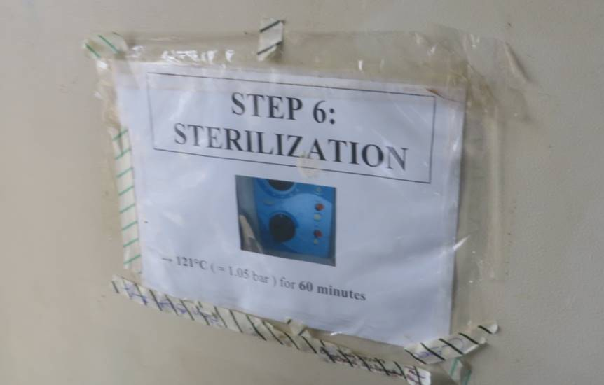
© WHO/Nizam Damani

Slide 74
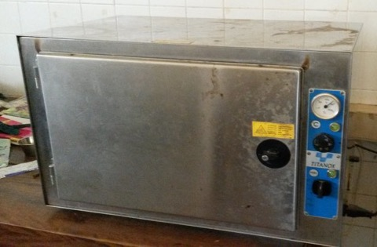
Dry heat sterilizer (hot-air oven)
Advantages
Disadvantages
  The dry heat sterilizer is a suitable option for sterilization for medical devices that are damaged by steam.
  It is suitable for sterilization of glassware, metallic items, heat-stable powders and non-aqueous liquids such as Vaseline, kerosene and grease.
  The decontamination cycle is long: pre-heating is essential prior to sterilization and post-sterilization cooling time is lengthy.
  Dense loads often a cause a problem as the convection/conduction method used to heat the chamber does a poor job of penetrating tightly packed items.
  Items cannot be wrapped in the sterilizer, to avoid a fire risk.
  It is therefore difficult to keep items sterile once they have been through the cycle.
  Cloth must not be placed inside, to avoid the risk of fires.
  The lack of a fan causes poor distribution of heat.
  The dry heat sterilizer cannot be used for aqueous fluids.
  Plastics, rubber and paper cannot be used.
  The sterilization process cannot be audited.
© WHO/Nizam Damani

Slide 75
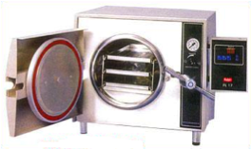
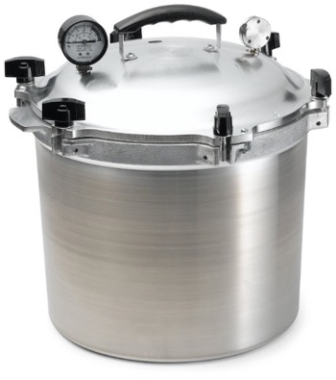
High-level (critical) decontamination: steam sterilization
Non-vacuum autoclaves, including bench-top sterilizers and pressure cookers, are not recommended.
Limitations include:
  a lack of downward displacement;
  a lack of penetration, meaning they are only suitable for solid items such as scissors;
  instruments becoming non-sterile on removal because they are not wrapped;
  no drying cycle.
Source: Decontamination and reprocessing of medical devices for health-care facilities. Geneva: World Health Organization; 2016 (https://www.who.int/infection-prevention/publications/decontamination/en/, accessed 21 February 2019).

Slide 76

High-pressure cooker (1)
This method is NOT recommended because medical devices are just thermally disinfected, and cannot be sterilized.
However, in many limited resource settings, high-pressure cookers are unfortunately the most common method for thermal disinfection.
The IPC focal person must advocate to leadership the need for more appropriate and recommended methods for decontamination of medical devices.
This type of thermal disinfection should only be an interim solution until a recommended method is available.
© ICAN/Shaheen Mehtar
Note: in this picture the heat source is inadequate to heat up the pressure cooker: it needs to be operated electrically.

Slide 77
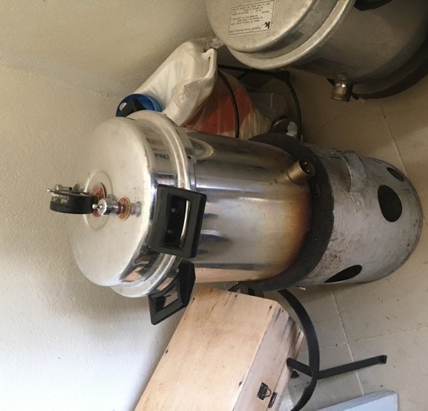
High-pressure cooker (2)
If used as a temporary solution:
  The cycle should take 20 minutes.
  Set the temperature at ≥100 °C.
  Fill the cooker with a layer of water.
  Put the rack with the cleaned instruments in the cooker.
Warning: ensure staff are aware of the risk of burning/scalding when emptying the cooker.
© ICAN/Shaheen Mehtar
Note: in this picture the heat source is inadequate to heat up the pressure cooker: it needs to be operated electrically.

Slide 78
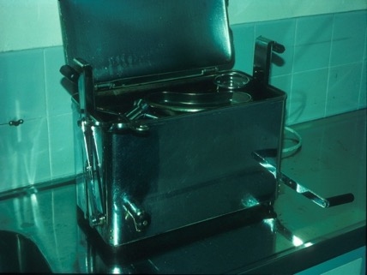
Boiler: thermal disinfection (1)
This method uses boiling water at 100 °C for 5–10 minutes.
Requirements:
temperature control (using a thermometer)
a working gauge
timing of procedure (using a timer)
a basket (avoid use of cheatle forceps to prevent contamination)
a cover with a lockable lid to avoid more items being added before the timed period has elapsed
total immersion of instruments
© IFIC/Christina Bradley
Notes:
Next Slide
min (this will allow for the water to heat back up to 100ºC after the items are added)

Slide 79

Boiler: thermal disinfection (2)
Advantages
Disadvantages
Effective
Inexpensive
No toxic residues
Unsuitable for heat-sensitive items
No process controls, such as time/temperature interlock
Risk of scalding/burning the health worker
Requires items to be clean before immersion
Forceps required for instrument removal
Pots can become contaminated when not in use
© IFIC/Christina Bradley
Notes:
Next Slide

Slide 80
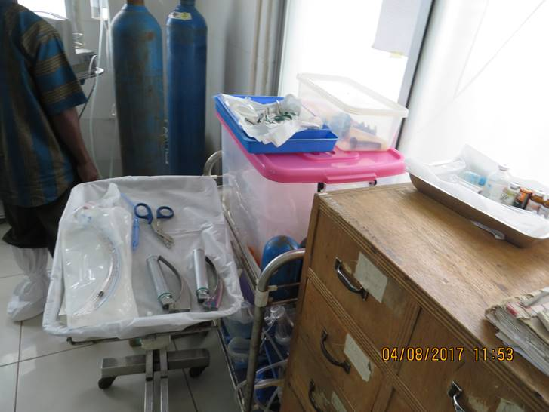
Difficulties maintaining sterility of items
© WHO/Nizam Damani

Slide 81
Validation and testing of sterilization methods
How do you know a piece of equipment
is safe for use?
All sterilization methods must be validated to ensure the process is working properly and safely.
The results are logged in a register, as well as the patient’s notes, as an essential record.
Interactive question

Slide 82
What is validation?
Validation applies to equipment or procedures used when reprocessing medical devices for reuse.
Each step of the decontamination cycle requires validation as part of the quality assurance programme.
Validating a process consists of systematically carrying it out in a specific manner to improve it by:
  establishing temporary programmes and checklists;
  validating protocols with criteria for acceptance/rejection;
  planning for resource needs;
  performing risk analysis.

Slide 83
Installation qualification
Ensure the equipment you buy or accept as a donation is fit for purpose.
Installation qualification is a process of obtaining and documenting evidence that equipment has been provided and installed in accordance with its specifications.
Processes to consider include the following.
  Verify the correct installation of connections: water, steam, electricity, compressed air and ventilation: this verifies that the different parameters meet the manufacturer’s specifications and any applicable regulations.
  Verify the correct operation of the equipment’s different security functions, according to the manufacturer’s guidelines.
  Confirm that the machine is equipped with the adequate technical documentation – such as installation plans and a technical/operational user manual.

Slide 84
Operational qualification
Operational qualification is a process of obtaining and documenting evidence that the installed equipment operates within predetermined limits when used in accordance with its operational procedures.
The following steps should be taken for a pre-vacuum autoclave:
  calibration of the regulation and control elements;
  running a cycle with the vacuum test;
  running a cycle with the Bowie Dick test;
  implementing three thermometric tests in an empty chamber in order to obtain the temperature profile at all points of the chamber.
The following steps should be taken for a displacement autoclave:
  calibration of the regulation and control elements;
  implementing three thermometric tests in an empty chamber in order to obtain the temperature profile at all points of the chamber.

Slide 85
Performance qualification
Performance qualification is a process of obtaining and documenting evidence that the equipment:
  is installed and operates in accordance with operational procedures;
  consistently performs in accordance with predetermined criteria;
  thereby, yields a product meeting its specification.

Slide 86
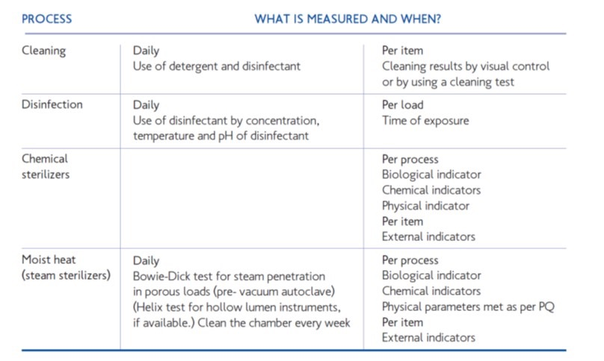
Decontamination processes, measurements for validation and their application

Slide 87
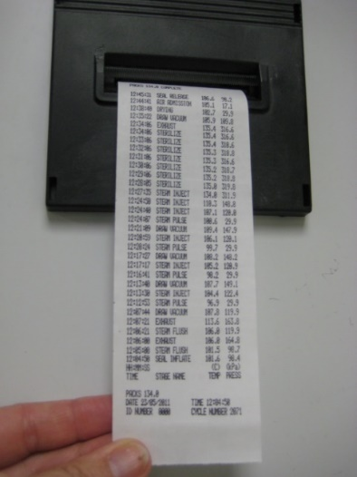
Validation for steam sterilizers
Various methods can be used to validate steam sterilizers.
Visual inspection
  All packs must be dry (no visible moisture on inspection).
Thermocouple test (a temperature-measuring device used by engineers)
  Leads are placed in different parts of the load and chamber (and drain) during a sterilization cycle.
Physical indicators
  Temperature and pressure charts are created.
Leak test
  A vacuum is created and the return to atmospheric pressure is observed.
Temperature and
pressure charts
© ICAN/Shaheen Mehtar

Slide 88
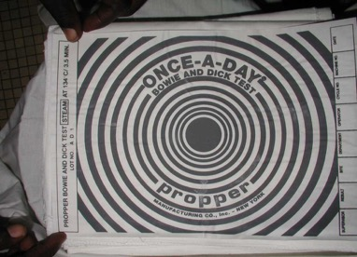
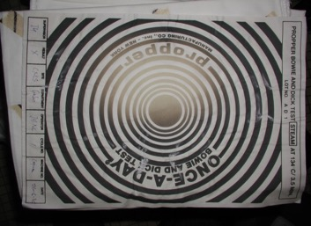

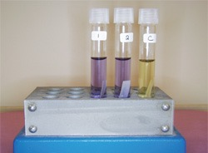
Suggested tests for validating steam sterilizers
Air removal test:
Bowie Dick
The following tests aim to measure the accuracy of the sterilizer during the sterilization cycle.
Air removal test: Bowie Dick test for air removal (look for uniform change of colour)
Thermocouple test: for any sterilizer
Air detector test: pre-vacuum
Chemical indicators: dry and steam (colour-changing tape)
Biological indicators: contain spores which should be killed by the process (note colour change)
© ICAN/Shaheen Mehtar
Biological indicators

Slide 89
Session 6
Disinfection and sterilization
Part B: methods of decontamination using chemicals

Slide 90
Definitions (2)
Disinfectant
A chemical agent that is capable of killing most pathogenic micro-organisms under defined conditions, but not necessarily bacterial spores. It is a substance recommended for application to inanimate surfaces to kill a range of micro-organisms.
Antiseptic
The equivalent agent, which kills micro-organisms present on skin and mucous membrane.

Slide 91
Considerations when choosing a disinfectant
Purpose: the level of decontamination required
Range and level of activity (see details on the next slide)
Rate of kill/turnaround time
How quickly it dries and whether it leaves a residue
Health and safety issues, e.g. Glutaraldehyde
Compatibility with the material used – for example, hypochlorite (bleach) damages surgical instruments
Inactivation by organic matter, e.g. alcohol and hypochlorite (bleach)
Ease of use
Cost

Slide 92
Resistance to germicidal activity of chemical disinfectants against various micro-organisms
Source: Damani N. Manual of infection prevention and control. Oxford: Oxford University Press; 2019.

Slide 93

Antimicrobial activity and summary of properties of disinfectants
Source: Damani N. Manual of infection prevention and control. Oxford: Oxford University Press; 2019.

Slide 94
Chlorine-releasing agents (1)
These include liquid bleach and sodium dichloroisocyanurate (NaDCC) tablets.
Their main use is for disinfection of the environment unless otherwise recommended by the manufacturer of the medical device.
Diluted solutions are unstable, and should therefore be:
  freshly prepared daily
  used before the expiry date.
Decomposition of chlorine is accelerated by light, heat and heavy metal.

Slide 95
Chlorine-releasing agents (2)
They may bleach fabrics, carpets or soft furnishings.
They are inactivated by organic matter such as blood.
Cleaning the device prior to using the agent is essential.
They are corrosive to metal, damaged plastic, rubber and similar components on prolonged contact.
They are not recommended for use on surgical instruments prior to cleaning.
They are not recommended for disinfection of PPE.

Slide 96




Uses of chlorine and recommended solution strengths
© WHO/Nizam Damani

Slide 97
Unacceptable chemical disinfectants for medical devices
Chlorhexidine gluconate
Hexachlorophene
Iodophor
Benzalkonium chloride
Cetrimide
Quaternary ammonium compounds

Slide 98

Requirements for storage of sterile medical devices
The environment should be dry, clean and dust-free, with no water tapping points.
The room temperature should be 20 °C.
The devices should not be in direct sunlight.
They should be well labelled (with name, expiry date, sterilization indicator).
They should not be piled on top of each other; this will allow air circulation.
They should not touch the ground, the walls or the ceiling.
They should not be placed on wooden shelves.
The expiry dates should be checked at least once a year and the data secured with a signed list.
© IFIC/Christina Bradley

Slide 99

Key references
CDC (2008). Guideline for disinfection and sterilization in healthcare facilities. Atlanta, GA: Centers for Disease Control and Prevention (https://www.cdc.gov/infectioncontrol/guidelines/disinfection/index.html)
Damani N (2019). Manual of infection prevention and control. Oxford: Oxford University Press.
Department of Health (2016). Health Technical Memorandum 01-01: management and decontamination of surgical instruments (medical devices) used in acute care. Part A: management and provision. London: Department of Health (https://www.gov.uk/government/publications/management-and-decontamination-of-surgical-instruments-used-in-acute-care).
Ministry of Health and Sanitation (2015). National infection prevention and control policy. Freetown: Government of the Republic of Sierra Leone (https://afro.who.int/sites/default/files/2017-05/ipcpolicy.pdf).
WHO (2016). Decontamination and reprocessing of medical devices for health-care facilities. Geneva: World Health Organization (https://www.who.int/infection-prevention/publications/decontamination/en/).
Note: all hyperlinks accessed 21 February 2019.
Key resource

Slide 100


WHO Infection Prevention and Control Global Unit

