Slide 1
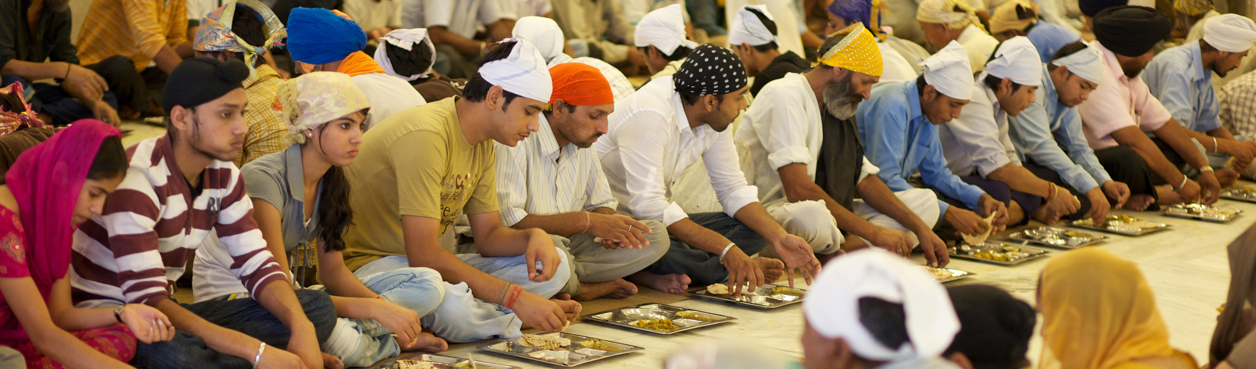
A Foodborne Outbreak in the context of a Mass Gathering Event
Simulation Exercise
SIMULATION EXERCISES AND ACTION REVIEWS TEAM
MASS GATHERINGS TEAM
© WHO / Tom Pietrasik
© WHO 2025. Some rights reserved. This work is available under the CC BY-NC-SA 3.0 IGO licence.

Slide 2
Disclaimer
This simulation exercise scenario is designed to assess health preparedness and response to a foodborne outbreak during a mass gathering (MG) event.
This PowerPoint template should be adapted to the event and local context during the planning phase of the exercise.
© WHO 2025. Some rights reserved. This work is available under the CC BY-NC-SA 3.0 IGO licence.

Slide 3

© WHO 2025. Some rights reserved. This work is available under the CC BY-NC-SA 3.0 IGO licence.

Slide 4

Agenda
09:00 Welcome and introductions (10 mins)
STARTEX
09:10 Exercise briefing (10 mins)
09:20 Session 1 and recap discussion (60 mins)
10:20 Coffee break (20 mins)
10:40 Session 2 and recap discussion (60 mins)
11:40 Session 3 and recap discussion (60 mins)
ENDEX
12:40 Exercise debrief and feedback form (35 mins)
13:15 Closing

Slide 5

Introductions
5 mins
Please provide brief information about yourself:
Name
Job title
Authority that you are representing

Slide 6

How to participate?
Rules:
Use your practices, procedures, guidelines and regulations to inform your responses
Do not make up material, this exercise has all the material you require
Work as part of a team
Focus on solutions
Be prepared to provide feedback to the wider group
Roles – in this exercise, you will be acting your real-life role
Notetakers: record discussions and responses to questions

Slide 7



Assumptions
Event and local context may differ from what exists or may contain false assumptions. This is only for simulation purposes.
The exercise is designed to ensure that all objectives can be achieved: please embrace the scenario as it is designed.
There are no deceptions or traps, so respond to the scenario and contribute to discussions as you would in an actual incident.

Slide 8
Purpose and objectives
Purpose
Objectives
To assess health preparedness and response to a foodborne outbreak during a mass gathering (MG) event.
To clarify the roles and responsibilities of health authorities and other key stakeholders including MG event organizers in the response to a foodborne outbreak based on existing health emergency preparedness and response plans.
To review coordination mechanisms among health authorities and other key stakeholders including event organizers in the response to a foodborne outbreak.
To identify the information flow and communication mechanisms both within health authorities and across other key stakeholders including event organizers in the response to a foodborne outbreak.
To review risk communication and community engagement procedures including those specifically related to a foodborne outbreak.

Slide 9
StartEx

Slide 10

Background
“FearFest” is an annual three-day spooky-themed food festival known for its diverse and exotic food offerings. The event features food stalls serving a variety of dishes, including rare and unconventional ingredients to enhance the spooky culinary experience.
As “FearFest” kicks off, food enthusiasts flock from all over the world to the event venues, eager to indulge in the unique gastronomic experience. The festival boasts a record number of attendees, with an estimated number of 150 000 people present on the opening day.
© WHO 2025. Some rights reserved. This work is available under the CC BY-NC-SA 3.0 IGO licence.

Slide 11

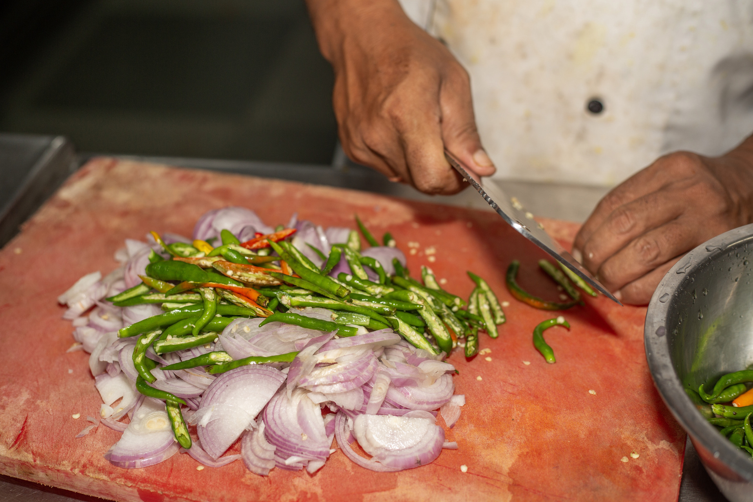


Session 1
Situation update: 12 hours since the beginning of the “FearFest” Festival
Some participants who have consumed food begin to experience symptoms such as nausea, abdominal cramps, vomiting, diarrhoea and a high temperature of 38°C or above.
The number of cases rapidly multiplies, surpassing 300 people with similar symptoms. There is concern among participants, with significant negative social messaging. This cumulates in a surge of patients seeking medical care both at on-site first-aid stations and local hospitals.
The local public health department has been informed about a potential foodborne outbreak at the Festival and an epidemiological investigation initiated.
© WHO / Sue Price

Slide 12
TASK 1
45 mins
Which national/regional and/or local protocols, plans, standard operating procedures (SOPs) are in place for a foodborne outbreak response? Do any specific protocols exist for MG events?
Who are the stakeholders involved in the foodborne outbreak response? Which authority officially declares foodborne outbreaks including during a MG event?
What are the roles and responsibilities of health authorities involved in the foodborne outbreak response?
What are the roles and responsibilities of other non-health sector stakeholders in the foodborne outbreak response, including participating event organizers?

Slide 13
TASK 1
45 mins
Which authority would coordinate health operations in these circumstances?
How do public health authorities ensure a coordinated response to foodborne outbreaks with multisectoral stakeholders, including event organizers and the non-governmental sector?
How is the information related to foodborne outbreaks during MG events collected, analysed and shared across health authorities and other key non-health sector stakeholders while maintaining data confidentiality?
Is communication, information-sharing with local community and event participants and addressing rumours considered in the early stages of the foodborne outbreak response?

Slide 14
Recap discussion
Session 1
15 mins

Slide 15
Coffee break
20 mins
© WHO 2025. Some rights reserved. This work is available under the CC BY-NC-SA 3.0 IGO licence.

Slide 16



SESSION 2
Situation update: 24 hours since the beginning of the “FearFest” Festival
The festival is still ongoing; however, the atmosphere takes a grim turn as the number of confirmed cases rises steeply to 750 within a short span of time. Tragedy strikes when a 15-year-old patient known to have attended the festival the previous day, dies due to gastrointestinal illness in a local hospital.
Medical teams (first aid, ambulance services, EMTs) have been working 24/7 on-site to provide care and support to the growing number of patients. The nearby hospitals are facing overwhelming challenges due to the high volume of patients seeking treatment. This surge has led to shortages in essential medicines, fluids and medical supplies.
Laboratory bacteriological studies confirm a gastrointestinal pathogen in the faeces of 60 patients who attended the “FearFest”.
An epidemiological investigation is ongoing to identify the source of contamination. Inspections of food stalls and food preparation areas are being conducted to identify the sources of the foodborne outbreak and prevent further spread of the pathogen.

Slide 17
TASK 2
45 mins
Which standard operating procedures (SOPs) are in place for conducting epidemiological investigations of foodborne outbreaks? Which procedures would diverge from "business as usual" in the context of a MG event?
Which procedures are in place to control the further spread of the pathogen? Which procedures would diverge from "business as usual" in the context of a MG event?
How is the health care system managing the surge of resources (e.g. shortages of medicines and supplies, lab capacities, health-care personnel, medical facilities and how are they prioritized, etc.)? Please elaborate.
Are there established communication channels/mechanisms within the health sector and across different types of emergency responders, as well as within the main emergency operations center (EOC), if applicable, to respond to a foodborne outbreak?

Slide 18
TASK 2
45 mins
Are there established communication channels/mechanisms with non-health sector authorities, event organizers and private organizations(e.g. food vendors, caterers, etc.) to respond to a foodborne outbreak?
Are there established communication channels/mechanisms with local community and mass gathering event participants to receive and share information on foodborne outbreaks?
Are there established agreements/collaborations with other health-care organizations, including the non-governmental sector to support the medical response to a foodborne outbreaks during a MG event?

Slide 19
Recap discussion
Session 2
15 mins

Slide 20


SESSION 3
Situation update: 36 hours since the beginning of the "FearFest" Festival
The situation is attracting media attention, with both local and international news reporting on the foodborne outbreak and the number of sick individuals. Rumours are circulating about a severe food poisoning incident at the “FearFest” event.
These rumours claim that the situation is almost critical and that sick individuals are struggling to gain hospital admission and tragically passing away.
As the number of sick individuals continues to rise to over 800 cases and misinformation spreads on social media, concerned patients’ relatives are arriving at the hospitals. People are desperately seeking information about the whereabouts and condition of their loved ones.

Slide 21
TASK 3
45 mins
How are “FearFest” event participants and the local community informed about the availability and location of medical facilities, first-aid stations and emergency services at the event venues and in the hosting city in a timely manner?
Is there prior experience of implementing risk communication and community engagement (RCCE) campaigns for planned MG events based on risk assessment findings in response to a foodborne outbreak? If yes, please elaborate.
What type of information, including epidemiological and laboratory (Epi/Lab) investigation findings, provides the content of RCCE messages for local community and event participants in response to a foodborne outbreak?

Slide 22
TASK 3
45 mins
What type of activities are implemented to engage and train health-care professionals, catering providers, event volunteers and other event personnel on potential health risks associated with foodborne outbreaks? What type of activities would diverge from "business as usual" in the context of a MG event?
Which water, sanitation and hygiene (WASH) practices are communicated to event participants, organizers and personnel to prevent foodborne outbreaks in the context of mass gatherings? To the local community?
What type of strategies could be used to maintain transparency, handle misinformation and deliver accurate information, and foster public trust during the public health emergency response in a foodborne outbreak, especially in light of the significant media attention and rumours surrounding the MG event?

Slide 23
Recap discussion
Session 3
15 mins

Slide 24
EndEx

Slide 25
Exercise debrief
30 mins
Consider the following questions based on the exercise objectives :
What challenges related to MG preparedness and response have been identified through the exercise?
What measures should be undertaken to improve MG preparedness and response?

Slide 26
Exercise feedback form
5 mins
Statement | Strongly disagree → Strongly agree
1. The simulation exercise was well structured (content, facilitation, debrief, etc.) | 1 | 2 | 3 | 4 | 5
2. The scenario was realistic | 1 | 2 | 3 | 4 | 5
3. I was familiar with the preparedness and response plan based on the local and event context prior to participating in this exercise | 1 | 2 | 3 | 4 | 5
4. The simulation exercise briefing was useful for engaging participants | 1 | 2 | 3 | 4 | 5
5. The simulation exercise was able to test specific areas of the mass gathering preparedness and response plans and/or health systems | 1 | 2 | 3 | 4 | 5
6. The simulation exercise helped to clarify my and other key stakeholder roles and responsibilities identified through the mass gathering preparedness and response plans | 1 | 2 | 3 | 4 | 5
7. The simulation exercise identified opportunities to strengthen multisectoral coordination and communication mechanisms in the context of mass gatherings | 1 | 2 | 3 | 4 | 5
8. The simulation exercise identified opportunities to strengthen risk communications and community engagement capacities and functions in the context of mass gatherings | 1 | 2 | 3 | 4 | 5
9. The simulation exercise was helpful to identify gaps and areas for improvement in relation to health emergency incident preparedness and response in the context of mass gatherings | 1 | 2 | 3 | 4 | 5
10. Administrative arrangements were well organized and implemented | 1 | 2 | 3 | 4 | 5
11. The simulation exercise provided a practical platform to test and assess the effectiveness of risk mitigation strategies and emergency response plans for mass gatherings | 1 | 2 | 3 | 4 | 5

Slide 27
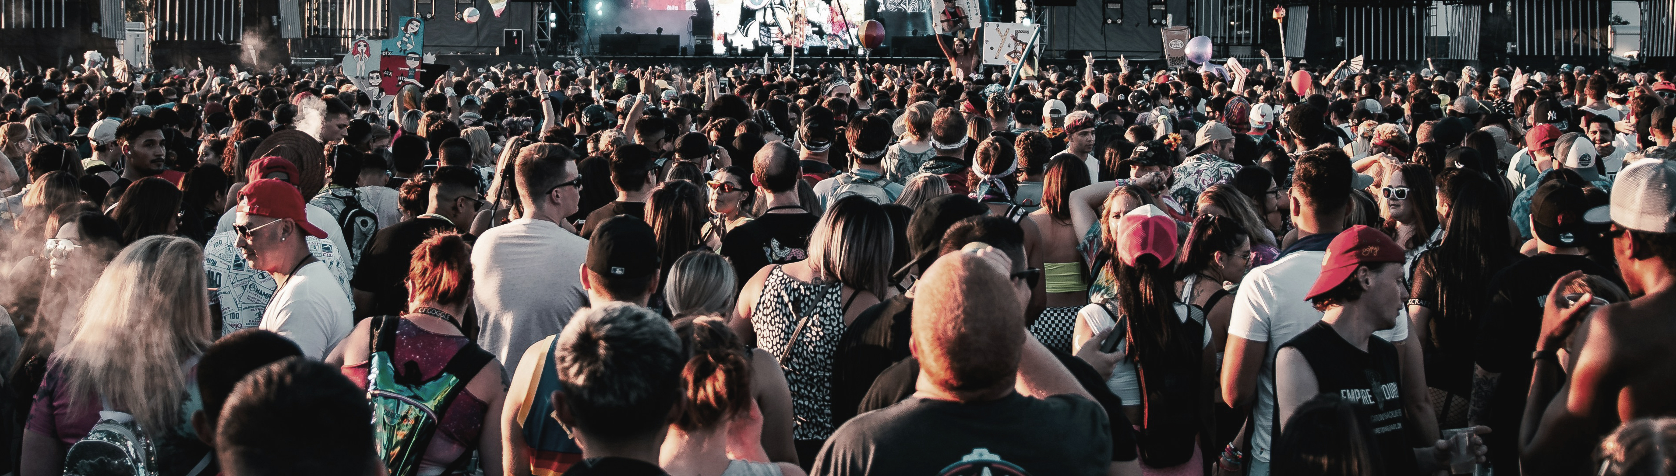
Questions or comments?
Thank you for your participation!
© Unsplash / Colin Lloyd
© WHO 2025. Some rights reserved. This work is available under the CC BY-NC-SA 3.0 IGO licence.

