Slide 1
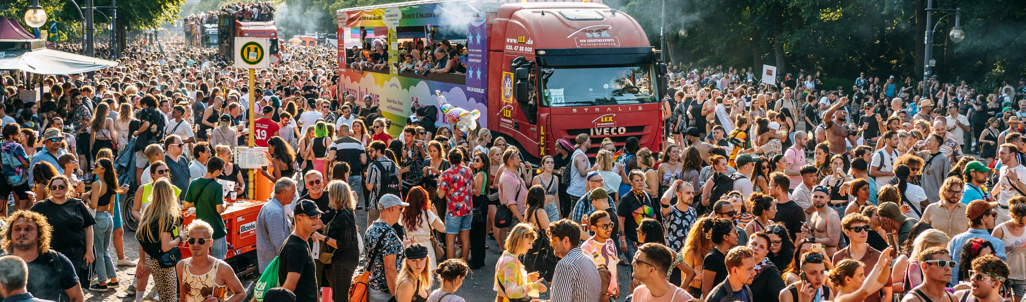
A Crowd Surge in the context of a
Mass Gathering Event
​Simulation Exercise
SIMULATION EXERCISES AND ACTION REVIEWS TEAM
MASS GATHERINGS TEAM
© Unsplash / Raphael Renter
© WHO 2025. Some rights reserved. This work is available under the CC BY-NC-SA 3.0 IGO licence.

Slide 2
Disclaimer
This simulation exercise scenario is designed to assess health preparedness and response to a crowd surge during a mass gathering (MG) event.
This PowerPoint template should be adapted to the event and local context during the planning phase of the exercise.

Slide 3


Slide 4

Agenda
09:00 Welcome and introductions (10 mins)
09:10 Exercise briefing (10 mins)
STARTEX
09:20 Session 1 and recap discussion (60 mins)
10:20 Coffee break ( 20 mins)​
10:40 Session 2 and recap discussion (60 mins)
11:40 Session 3 and recap discussion (60 mins)
ENDEX
12:40 Exercise debrief and feedback form (35 mins)
13:15 Closing

Slide 5

Introductions
5 mins
Please provide brief information about yourself:
Name
Job title
Authority that you are representing

Slide 6

How to participate?
Rules​:
Use your practices, procedures, guidelines and regulations to inform your responses​
Do not make up material, this exercise has all the material you require
Work as part of a team​
Focus on solutions​
Be prepared to provide feedback ​to the wider group
Roles – in this exercise, you will be acting your real-life role
Notetakers: record discussions and responses to questions​

Slide 7



Assumptions
Event and local context may differ from what exists or may contain false assumptions. This is only for simulation purposes.
The exercise is designed to ensure that all objectives can be achieved: please embrace the scenario as it is designed.
There are no deceptions or traps, so respond to the scenario and contribute to discussions as you would in an actual incident.

Slide 8
Purpose and objectives
Purpose
Objectives
To assess health preparedness and response to a crowd surge during a mass gathering (MG) event.
To clarify the roles and responsibilities of health authorities and other key stakeholders including MG event organizers in the response to a crowd surge based on existing health emergency preparedness and response plans.
To review coordination mechanisms among health authorities and other key stakeholders including event organizers in the response to a crowd surge.
To identify the information flow and communication mechanisms both within health authorities and across other key stakeholders in the response to a crowd surge.
To review risk communication and community engagement procedures including those specifically related to a crowd surge.

Slide 9
StartEx

Slide 10

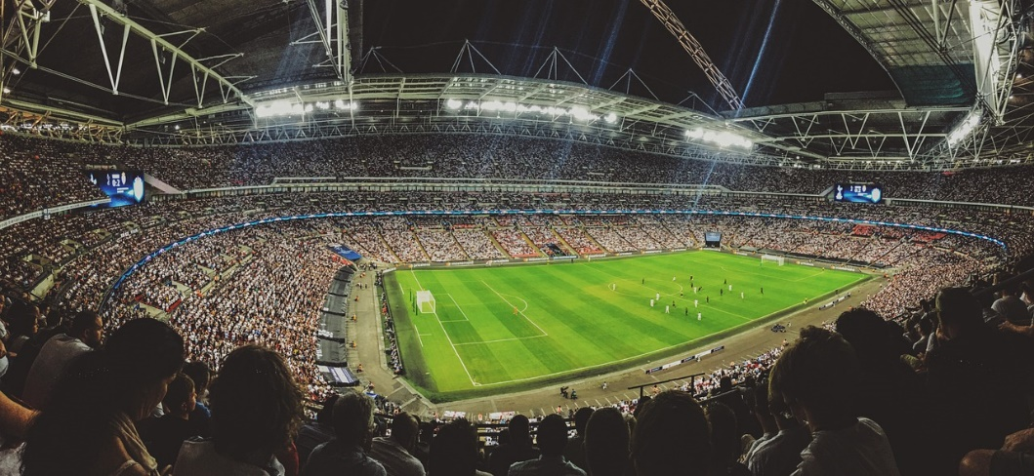
SESSION 1
Situation update: match day – 20:00
A major international football tournament has drawn a large crowd of fans from all over the world. All tickets were sold out for the most popular match that kicks off at 20:00. The stadium has a capacity of 70 000 seats.
© Pixabay | stock image

Slide 11

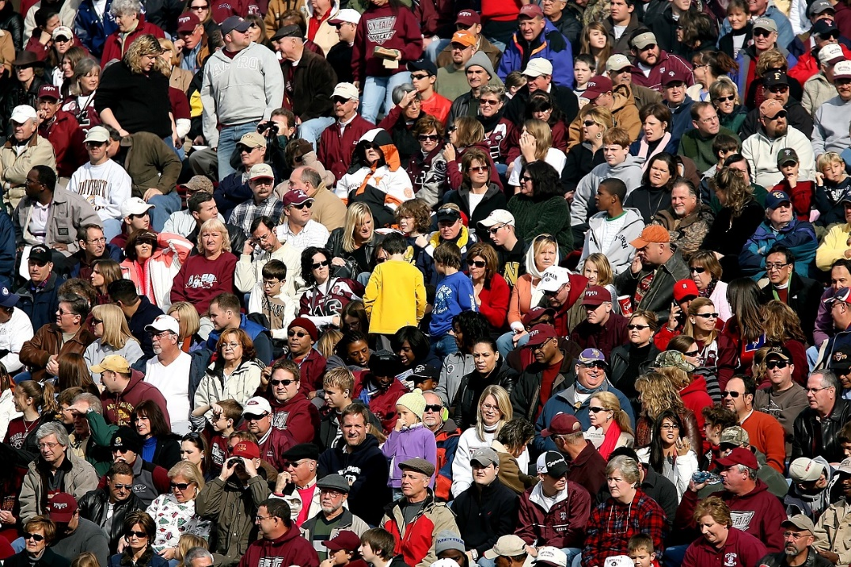


SESSION 1
Situation update: match day - 20:30
During the match a sudden power outage causes the stadium lights to go out. The fans become agitated, and many of them begin to leave their seats and congregate around the exits, hoping to leave the stadium. At this point, several fans set off flares and firecrackers, causing an uncontrolled movement and panic among the crowd.
Due to the power outage, there were no public official announcements from event organizers. Unverified messages and rumours begin to circulate on social media. Several posts and tweets claim that the power outage happened due to a terrorist attack in the stadium.
In the chaotic rush towards the exits, fans get trampled on and injured. The panic results in a high number of casualties and severe traumas (e.g. fractures, crush injuries and asphyxiation-related complications). Fatalities are also reported during the crowd surge event.
© Pixabay | Keith Johnston

Slide 12
TASK 1
45 mins
Which emergency preparedness and response plans and standard operating procedures (SOPs) (local, regional, national) and event-specific venue plans (e.g. stadium) are in place for a crowd surge?
Does the emergency plan consider backups for unforeseen circumstances (e.g. electricity failure or blackout, terrorist attacks, etc.)?
Are the emergency plans discussed, agreed and tested with other stakeholders including event organizers?
What are the roles and responsibilities of various health sector actors involved in the response to a crowd surge event: Ministry of Health (MoH), emergency medical services, hospitals, emergency medical teams (EMTs) and first-line responders defined in the event plans and SOPs?

Slide 13
TASK 1
45 mins
What are the roles and responsibilities of non-health sector authorities involved in the crowd surge and mass casualty incident response?
How is information related to crowd surge incidents collected, analysed and disseminated within health authorities? With other key stakeholders? How does this information inform decision-making to ensure an effective multisectoral response to mass casualty incidents?
Which mechanisms or systems are in place to detect, track and manage misinformation, disinformation and rumours on social media to ensure public safety and maintain the reputation of the event?

Slide 14
Recap discussion
Session 1
15 mins

Slide 15
Coffee break
20 mins
© WHO 2025. Some rights reserved. This work is available under the CC BY-NC-SA 3.0 IGO licence.

Slide 16




SESSION 2
Situation update: match day - 21:30
There were 472 people reported injured and 38 confirmed deaths.
The injured have been transported to nearby hospitals and several of them are in a critical condition. The event reference hospitals are struggling to cope with the number of casualties. Urgent requests to the MoH for additional resources and personnel have been initiated.
Access to the stadium has been limited by the presence of bystanders making the emergency response efforts difficult.
The mounting number of casualties has strained hospitals, depleting blood supplies and resulting in a shortage of beds in emergency departments and operating theatres. Ambulances are queuing and struggling to hand over patients to emergency departments.

Slide 17
TASK 2
45 mins
How does communication between the on-site medical teams (stadium medical teams, ambulance staff and first-line responders), event organizers and security personnel function?
What type of protocols are in place for timely reporting and tracking of casualty numbers during MG events?
What type of procedures are in place for requesting additional resources?
Are there any agreements with the nongovernmental health sector and other health-care facilities to support the medical response for crowd surge and mass casualty incidents during MG events? When are other government agencies (police, national guard, etc.) called in to respond?

Slide 18
TASK 2
45 mins
What type of financial contingency resources/mechanisms exist in [your host country] to ensure an effective health emergency response?​
Do event personnel receive training on crowd management and mass casualty incident response? Please elaborate on the categories of trained personnel.
Do event emergency preparedness and response plans and SOPs consider ad hoc ambulance access to MG event venues? How do they coordinate with security measures? Do employees know the SOPs or only those in emergency operating centres?

Slide 19
Recap discussion
Session 2
15 mins

Slide 20




SESSION 3
Situation update: match day - 23:30
Hospitals are struggling to manage the crowds of concerned people searching for information about injured fans, further adding to the chaotic environment. Hospitals are grappling with the challenge of communicating with fans and relatives and providing accurate and timely information.
Rumours and misinformation on social media increase the tension among the community.
Hospitals have limited capacity to provide accurate and timely updates to health authorities.
There is an urgent need for additional resources and support to alleviate the strain on the health-care system. Daily health-care services have been disrupted to allow hospitals to manage critical patients from the stadium.

Slide 21
TASK 3
45 mins
How are the public and fans informed about the availability of medical services and location of first aid stations/ambulances during the health emergency?
How is information on the risks of crowd and mass casualty incidents communicated to the fans and public during MG events?
What type of activities are implemented to train medical teams and event volunteers on potential health risks associated with crowd surges and response measures during MG events?
Are there procedures and protocols in place for bringing families together?
What type of procedures and capacities exist for management of deceased persons after mass casualty incidents, i.e. identification, documentation, transportation and burial of the deceased?

Slide 22
Recap discussion
Session 3
15 mins

Slide 23
EndEx

Slide 24
Exercise debrief
30 mins
Consider the following questions based on the exercise objectives:
What challenges related to MG preparedness and response have been identified through the exercise?
What measures should be undertaken to improve MG preparedness and response?

Slide 25
Exercise feedback form
5 mins
Statement | Strongly disagree → Strongly agree
1. The simulation exercise was well structured (content, facilitation, debrief, etc.) | 1 | 2 | 3 | 4 | 5
2. The scenario was realistic | 1 | 2 | 3 | 4 | 5
3. I was familiar with the preparedness and response plan based on the local and event context prior to participating in this exercise | 1 | 2 | 3 | 4 | 5
4. The simulation exercise briefing was useful for engaging participants | 1 | 2 | 3 | 4 | 5
5. The simulation exercise was able to test specific areas of the mass gathering preparedness and response plans and/or health systems | 1 | 2 | 3 | 4 | 5
6. The simulation exercise helped to clarify my and other key stakeholder roles and responsibilities identified through the mass gathering preparedness and response plans | 1 | 2 | 3 | 4 | 5
7. The simulation exercise identified opportunities to strengthen multisectoral coordination and communication mechanisms in the context of mass gatherings | 1 | 2 | 3 | 4 | 5
8. The simulation exercise identified opportunities to strengthen risk communications and community engagement capacities and functions in the context of mass gatherings | 1 | 2 | 3 | 4 | 5
9. The simulation exercise was helpful to identify gaps and areas for improvement in relation to health emergency incidents preparedness and response in the context of mass gatherings | 1 | 2 | 3 | 4 | 5
10. Administrative arrangements were well organized and implemented | 1 | 2 | 3 | 4 | 5
11. The simulation exercise provided a practical platform to test and assess the effectiveness of risk mitigation strategies and emergency response plans for mass gatherings | 1 | 2 | 3 | 4 | 5

Slide 26
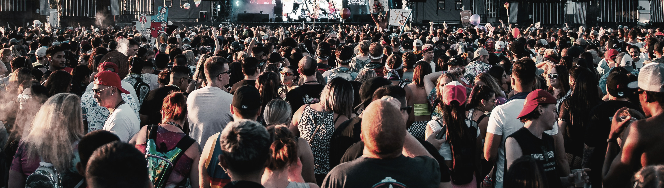
Questions or comments?
Thank you for your participation!
© Unsplash / Colin Lloyd
© WHO 2025. Some rights reserved. This work is available under the CC BY-NC-SA 3.0 IGO licence.

