Slide 1
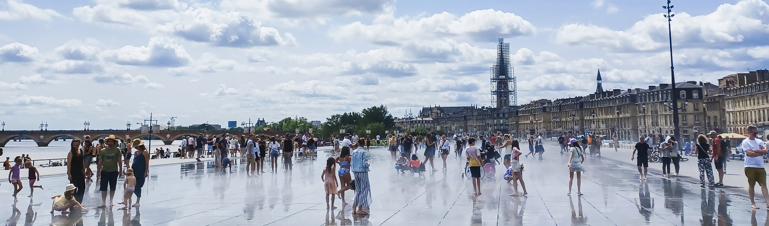
A Heatwave in the context of a
Mass Gathering Event
Simulation Exercise
SIMULATION EXERCISES AND ACTION REVIEWS TEAM
MASS GATHERINGS TEAM
© WHO / Alice Allan
© WHO 2025. Some rights reserved. This work is available under the CC BY-NC-SA 3.0 IGO licence.

Slide 2
Disclaimer
This simulation exercise scenario is designed to assess health preparedness and response to a heat wave during a mass gathering (MG) event.
This PowerPoint template should be adapted to the event and local context during the planning phase of the exercise.
© WHO 2025. Some rights reserved. This work is available under the CC BY-NC-SA 3.0 IGO licence.

Slide 3

© WHO 2025. Some rights reserved. This work is available under the CC BY-NC-SA 3.0 IGO licence.

Slide 4

Agenda
09:00 Welcome and introductions (10 mins)
09:10 Exercise briefing (10 mins)
STARTEX
09:20 Session 1 and recap discussion (60 mins)
10:20 Coffee break (20 mins)​
10:40 Session 2 and recap discussion (60 mins)
11:40 Session 3 and recap discussion (60 mins)
ENDEX
12:40 Exercise debrief and feedback form (35 mins)
13:15 Closing

Slide 5

Introductions
5 mins
Please provide brief information about yourself:
Name
Job title
Authority that you are representing

Slide 6

How to participate?
Rules​:
Use your practices, procedures, guidelines and regulations to inform your responses​
Do not make up material, the exercise has all the material you require
Work as part of a team​
Focus on solutions​
Be prepared to provide feedback ​to the wider group
Roles – in this exercise, you will be acting your real-life role
Notetakers: record discussions and responses to questions

Slide 7



Assumptions
Event and local context may differ from what exists or may contain false assumptions. This is only for simulation purposes.
The exercise is designed to ensure that all objectives can be achieved: please embrace the scenario as it is designed.
There are no deceptions or traps, so respond to the scenario and contribute to discussions as you would in an actual incident.

Slide 8
Purpose and objectives
Purpose
Objectives
To assess health preparedness and response to a heatwave during a mass gathering (MG) event.
To clarify the roles and responsibilities of health authorities and other key stakeholders including MG event organizers in response to a heatwave based on existing health emergency preparedness and response plans.
To review coordination mechanisms among health authorities and other key stakeholders including event organizers in the response to a heatwave.
To identify the information flow and communication mechanisms both within health authorities and across other key stakeholders including event organizers in the response to a heatwave.
To review risk communication and community engagement procedures including those specifically related to a heatwave.

Slide 9
StartEx

Slide 10

Background
A huge seven-day outdoor Youth Music Festival is ongoing in city X, gathering around 30 000 international participants from various corners of the globe. The participants are primarily teenagers who are camping on site.
The Youth Music Festival organizer’s team is responsible for event coordination.
In line with recent weather updates, the region is experiencing a heatwave, and there is also a forecast of a possible intense storm approaching in the subsequent days.
© WHO 2025. Some rights reserved. This work is available under the CC BY-NC-SA 3.0 IGO licence.

Slide 11


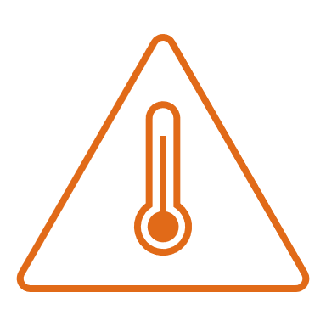
SESSION 1
Situation update: festival day 1
Morning. Contrary to the forecast, the day heats up more quickly than expected. As most participants are engaged in outdoor activities, first aid stations receive a significant influx of teenagers displaying symptoms of dehydration and heat fatigue. The weather forecast has been updated showing high humidity in addition to high temperatures for the day.
Afternoon. An outdoor open dancing class is called off when several teenagers start presenting with symptoms of heat exhaustion. The event's temporary catering stations (or food court) are already facing a critical shortage of bottled water.
Evening. A subsequent weather forecast update warns of even steeper temperature hikes and increased humidity for the following day.

Slide 12
TASK 1
45 mins
Which national, regional and/or local protocols, plans and standard operating procedures (SOPs) are in place for a heatwave emergency response? ​Are there any specific protocols for a MG event?
Who are the stakeholders involved in the heatwave emergency response? Which authority is responsible for coordinating health emergency operations on site and at medical facilities during the MG event?​​
What are the roles and responsibilities of health authorities, other non-health sector stakeholders including event organizers in the response to the heatwave emergency?​

Slide 13
TASK 1
45 mins
​​What type of coordination and stakeholder engagement mechanisms are required and have been established with non-health sectors (police, firefighters, meteorological stations, water companies, electricity providers, mobile tent distributors, logistics, supply chain and transport companies, etc.) to support the response during heat-related emergencies? Which procedures would diverge from "business as usual" in the context of a MG event?
What type of heatwave precautionary measures should be implemented at the festival (e.g. location of water points, cooling stations, tents, provision of first aid stations and foot patrols, emergency services, communications plans) to mitigate the risk? When should each of these precautionary measures be implemented?

Slide 14
Recap discussion
Session 1
15 mins

Slide 15
Coffee break
20 mins
© WHO 2025. Some rights reserved. This work is available under the CC BY-NC-SA 3.0 IGO licence.

Slide 16




SESSION 2
Situation update: festival day 2
Morning. Even in the early morning hours, the heat is exhausting. Some teenagers look for shade in the tents, but some tents offer little protection against the extreme temperature. Event first aid and medical stations are swamped with participants suffering from heat-related conditions.
A 17-year-old teenager dies due to heat stroke at the event, marking the first fatality in the already escalating crisis. Almost immediately, many unofficial warnings and speculations begin to spread on social media, increasing panic among the young participants. The event organizer’s team refuses to cancel the event.
Afternoon. One fatality and about 500 people with heat-related conditions at the event have been reported.
Afternoon. The weather agency issues a warning about an impending storm heading towards the festival location. Meanwhile, social media rumours exaggerated the storm's expected severity, even calling it a “violent storm”.

Slide 17
TASK 2
45 mins
What type of mechanisms are in place to modify the event (e.g. implement various precautionary measures, request additional resources, activate a multisectoral response, reschedule activities to the evening or even cancel the event)? Which authority can scale up the request if needed, and which authority is the decision-maker?
What type of procedures are in place for requesting additional resources in response to a heatwave emergency (e.g. medical supplies, health and non-health personnel, WASH (water, sanitation and hygiene) measures, especially drinking water supplies, tarps to provide shade/shelter, fans, electric generators, etc.) during a MG event?
Which financial contingency resources/mechanisms are in place to support the emergency response to a heatwave and other extreme climate conditions? Are there any specific protocols in the context of a MG event?

Slide 18
TASK 2
45 mins
What type of communication channels are established for information-sharing within and between event medical teams, across event organizers and other non-health first responders at a MG event (e.g. firefighters, security personnel, disaster management and law enforcement agencies)?
What type of monitoring and reporting systems are used to collect, analyse, assess and share information on heat-related cases across health sector authorities, event organizers and other key stakeholders in routine practice? And in the context of a MG event?
What type of measures are in place to provide medical care to minors, i.e. to contact parents or guardians to obtain consent to treatment?

Slide 19
Recap discussion
Session 2
15 mins

Slide 20




SESSION 3
Situation update: festival day 3
Morning. The wind has picked up, but the air temperature remains steady, not dropping. The festival organizer’s team has been implementing wind-protective measures in the camp. Meanwhile, a social media video showing a tent being blown away goes viral, creating concern. New rumours start up that some teenagers are missing.
Afternoon. Various confusing alerts circulate providing contradictory information.
Concerned parents have been constantly trying to contact local authorities and event organizers, seeking information about their children and the situation. Participants start to leave the festival.
Evening. Local authorities and event organizers announce the immediate cancellation of the festival.

Slide 21
TASK 3
45 mins
How do health authorities, event organizers and other key stakeholders involved in event delivery communicate effectively while maintaining coherent information on heat-related health risks to event participants, event personnel and the local community before and during mass gatherings?
Which risk communication and community engagement and infodemic management (RCCE-IM) strategies are in place to inform participants, personnel and the community about misinformation, disinformation and rumours during a MG event? What type of mechanisms exist to verify or discredit such claims rapidly and ensure that credible information is provided?

Slide 22
TASK 3
45 mins
What type of strategies are routinely implemented to raise awareness and train medical teams and event volunteers, as well other non-health first-line personnel, on potential heat-related health risks, self-care practices and emergency responses during mass gatherings?
Do you have prior experience of implementing RCCE-IM campaigns for planned mass gathering events based on risk assessment findings, particularly in response to heatwave emergencies? If yes, please elaborate.
How should lessons learned from previous events and retrospective analysis of the current event should be assimilated in planning readiness strategies for health emergencies, including for further mass gatherings?

Slide 23
Recap discussion
Session 3
15 mins

Slide 24
EndEx

Slide 25
Exercise debrief
30 mins
Consider the following questions based on the exercise objectives:
What challenges related to mass gathering preparedness and response have been identified through the exercise?
What measures should be undertaken to improve mass gathering preparedness and response?

Slide 26
Exercise feedback form
5 mins
Statement | Strongly disagree → Strongly agree
1. The simulation exercise was well structured (content, facilitation, debrief, etc.) | 1 | 2 | 3 | 4 | 5
2. The scenario was realistic | 1 | 2 | 3 | 4 | 5
3. I was familiar with the preparedness and response plan based on the local and event context prior to participating in this exercise | 1 | 2 | 3 | 4 | 5
4. The simulation exercise briefing was useful for engaging participants | 1 | 2 | 3 | 4 | 5
5. The simulation exercise was able to test specific areas of the mass gathering preparedness and response plans and/or health systems | 1 | 2 | 3 | 4 | 5
6. The simulation exercise helped to clarify my and other key stakeholder roles and responsibilities identified through the mass gathering preparedness and response plans | 1 | 2 | 3 | 4 | 5
7. The simulation exercise identified opportunities to strengthen multisectoral coordination and communication mechanisms in the context of mass gatherings | 1 | 2 | 3 | 4 | 5
8. The simulation exercise identified opportunities to strengthen risk communications and community engagement capacities and functions in the context of mass gatherings | 1 | 2 | 3 | 4 | 5
9. The simulation exercise was helpful to identify gaps and areas for improvement in relation to health emergency incidents preparedness and response in the context of mass gatherings | 1 | 2 | 3 | 4 | 5
10. Administrative arrangements were well organized and implemented | 1 | 2 | 3 | 4 | 5
11. The simulation exercise provided a practical platform to test and assess the effectiveness of risk mitigation strategies and emergency response plans for mass gatherings | 1 | 2 | 3 | 4 | 5

Slide 27
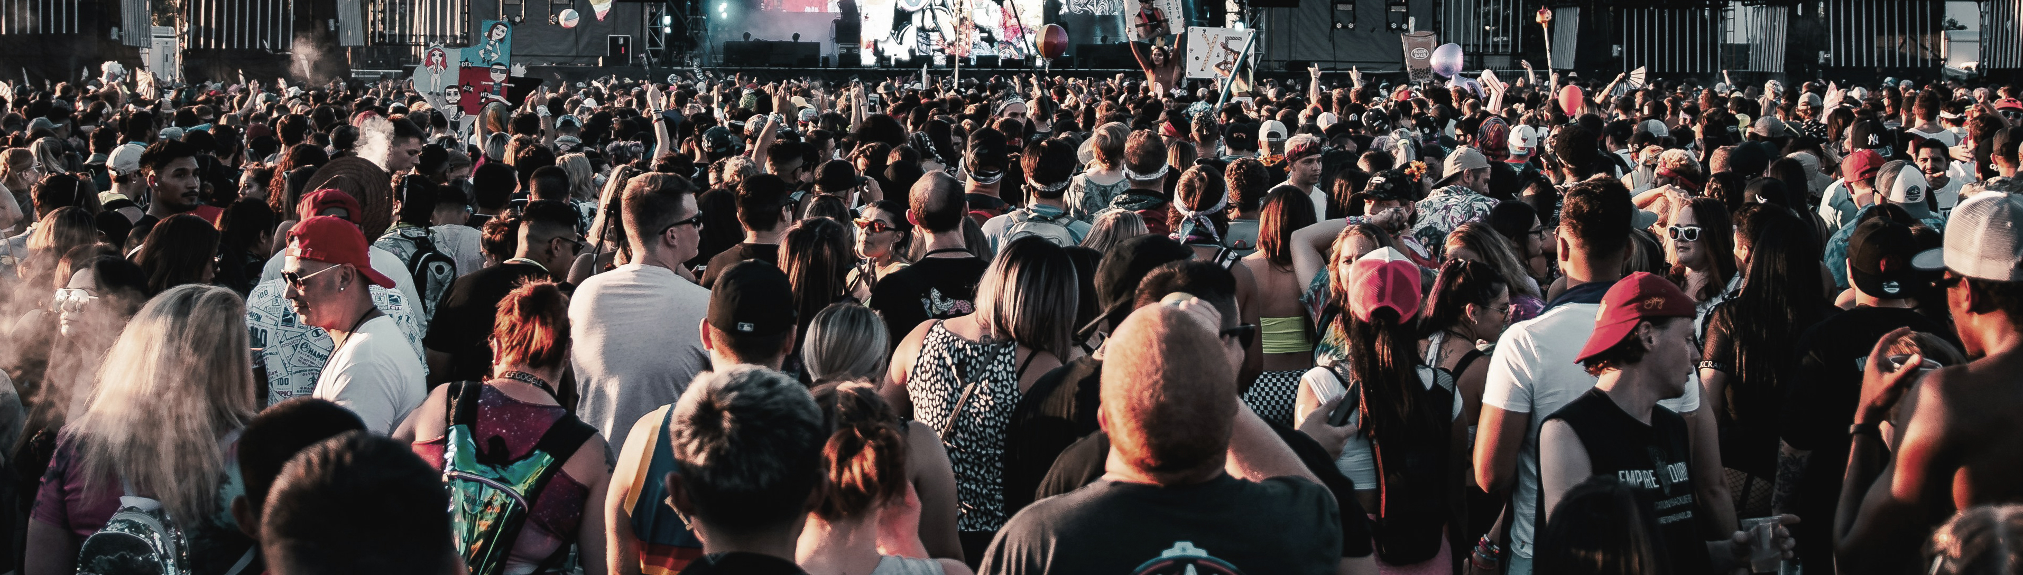
Questions or comments?
Thank you for your participation!
© Unsplash / Colin Lloyd
© WHO 2025. Some rights reserved. This work is available under the CC BY-NC-SA 3.0 IGO licence.

