Slide 1
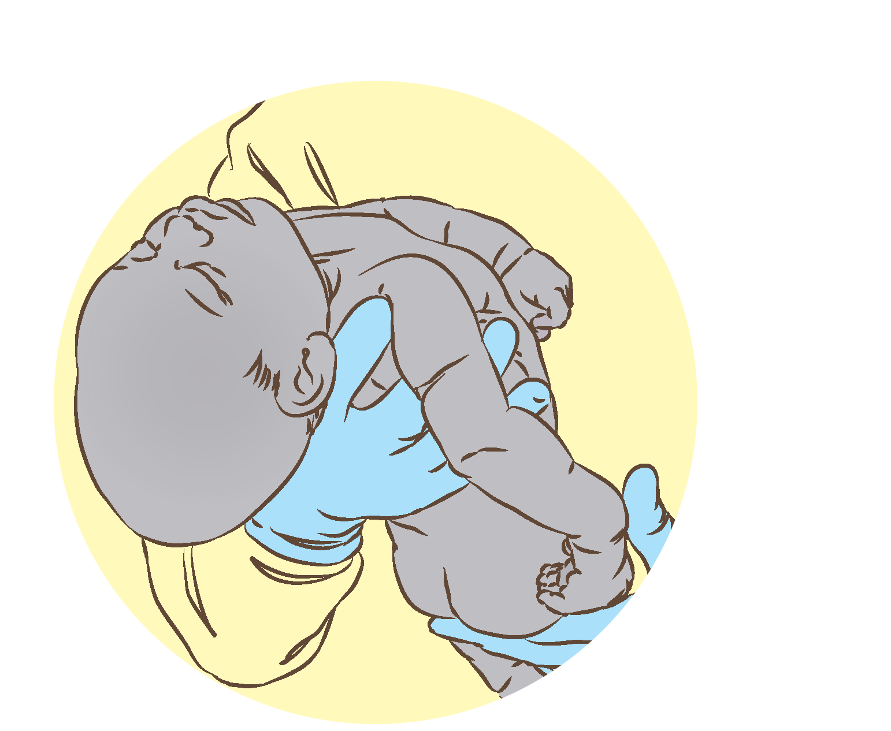

Basic resuscitation of the newborn
Notes:
© World Health Organization 2024. All rights reserved.
Materials for demonstrations, practice, and simulations
Organise one set per group of 2-3 participants and a set for the facilitator (as available).
If possible, use a vacant delivery area for simulations in this module.
Hand hygiene (soap and water or alcohol handrub)
Newborn mannequin with inflatable lungs
Gloves (sterile/non-sterile) and personal protective equipment (appropriate to context and health worker role)
Delivery set or clean delivery kit (appropriate to context and health worker role)
Uterotonic (for mother)
Clock with second hand
Room thermometer
Two towels for drying
Head covering (for newborn)
Soft, warm cover (for mother and newborn)
Cord clamps/ties
Sterile scissors/blade
Self-inflating bag (250–400 mL)
Two neonatal masks (sizes 0 and 1)
Suction device (reusable)
Stethoscope
Newborn record
Newborn identity bracelet
Colour coded waste receptacles

Slide 2
Content
Goal and learning outcomes
The situation
Initial steps
Ventilation with bag and mask
Care after resuscitation
Summary
Clinical practice
Quality improvement
References and additional resources

Slide 3
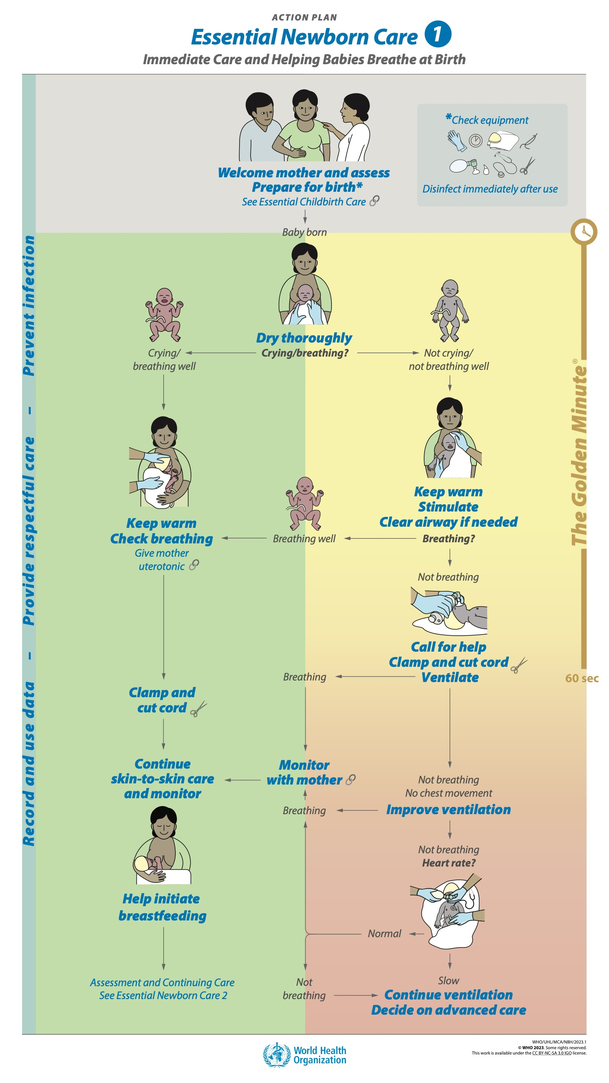
Goal and learning outcomes
All newborns who do not breathe
at birth receive basic resuscitation.
  Recognize a newborn who requires
  help to breathe at birth.
  Provide stimulation to breathe.
  Clear the airway only when needed.
  Ventilate effectively with bag and mask.
  Monitor and provide ongoing care.

Slide 4
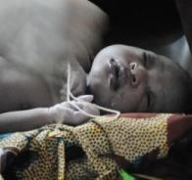
The situation
After a normal healthy pregnancy,
Delia, age 28 years, delivers her
first baby, a girl.
The baby is not breathing.
Health workers dry and stimulate her.
She does not receive bag-and-mask
ventilation.
She dies.
What can change this situation?
© WHO/Dr Helenlouise Taylor
Notes:
What is the situation in your health facility and in your community?
Are all health workers trained and equipped to help a baby breathe?
Basic resuscitation begins in the first minute after birth (The Golden Minute). Your skills in helping babies breathe are essential for newborns to survive and avoid preventable disabilities.
Up to 1 in every 10 newborns will require resuscitation at birth.
Even the most basic facility where birth takes place should be prepared to give bag-and-mask resuscitation to newborns who require it.
Facilities should have trained staff and the necessary equipment and supplies.
A functional referral system should link the facility to secondary and tertiary levels of care for infants who need special care.

Slide 5
Basic resuscitation at birth
Form groups (mother, companion, and doctor).
Help Elias breathe.
Debrief with your team and facilitator.
Sophie is a healthy 25-year-old teacher, at term with her first child.
She has attended every antenatal care appointment.
All examinations were normal, and she has no health concerns.
You deliver Elias. He is not breathing.
Notes:
Baseline simulation
Skills and performance – participants demonstrate basic resuscitation.
Drying thoroughly
Assessment of crying/breathing
Keeping warm with skin-to-skin contact
Stimulating to breathe
Clearing the airway if needed
Assessment of breathing
Calling for help
Clamping and cutting the umbilical cord
Preparing to ventilate
Ventilating with bag and mask
Improving ventilation
Assessment of heart rate
Deciding on advanced care
Debriefing – participants self-reflect and give feedback to one another in their roles.
Provision of care (performance objectives)
What was done well?
What could have been done better?
What will you change the next time?
Experience of care
Was the communication respectful and the language appropriate?
Was handling of the baby gentle?
Was the baby kept warm?

Slide 6

What is the goal of basic resuscitation?
By one minute after birth a newborn should
be breathing well or receiving ventilation
with bag and mask.
Breathing air delivers oxygen to the lungs.
Lack of oxygen can result in death or disabilities.
Bag and mask ventilation deliver air and
oxygen to the lungs when a newborn is not
breathing well.
Prompt action in the first minute, The Golden Minute,
reduces the risk of death and disabilities.
Notes:
As a health care worker, you can make the difference in a newborn’s outcome by providing timely help to breathe.

Slide 7
Prepare for resuscitation

Slide 8
Which newborns may need help to breathe?
Any newborn may have breathing difficulties at birth.
Which newborns are more likely to need support?
Preterm or post-term.
Born after long, traumatic labour or fetal distress.
Born to mothers who received sedation during the late stages of labour.
Notes:
Risk factors are not perfect predictors of need for help to breathe.
Up to one half of newborns who require resuscitation have no identifiable risk factors before birth. Therefore, if you attend births, you must always be ready to help a baby breathe.
Anticipate and recognize newborns who need help to breathe.
Be prepared with equipment that functions.
Know what steps to take and their correct order.
Be present at birth and be able to work quickly.

Slide 9
Prepare equipment for the newborn and delivery
Gloves
Two clean, warm towels/cloths
Head covering for the newborn
Soft, warm cover for mother and newborn
Cord ties or cord clamp and sterile scissors or blade
Newborn-size self-inflating bag
Newborn masks: term and preterm
Suction device (reusable)
Stethoscope
Clock with second hand
Room thermometer
Additional equipment for delivery
Clean delivery kit
Uterotonic
Gloves, apron, mask, eye protection
Bucket or other receptacle with 0.5% chlorine solution
for decontamination
Colour coded waste segregation and sharps box
Notes:
Practise organising the equipment and supplies needed to care for the newborn at birth and help a baby breathe.
What is the consequence of not having all the necessary equipment available and functional?

Slide 10
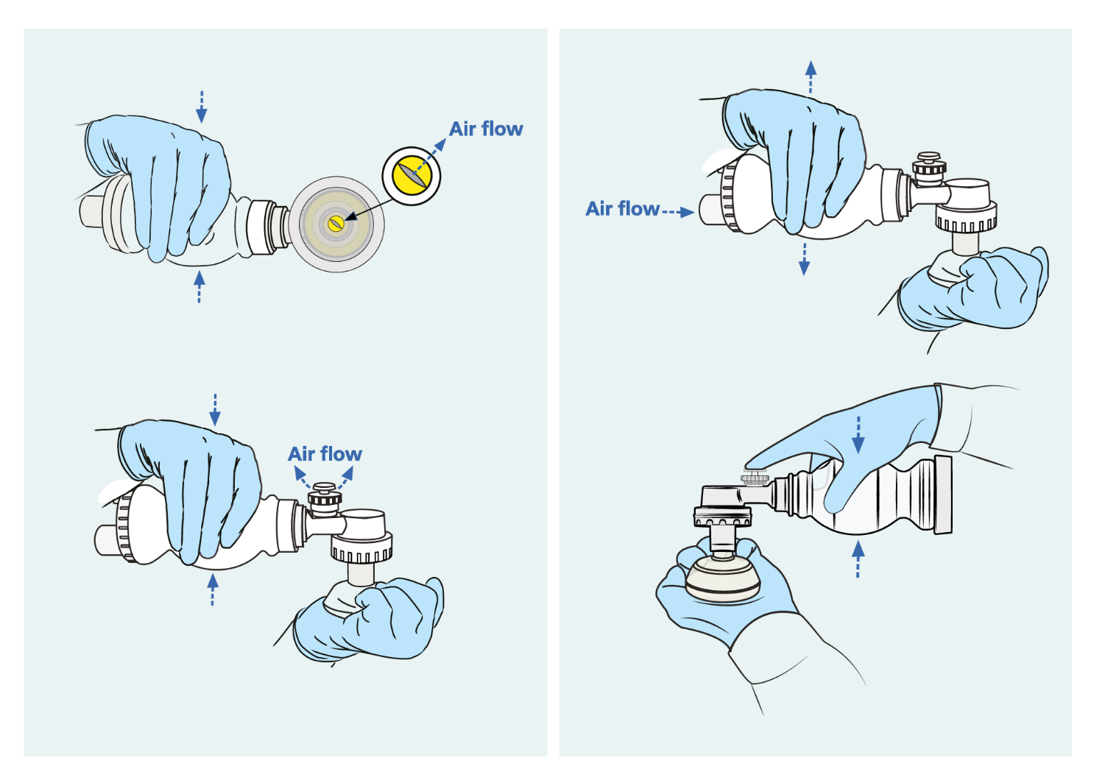

Check the self-inflating bag and suction device
Air flows through patient outlet
Air flow
reinflates bag
Device stays compressed (no leak)
Pressure-relief valve activates
Pressure-relief valve by-passed
Check equipment (1:26-2:10)
Notes:
Practise checking the function of the self-inflating bag (4 steps) and the suction device.

Slide 11
Initial steps

Slide 12
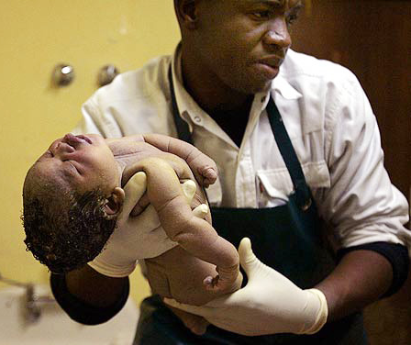
Is the baby crying/breathing well?
Elias was just born and is not crying or breathing.
A newborn who is not crying/breathing well
Is not breathing at all
OR
Is gasping
OR
Is breathing abnormally
AND
Has poor tone and activity
Notes:
What do you see in the photo?
Describe the appearance of this newborn:
Tone and activity
Colour

Slide 13
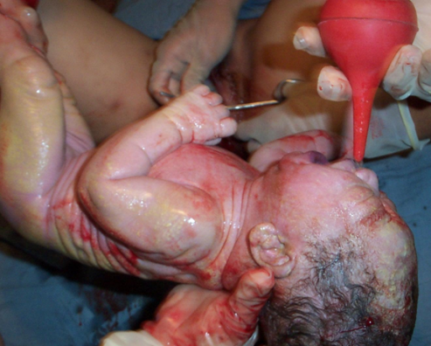
Is the baby crying/breathing well?
Peter was just born and
is crying.
A newborn who is crying/breathing well
Is crying
OR
Is breathing quietly and regularly
AND
Has good tone and activity
© WHO/WPRO/Dr Helenlouise Taylor
Notes:
Contrast this newborn’s appearance with the baby shown in the previous photo:
Tone and activity
Colour
Why is this baby being suctioned?
Is this intervention necessary?
Is it recommended?

Slide 14
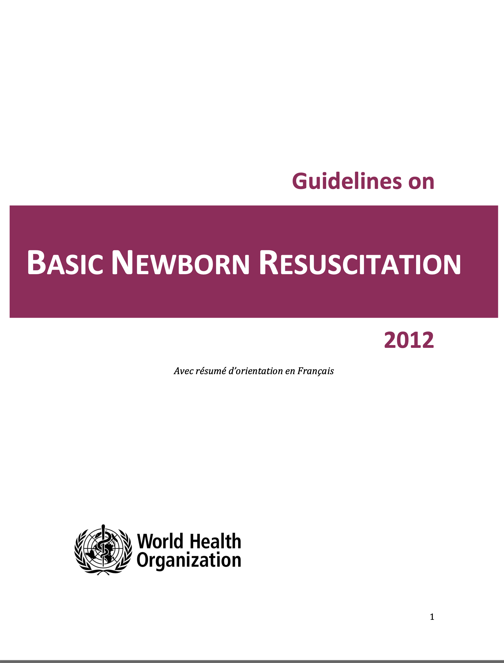
Which newborns require suctioning?
Find the recommendations and review the evidence on pages 26 – 31.
Notes:
Use a printed or digital copy (pdf) of the document to find the recommendations and review the evidence.

Slide 15
Recommendations and reasons
When the amniotic fluid is clear, suctioning should be done only if the mouth
or nose is full of secretions.
Harms of routine suctioning:
    Delays the start of effective positive pressure ventilation.
    Lowers oxygen saturation levels.
In neonates born through clear amniotic fluid who start breathing on their
own after birth, suctioning of the mouth and nose should not be performed.
In neonates born through clear amniotic fluid who do not start breathing
after thorough drying and rubbing the back 2–3 times, suctioning of the
mouth and nose should not be done routinely before initiating positive-
pressure ventilation.
Notes:
Is this recommendation currently applied in your place of work?
If yes, what enabling factors support the application of this recommendation?
If no, what are the barriers to applying this recommendation?

Slide 16
Help the newborn breathe in
The Golden Minute
Elias has been delivered to Sophie after
a long labour.
He is not crying/not breathing well.
Keep warm
– cover the head and body with a cloth
Stimulate to breathe
– by rubbing the back firmly 2 or 3 times
Clear airway only if needed
– first the mouth, then the nose
Notes:
How should you stimulate Elias to breathe?
Stimulate breathing by rubbing the back firmly 2 or 3 times to improve or start breathing.
Is drying the same as stimulating to breathe?
Stimulation by rubbing the back is a separate step from drying.
Babies with shallow or irregular breathing may benefit from stimulation to deepen and sustain regular breathing.
Practise safe use of a bulb suction device:
Squeeze the bulb before inserting into the mouth or nose.
Clear the mouth first and then the nose.
Spend no longer than 10 seconds using suction.
Suctioning repeatedly or too long is harmful. The baby needs ventilation to survive and prevent disabilities.
Optional
Demonstrate safe use of a suction tube:
Suction first the mouth and then the nose.
Gently introduce the suction tube 5 cm into the newborn’s mouth (until the “5 cm” mark is at the newborn’s lips).
Apply suction while withdrawing the tube.
Next, introduce the suction tube 3 cm into each nostril.
Apply suction while withdrawing the tube.
Repeat suctioning only if necessary, for no more than 10 seconds duration in total.

Slide 17
Ventilation with bag and mask

Slide 18
Prepare to ventilate in The Golden Minute
Elias has been delivered to Sophie after a long labour. He is not crying/not breathing well.
If the baby is gasping or not breathing after
thorough drying and stimulation:
Call for help
Explain to Sophie that Elias needs help
to breathe
Clamp and cut the cord
Transfer Elias to a flat, firm, warm surface to
begin ventilation
Notes:
Practise preparing to ventilate if the baby is gasping or not breathing:
Call for help.
Explain to Sophie that Elias needs help to breathe.
Clamp and cut the cord.
Transfer Elias to a flat, firm, warm surface to begin ventilation.
How much time do you have to start ventilation?
Were you able to begin ventilation in The Golden Minute?

Slide 19
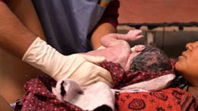

Steps for helping a newborn breathe
Teaching points for newborn resuscitation
Notes:
View video
What new knowledge is presented in this video?
Are there any skills or practices that differ from your current practice?
What provider behaviours differ from your current practice?
Does this video highlight any quality gaps in your facility?

Slide 20


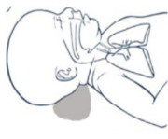
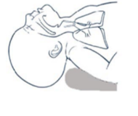
Position the head slightly extended
Place Elias on his back.
Position his head so that it is slightly extended. Do not over-extend.
Stand at Elias’s head.
Notes:
Practise good position of the head and contrast with over-extension.

Slide 21
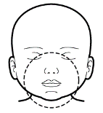
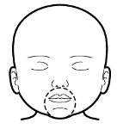
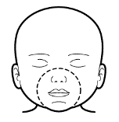
Select the correct mask size
Face mask that is too LARGE
Covers the eyes
Extends over the tip of the chin
Face mask that is too SMALL
Does not cover the nose
Does not cover the mouth effectively
Correct size face mask in the
correct position covers:
The nose
The mouth
The tip of the chin
but not the eyes
Notes:
Practise selecting the correct mask that covers the tip of the chin, the mouth, and the nose, but not the eyes.

Slide 22
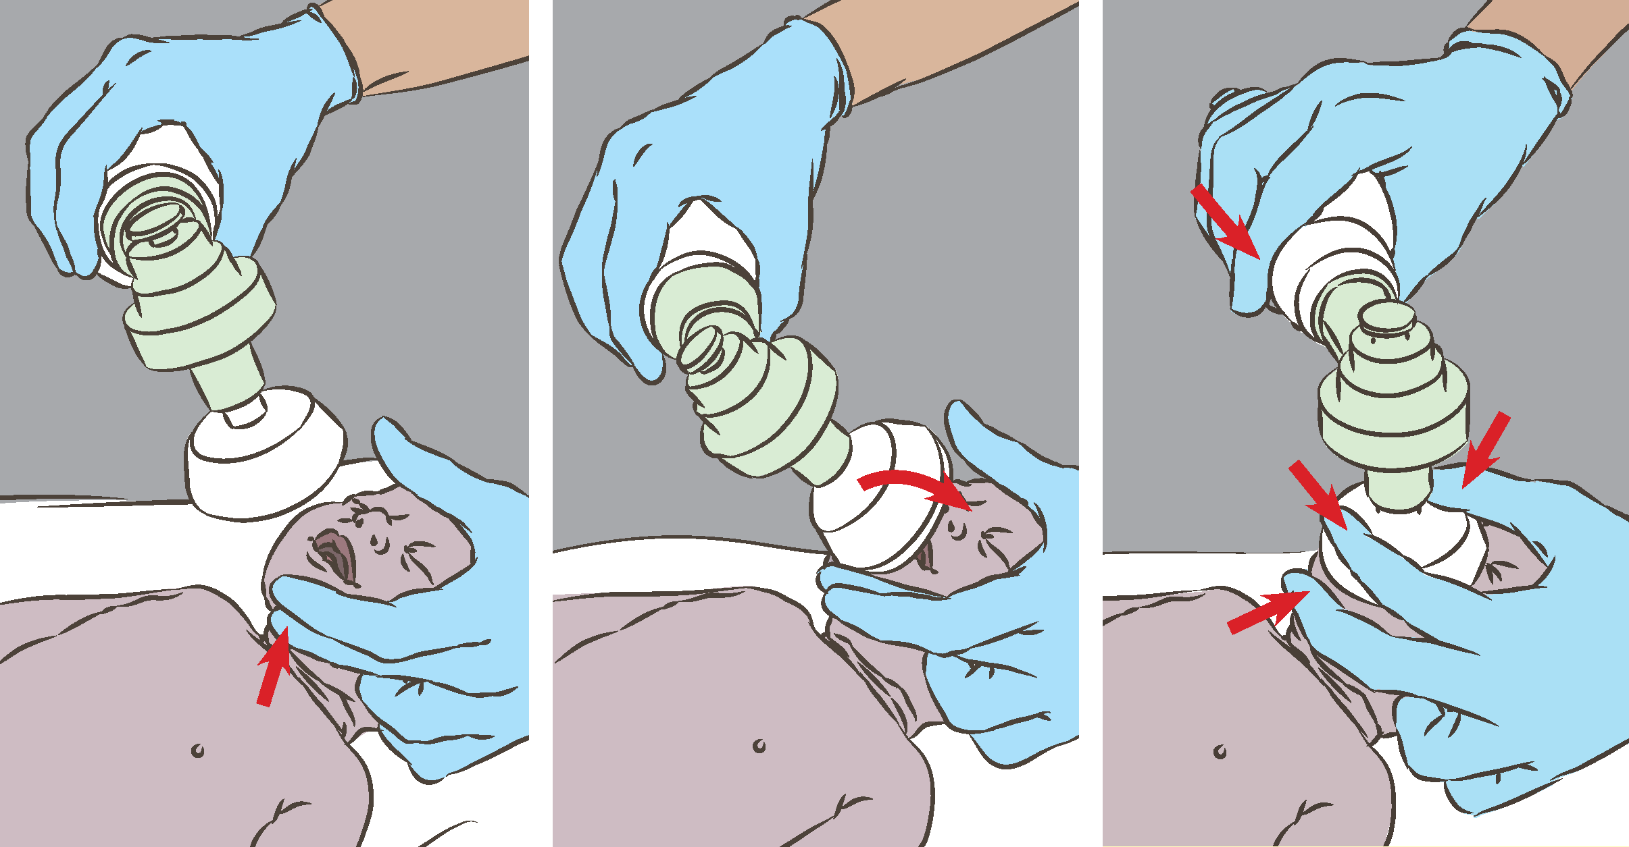
Position the mask to make a good seal and ventilate
Notes:
Practise positioning the head slightly extended.
Lift the chin up with the middle finger.
Apply the mask to the face: position the edge of the mask on the chin and roll the mask over the mouth and nose.
Make a tight seal between the edge of the mask and the face: pull up on the chin with the middle finger and press down on the top of the mask with the thumb and index finger.

Slide 23
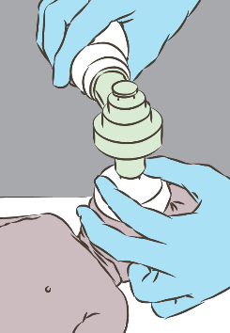
Ventilate effectively
Squeeze the bag to produce gentle movement of the chest.
If the chest is not rising:
    Reapply the mask
    Reposition the head
Ventilate at 40 breaths per minute.
Observe the chest while ventilating.
    Is it moving with the ventilation?
    Is the newborn breathing spontaneously?
    If the chest still is not rising:
    Reapply the mask
    Reposition the head
    Clear mouth and nose of secretions
    Open the mouth slightly
    Squeeze the bag harder
Notes:
Practise ventilation with a rate of 40 breaths per minute and good chest movement with each breath.
H, M, B can help recall the steps in improving ventilation:
H – reapply mask to face and reposition head
M – clear mouth and nose and open mouth slightly
B – squeeze bag harder or replace bag if it is not functioning

Slide 24
If the chest is not moving, improve ventilation
Mask seal
Correct mask size?
Mask positioned correctly?
Air escaping under the mask?
Airway blockage
Head flexed or over-extended?
Fingers blocking the airway?
Secretions blocking the airway?
Tongue blocking the posterior airway?
Abnormal lungs
Enough air entering the lungs?
Notes:
Practise with the neonatal mannequin to determine the cause of poor chest movement and improve ventilation.
Provide ventilation for 1 full minute with good chest movement.

Slide 25
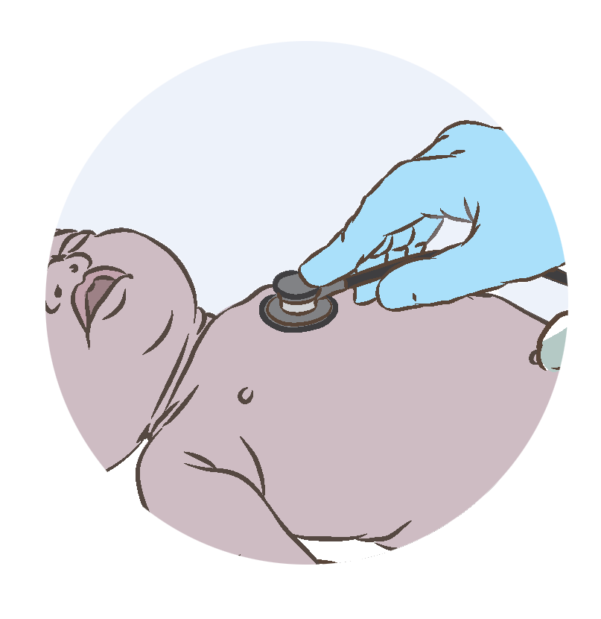

Check heart rate
Heart rate is an important indicator of whether ventilation is adequate.
Check the heart rate by
    Listening to the heartbeat with
    a stethoscope.
    Feeling the umbilical cord pulse
    (if stethoscope not available).
Is the rate normal for a newborn?
    Normal heart rate: >100 beats/min
    Slow heart rate: <100 beats/min
A baby who has a slow heart rate despite good ventilation with bag and mask may
benefit from more advanced resuscitation. Where available, initiate advanced
resuscitation without delay.
Notes:
Practise both methods of checking the heart rate with the mannequin (and a partner).
Count the heart rate.
Decide whether the heart rate is normal or slow.

Slide 26
Ventilate Elias for one minute
Did you squeeze the bag too hard or too little?
Was there good chest movement with every breath?
How many breaths per minute did you give?
How did you check that ventilation was adequate?
If Elias began breathing or crying, what did you do?
Notes:
Practise ventilating with good chest movement for 1 minute (while a partner observes).
Give feedback and then switch roles.

Slide 27
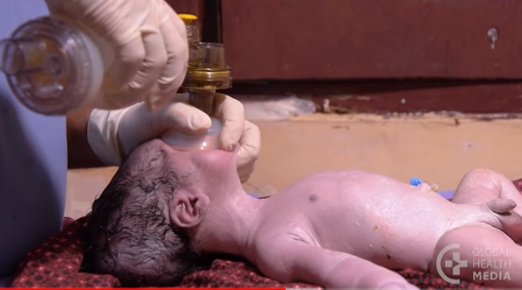

Ventilating the newborn
Helping babies breathe at birth
Notes:
View video
Is there anything you would do differently?
Ensure the newborn is kept warm; improve thermal care during resuscitation.
Ensure good chest movement.
What is new knowledge for you in this video?
Are there any skills or practices that are different from your current practice?
What provider behaviours are different from your current practice?
Does this video highlight a quality gap in your setting?

Slide 28
Assess breathing after ventilation
If breathing or crying, stop ventilation
Count breaths per minute
Look for chest in-drawing
Listen for grunting
If breathing inadequately or with chest indrawing or grunting, assess the need for continued
respiratory support.
In-drawing of chest
Grunting
Notes:
View videos
If a newborn is grunting or has chest wall indrawing, what do you do?
Do not leave a baby with breathing problems alone.
Monitor the baby every 15 minutes; if breathing difficulty is severe or worsens, refer urgently.
Seek consultation on-site or by phone.
Babies who have needed help to breathe are at higher risk of dying in the first days than those who breathe on their own.
Monitor closely for danger signs throughout the stay in the facility and the need for extra support.
It may be necessary to refer a baby with breathing problems for advanced care with supplemental oxygen, other breathing support or treatment for infection.

Slide 29
Care after resuscitation

Slide 30
Monitor with mother
If breathing well (>30 breaths/min) with good tone
and activity:
Place skin-to-skin, cover to keep warm
Reassure mother and companion
Monitor closely. Check breathing, temperature
and colour every 15 minutes
Explain to the mother how to check the baby
(breathing and colour) and when to call for help
Help mother initiate breastfeeding
Do not separate mother and baby or leave mother
and newborn alone immediately after birth.
Notes:
Practise communicating with mother as you monitor the baby in skin-to-skin contact.
Explain what was done to help the baby breathe.
Check breathing, temperature and colour.
Explain to mother and the companion how to check the baby.

Slide 31
Monitoring and ongoing care after ventilation
Form groups (mother, companion, neonatal nurse).
Monitor and provide ongoing care for Elias and Sophie.
Debrief with your team and facilitator.
You ventilated Elias with bag and mask for 4 minutes.
He is now breathing on his own at 36 breaths per minute.
There is no chest indrawing.
Notes:
Simulation
Skills and performance – participants demonstrate monitoring and ongoing care after resuscitation.
Assessing breathing: rate, grunting, and chest indrawing.
Keeping the mother and newborn together in the birthing area, not separating them.
Explaining to the mother and family what happened and the newborn’s condition.
Monitoring newborn and mother every 15 minutes during the first hour.
Encouraging the mother to breastfeed as soon as the baby is ready - to prevent low blood sugar (hypoglycaemia).
Recording in the newborn’s notes and in the labour record, including:
Date and time of birth
Steps of resuscitation performed
Duration of resuscitation
Outcome
Debriefing – participants self-reflect and give feedback to one another in their roles.
Provision of care (performance objectives)
What was done well?
What could have been done better?
What will you change the next time?
Was data recorded?
Experience of care
Was the communication respectful and the language appropriate?
Was handling of the baby gentle?
Were infection prevention practices followed?

Slide 32
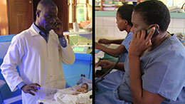
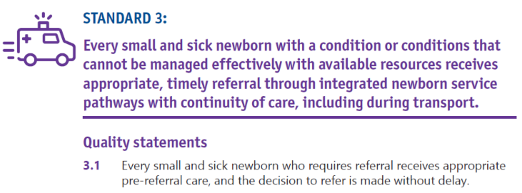
What is needed for safe referral of a newborn?
Referral can be either within or between health facilities.
Communicate and gain consent of parents.
Communicate appropriate information to receiving health staff.
Transfer newborn in KMC position with mother when possible.
Continue supportive care during transfer.
Referring a Small Baby
Notes:
View video
To learn more
Standards for improving the quality of care for small and sick newborns in health facilities

Slide 33
Refer to the appropriate level of care
Seek consultation and decide on advanced care.
Communicate with the receiving facility to arrange referral.
Explain to the mother and companion what happened and what is needed.
Obtain consent and support the family.
Complete labour record, newborn record, referral form.
Stabilize the newborn and mother as indicated:
Keep the newborn warm
Continue ventilation
Consider alternative methods of feeding
Continue skin-to-skin care and monitoring of the baby throughout transportation.
Temperature
Breathing and colour
Notes:
In what circumstances would you refer a baby who has required help to breathe?
Slow breathing (< 30 breaths/min)?
Gasping?
Grunting?
Severe chest indrawing?
Slow heart rate (<100 beats/min)?
Practise the steps outlined as a dialogue between:
the health worker and the receiving center and
the health worker and the family.

Slide 34
When is ventilation stopped if the newborn is not breathing?
The decision to stop ventilation depends on access to advanced care, national
and facility policies and communication with the family.
If advanced care or transport is not available, consider stopping ventilation
and discuss with the parents…
    … if no heart rate has been detected after 10 minutes
    of effective ventilation OR
    … if the heart rate remains slow, <60 bpm, and
    the baby is not breathing after 20 minutes.
If the heart rate is normal but the baby is not breathing, seek advice from
a referral centre.
Notes:
The decision to stop when ventilation is not successful is always difficult.
Usually, a senior member of the team will take this responsibility.
The decision will depend on access to advanced care and national and facility policies.
Guidelines for when to stop ventilation may differ where there is access to advanced care (medications, oxygen, mechanical ventilation)
Communication with the family is key and should be compassionate and sensitive at this very difficult time.

Slide 35
What do you do if resuscitation is not successful?
Provide compassionate, supportive care.
Explain what has happened and answer any questions.
Ensure that companion or family member comforts and cares for mother.
Allow mother and family to see and hold baby (ensure that cultural practices
are respected).
Register birth and death.
Document key information in notes (sex, birthweight, estimated gestational age,
date and times of birth and death).
Fill out perinatal death surveillance and response (PDSR) form.
Ensure postnatal care of mother including prevention of engorgement and
family planning.
Organize counselling and support for mother and family.
Notes:
Discuss how these steps are carried out in your facility.

Slide 36
Basic resuscitation at birth
Form groups (mother, companion and midwife).
Help Elias to breathe.
Debrief with your team and facilitator.
Sophie is a healthy 25-year-old teacher.
There are no complications.
You deliver Elias. He is not breathing.
Notes:
Repeat simulation
Skills and performance – participants demonstrate care for a newborn who requires bag and mask ventilation for 2 minutes before beginning to breathe.
Drying thoroughly
Assessment of crying/breathing – not breathing
Keeping warm with skin-to-skin contact
Stimulating to breathe
Clearing the airway if needed – not needed
Assessment of breathing- not breathing
Calling for help
Clamping and cutting the umbilical cord
Preparing to ventilate
Ventilating with bag and mask – ventilate for 2 minutes
Improving ventilation – whenever chest movement inadequate
Assessing of heart rate
Deciding on advanced care
Debriefing – participants self-reflect and give feedback to one another in their roles.
Provision of care (performance objectives)
What was done well?
What could have been done better?
What will you change the next time?
Was data recorded in notes on resuscitation process, duration and outcome?
Experience of care
Was the communication respectful and the language appropriate?
Was handling of the baby gentle?
Was the baby kept warm?

Slide 37
Summary:
Basic resuscitation of the newborn
In this module you have:
Described the newborn who requires help to breathe at birth.
Demonstrated keeping a baby warm, stimulation to breathe,
and appropriate clearing of the airway.
Practised ventilation with bag and mask.
Practised checking the heart rate and determining if it is normal or slow.
Demonstrated how to care for a newborn after resuscitation and when resuscitation is not successful.

Slide 38
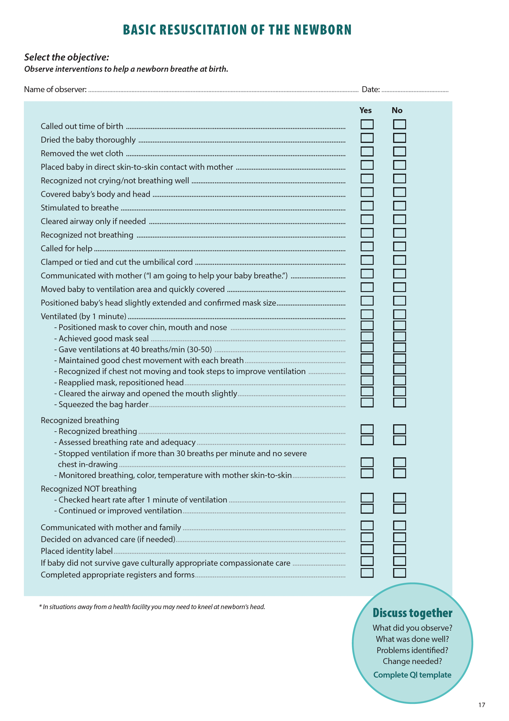
Notes:
Review the Clinical practice checklist before observing or participating in selected simulations (see additional resources).

Slide 39
Notes:
After the clinical practice, discuss the observations made, possible reasons for practices, and changes needed to improve the quality of essential newborn care.
What new things will you do?
What old things will you not do?
How will you make a change?

Slide 40
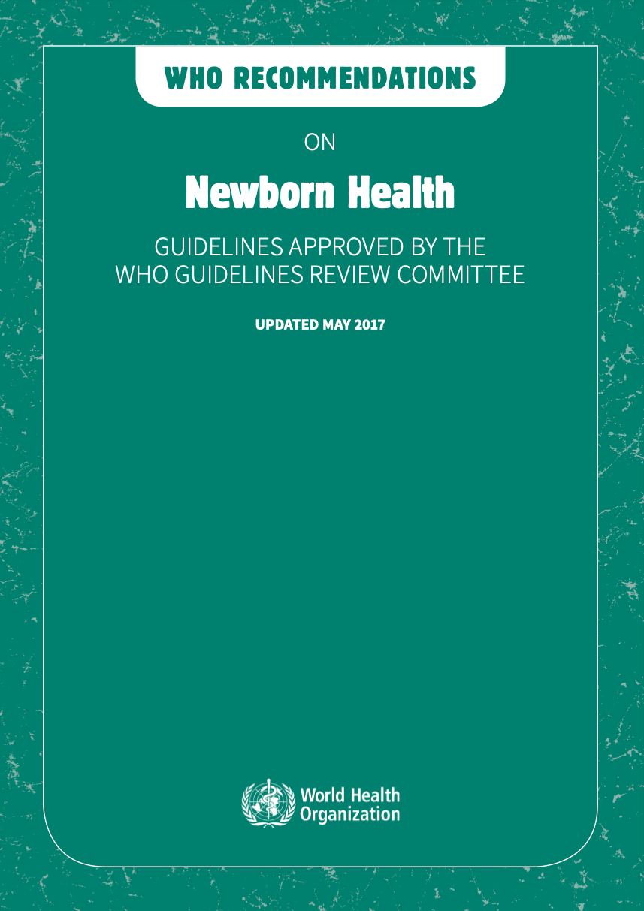
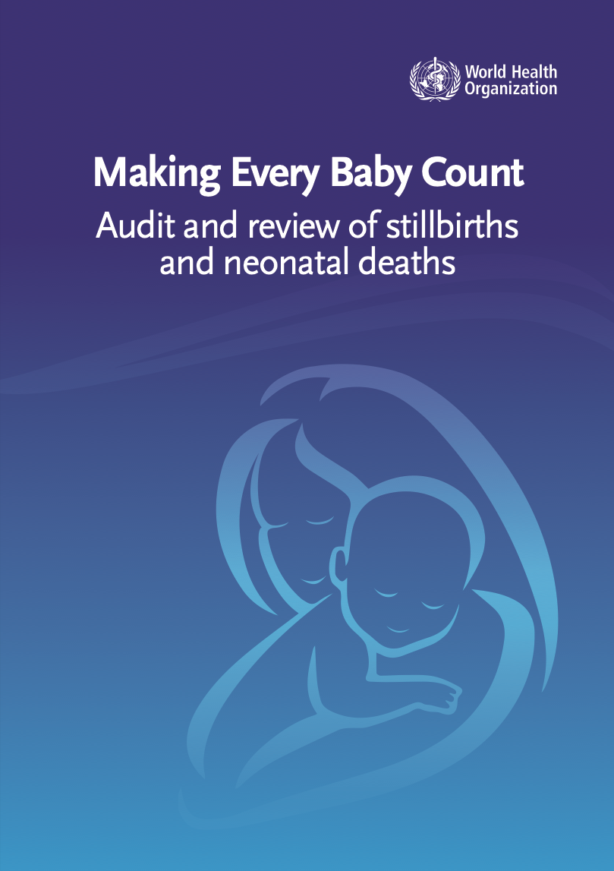
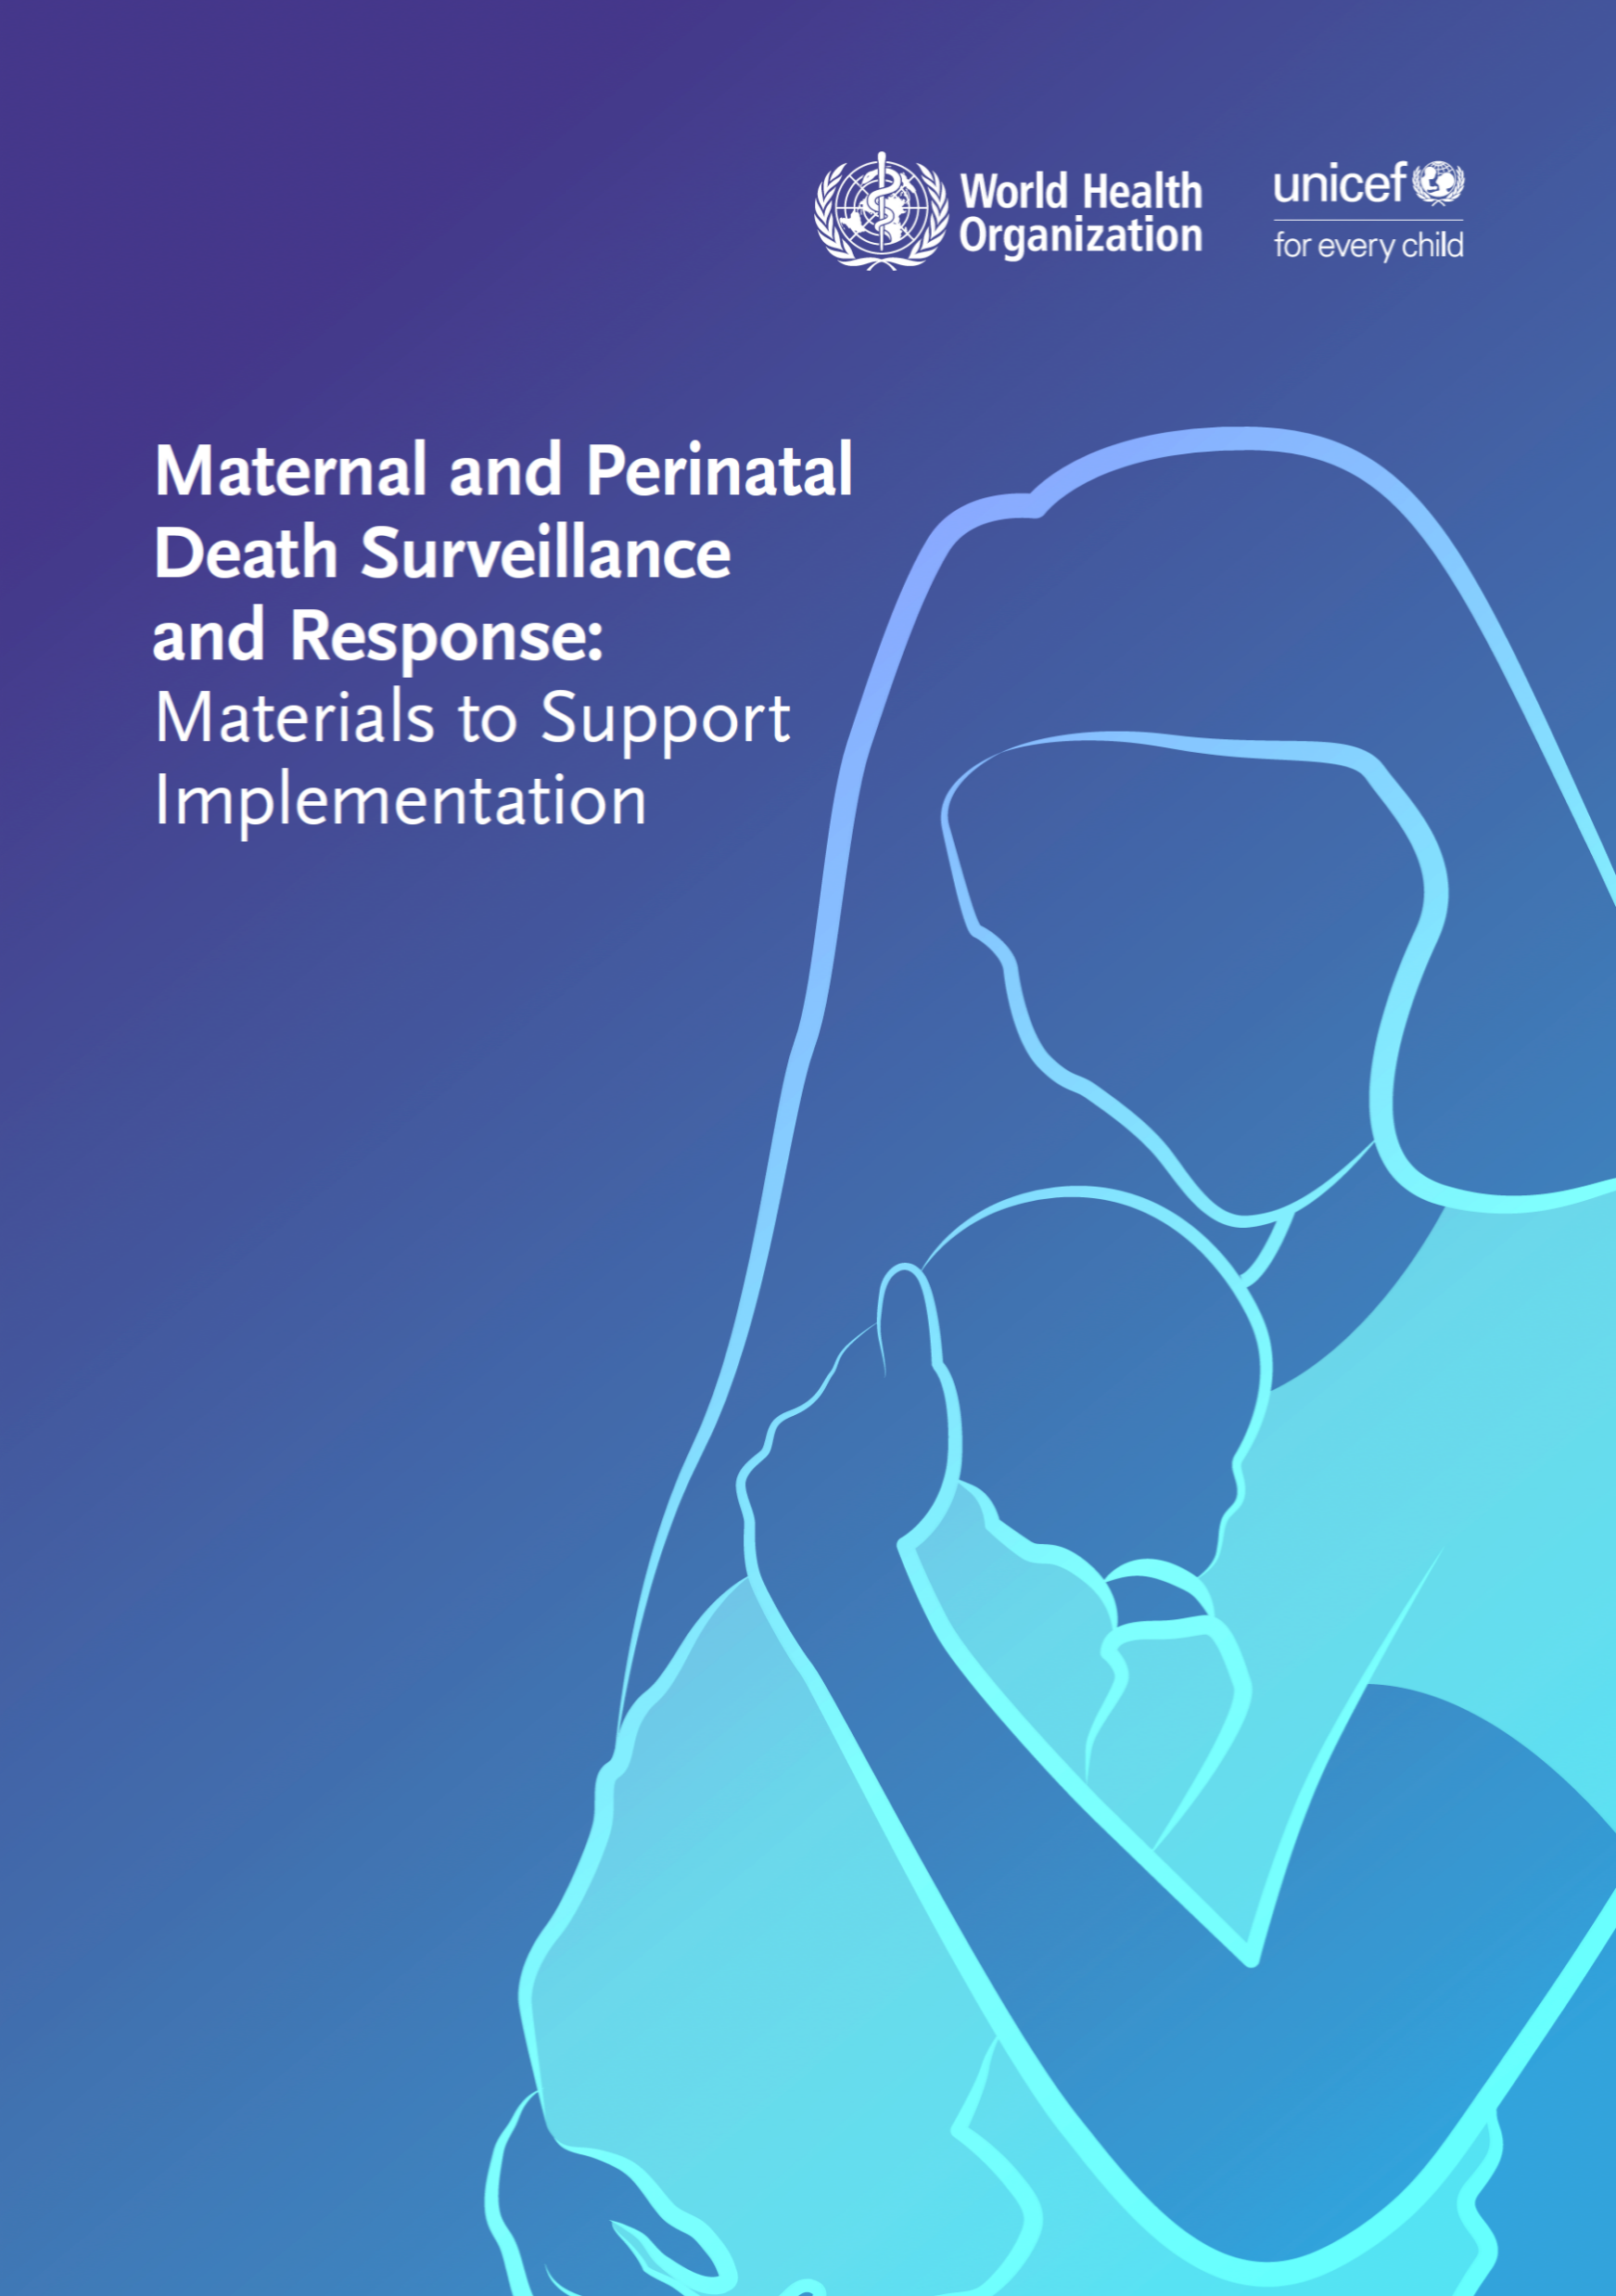
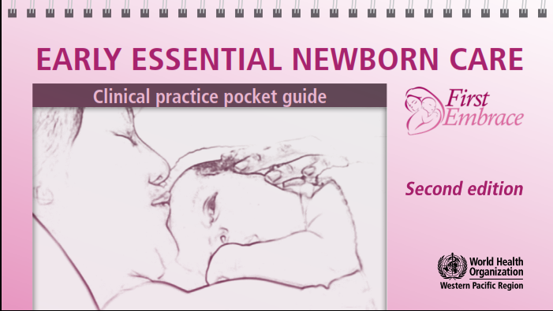
References and additional resources
Neonatal resuscitation AIIMS
Teaching points for newborn resuscitation
ENC video collection

Slide 41
Thu is gasping
Form groups (mother, midwife, companion).
Show what you do.
Show what you do next.
Show what you do next.
Debrief with your team and facilitator.
Thu has just been born and is gasping.
After 1 minute of ventilation, Thu starts crying.
Thu is breathing 50 breaths per minute. There is no chest in-drawing.
Notes:
Simulation
Skills and performance – participants demonstrate care for a newborn who requires brief bag and mask ventilation before breathing well.
Thoroughly drying stimulating the baby and keeping the baby warm
Positioning correctly, ventilating at 40 breaths per minute with adequate chest movement
Improving ventilation as necessary for good chest movement.- ventilate for 1 minute
Assessing breathing - no chest indrawing
Placing in skin-to-skin contact, covering and encouraging breastfeeding
Monitoring every 15 minutes for breathing and warmth – breathing 50 breaths/min
Communicating effectively with mother, explaining what happened and what will happen next.
Debriefing – participants self-reflect and give feedback to one another in their roles.
Provision of care (performance objectives)
What was done well?
What could have been done better?
What will you change the next time?
Was data recorded in notes and partograph resuscitation process, duration and outcome?
Experience of care
Was the communication respectful and the language appropriate?
Was handling of the baby gentle?
Was the baby kept warm?

Slide 42
Aisha has just been born through meconium-stained fluid
Form groups (mother, nurse, companion).
Show what you do.
Show what you do next.
Debrief with your team and facilitator.
Aisha has just been born.
The amniotic fluid was meconium-stained.
After drying and stimulation she is crying.
Aisha is breathing, with a respiratory rate of 46 breaths per minute.
There is no chest in-drawing.
Notes:
Simulation
Skills and performance – participants demonstrate care of a vigorous baby with meconium in the amniotic fluid.
Drying thoroughly
Assessment of crying/breathing - crying
Keeping warm with skin-to-skin contact
Stimulating to breathe – not needed
Clearing the airway if needed – not needed
Assessment of breathing – breathing 46 breaths/min with no chest indrawing
Positioning Aisha in skin-to-skin contact and encouraging breastfeeding
Monitoring every 15 minutes for breathing and warmth
Communicating with mother what happened and what to observe
Recording in the newborn and labour case notes the resuscitation duration and outcome
Note: Resuscitation guidelines support not suctioning Aisha, which in the past might have happened.

Slide 43
Arabella has just been born through heavily meconium-stained fluid
Form groups (mother, nurse, companion).
Show what you do.
Show what you do next.
Debrief with your team and facilitator.
Arabella has just been born.
The amniotic fluid was heavily meconium-stained.
After drying, she is not crying or breathing
After 3 minutes Aisha is breathing, with a respiratory rate of 46 breaths/minute.
There is chest in-drawing.
Notes:
Simulation
Skills and performance – participants demonstrate care for a baby born through amniotic fluid heavily stained with meconium.
Drying thoroughly
Assessment of crying/breathing – not crying or breathing
Keeping warm with skin-to-skin contact
Stimulating to breathe
Clearing the airway if needed – clearing of thick meconium from mouth and nose
Assessment of breathing – not breathing
Calling for help
Clamping and cutting the umbilical cord
Preparing to ventilate
Ventilating with bag and mask – ventilate for 3 minutes
Improving ventilation – as needed for good chest movement
Assessment of heart rate and breathing – breathing 46 breaths/min with chest indrawing
Deciding on advanced care – referral
Recording the resuscitation actions, duration and outcome.
Debriefing – participants self-reflect and give feedback to one another in their roles.
Provision of care (performance objectives)
What was done well?
What could have been done better?
What will you change the next time?
Was data recorded in notes and partograph?
Experience of care:
Was the communication respectful and the language appropriate?
Was handling of the baby gentle?
Was the baby kept warm?

Slide 44
Iqbal has just been born and is not breathing
Form groups (mother, doctor, companion).
Show what you do.
Show what you do next.
Show what you do next.
Debrief with your team and facilitator.
Iqbal has just been born. He is not breathing at all.
After 4 minutes of ventilation, he starts breathing spontaneously.
Iqbal is breathing 65 breaths per minute and has severe chest in-drawing.
Notes:
Simulation
Skills and performance – participants demonstrate care for a newborn who needs prolonged ventilation with bag and mask.
Drying thoroughly
Assessment of crying/breathing – not breathing
Keeping warm with skin-to-skin contact
Stimulating to breathe – not breathing
Clearing the airway if needed – not needed with clear fluid
Assessment of breathing – not breathing
Calling for help
Clamping and cutting the umbilical cord
Preparing to ventilate
Ventilating with bag and mask – ventilate 4 minutes
Improving ventilation – as needed for good chest movement
Assessment of breathing – breathing 65 breaths/min with severe chest indrawing
Continuing breathing support
Arranging for immediate referral, communicating with referral unit
Explaining to the parents what has happened, newborn’s condition and gaining consent.
Completing the referral form and clinical notes
Continuing supportive care during transfer
Debriefing – participants self-reflect and give feedback to one another in their roles.
Provision of care (performance objectives)
What was done well?
What could have been done better?
What will you change the next time?
Was data recorded in notes and partograph?
Experience of care:
Was the communication respectful and the language appropriate?
Was handling of the baby gentle?
Was the baby kept warm?

Slide 45
Nat has just been born and is not breathing
Form groups (mother, doctor, companion).
Show what you do.
Show what you do next.
Debrief with your team and facilitator.
Nat has just been born to Miriam. He is not breathing at all.
After 20 minutes of ventilation, Nat is not breathing spontaneously at all.
On palpating the umbilical cord, you cannot detect a pulse.
You listen with your stethoscope. You hear no heart beat.
Notes:
Simulation
Skills and performance – participants demonstrate care for a newborn who fails to breathe after prolonged bag and mask ventilation.
Drying thoroughly
Assessment of crying/breathing – not breathing
Keeping warm with skin-to-skin contact
Stimulating to breathe
Clearing the airway if needed – not needed
Assessment of breathing - not breathing
Calling for help
Clamping and cutting the umbilical cord
Preparing to ventilate
Ventilating with bag and mask – ventilate 20 minutes
Improving ventilation – as needed for good chest movement
Assessing heart rate and breathing.
Following guidelines on when to stop resuscitation
Explaining to the mother and family what happened with sensitivity.
Following guidance on culturally appropriate practices such as dressing the baby and asking Miriam if she wants to hold the baby.
Arranging for someone close to stay with the mother.
Filling out the birth and death certificates.
Recording in the medical record, ensuring key data recorded include sex, estimated gestational age, weight, duration of labour and information from partograph.
Filling out perinatal death review and response form (if available).
Debriefing – participants self-reflect and give feedback to one another in their roles.
Provision of care (performance objectives)
What was done well?
What could have been done better?
What will you change the next time?
Experience of care:
Was the communication respectful and the language appropriate?
Was handling of the baby respectful?

Slide 46
When do you use air or oxygen for newborn resuscitation?
Find the recommendations and review the evidence on pages 34–36.
Notes:
Find the answer on pages 34-36.

Slide 47
Recommendations and reasons
In newly born term or preterm (>32 weeks gestation) babies requiring positive
pressure ventilation, ventilation should be initiated with air.
Benefits of using air for resuscitation:
    Lower short-term mortality in term and preterm neonates >32 weeks gestation
    without apparent harms.
    Requires significantly fewer resources than 100% oxygen.
Infants < 32 weeks, who often need resuscitation with higher oxygen
concentrations, may have better outcome if resuscitation is initiated with
30% rather than 90% oxygen.
Notes:
Is this recommendation currently being applied in your place of work?
If yes, what enabling factors support the application of this recommendation?
If no, what are the barriers to applying this recommendation?

Slide 48

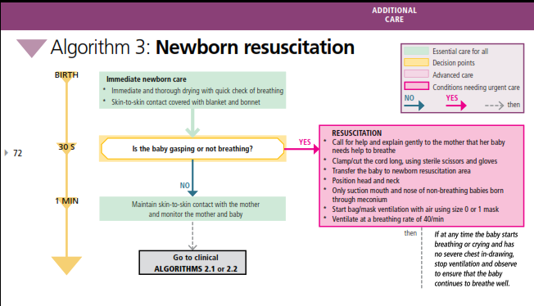
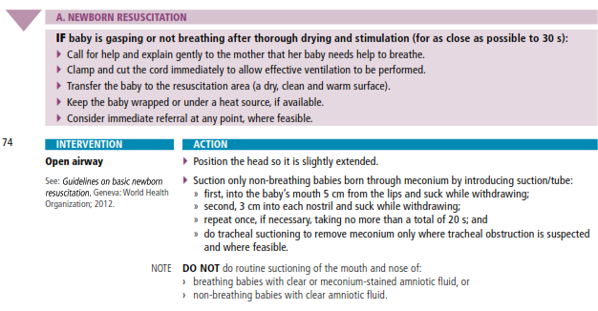
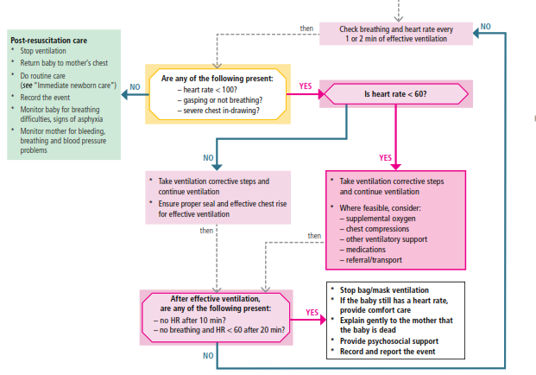
Example of resuscitation algorithm
Notes:
The action plan takes you through the steps for newborn resuscitation.
What do you use in your place of work?
Here is an example of an algorithm used for newborn resuscitation used in several regions of the world.
Use the action plan or protocol adopted by your Ministry of Health.

Slide 49
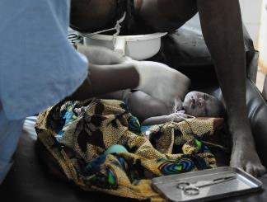
What actions ensure basic newborn resuscitation for all non breathing newborns?
Ensure all staff can provide quality basic resuscitation.
Ensure availability of functional equipment.
Use up-to-date guidelines on resuscitation.
Conduct quality improvement activities, documenting
and monitoring progress and outcomes for newborns.
Maintain resuscitation skills of all staff
attending deliveries (coaching, mentoring).
Maintain skills of staff responsible for essential
newborn care and care of sick or small newborns.
Ensure teamwork and debrief together after
every resuscitation.
©WHO/Dr Helenlouise Taylor
Notes:
What actions could you carry out to improve basic resuscitation in the health facility?

