Slide 1
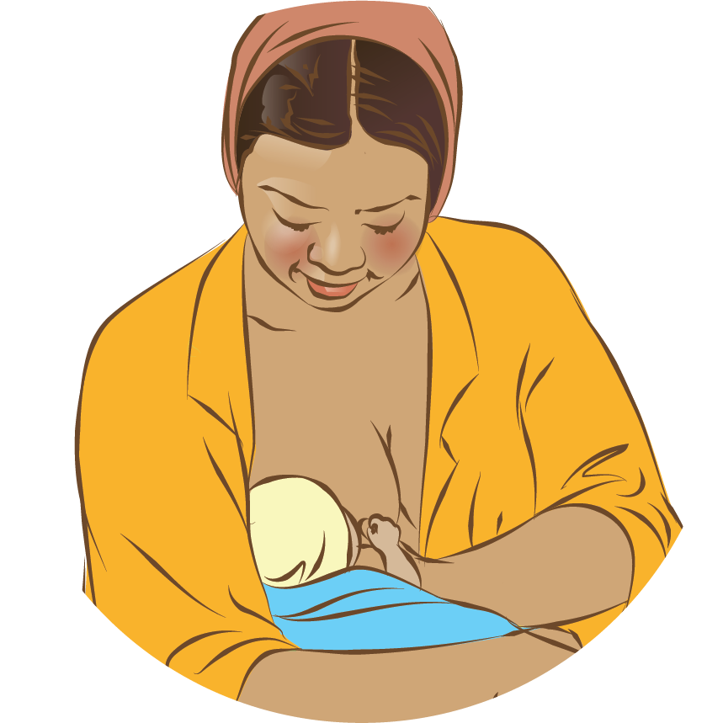

Breastfeeding:
Ensuring a good start
Breastfeeding:
Ensuring a good start
Notes:
© World Health Organization 2024. All rights reserved.
Materials for demonstrations, practice, and simulations
One set per group of 3 participants and a set for the facilitator (as available).
Newborn mannequin or breastfeeding doll (wide-open mouth)
Breast models or breast simulator filled with water (as available)
Cloth or shawl to cover mother while breastfeeding
Local clinical notes and referral forms
Breast feeding observation forms and local tools

Slide 2
Content
Goal and learning outcomes
The situation
Principles of lactation
Benefits of breast milk and breastfeeding
Early initiation
Practical support
Summary
Clinical practice
Quality improvement
References and additional resources

Slide 3
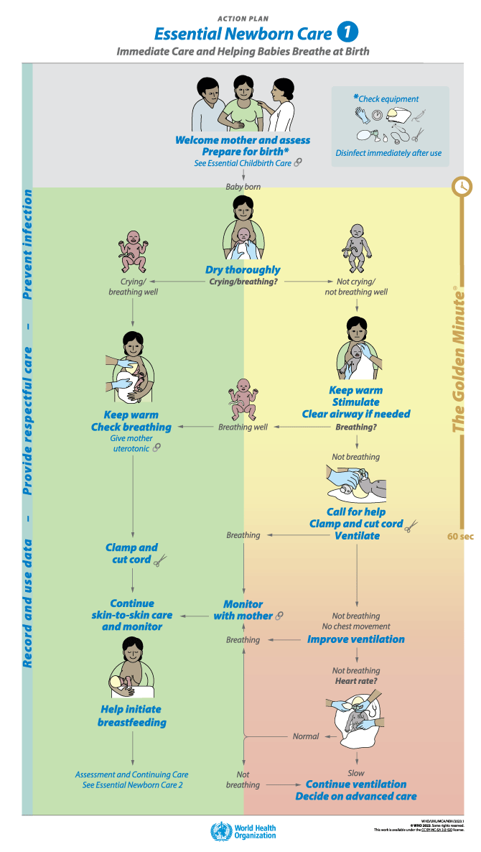
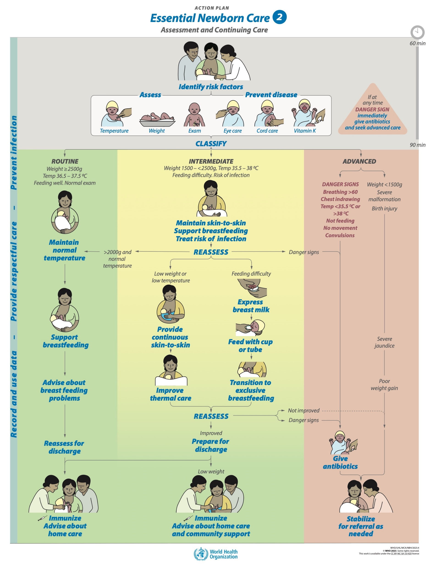
Goal and learning outcomes
Early initiation and establishment of breastfeeding is supported for all newborns.
Know the principles of lactation.
Identify good and poor positioning and attachment.
Give practical support to mothers
for early initiation of breastfeeding and successful breastfeeding.
Promote early and exclusive
breastfeeding in health facilities
and at home.

Slide 4
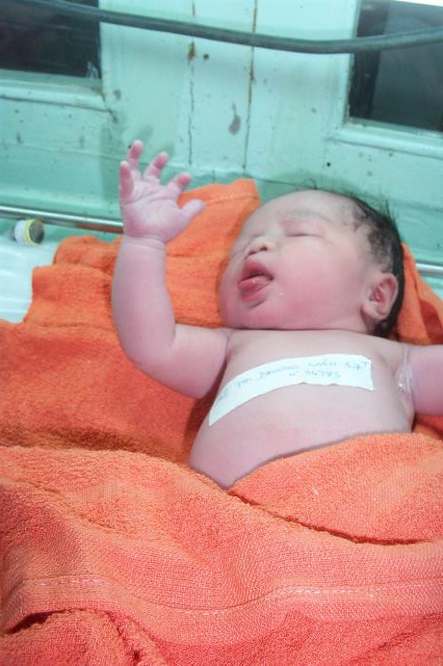
The situation
Ella was born 30 minutes ago by spontaneous vaginal delivery.
She is showing feeding cues.
How would you have managed Ella differently to ensure a good start
for breastfeeding?
© WHO/VN Dr Helenlouise Taylor
Notes:
Reflect on the care of Ella and her mother.
Would you do anything differently?
Is this respectful care?

Slide 5
Support early initiation of breastfeeding
Form groups (mother, midwife, companion).
Support Leela to initiate breastfeeding.
Support Charity to initiate breastfeeding.
Debrief with your team and facilitator.
Leela delivered Ekta 50 minutes ago by spontaneous vaginal delivery.
Ekta is in skin-to-skin contact with her mother on the post natal ward.
Leela asks for support to breastfeed. She thinks the baby may be hungry.
This is her first baby.
Charity is in recovery. She delivered by caesarean section 60 minutes ago.
She is uncomfortable.
Her baby is showing feeding cues. She asks for help to breastfeed.
Notes:
Baseline simulation
Choose a simulation that is appropriate to your situation.
Skills and performance – participants demonstrate communicating effectively and giving practical support for breastfeeding.
Helping mother find a comfortable position semi-reclining with the newborn on chest/upper abdomen
Recognizing feeding cues
Communicating and confirming the signs of good positoning for attachment and maternal comfort.
Communicating and confirming the signs of good attachment.
Counseling mother on the results of poor attachment
Debriefing – participants self-reflect and give feedback in their roles.
Provision of care (performance objectives)
What was done well?
What could have been done better?
What will you change the next time?
Was data recorded and used?
Did the health worker give samples of breast-milk substitutes or advertising materials?
Experience of care
Was the communication respectful and the language appropriate?
Was handling of the baby gentle?
Were infection prevention practices followed?
Did the health worker ask for permission before touching mother or baby?
Did the health worker guide mother’s own hand in giving practical support?

Slide 6


What are the WHO recommendations?
Immediate and uninterrupted skin-to-skin contact
from birth and with early initiation of breastfeeding
within one hour of birth
Exclusive breastfeeding with the infant receiving only
breast milk and no other foods or fluids
Breastfeeding responsively, early and often, and for as
long as the baby wants, day and night
Counselling mothers on the risks and use of feeding
bottles, teats or pacifiers

Slide 7
Principles of lactation

Slide 8
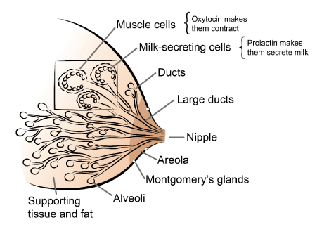
How does breastfeeding work?
Anatomy of breast
Notes:
Consider each part of the breast and its function in turn:
Nipple: opening of milk ducts
Areola: dark skin surrounding the nipple. A baby needs to have a large amount of the areola in the mouth to feed well.
Montgomery’s glands: secrete an oily fluid to keep the skin healthy, clean and lubricated. They are the source of the smell of the mother’s breasts, which helps the baby find the breast and recognize mother.
Alveoli: small sacs made of milk-secreting cells. The hormone prolactin stimulates these cells to produce milk.
Muscle cells: surround the alveoli contracting and squeezing out the milk. The hormone oxytocin makes the muscle cells contract.
Ducts: Small tubes, or ducts, carry milk from the alveoli to the outside.
Between feeds, milk is stored in the alveoli and small ducts.
The ducts join to form 7 to 10 larger ducts that pass through the nipple.
The larger ducts beneath the areola dilate during feeding and hold the breast milk temporarily during the feed.
The secretory alveoli and ducts are surrounded by supporting tissue and fat.

Slide 9
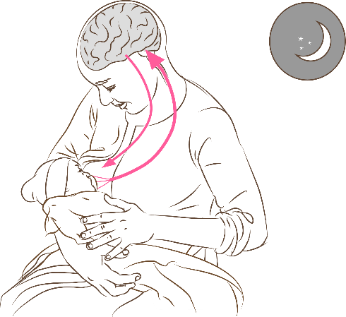
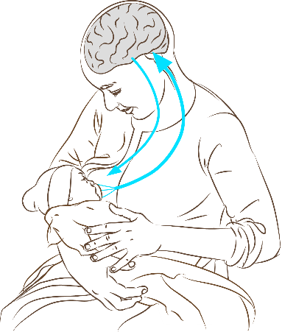
Which hormones are involved in milk production?
Sensory impulses from nipple
Prolactin in blood
Prolactin: milk production
Secreted after feed to produce next feed
Higher levels during night
Suppresses ovulation
Oxytocin: milk flow
Works before or during a feed to make
milk flow
Makes uterus contract
Sensory impulses from nipple
Oxytocin in blood
Notes:
There are 2 hormones involved in milk production (prolactin) and milk flow (oxytocin).

Slide 10
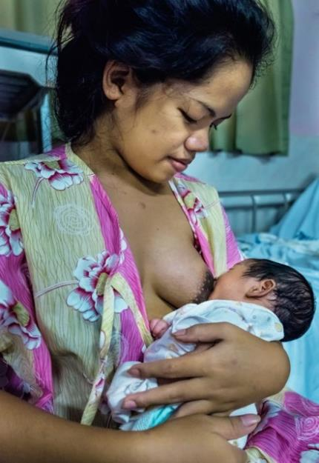
What helps or hinders the oxytocin reflex for milk flow?
What helps the reflex?
Thinking lovingly of the baby
Hearing the baby
Seeing the baby
Smelling the baby
Touching the baby
Having confidence in ability to breastfeed
What hinders the reflex?
Worry
Stress
Pain
Doubt
Separation of the baby from the mother
© WHO/Yoshi Shimizu
Notes:
The attitudes and behaviours of the health worker can both help and hinder the oxytocin reflex.
A supportive health worker can improve mother’s confidence.

Slide 11
What are the signs and sensations of oxytocin reflex?
A squeezing or tingling sensation in the breasts just before or during a feed.
Milk flowing from the breasts when thinking of the baby or hearing
the baby cry.
Milk dripping from the other breast when the baby is suckling.
Milk flowing from the breast in fine streams, if the baby comes off the
breast during a feed.
Pain from uterine contractions, sometimes with a rush of blood, during
feeds in the first week.
Slow deep sucks and swallowing by the baby, which show that breast milk
is flowing into the mouth.

Slide 12
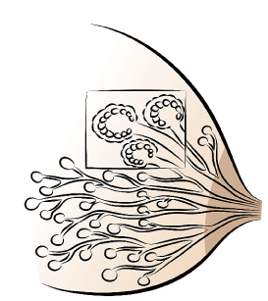
What controls milk supply?
An inhibitor in breast milk, feedback
inhibitor of lactation (FIL), blocks
milk production.
If breast remains full of milk,
there will be less milk at the next
feed (negative feedback).
Milk secreting cells being blocked by FIL
Notes:
Production of breast milk is controlled within the breast itself.
If milk is removed from the breast, the inhibitor level falls and milk production increases. The amount of milk produced depends on how much is removed.
If a baby stops suckling from one breast, that breast stops making milk.
If a baby suckles more from one breast, that breast makes more milk and becomes larger than the other.
If a baby cannot suckle from one or both breasts, the breast milk must be removed by expression for production to continue.
This local control of breast-milk production is especially important after the first few weeks, when the level of prolactin decreases.

Slide 13
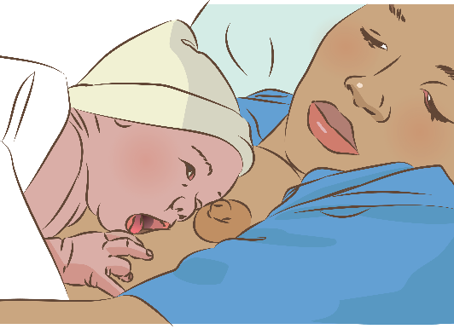
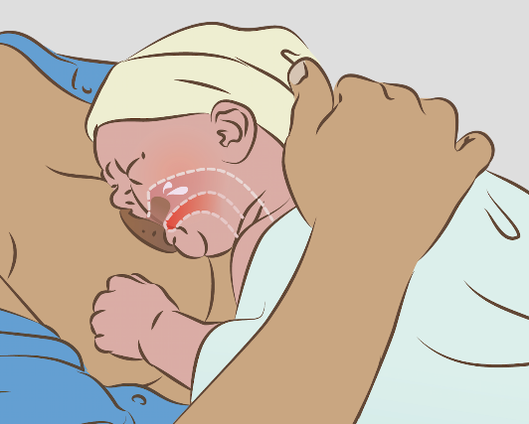
What newborn reflexes are involved in breastfeeding?
Rooting reflex
When something touches the lips, the baby
opens the mouth and puts the tongue down
and forward.
Sucking reflex
When something touches the palate,
the baby sucks.
Swallowing reflex
When the mouth fills with milk, the baby
swallows.
Breastfeeding is a skill, NOT a reflex
The mother learns to position the baby.
The baby learns to take the breast.
Notes:
Taking the breast far enough into the mouth is NOT completely automatic for the baby.
Positioning the baby close to the breast underneath the nipple with mother in a comfortable reclining position helps the reflexes work.
Most healthy term infants can attach themselves to the breast instinctively in the first hour after birth.
Mother and baby must be kept together in a comfortable, supportive environment that helps the reflexes. Mothers need to learn how to avoid uncomfortable positions and ways of holding the baby that inhibit the reflexes.
Health workers need not interfere if things are going well.
However, they should be aware of those mothers who do need help.

Slide 14
Benefits of breast milk and breastfeeding

Slide 15
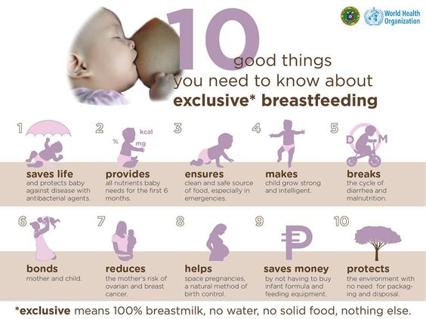
What are benefits of breast milk and breastfeeding?
Benefits of breast milk
Provides complete nutrients
Digests easily
Protects against infection
Protects against long-term
noncommunicable diseases
Costs less than artificial feeding
Benefits of breastfeeding
Helps bonding and development
Helps delay a new pregnancy
Protects mother’s health
Notes:
View video
What new knowledge is presented in this video?
Does this video highlight any quality gaps in your facility?
To learn more
UNICEF best-beginnings
Responsive nurturing care

Slide 16
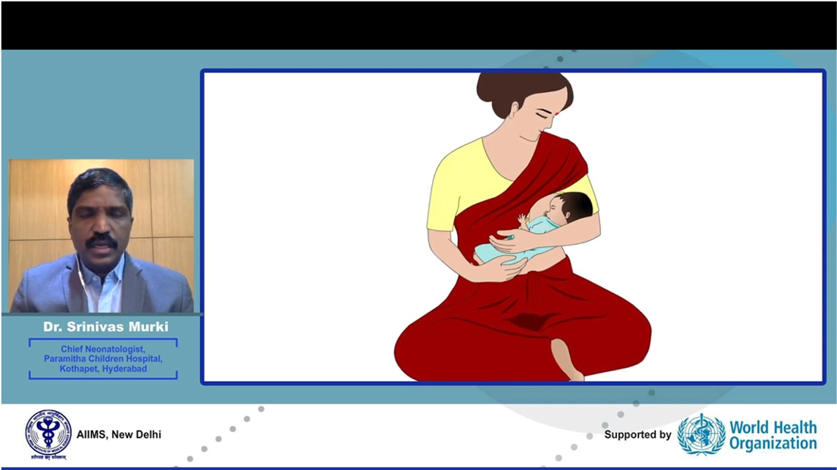


How does breastmilk meet a newborn’s nutritional needs?
Breast milk composition
Notes:
View video
What is colostrum?
Colostrum is the first milk a newborn consumes immediately after birth. Colostrum is present in the breasts before a baby is born in small amounts, approximately 2–10 mL.
Colostrum has many benefits:
Contains immune factors - more white blood cells than mature milk, protecting against infections
Has a mild laxative effect - helping to clear the baby’s gut of meconium and bilirubin
Contains many growth factors – to mature the intestine and provide a protective lining that helps prevent allergies and food intolerance.
Is rich in vitamin A.
What is foremilk?
Foremilk is the watery breastmilk that is produced early in a feed.
What is hindmilk?
Hindmilk is the fat-rich breastmilk that is produced later in a feed.
What does the phrase “milk coming in” mean?
A few days after delivery, colostrum changes into mature milk and the volume increases. A woman’s breasts feel full, hard and heavy. Some people call this the milk “coming in”, but this can be confusing to a new mother. It is better for health care workers to describe the changes in her milk in the first week.
To learn more
Maximising-breastmilk production

Slide 17
Early initiation

Slide 18

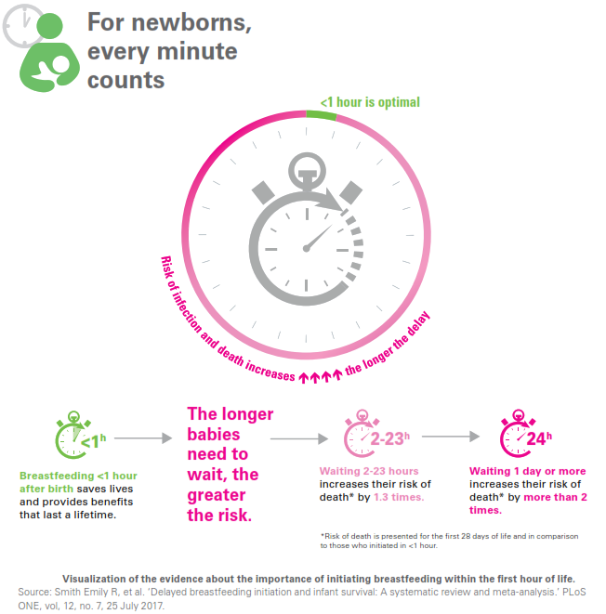
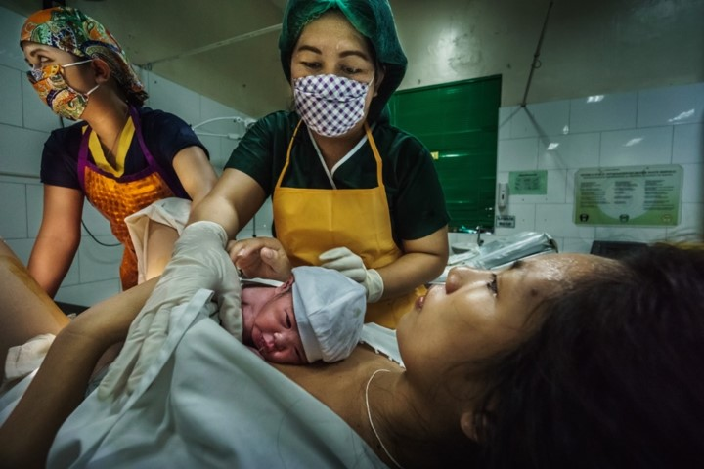
Why is early initiation of breastfeeding important?
© WHO/Yoshi Shimizu
Notes:
Skin-to-skin contact after birth promotes reflexes and behaviours needed to initiate breastfeeding.
Separation interferes with initiation of breastfeeding.
Delay in initiation contributes to difficulties breastfeeding and increases the risk of mortality.
To learn more
Meeting baby for the first time

Slide 19
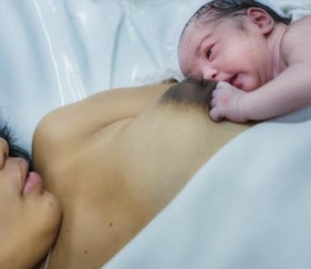


What do you observe?
All images: © WHO/Yoshi Shimizu
The baby is moving his whole body to reach the nipple and breast.
Notes:
As the baby is moving towards the breast, what is the health worker doing?
The health worker is providing a calm relaxed atmosphere and not interfering in the process in order to support the normal progression:
Most babies slowly crawl toward the breast while they are in skin-to-skin contact.
If the mother has received medication, the baby may take much longer to respond.
When a mother and baby are in skin-to-skin contact without interruption, the baby will typically work through a series of instinctual pre-feeding behaviours called the 9 stages:
Birth cry
Relaxation
Awakening
Activity
Crawling
First resting
Familiarizing
Suckling
Sleeping
A longer period of skin-to-skin contact is recommended if the baby has not suckled by one hour after birth.

Slide 20
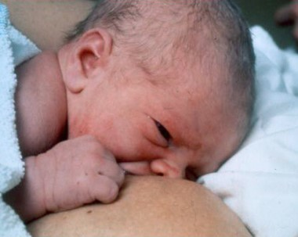
What do you observe?
Self-attachment or baby-led
attachment
A baby may take 10–90 minutes before starting to breastfeed.
© Sandra Lang
Notes:
Many babies attach to the breast and suckle very well without help. This baby has attached to the breast by himself and has started suckling and touching the nipple with his hand.
What happens if the mother and baby are separated?
The baby’s pattern of behaviour changes.
The baby is less organized and takes longer to start to breastfeed. This makes it more difficult to establish breastfeeding.
Unless there is a known medical reason for not breastfeeding, all mothers should be encouraged to let their baby suckle at the breast.
To learn more
Baby-led-attachment
The first time the baby suckles at the breast should be considered an introduction to the breast rather than a feed. This is key in providing encouragement and building the mother’s confidence.
There should be NO pressure on the mother or baby regarding:
how soon the first feed takes place
how long a first feed lasts
how well attached the baby is at this first feed
how much colostrum the baby takes.

Slide 21
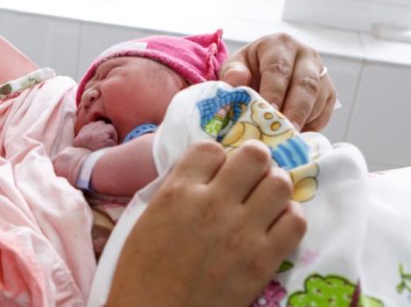

What feeding cues do you know?
  Opening mouth and turning head trying
  to find the breast
  Becoming wakeful and restless
  Making small noises
  Moving hand to mouth
  Sucking fingers
  Observe feeding cues and early initiation.
© UNICEF/UN0155819/Zammit
Early initiation of breastfeeding
© UNICEF/UN0232291
Notes:
View video
What new knowledge is presented in this video?
Does this video highlight any quality gaps in your facility?

Slide 22
4 key signs of good positioning
The mother must be relaxed and comfortable.
Whatever position the mother uses, the same four key points apply:
The baby's head and body should be in a straight line.
The mother should hold the baby’s body close to hers.
If the baby is newborn, support the whole body, not just the head
and shoulders.
The baby’s face should face the breast with the baby’s nose opposite
the nipple.
Breastfeeding positions
Notes:
View video
Practise helping a mother position the baby for breastfeeding.
To learn more
Breastfeeding-positions-pictures

Slide 23
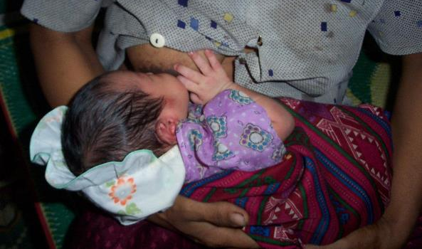
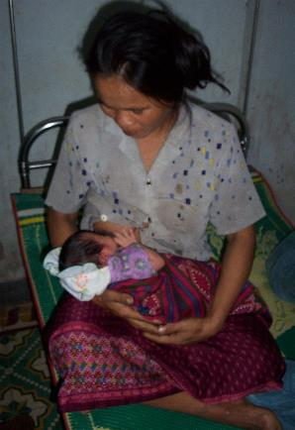
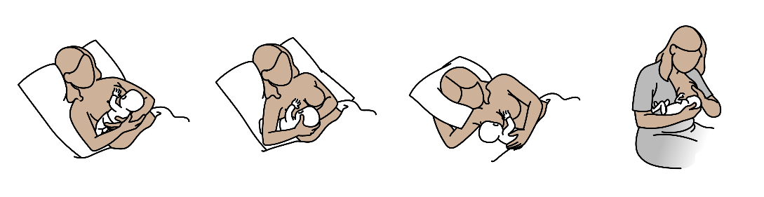
Alternative positions
© WHO/Dr Helenlouise Taylor
1
2
3
4
Notes:
Practise different positions using a breast model.
The mother shown in the picture is blind. Mothers with disabilities may need extra support for positioning and attachment.
1 . Comfortable position for new mothers - Baby’s lower arm is tucked around the mother’s side, Ensure that the baby’s head is not too far into the crook of the mother’s arm as this makes it difficult to stay well attached.
2. Useful position for small or ill baby -The mother has good control of the baby’s head and body. Take care that the baby’s head is not held too tightly, which prevents movement.
3. Comfortable positions after caesarian section:
Side-lying in bed - helps to avoid pain and allows breastfeeding even if the mother must lie flat after spinal anesthesia.
Sitting up with a pillow over the incision or with the baby held along the side of mother’s body with the arm closest to the breast.
Lying flat with the baby lying on top of the mother.
Support (for example, a pillow) under knees when sitting up, or under the top knee and behind back when side-lying.
4 Useful position for twins or to drain all areas of the breast - Gives the mother a good view of the attachment. Take care that the baby is not bending his or her neck, forcing the chin down to the chest.
To learn more
Breastfeeding holds

Slide 24
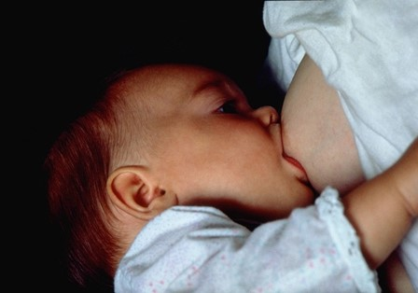
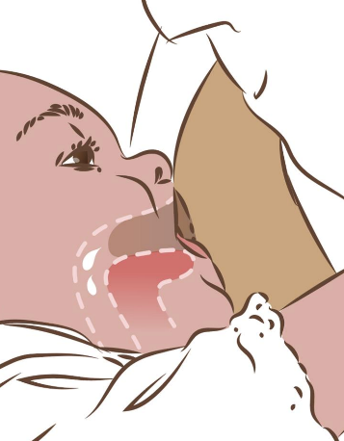
What are the 4 key signs of good attachment?
© Felicity Savage
More areola is visible above the baby’s mouth than below.
The baby’s mouth is wide open.
The lower lip is turned out.
The chin is touching the breast (or nearly so).
Breastfeeding attachment
Notes:
Good attachment helps the newborn transfer milk from the breast into the mouth.
The large ducts that lie beneath the areola are inside the baby’s mouth.
The baby’s tongue reaches forward over the lower gum, so that it can press the milk out of the breast (suckling).
View video

Slide 25
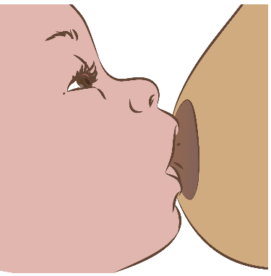
What do you observe with poor attachment?
Less areola is visible above the baby’s mouth
than below. (You might see equal amounts of
areola above and below the mouth.)
The mouth is not wide open.
The lower lip is pointing forward or turned in.
The chin does not touch the breast.
Poor Attachment
Notes:
View video

Slide 26
What are the results of poor attachment?
Painful nipples
Damaged nipples (cracked)
Engorgement
Decreased milk production
Failure to gain weight
Frequent feeds
Frequent crying from unsatisfied hunger
Notes:
Many problems can be prevented by good positioning and attachment.
To learn more
Positioning and attachment

Slide 27
Practical support

Slide 28


What is the role of health workers in supporting breastfeeding?
Explaining the importance of breastfeeding and
providing practical support.
Protecting newborns from harmful practices such
as separation, pre-lacteal feeds or supplementation with infant formula.
Knowing and meeting obligations under the
International Code of Marketing of Breast-milk
Substitutes.
Notes:
Review the code pamphlet.
Do health workers apply these actions for newborns in your facility?
A collaborative multidisciplinary approach among all who care for newborns is vital.
To learn more
The cost of not breastfeeding
Formula milk marketing and infant feeding

Slide 29



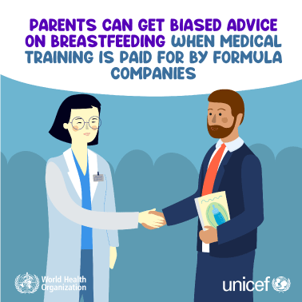
How do companies undermine breastfeeding?
Notes:
Posters and social media tiles are available for sharing with colleagues.
To learn more
Formula milk marketing and infant feeding

Slide 30
What are the consequences of misinterpreting newborn cues?
Crying, fussiness and short sleep duration
undermine mother’s confidence.
  Families and staff may interpret these cues
  as insufficient supply (not enough milk).
Stopping breast feeding and introduction of
commercial milk formula can be the result.
What is the role of the health worker
at this time?
© UNICEF/UN0155819/Zammit
Optimizing breast feeding
© UNICEF/UN0232291
Notes:
Do mothers and families understand newborn cues?
Explain normal newborn behaviours and answer any questions.
Normal sleep patterns of infants don’t align with adult sleep patterns.
Newborns express discomfort through crying, signaling the need for help and care.
Crying is adaptive and communicates many needs.
Take time and offer empathy and a calm atmosphere.
View video

Slide 31
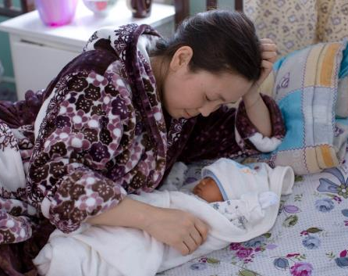
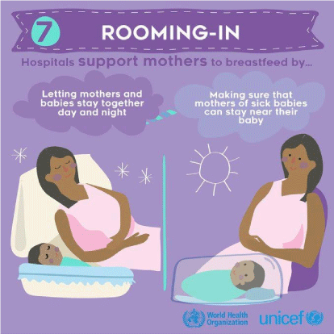
What are the benefits of rooming-in?
Mothers and babies are together day and night.
Mother can respond to baby and feeding cues.
Mother is more confident about breastfeeding.
Babies gain weight more quickly.
Breastfeeding continues longer.
Minimizing separation helps bonding.
© WHO / Almaz Zhumaliev
Notes:
Do you practice rooming-in at your health facility?
Which babies are in a newborn nursery?

Slide 32
How do birth practices impact breastfeeding?
Birth practice
Mother required to lie flat on her
back during labour and delivery
Lack of support or empathy from
staff
Withholding food and fluids during
labour
Pain medications, episiotomy,
intravenous lines and other
interventions without medical
reasons
Wrapping the baby tightly/
swaddling after birth/gloves
Separating the mother and baby.
Impact on breastfeeding
Mother’s discomfort can be a barrier
to early initiation of breastfeeding.
Support from medical staff, birth
companions and family is key to early
initiation and continued feeding.
Fatigue and dehydration interfere with
the initiation of breastfeeding.
Pain medications and interventions
will decrease the baby’s alertness and
ability to breastfeed.
Interferes with reflexes and movement
for early initiation of breastfeeding in
the first hour.
Mother and baby need to be together
for responsive breastfeeding.
Notes:
Which practices have you observed in your health facility?
To learn more
Practices that effect breastfeeding and giving practical support

Slide 33
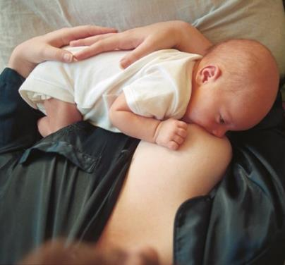
How do feeding patterns change over the first days?
First 24 hours
Breastfeed in the first hour may be followed by a long sleep.
Breastfeeding frequency varies in the first 24 hours (5-12 times per day) – depending on skin-to-skin contact and rooming-in.
Days 2–3
Frequency often increases to 10–12 times per day, still variable.
After day 3
Milk “comes in”, volume increases and composition changes.
Intervals between feeds become longer as feeds become
larger.
Frequency of breastfeeding averages about 8 times in 24 hours. Mothers should keep babies close and respond to cues.
©WHO/Yoshi Shimizu
Notes:
What is normal and what is cause for concern changes over the first several days after birth.
To learn more
Holmes AV, McLeod AY, Bunik M. ABM clinical protocol #5: peripartum breastfeeding management for the healthy mother and infant at term

Slide 34

What communication practices support mothers for breastfeeding?
Language: Use simple words, ask open questions, avoid
judgement.
Posture: Sit at the same level and close to the mother.
Eye contact: Pay attention to the mother, avoid getting
distracted and practise acitve listening.
Barriers: Remove any physical barriers.
Time: Take time without hurrying or looking at
awatch or mobile phone.
Touch: Only touch mother in an appropriate way.
Do not touch her breasts or her baby without her
permission. Use hand-on-hand technique to help with
positioning and attachement.
© UNICEF/UN0281006/Vishwanathan
UNICEF Questions mothers ask
Notes:
Empathy and kindness are important for mothers especially when they are having difficulties.
View video
What new knowledge is presented in this video?
Are there any skills or practices that differ from your current practice?
What provider behaviours differ from your current practice?
Does this video highlight any quality gaps in your facility?

Slide 35
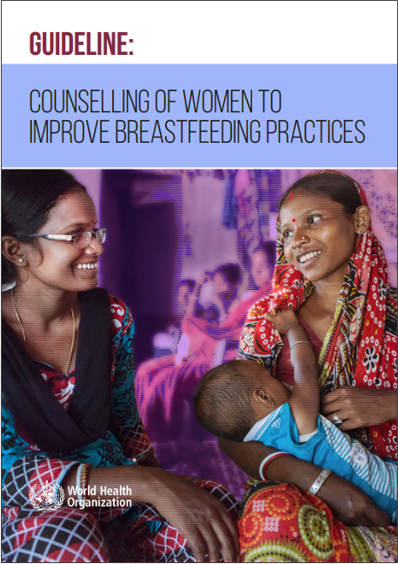
Who needs breast feeding counselling?
Find the recommendation on page 15-18.
Notes:
Use a printed or digital copy (pdf) of the document.

Slide 36
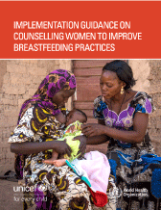
Recommendation and reasons
Breastfeeding counselling should be provided to all
pregnant women and mothers with young children.
Benefits of breastfeeding counselling for pregnant women
and mothers
    Promotes the initiation of breastfeeding within the first hour
    after birth
    Promotes breastfeeding and exclusive breastfeeding
    Reduces giving pre lacteal feeds, additional food or fluids
    other than breast milk
    Reduces the use of artificial teats and bottles
Notes:
Is this recommendation currently applied in your place of work?
If yes, what enabling factors support the application of this recommendation?
If no, what are the barriers to applying this recommendation?
To learn more
Implementation guidance on counselling women to improve breastfeeding practices

Slide 37
Support establishment of breastfeeding
Form groups (mother, midwife, companion).
Support Leela. Observe a breastfeed and counsel her about
responsive feeding.
Debrief with your team and facilitator.
Ekta is 2 days old and Leela is preparing to go home.
Notes:
Repeat simulation
Skills and performance – participants demonstrate communicating effectively and giving practical support for breastfeeding.
Confirming that mother finds a comfortable position with the newborn
Reinforcing and confirming the 4 signs of good positoning for attachment and maternal comfort.
Communicating and confirming the 4 signs of good attachment.
Counseling mother on responsive feeding
Debriefing – participants self-reflect and give feedback in their roles.
Provision of care (performance objectives)
What was done well?
What could have been done better?
What will you change the next time?
Did you use an observation checklist?
Did the health worker give samples of breast milk substitutes or advertising materials?
Experience of care
Was the communication respectful and the language appropriate?
Were infection prevention practices followed?
Did the health worker gain consent before touching the mother and baby?
Did the health worker guide mother’s own hand in giving practical support?

Slide 38
Summary
In this module, you have:
Related the principles of lactation to practical support for breastfeeding
Demonstrated how to assess and support positioning and attachment
for breastfeeding
Demonstrated how to give practical support for early initiation
of breastfeeding and successful breastfeeding
Reviewed advocacy, counselling, and practical actions to support early and exclusive breastfeeding in the facility and at home.
Notes:
To learn more
Breastfeeding healthy newborns
Helping a breastfeeding mother

Slide 39

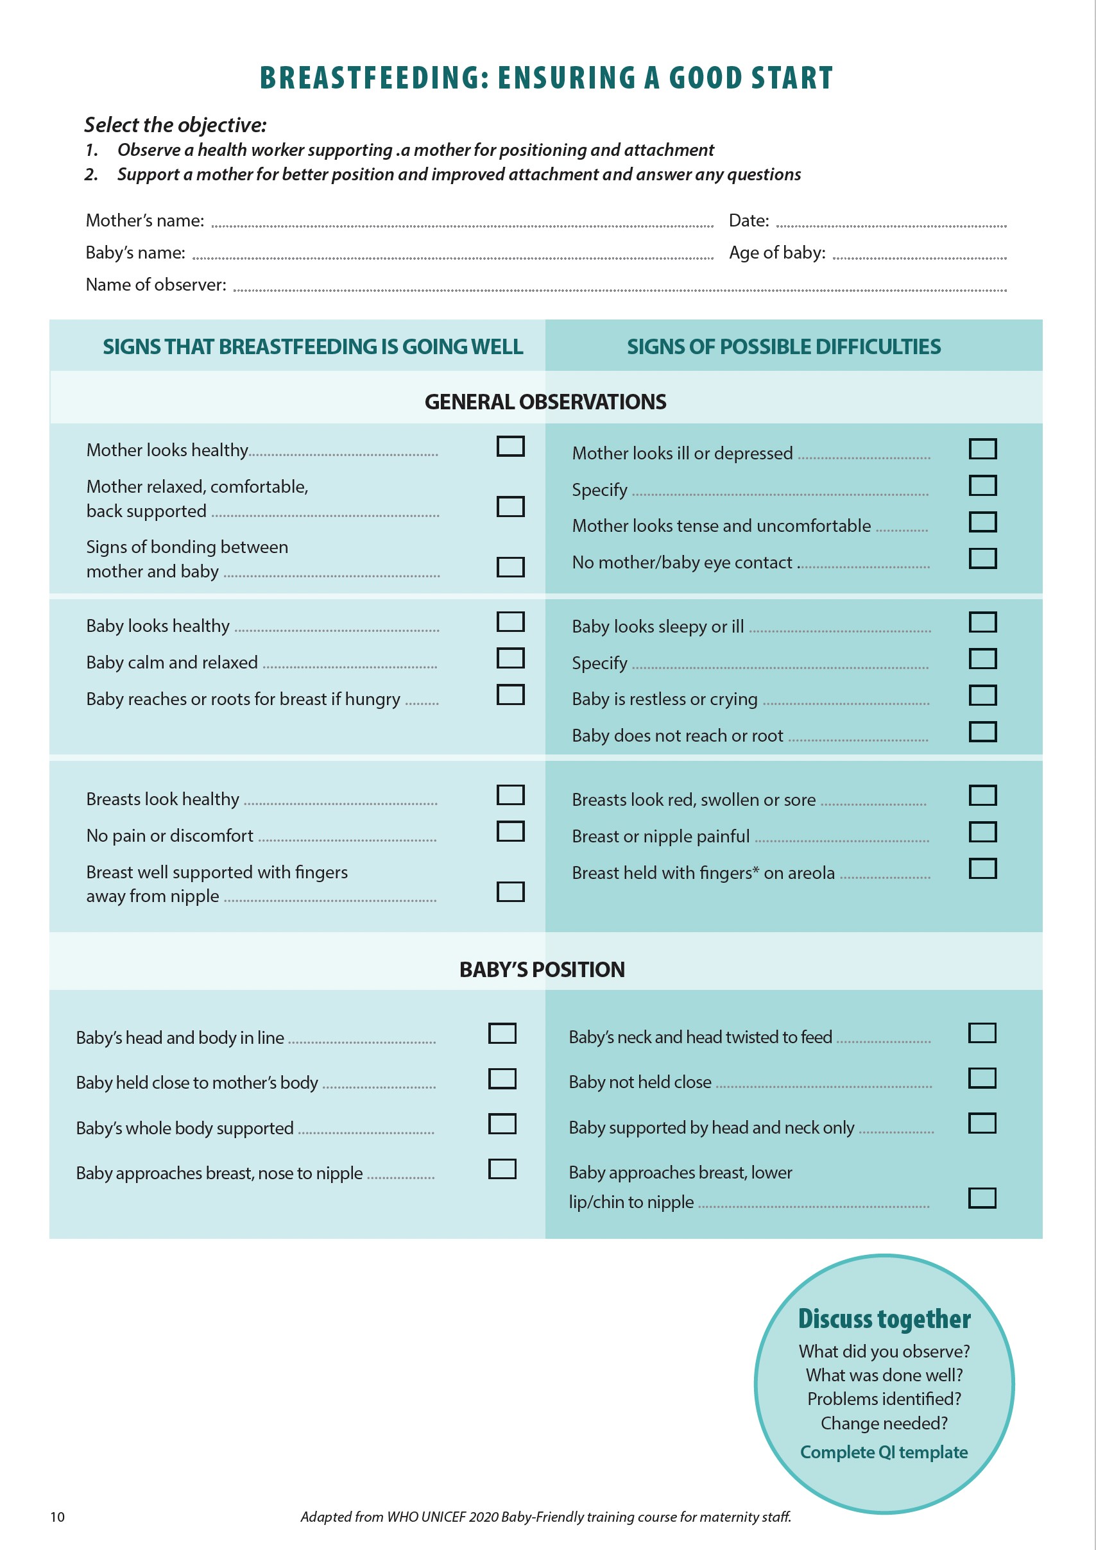
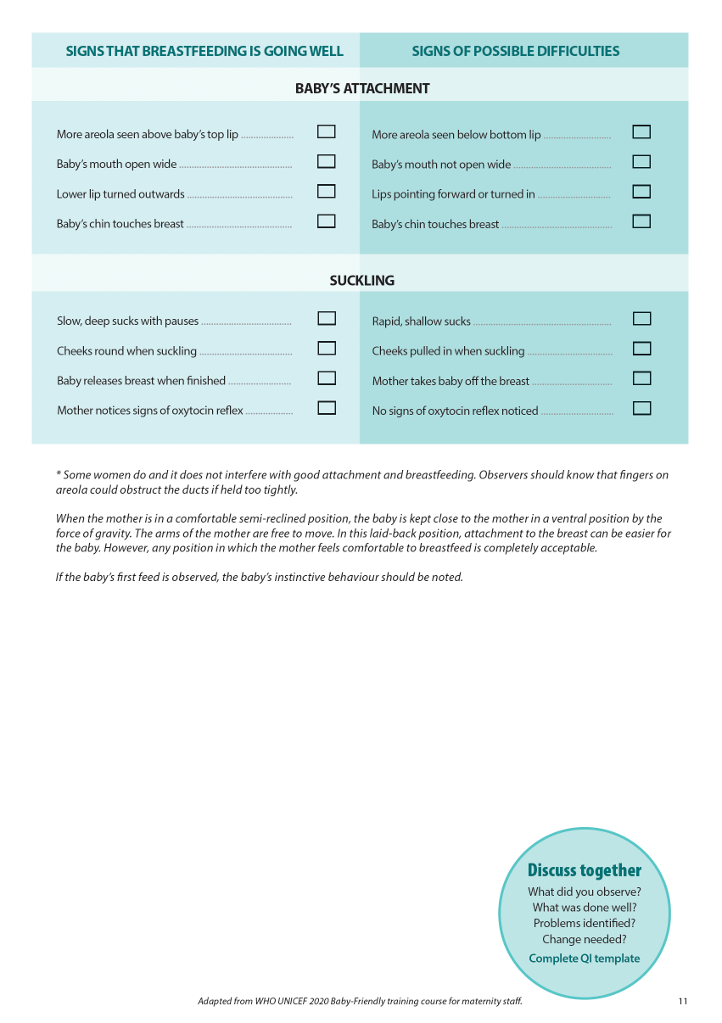
Clinical practice
Notes:
Review the Clinical practice checklist before observing or practicing in the clinical area.

Slide 40
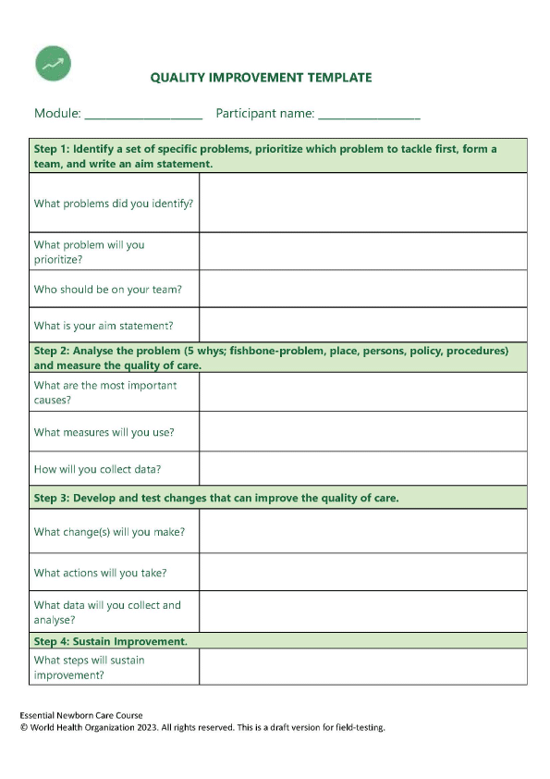
Quality improvement
Notes:
After the clinical practice, discuss the observations made, possible reasons for practices, and changes needed to improve the quality of essential newborn care.
What new things will you do?
What old things will you not do?
How will you make a change?

Slide 41
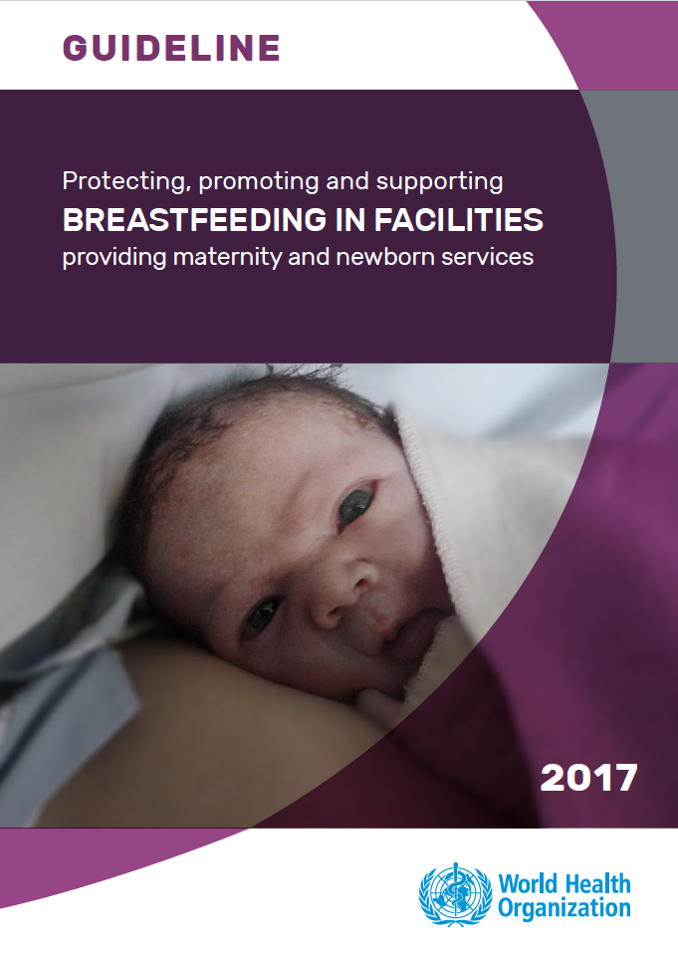



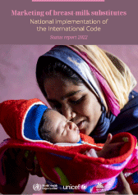
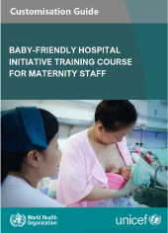
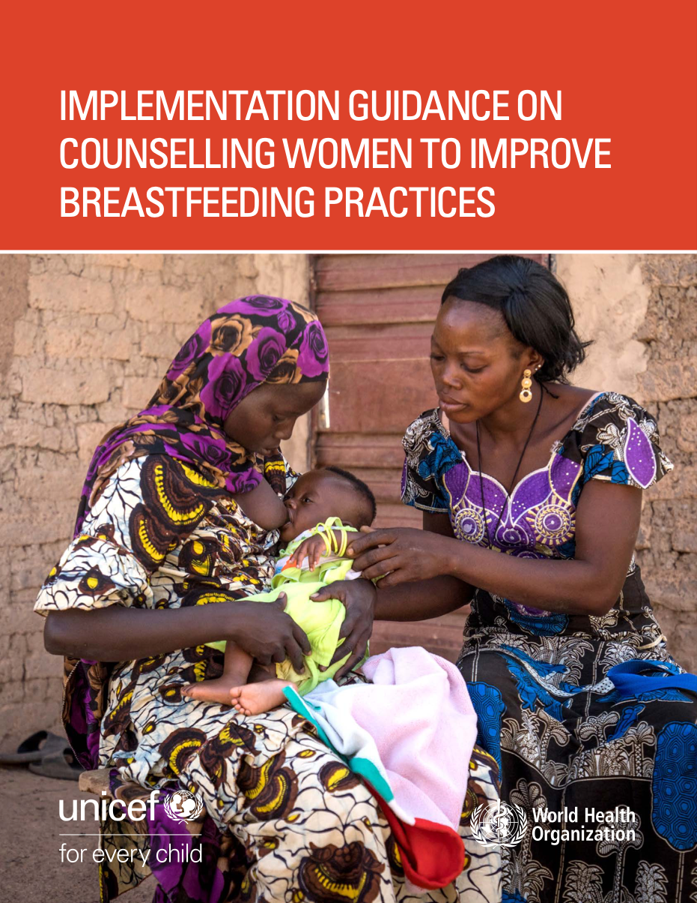
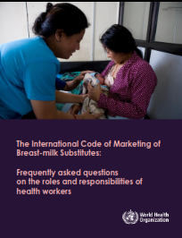

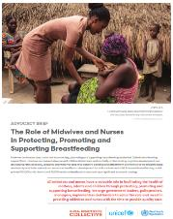


References and additional resources

Slide 42
A question of lunch, some posters, educational materials and equipment
Form groups (doctor, midwife, neonatal nurse, administrator).
Discuss the meeting and how to proceed.
Debrief with your team and facilitator.
Betty the ward administrator has organised for a milk company representative to support a continuing education session.
The representative has agreed to provide lunch for all attendees, posters and other educational materials and a laptop for the department.
The meeting will take place next month.
Notes:
Additional simulation
Skills and performance – participants demonstrate reviewing the Breast milk substitute code leaflet as an interdisciplinary team.
Establishing that acceptance of gifts and gifts in kind is contrary to the code on marketing of breast milk substitutes
Making a plan of action for ensuring educational activities continue without violating the code.
Debriefing – participants self-reflect and give feedback in their roles.
What was done well?
What could have been done better?
What will you change the next time?
Was the communication respectful and the language appropriate?
Were you aware of the code, violations and how to report them?

Slide 43
Counsel mother for establishment of breastfeeding
Form groups (mother, midwife, companion).
Counsel Susie and support her for positioning and attachment.
Debrief with your team and facilitator.
Mollie is 4 hours old. She was born at term by spontaneous vaginal delivery.
She was placed skin-to-skin immediately after birth. She crawled and attached herself to the breast, to the surprise of her mother and father.
Her mother, Susie, has never been counselled on breastfeeding bottle feeding her previous 2 children. She has decided to breastfeed.
Mollie is showing feeding cues.
Notes:
Additional simulation
Skills and performance – participants demonstrate counselling a mother who has bottle fed her previous children and supporting her for correct positioning and attachment.
Demonstrating to mother good positioning and attachment ( 4 key points) using a mannequin
Explaining to mother how breastfeeding and bottle feeding differ
- Nose opposite nipple and NOT opposite mouth
- How she will know that the baby has taken enough milk
- How she will know that she is producing enough milk
Supporting mother to position and attach her newborn comfortably at the breast
Debriefing – participants self-reflect and give feedback in their roles.
Provision of care (performance objectives)
What was done well?
What could have been done better?
What will you change the next time?
Experience of care
Was the communication respectful and the language appropriate?
Were infection prevention practices followed?
Did the health worker ask for consent before touching newborn or breast?
Did the health worker demonstrate on a mannequin or directly on the breast?

Slide 44
Support Charity to establish breastfeeding
Form groups (mother, companion, neonatal nurse).
Support Charity to find comfortable positioning and good attachment.
Debrief with your team and facilitator.
Charity delivered by caesarean section 2 days ago.
She is uncomfortable and in pain from her caesarian incision.
She is in tears.
Notes:
Additional simulation
Skills and performance – participants demonstrate supporting a mother in pain after caesarean section to find comfortable positioning and good attachment.
Assessing pain and providing appropriate pain relief
Assessing current positioning and attachment
Supporting mother for comfortable positioning and attachment (related to caesarean section).
Communicating with kindness and giving answering questions
Debriefing – participants self-reflect and give feedback in their roles.
Provision of care (performance objectives)
What was done well?
What could have been done better?
What will you change the next time?
Experience of care
Was the communication respectful and the language appropriate?
Did the health worker gain consent before touching mother or baby?
Were infection prevention practices followed?

